Slide 1

Systems Engineering Handbook V5.0 Tutorial
Product Number: TBD
INCOSE North Texas Chapter
For more information visit:
https://www.incose.org/certification
© 2025 International Council on Systems Engineering
March 16, 2025
Subject to the restrictions on the copyright pages

Slide 2
INCOSE Copyright Notice (to be updated)
Copyright (c) 2025 by INCOSE, subject to the following restrictions:
This International Council on Systems Engineering (INCOSE) Technical Data was prepared by the INCOSE North Texas Chapter. It has been released by the North Texas Chapter as INCOSE Technical Data. Future releases will be developed by the North Texas Chapter for approval as a Technical Product. Forward comments to TBD
Author Use: Authors have full rights to use their contributions unfettered, with credit to the INCOSE technical source,
except as noted in the following text. Abstraction is permitted with credit to the source.
INCOSE Use: Permission to reproduce and use this document or parts thereof by members of INCOSE and to prepare derivative works from this document for INCOSE use is granted, with attribution to INCOSE and the original author(s) where practical, provided this copyright notice is included with all reproductions and derivative works. Content from ISO/IEC/IEEE 15288 and ISO/IEC/IEEE 24748‐1 is used by permission and is not to be reproduced other than as part of this total document.
External Use: This document may not be shared or distributed to any non‐INCOSE third party. Requests for permission to reproduce this document in whole or in part, or to prepare derivative works of this document for external and/or commercial use, will be denied unless covered by other formal agreements with INCOSE. Copying, scanning, retyping, or any other form of reproduction or use of the content of whole pages or source documents are prohibited, except as approved by the INCOSE Administrative Office, 7670 Opportunity Road, Suite 220, San Diego, CA 92111‐2222, USA.
Electronic Version Use: All electronic versions (e.g., eBook, PDF, PPT) of this document are to be used for personal professional use only and are not to be placed on non‐INCOSE sponsored servers for general use. Any additional use of these materials must have written approval from the INCOSE Administrative Office.
General Citation Guidelines: References to the handbook should be formatted as follows, with appropriate adjustments for formally recognized styles:
INCOSE (2023). Systems Engineering Handbook: A Guide for System Life Cycle Process and Activities (5th ed.).
D. D. Walden, B. A. Delicado, D. Endler, G. J. Roedler, O. Mornas, T. M. Shortell, and Y. Yew-Seng (Eds.). San Diego, CA: International Council on Systems Engineering. Published by John Wiley & Sons, Inc.
Notice: A hardcopy of this Tutorial may not be the most current version. The current approved version is always the version on the INCOSE Training Working Group site.

Slide 3
INCOSE Copyright Notice (cont)
Copyright (c) 2025 by INCOSE, subject to the following restrictions:
In accordance with the following terms and conditions, the figures (the "Product") in this material are licensed to John O. Clark, as an instructor, for instructional use only. Under no circumstances may this Product or any portion thereof be sold, licensed, auctioned, or otherwise redistributed except as may be permitted by the terms herein.
INCOSE provides John O. Clark with this Product for instructional use and review. He and his students may use this Product for instructional use subject to the terms described below. INCOSE has established these use limitations in response to concerns raised by authors, instructors, and other users regarding the problems stemming from unlimited distribution of supplemental material.
INCOSE hereby grants John Clark permission to use the Product for his personal, noncommercial use only. The Product may not be reproduced or distributed, except that portions of the Product may be provided to his students in connection with his classroom instruction. This Product may be made available in the classroom or posted electronically as described herein. Any portion of the Product posted electronically must be through a password-protected website or a learning management system accessible solely by his students. Copy and download functionality by his students is authorized by INCOSE. He may not sell, license, auction, or otherwise redistribute the Product in any form. INCOSE asks that he take reasonable steps to protect the Product from unauthorized use, reproduction, or distribution. His use of the Product indicates his acceptance of the conditions set forth in this Agreement.
All rights (including without limitation, copyrights, patents, and trade secrets) in the Product are and will remain the sole and exclusive property of INCOSE and/or its licensors. The Product is furnished by INCOSE on an "as is" basis without any warranties, express or implied. This Agreement will be governed by and construed pursuant to the laws of the State of California, without regard to such State's conflict of law rules that would require the application of the laws of another jurisdiction.
The following notice should appear on each page of this Product:
© 2023 John Wiley & Sons, Inc. May not be copied, scanned, or duplicated, in whole or in part, except for use as permitted by license on a password-protected website for instructional use.
Thank you for your assistance in helping to safeguard the integrity of the content contained in this Product. We trust you find the Product a useful teaching tool.

Slide 4
Handbook Contents
How to Use This Handbook
Chapter 1 – Systems Engineering Introduction
Chapter 2 – System Life Cycle Terms and Concepts
Chapter 3 – Life Cycle Analyses and Methods
Chapter 4 – Tailoring and Application Considerations
Chapter 5 – Systems Engineering in Practice
Chapter 6 – Case Studies
Appendix A – References
Appendix B – Acronyms
Appendix C – Terms and Definitions
Appendix D – N² Diagram of Systems Engineering Processes
Appendix E – Input/Output Descriptions
Appendix F – Acknowledgements
Appendix G – Comment Form
Index
Not every process will apply universally. Careful selection of the material is recommended. Reliance on process over progress will not deliver a system.

Slide 5
Chapter 4
Tailoring and Application Considerations

Slide 6
Chapter 4 Contents
  4.1 Tailoring Consideration…..……………………………...215
  4.2 SE Methodology / Approach Considerations………….219
  4.2.1 Model-Based SE………………………………….219
  4.2.2 Agile Systems Engineering……………………...221
  4.2.3 Lean Systems Engineering……………………...224
  4.2.4 Product Line Engineering (PLE)………………...226
  4.3 System Types Consideration……………………………229
  4.3.1 Greenfield/Clean Sheet Systems……………….229
  4.3.2 Brownfield/Legacy………………………………..230
  4.3.3 Commercial-off-the-Shelf Systems……………..231
  4.3.4 Software-Intensive Systems…………………….232
  4.3.5 Cyber-Physical Systems…………………………233

Slide 7
Chapter 4 Contents (cont’d)
  4.3.6 Systems of Systems (SoS)…………………..….235
  4.3.7 Internet of Things (IoT)/Big Data-Driven Systems …………………………………………………..........238
  4.3.8 Service Systems….…..……………………….…239
  4.3.9 Enterprise Systems………………………………241

Slide 8
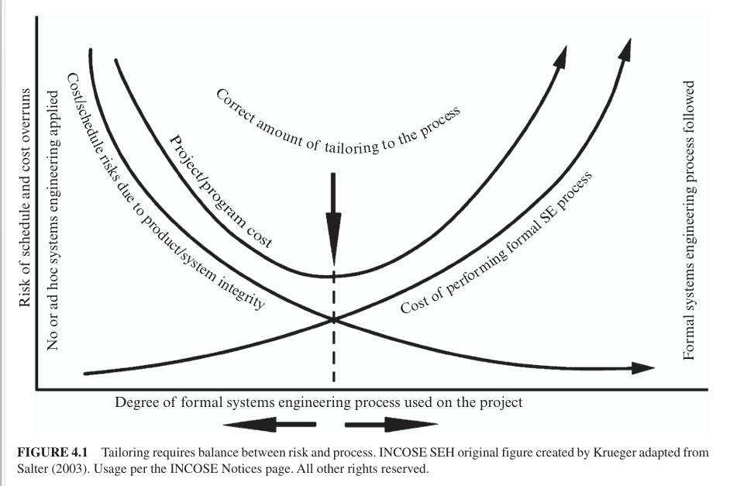
4.1 Tailoring Considerations
Tailoring balances process rigor with the risk of cost and schedule overruns, as illustrated in Figure 4.1 (Salter, 2003). Insufficient SE effort increases technical, cost, and schedule risks, while excessive rigor can also raise costs and delay schedules. Tailoring should be dynamic, continuously monitored, and adjusted based on evolving risks and circumstances. This section describes the process of tailoring the system life cycle models and SE processes to meet organization and project needs.
Notes:
4.1 Page 215-216

Slide 9
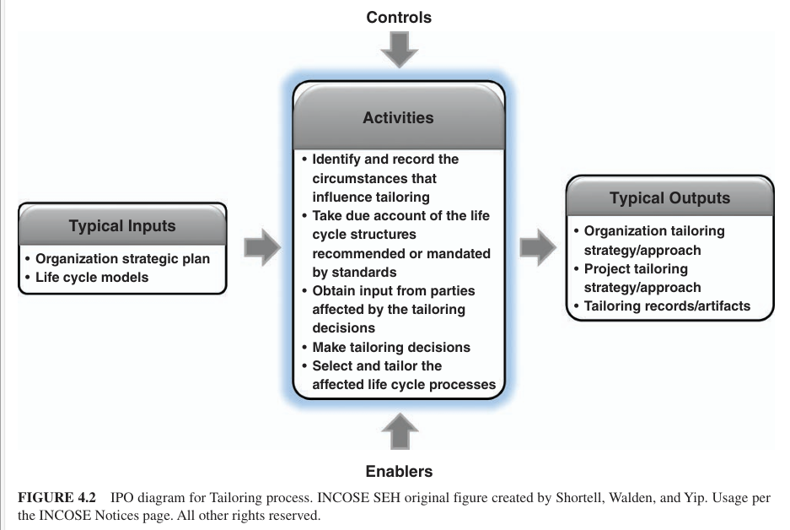
4.1 Tailoring and Application Considerations
Tailoring Process--
Overview
Purpose <As stated in ISO/IEC/IEEE 15288>
Description
Inputs/Outputs <See Figure 4.2, below>
Process Activities
Notes:
4.1 Page 217

Slide 10
4.1 Tailoring and Application Considerations
Process activities (continued)
    Identify and record the circumstances that influence tailoring
    Take due account of the life cycle structures recommended or mandated by standards
    Obtain input from parties affected by the tailoring decisions
    Make tailoring decisions
    Select and tailor the affected life cycle processes.
NOTE: Tailoring can include the deletion, modification, or addition of outcomes, activities, tasks, typical inputs, or typical outputs.
Notes:
4.1 Page 217

Slide 11
4.1 Tailoring Considerations
Common approaches and tips:
Base decisions on facts and obtain approval from an independent authority
Use the Decision Management process to assist in tailoring decisions
Constrain the tailoring based on agreements between organizations
Control the extent of tailoring based on issues of compliance to stakeholder, customer, and organization policies, objectives, and legal requirements
Have different organizations propose and approve the tailoring
Notes:
4.1 Page 218

Slide 12
4.1 Tailoring Considerations
Common approaches and tips (cont’d):
Influence the extent of tailoring of the agreement process activities based on the methods of procurement or intellectual property
Remove extra activities as the level of trust builds between parties
Identify the assumptions and criteria for tailoring throughout the life cycle to optimize the use of formal processes
Document the rationale for tailoring decisions
Notes:
4.1 Page 218

Slide 13
4.1 Tailoring Considerations
Elaboration:
Organizational Tailoring applies specifically to the creating and maintaining organizational-level processes used by all projects. It is done in conjunction with the Life Cycle Model Management process (see Section 2.3.3.1).
Project Tailoring applies specifically to the work executed through projects. It is done in conjunction with the Project Planning process (see Section 2.3.4.1).
Traps in Tailoring include, but are not limited to:
      Reuse of a tailored baseline from another system without repeating the tailoring process
      Using all processes and activities “just to be safe”
      Assuming there is a single set of measures, risks, or other controls that apply to all projects without tailoring
      Using a pre-established tailored baseline
      Failure to include relevant stakeholders.
Notes:
4.1 Page 218

Slide 14
4.2 SE Methodology/Approach Considerations
The system definition activities, especially the portioning of the system requires that integration is considered throughout the development stage of the life cycle.
This section introduces considerations for the following SE methodologies and approaches:
Model-Based Systems Engineering (MBSE)
Agile Systems Engineering
Lean Systems Engineering
Product Line Engineering (PLE)
Notes:
4.2 SE Methodology / Approach Considerations, Page 219

Slide 15
4.2.1 Model-Based SE
This section provides an overview of the Model-Based Systems Engineering (MBSE) approach and includes a summary of its benefits relative to a more document-based approach.
MBSE Overview
The INCOSE Systems Engineering Vision 2020 (2007) defines MBSE as:
The formalized application of modeling to support system requirements, design, analysis, verification, and validation activities beginning in the [concept stage] and continuing throughout development and later life cycle [stages].
Notes:
4.2.1 Model-Based SE, Page 219

Slide 16
4.2.1 Model-Based SE (cont’d)
MBSE is often contrasted with a document-based approach to SE. In a document-based SE approach, there is often considerable information generated about the system that is contained in documents and other artifacts such as specifications, interface control documents, system description documents, trade studies, analysis reports, and verification plans, procedures, and reports.
Although many systems have been developed using a traditional document-based approach, a model-based approach is becoming essential to address the increasing complexity of systems and support approaches that can more effectively and efficiently adapt to requirements and design changes.
Notes:
4.2.1 Model-Based SE, Page 220

Slide 17
4.2.1 Model-Based SE (cont’d)
MBSE enhances the ability to capture, analyze, share, and manage the information associated with the specification of a product that can result in the benefits listed below.
Improved communications
Increased ability to manage system complexity
Improved product quality
Reduced cycle time
Reduced risk by surfacing requirements and design issues early
Enhanced knowledge capture and reuse
Improved ability to teach and learn SE fundamentals
Notes:
There is some quantitative data (Rogers and Mitchell, 2021) and considerable qualitative data (OMG MBSE Wiki, 2023, MBSE Events and Related Meetings) from industry papers and presentations that support

Slide 18
4.2.1 Model-Based SE (cont’d)
MBSE Methodologies are traditionally captured in informal diagrams, text, and tables in a descriptive system model (see Section 3.2.1) including information about the system context, the requirements on the system and its elements, the system architecture (including its structure and behavior), the critical parameters needed to specify the analysis of the system, and information about how the system is verified to satisfy requirements.
In an MBSE approach, the system descriptive model is a primary artifact of the SE process. An MBSE methodology describes how MBSE is performed to capture the required information in the system descriptive model and related artifacts. It must be tailored to the particular need of the organization and/or project (See Section 4.1).
Notes:
Modeling languages such as SysML (OMG SysML, 2021) (see Section 3.2.1).

Slide 19
4.2.1 Model-Based SE
OOSEM Summary is an MBSE method intended to help architect systems that satisfy evolving mission and system requirements and can accommodate changes in technology and design. It can be adapted to different life cycle models to support the specification, analysis, design, and verification of systems.
The OOSEM supports the development process that includes the following subprocesses and activities:
Manage the system development
Specify and design the system
Develop the system elements
Integrate and verify the system.
Notes:
Page 221

Slide 20
4.2.2 Agile Systems Engineering
Agile Systems Engineering is a principle-based approach for designing, building, sustaining, and evolving systems when knowledge is uncertain, or environments are dynamic; thus, Agile Systems Engineering (ASE) is a what, not a how. When evolution of the system’s operational environment does not stop with initial deployment, a system’s functional capabilities must evolve if it is to remain viable, thus it is virtually never ending, and retirement is generally an issue of safe and secure functional capability disposal rather than system decommissioning.
There are many life cycle models (e.g., Vee, Incremental Commitment Spiral Model (ICSM), DevSecOps (Development, Security Operations) (see Section 2.2).
Notes:
4.2.2 Page 221

Slide 21
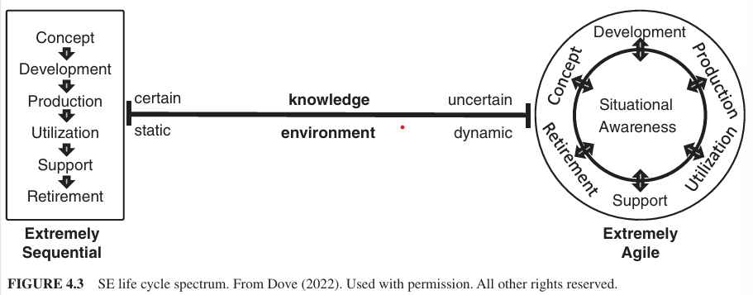
4.2.2 Agile Systems Engineering (cont’d)
ASE is best understood when contrasted with the sequential life cycle approach and in how the two relate to the system life cycle spectrum (see Figure 4.3). All life cycle approaches fall somewhere between the two ends of the spectrum. An ASE process is based on strategies for timely and continual knowledge development and affordable application of new knowledge in system development in some way (see Sections 2.2.2 and 2.2.3) as a means to produce demonstrable and/or usable work in process that provokes feedback for real time learning and subsequent application.
Notes:
4.2.2 Page 221-222

Slide 22
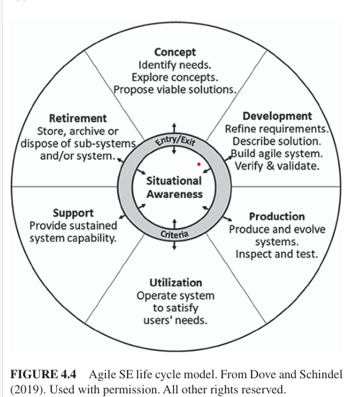
4.2.2 Agile Systems Engineering (cont’d)
The Agile SE Life Cycle Model (in Figure 4.4) has six system life cycle stages around the perimeter, with situational awareness featured in the center. This model can accommodate activities in any and all of the stages concurrently without progressive sequencing. Situational awareness has no entry or exit criteria; it is a continuous activity all other stages begins with a decision to act upon specific triggering awareness, and may require process-prudent, or contract-required, engagement criteria for a stage(s) to be entered.
The VEE model (in Section 2.2.1) depicts relationships among SE activities applicable in sequential, iterative, and evolutionary approaches, which differs from the Agile SE life cycle model .
Notes:
4.2.2 Page 222-223

Slide 23
4.2.2 Agile Systems Engineering (cont’d)
Agile Systems Engineering Life Cycle Operational Considerations:
Principles and strategies that facilitate operational agility
in action include sensing, responding, and evolving.
The architecture and structural principles that enable system agility are covered in Section 3.1.3.
A few Agile Systems Engineering Examples are listed on page 224.
Notes:
4.2.2 page 223-224

Slide 24
4.2.3 Lean Systems Engineering
Lean SE, is the area of synergy between lean thinking (“just-in-time” philosophy) and SE, with the goal to deliver the best life-cycle value for technically complex systems with minimal waste. Lean SE does not take away anything from SE and it does not mean less SE. Lean SE means better SE with higher responsibility, authority, and accountability, leading to better, waste-free workflows with increased mission assurance.
Three concepts are fundamental to the understanding of lean: value, waste, and the process of creating value without waste (captured into lean principles). In lean SE, value is defined simply a mission assurance (i.e., the delivery of a flawless complex system, with flawless technical performance, during the product or mission development life cycle) and satisfying the customer and all other stakeholders. This implies completion with minimal waste, minimal cost, and the shortest possible schedule.
Notes:
4.2.3 Page 224 -225

Slide 25
4.2.3 Lean Systems Engineering (cont’d.)
Waste in Production Development, waste is “the work element that adds no value to the product or service in the eyes of the customer. Waste only adds cost and time” (Womack and Jones, 1996). The following are seven waste categories (McManus, 2005); an eighth category, the waste of human potential, is increasingly added.
Overprocessing
Waiting
Unnecessary movement
Overproduction
Transportation
Inventory
Defects
Waste of human potential.
Notes:
4.2.3 Page 225

Slide 26
4.2.3 Lean Systems Engineering (cont’d)
Lean Principles and Lean Enablers for Systems Engineering, Womack and Jones (1996) cited the following as the ‘process of creating value without waste” described in (Oppenheim, 2011):
Value Principle – a robust process of establishing the value of the system to the customer with crystal clarity early in the project.
    The value stream principle emphasizes detailed project planning and waste-preventing measures, solid preparation of the personnel and processes for subsequent efficient workflow.
    The flow principle promotes the uninterrupted flow of robust quality work and first-time-right products and processes…
    The pull principle is a powerful guard against waste of rework and overproduction.
    The perfection principle promotes excellence in the SE and organization processes, utilization of the wealth of lessons learned…
    The respect-for-people principle promotes the enterprise culture of trust, openness, honesty, respect, empowerment, cooperation, teamwork, synergy, and good communication and coordination and enables people for excellence.
.
Notes:
4.2.3 Page 225

Slide 27
4.2.3 Lean Systems Engineering (cont’d)
Common Project Management Challenges
Firefighting-reactive project execution
Unstable, unclear, and incomplete requirements
Insufficient alignment and coordination
Locally optimized processes, lack of integration
Unclear roles, responsibilities, and accountability
Mismanagement of project culture and team competency
Insufficient project planning
Improper metrics and key performance indicators
Lack of proactive project risk management
Poor project acquisition and contracting practices
Notes:
4.2.3 Page 225

Slide 28
4.2.4 Product Line Engineering (PLE)
In many cases, SE is performed in the context of a product line-a family of similar systems with variations in features and functions PLE addresses this mismatch by providing models, tools, and methods for holistic engineering of system families.
NOTE: Where the PLE field and standards refer to "product," "product line," and "product line engineering," the equivalent terms in SE are "system," "system family," and "system family engineering," respectively. These terms can be used interchangeably (Krueger, 2022).
Challenges with Early Generation System Family Engineering Approaches When systems in a system family are engineered as individual point solutions, techniques such as clone-and-own reuse or branch-and-merge result in ever-growing duplicate and divergent engineering effort.This is a self-inflicted complexity, over and above the complexity inherent in the systems being engineered.
Feature-based Product Line Engineering offers significant improvements and benefits in effort, cost, time, scale, and quality by exploiting system similarity while formally managing variation. Feature-based PLE is used to engineer a system family as a single holistic system rather than a multitude of individual systems. Engineering assets in each engineering discipline are consolidated to eliminate duplication and divergence.
Notes:
4.2.4 Page 226
Feature-based PLE is the modern digital engineering industry good practice for PLE, as defined in the INCOSE PLE Primer (2019) and ISO/IEC 26580 (2021).

Slide 29
4.2.4 Product Line Engineering (PLE) (cont’d)
Key Elements of a Feature-based PLE Factory
Feature Catalogue, as shown in the upper left of Figure 4.5, captures a formal model of the distinguishing characteristics about how the members of the system family differ from each other and provides a common language and single authoritative source of truth about variation throughout the engineering organization.
Bill-of-Features, as shown in the upper right of Figure 4.5, specifies the features selected from the Feature Catalogue for each system in a system family portfolio.
Shared Asset Supersets, as shown in the lower left of Figure 4.5, are the engineering artifacts that support the creation, design, implementation, deployment, and operation of systems in a system family. They contain variation points, which are pieces of content that can be included, omitted, generated, or transformed for a system instance, based on the features selected in a Bill-of-Features for that system.
Notes:
4.2.4 PLE Page 226
Feature-based PLE uses a PLE Factory metaphor, as illustrated inFigure 4.5. See ISO/IEC 26580 (2021) for a full description.

Slide 30
4.2.4 Product Line Engineering (PLE) (cont’d)
Key Elements of a Feature-based PLE Factory (cont’d)
PLE Factory Configurator, shown in the center of Figure 4.5, is an automation that applies a Bill-of-Features for a system to each variation point in the Shared Asset Supersets, to determine each variation point's content for the system instance.
Product Asset Instances, shown in the lower right of Figure 4.5, each contain only the shared asset content suited for that onesystem in the system family.
Notes:
4.2.4 PLE Page 226
Feature-based PLE uses a PLE Factory metaphor, as illustrated inFigure 4.5. See ISO/IEC 26580 (2021) for a full description.

Slide 31
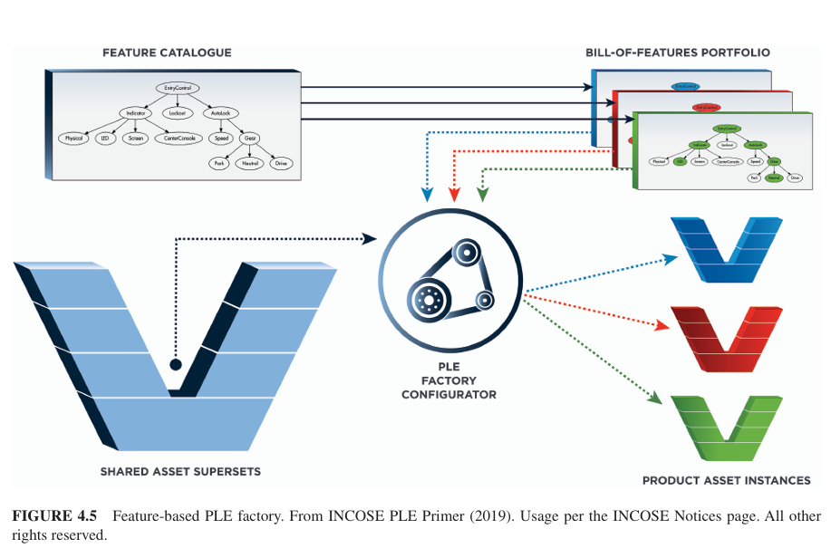
4.2.4 Product Line Engineering (PLE) (cont’d)

Slide 32
4.2.4 Product Line Engineering (PLE) (cont’d)
Shared Asset Supersets and Variation Points
To work in a PLE Factory, engineers must learn how to create and maintain Shared Asset Supersets, including variation points, for their discipline, for example:
Requirements engineers learn how to create requirements Shared Asset Supersets with variation points,
Test engineers learn how to create verification and validation Shared Asset Supersets with variation points, and
Software engineers learn how to create source code Shared Asset Supersets with variation points.
A Shared Asset Superset contains a single copy of all content used in any system-that is, there is no duplication of content.
MBSE models can be developed as Shared Asset Supersets and instrumented with variation points.
Notes:
4.2.4 PLE, Page 228

Slide 33
4.2.4 Product Line Engineering (PLE) (cont’d)
Organizational Change and Return-on-Investment (ROI) with Feature-based Product Line Engineering
The ROI to justify the organizational change is in most cases compelling, based on the elimination of low-value, mundane, replicative work, with doubling, tripling and larger improvements in engineering metrics such as: lowering engineering complexity; reducing overall engineering time, cost, and effort; increasing portfolio scalability; and improving system quality (Gregg, et al., 2015 and McNicholas, 2021).
Notes:
4.2.4 PLE, Page 229

Slide 34
4.3 System Types Considerations
The concept of Sol was introduced in Section 1.3.1. The type of Sol has significant implications on SE. This section introduces SE considerations for the following types of Sols:
Greenfield/Clean Sheet Systems
Brownfield/Legacy Systems
Commercial-off-the-Shelf (COTS)-Based Systems
Software-Intensive Systems
Cyber-Physical Systems (CPS)
System of Systems (SoS)
Internet of Things (IoT)/Big Data-Driven Systems
Service Systems
Enterprise Systems.
NOTE: Other types of Sols exist.
Notes:
4.3 System Types Considerations, Page 229

Slide 35
4.3.1 Greenfield/Clean Sheet Systems
"Greenfield" and "brownfield" are real estate terms: greenfield refers to undeveloped land, while brownfield indicates previously developed sites that may include structures, services, or contamination. In systems engineering (SE), greenfield or clean sheet systems are new designs with minimal legacy constraints aside from interfaces. However, with iterative development practices, greenfield projects may become brownfield before delivery.
SE education traditionally starts from a greenfield perspective—beginning with a blank slate to identify stakeholders, derive system requirements, and progress through design, implementation, integration, verification, and validation. Though useful pedagogically, true greenfield projects are rare in practice.
Organizations accustomed to long-term brownfield development may struggle to shift back to greenfield efforts and may need to relearn foundational practices (Axehill, 2021).
Notes:
4.3.1 Greenfield/Clean Sheet Systems Page 229

Slide 36
4.3.2 Brownfield/Legacy Systems
As noted in Section 4.3.1, brownfield refers to previously developed land that may include existing infrastructure and hazardous materials requiring remediation. In systems engineering (SE), brownfield or legacy SE involves modifying or replacing an existing "as-is" system within its current environment to achieve an updated "to-be" state. These systems often include technical debt or other forms of "waste" requiring attention (Seacord et al., 2003; Hopkins & Jenkins, 2008), and "in-service" systems are common examples (Kemp, 2010; Van De Ven et al., 2012). They also require continuity of operations during transition.
Greenfield and brownfield systems demand different life cycle strategies, with varying SE priorities. Table 4.1 highlights these differences (Walden, 2019; Baley & Belcham, 2010). These distinctions shape both the system solution and the development team. As outlined in Section 4.1, SE processes must be tailored to each project. For brownfield efforts, this includes site surveys and reconstruction activities to assess current systems, identify gaps, and design the future system (Walden, 2019).
Notes:
4.3.2 Brownfield/Legacy Systems Page 230

Slide 37
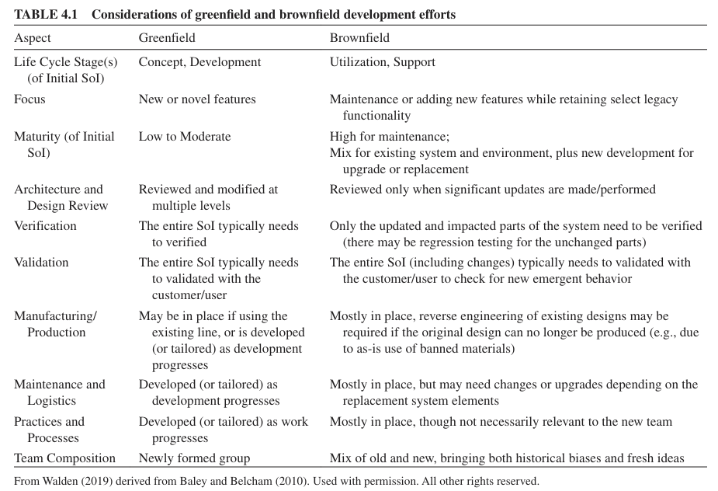
4.3.2 Brownfield/Legacy Systems (cont’d)
Notes:
4.3.2 Brownfield/Legacy Systems, Page 230

Slide 38
4.3.3 Commercial-Off-The-Shelf (COTS)-Based Systems
One of the key trade-off studies SE practitioners perform is the "make vs. buy" decision on system elements. "Make“ represents custom-built solutions; "buy" represents outsourced development and commercial-off-the-shelf (COTS) solutions. Most systems have some COTS content. The following characteristics can be useful when deciding if a particular system or system element can be characterized as COTS (Oberndorf, et al.,2000) (Tyson, et al., 2003):
Sold, leased, or licensed to the general public;
Offered by a vendor trying to profit from it;
Supported and evolved by the vendor, who retains the intellectual property rights;
Vendor (not acquirer) controls the frequency of the product's maintenance and updates;
Available in multiple, identical copies;
Used without hardware or source code modification.
Notes:
4.3.3 COTS-Based Systems, Page 231

Slide 39
4.3.3 Commercial-Off-The-Shelf (COTS)-Based Systems (cont’d.)
The promise of COTS is to save development time, reduce technical risk, reduce time-to-market, reduce cost-to-market, and take advantage of latest technology. However, often these promises are not realized. Considerations for COTS-based systems include (Long, 2000):
COTS products not built to your specific requirements (including missing functionality, extra functionality, and unwanted behaviors).
Unique, or different than expected, interfaces, including a vendor's use of proprietary data formats and/or communications protocols, may occur.
Vendor claims and decisions may impact schedule.
The details needed to understand how COTS products may impact the safe and secure operation of the Sol may not be readily available, including the trustworthiness of the vendor, the use of open-source software, and the use of third-party software of unknown origin.
COTS product may be insufficiently documented.
"Not Invented Here" (NIH) syndrome may deter engineers from using COTS.
Notes:
4.3.3 COTS-Based Systems, Page 231

Slide 40
4.3.3 Commercial-Off-The-Shelf (COTS)-Based Systems (cont’d.)
Considerations for COTS-based systems include (Long, 2000) (cont’d):
Delivery times may not be met.
Special integration challenges may occur.
COTS products are often not verified to your specific requirements and may lack verification data for the operating environment for the Sol.
"Sole Source" suppliers result in more risk.
Need to consider the entire life cycle cost (LCC) of maintenance and technology rolls/refresh due to COTS obsolescence and diminishing manufacturing sources and material shortages (DMSMS) (NOTE: IEC 62402 (2019) provides guidance for establishing a framework for obsolescence management process which is applicable through all stages of system life cycle).
Some of the key COTS-based SE considerations are shown in Table 4.2. Effective use of COTS generally requires COTS evaluation starting during needs analysis.
Notes:
4.3.3 COTS-Based Systems, Page 231

Slide 41
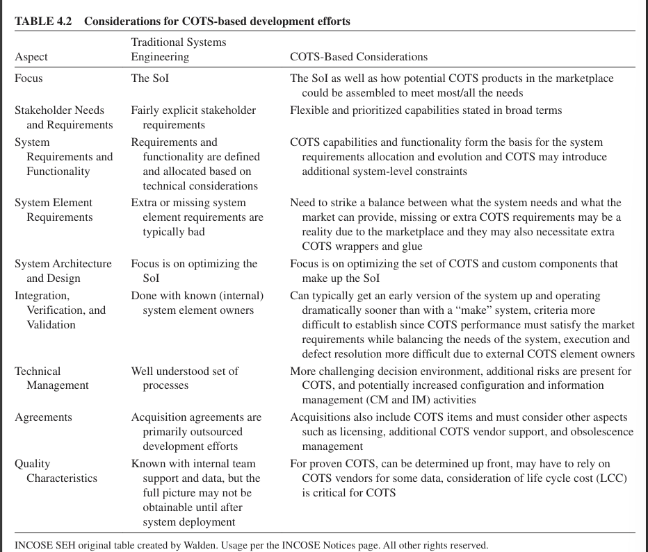
4.3.3 Commercial-Off-The-Shelf (COTS)-Based Systems (cont’d.)
Notes:
4.3.3 COTS-Based Systems, Page 232

Slide 42
4.3.4 Software-Intensive Systems
ISO/IEC/IEEE 42010 (2022) defines a software-intensive system as:
Any system where software contributes essential influences to the design, construction, deployment, and evolution of the system as a whole.
Software elements often contribute to system functionality, behavior, quality characteristics, interfaces, and observable performance indicators for software-intensive systems. Encapsulated software is sometimes custom-built and is sometimes obtained by using software elements from libraries. Reused software elements may be modified by tailoring them for intended use.
Developing and modifying software-intensive systems presents challenges for SE practitioners when partitioning system requirements and elements of the architecture, allocating performance parameters to physical elements and to software elements, establishing and controlling physical-software interfaces, and facilitating integration of physical elements with software elements (Fairley, 2019).
Notes:
4.3.4 Software-Intensive Systems, Page 233-234

Slide 43
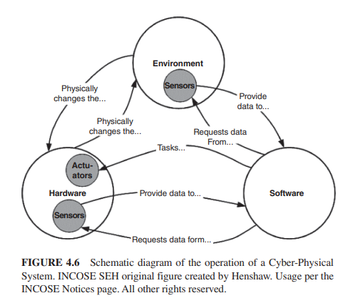
4.3.5 Cyber-Physical Systems (CPS)
CPS are the integration of physical and cyber (software) processes in which the software monitors and controls the physical processes and is, in turn, affected by them.
CPS are enabled by sensors and feedback loops and their provenance has increased because of significant advances in sensor technology and affordability. (see Figure 4.6)
Notes:
4.3.5 Cyber-Physical Systems (CPS), Page 233-234

Slide 44
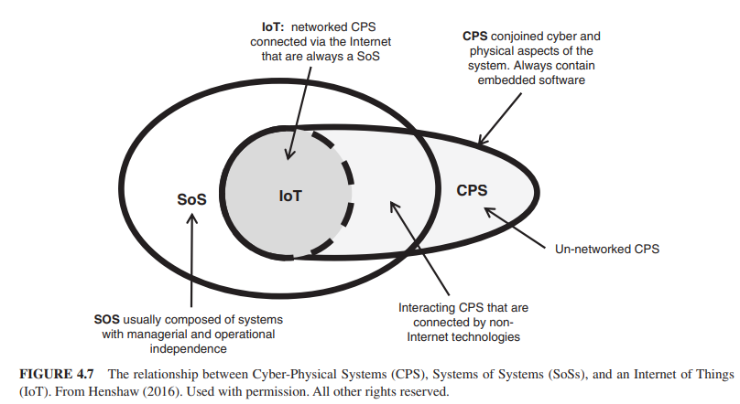
4.3.5 Cyber-Physical Systems (CPS) (contd)
The relationships between the concepts of SoS, CPS, and IoT are illustrated in Figure 4.7 (below). The “Things” in IoT are constituent systems and they are always networked, and therefore, always an SoS.
Notes:
4.3.5 Cyber-Physical Systems (CPS) contd, Page 234.

Slide 45
4.3.6 Systems of Systems (SoS)
ISO/IEEE/IEC 21839 (2019) defines a System of Systems (SoS) as:
A set of systems or system elements that interact to provide a unique capability that none of the constituent systems can accomplish on its own.
Constituent systems can be part of one or more SoS.
The following characteristics can be useful when deciding if a particular SoI can be better be understood as an SoS (Maier, 1998):

Slide 46
4.3.6 Systems of Systems (SoS) (contd)
The following characteristics can be useful when deciding if a particular SoI can be better be understood as an SoS (Maier, 1998):
Operational independence of constituent systems
Managerial independence of constituent systems
Geographical distribution
Emergent behavior
Evolutionary development processes.
Of these, operational independence and managerial independence are the two principal distinguishing characteristics for applying the term SoS.
Notes:
4.3.6 System of Systems (SoS), page 235

Slide 47
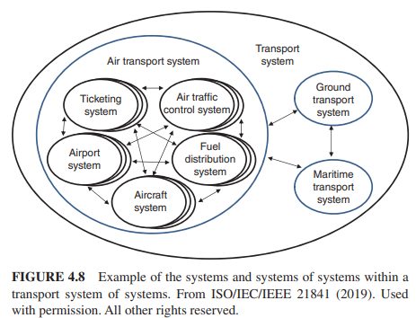
4.3.6 System of Systems (SoS) (contd)
Figure 4.8 (below) illustrates the concept of an SoS.
Notes:
4.3.6 System of Systems (SoS), page 236.

Slide 48
4.3.6 System of Systems (SoS) (contd)
There are 3 international standards that provide useful guidance on SoS:
ISO/IEC/IEEE 21839 (2019)—”System of systems (SoS) considerations in life cycle stages of a system”
ISO/IEC/IEEE 21840 (2019)—”Guidelines for the utilization of ISO/IEC/IEEE 15288 in the context of systems (SoS)”
ISO/IEC/IEEE 21841 (2019)—”Taxonomy of systems of systems”

Slide 49
4.3.6 System of Systems (SoS) (contd)
Dahmann (2014) identified the following challenges that influence the engineering of an SoS:
SoS authorities- In an SoS, each constituent system has its own local "owner" with its stakeholders, users, business processes, and development approach. As a result, the type of organizational structure assumed for most traditional SE under a single authority responsible for the entire system is absent from most SoS. (See SoS Types in Table 4.3, page 236),
Leadership- Recognizing that the lack of common authorities and funding poses challenges for SoS, a related issue is the challenge of leadership in the multiple organizational environments of SoS.
Constituent Systems- SoS are typically composed, at least in part, of in-service systems, which were often developed for other purposes and are now being leveraged to meet a new or different application with new objectives.
Capabilities and requirements- Traditionally (and ideally), the system engineering process begins with a clear, complete set of initial user requirements and provides a disciplined approach to develop and evolve a system to meet these and emerging requirements.
Notes:
4.3.6 System of Systems, Page 236. Also see Table 4.3 SoS Types (p. 236) and Table 4.4 Impact of SoS considerations on the SE processes (p. 237)

Slide 50
4.3.6 System of Systems (SoS) (contd)
Dahmann (2014) identified the following challenges that influence the engineering of an SoS (contd):
Autonomy, interdependence, and emergence- The independence of constituent systems in an SoS is the source of a number of technical issues when applying SE to an SoS.
Testing- The fact that SoS are typically composed of constituent systems that are independent of the SoS poses challenges in conducting end-to-end SoS testing, as is typically done with systems. First, unless there is a clear understanding of the SoS-level expectations and measures of those expectations, it can be very difficult to assess …or to ensure users of the capabilities and limitations of the SoS. Even when there is a clear understanding of SoS objectives and metrics, testing in a traditional sense can be difficult. Depending on the SoS context, there may not be funding or authority for SoS testing.. With multiple constituent systems subject to asynchronous development cycles, finding ways to conduct traditional end-to-end testing across the SoS can be difficult if not impossible. In addition, many SoS are large and diverse, making traditional full end-to-end testing with every change in a constituent system prohibitively costly. Nonetheless, the SoS SE team needs to enable continuity of operation and performance of the SoS despite these challenges.
Notes:
4.3.6 System of Systems, Page 237-238.

Slide 51
4.3.6 System of Systems (SoS) (contd)
Dahmann (2014) identified the following challenges that influence the engineering of an SoS (contd):
SoS Principles- SoS is an area where there has been limited attention given to ways to extend systems thinking to the issues particular to SoS. The community is beginning to identify and articulate the crosscutting principles that apply to SoS in general and to develop working examples of the application of these principles. There is a major learning curve for the average SE practitioner moving to an SoS environment and a problem with SoS knowledge transfer within or across organizations.
Notes:
4.3.6 System of Systems, Page 238.

Slide 52
4.3.7 Internet of Things (IoT)/
Big Data-Driven Systems
SE is based on engineering requirements, engineering calculations, testing, modeling, and simulations-and all are based on data or data generation. SE practitioners often make decisions based on intuition, previous experience, or qualitative assessments. The 4th Industrial Revolution, with its proliferation of sensors of various types and big data analytics, creates an opportunity for SE, as a discipline, and for SE practitioners, as professionals and decisions makers, to be more data-driven.
There are three general goals in analyzing data:
Prediction: To predict the response to future values of the input variables.
Estimation: To infer how response variables are associated with input variables.
Explanation: To understand the relative contribution of input variables to response values.
SE practitioners should view a system as interconnected system elements performing the system functions. To meet this challenge, the SE practitioner who leads data-driven designs needs interdisciplinary knowledge of the main aspects of IoT, computing sensors/actuators, software, network, analytics, and data science.
Notes:
4.3.7 Internet of Things (IoT)/Big Data-Driven Systems, Page 238-239

Slide 53
4.3.8 Service Systems
OASIS (2012) defines a service as:
A mechanism to enable access to one or more capabilities, where the access is provided using a prescribed interface and is exercised consistently with constraints and policies as specified by the service description.
Typically, a service system is composed ofservice system entities that interact through processes defined by governance and management rules to create differenttypes of outcomes in the context of stakeholders with the purpose of providing improved customer interaction andvalue cocreation.
Figure 4.9 illustrates the conceptual framework of a service system.
Notes:
4. 3.8 Service Systems, page 239-240

Slide 54
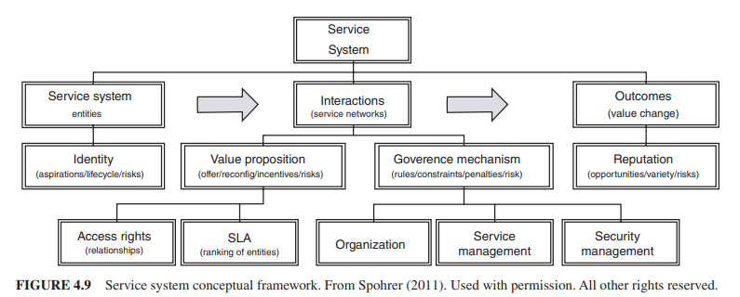
4.3.8 Service Systems (contd)
Figure 4.9 (below) illustrates the conceptual framework of a service system. Typically, a service system is composed of service system entities that interact through processes defined by governance and management rules to create different types of outcomes in the context of stakeholders with the purpose of providing improved customer interaction and value cocreation.
Notes:
4. 3.8 Service Systems, page 239-240

Slide 55
4.3.8 Service Systems (contd)
In summary, in a service system environment, SE practitioners should bring a customer focus to promote service excellence and to facilitate service innovation through the use of emerging technologies to propose creation of new service systems and value cocreation. SE practitioners must play the role of an integrator, considering the interface requirements for the interoperability of service system entities-not only for technical integration but also for the processes and organization required for optimal customer experience during service operations.
Notes:
4. 3.8 Service Systems, page 240

Slide 56
4.3.9 Enterprise Systems
This section illustrates the applications of SE principles and concepts when the Sol is an enterprise. The aim is to continuously improve and help transform the enterprise to better deliver value and to survive in a globally competitive environment. Enterprise SE is an emerging discipline that focuses on frameworks, tools, and problem-solving approaches for dealing with the inherent complexities of the enterprise including exploitation of new opportunities that can facilitate achievement of enterprise goals. A good overall description of enterprise SE is provided in Rebovich and White (2011). For more detailed information on this topic, please see the Enterprise SE articles in Part 4 of SEBoK (2023).
Notes:
4.3.9 Enterprise Systems, Page 241.

Slide 57
4.3.9 Enterprise Systems (contd)
It is worth noting that an enterprise is not equivalent to an "organization." As shown in Figure 4.10, an enterprise has organizations that participate in it, but these organizations are not necessarily "part" of the enterprise. The organizations that participate in the enterprise will manage a variety of resources for the benefit of the enterprise, such as people, knowledge, and other assets such as processes, principles, policies, practices, culture, doctrine, theories, beliefs, facilities, land, and intellectual property. These organizational resources will consume or produce money, time, energy, and material when acting on behalf of the enterprise.

Slide 58
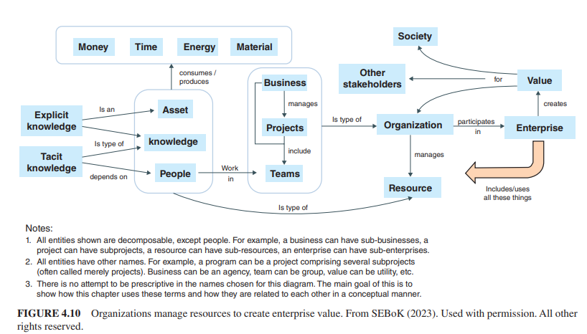
4.3.9 Enterprise Systems (contd)
Notes:
4.3.9 Enterprise Systems, Page 241

Slide 59
4.3.9 Enterprise Systems (contd)
Capabilities in the Enterprise As shown in Figure 4.11 (next slide), the enterprise acquires or develops systems or individual elements of a system. The enterprise can also create, supply, use, and operate systems or system elements. Since there could possibly be several organizations involved in this enterprise venture, each organization could be responsible for particular systems or perhaps for certain kinds of elements. Each organization brings their own organizational capability with them, and the unique combination of these organizations leads to the overall operational capability of the whole enterprise.
Notes:
4.3.9 Enterprise Systems, Page 242

Slide 60
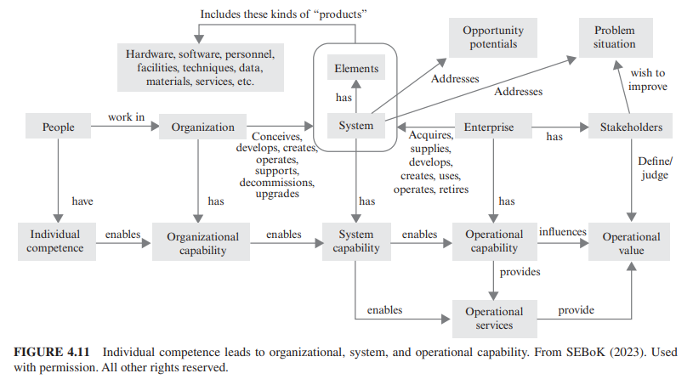
4.3.9 Enterprise Systems (contd)
Notes:
4.3.9 Enterprise Systems, Page 242

Slide 61
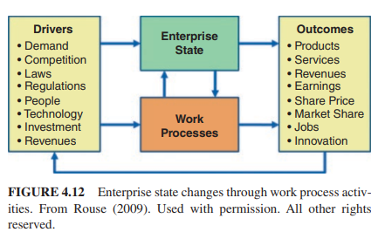
4.3.9 Enterprise Systems (contd)
Enterprise Drivers and Outcomes An enterprise needs to consider its own needs that relate to enabling assets (e.g., personnel, facilities, communication networks, computing facilities, policies and practices, tools and methods, funding and partnerships, equipment and supplies) when addressing the stakeholders' needs. The purpose of the enterprise's enabling assets is to effect state changes to relevant elements of the enterprise necessary to achieve targeted levels of performance. The enterprise "state" shown in Figure 4.12 (below) is a complex web of past, current, and future states(Rouse, 2009). The enterprise work processes use these enabling assets to accomplish their work objectives to achieve the desired future states.
Notes:
4.3.9 Enterprise Systems, Page 243

Slide 62
4.3.9 Enterprise Systems (contd)
Practical Considerations When it comes to performing SE at the enterprise level, Rebovich and White (2011) pro-vide several good practices:
Set enterprise fitness as the key measure of system success. Leverage game theory and ecology, along with the practices of satisfying and governing the commons.
Deal with uncertainty and conflict in the enterprise through adaptation: variety, selection, exploration, and experimentation.
Leverage the practice of layered architectures with loose couplers and the theory of order and chaos in networks.
Enterprise governance involves shaping the political, operational, economic, and technical landscape. One should not try to control the enterprise like one would in a traditional SE effort at the project level.
Notes:
4.3.9 Enterprise Systems, Page 244

Slide 63
Review Questions

Slide 64
Review Question:
What is the primary goal of tailoring in systems engineering?
To eliminate all risks associated with cost and schedule overruns.
To balance process rigor with the risk of cost and schedule overruns.
To ensure maximum rigor in all SE processes.
To avoid the use of system life cycle models.
Notes:
4.1 Tailoring Considerations, page 215 [Answer is B]

Slide 65
Review Question:
What is the primary goal of tailoring in systems engineering?
To eliminate all risks associated with cost and schedule overruns.
To balance process rigor with the risk of cost and schedule overruns.
To ensure maximum rigor in all SE processes.
To avoid the use of system life cycle models.
X
Notes:
4.1 Tailoring Considerations, page 215 [Answer is B]

Slide 66
Review Question:

