Slide 1
Elevating Our Understanding of Non-malicious Employees in Cybersecurity
Dr. Matthew Canham
Institute for Simulation & Training @ UCF
President & CEO
Dr. Clay Posey
College of Business
Cybersecurity & Privacy Cluster @ UCF
Chief Research Scientist

Slide 2
Early Experiences (or Why We Are the Way We Are)

Slide 3
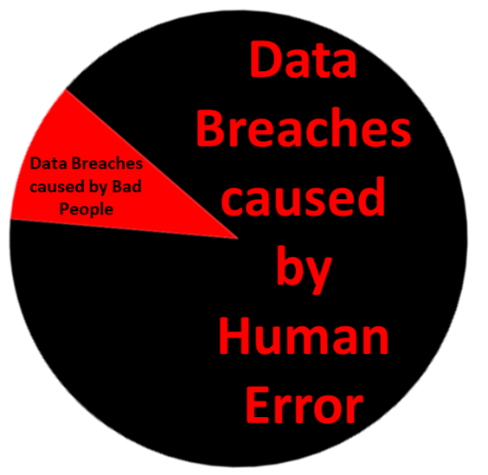
Causes of Data Breach
Human Error (Non-Malicious)
88% (Kroll Associates – UK Information Commissioner (ICO) Report, 2018)
Confidential data being emailed to the incorrect recipient (18.5%)
Loss of paperwork (18.1%)
Data left in an insecure location (6.7%)
95% (IBM - 2014 Cyber Security Intelligence Index, 2014)
~10% of data breaches result from malicious attacks
ALL DATA BREACHES

Slide 4
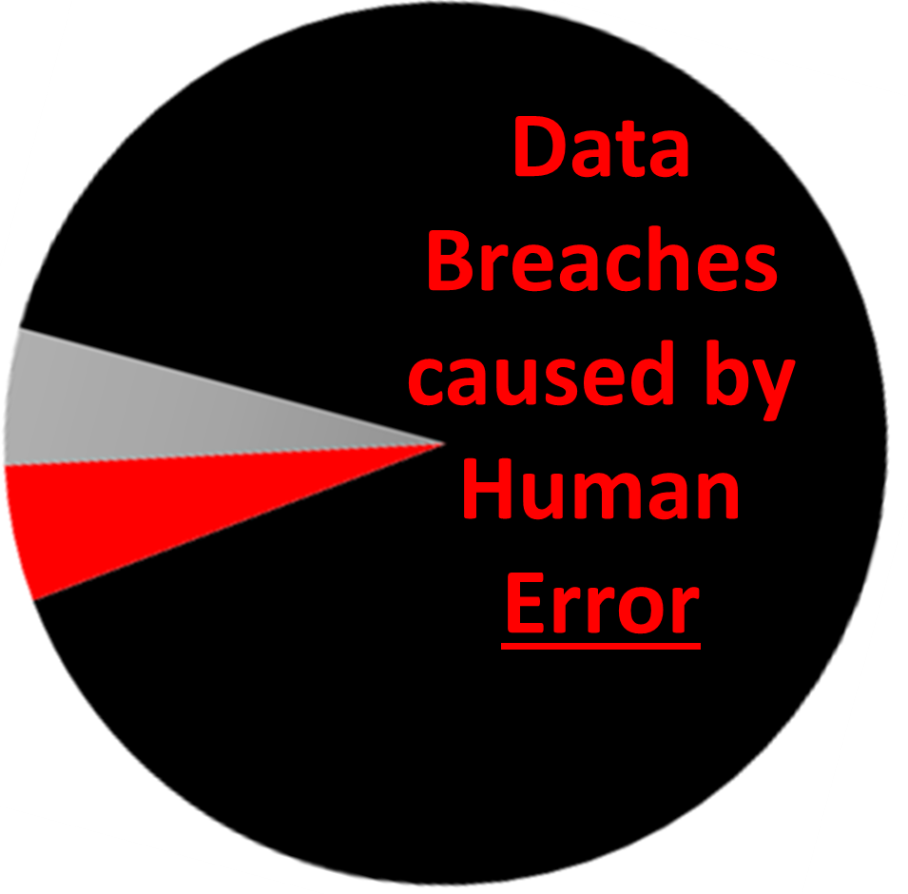
Human as an Attack Vector
Data Breaches caused by BAD PEOPLE
Human Attack Vectors (~50%)
Technical Attack Vectors (50%)
91% (KnowBe4, 2019)
43% (Verizon DBIR, 2017)
~50% of data breaches leveraging social engineering

Slide 5
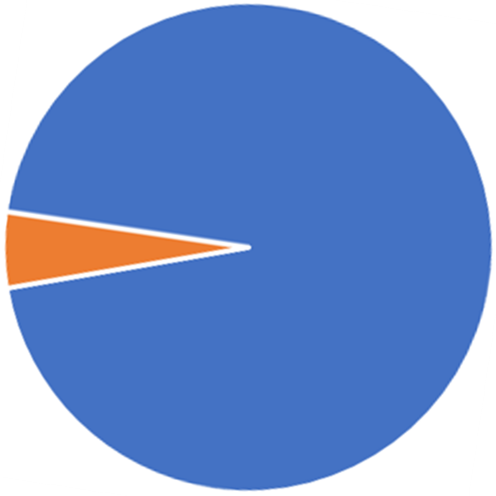
Data Breaches resulting from Technical Attack Vectors
~90% Human Error + ~5% Human Vector Attacks
~ 5% Data Breaches originate from Malicious Actors relying on technical attack vectors

Slide 6
Show me the !
Amount spent on security awareness training in the U.S. 2017
$370 Million (Gartner, 2017)

Slide 7
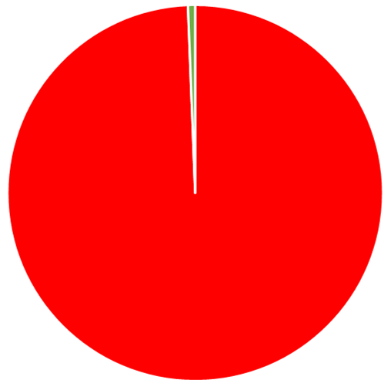
Show me the !
0.62% ($370 Million) spent on security awareness training
Total amount spent on cyber defense in the U.S. in 2017 $60.4 Billion

Slide 8
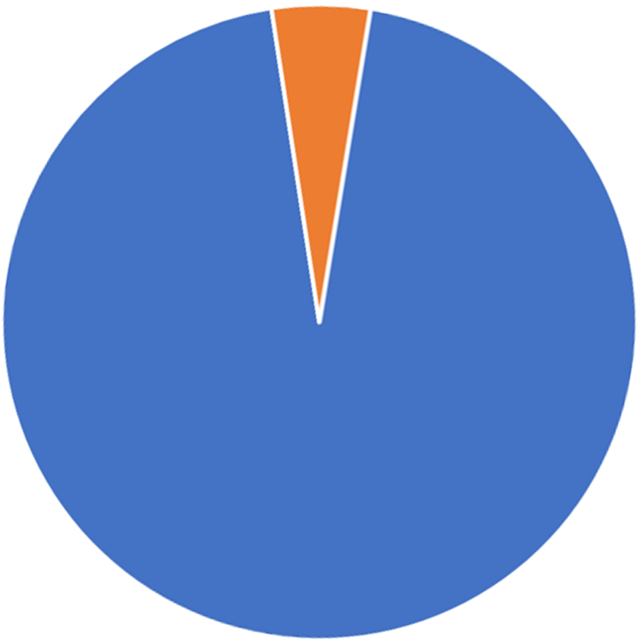
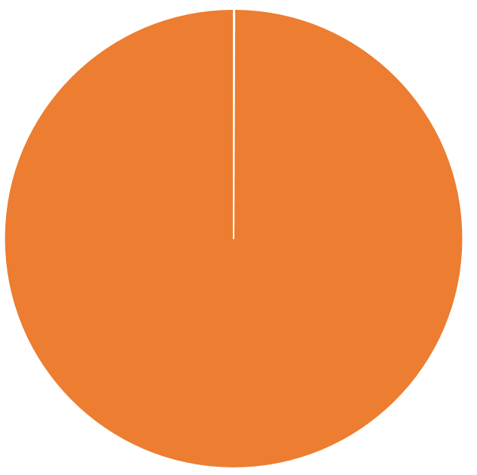
Proportion of Data Breaches resulting from Malicious Technical Attack Vectors
Proportion of funding spent on security awareness training in the U.S. 2017
Proportion of Data Breaches resulting from Human Error or Human Vector Attack
Amount spent to defend against Malicious Technical Attack Vectors in 2017

Slide 9
Deviations from Policy
Intentional
Deliberate Violations
(Shadow IT and workarounds)
Unintentional
Slips
Correct goal, flawed execution.
Mistakes
Wrong goal, good execution.

Slide 10
Species of Phish
QRshing
Business Email Compromise
smshing (text messaging)
vishing (voice)
Spear Phish
Whaling

Slide 11
Business Email Compromise

Slide 12
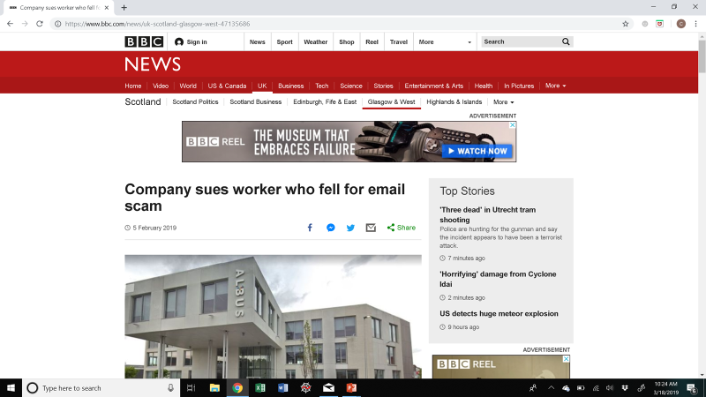
Just last month…

Slide 13
Taking a Longitudinal View
47%
13%
32%
8%

Slide 14
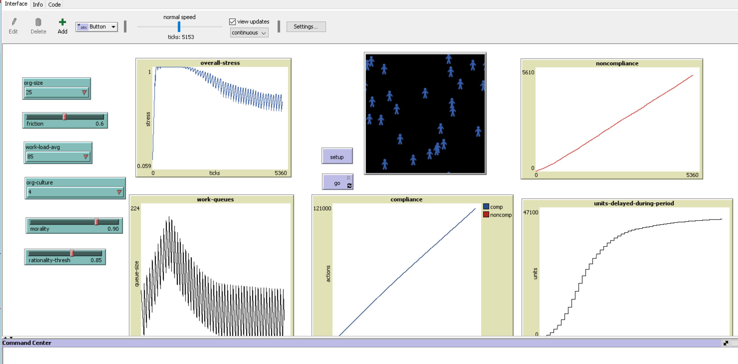
Complex Adaptive Systems and “What If” Analyses

Slide 15
Ending on a Positive Note
• Most employees don’t enter their organization everyday and think: “How can I screw up things for my company?”
• Need to stop treating them like all have cruel intentions
• Realize and readily accept that errors will happen and form meaningful strategies that build resilient organizational cultures
- “A million accidents that should have occurred today but didn’t”
• Employees are the most significant component of organizational cybersecurity
vs.

Slide 16
Contact Information
Dr. Matthew Canham
Institute for Simulation & Training
University of Central Florida
mcanham@ist.ucf.edu
President & CEO
matthew@belay7.com
Dr. Clay Posey
College of Business
Cybersecurity & Privacy Cluster
University of Central Florida
clay.posey@ucf.edu
Chief Research Scientist
clay@belay7.com

