Slide 1
“The difficulty lies not in the new ideas, but in escaping from the old ones.”
John Maynard Keynes, 1935

Slide 2
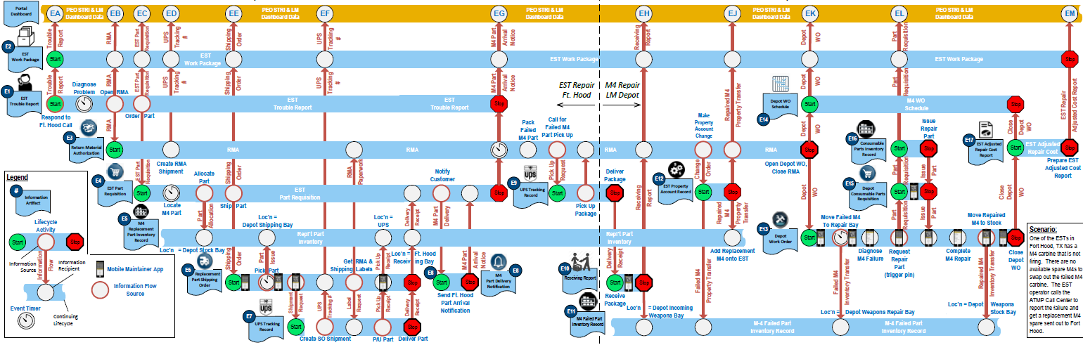
Information Lifecycle Diagrams
Ian Phillips
September 19th, 2019

Slide 3
Information Lifecycle Diagram Defined
An Information Lifecycle Diagram (ILD) lays out the various states of a primary Information Item over that Item’s entire lifecycle for a given scenario. It also specifies how the primary Information Item transfers information with secondary Information Items.

Slide 4

What is IT all about?
IT = Information Technology
  IT is all about the data!
IT is less about software development, more about managing data, lots of data!
The piles of IT data keep getting bigger
  Operational Data Stores
  Date Warehouses
  Data Marts
  In memory databases
  OLAP and Data Cubes
  Data Lakes and NoSQL data bases
Big Data
To develop robust applications, developers need to understand the information lifecycle

Slide 5
The IT Paradigm Gap!
Object Oriented Programming
C++, C#, JAVA, Python, Ruby
Functional Analysis
Object Modeling
Workflow
BPMN
Object Oriented
Data is encapsulated within functional objects
Computer Programs
Paradigm Gap!
Data lives by itself without functions
SQL RDBMS
Data Warehouses
Data Marts / Analytics / Cubes
Data Lakes / Data Mining / NoSQL
Master Data Management
Entity Relationship Diagrams
Information Technology

Slide 6
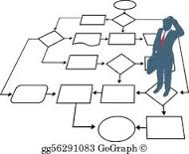
Workflow vs Information Lifecycle
Proposed Solutions
Of course it is important to understand the business process details that an IT system will support
  Necessary but not sufficient
Business processes are actually very flexible
Business closely defines information capture and use
Information lifecycles tend to be well defined
  Specific fields are usually required.
  Flexibility exists in how data is captured (process), not in what is captured (information).
It is easier to agree on the information transaction points when compared to the business process.
Notes:
Business process specs tend to be an idealized compromise, and don’t reflect what individuals actually do
Business process specs tend towards “happy path”
But in the real world, individuals tend to do things “their own way”

Slide 7
Activity Workflow Problem Example
Identify BER for material cost against WO event based on 80% of replacement cost
Change status of part to BER, and 30 day TAT to replace item starts
N
Inform government and solicit contract mod and close WO
Continue repair?
N
Is part cost under $35,000?
CMMS process
Y
AWARE
Y
AWARE
Property Manager
LM – buyer or
Create BER demand requisition and close WO
Receive part into inventory and perform disposition process for failed part
AWARE
Part received within 30 days?
Y
Reference repair process
LM - SCM
N
Notify government and provide status
This is an actual workflow specification of a part maintenance activity for an active program.
Attempt to describe business process generates much debate amongst participants.
This specification is for only one “happy path”, many secondary paths are discarded during the discussion.
Data is not usually explicitly specified or discussed.
AWARE

Slide 8
Activity Workflow Information Elements
Identify BER for material cost against WO event based on 80% of replacement cost
Change status of part to BER, and 30 day TAT to replace item starts
N
Inform government and solicit contract mod and close WO
Continue repair?
N
Is part cost under $35,000?
CMMS process
Y
AWARE
Y
AWARE
Property Manager
LM – buyer or
Create BER demand requisition and close WO
Receive part into inventory and perform disposition process for failed part
AWARE
Part received within 30 days?
Y
Reference repair process
LM - SCM
N
Notify government and provide status
AWARE
Lets look at the information elements involved in the workflow
An analysis identifies a wide variety of different data types
Workflows tends to under-emphasize data in the workflow
None of the data elements are formally referenced
No interrelationships of data elements are shown

Slide 9
SysML Diagram Types
None of these 9 existing SysML diagrams deal with the Information Lifecycle.

Slide 10
Overview
Problem: The most common method (by far) for software development is object oriented; analysis, design and coding. This approach encapsulates data within objects. Specifying IT systems with confidence is highly problematic. IT applications are data oriented, not object oriented. Almost all modern IT analysis and design methods are object oriented, and deal with data in a very fragmented way. This makes it difficult to develop data centric IT applications using conventional system analysis artefacts.
Solution: An Information Lifecycle Diagram (ILD) lays out the various states of a primary Information Item over that Item’s entire lifecycle for a given scenario. It also specifies how the primary Information Item transfers information with secondary Information Items.
An Information Lifecycle Diagram illustrates the lifecycle of one or more information items from the time they are created until the time they are
completed. It shows interactions between the various information items while completing actions associated with a business scenario.

Slide 11
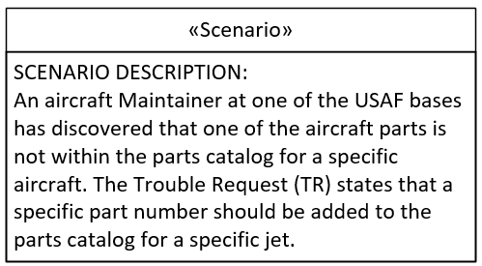
The Scenario
An ILD reflects a defined scenario.

Slide 12
Information Items / Information Lifelines
Notional Information Lifecycle Diagram (ILD)
Primary Information Lifeline
Secondary Information Lifelines
Scenario:
This box contains a detailed description of the scenario that the ILD is to address.

Slide 13
Information Transfers between Information Items
Notional Information Lifecycle Diagram (ILD)
Information Transfers
Scenario:
This box contains a detailed description of the scenario described by the ILD

Slide 14
The Information Item
(Information Lifeline)
Time Elapsing
All events associated with an Information Item are represented by activities and activity related items that are located along the Information Lifeline.
Time is represented by the relative horizontal placement of items along the lifeline. Follow on events are always represented to the right of the current event on the lifeline.
Time is relative, not to scale.
Notes:
We expand a scenario out in the ILD, breaking the scenario up into all of its constituent parts.
Each Information Item has a name. This name is captured in a label at the left of the Start Activity for that information item.
As the Lifecycle of the Information Item unfolds, the activities and events are shown in order of execution. As time elapses, the activities are shown in sequence, moving towards the right. In other words, if there are two activites on an Information Lifeline, the activity on the left precedes the activity on the right.
As events unfold, the activities and events are always on the right, so the concept of looping back to a previous activity or event, as one would do on a flowchart, is not a valid concept.
Activities continue to be shown to the right as time passes.
The rate of time elapsing in the diagram is not constant. So activites are regularly spaced on the information lifecycle, whether they complete quickly, or take a long time.

Slide 15
Information Item Node Types
Node Types are:
  Information Item
  Action
  Transfer
  Time Passes
  Information Transmit
  Inspect
  Stop
  Continue
The Continue node is used to include part of an Information Item’s lifecycle in an ILD.
Notes:
Lifeline elements include
Time passing with no activity
Transport of information item to another control domain, e.g. ownership passes from one role to another role.
Decision points that allow alternate Information Lifeline paths to be represented.

Slide 16
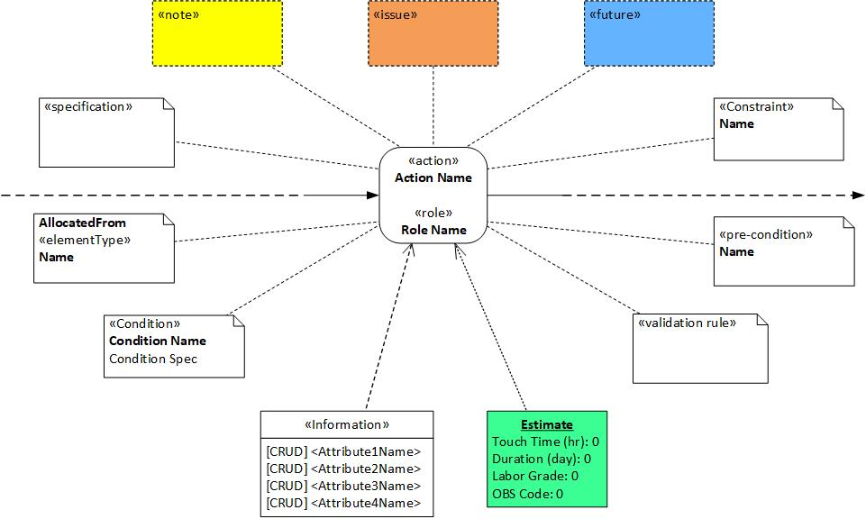
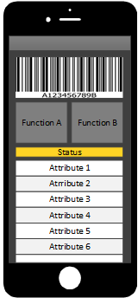
The Action and Related Items
Action related items may include involved information attributes, business rules, specifications, notes, issues, cost and screenshots
Notes:
Activity labels contain two components, the Role Name, and the Activity Name. The Role Name describes the role of the person(s) who perform the activity. The Activity Name is usually a summary description of the activity taking place. The Activity Name is usually a noun – verb pair, or some expansion of that concept. A detailed description of the activity can also be optionally captured.
The rest of the related items are optional. The Business Rule allows business rules associated with the activity to be formally described. The Information Entity allows the information that is relevant to the activity to be identified. Information Entities and Attributes are formally described in a separate glossary. Each attribute can specify whether it is Created, Read, Updated or Deleted (CRUD) at this point in the information lifecycle.
Notes can capture any unique information about the activity. It allows a text description to be captured and associated with the activity.
Issue / Finding can capture any issue or finding about the activity. It allows a text description to be captured and associated with the activity. The Issue or Finding is usually used to highlight things that need to be addressed when moving from an as-is to a to-be Information Lifecycle. We would normally expect the to-be information lifecycle to make changes to eliminate all Issues and Findings that were captured during the as-is Information Lifecycle elucidation.
One or more Business Forms and Screen Shots can also be presented. They will help provide a better context for the interactions occurring with the Information Item at this Activity node.
The only required information for an Activity Node is the Role Name and the Activity Name.

Slide 17
The Information Item – Information Capture
Information is described at each Node in an Information Item lifeline
«Transmittal»
Transmittal
Information activity is described for each Information Transfer to and from an Information Item
«Transmittal»
Transmittal
The most important expression in an ILD is how the Primary Information Item interacts with secondary Information Items, and what effects occur due to these interactions.
The interactions are expressed with vertical lines that connect two or more Information Lifelines.
Data is often shared during these interactions.

Slide 18
Notional ILD – Information Item 1 Schema Views
The Information Item – Information Capture
Information Item 1 Action Schemas
Information Trans fer
Schemas
Information Item Summary Schemas
An ILD has an underlying formal data architecture.
Each Information Item & Information Transfer has a discrete data schema.
Each Action Node in a horizontal Information Item has a discrete data schema.
Each Information Transfer has its own data schema that describes the relationship between the interacting Action Nodes.

Slide 19
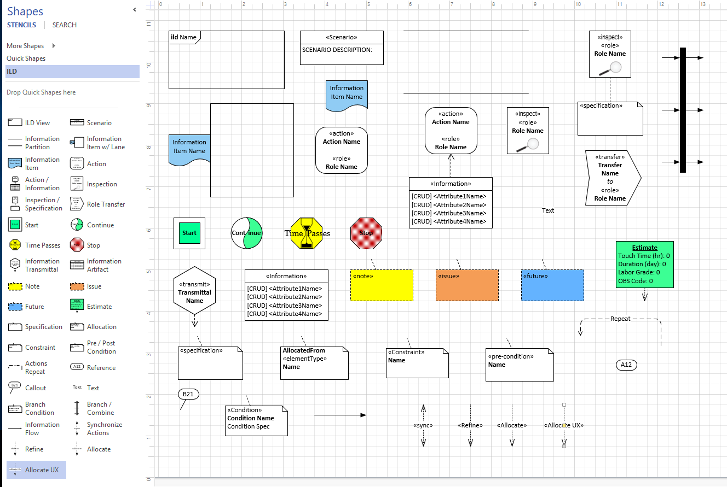

Slide 20
ILD Novel Attributes
Documents the dynamic information lifecycle in a system-of-systems context, especially useful where information is the primary focus.
Formal data-oriented specification that is captured in an underlying MBSE model. (Like SysML, UML, BPMN, etc.)
All requirements for a primary information item’s entire lifecycle are presented in a single view. (AKA Digital Thread)
The ILD is expressed in the context of user roles, which enables users to understand their interactions with the information items.
Supports as-is and to-be views of an information item lifecycle.

Slide 21
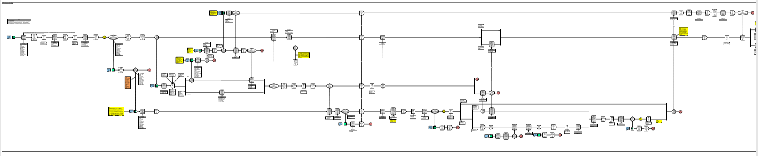
ILD Summary
An Information Lifecycle Diagram illustrates the lifecycle of one or more information items from the time they are created until the time they are completed.
It shows interactions between the various information artifacts while achieving a business objective.
Understanding information lifelines using Information Lifecycle Diagrams significantly reduces IT implementation risk.
Understanding information lifelines using Information Lifecycle Diagrams significantly reduces IT implementation risk.
Notes:
Information lifecycles are associated with their complimentary business process lifecycle
Understanding the lifecycle of information is the foundation of IT system implementations
Information lifecycles are very stable
They contain discrete business process activities linked along the information lifelines
Stable Information lifecycles
Enable flexible business processes around them.
Include interaction with other information elements

Slide 23
Digital Thread
A digital thread describes the framework which connects data flows and produces a holistic view of an asset's data across its product lifecycle.[1]
The term digital thread is also used to describe the traceability of the digital twin back to the requirements, parts and control systems that make up the physical asset.[2]
[1] Leiva, Conrad (2016-12-23). "What is the Digital Thread?". iBASEt.
Retrieved 2018-11-22.
[2] Gould, Lawrence S. "What Are Digital Twins and Digital Threads?". Automotive Design & Production. Retrieved 2018-11-22.
ILDs can be used as a rigorous approach to analyzing
and specifying Digital Threads.

