Slide 1
Program Protection Planning Awareness & SAP Initiatives for the Defense Industry Base
Presentation to:
INCOSE Orlando
Darin J. Smith
Director, Special Programs
Security & Intelligence Directorate
July 2016

Slide 2
“These military devices, leading to victory, must not be divulged beforehand.”
― Sun Tzu, The Art of War

Slide 3
Meanwhile …

Slide 4
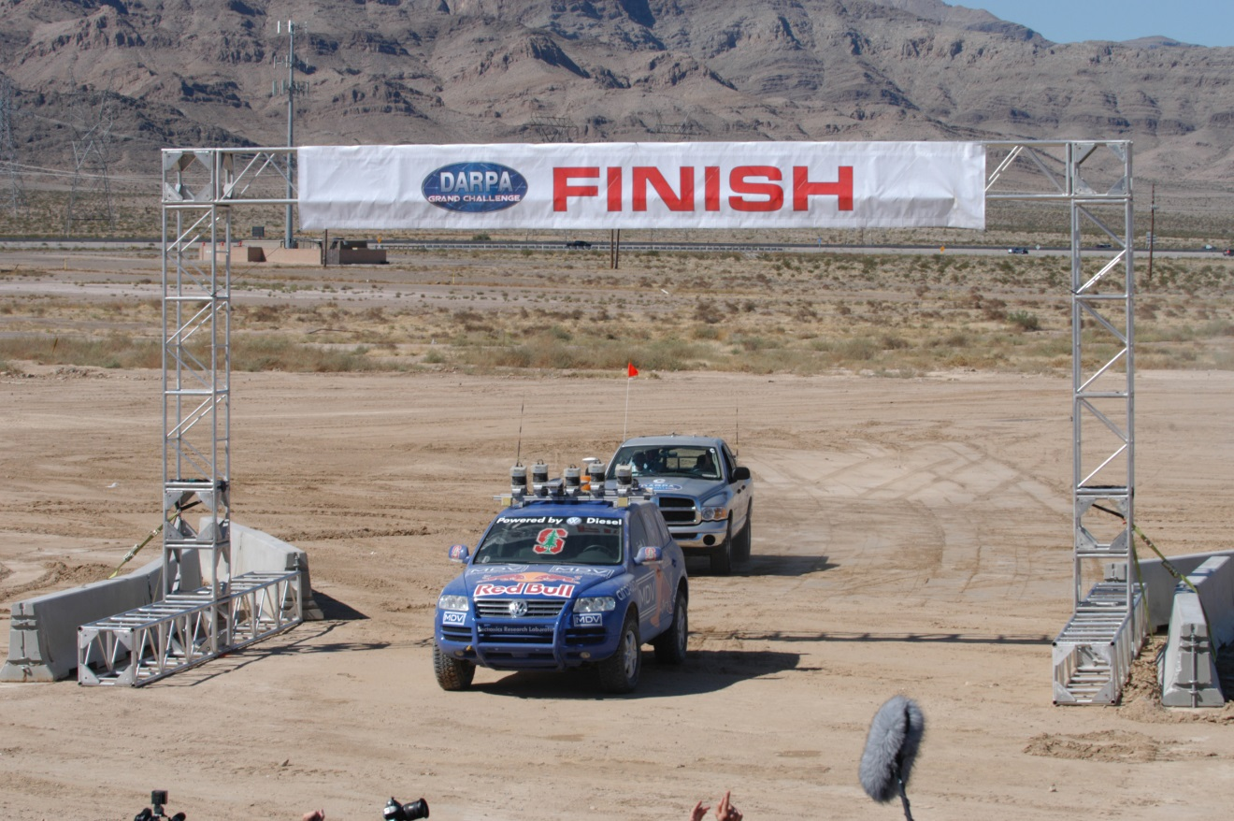
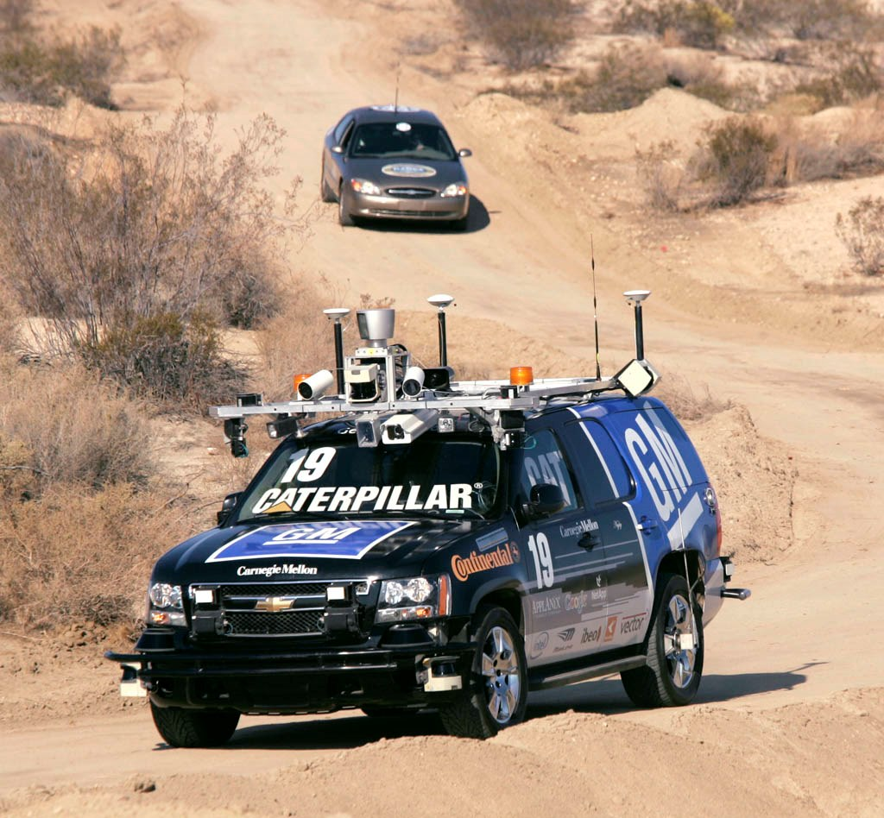
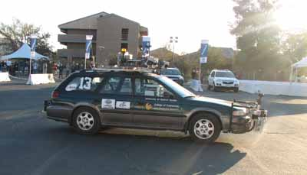
Source: DARPA
Source: DARPA
Source: SPIE.org
Source: DARPA

Slide 5
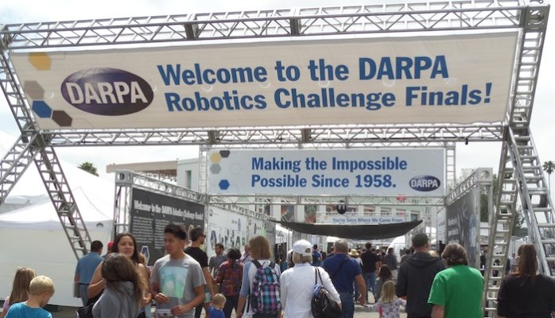
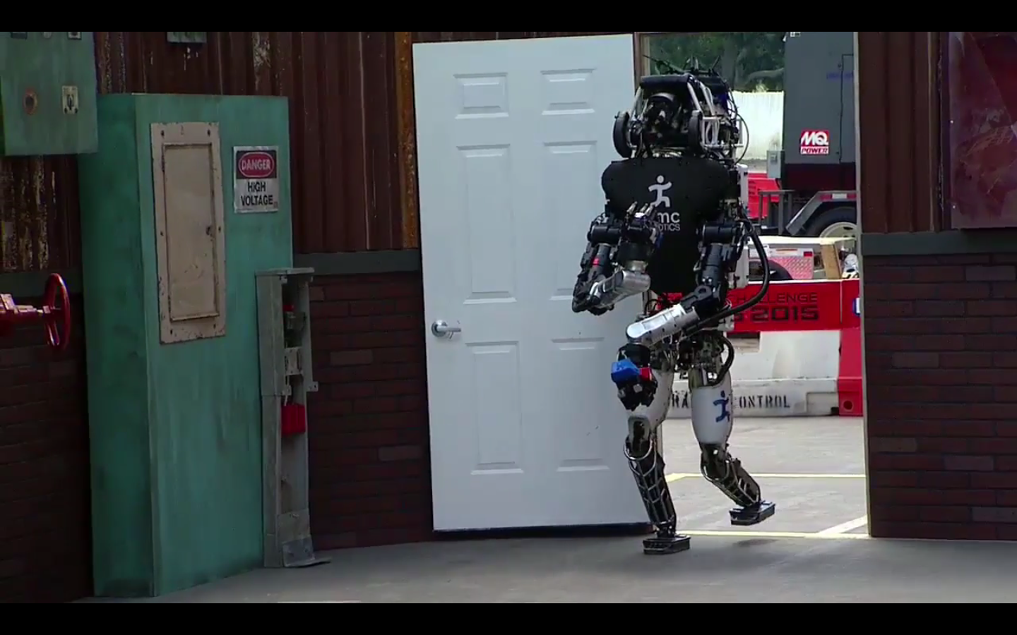
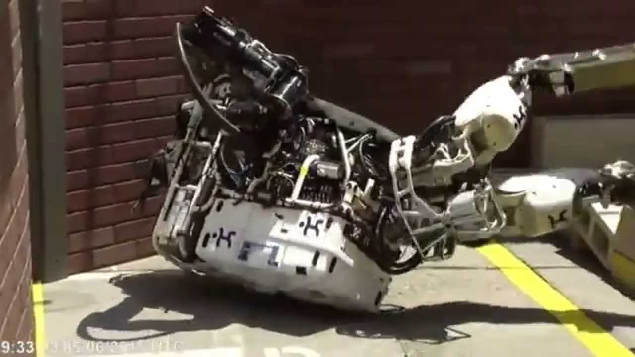
Source: DARPA
Source: DARPA
Source: DARPA
Source: DARPA
Approved for Public Release – Distribution Unlimited
Source: DARPA

Slide 6
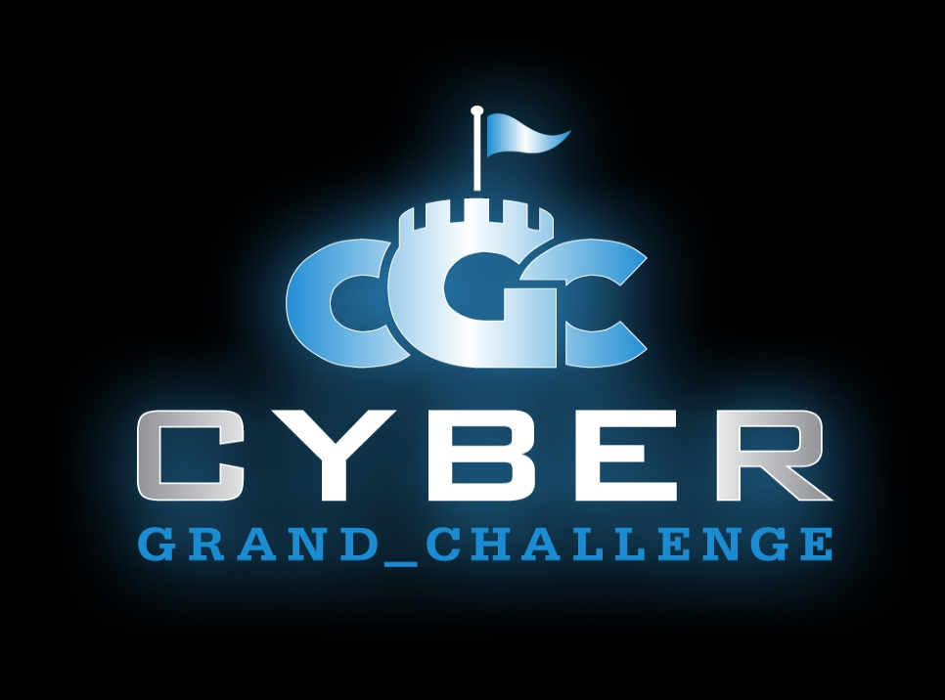
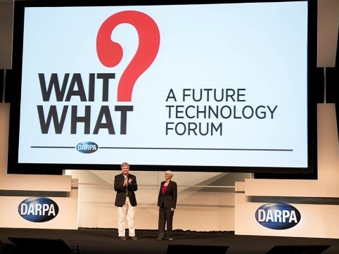
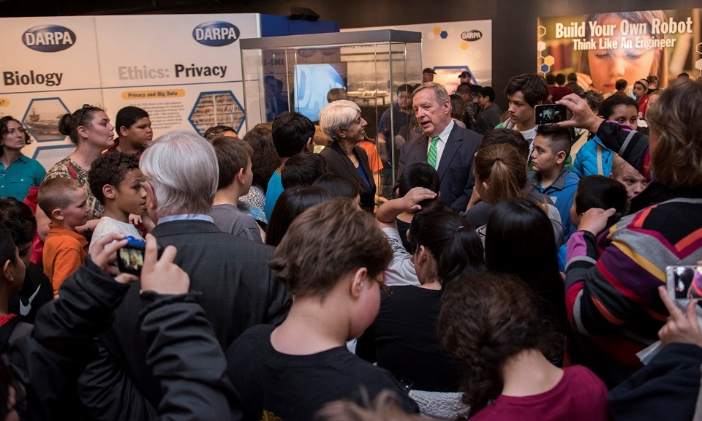
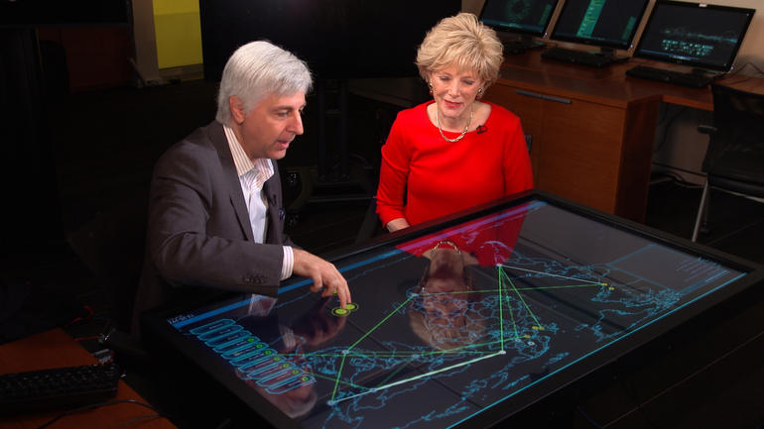
Source: DARPA
Source: DARPA
Source: DARPA
Source: cbsnews.com

Slide 7
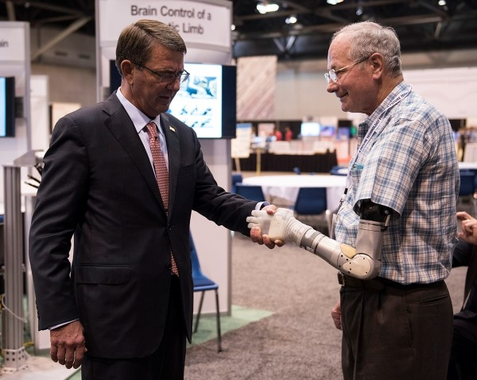
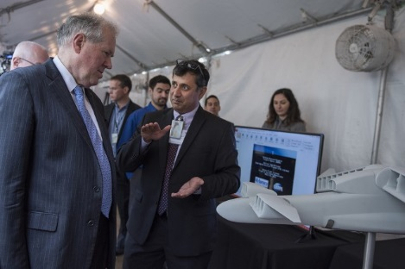
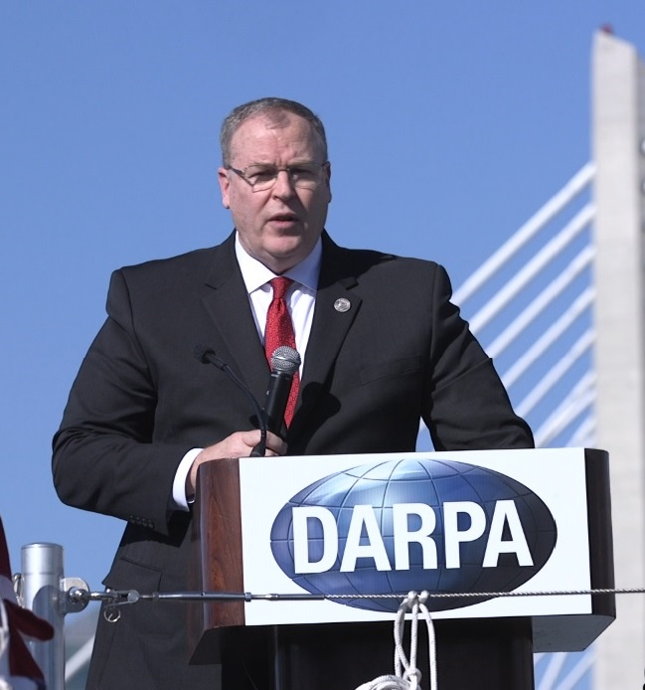
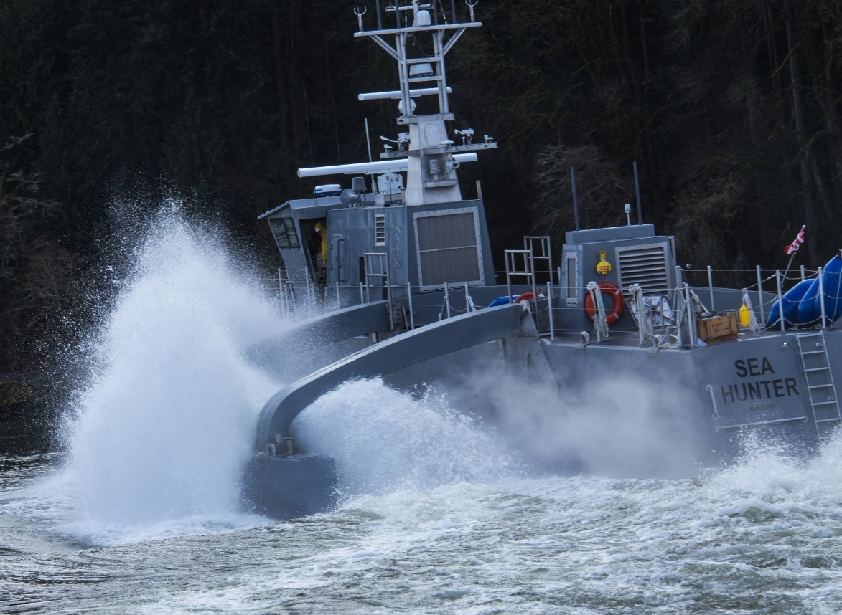
Source: DARPA
Source: DARPA
Source: DARPA
Source: DARPA

Slide 8
Mark Zuckerberg
Source: DARPA. Facebook. 3 Mar 16

Slide 9
@HamillHimself
Source: DARPA (@DARPA)

Slide 10
Source: DARPA (@DARPA)

Slide 11
But the adversary is not just watching …

Slide 12
“In S&T management China lacks effective organization in institutional support … China must absorb the advanced lessons of the U.S. DARPA model, and improve its S&T management model to increase innovation and to seize the initiative in competition with the United States.”
- Chinese Academy of Science and Technology for Development
“The scale of international theft of American intellectual property (IP) is unprecedented—hundreds of billions of dollars per year, on the order of the size of U.S. exports to Asia.”
“A core component of China’s successful growth strategy is acquiring science and technology…National industrial policy goals in China encourage IP theft, and an extraordinary number of Chinese in business and government entities are engaged in this practice.”
Approved for Public Release – Distribution Unlimited

Slide 13
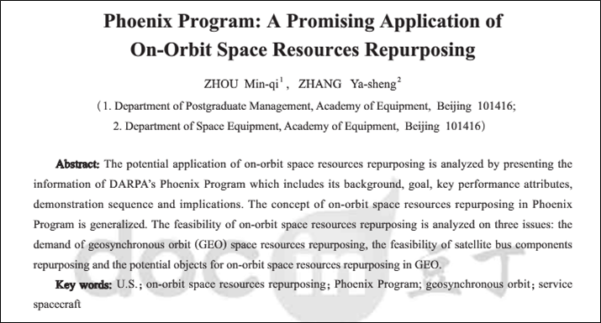
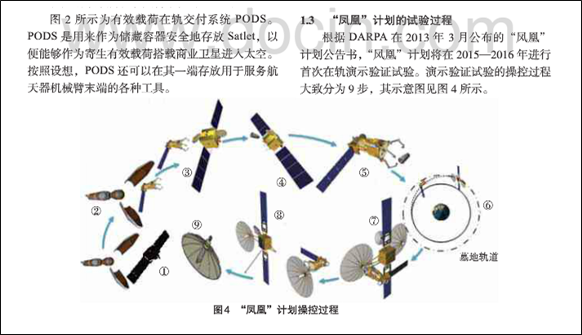
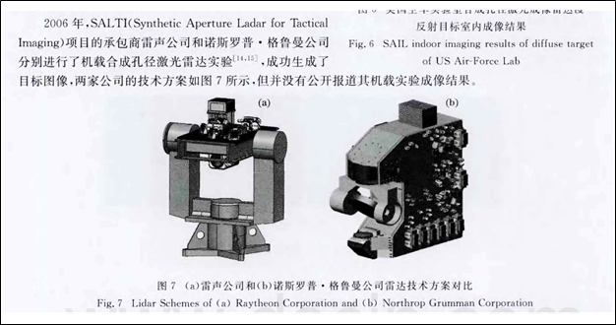
Approved for Public Release – Distribution Unlimited
Sources: space.com, DARPA

Slide 14
As a critical component of the S&T “ecosystem,” DARPA can’t ignore the need to nourish that system. So what do we do?

Slide 15
What is Program Protection? The Textbook Answer
The integrating process for mitigating and managing risks to advanced technology and mission-critical system functionality from foreign collection, design vulnerability, supply chain exploitation/insertion, battlefield loss, and unauthorized or inadvertent disclosure throughout the acquisition lifecycle.
Protects technology, components, and information from compromise through the cost-effective application of countermeasures to mitigate risks posed by threats and vulnerabilities.
Seeks to defend warfighting capability by “keeping secret things from getting out” and “keeping malicious things from getting in.”
Where the capability is derived from advanced or leading-edge technology, Program Protection mitigates the risk that the technology will be lost to an adversary.
Where the capability is derived from integration of commercially available or developed components, Program Protection mitigates the risk that design vulnerabilities or supply chains will be exploited to degrade system performance.
- Defense Acquisition Guidebook, Ch. 13, Published 16 Sep 2013

Slide 16
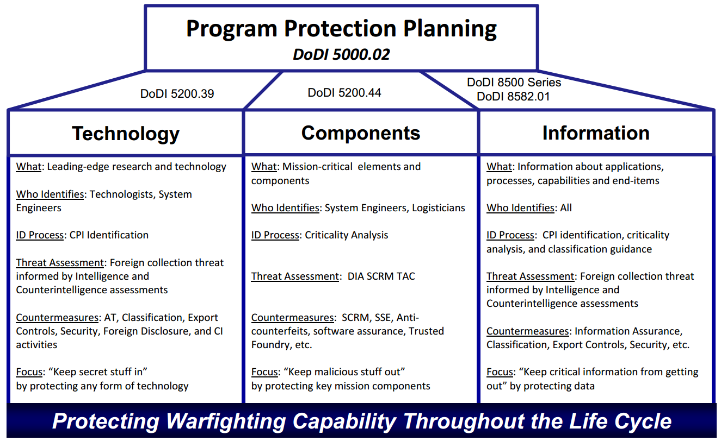
Broken down a little..
Source: Air Force Pamphlet 63-113, 17 Oct 2013

Slide 17
Other things to consider…
Source: DARPA

Slide 18
Program Protection Process
1
2
IDENTIFY CANDIDATE CRITICAL PROGRAM INFORMATION
DETERMINE POSSIBLE RISKS AND IMPACT OF LOSS
8
3
APPLY UPDATES AS NECESSARY
Read BAA, SCG, SOWs
Technology maturation
Proactive monitoring
Integrated SMEs
Political (Foreign & U.S.)
Operations
Expenditures
Technology
Security
DEVELOP MITIGATION STRATEGIES
Program
Elements
Evolve
Enhanced
Protection
PROGRAM PROTECTION
PERIODICALLY REVIEW PROGRAM
Monitor for
Effectiveness
Gov/Performer
Consensus
COMMUNICATE WITH STAKEHOLDERS
Performers
Government
Transition Partners
Internal and External
CI Support
Outside Work
Test Planning
Public Relations
Operations Security
7
DISSEMINATE
CREATE PLANS
4
6
5

Slide 19
So how does (or should) this process get applied? It’s a team sport

Slide 20
How PM’s think
“The Heilmeier Catechism”
What are we trying to do?
How does this get done at present?
What is new about the approach?
If we succeed, what difference will it make?
How long will it take?
Can we transition it (to the DoD or others)?
How much will it cost?

Slide 21
How PSOs (should) think
“Critical Thinking”
Disciplined analysis that combines research, historical context, and balanced judgment.
Assess protection strategy from multiple points of view and utilize available resources to craft solutions that meet policy “spirit and intent.”
Evolve from “Black and White” compliance to tailored protection.
Don’t forget that early program protection decisions may establish the foundation for future requirements.
DARPA is only in on the beginning of the life cycle.
Think through the “what ifs” and consider unintended consequences.
Critical thinking is NOT:
Paralysis by analysis
Needing a 100% solution

Slide 22
What PSOs (should) think about
What must we protect about this project?
Why are we protecting it?
Who are we protecting it from?
Where and when do we need to protect it?
How long do we need to protect it?
Will protection requirements change during future phases?
Who has done this before and what can we learn?
Who do we need to coordinate with internally and externally?
What policies, regulations, treaties, or laws need to be addressed?
How do we handle inadvertent exposure, contingencies, transition?
How do these answers impact program cost, schedule, and performance?

Slide 23
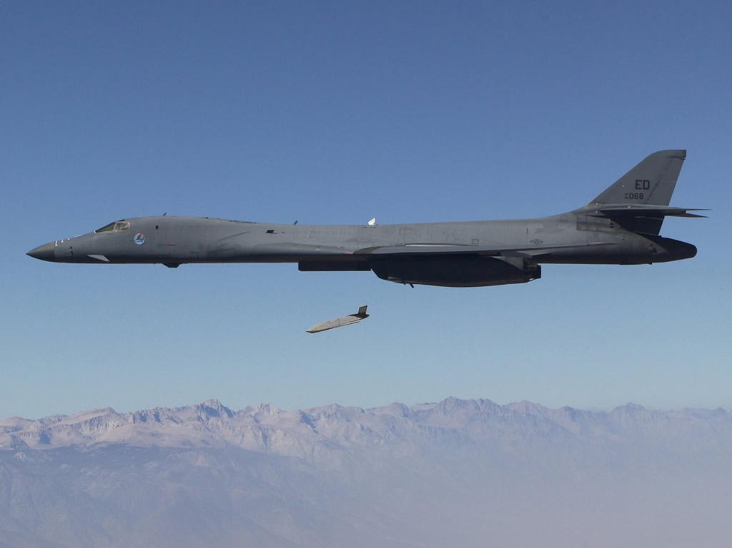
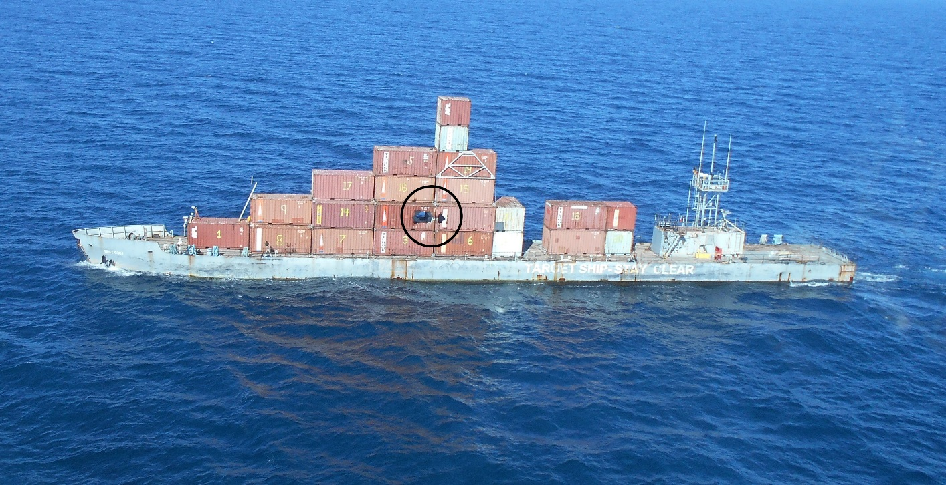
Case in Point: LRASM
The AGM-158C LRASM (Long Range Anti-Ship Missile) is an anti-ship cruise missile developed by DARPA, then transitioned to the LRASM Deployment Office.
The Navy was authorized to put LRASM into limited production as the OASuW Increment 1 solution in 2018 as an urgent capability stop-gap while a competition for Increment 2 is developed.
Source: wikipedia.org
Production and fielding of the system was not envisioned at the beginning of the DARPA program, causing a number of unique program protection issues.
Source: wikipedia.org

Slide 24
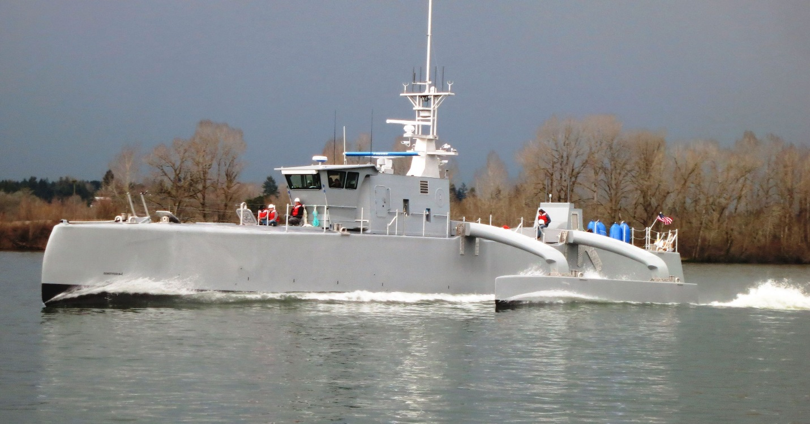
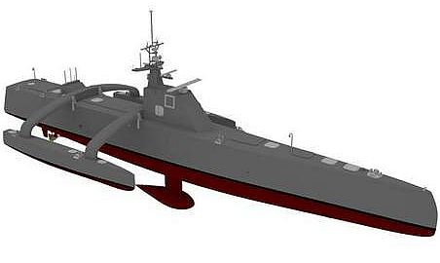
Case in Point: ACTUV
The Anti-Submarine Warfare (ASW) Continuous Trail Unmanned Vessel (ACTUV) is developing an unmanned vessel to track quiet diesel electric submarines.
Source: DARPA
Unmanned maritime system autonomy to enable missions spanning thousands of kilometers and months of endurance.
While focused on ASW tracking, the core technologies are extendable to underpin a wide range of missions and configurations for future unmanned naval vessels.
Source: DARPA

Slide 25
SAP Initiatives for the Defense Industry Base
Enabling Better Buying Power and 3rd Offset Strategy Contribution
April 2016

Slide 26
What are we trying to do, and how?
Improve the Defense Industry Base (DIB) ability to enable Better Buying Power and increase their contribution to the 3rd Offset Strategy through more efficient utilization and integration of government and contractor knowledge, infrastructure, and intelligence information.
The foundational pillars that support this are:
SAP Governance – Access for key DIB senior leadership to ensure appropriate insight/oversight for programs under contract across their company and to allow informed IR&D investment.
Facilities – Policy that allows DIB facilities to leverage existing space at company locations for discussions across their SAP portfolios.
Information Technology – Accreditation of DIB SAP networks to allow increased, efficient communication across their SAP portfolios, to include IR&D.
Threat Intelligence – Access to threat intelligence to inform contracted work and IR&D.
Governance
Facilities
Information Technology
Intelligence

Slide 27
How does it get done today, by whom, and what are the limitations/impacts?
SAP Governance – Access for key DIB senior leadership is decentralized within components. Access is approved on contract-by-contract basis by each Access Approval Authority (AAA). Each AAA typically approves access based on their specific contract/program needs. No single program office or organization is responsible for considering uniform application across the DoD or the broader DIB enterprise contributions.
Facilities – Accreditation for SAP facilities is decentralized within components. Each SAP facility is approved at a specific program level(s) and linked to a contract/program. While facilities are approved to a common standard, discussions within the facilities are limited to a specific contract/program. This unintentionally hinders DIB discussions about their aggregate work and imposes costs in the form of lost productivity time and travel.
Information Technology (IT) – Accreditation for SAP IT is decentralized within components. Each DIB SAP IT solution is approved at a specific program level(s) and linked to a contract/program. Industry does not have enterprise SAP systems like those in use within the DoD. This unintentionally hinders DIB’s ability to leverage and integrate their aggregate work for the DoD, imposes overhead cost to maintain multiple stove-piped systems, and prohibits enterprise-level security/insider-threat management.
Threat Intelligence – The DIB has many personnel briefed to SCI. However, access to threat intelligence content is provided within the components on a contract/program basis. Each contract specifies intelligence requirements and each program office provides access to threat intelligence specific to their program. No process is in place to consider broader DIB enterprise threat intelligence content needs (i.e., to inform innovative national security solutions, IR&D, and CR&D).

Slide 28
Where are we and what issues remain?
SAP Governance
USD(AT&L) issued memorandum directing DoD SAPCO to work with Industry upon request to establish access portfolios and a maintenance plan. Currently scoped to specific technology/mission areas to facilitate smoother initiation.
Facilities
DoD SAPCO issued policy memorandum to allow any DoD accredited SAP facility to be used for discussion and transient processing of any DoD SAP. Requires DIB to develop implementation plans customized to their facilities.
Information Technology
DoD SAP CIO developing a plan to pilot an enterprise IT solution in industry.
Threat Intelligence
Not yet addressed. Recommend discussion among the SAP Senior Working Group on feasibility and a potential way ahead.

