Slide 1
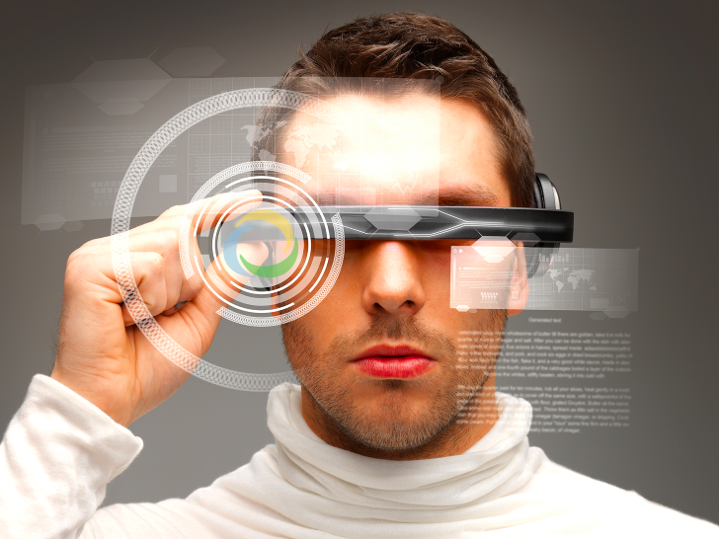
The Top Emerging Technologies
Joe Vandeville
4 May 2017

Slide 2



Purpose
The purpose of this presentation is explore some of the emerging technologies that have been recently described
Will they affect you?
(When?)
Where do you find about these things?

Slide 3


Where to Find Out . . .
If you are a scientist – you create them
If you are a scholar – you research them
If you are curious – you seek them
If you are lazy – sometimes they drift by
If you are indifferent – ignore them
These are not mutually exclusive
You can move among them
Notes:
Laziness is the Mother of Invention - Rear Admiral Grace Murray Hopper '28 is best known for the invention of the compiler, "the intermediate program that translates English language instructions into the language of the target computer. She did this, she said, because she was lazy and hoped that 'the programmer may return to being a mathematician.'
Laziness is the Father of Innovation - Professor John Atanasoff, along with graduate student Clifford Berry, built the world’s first electronic-digital computer back in the late 1930’s. Why did he do this? He said, “I was too lazy to calculate and so I invented the computer.”
A number of years back while working for a computer manufacturer, the department head dubbed me the “Chief Laziness Officer.” He meant that as a compliment. I was constantly finding ways to reduce my workload. I got so good at it that in my spare time I helped others do the same.

Slide 4

Lazy?
(He can’t be talking about me . . . )
Laziness is the Mother of Invention – Rear Admiral Grace Murray Hopper
Rear Admiral Hopper is best known for the invention of the compiler, the intermediate program that translates English language instructions into the language of the target computer. She did this, she said, because she was lazy and hoped that 'the programmer may return to being a mathematician.'
Laziness is the Father of Innovation - Professor John Atanasoff
Professor Atanasoff, along with graduate student Clifford Berry, built the world’s first electronic-digital computer back in the late 1930’s. Why did he do this? He said, “I was too lazy to calculate and so I invented the computer.”

Slide 5
Where to Find Out . . .
This presentation is for the
curious and lazy
The scholarly stuff is often very narrowly focused and dry. It may not peak your interest unless you are in that field.
BUT – it is incredibly important to work that follows.

Slide 6

Where to Find Out . . .
Caution
The curious & lazy stuff
may not be peer reviewed
may not be accurate
may be an outright lie
(aka alternative facts)
Note: the same may be said for fine literature (like science fiction) but it is still fun and may make your creative juices flow.

Slide 7
Where to Find Out . . .
World Economic Forum
www.weforum.org
Gartner Group
www.gartner.com
Google (search engine)
MIT Technology Review
www.technologyreview.com
Scientific American
www.scientificamerican.com
Tech News World
www.technewsworld.com
New Atlas (was Gizmag)
newatlas.com/
Harvard Business Review
hbr.org
https://hbr.org/2015/12/8-tech-trends-to-watch-in-2016
Forbes
http://www.forbes.com/
Florida Today newspaper
“Technology Today” column

Slide 8
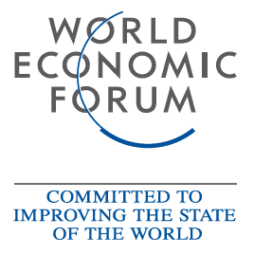
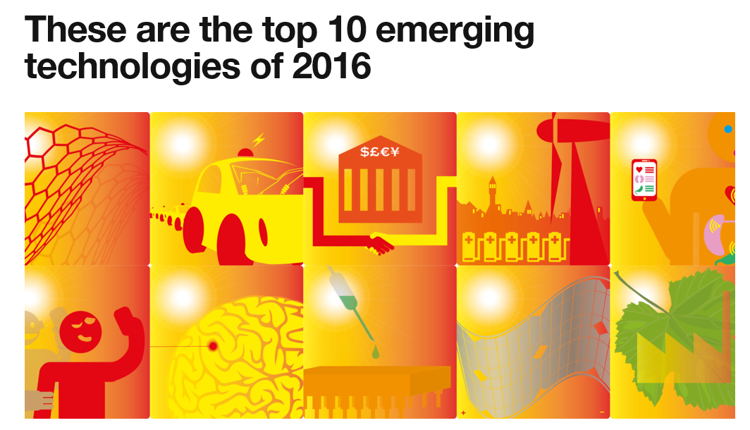
World Economic Forum
https://www.weforum.org/agenda/2016/06/top-10-emerging-technologies-2016
The Report is an 18 page pdf.
Notes:
The World Economic Forum, committed to improving the state of the world, is the International Organization for Public-Private Cooperation.
The Forum engages the foremost political, business and other leaders of society to shape global, regional and industry agendas.
It was established in 1971 as a not-for-profit foundation and is headquartered in Geneva, Switzerland. It is independent, impartial and not tied to any special interests. The Forum strives in all its efforts to demonstrate entrepreneurship in the global public interest while upholding the highest standards of governance. Moral and intellectual integrity is at the heart of everything it does.
Our activities are shaped by a unique institutional culture founded on the stakeholder theory, which asserts that an organization is accountable to all parts of society. The institution carefully blends and balances the best of many kinds of organizations, from both the public and private sectors, international organizations and academic institutions.
We believe that progress happens by bringing together people from all walks of life who have the drive and the influence to make positive change.

Slide 9
World Economic Forum
https://www.weforum.org/agenda/2016/06/top-10-emerging-technologies-2016
1. Nanosensors and the Internet of Nanothings
2. Next Generation Batteries
3. The Blockchain
4. 2D Materials
5. Autonomous Vehicles
6. Organs-on-chips
7. Perovskite Solar Cells
8. Open AI Ecosystem
9. Optogenetics
10. Systems Metabolic Engineering

Slide 10
Gartner
Gartner's annual Symposium/ITxpo
The top 10 strategic technology trends for 2016 are:
1. The Device Mesh
2. Ambient User Experience
3. 3D Printing Materials
4. Information of Everything
5. Advanced Machine Learning
6. Autonomous Agents and Things
7. Adaptive Security Architecture
8. Advanced System Architecture
9. Mesh App and Service Architecture
10. Internet of Things Platforms
http://www.gartner.com/newsroom/id/3143521

Slide 11

Lists are good, but . . .
. . . what technologies are likely to really take off?
July 2016 - Flirtey (drone maker) and 7-Eleven made history when one 7-Eleven customer’s order of a chicken sandwich, donuts, candy, Slurpees and hot coffee was completed via drone. The companies claim it was the first time a drone delivered a package to a U.S. resident who placed an order with a retailer.
Notes:
July 2016 - Flirtey (drone maker) and 7-Eleven made history when one 7-Eleven customer’s order of a chicken sandwich, donuts, candy, Slurpees and hot coffee was completed via drone. The companies claim it was the first time a drone delivered a package to a U.S. resident who placed an order with a retailer.

Slide 12

Tipping Points
(a short interlude)

Slide 13
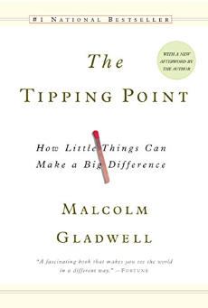

You May Have Heard of This
The Tipping Point: How Little Things Can Make a Big Difference
by Malcolm Gladwell (first published by Little Brown in 2000)
Gladwell defines a tipping point as "the moment of critical mass, the threshold, the boiling point".
Notes:
Malcolm Gladwell has been a staff writer at The New Yorker since 1996. He is the author of The Tipping Point, Blink, Outliers, and What the Dog Saw. Prior to joining The New Yorker, he was a reporter at the Washington Post. Gladwell was born in England and grew up in rural Ontario. He now lives in New York.

Slide 14
Tipping Point
Literally: the point at which a thing would begin to tip over
The point at which a series of small changes or incidents becomes significant enough to cause a larger, more important change.
Some examples:
Epidemiology: when an infectious disease reaches a point beyond any local ability to control it from spreading more widely. A tipping point is often considered to be a turning point.
“White Flight” (1950’s): Point at which a majority withdraws from a neighborhood when a minority moves in (10 – 15%)
Business marketing . . .
Notes:
Thomas Schelling - He was awarded the 2005 Nobel Memorial Prize in Economic Sciences (shared with Robert Aumann) for "having enhanced our understanding of conflict and cooperation through game-theory analysis". Described tipping points 30 years before Gladwell. Used tipping points to describe how neighborhoods form.

Slide 15
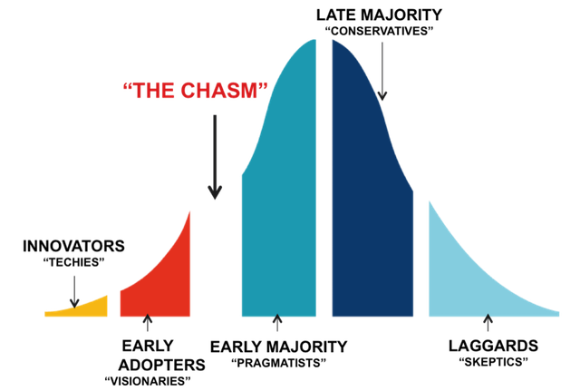
The “Chasm”
Crossing the Chasm, Marketing and Selling High-Tech Products to Mainstream Customer (revised edition),
- Geoffrey A. Moore, HarperCollins Publishers, New York, 1999
The chasm is a gap between visionary early adopters and the pragmatic majority. Crossing the chasm requires securing a specific niche as a beachhead first. Position yourself as a market leader in your niche by making a strong claim

Slide 16
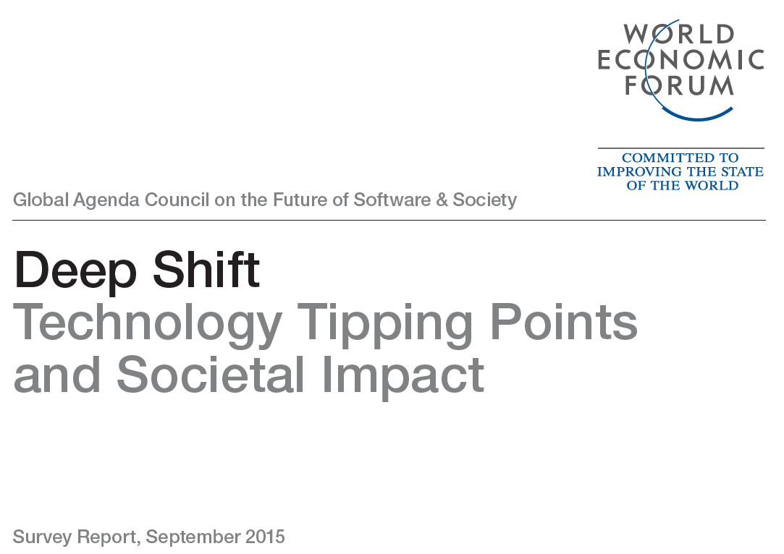
Technology Tipping Points
http://www3.weforum.org/docs/WEF_GAC15_Technological_Tipping_Points_report_2015.pdf

Slide 17
Tipping Point Survey
“Now comes the second machine age. Computers and other digital advances are doing for mental power – the ability to use our brains to understand and shape our environments – what the steam engine and its descendants did for muscle power.”
-- Erik Brynjolfsson, Council Vice-Chair; Director, MIT Initiative on the Digital Economy
Early 2015, the World Economic Forum’s Global Agenda Council on the Future of Software and Society set out to help people prepare for changes enabled by software.
21 examples of these potential changes will have far reaching impacts on human health, the environment, global commerce and international relations.

Slide 18
Tipping Point Survey
In March 2015, the Technological Tipping Points survey was launched.
Based on the council’s discussions over previous months, the survey asked respondents for their views on 21 “tipping points” – moments when specific technological shifts hit mainstream society.
Survey of over 800 executives and experts from the information and communications technology sector.
The survey asked respondents for their perception of when these tipping points would occur, offering date ranges from “it has already happened” to “20+ years”. The option of “never” was also available.

Slide 19
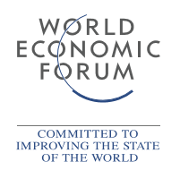
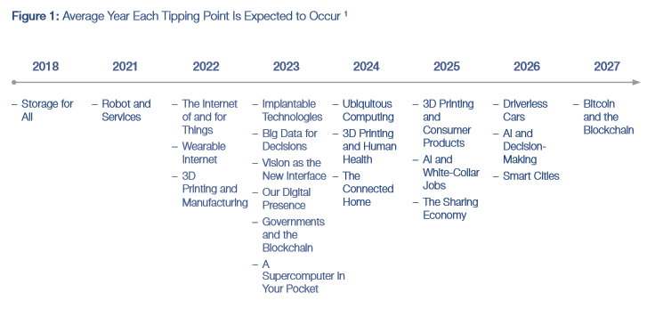
Tipping Point Survey
http://www3.weforum.org/docs/WEF_GAC15_Technological_Tipping_Points_report_2015.pdf

Slide 20
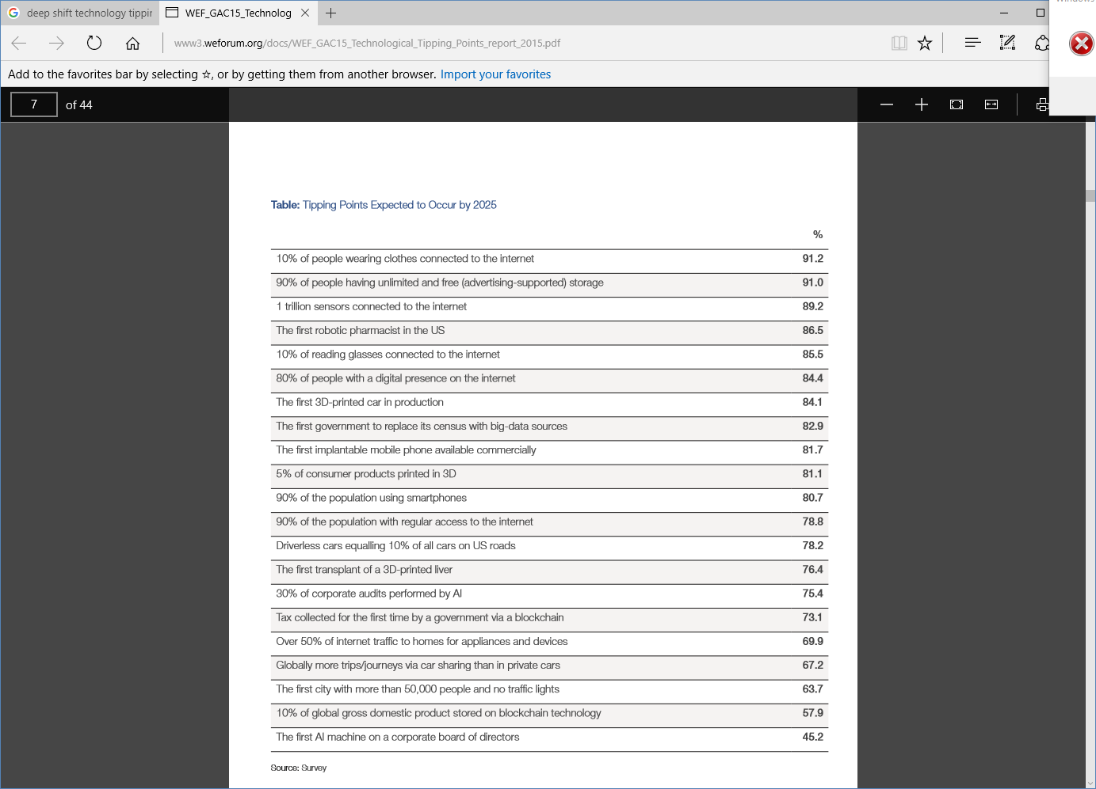
TPs Expected to Occur by 2025
percentage of the respondents that expect the tipping point to have occurred by 2025

Slide 21
TPs Expected to Occur by 2025
percentage of the respondents that expect the tipping point to have occurred by 2025

Slide 22
Implantable Technologies
2023: The first implantable mobile phone available commercially
People are becoming more and more connected to devices
Devices are increasingly becoming connected to our bodies
Devices are not just being worn, but also being implanted into bodies
Providing communications, location and behavior monitoring, and health functions.
Pacemakers and cochlear implants were just the beginning
New devices will be able to sense the parameters of diseases, enable individuals to take action, send data to monitoring centers, or potentially release healing medicines automatically
Smart tattoos and other unique chips could help with identification and location. Implanted devices will likely also help to communicate thoughts normally expressed verbally through a “built-in” smartphone by reading brainwaves and other signals.

Slide 23
Vision as the New Interface
2023: 10% of reading glasses connected to the internet
Glasses, headsets and eye-tracking devices can become “intelligent” with eyes and vision being connected to the internet and other devices
Direct access to internet applications and data through vision, can enhance, mediate or completely augment an individual’s experiences to provide immersive reality
With emerging eye-tracking technologies, devices can feed information through visual interfaces, and eyes can be the source for interacting with and responding to the information.
Enabling vision as an immediate, direct interface – by providing instruction, visualization and interaction – can change the way that learning, navigation, instruction and feedback for producing goods and services, experiencing entertainment and enabling the disabled are helping people to engage more fully with the world.

Slide 24
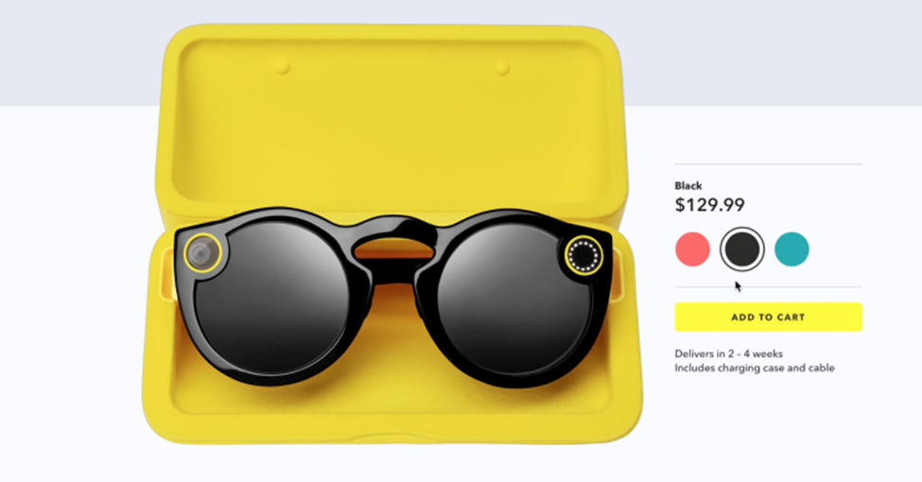
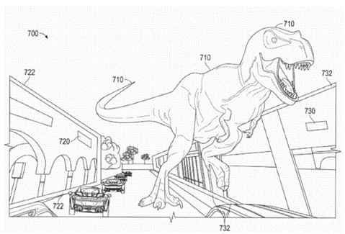
Vision as the New Interface
Snap is developing a second version of Spectacles which may include augmented reality
Estimated sales:
34,600 pairs in Q4 2016 63,800 pairs in Q1 2017
6/13/2017 Jon Russell http://www.msn.com/en-us/news/technology/snap-is-developing-a-second-version-of-spectacles-which-may-include-augmented-reality/ar-BBCzEm8?ocid=spartandhp#image=3

Slide 25
Wearable Internet
2022: 10% of people will be wearing clothes connected to the internet
Technology is becoming increasingly personal. Computers were first located in large rooms, then on desks and, following that, on people’s laps.
While technology can now be found in people’s mobile phones in their pockets, it will soon be integrated directly into clothing and accessories.
Released in 2015, Apple Watch is connected to the internet and contains many of the same functional capabilities as a smartphone.
Increasingly, clothing and other equipment worn by people will have embedded chips that connect the article and person wearing it to the internet.

Slide 26
Supercomputer in Your Pocket
2023: 90% of the population using smartphones
Google published in 2012 that, “It takes about the same amount of computing to answer one Google Search query as all the computing done – in flight and on the ground – for the entire Apollo programme!”
Current smartphones and tablets contain more computing power than many of the formerly known supercomputers, which used to fill an entire room.
Global smartphone subscribers are anticipated to total 3.5 billion by 2019; that will equate to 59% smartphone penetration by population
In Kenya, Safaricom, the leading mobile service operator, reported that 67% of handset sales were smartphones in 2014, and the GSMA forecasts that Africa will have over half a billion smartphone users by 2020
. . .
Notes:
Manber, U. and P. Norvig, “The power of the Apollo missions in a single Google search”, Google Inside Search, 28 August 2012, http://insidesearch.blogspot.com/2012/08/the-power-of-apollo-missions-in-single.html.
The GSM Association is a trade body that represents the interests of mobile operators worldwide. Approximately 800 mobile operators are full GSMA members and a further 300 companies in the broader mobile ecosystem are associate members

Slide 27
Supercomputer in Your Pocket
2023: 90% of the population using smartphones
The shift in devices has already occurred in many countries across different continents (with Asia leading the trend today), as more people are using their smartphones rather than traditional PCs.
Society is headed towards adopting even faster machines that will allow users to perform complicated tasks on the go.
Most likely, the number of devices that each person uses will grow strongly, not only with new functions performed but also with specialization of tasks.
Notes:
Manber, U. and P. Norvig, “The power of the Apollo missions in a single Google search”, Google Inside Search, 28 August 2012, http://insidesearch.blogspot.com/2012/08/the-power-of-apollo-missions-in-single.html.

Slide 28
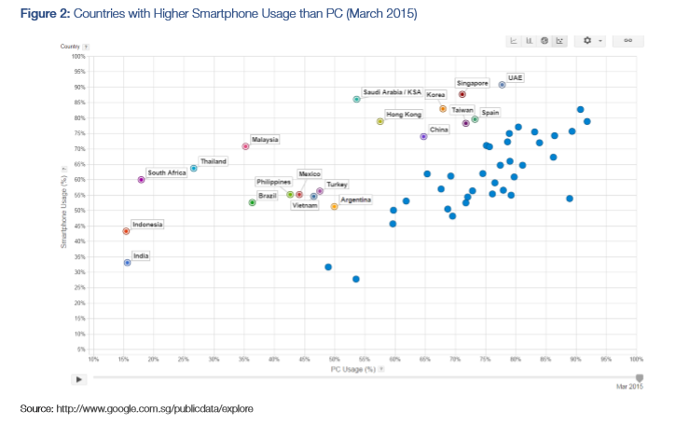
Smartphones vs. PCs

Slide 29
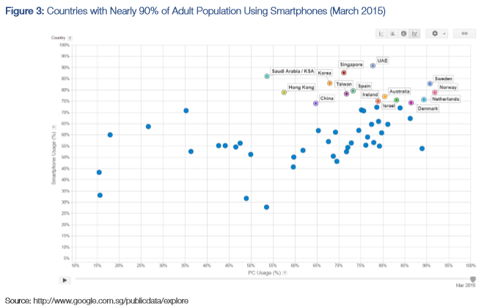
~ 90% Smartphone Usage
Countries such as Singapore, South Korea and the United Arab Emirates (UAE) are the closest to reaching the tipping point of 90% of the adult population using smartphones

Slide 30
The Connected Home
2024: Over 50% of internet traffic delivered to homes for appliances and devices (not for entertainment or communication)
In the 20th century, most of the energy going into a home was for direct personal consumption (lighting).
But over time, the amount of energy used for this and other needs was eclipsed by much more complex devices, from toasters and
dishwashers to televisions and air conditioners.
The internet is going the same way: most internet traffic to homes is currently for personal consumption, in communication or entertainment.
. . .

Slide 31
The Connected Home
2024: Over 50% of internet traffic delivered to homes for appliances and devices (not for entertainment or communication)
Very fast changes are already occurring in home automation, enabling people to control lights, shades, ventilation, air conditioning, audio and video, security systems and home appliances.
Additional support is provided by connected robots for all kinds of services – as, for example, vacuum cleaning.
Nest, makers of the Internet-connected thermostat and smoke detector … announced [in 2014] the ‘Works with Nest’ developer program, which makes sure products from different companies work with its software. For example, a partnership with Mercedes Benz means your car can tell Nest to turn up the heat at home so it’s warm when you arrive

Slide 32
Smart Cities
2026: The first city with more than 50,000 inhabitants and no traffic lights
Many cities will connect services, utilities and roads to the internet.
These smart cities will manage their energy, material flows, logistics and traffic.
Progressive cities, such as Singapore and Barcelona, are already implementing many new data-driven services, including intelligent parking solutions, smart trash collection and intelligent lighting.
Smart cities are continuously extending their network of sensor technology and working on their data platforms, which will be the core for connecting the different technology projects and adding future services based on data analytics and predictive modelling.
Notes:
says Yusuf. "Parking is generally the second or third largest source of revenue for a city.” "This is a piece of real estate that isn't priced appropriately, that isn’t allocated appropriately,“ - Zia Yusuf, CEO at Streetline, a company that specializes in implementing what are being called intelligent parking systems.

Slide 33
AI and Decision-Making
2026: The first Artificial Intelligence (AI) machine on a corporate board of directors
Beyond driving cars, AI can learn from previous situations to provide input and automate complex future decision processes, making it easier and faster to arrive at concrete conclusions based on data and past experiences.
[IT News Africa wrote]: An artificial intelligent system using natural language processing, ontologies and reasoning can be effective in gathering and extracting information from large data sources and has the ability to identify the cause and effect within data. These knowledge processing systems, through the process of learning, identify relationships and connections between databases, help fulfil the role of marketing companies through effectively aiding in market segmentation and measurement of performance while reducing costs and improving accuracy.

Slide 34
3D Printing and Human Health
2024: The first transplant of a 3D-printed liver
One day, 3D printers may create not only things, but also human organs – a process called “bioprinting”. In much the same process as for printed objects, an organ is printed layer by layer from a digital 3D model.
The material used to print an organ would obviously be different from what is used to print a bike, and experimenting can be done with the kinds of materials that will work, such as titanium powder for making bones. 3D printing has great potential to service custom design needs; and, there is nothing more custom than a human body.
The first use of a 3D-printed spine implant was reported by Popular Science: [In 2014], doctors at Peking University Third Hospital successfully implanted the first ever 3-D-printed section of vertebra into a young patient to replace a cancerous vertebra in his neck. The replacement vertebra was modelled from the boy’s existing vertebra, which made it easier for them to integrate.

Slide 35
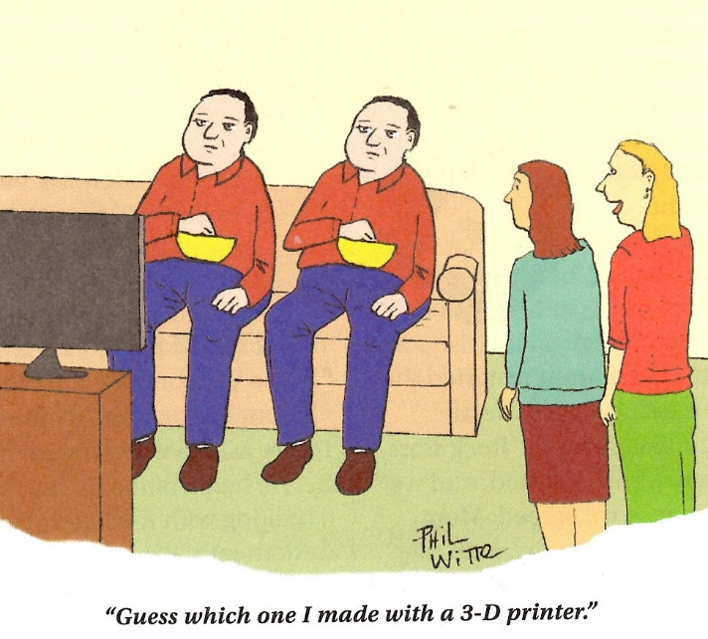

Slide 36
Conclusions
(From the 2015 WEF GAC15 Technological Tipping Points report)
The potential is huge. Imagine the positives of being able to access any service you want, or physical asset or tool you need, when and where you need it; or being able to predict a serious health problem before it happens, and get the needed service – or an organ perfectly made just for you – wherever you are. While the potential for democratization and transparency are great, real concerns arise. With data created on everything, will individuals still have acceptable levels of privacy? What will happen to the sense of worth, place and contribution to society that people derive from work and have felt throughout history?

Slide 38
About the Presentation:
This presentation on emerging technologies will explore who is interested in technology and why. It will look at organizations and groups that make technology predictions and what they are predicting. And it will examine the concept of technology tipping points, the point at which a technology takes off, and what the potential time frame is for various technologies to reach this point.
About our Presenter:
Joe Vandeville is a retired Northrop Grumman engineer and a past president of INCOSE Space Coast. He has over 40 years of experience in hardware and software development in both commercial and military systems and prior to Northrop Grumman worked for ITT, Alcatel-Lucent and Rockwell Collins. He has a Bachelor of Science degree in Electronic Engineering Technology, a Master of Science degree in Computer Science and a Master of Science in Systems Engineering.

