Slide 1
System to Software Transition
Cameo/Rhapsody Integration for Code Generation
Approved for public release: 2024-Q1

Slide 2
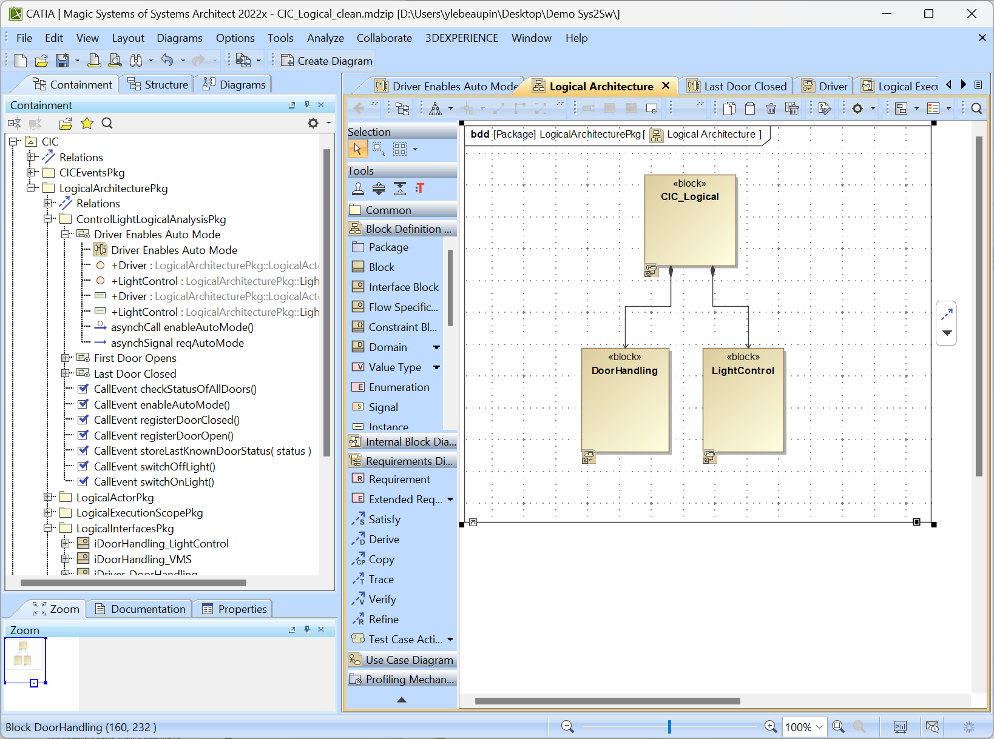
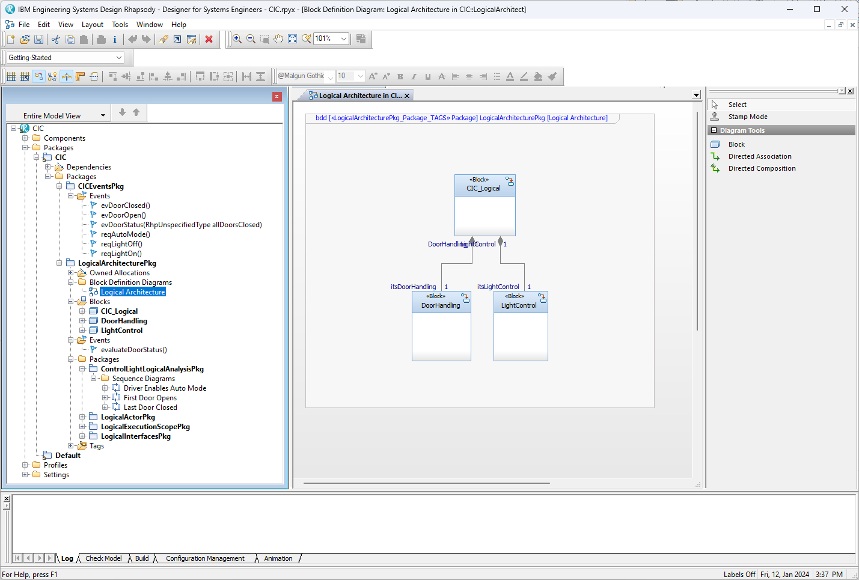
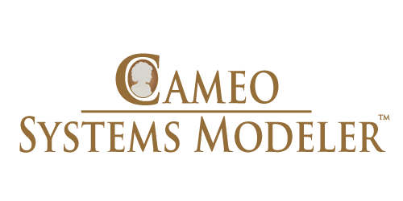

Challenges Transitioning from System to Software
Converting the concepts between the MBSE and MBSW applications
  Transformation of UML/SysML/Custom models between tools
Supporting multiple iterations across the project lifecycle
  Detecting changes
Supporting traceability and linking between the domains (Digital Engineering)
  Maintaining traceability across iterations
Software-to-System feedback and related change management
System Engineering
Software
Engineering

Slide 3
Linking or Exchanging Models?
Different constraints when transitioning from System to Software
  Inside the same organization
  Across organizational boundaries
Using links between models would be the preferred solution
  Minimize copies of data
  Preserve a single source of truth
OSLC (linking) implementations in the market do not fully support configuration-aware scenarios
Impossible to use linking across organizations due to access and networking issues
Exchange of models is the only solution most of the time between different organizations or different applications
Notes:
About OSLC Linking, we are today limited by both OSLC standard and implementation provided by Dassault.
considering TWC+ Collaborator implementation, it does not expose configuration, do not support neither link or backlink, no TRS feed
this is not usable for production and there is no huge changes planned for middle-term by Dassault R&D teams
considering OSLC standard, there is no linking capabilities between 2 AM domains
An alternative Q1 2025 (beta Q2/Q3 2024, production ready end of 2024) could be to expose Cameo models into SECollab, with the ability to provide both
TRS feed and full compatibility with ELM GC (SECollab acting as GC participant in this case).
Exposing Cameo elements as AM and RM artifacts

Slide 4





Exchanging System to Software Models
1 - Import System Model into Rhapsody using the Sodius Publisher for Rhapsody plugin
EWM / ELM Configurations
SysML System Model
(IBM Rhapsody)
5a. – Track Change Requests (Annotate the System Model)
System Model
(CATIA Cameo)
3 - Create Traceability manually
5b. – Track Change Requests (Use a CM system)
2 - Derive Software Model from System Model
5a. – Publish the changes for a diff/merge
4 - Generate Code with Rhapsody
UML Software Model
(IBM Rhapsody)
6 – Iterate

Slide 5
Steps
1. Import the System model into IBM Rhapsody using the Sodius Publisher for Rhapsody plugin
  - Provides the configuration backbone
2. Derive the Software UML model from SysML System model
  - Can be partially automated if strict modeling rules are enforced using Model-to-Model (M2M) Transformation for Rhapsody
3. Create traceability links from the UML model to the SysML model
  - Requires both models to be configuration-managed
  - Can be automated if strict modeling rules are enforced
4. Generate code with IBM Rhapsody
  - Certifiable code is available with the SodiusWillert Embedded UML RXF-Cert extension for Rhapsody
5. Track change requests
  a. Annotate the converted System model
  - Publish back to source format using Sodius Publisher for Rhapsody
  - Use diff / merge to bring changes into source model
  b. Create change requests in a CM system (EWM, Jira) and link to model elements
6. Iterate

Slide 6
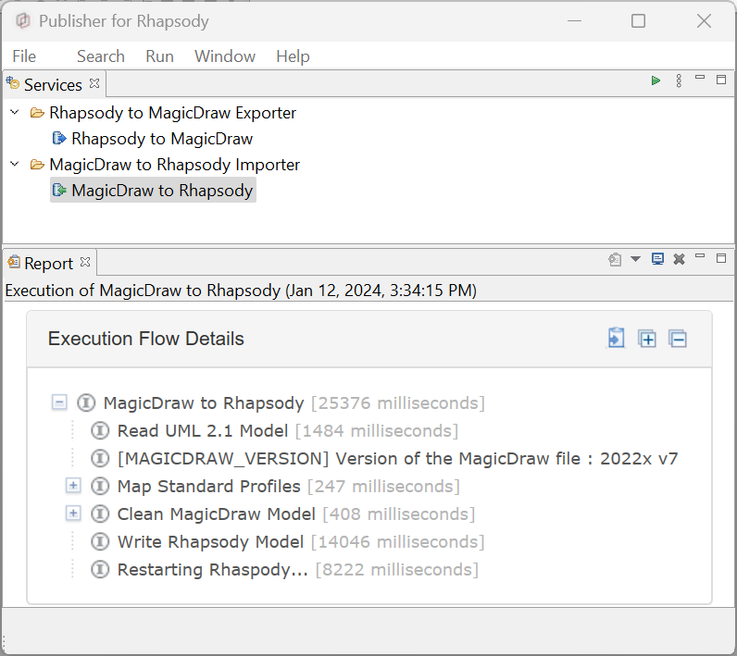
Sodius Publisher: Imports the CATIA Cameo System Model into IBM Rhapsody
System Model
(Cameo)
System Model
(Rhapsody)

Slide 7
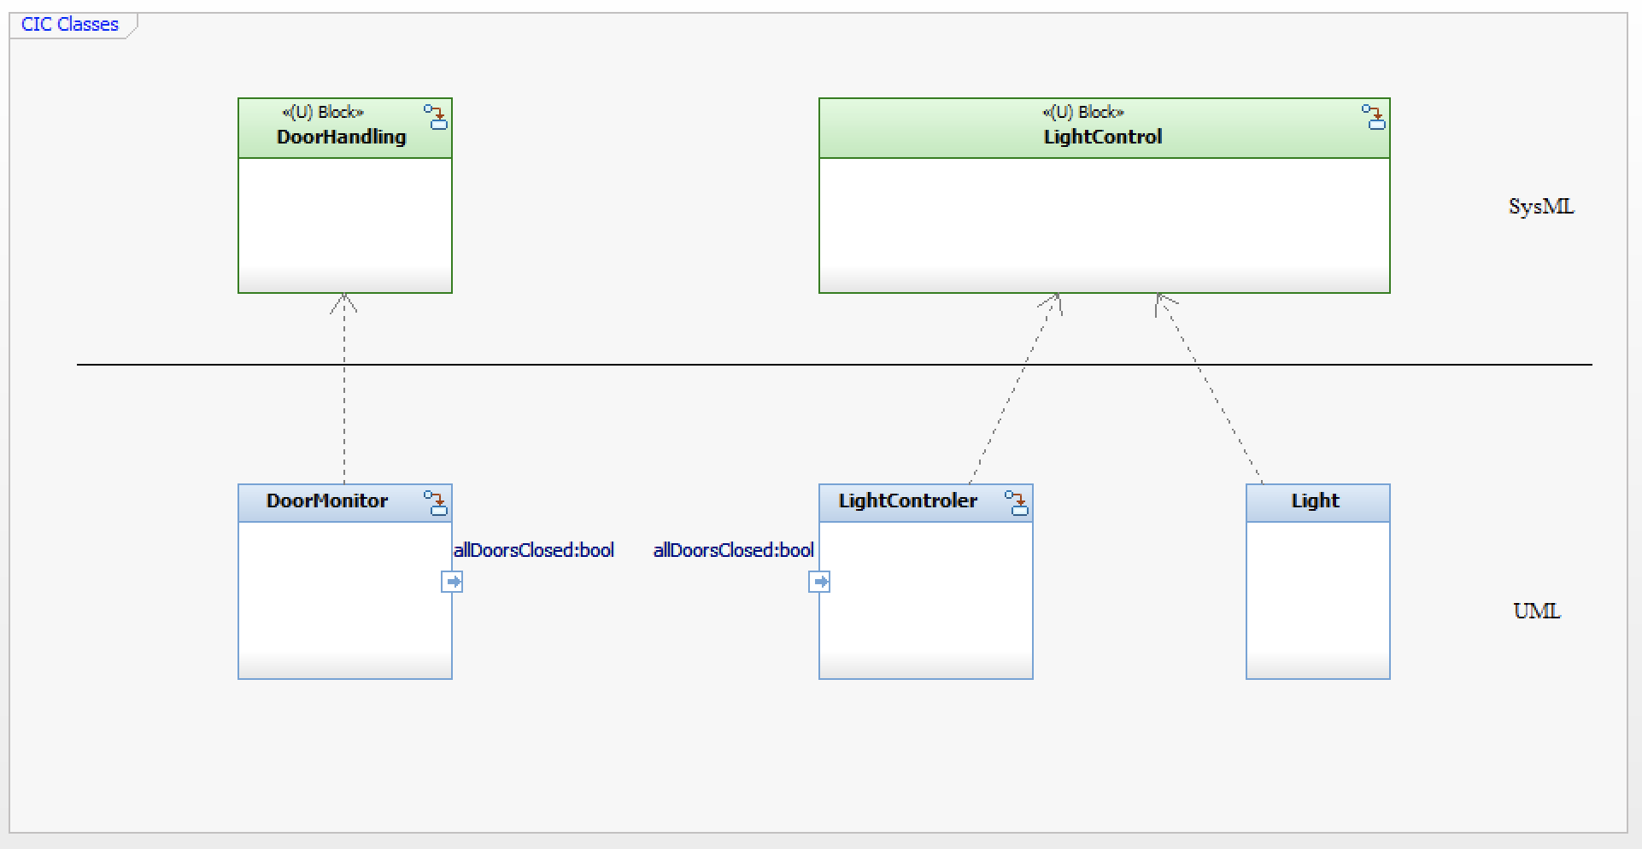
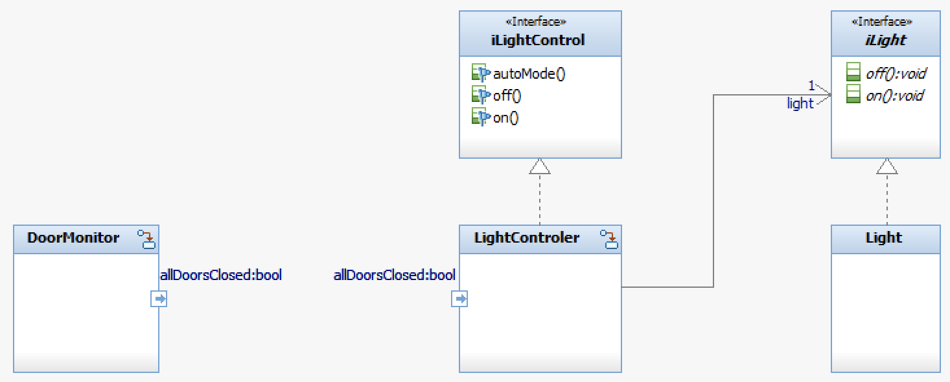
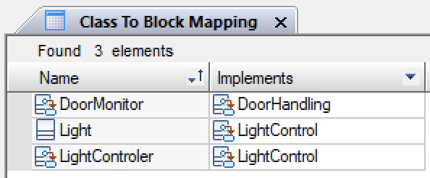
Rhapsody: Derive UML Software Model from SysML System Model
This is a design activity. When creating the Software model, traceability is established with the source System model in Rhapsody.
System Model
Software Model
2 - Derive Software Model from System Model
Software Model
3 - Create Traceability manually

Slide 8
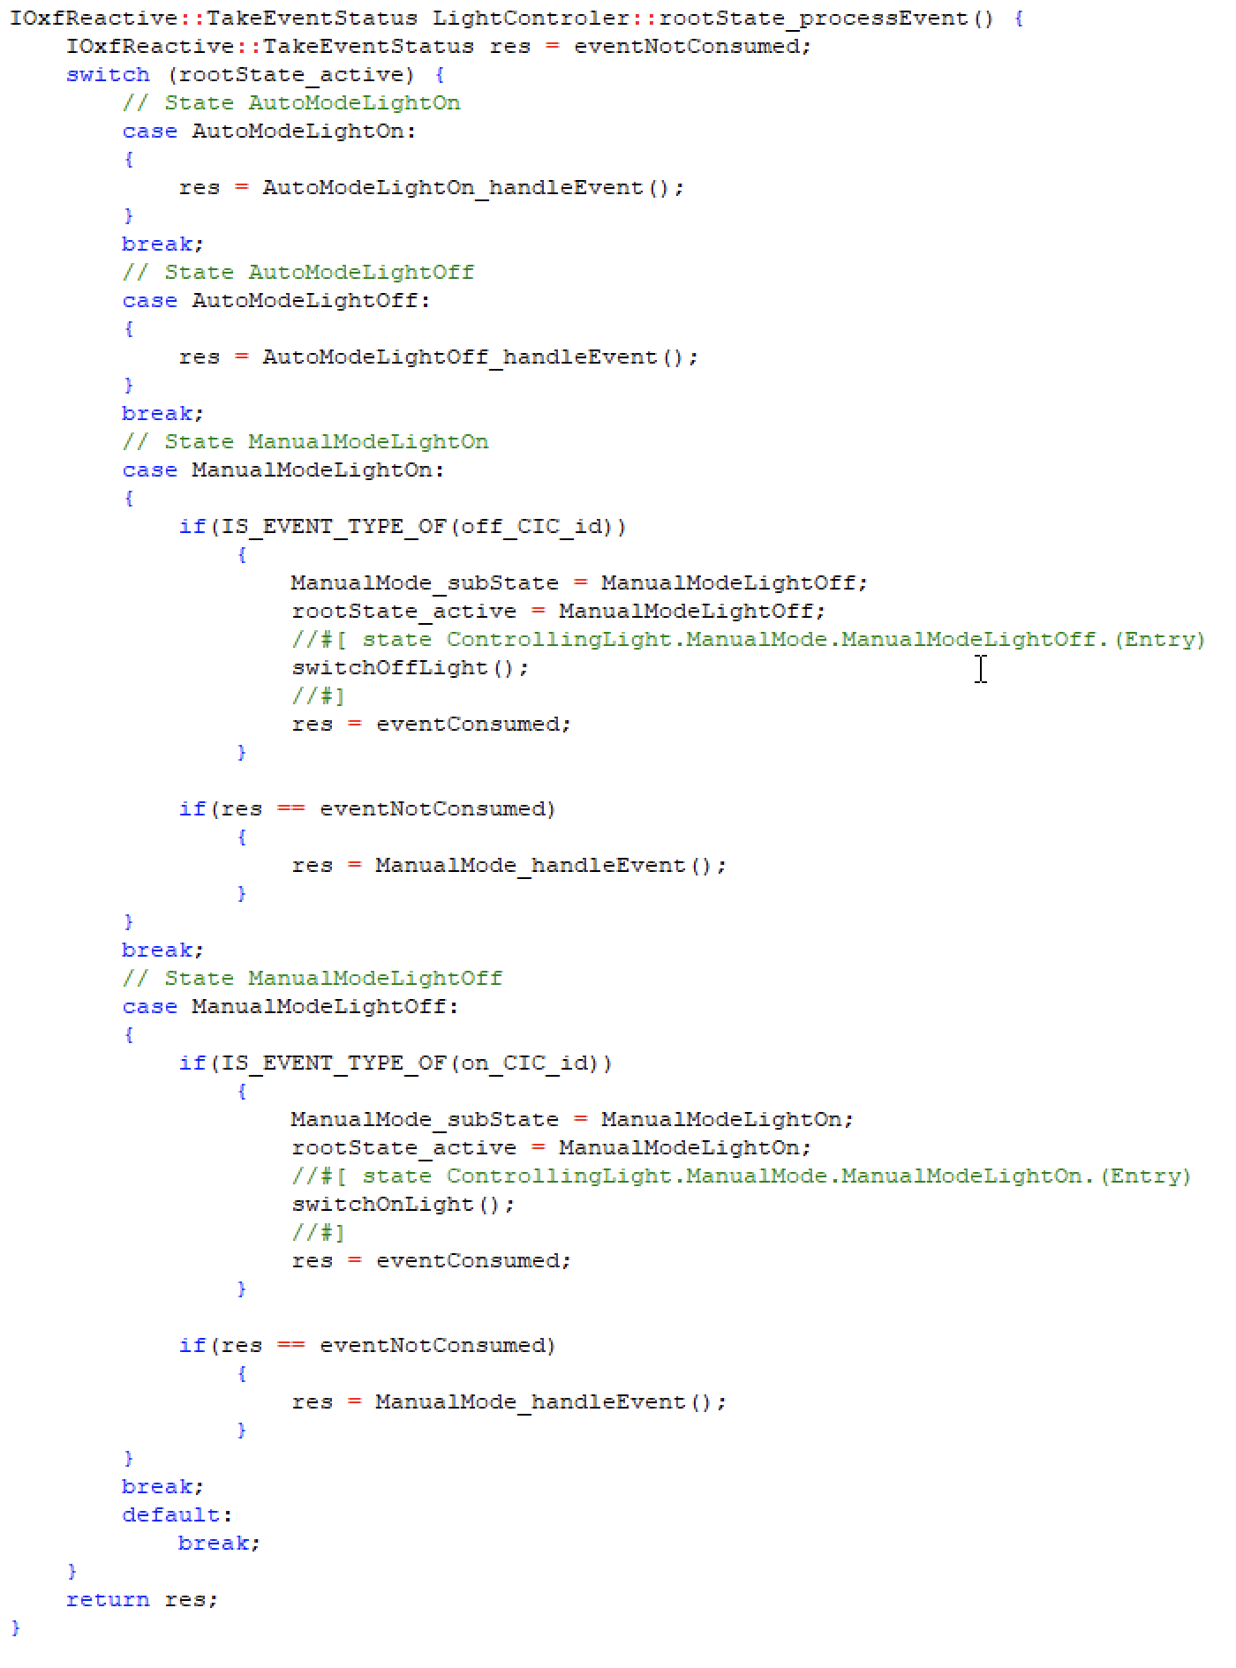
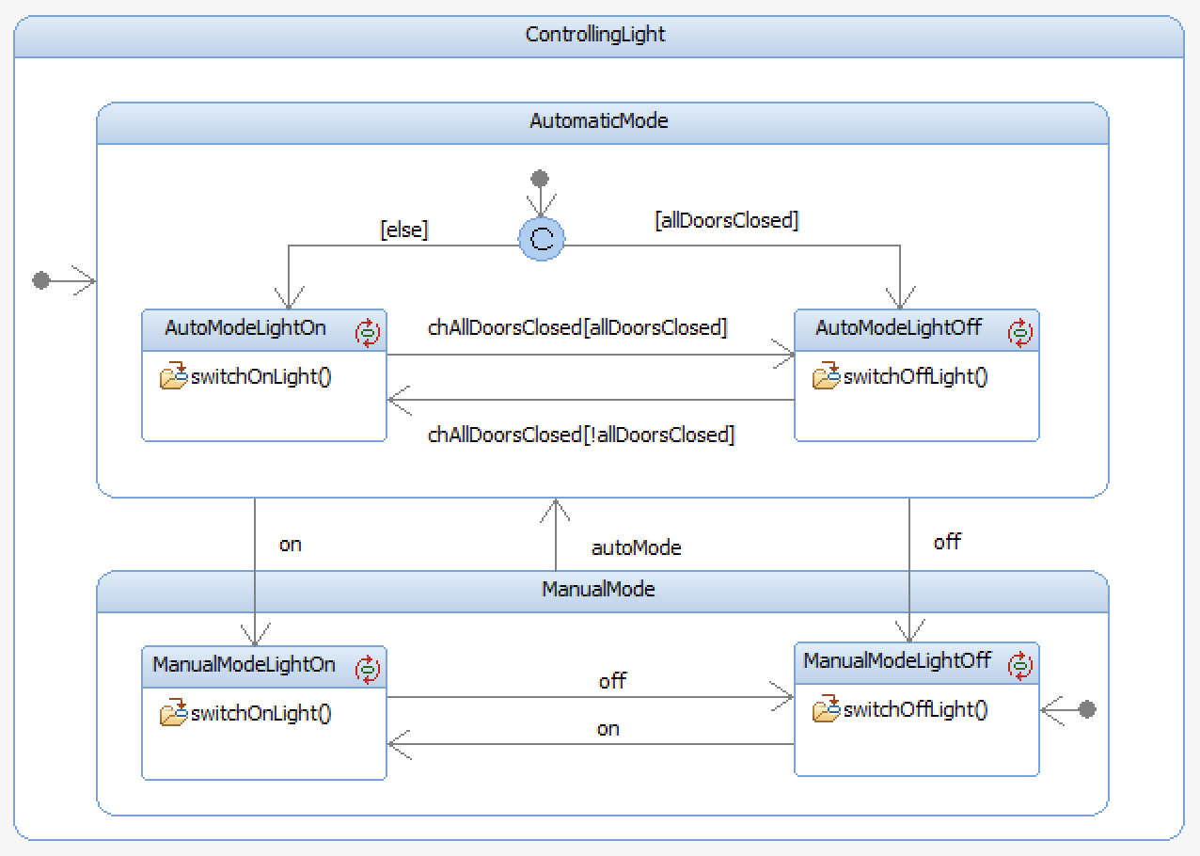
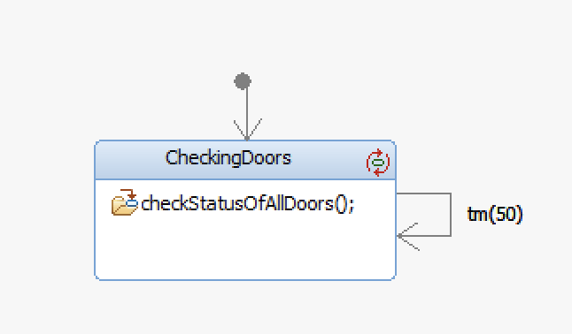
Rhapsody: Complete the Software model for Code Generation
In Rhapsody, complete the model to get executable code.
4 - Generate Code with Rhapsody
Implementation based on state charts

Slide 9
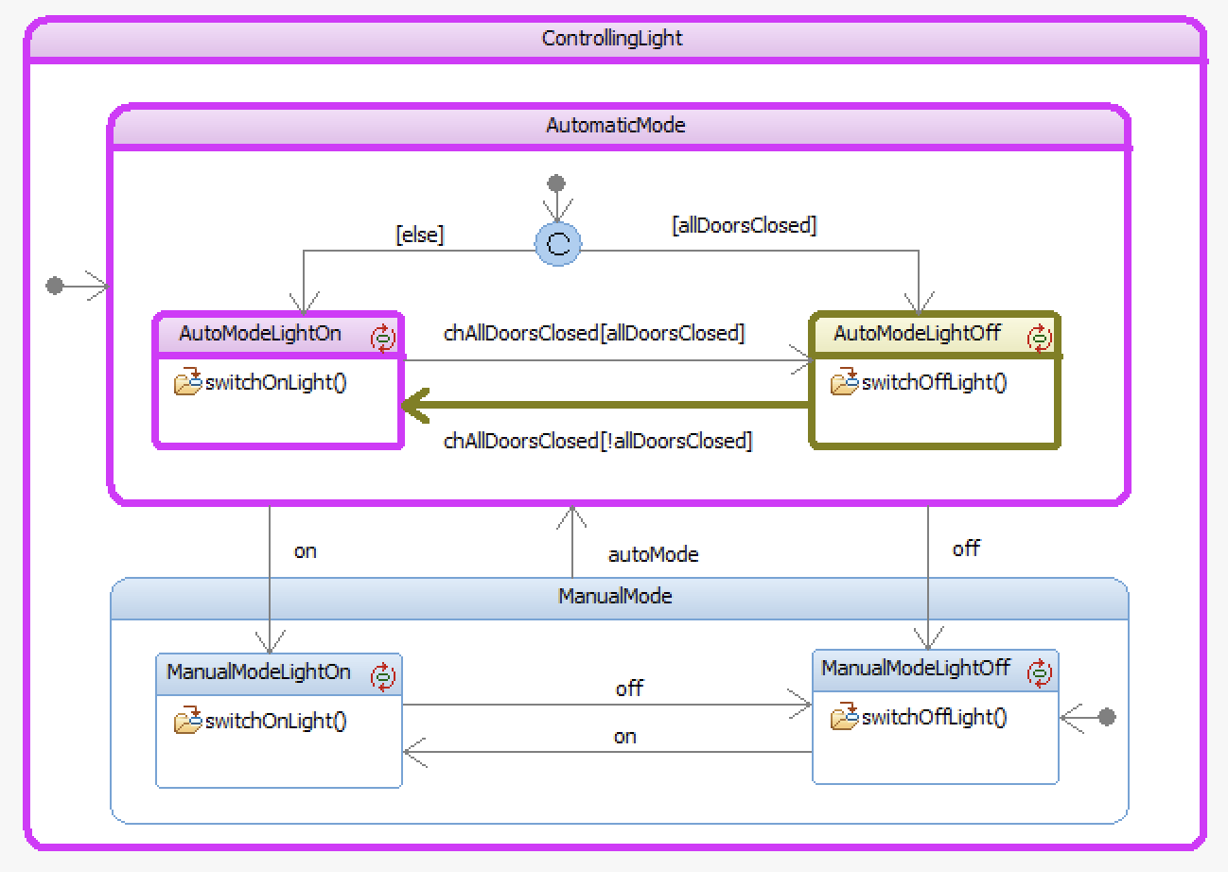
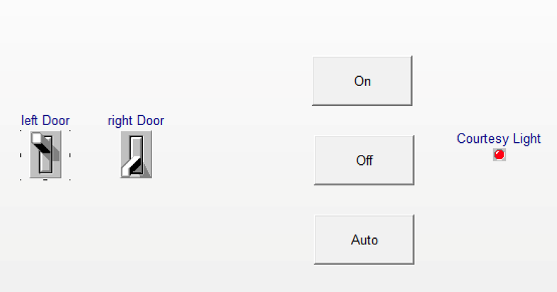
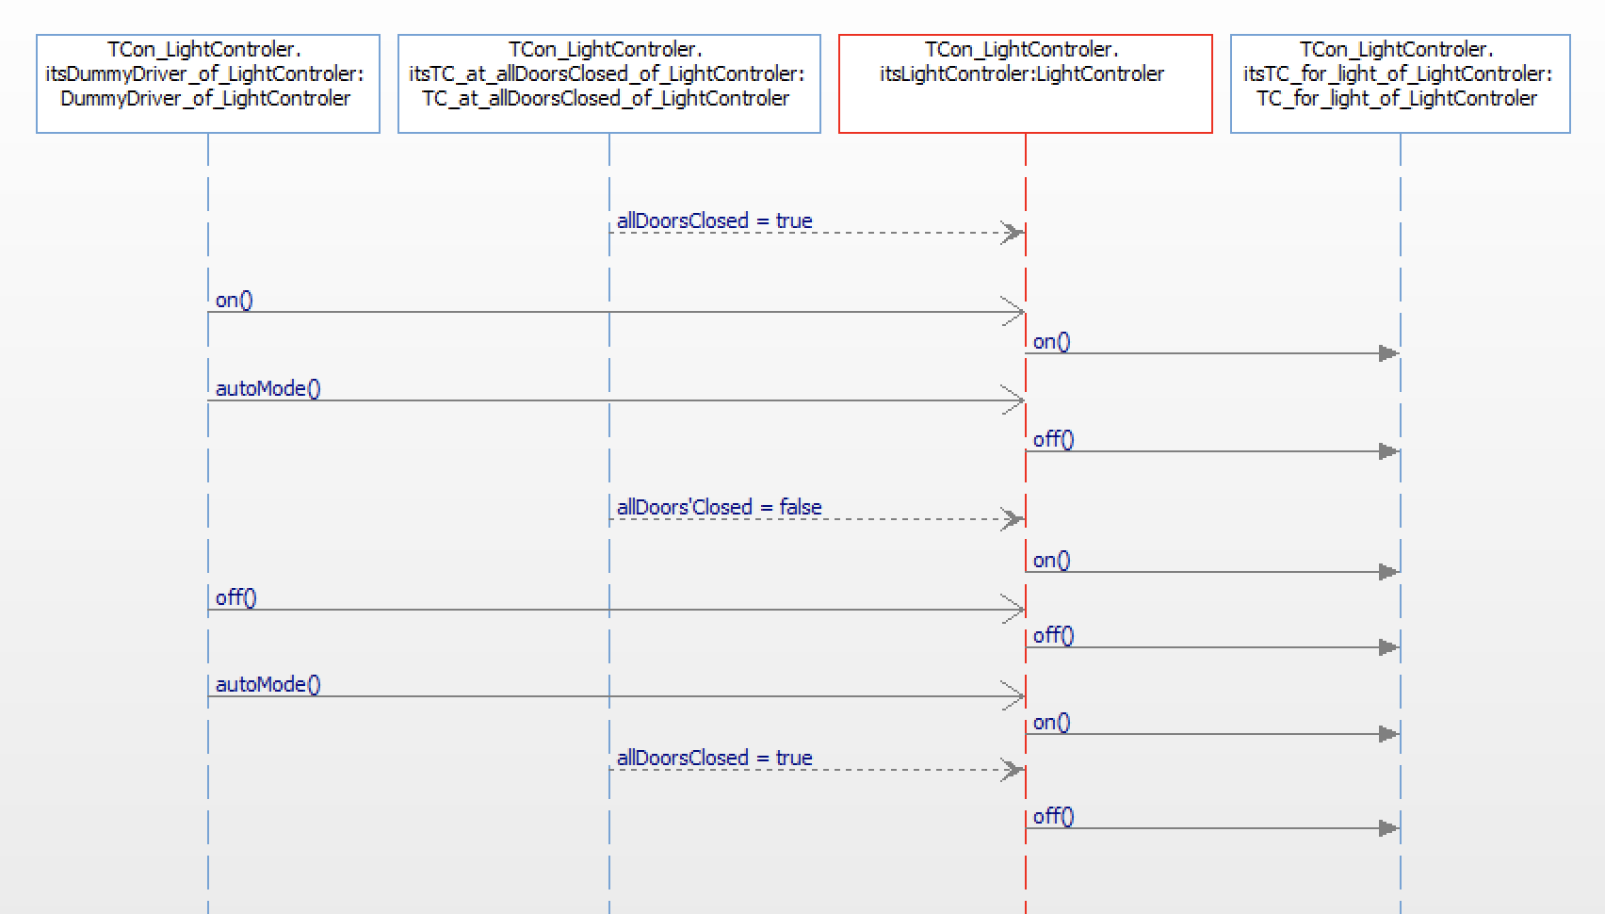
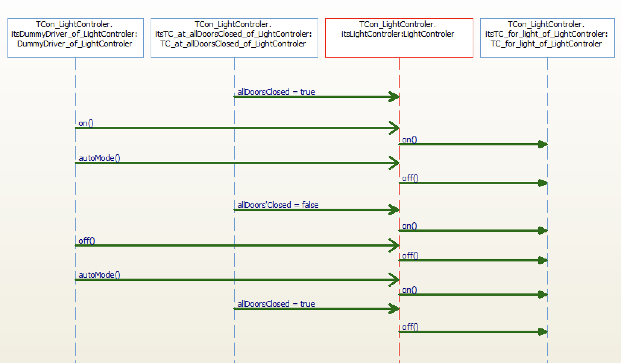
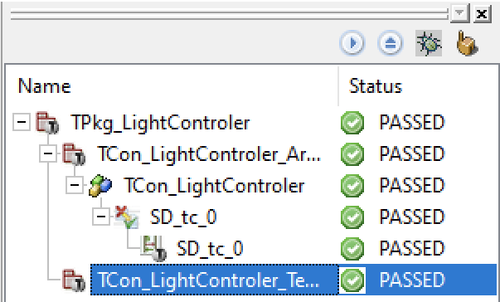
Rhapsody: Simulate and Implement Tests
Simulation with control panel
  Animation of state charts based on the executed code
Specification of test cases with sequences and testing with Test Conductor

Slide 10
Rhapsody: Reverse Engineering of Legacy Code
Options are highly dependent of the structure of the existing of the code
  Code-Centric
    Keep the code as it is
    Don’t get good models
    A lot of hidden artifacts are created to preserve the code
  Model-Centric
    Need to regenerate
    Changes the legacy code
    Implies a change in the way code is maintained
  Interface-Centric
    No regeneration
    Import “black boxes” in Rhapsody

