Slide 1
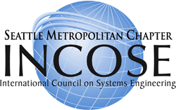
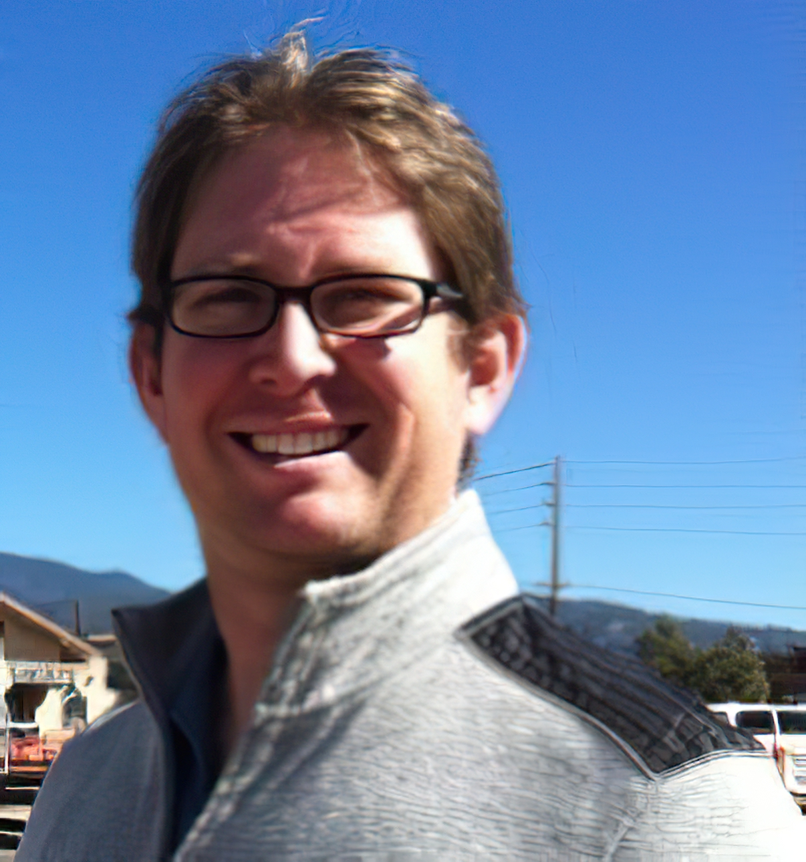

Model Based Systems Engineering
Three Ways
Get help with building effective MBSE models and explore simulation of a representative system from industry experts, share your experiences and challenges with peers across the local industry
Saturday November 18th, 2023
8:30 AM – 12:30 PM PDT
Virtual workshop
Casey Medina
CSEP®, OCSMP, Studio SE Owner
Hands-on Virtual Workshop: Come to connect and share, learn Model Based Systems Engineering essential principles in modeling
Virtual INCOSE Professional Development Workshop – $40/ $70 Registration Required*
Mr. Medina publishes regularly on LinkedIn.

Slide 2
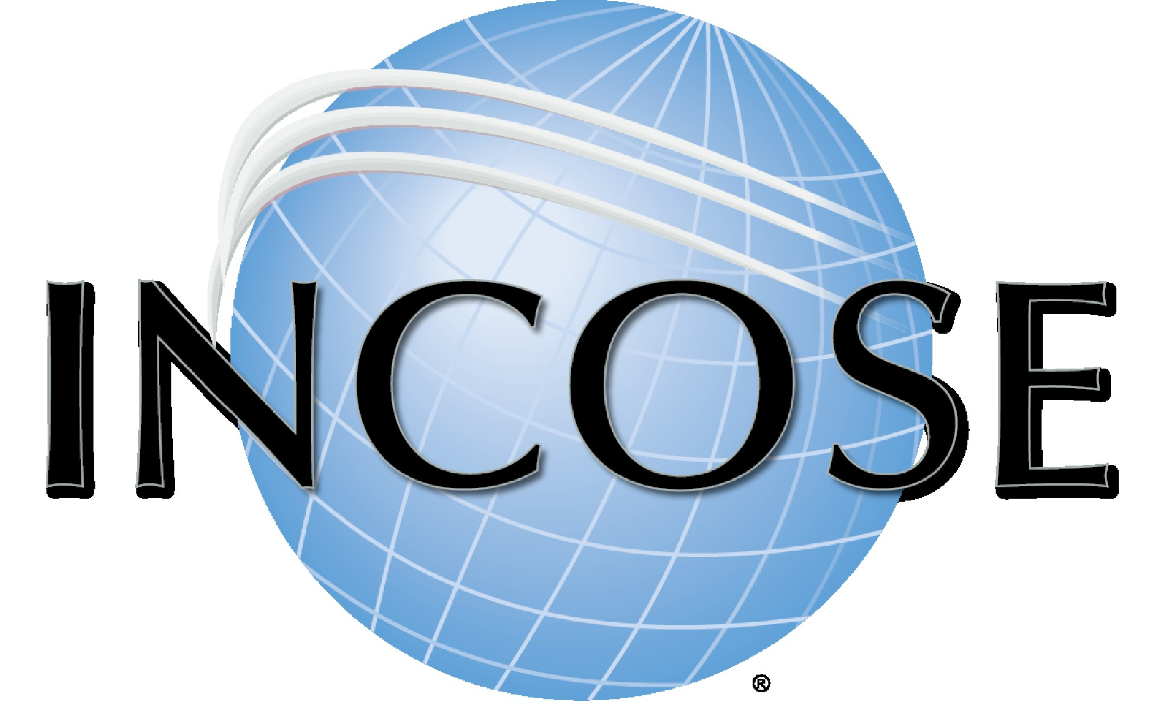
Agenda/Schedule
Overview: Exploring Advanced Topics in Modeling and Simulation with SysML - This hands-on, interactive workshop will employ Dassault’s Catia Magic Cyber Systems Engineer and Catia Magic Model Analyst (formerly known as Cameo) to build an executable model that demonstrates the power of simulation in describing a system of interest. We will build a Monte-Carlo analysis, together, from “scratch” that creates a framework for consistent analysis of non-trivial systems. While some SysML experience helps, it is not necessary to participate in this session.
8:30 AM Tutorial Outline:
Advanced topics in Modeling and Simulation
Hands-on, interactive use of SysML
Dassault’s Catia Magic Cyber Systems Engineer and Catia Magic Model Analyst (i.e., Cameo)
Build an executable model during the workshop
Build a Monte-Carlo analysis from “scratch”
SysML experience helpful but is not required to participate
Venue*: the workshop will be conducted On-line.
Contact: Paul A. van Tulder – SMC Director at Large – paul.vantulder@incose.net; (206) 552-5569.
Tool & Licenses: Studio SE has 20 Catia Magic licenses with simulation capability. Participants may use their own licenses, if they possess them. Any participant that needs a license will need to be able to access the Studio SE license server on the day of the training and will need to access our file share site to download and install the Dassault toolset. As the workshop nears, we will distribute instructions to the registered participants.
REGISTER ON-LINE*
Members
Non-Members
Registration details *: $40 registration for SMC members, $70 for non-members. For registration by checks – make check payable to SMC-INCOSE and mail to: Paul Kostek, 8014 Stroud Ave N, Seattle WA 98103. Please include your email address with the check in case of updated announcements and to receive Studio SE instructions to install the toolset models.
On-line registration deadline is Thursday November 16th. Space is limited to 30 participants.
The International Council on Systems Engineering (INCOSE) is a not-for-profit membership organization founded in 1990 to develop and disseminate transdisciplinary principles and practices that enable the realization of successful systems. INCOSE is designed to connect systems engineering professionals with educational, networking, and career-advancement opportunities in the interest of developing the global community of systems engineers and systems approaches to problems. We are also focused on producing state-of-the-art work products that support and enhance this discipline’s visibility in the world.

