Slide 1
An Introduction to the Unified Architecture Framework (UAF)
An INCOSE presentation by
Eric Barnhart

Slide 2
Introduction
“Have you ever gone to DoDAF class and left more confused than when you went in?”
“Now try going to a UAF class!”

Slide 3
What is UAF?
Quick answer:
  UAF is the next generation of the Unified Profile for DoDAF and MoDAF (UPDM)
  At one time referred to as UPDM 3
Longer Answer:
  An enterprise architecture framework
  Applicable for domains similar to DoDAF, MoDAF and NAF (NATO Architecture Framework)
  Flexible enough for non-defense domains
  Implemented as a UML profile on top of SysML
Realistic answer:
  A complicated framework that makes enterprise architecture even harder

Slide 4
What is UAF Good For?
Provides a framework for enterprise analysis
  Common terminology across domains
  Common concepts and models
  Everybody speaks the same language
Unifies the terminology across multiple frameworks
Allows MBSE / SysML implementation of the models

Slide 5
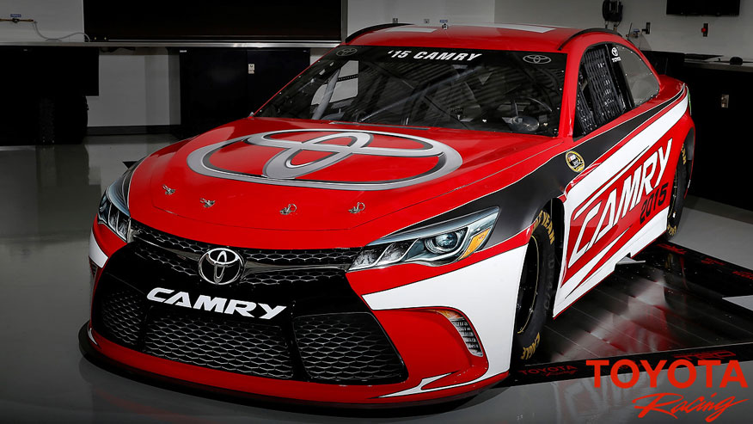

EA vs. MBSE
Despite looking similar and having common features, these are two autos are very different things
These require very different mindsets
Enterprise Architecture and Solution Architecture / Systems Engineering look similar but require different mindsets

Slide 6
EA vs. MBSE
Enterprise Architecture (EA)
  Strategic information asset base
  Defines mission, info needed to perform the mission, technologies to perform the mission
  Defines technology transition processes
Solution Architecture (SE, MBSE)
  Framework or structure
  Defines elements and relationships of a system that answers a problem
Strategic level
Mission oriented
Technology and transition
Answers questions
Solution focused
Structural elements and relationships
Systems engineering-like
Provides solutions

Slide 7
Framework Relationships
DoDAF
United States Department of Defense
MoDAF
British Ministry of Defense
extends
NAF
NATO
extends
Nobody is speaking the same language any more!

Slide 8
Framework Relationships
DoDAF
MoDAF
Implements in SysML
extends
NAF
extends
UPDM
Implements in SysML
UPDM attempted to unify models under SysML / UML

Slide 9
Framework Relationships
DoDAF
Implements in SysML
MoDAF
Implements in SysML
Implements in SysML
extends
NAF
Implements in SysML
extends
UPDM
Implements in SysML
updates
UAF
UAF continues the effort and modernizes the framework

Slide 10
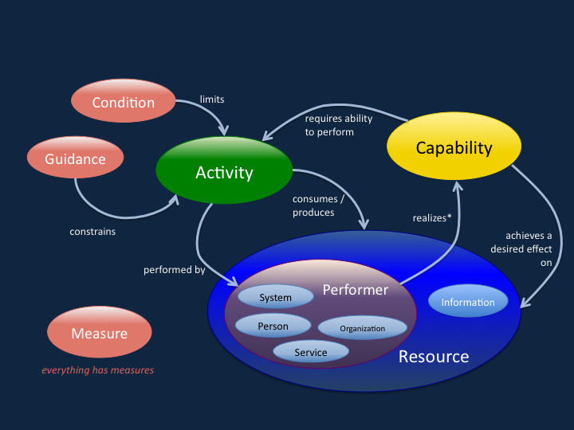
IDEAS Model
In DoDAF 2, understanding this conceptual model made everything much easier.
UAF retains this model, but 1) changes terminology and 2) adds many new concepts

Slide 11
Significant Changes in UAF
Personnel (enhanced)
Project Strategy (new)
Security (new!)
Services (enhanced)
Standards (enhanced)
Nodes (gone!)
Actual Resources
  better support for instances versus classes / blocks

Slide 12
Two level taxonomy
UAF provides a better model taxonomy than UPDM
Level 1
  Actual_Resources
  Dictionary
  Metadata
  Operational
  Parameters
  Personnel
  Project
  Resources
  Security
  Services
  Standards
  Strategic
  Summary_and_Overview
Level 2
  Connectivity
  Constraints
  Information
  Interaction_Scenarios
  Processes
  Roadmap
  States
  Structure
  Taxonomy
  Traceability
This leads to the view matrix…

Slide 13
View Matrix
 | Taxonomy Tx | Structure Sr | Connectivity Cn | Processes Pr | States St | Interaction Scenarios Is | Information If | Parameters Pm | Constraints Ct | Roadmap Rm | Traceability Tr
Metadata | Md-Tx | Md-Sr | Md-Cn | Md-Pr |  |  | Data Models | Environment & Measurements | Md-Ct |  | Md-Tr
Strategic | St-Tx | St-Sr | St-Cn |  | St-St |  |  |  | St-Ct | St-Rm | St-Tr
Operational | Op-Tx | Op-Sr | Op-Cn | Op-Pr | Op-St | Op-Is |  |  | Op-Ct
Services | Sv-Tx | Sv-Sr | Sv-Cn | Sv-Pr | Sv-St | Sv-Is |  |  | Sv-Ct | Sv-Rm | Sv-Tr
Personnel | Pr-Tx | Pr-Sr | Pr-Cn | Pr-Pr | Pr-St | Pr-Is |  |  | Pr-Ct | Pr-Rm | Pr-Tr
Resources | Rs-Tx | Rs-Sr | Rs-Cn | Rs-Pr | Rs-St | Rs-Is
 |  |  |  |  |  |  |  |  | Rs-Ct | Rs-Rm | Rs-Tr
Security | Sc-Tx | Sc-Sr | Sc-Cn | Sc-Pr |  |  |  |  | Sc-Ct
Projects | Pj-Tx | Pj-Sr | Pr-Cn |  |  |  |  |  |  | Pj-Rm | Pj-Tr
Standards | Sd-Tx | Sd-Sr |  |  |  |  |  |  |  | Sd-Rm | Sd-Tr
Actual Resources |  | Ar-Sr | Ar-Cn
A better taxonomy provides more logic and order to the set of views available in UAF

Slide 14
Viewing Information in UAF
Example: suppose you want to look at Operational Information for your problem domain
UAF provides view definitions for:
  Operational taxonomy (Op-Tx)
  Operational structure (Op-Sr)
  Operational connectivity (Op-Cn)
  Operational processes (Op-Pr)
  Operational states (Op-St)
  Operational interaction scenarios (Op-Is)
  Operational constraints (Op-Ct)
Choose what makes sense for your needs
Pattern is replicated across entities as appropriate
Numbered views (OV-1, OV-2, OV-5 etc) are replaced with more meaningful and consistent views

Slide 15
Data Mining the Profile
The draft UAF profile is ready for use at OMG.org
  http://www.omg.org/spec/UAF/1.0/Beta1/
Here’s the catch…
  The profile is missing a version statement in the opening XMI line; add one and it loads properly in Rhapsody
  The profile does NOT include tool-specific customizations
    No menu selections
    No contextual help
    No error checking
Examine the profile in your tool of choice to find all sorts of cool information
  Here’s an Excel spreadsheet: http://bit.ly/2qCEMKG-vmcse-uaf

Slide 16
Sample Definitions
UAF::Operational::Structure
OperationalAgent | An abstract element grouping LogicalArchitecture and OperationalPerformer.
OperationalRole | Usage of a OperationalPerformer or OperationalArchitecture in the context of another OperationalPerformer or OperationalArchitecture. Creates a whole-part relationship.
OperationalArchitecture | An element used to denote a model of the Architecture, described from the Operational perspective.
KnownResource | Asserts that a known ResourcePerformer plays a part in the LogicalArchitecture.
OperationalPerformer | A logical agent that IsCapableToPerform OperationalActivities which produce, consume and process Resources.
ProblemDomain | A property associated with a logical architecture, used to specify the scope of the problem.
OperationalPort | Usage of a OperationalPerformer or LogicalArchitecture in the context of another OperationalPerformer or LogicalArchitecture. Creates a whole-part relationship.
OperationalMethod | A behavioral feature of a OperationalPerformer whose behavior is specified in an OperationalActivity.
OperationalParameter | An element that represents inputs and outputs of an OperationalActivity. It is typed by an OperationalExchangeItem.

Slide 17
Looking at the Views
Most UAF documentation still refers to DoDAF view identification
  It’s unclear if DoDAF nomenclature is obsolete or not
  UAF spec from OMG does not use the DoDAF view names

Slide 18
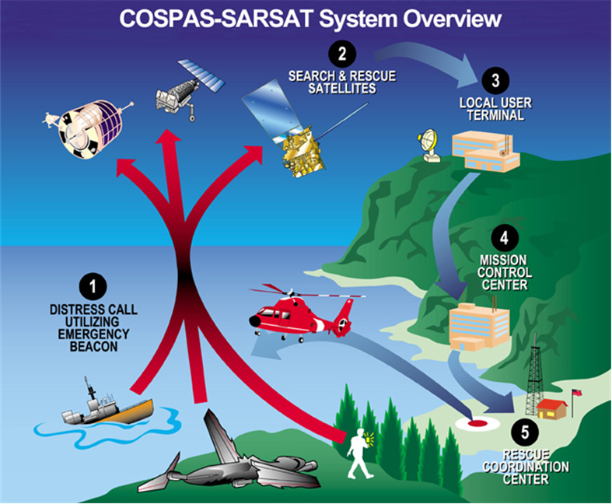
Operational View
OV-1 is like an Op-Sr Operational Structure
The elements are now <<operational performers>>
From: DoDAF V2.0 Community Update Overview 12 August 2010
MR. MICHAEL WAYSON;
Architecture and Infrastructure Directorate;
Office of the DoD Deputy Chief Information Officer

Slide 19
Capabilities
CV-1 is like an St-Sr Strategic Structure
Increase Effectiveness of SAR Operations
<<Enterprise Goal>>
Improve Location Accuracy
<<Enterprise Goal>>
Reduce Response Time
<<Enterprise Goal>>
Transit Resources to Source
Provide Assistance
Locate Source of Signal
<<Capability>>
<<Capability>>
<<Capability>>
<<Measure>>
<<Measure>>
Location Accuracy
Time

Slide 20
Capabilities
CV-2 is like an St-Tx Strategic Taxonomy
Transit Resources to Search Area
<<Capability>>
Calculate Distance
<<Capability>>
Determine Resources Required
<<Capability>>
Evaluate Weather
<<Capability>>
Evaluate Environment
<<Capability>>
Check Resource Availability
<<Capability>>
<<Capability>>
Assign Crew

Slide 21
Operational Views
OV-2 is like an Op-Cn Operational Connectivity
Satellite Status
<<System>>
<<System>>
GOES
Satellite
<<Organization>>
NOAA
<<Organization>>
DoD
Satellite Status
Downlink
Distress Signal
GRB
Downlink
Distress Signal
Aid
Coast Guard
<<Organization Performer>>
<<Resource Performer>>
Beacon
<<Resource Performer>>
Emergency Response
Search Directives
<<person>>
Distressed Person
Status

Slide 22
Personnel
OV-4 is like an Pr-Sr Personnel Structure
Commandant
<<Responsibility>>
Vice Commandant
Delegates
<<Responsibility>>
Commands
Commander Pacific Area
Commander Atlantic Area
<<Responsibility>>
<<Responsibility>>
Chief of Staff
<<Responsibility>>
Commands
Human Resources
<<Organization>>
<<Organization>>
Intel & Criminal Investigations
Operations
<<Organization>>
Plans & Policy
<<Organization>>
C⁴ &IT
<<Organization>>
Resources
<<Organization>>

Slide 23
Operational
OV-5b is like an Op-Pr Operational Processes
Activate Distress Beacon
<<OperationalActivity>>
Receive Distress Beacon
<<OperationalActivity>>
Dispatch Team
<<OperationalActivity>>
Relay Downlink to CG
<<OperationalActivity>>
Render Aid
<<OperationalActivity>>
Assess Emergency
<<OperationalActivity>>
Transport
<<OperationalActivity>>

Slide 24
Summary
UAF is the next step in standardized architectures
Use of UAF vs DoDAF nomenclature does not appear to be resolved
UAF views are better organized than DoDAF views
UAF views are NOT much different from DoDAF views
UAF has a long and shallow learning curve – expect slow adoption

