Slide 1

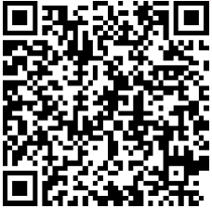

Thursday, January 19, 2017
5:30 PM Networking
6:00 PM Program
INCOSE TGCC 2017 Kick-Off!
General Round Table Discussion Meeting – Bring your Ideas!
Key Topics:
TGCC Board of Directors Introductions and Vision
Oil & Gas Working Group –Status and Plan
INCOSE Certification Update
Call for Presentations – Inaugural TGCC SE Conference
ISS Conference Center,
1800 Space Park Drive, Ste. 100,
Nassau Bay, TX 77058
Transocean, Room C-100 Concourse Level
4 Greenway Plaza
Houston TX 77046
January Program
Website
RSVP
This event is FREE and focused on Systems Engineering professionals. INCOSE membership is not required.
If you plan to attend, attendance and location is requested by noon 1/15/17 at http://doodle.com/poll/utguedufzyxaggin.
For more information or to attend via telecon and web-meeting, please see: http://www.incose.org/ChaptersGroups/Chapters/ChapterSites/texas-gulf-coast/chapter-home

