Slide 1

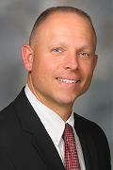
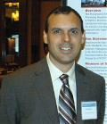

Thursday, July 21, 2016
5:30 PM Networking
6:00 PM Program
Healthcare Systems Engineering at MD Anderson Cancer Center.
The University of Texas MD Anderson Cancer Center is one of the world's most respected centers, dedicated exclusively to cancer care, research, education and prevention. MD Anderson aims to provide safe, timely, effective, equitable, efficient and patient-centered care as part of its mission to eliminate cancer. The Healthcare Systems Engineering team at MD Anderson supports this goal by facilitating the design, implementation and improvement of healthcare systems using proven systems engineering methods and principles. Jeremy Meade and David Bivins will provide an overview of their roles, organization structure, training programs and examples of projects using systems engineering tools.
Jeremy Meade
David Bivins
ISS Conference Center,
1800 Space Park Drive, Ste. 100, Nassau Bay, TX 77058
This event is FREE and focused on Systems Engineering professionals. INCOSE membership is not required.
If you plan to attend, attendance and location is requested by noon 7/19/16 at tgcc.incose@outlook.com.
For more information or to attend via telecon and web-meeting, please see: http://www.incose.org/ChaptersGroups/Chapters/ChapterSites/texas-gulf-coast/chapter-home

