Slide 1

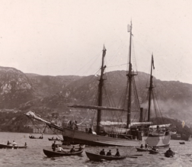
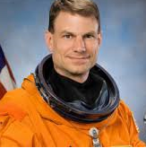


Tuesday, September 27, 2016
5:30 PM Networking
6:00 PM Program
Nansen's Farm Expedition: a Nineteenth Century Model for the Human Exploration of Mars
A small team of explorers spend three years isolated in cramped quarters with a lethal environment outside, far beyond the reach of any human assistance or even contact. It sounds like a mission to Mars, but it's not. In 1893, a time when most polar expeditions ended in failure and death, Norwegian explorer Fridtjof Nansen tried to conquer the North Pole by deliberately trapping a purpose-built ship, the “Fram,” in the Arctic icepack and exploiting the natural movement of the ice to simply drift to 90 degrees North. Although they didn't reach the Pole, the members of the expedition established a new "Farthest North" record and returned safely to be hailed as heroes.
Join Antarctic veteran and NASA astronaut Dr. Stan Love for a discussion of the Fram expedition, the design of the ship, its provisioning, and the onboard social system that together made it a success--and a useful Systems Engineering model for planning future flights into deep space.
ISS Conference Center,
1800 Space Park Drive, Ste. 100, Nassau Bay, TX 77058
This event is FREE and focused on Systems Engineering professionals. INCOSE membership not required.
If you plan to attend, attendance and location is requested by noon 9/23/16 at tgcc.incose@outlook.com.
For more information or to attend via telecon and web-meeting, please see: http://www.incose.org/ChaptersGroups/Chapters/ChapterSites/texas-gulf-coast/chapter-home
Sept Program
Website
RSVP

