Slide 1
INCOSE Texas Gulf Coast Chapter (TGCC) May 2022 Monthly Meeting
May 19, 2022

Slide 2
Agenda
New Members April/May 2022
Proposed Change in TGCC By Laws
INCOSE International Symposium (IS) 2022
Introduction Speaker for May 2022 (Rusty Eckman, ESEP)

Slide 3
New Members
7 New Members in April/May 2022
Matthew Buttry, Joy Rodriguez, Heath Buttery, Caroline Magee, Desiree Walters, Olivia Gallegos, David Belleza

Slide 4
Proposed Changes in the TGCC By Laws
BYLAW IX – NOMINATIONS AND ELECTIONS Section 3
FROM: The officers and directors shall serve for one year.
TO: With the exception of the President, Vice President and Past President, the officers and directors shall serve for one year. The President, Vice President and Past President shall serve a term of two years.
BYLAW XI – MEETINGS Section 1
FROM: The organization of the CHAPTER membership business meeting and program meetings shall be the responsibility of the Program Committee
TO: Add at the end…or in absence of a committee the President.
BYLAW XV – AMENDMENTS TO THE BYLAWS Section 4
FROM: For amendment of these Bylaws, a quorum shall be defined as 20 percent of the membership
TO: For amendment of these Bylaws, a quorum shall be defined as 10 percent of the membership

Slide 5
Proposed Changes in the TGCC By Laws
Need 20% voting participation from TGCC members (163 current members)
Benefits of these changes:
President can advance his/her vision for the chapter with a 2-year term
Gives more time for the Vice President to learn from the President for an easier transition
For the Program Committee to line up monthly speakers, the modified wording aligns with the current process
Provides better probability that we will have enough member participation to vote on future changes/amendments
Will send out an email detailing the changes and how to vote to approve or reject the changes

Slide 6
INCOSE International Symposium (IS) 2022
Date: June 25 – 30, 2022
Location: Detroit, MI
Hybrid event
In-person: $1520 member
Virtual: $750 member

Slide 7
Resources
Chapter Information
https://www.incose.org/incose-member-resources/chapters-groups/ChapterSites/texas-gulf-coast/chapter-home
LinkedIn https://www.linkedin.com/groups/3790414/
Facebook https://www.facebook.com/groups/tgccincose
Twitter https://twitter.com/tgcc_incose
Any chapter questions or suggestions for future speakers
Email tgcc.incose@outlook.com
INCOSE Homepage
https://www.incose.org/

Slide 8
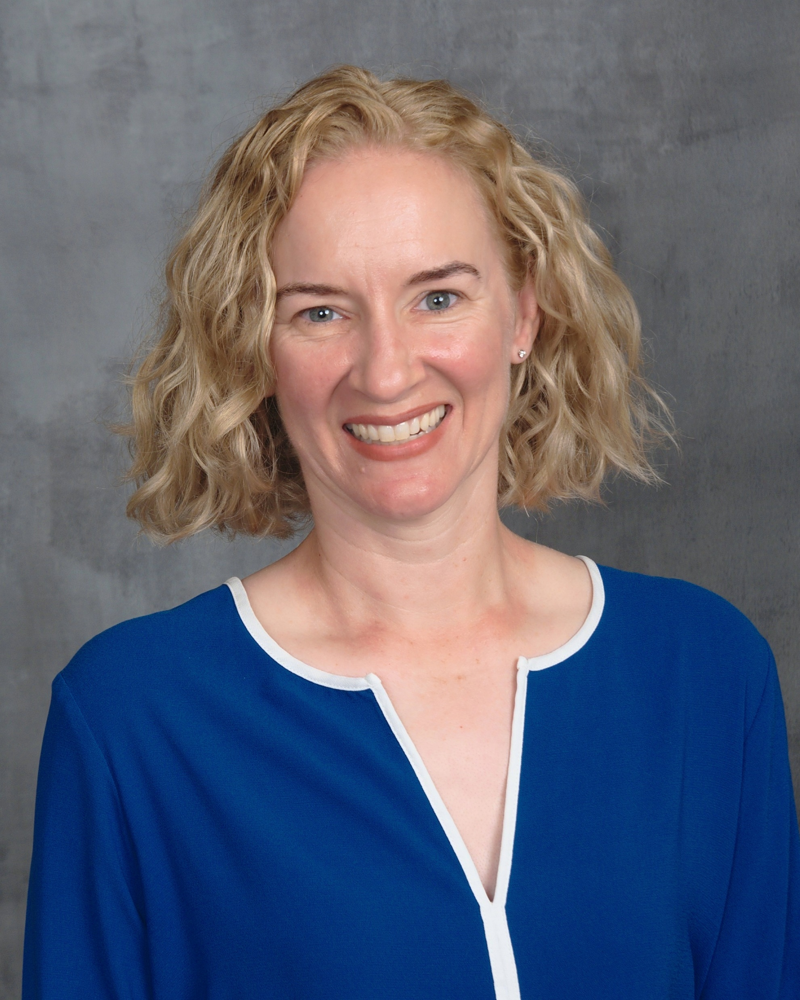
Speaker Introduction: Courtney Wright, CSEP
Title: How to get INCOSE certification without taking a scary test
Courtney Wright is a Certified Systems Engineering Professional (CSEP) and the Program Manager for INCOSE’s Certification Program.
She has over twenty years of experience working as an SE, including at NASA, the US Department of Defense, and the Federal Aviation Administration.
She enjoys describing everything in her life using systems engineering terminology, much to the dismay of her family and the amusement of her friends. She knows better than to say, “Actually …” and hasn’t yet accepted that “Interestingly …” is just as bad.
She has a bachelor’s degree in Mechanical Engineering and a master’s in Operations Research, and she worked at JSC from 2005 to 2011.

Slide 9
Back up

