Slide 1


In this Complex Age of Digitalization, Professional Development is Crucial
Don S. Gelosh, PhD, CSEP-Acq
Director, Systems Engineering Programs
Worcester Polytechnic Institute
Services Director
International Council on Systems Engineering
Copyright © 2019 by Don Gelosh. Permission granted to INCOSE to publish and use.

Slide 2

In This Presentation
Systems engineering facilitates program success
Discipline engineer versus an interdisciplinary systems engineer
Proposed career development path for discipline engineers to become more effective as systems engineers
INCOSE Services Operations and the Value Streams of Certification, Events, and Education & Training
Professional Development Resources
Notes:
In this complex age of digitalization, we need highly skilled and proficient systems engineers more than ever. Dr. Don Gelosh, Services Director for the International Council on Systems Engineering (INCOSE) will discuss why Professional Development for systems engineers is crucial to success.
Dr. Gelosh will begin by discussing how systems engineering facilitates overall program success and will present a brief list of system failures that can be traced to a lack of skilled systems engineers or incorrect application of systems engineering techniques.
Dr. Gelosh will then briefly explore the typical focus of a discipline engineer versus an interdisciplinary systems engineer, followed by a proposed career development path for discipline engineers to become more effective as systems engineers.
Dr. Gelosh will explain why the career development of an organization’s employees, their Human Capital, is the single best investment they can make.
Dr. Gelosh will finish by describing his new role as the Services Director and how the INCOSE Value Streams of Certification, Events, and Education & Training are working together in a synergistic manner to provide professional development services to INCOSE members and participating organizations.

Slide 3
Systems Engineering and Program Success
There is tremendous potential for wasted effort on large projects, since their development requires that many subsystems be developed in parallel.
Without a clear understanding of what must be done for each subsystem, the development team risks having inconsistent designs, conflicting interfaces, or duplication of effort.
Systems engineering provides a systematic, disciplined approach to defining, for each member of the development team, what must be done for success.
Systems engineering can contribute significantly to successful systems, and to achieving the right balance of performance, cost, and schedule through the system life cycle.
As we work and evolve in this complex age of digitalization, the need for well trained and educated systems engineers is more critical than ever.

Slide 4
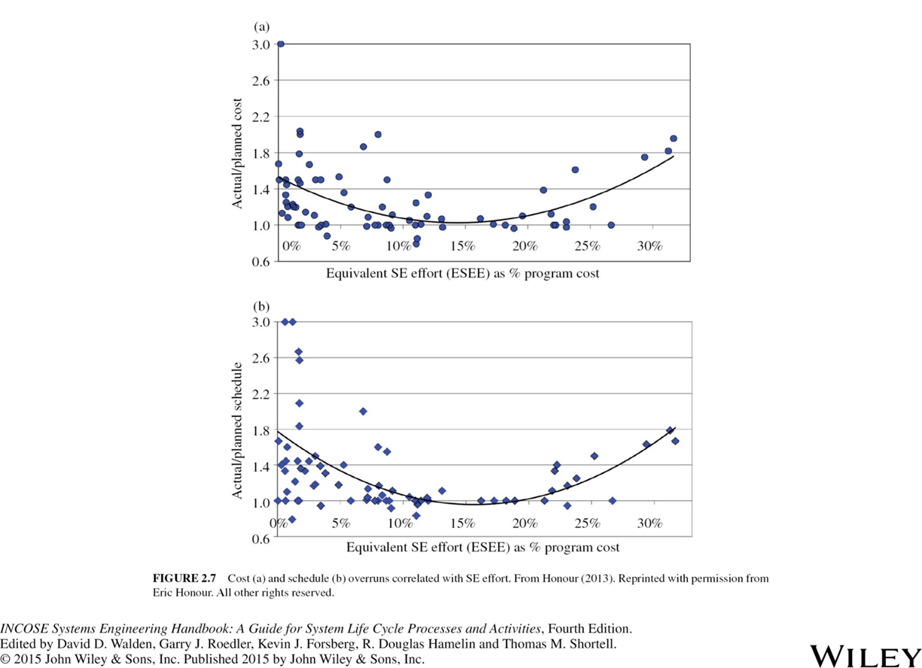
Systems Engineering Return on Investment (ROI)
Figure 2.7 to the right shows the results of a research project completed by Eric Honour and the University of South Australia in 2012 to quantify the ROI of SE activities.
This project gathered 43 survey points and 48 detailed interviews, each point representing the total results of a single system development project.
Figure 2.7 compares the equivalent SE effort as a percentage of program cost with respect to cost compliance (top) and schedule performance (bottom).
The research results showed that the optimum level of SE effort for a normalized program is about 14% of the total program development cost.

Slide 5
Systems Engineering Enhances Competition
Innovation increases risks
  Use of new technology and tools may have unintended consequences
  Characteristics of new materials, processes and components not well understood
  Unanticipated issues (risks) may arise during system development that could:
    Create confusion
    Increase costs
    Delay program delivery
Conservative approach also risky
  Competitive advantage relies on bringing new products and technologies to market ahead of your competitors – we have to try new methods and techniques
  Inferior products become obsolete quickly
Systems Engineering enables us to effectively manage risks

Slide 6
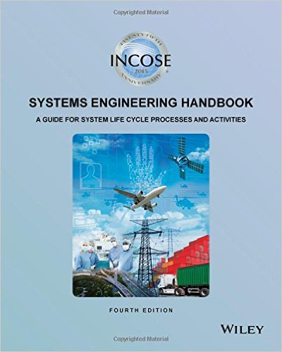
Value of Systems Engineering
100%
Committed
Costs
95%
90%
85%
80%
50 – 1000x
70%
70%
Operations Through Disposal
20 – 100x
60%
Cumulative Percentage Life Cycle Cost Against Time
Cost to Extract Defects
Prod/Test
100%
50%
40%
3 – 6x
50%
30%
Develop
20%
Design
Expended costs
Concept
20%
10%
15%
0%
Time
Work and decisions made early in the project set the stage for project success or failure. In which of these stages is systems engineering most important?
Reference: INCOSE SE Handbook, 4th Edition, Figure 2.4 pg. 14

Slide 7

Examples of Failures
Hubble Space Telescope
Space Shuttle Challenger
Apollo 13
Mars Polar Lander
Mars Climate Orbiter
F16s and European Radio Stations
Many Others …
Notes:
https://www.space.com/8193-caused-apollo-13-accident.html

Slide 8

Systems Engineering ⇔ Traditional Engineering
Systems engineering is focused on the system as a whole
  Emphasizes total system operation
  Includes interactions between the system and its intended operational environment
Systems engineers lead the formative stage of development
  Making critical design decisions
  Leading to the system’s functional design
Systems engineering bridges the traditional engineering disciplines
  Traditional engineering focuses on the development of unique system elements
  Systems engineering must ensure that all elements function properly in combination with one another to realize an operational system

Slide 9
Characteristics of Systems Engineers
Ability to focus on complex problems and break them down into smaller manageable problems
Ability to balance risk and opportunity
Ability to facilitate problem solving (involving various domain experts)
Excellent logic capability and disciplined work habits
Process data and come to conclusion in a timely manner
Process awareness and applicability
Ability to visualize the whole system and its Concepts of Operations (CONOPS)
Ability to work in teams across functional boundaries
Excellent interpersonal communications and leadership skills (to elicit requirements, lead teams, etc.)

Slide 10
Communications are Critical!
Systems Engineers must communicate:
  ideas
  concepts
  requirements
  solutions
Across organizational:
  boundaries
  levels
  disciplines
  environments
To achieve:
  mutual understanding
  mutual agreement
  stakeholder satisfaction
  a solution with system integrity
Systems Engineers facilitate the “Single Source of Truth”
10

Slide 11
Systems Engineering Competency Framework
Represents a world view of 5 competency groupings with 36 competencies central to the profession of Systems Engineering, including indicators of knowledge, skills, abilities and behaviors across 5 levels of proficiency.
Aligns with major ongoing INCOSE initiatives.
Supports a wide variety of usage scenarios including individual and organizational capability assessments.
Enables organizations to tailor and derive their own competency models that address their unique challenges.

Slide 12
36 Competencies Across 5 Groups
SE Management
Professional
Information Management
Planning
Monitoring and Control
Communications
Facilitation
Risk and Opportunity Management
Ethics and
Professionalism
Coaching &
Mentoring
Business & Enterprise Integration
Decision Management
Concurrent
Engineering
Configuration
Management
Acquisition
and Supply
Technical
Leadership
Emotional
Intelligence
Negotiation
Team Dynamics
Core SE Principles
Technical
General
Engineering
Systems
Thinking
Integrating
Requirements
Definition
Systems
Architecting
Transition
Operations
and Support
Capability
Engineering
Critical
Thinking
Quality
Finance
Project
Management
Logistics
Design For …
Integration
Interfaces
Verification
Validation
Systems Modelling
and Analysis
Lifecycles

Slide 13

Oil & Gas Domain Areas
Upstream (5 Domain Areas):
Exploration & Evaluation (5 Competencies)
Drilling (10 Competencies)
Completions (8 Competencies)
Production (5 Competencies)
Subsea & Offshore (9 Competencies)
Midstream (2 Domain Areas):
Gas Processing (6 Competencies)
Transportation & Storage (3 Competencies)
Downstream (2 Domain Areas):
Refining (4 Competencies)
Petrochemical (7 Competencies)
Source: https://www.oilandgasiq.com/strategy-management-and-information/articles/oil-gas-industry-an-introduction
Source: INCOSE Oil and Gas Working Group, presentation to Europe, Middle East and Africa (EMEA) Workshop, Mannheim, Germany, September 2017.
Notes:
If we use the INCOSE SE Competency Framework to develop an Oil and Gas Competency Model, we would develop a Proficiency Level Table for each of the 57 competencies. For the purposes of this paper and as a notional example, we will develop and describe a proficiency level table for one of the competencies. In the category of Upstream, we chose the domain area of Production. Under the Production domain area are five competencies: Surface Production, Production Stimulation, Well Intervention, Flow Assurance and Monitoring, and Well Performance. We chose Surface Production as the example competency. Within this competency, there are eight Competency Areas defined: Surface Flow Control, Manifolds and Flow Gathering, Separation, Oil Treatment, Gas Compression and Treatment, Water Treatment, Production Control and Monitoring, and Storage and Metering.

Slide 14
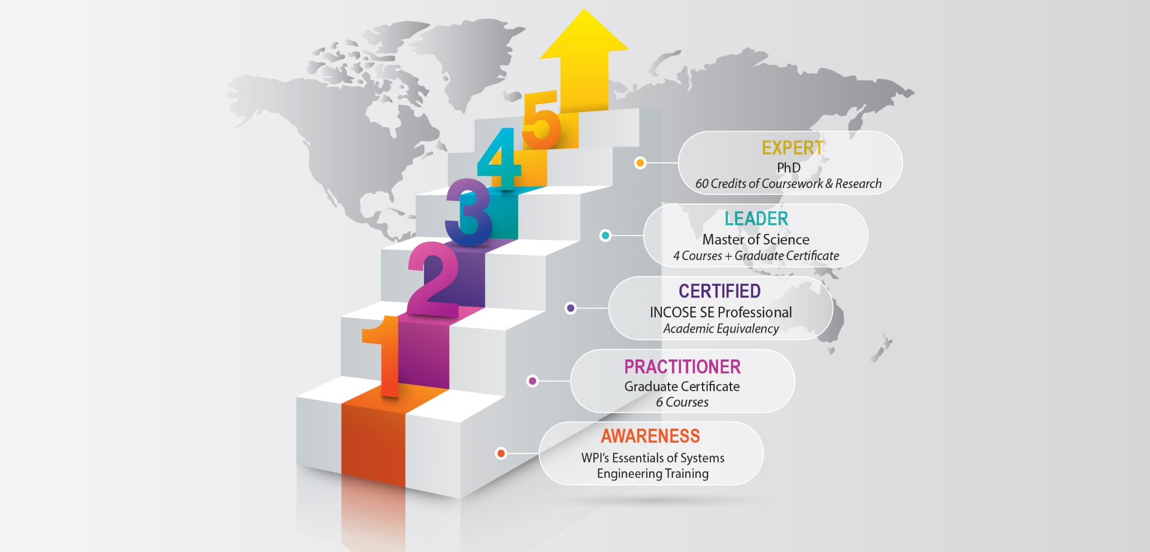
Systems Engineering Career Path Development

Slide 15
15
Systems Engineering Career Paths
Chief of Test
Business Development
Customer Support Management
Program Director
Chief Engineer
Functional Engineering
SYSTEMS ENGINEERING
IPT Lead
VP of Engineering
Functional Management
VP Innovations
Program Management

Slide 16
INCOSE Services Operations
Certification
The key to advancement of INCOSE as a Professional Society is knowledge – knowledge creation, discovery, and transfer – all contributing to the state-of-the-art for Systems Engineering.
Systems Engineering Knowledge
While each Value Stream deals with certain perspectives of knowledge, all three work together in a synergistic fashion to enhance all the facets of knowledge.
Education & Training
Events
Tremendous opportunities arise when all three Value Streams coordinate and collaborate their perspectives on knowledge to enhance the overall Value of INCOSE to its members and the Systems Engineering community.
“Provide Value Through Impactful Services”

Slide 17
Professional Development Resources
Professional Development Portal prototype demonstrated at IS2019
Tons of webinars and tutorials available on www.incose.org
Local INCOSE Chapters provide presentations on wide range of topics
SE Education: https://www.incose.org/academic-affairs-and-careers/se-education
Worldwide Directory: https://www.incose.org/docs/default-source/aboutse/se-academic-program-directory0231BA07E0A3.pdf?sfvrsn=a06bdc6_22
Academic Equivalency to Certification Knowledge Exam: https://www.incose.org/systems-engineering-certification/certification-agreements/equivalency-programs

Slide 18
Questions?

Slide 19
Thank you!
For more information please contact:
Dr. Don Gelosh
+1-540-508-4774
dsgelosh@wpi.edu
https://www.wpi.edu/academics/departments/systems-engineering

