Slide 1
Applying Model-Based System Engineering on the Dream Chaser® Spacecraft Program
Tami Katz 9-25-19

Slide 2
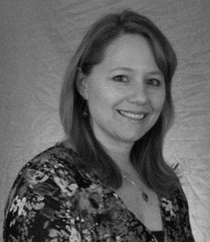
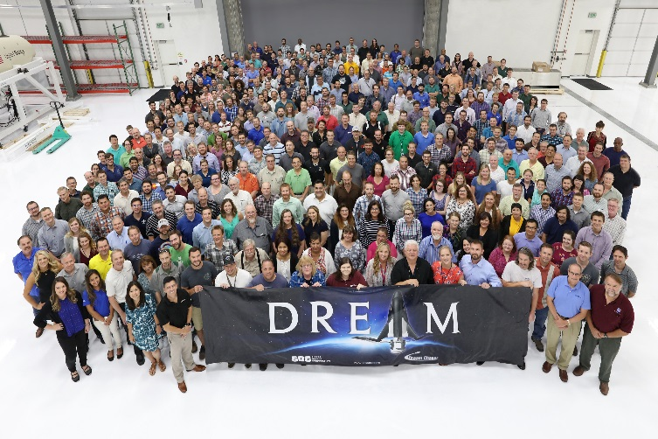
Introduction
Tami Katz
Director of Project Engineering, SNC
Lead of the Dream Chaser Systems Engineering, Systems Analysis, Specialty Engineering, and Test Operations Teams
INCOSE CSEP and Requirement Working Group Chair
Prior Experience
Principal System Engineer, SNC and Ball Aerospace
Test Engineer, Ball Aerospace and Boeing Satellite Systems
Vehicle and Design Engineer, Hughes Space and Communications
Education
Current – Ph.D student, Systems Engineering, Colorado State University
MS Aero Eng, University of Southern California
BS Aerospace Engineering, Cal Poly Pomona

Slide 3
Applying Model-Based Systems Engineering During Dream Chaser Development
This presentation discusses how systems engineering is practiced on the Dream Chaser program with a focus on how challenges were addressed during the application of Model-Based Systems Engineering (MBSE).
Agenda:
Overview of Sierra Nevada Corporation (SNC)
Overview of Dream Chaser Cargo System
Dream Chaser Cargo System systems engineering processes & associated challenges
Applying MBSE & associated challenges

Slide 4
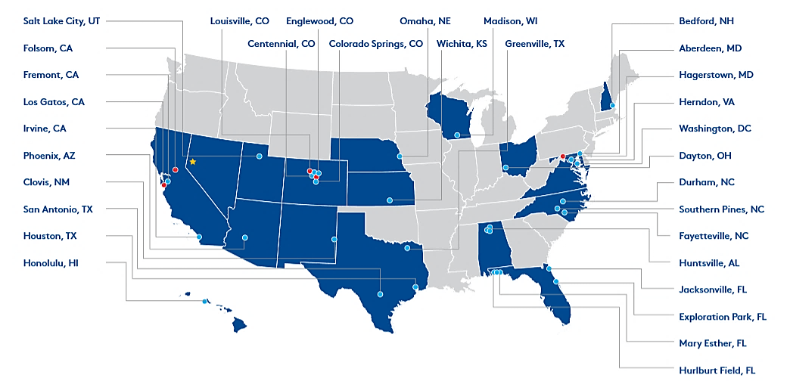
Sierra Nevada Corporation
From engineers and scientists to cyber experts and software developers, SNC brings together more than 4,000 team members committed to solving the world's toughest and most complex technology challenges.
33 Locations in 19 states, England, Germany and Turkey
Privately Held, Woman-owned Business
www.sncorp.com
^{Corporate Headquarters}
^{Sparks, NV}
^{Business Area Headquarters}
Space Systems (SSG); Louisville, CO
Intelligence, Surveillance and Reconnaissance, Aviation and Security (IAR); Centennial, CO
Integrated and Information Systems (EIS); Folsom, CA
^{Field Offices}
Notes:
50+ years of experience with over 3000 employees

Slide 5
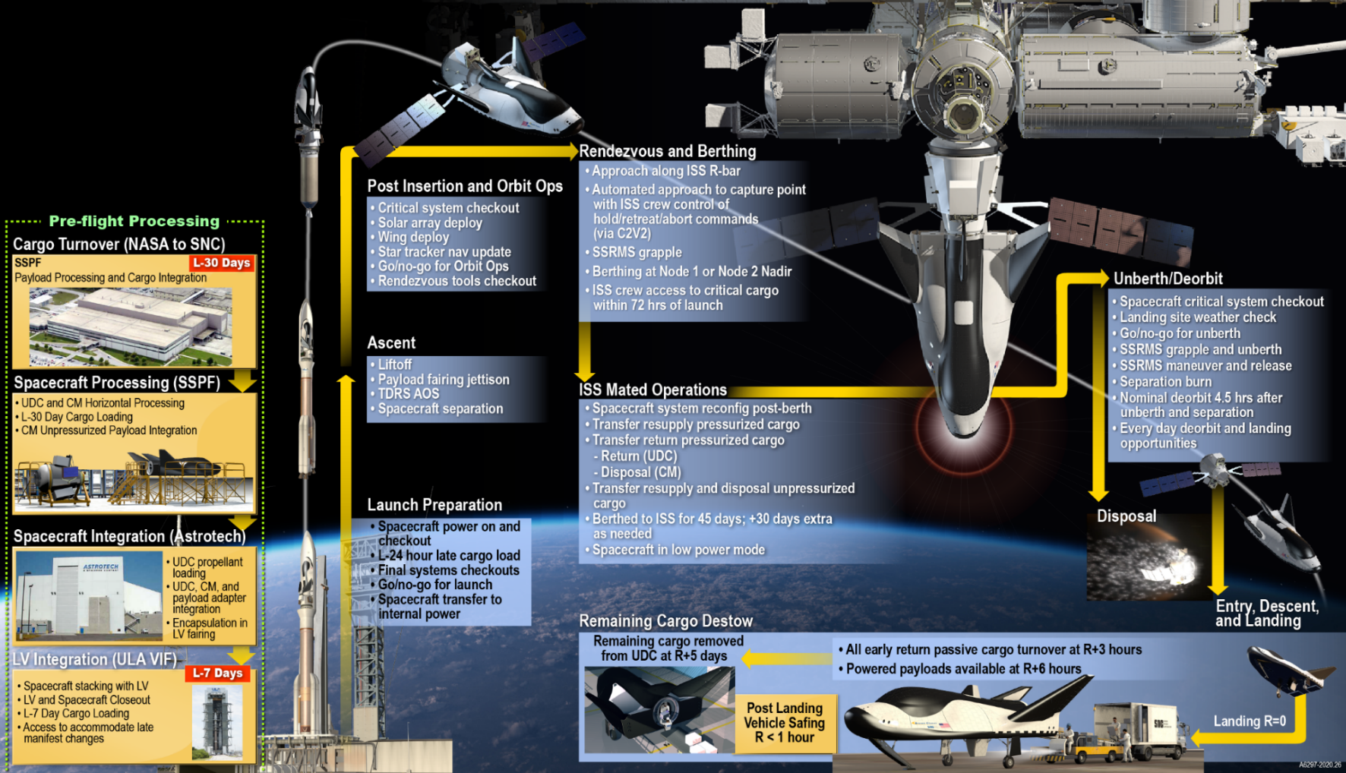
Dream Chaser Cargo System Overview
Graphic credited to Sierra Nevada Corporation

Slide 6
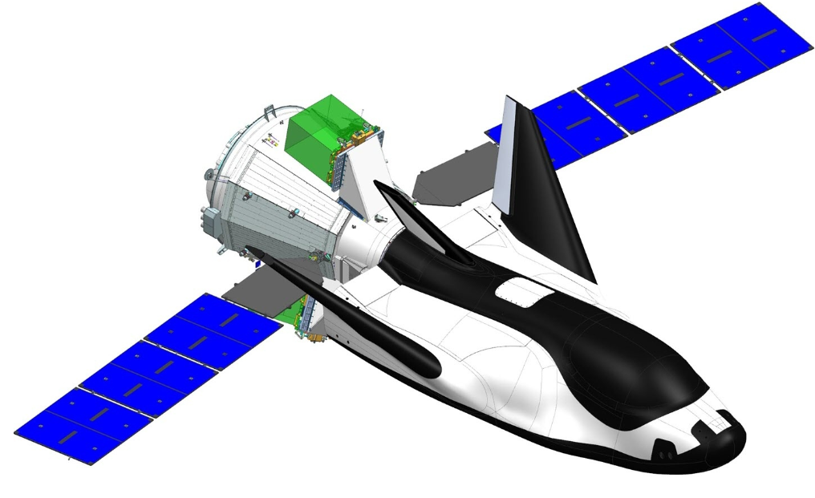
Overview of Dream Chaser Cargo System
Dream Chaser Cargo System is the SNC approach towards fulfilling the NASA Cargo Resupply Services 2 (CRS-2) Contract, and includes:
Lifting-body spacecraft with an attached, disposable cargo module
Carries up to 5,500 kg (12,125 lb) to the International Space Station
Provides the return of a significant amount of cargo back to Earth (1,750-1925 kg or 3,850 – 4235 lbs), and disposes of a large amount of unwanted trash from the space station (at least 3250 kg)
Autonomous launch, flight and landing capabilities
Capable of launching vertically on top of a variety of rockets
15 + times reusability
Low, 1.5 g atmospheric entry
Gentle runway landing compatible with runways worldwide
Immediate access to cargo upon landing
SNC is developing a space system that relies on several teams working collaboratively and concurrently.
SNC is developing the spacecraft, all of the ground equipment and missions systems, personnel and procedures to operate the missions and tailor the configuration of design for each mission
This meets the definition of a complex system!

Slide 7
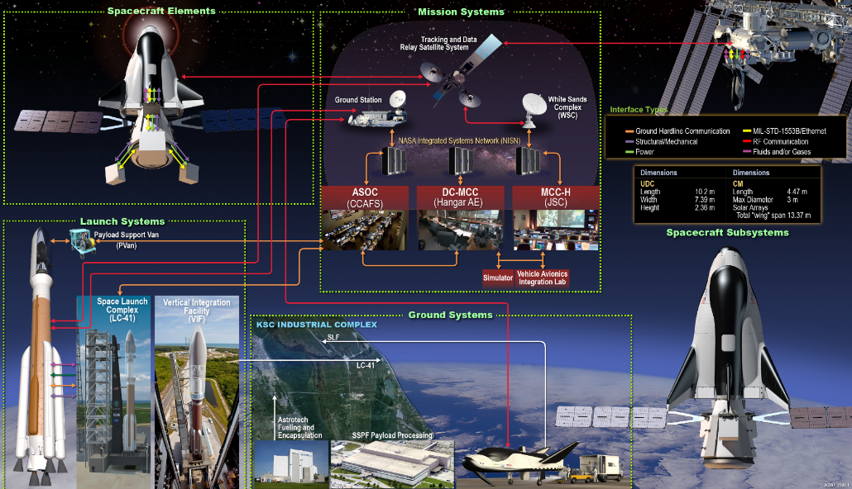
Systems Engineering Challenges During Dream Chaser Cargo System Development
Challenges to performing systems engineering:
With a system this complex, how best to represent all of the components, behaviors, and interactions?
How can we ensure that the requirement set was complete and aligned to the expected contractual and derived operations?
How can we ensure the requirements mapped to the implemented architecture?
Traditional document-centric approaches were tried, yet the concurrent development activities meant a solution was needed that allowed dynamic connections and quick ability to update architecture parameters as they changed.
Graphic credited to Sierra Nevada Corporation

Slide 8
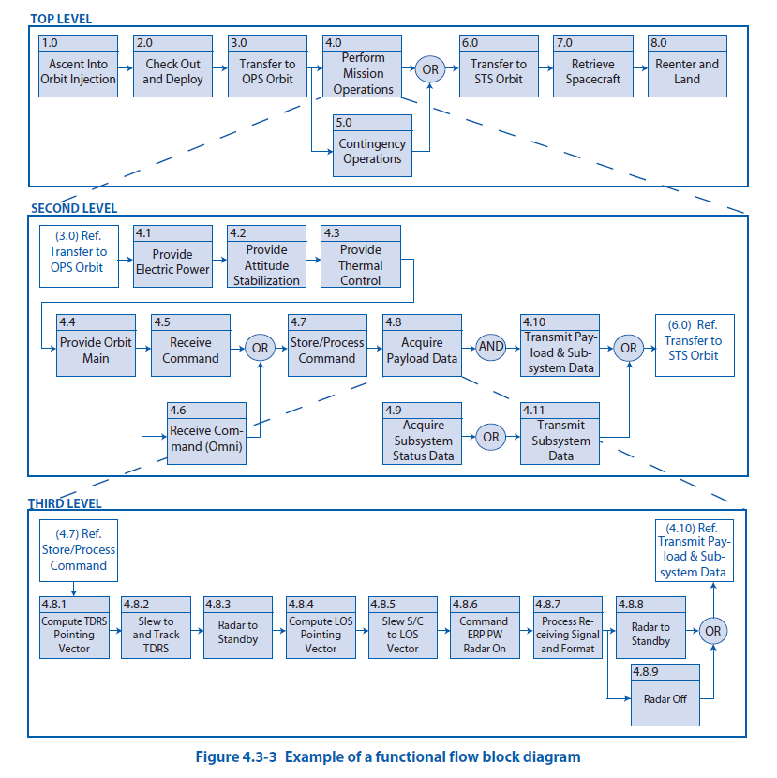
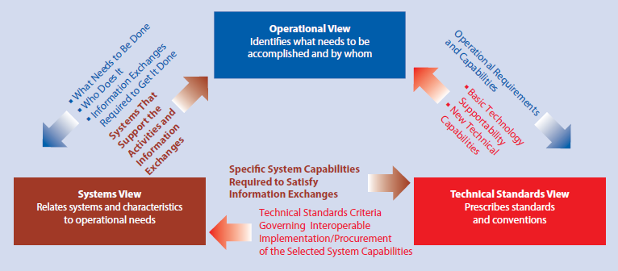
Investigated Options on How to Address the Challenges….
The NASA Systems Engineering (SE) Handbook NASA/SP-2007-6105 (section 4.3.2.2) describes approaches on functional analysis.
Provides a framework to think about and organize a system based on how it achieves mission objectives
Looking at functional analysis approaches further, the team found the DoD Architecture Framework (DoDAF). From NASA SE handbook:
“… there are multiple tools that can be utilized to develop a system’s architecture. … For example, one way of doing architecture is the [DoDAF].”
DoD Architecture Framework Version 2.0 (DoDAF 2.0): http://dodcio.defense.gov/Library/DoD-Architecture-Framework/dodaf20_sv4/

Slide 9
Solutions Considered – DoDAF Diagrams
Looking at the DoDAF framework, the team decided to try to create operational and systems diagrams to describe the system architecture and behavior.
These diagrams were started in a diagramming application (document centric).
https://dodcio.defense.gov/Library/DoD-Architecture-Framework/

Slide 10
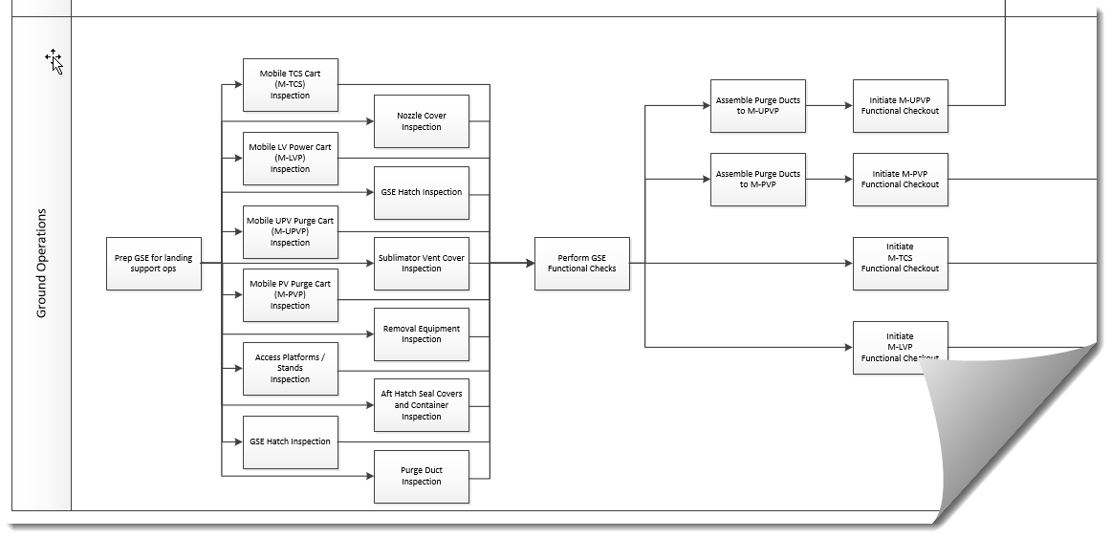
Applying SV-4 Functional Diagraming
An example of our application of SV-4 Diagram on our ground operations effort is shown here.
Graphic credited to Sierra Nevada Corporation

Slide 11
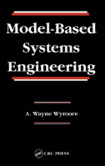
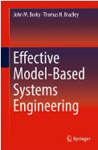
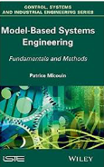
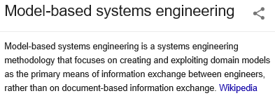
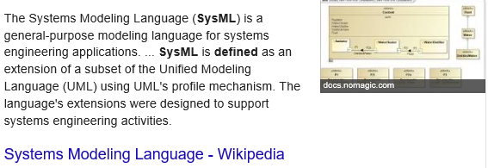
What is this thing called “MBSE”?
As the team was implementing the diagrams the idea of “MBSE” was introduced.
Model Based Systems Engineering – a new idea, the team was interested...
However, there was a limitation on resources and time, how could we do this quickly?
The team investigated the practice of MBSE and worked a tool trade between different modeling applications.

Slide 12
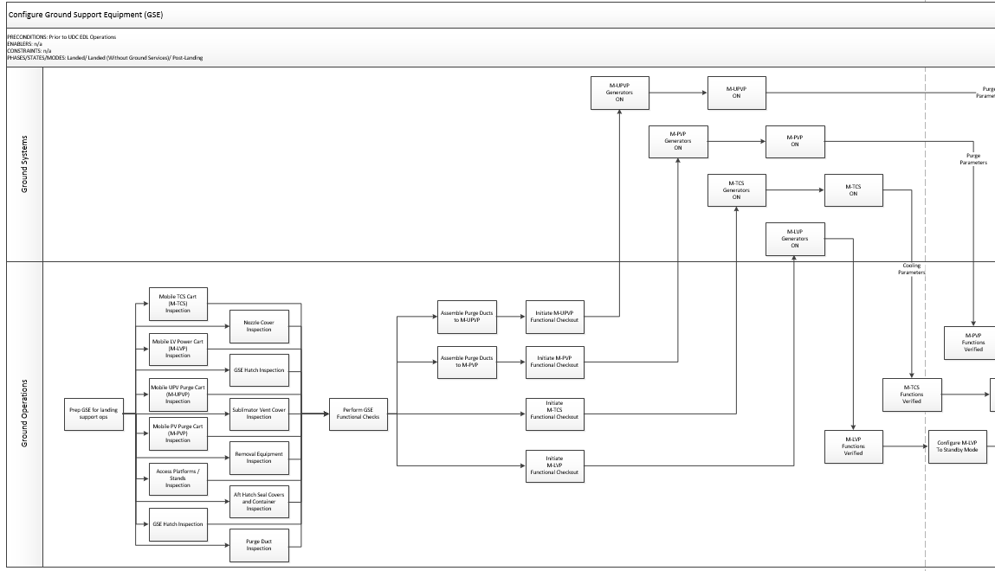
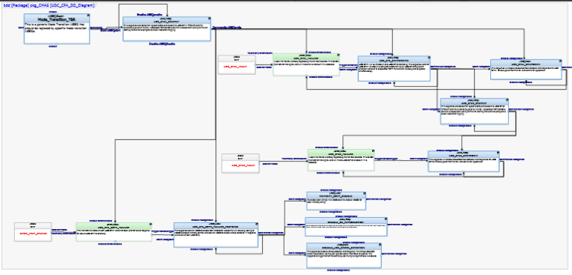
Steps Taken in Applying MBSE Efforts
A tool was purchased along with consultant help to ensure the team was trained in the SysML language and tool usage.
Diagrams were recreated in the modeling tool, and all of a sudden different view points could be seen, interactions uncovered and requirement traces to architecture could be made.
This initial effort was done by a small group of systems engineers, not enough to model the system, so more systems engineers were trained in the application to help out with the models.
Today, Dream Chaser has modeled its operational, functional and physical architecture, with focus on safety critical and hardware/software applications. Functions have been identified, and continued work is occurring to refine the hardware/software interactions to define software requirements.

Slide 13
MBSE Application Challenges and Lessons Learned
During the last couple of years the systems engineering team has made good progress in establishing a model of the Dream Chaser architecture.
Results are used in safety assessments, software development, requirement development, analysis of the behavior and interaction of the system elements.
While showing some benefit, there were several challenges towards getting to this point.

Slide 14
Concurrent Development Work While Learning MBSE
Defining the model structure while working the detailed design at the same time was the largest challenge to the effort.
While we had a tool expert to help us with nuances of SysML and tool usage, we were creating a unique model of our system and understanding the best approaches without formal training was a lot of trial and error.
There were some growing pains involved with scoping out the model and diagram structure while on a schedule for delivering resulting content to our customer.
The team was learning what worked to create the most effective diagrams as they went along, direction changes on how to implement items were very common the first month or two. They learned to have patience as new things were introduced.
The small team was able to share knowledge among each other to assist with keeping the project moving.
The initial effort was good, but not complete. The diagram structure and various linkages between diagrams, requirements and other project documents evolved for quite some time after the initial modeling effort began as the team started to understand what the modeling effort could really emulate (behaviors and interactions).

Slide 15
Adoption of the MBSE Concept in the Team
While creating our model we received some push back from people on the program who did not see the worth of the effort.
At first we really had to sell the benefit of the model to some of the program staff (both within systems engineering and in other organizations like hardware and software design).
We needed stakeholder involvement at many levels, and getting their attention to support this was challenging.
It was difficult to get support each time we tried to review/create a model diagram.
It took repeated, direct messaging through multiple forums to emphasize why we were working on the model and what the benefits would be.
At the last INCOSE International Workshop (IW2019), the INCOSE requirement working group had an information exchange on requirement work using MBSE, and the responses from organizations working MBSE for the first time were surprisingly similar – we were not alone in these challenges.
The key for all the companies was to have a management champion (funding tool and resources), as well as ability to work a smaller effort and display the benefits of that compared to older, document-centric approaches.

Slide 16
How Much to Model?
The three pillars of MBSE are to use a modeling language, a modeling tool and a modeling method. – Lenny Delligatti, SysML Distilled (recommended reading)
The modeling method is the roadmap of how the model will be constructed. While we had a modeling language and tool, the method was a bit ad hoc.
We had a rough idea on what would be modeled, but really learned as we started to create the model exactly how much we could model and meet our deliverables.
Ideally we would model the entire architecture, yet we knew we could not afford to spend those resources and effort and meet our other program due dates and deliverables.
Ultimately, we made the decision to create a system level model (functions and structure), subsystem functional models, and then a subset of the component functions based on criticality and need to support software development.

Slide 17
Parting Thoughts
When we have a chance to do this again on another project, some items we learned include:
Scope the work early and plan out the modeling method.
Understand the capability of the tool being used and decide which features will be used.
Try to define the structure of the model as clearly as is possible before beginning to model. (i.e. Do some thoughtful model method determination before starting the model.)
Decide if the model will be an executable version in SysML, how relationships within the model will be built (abstractions and domain dependencies and links), and how the model will map to program requirements
Set up a configuration management approach in advance.
We had single users at a time in the model – this is not workable on a large project!
Set up a common user access approach at the beginning of the effort.
Advertise early, advertise often.
The modeling effort will be most useful and successful when all groups working on the program understand the model and its uses/benefits. This is not an effort that can be undertaken by an SE team alone without the support of design, safety, and ops engineers as well.
Clearly advertising what the model is being used for, how it can be used as a resource for all teams, and problems that the model has helped identify and solve (there will be many of these!) will ensure that the modeling effort is successful and supported by the larger program team.
Models are a great communication tool.
Explaining how our system interacts and behaves with a model has proven useful to bring people up to speed.

Slide 18
Parting Thoughts
Modeling the functions is as import as modeling the physical elements of the system.
Much of the design team focused on the physical model, while the systems engineers focused on the functions needed and the behaviors – this allowed them to ensure the design was able to address the required functionality.
Tools have different features – determine what you need before selecting one.
We did a tool trade and found many of them comparable at first look. However, the more we used the tool, the more we realized we had need for features it did not perform.
While we did not know what we truly needed during the trade study, if we did it over again we would have taken time to research capabilities and functions most used in MBSE and made those parameters in our trade.
When teams understand the model and feel empowered to use it, the model can be used to integrate in ways not originally envisioned.
The more teams interact with the model, the more benefit they find and the more they understand how it can represent aspects of the system.
For example, the software development team now uses the model to help validate that software requirements are complete and identify Integration issues between software partitions. This was not part of the original vision, but if you build it, they will come!
The systems engineers working a system model had to learn areas not in their field of expertise.
Actually, this is quite common, and was a great learning opportunity!!

Slide 19
Questions??

