Slide 1
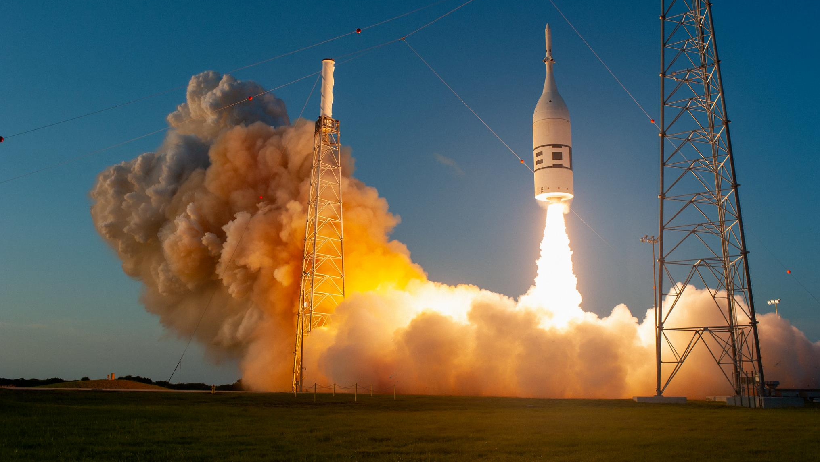




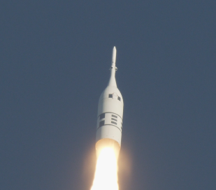
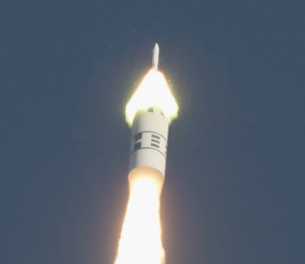
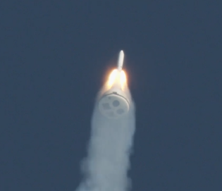
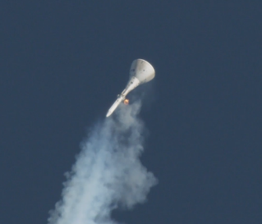
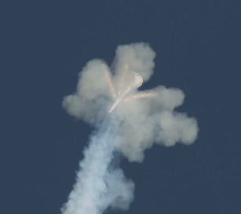
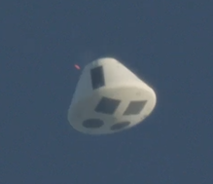
Orion Ascent Abort 2 Test – Benefits of a Digital Collaboration Environment
Jenny Devolites, AA-2 Project Manager and Test Conductor
Tony Williams, AA-2 Test & Verification Lead
October 10, 2019

Slide 2
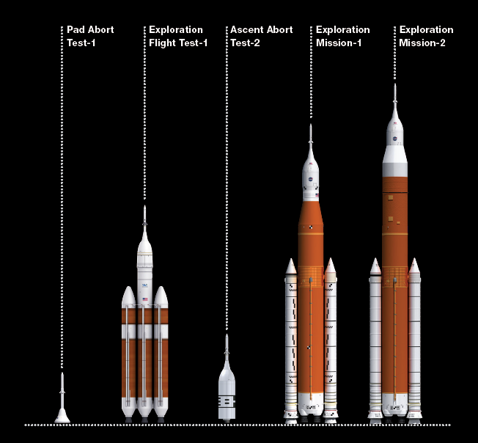
Orion Flight Testing and Near Term Missions
Artemis-1
Uncrewed
Artemis-2
Crewed
Artemis-3-
Human Lunar Landing
AA-2 demonstrated that Orion’s Launch Abort System (LAS) can safely separate and maneuver the Crew Module (CM) away from a launch vehicle during an abort in near‐transonic conditions.
AA-2 is the only planned flight test of the production Launch Abort System (LAS) before flying EM-2 with crew onboard.
Complete: 2010
Complete: 2014
Complete: July 2, 2019

Slide 3
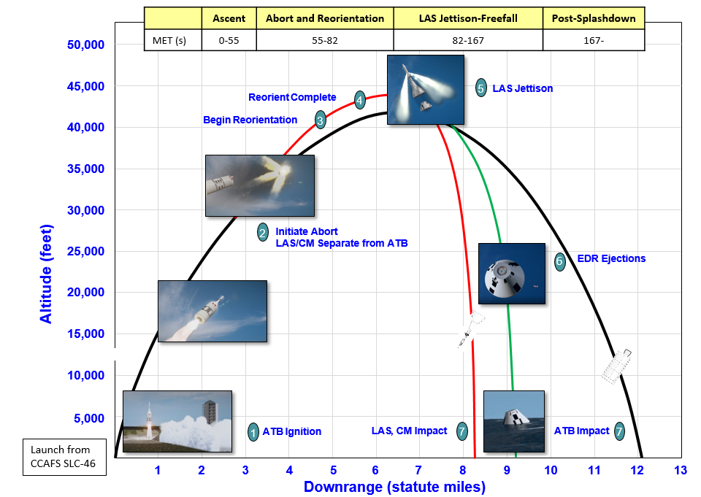
Orion Ascent Abort-2 – Reference Mission Characteristics
Purpose
  Demonstrate the abort hardware and software work together as planned
  Collect data from hundreds of sensors around the vehicle to further our understanding of this highly dynamic event
Target Test Condition for Abort Initiation
  Combination of Mach, Dynamic Pressure and Angle of Attack
  Predicted abort altitude ~29,000 feet
End of Test
  At the end of the test all elements impact the ocean
    No Parachutes
    No Recovery

Slide 4
The Flight Test – July 2, 2019

Slide 5
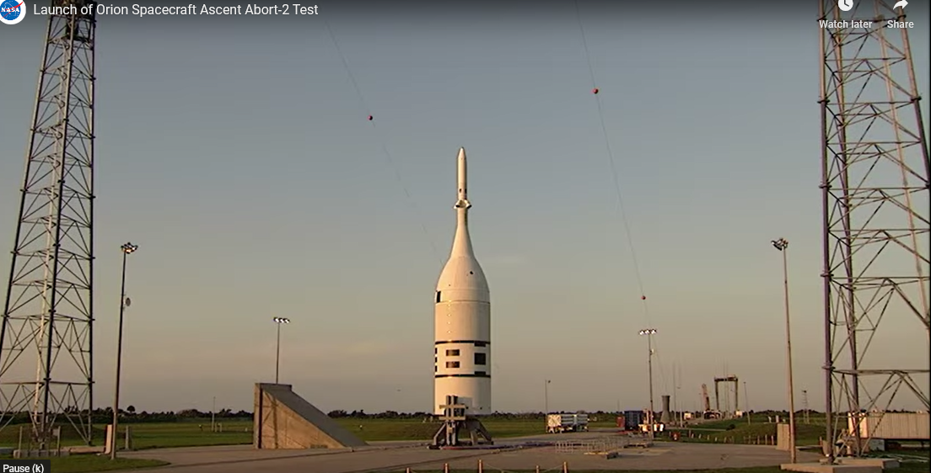


Slide 6


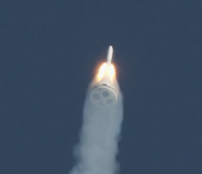
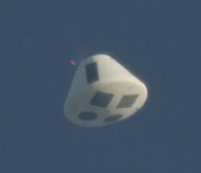
AA-2 Digital Environment Evolution: Starting with Morpheus Lander
From 2010-2014, NASA developed an in-house prototype lander for terrestrial demonstrations of key technologies: LOX-methane propulsion and autonomous precision landing and hazard avoidance
  Morpheus performed 63 flight tests at JSC and KSC: 12 static hot fires, 36 tether tests, and 15 free flights
  The final six free flights at KSC successfully reached an altitude of 245 m and traveled 406 m downrange to land safely in a hazard field (planetary surface analog)
This in-house development effort afforded the opportunity to explore innovative and streamlined ways of doing business, including using the SharePoint collaborative environment for project management and systems engineering processes and products
Several of the Morpheus team members, including project leadership, moved to the AA-2 CSR Project after Morpheus was complete, providing an opportunity to evaluate ways to “scale up” for a more rigorous project approach

Slide 7
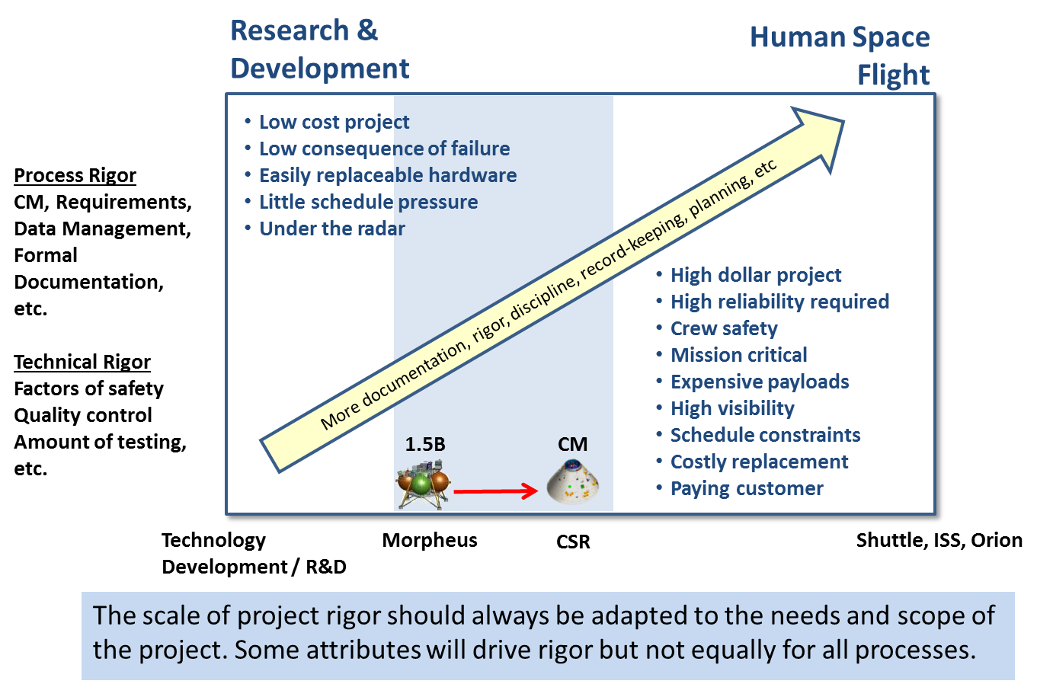
CSR Developed With Increased Rigor Compared To Morpheus
Orion’s AA-2 :
  Uncrewed flight test
  Inherently higher risk tolerance than human spaceflight
  High impact to the program if not successful
CSR built in-house at NASA
  Team encouraged to innovate
  Traditional institutional processes not mandatory as long as deliverables met requirements
Resulting risk approach
  Rigor and risk posture consistent with flight test
  CSR hardware handled as either flight or non-flight (classification)
  CSR flight software is Class B, safety critical, and leverages Goddard’s Core Flight Software
  Processes and tool use intended to be able to “scale up”

Slide 8
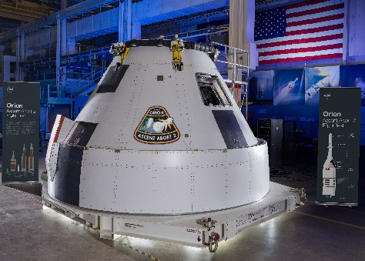
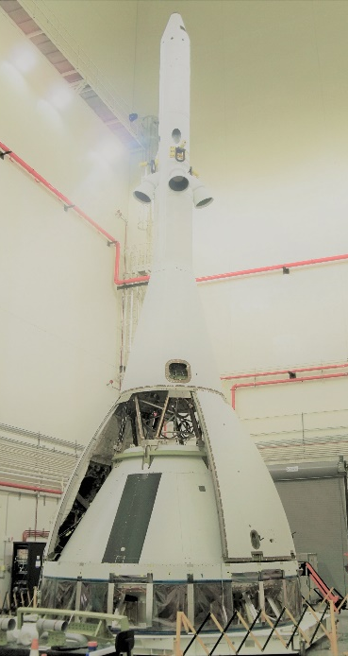
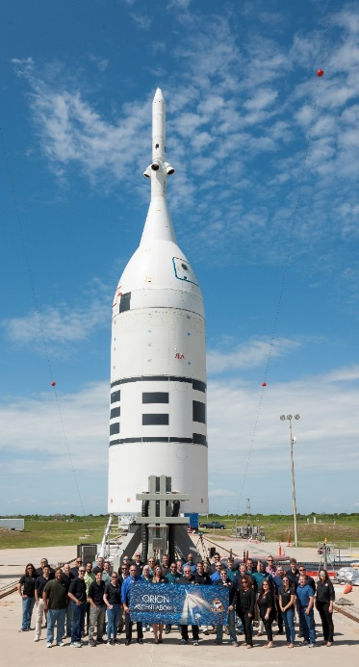

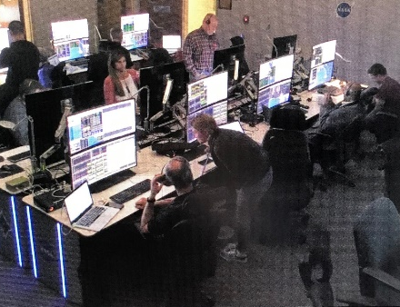
AA-2 CSR Delivered 6 Months Early and 2% Under Life Cycle Budget
AA-2 CSR (Total Lifecycle): <4 Years, Crew Module, Sep Ring, Control Center
2015 2016 2017 2018 2019
INITIAL PLAN OCT 2015
Kickoff
SRR
PDR
CDR
Ship to KSC
Launch
Subsystem DDT&E
CM and SR AI&T
KSC Int&Test
ACTUAL
Kickoff
SRR
PDR
CDR
Ship to KSC
Launch
Subsystem DDT&E
CM and SR AI&T
KSC Int&Test
PRODUCED:
  Fully integrated crew module, including structure, flight computers, power, instrumentation, communication, ejectable data recorders, wiring
  Fully integrated separation ring, including instrumentation and wiring
  Integrated the Lockheed Martin-provided production flight mechanisms and pyrotechnic components
  Provided and tested instrumentation components for the Launch Abort System and Abort Test Booster
  Created a hardware-in-the-loop test facility for closed-loop hardware/software and simulation testing
  Provided the mission control center hardware, software, procedures, and certified flight control team at KSC and CCAFS for integrated ground testing and flight operations

Slide 9
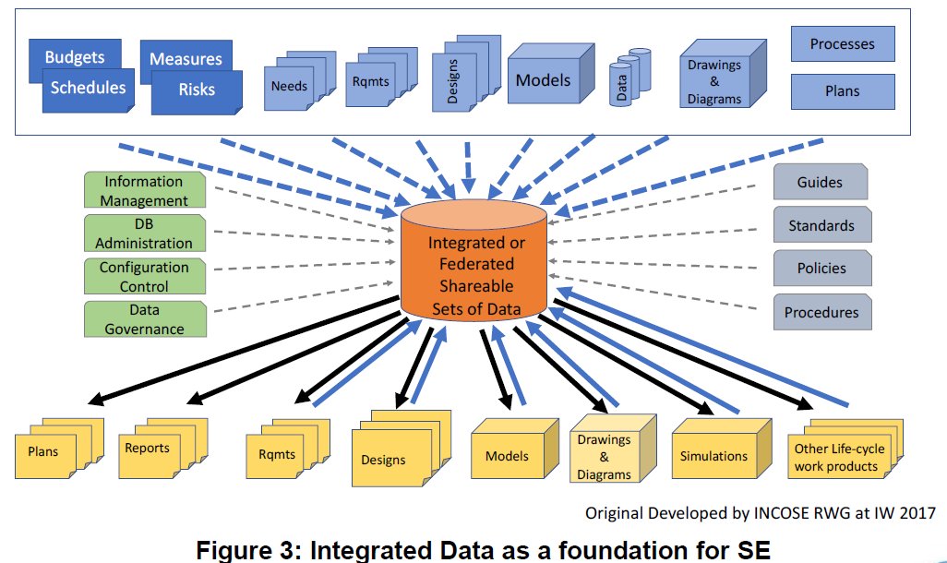
Integrated Data as a Foundation of SE
“The goal…is to have the capability to integrate PM and SE data and information into integrated (federated) shareable sets of data. …. These sets of data not only represent an architectural model of the system under development, but also a model of the system life cycle process activities and resulting work products that can be used to more effectively manage the system engineering efforts across all system life cycle stages. “
From: Integrated Data as a Foundation of Systems Engineering,
December 2018 - Whitepaper by the INCOSE Requirements Working Group

Slide 10
Data Centric SE&I Environment Enabled Linkages Among Traditional SE Data And Beyond
Systems Engineering Data
PM Data
RVTM
(L2 Requirements, Verification Tracking
Staffing*
Meetings
Verification Closures
Task Content
Schedules
Travel Support*
Budgets
Functions
Implemented by
Verification Requirements
Requirements (L3/L4)
Controlled Storage List
Interfaces
Specified by
Implemented by
Issues
Test/Verification Activity
Peer Reviews
Actions*
Performs
Master Equipment List
News Items
Employs
Public Affairs Items
Milestones*
Verified by
TPS
Creates
Many links
Architectures
TBX
Budgets*
Documents
Waivers
Test Configurations
Discrepancies
Results in
Sources
Change Requests
Representative – many more data types actually used
Hazards
Risks
Run Matrix
LCR RFAs
Causes
Controls
Verified by
Life Cycle Review Criteria
*Indicates multiple lists

Slide 11
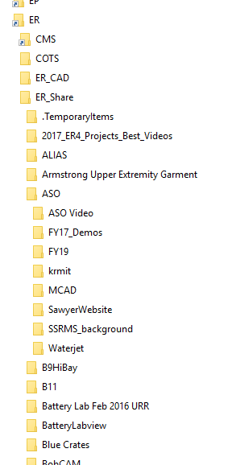
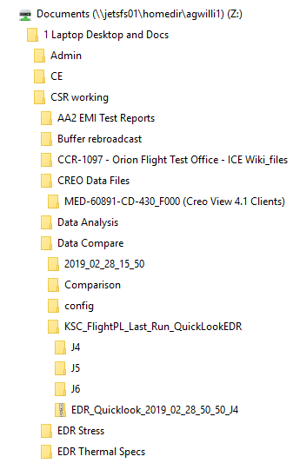
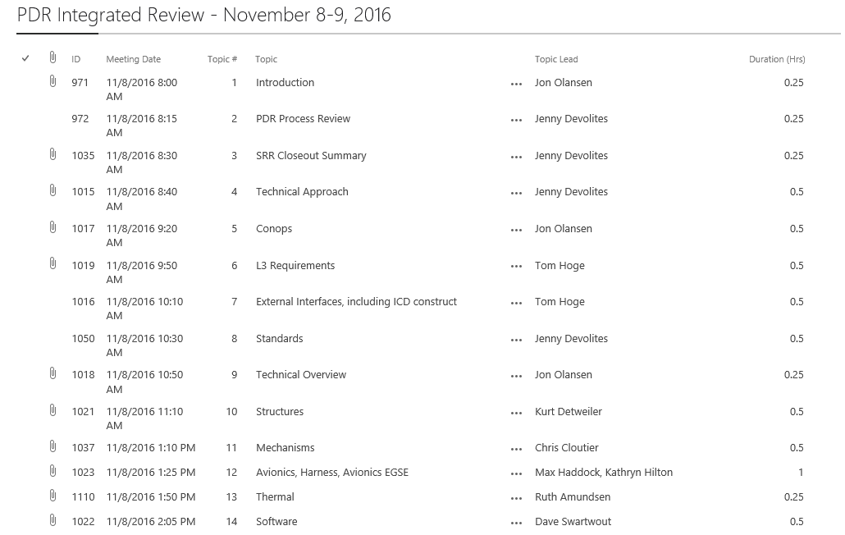
Data-Centric SE&I & PM Collaborative Environment
Typical file server data management schema degrades towards more chaos over time (entropy).
Documents are a limited and only represent a fixed selection of data items.
SharePoint lists take advantage of “metadata” – the principle that every data item has multiple fields, uses, and relationships to other data items

Slide 12
Significant Levels of Collaboration Provided by SharePoint Depending on Deployment Approach
Level 1:
Organize
documents
Level 2: Communicate from management to broader team
Level 3: Small subset of team members manage project data in collaborative environment
Level 4: Technical team
collaborates on data products
More use of the tool’s collaborative capabilities across the team
The team can benefit from any level of implementation, but the higher levels have the team members interacting directly in the collaborative environment, and owning their own data items

Slide 13
Implementation Alternatives for Effective Collaboration – Levels
Key Area for Success
Purpose | High Value | SharePoint Needs | Management Actions | Example Lists to Implement
Level 1: Organize project documents | Organize in key lists with metadata instead of folders | Staff trained on the basics of lists, access control, pages. No special skills. | Leaders are trained in SharePoint basics and advocate for use. | Meeting List Master Product Library
Level 2: Communicate from management to broader team | Use web page portals for project information, including embedded lists. | Same as above plus page development. Needs an engineering lead to determine value-added content. No special skills. | Leaders have mindset for establishing content, and are capable of implementing content themselves. | Weekly Portal: News, Decision Log, Calendar, Actions, Products Under Review, Controlled Milestones Project Plans
Level 3: Small subset of team members manage project data in collaborative environment | Authoritative source available in collaborative environment. Access always available by team. | Same as above. No special skills. May use SharePoint developer for some special features, but primarily out of the box. | Leaders understand application of PM and SE&I to SharePoint. Leaders are fluent in adding, reviewing and editing data. Able to apply appropriate level of rigor for project processes. | MEL / PEL / TEL Requirements, incl. Traceability Matrix Activity Log Change Requests Major Reviews Hazards
Level 4: Technical team collaborates on data products | Team members are responsible for their data. Fast collaboration on integrated products. | Same as above. | Leaders provide training to team over project life cycle and set expectations for use. Constructs are owned by team members who monitor and review . | Discrepancies Test Log, Run Matrix

Slide 14
Examples
Joint Development for a Master Equipment List
Creating a Spec for SRR
Integrating Data for CDR
Verification Planning & Closure

Slide 15
Data Elements used in MEL
Systems Engineering Data
PM Data
RVTM
(L2 Requirements, Verification Tracking
Staffing*
Meetings
Verification Closures
Task Content
Schedules
Travel Support*
Budgets
Functions
Implemented by
Verification Requirements
Requirements (L3/L4)
Controlled Storage List
Interfaces
Specified by
Implemented by
Issues
Test/Verification Activity
Peer Reviews
Actions*
Performs
Master Equipment List
News Items
Employs
Public Affairs Items
Milestones*
Verified by
TPS
Creates
Many links
Architectures
TBX
Budgets*
Documents
Waivers
Test Configurations
Discrepancies
Results in
Sources
Change Requests
Representative – many more data types actually used
Hazards
Risks
Run Matrix
LCR RFAs
Causes
Controls
Verified by
Life Cycle Review Criteria
*Indicates multiple lists

Slide 16
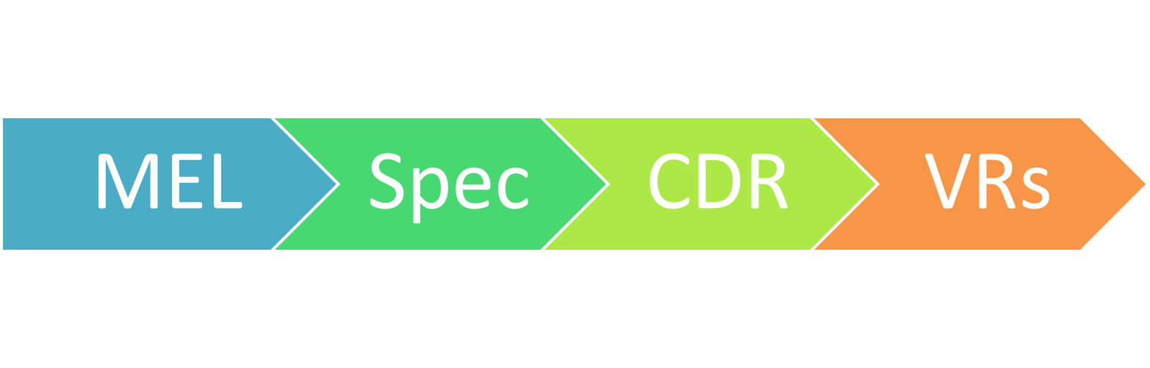
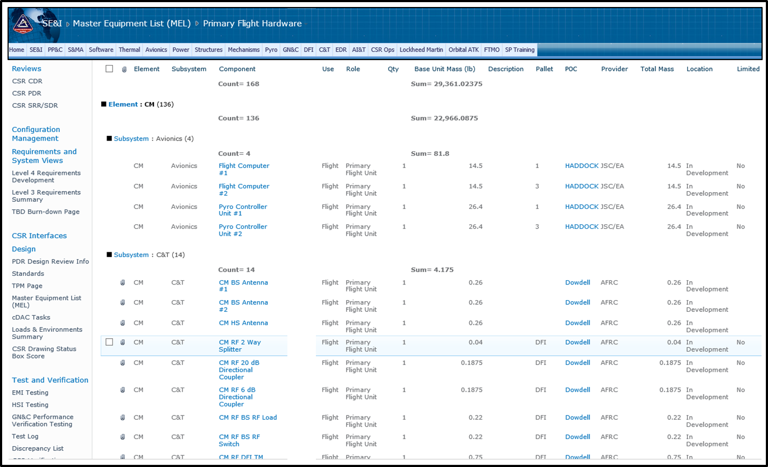
CSR Collaborative Environment
Foundation: Master Equipment List
Tracking: Mass, Location, Power Usage, Status
Multiple Simultaneous Collaborators
Multiple Simultaneous Collaborators

Slide 17
Data Elements used in Specifications
Systems Engineering Data
PM Data
RVTM
(L2 Requirements, Verification Tracking
Staffing*
Meetings
Verification Closures
Task Content
Schedules
Functions
Verification Requirements
Travel Support*
Budgets
Implemented by
Requirements (L3/L4)
Implemented by
Controlled Storage List
Interfaces
Specified by
Issues
Test/Verification Activity
Peer Reviews
News Items
Actions*
Performs
Master Equipment List
Employs
Public Affairs Items
Milestones*
Verified by
TPS
Creates
Many links
Architectures
TBX
Budgets*
Documents
Waivers
Test Configurations
Discrepancies
Results in
Sources
Change Requests
Representative – many more data types actually used
Hazards
Risks
Run Matrix
LCR RFAs
Causes
Controls
Verified by
Life Cycle Review Criteria
*Indicates multiple lists

Slide 18
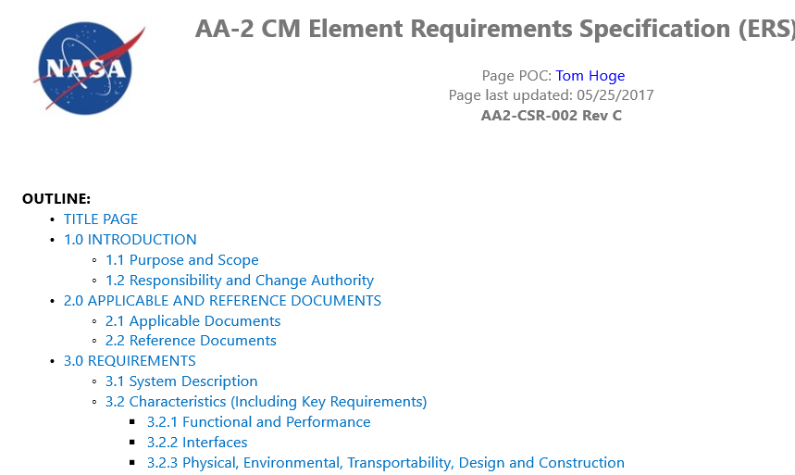
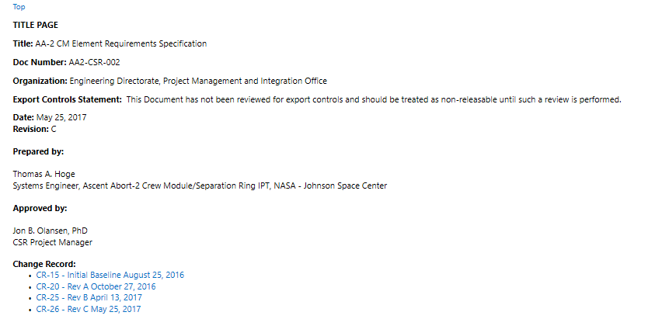
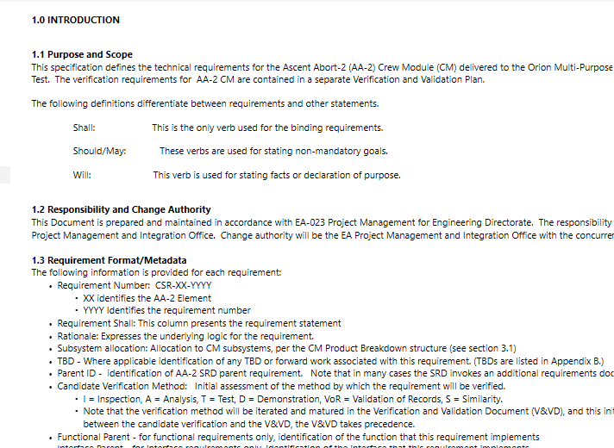
Requirements Specification
Front Matter – Web Content
TOC
TITLE PAGE
INTRO TEXT

Slide 19
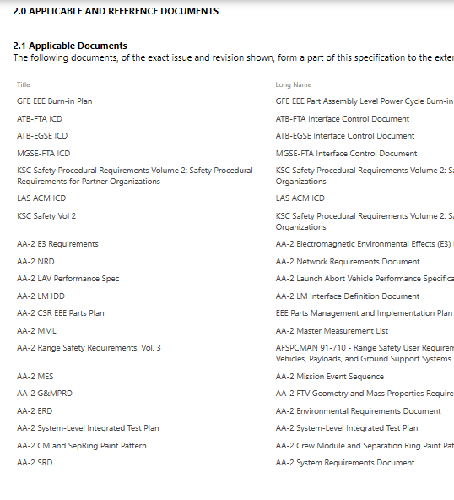
Requirements Specification
REFERENCES
References – Filtered view of Document List (data)

Slide 20
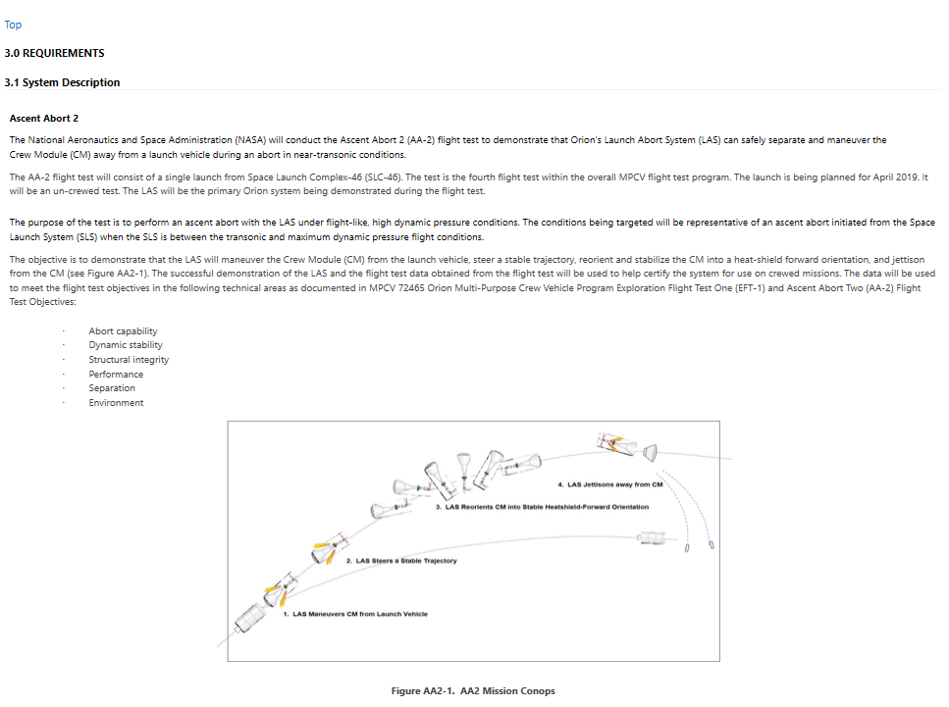
Requirements Specification
SYSTEM DESCRIPTION
System Description – Filtered view of Architecture list (data)

Slide 21
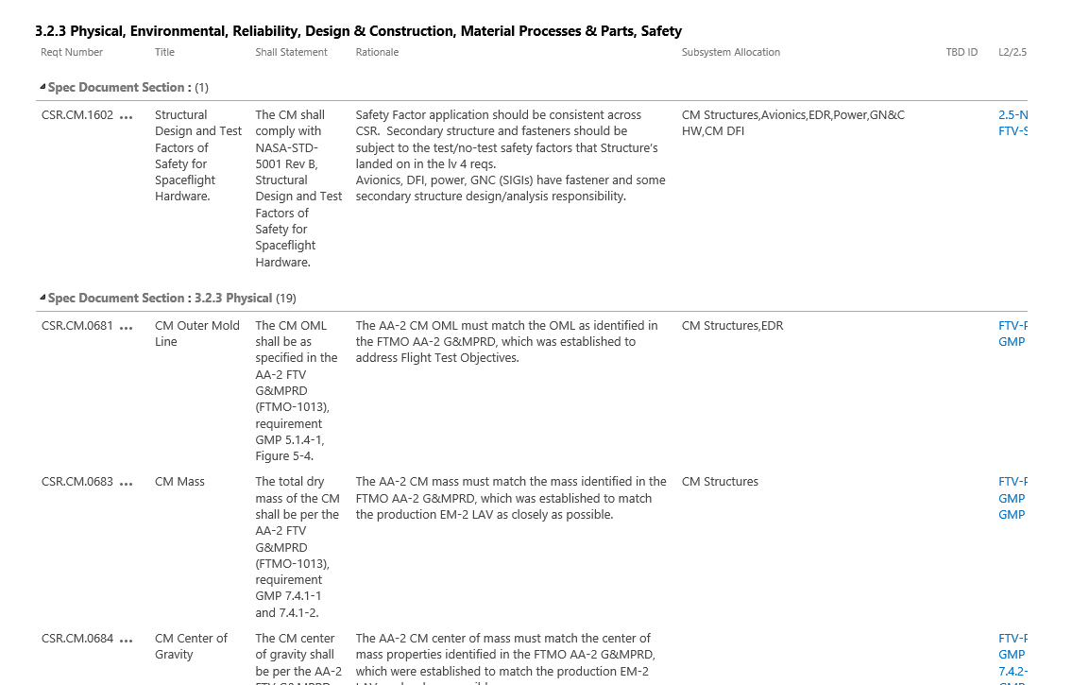
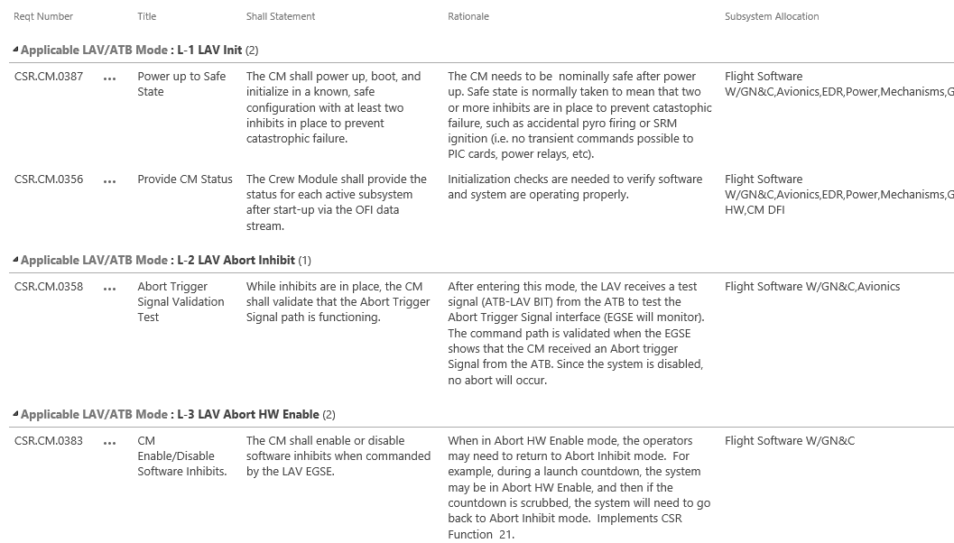
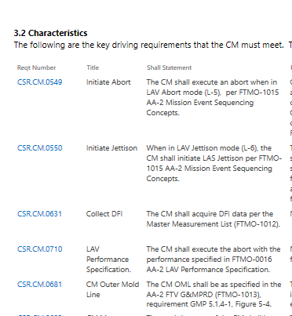
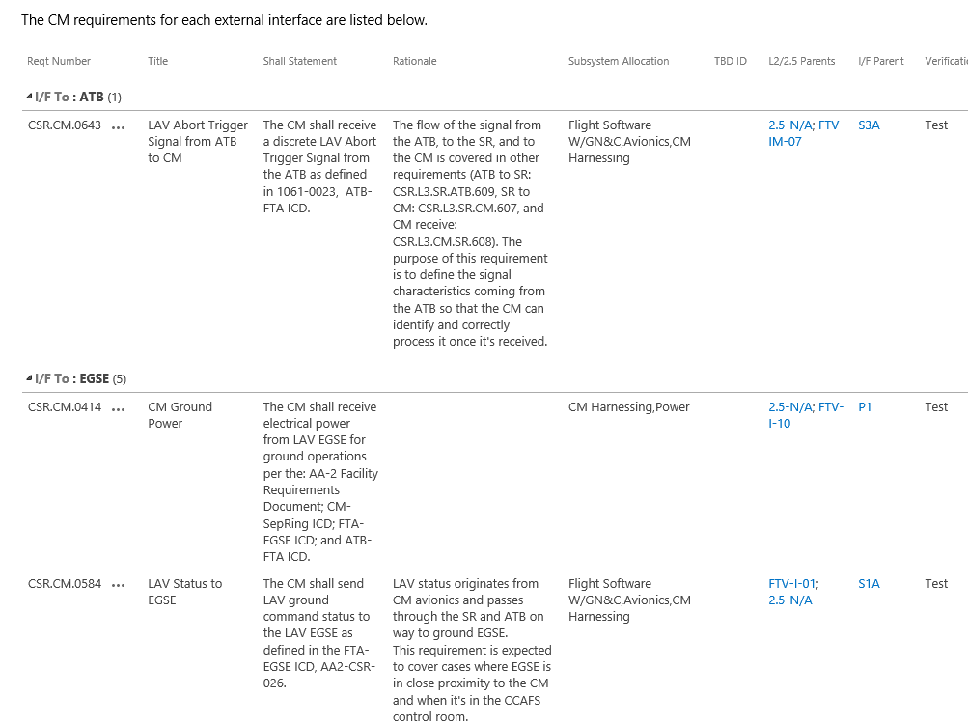
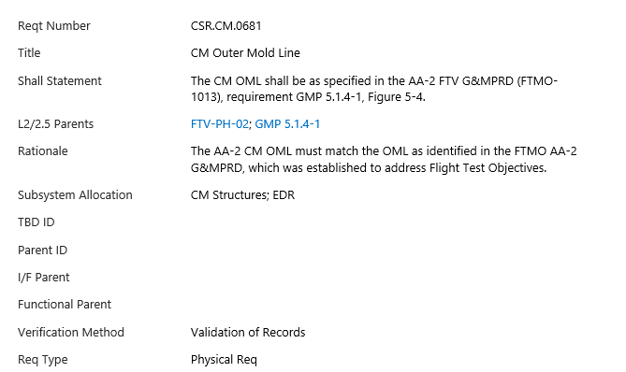
Requirements Specification
DESIGN REQUIREMENTS
INTERFACE REQUIREMENTS
KEY REQUIREMENTS
FUNCTIONAL REQUIREMENTS
REQUIREMENT DETAIL
Multiple Filtered Views from Requirements List
(data)
Note: Use slide show to properly view

Slide 22
Data Elements used in Design Review
Systems Engineering Data
PM Data
RVTM
(L2 Requirements, Verification Tracking
Staffing*
Meetings
Verification Closures
Task Content
Schedules
Functions
Verification Requirements
Travel Support*
Budgets
Implemented by
Requirements (L3/L4)
Implemented by
Controlled Storage List
Interfaces
Specified by
Issues
Test/Verification Activity
Peer Reviews
News Items
Actions*
Performs
Master Equipment List
Employs
Public Affairs Items
Milestones*
Verified by
TPS
Creates
Many links
Architectures
TBX
Budgets*
Documents
Waivers
Test Configurations
Discrepancies
Results in
Sources
Change Requests
Representative – many more data types actually used
Hazards
Risks
Run Matrix
LCR RFAs
Causes
Controls
Verified by
Life Cycle Review Criteria
*Indicates multiple lists

Slide 23
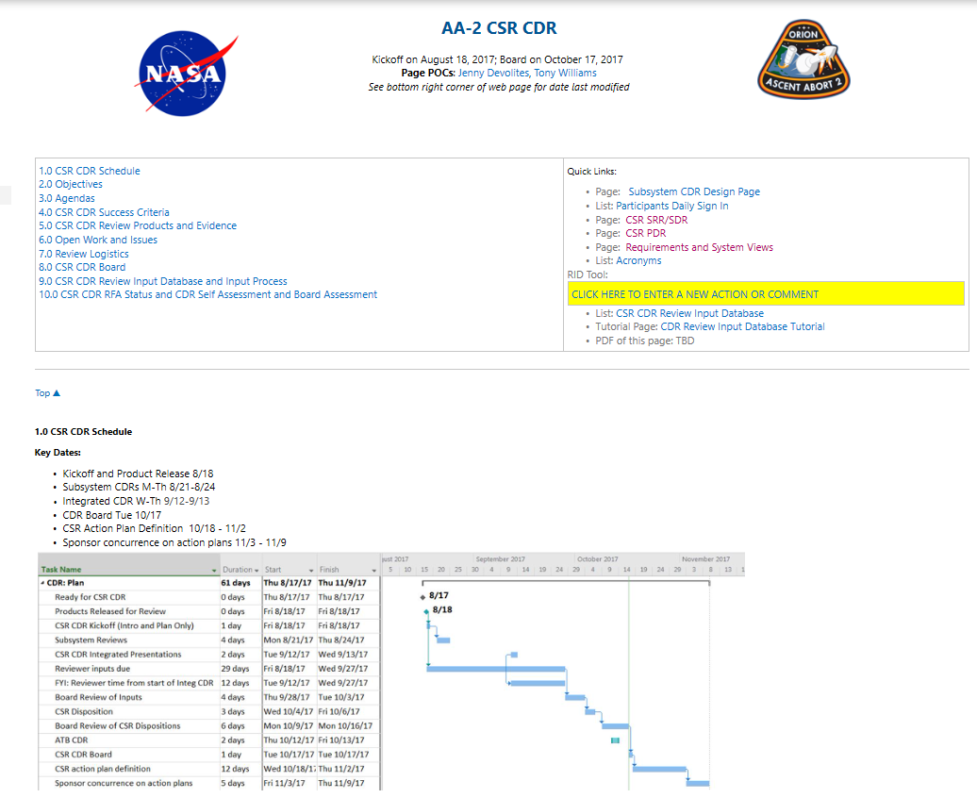
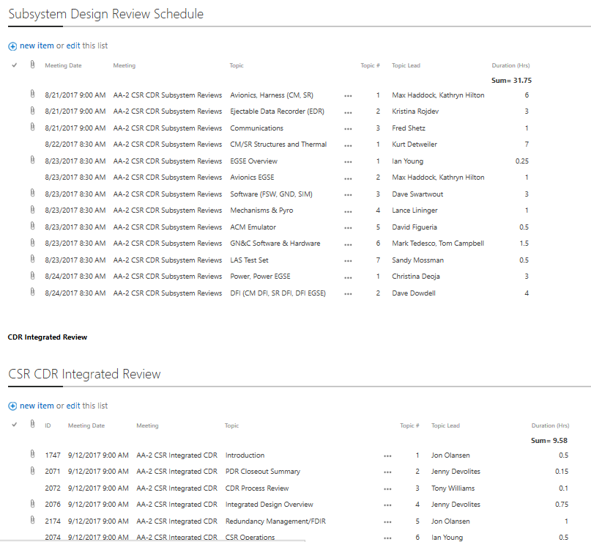
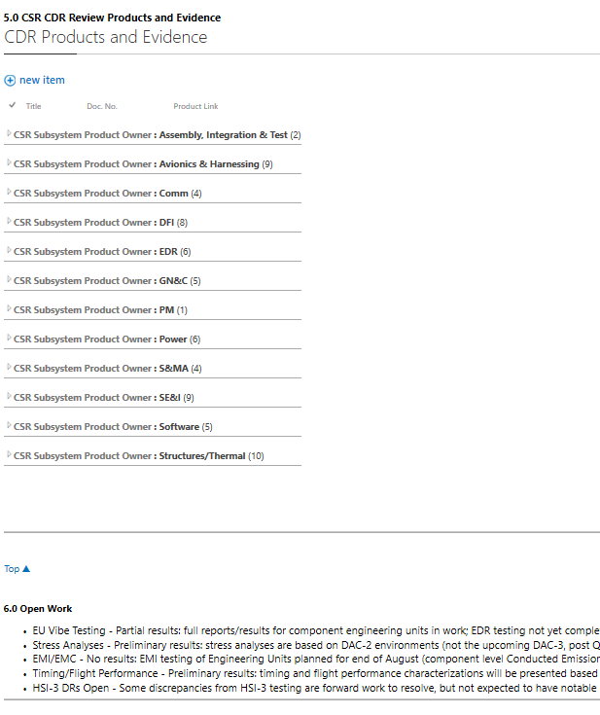
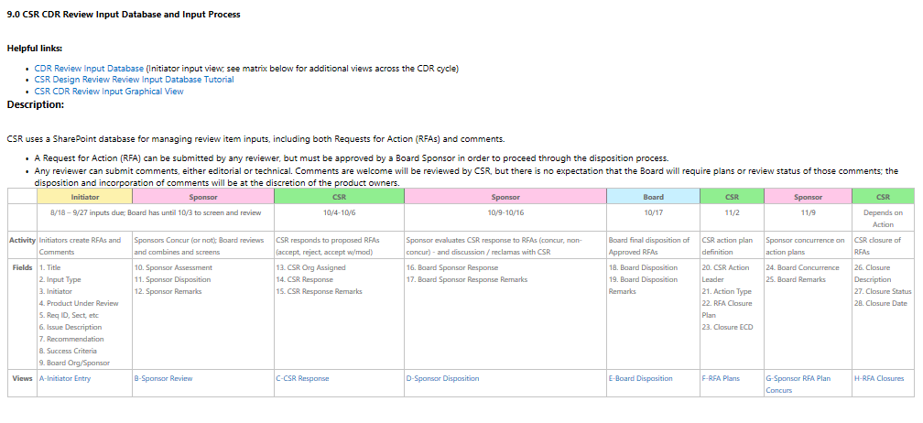
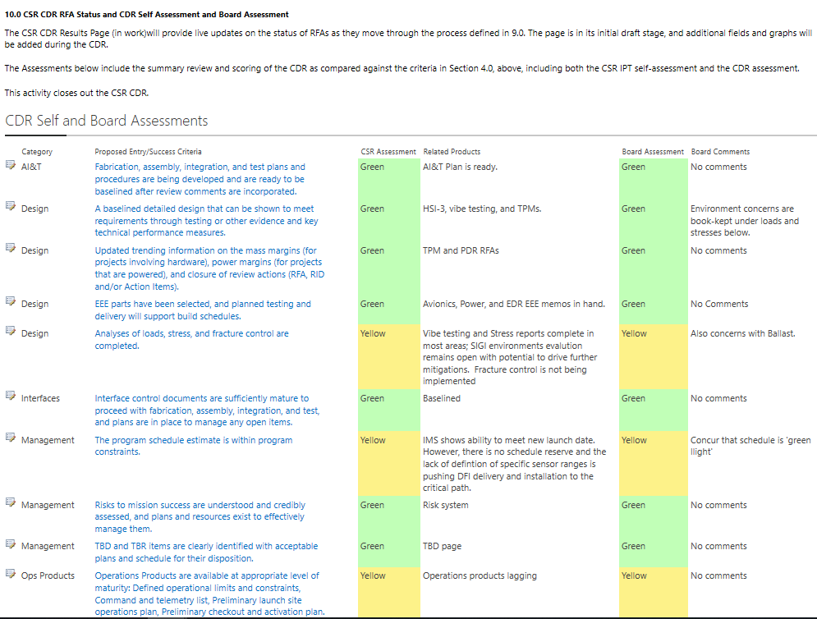
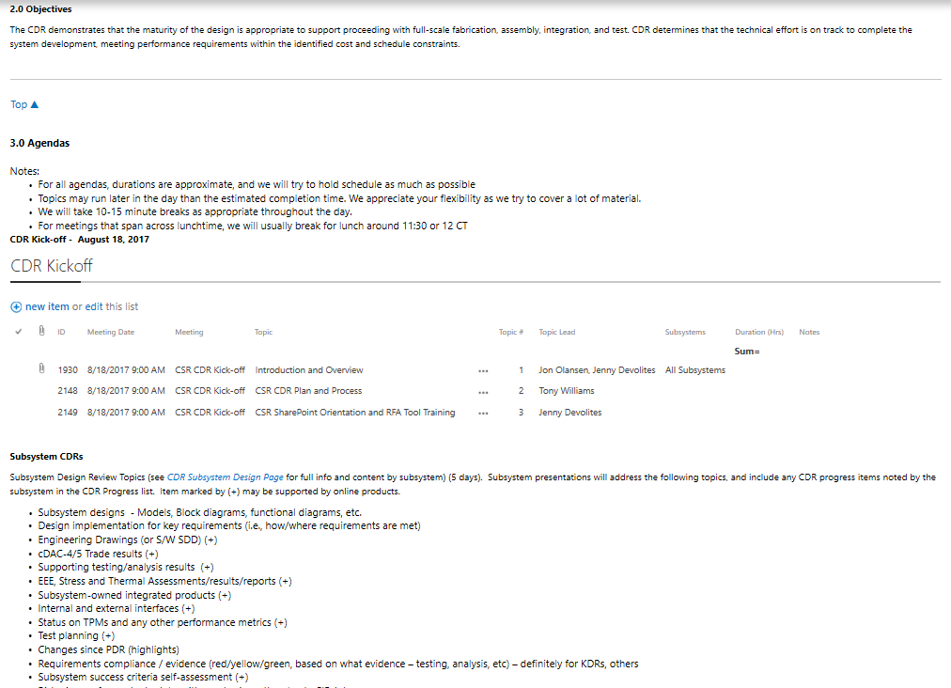
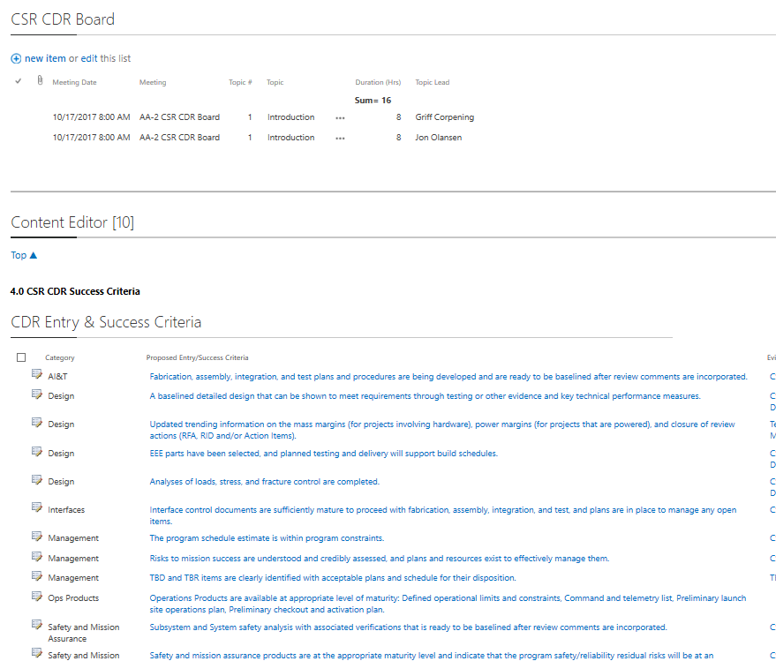
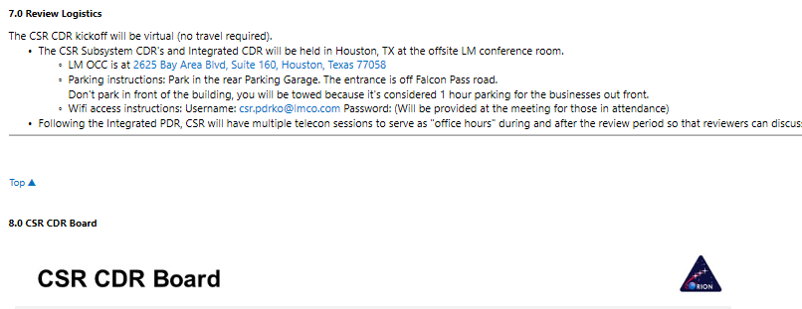
Critical Design Review Portal
This is all on a single web page
Index (web content)
Schedule (graphic)
Products for review (total of 70) (data)
Review Comments Database (data)
List of Open Work (data)
Agendas
Agendas (data)
Agendas
Review Board Membership (web content)
Assessments – Project Team and Review Board (data)
Entry and Exit Criteria (data)

Slide 24
Data Elements used in Verification Planning and Closure
Systems Engineering Data
PM Data
RVTM
(L2 Requirements, Verification Tracking
Staffing*
Meetings
Verification Closures
Task Content
Schedules
Functions
Verification Requirements
Travel Support*
Budgets
Implemented by
Requirements (L3/L4)
Implemented by
Controlled Storage List
Interfaces
Specified by
Issues
Test/Verification Activity
Peer Reviews
News Items
Actions*
Performs
Master Equipment List
Employs
Public Affairs Items
Milestones*
Verified by
TPS
Creates
Many links
Architectures
TBX
Budgets*
Documents
Waivers
Test Configurations
Discrepancies
Results in
Sources
Change Requests
Representative – many more data types actually used
Hazards
Risks
Run Matrix
LCR RFAs
Causes
Controls
Verified by
Life Cycle Review Criteria
*Indicates multiple lists

Slide 25
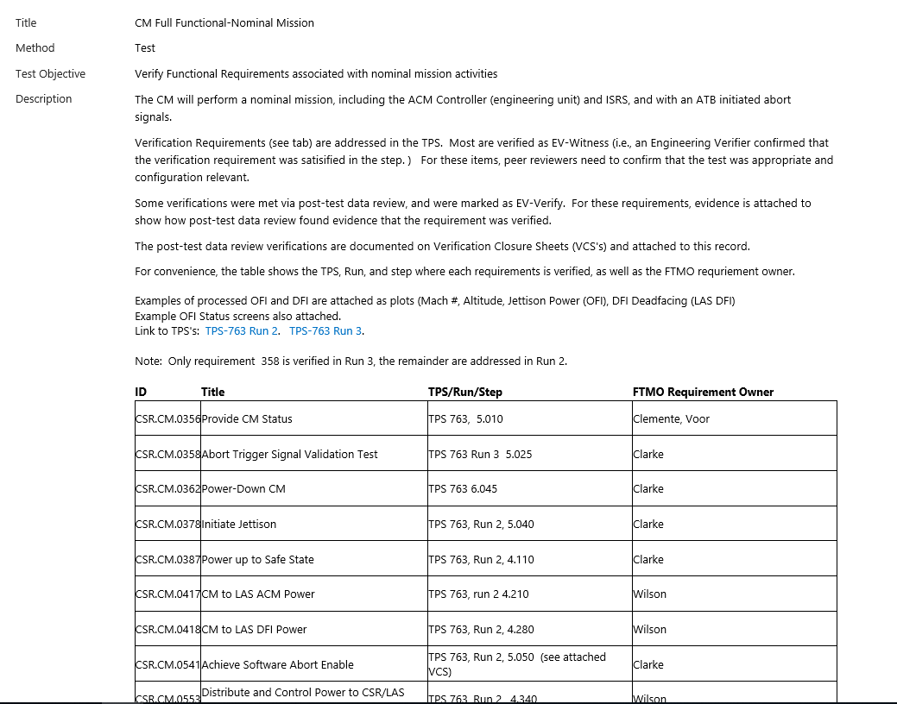
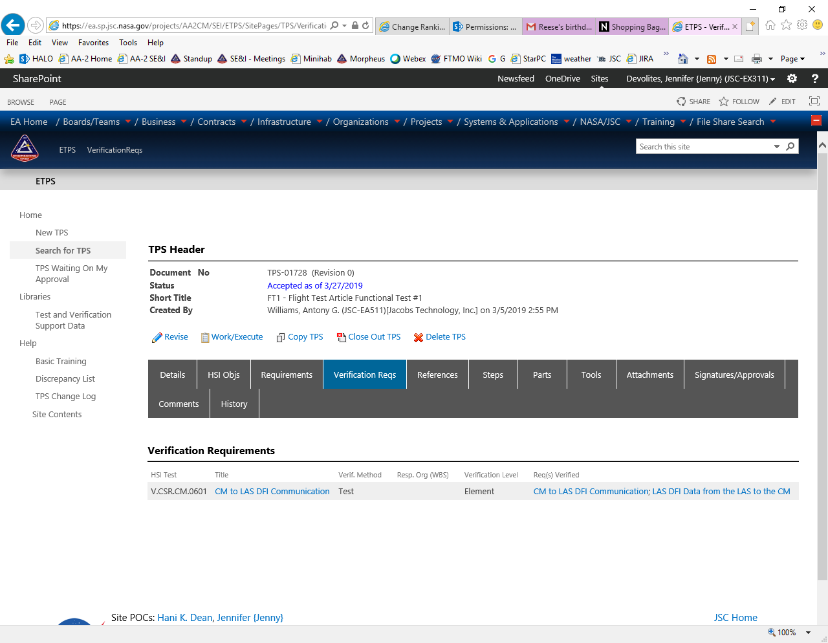
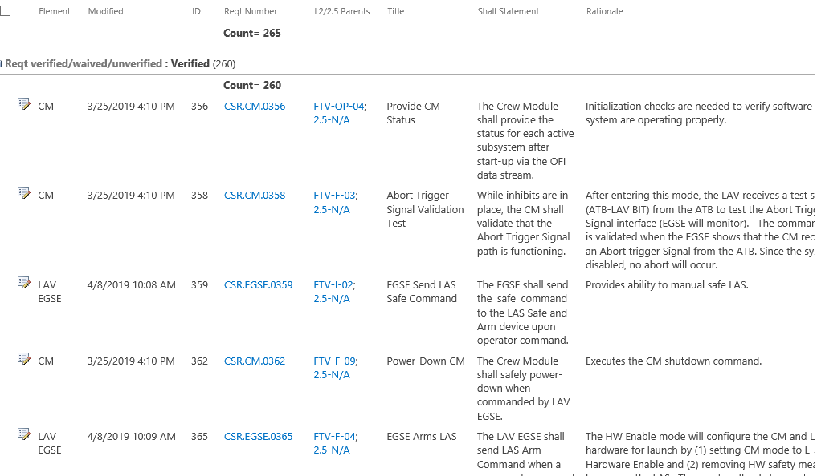
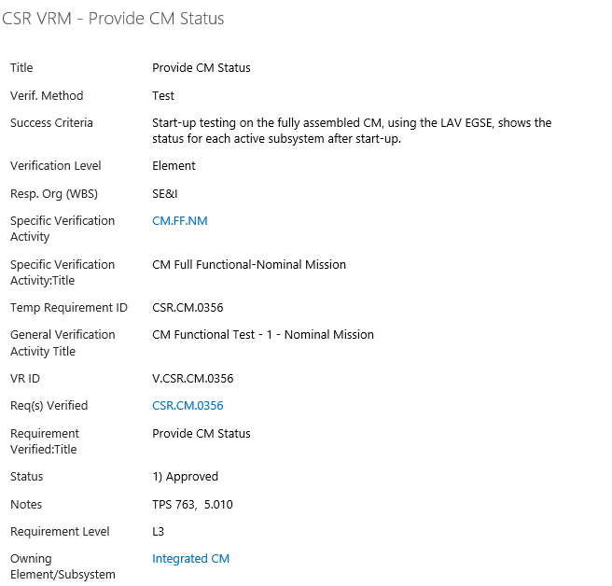
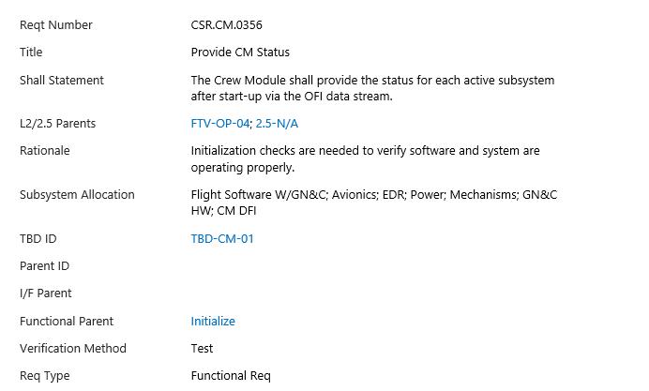
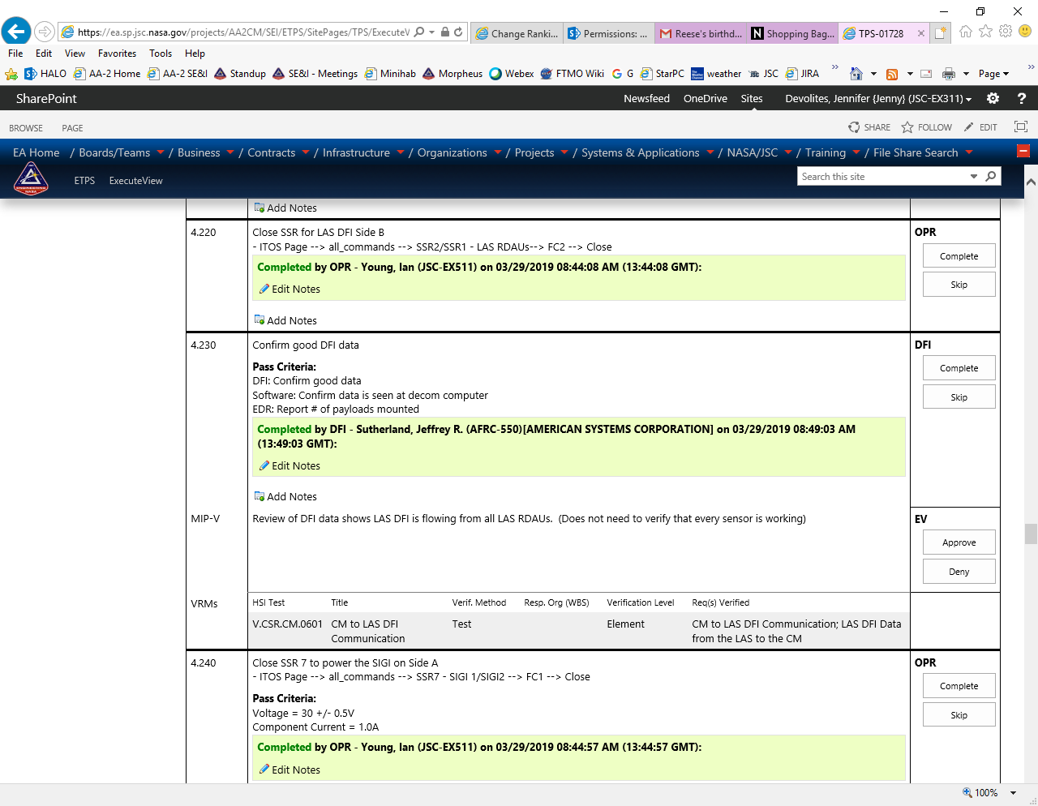
CSR Collaborative Environment
Foundation: Requirements & Verifications
TPS DEFINITION
VERIFICATION ACTIVITY
VERIFICATION REQUIREMENT
REQUIREMENTS LIST
REQUIREMENT DETAIL
TPS STEPS

Slide 26
Benefits of SharePoint for Projects
No more collating spreadsheets!! (So prone to error, and loss of insight into who made changes when)
Huge amount of capability without programming (OOTB – Out of the Box)
Minimizes need for specialized tools (RID tool, action item tool, requirements tool)
End-user training is straight-forward; every list is still just a list (not a different tool)
Database architecture without any special skills
Ability to create linked relationships between data items (no true bi-directional linking, which is a downside)
Has sites and sub-sites so can be easily used for project hierarchical team management
Every change can be tagged with who made it (and when)
Changes can have owners that approve them
Users can elect to be emailed when changes are made to items (or it can be forced upon them)
Easy to manage access roster and permissions (*within NASA NDC domain)
Good for not knowing everything you’ll ever need at the start, because lists and fields are easy to add or modify at any time
View information in its native environment (not by generating documents and reports)
Authoritative source is a list, not a document on someone’s hard drive or shared drive
Implement with as little or as much rigor as you need
Collaborative online editing of Word and PowerPoint (like Google Docs)

Slide 27
Challenges and Solutions
Challenge | Solutions/Options/Recommendations
Buy in – at first some communities were slow to adopt, but eventually every team member was proficient | Training Management commitment
House-keeping/Data Currency/Config Management | Use of automated triggers to identify stale data and notify data owners
Trying to ‘fake’ a full relational database | Use of custom back-end code – project-process dependent
Dependence on an ‘administrative’ data environment as your project operations tool – reliability issues | Coordination with SP administrators and operators – potentially additional funding to ensure proper support
Also need to ensure, on ongoing basis, that collaborating organizations and contractors maintain easy access | Ongoing training and communications

Slide 28
Conclusions
For AA-2, the SP Collaboration as a Systems Engineering environment was successful, providing team the ‘right’ level of rigor while also providing flexibility needed for an aggressive schedule
  Stretched the Morpheus implementation, including all SE&I data elements
  Implemented the Integrated Data concept connecting SE&I data with itself and PM data
  Provided Product Lifecycle Management (PLM) at the data element level (rather than product level)
New projects at JSC are looking at SP for their needs already
Sharepoint provides flexible environment with ability to scale rigor as needed
  Access controls defined by usage, owned by project users (not admins)
Custom applications and reports added critical needed capability without significant software development and maintenance overhead:
    Bi-directional traceability
    Procedure development

Slide 29
Backups

Slide 30
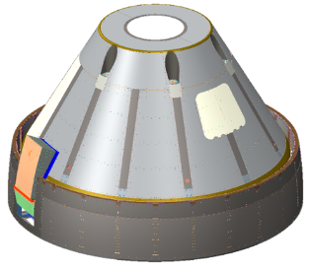
Collaborative Environment: Project Data Layers
Operations
Funding
UP & OUT LAYER
DIRECTION
Integration
Constraints
Cost
Risks
REPORTING
Req.
Directives
Schedule
Technical
PM/SE&I LAYER
Meetings
Decisions
Schedules
Req.
T&V Plans
CM
MANAGEMENT
Actions
Spending
Margin Mgmt
Risks & issues
Quality
DRs
SUBSYSTEM INTEGRATION LAYER
MEL
PEL
TEL
MWSL
Flt I/O
MML
Hazards
FMEA/SPF
ICDs
TPMs
CDD
CAD
END ITEM DEFINITION
Trajectory
Test Results
Analysis Results
Mass Props
Drawings & Schem.
END ITEMS
Physical End Items
(HW, SW, etc)
Notes:
Not meant to represent Level 2, 3, 4 per our project hierarchy; although the top layer includes L2 and our other customers
The arrows on each layer are just representative of relationships – not meant to be all-inclusive (or even fully applicable depending on project)
Our SharePoint environment is valuable for the PM/SE&I Layer and offers some integration with the bottom layer
For most projects, there is a large amount of information to manage, and much of it is interrelated. Efficiency and quality both benefit from (1) reducing the number of places that information must be updated, and (2) providing relational links between “authoritative” data sources

Slide 31
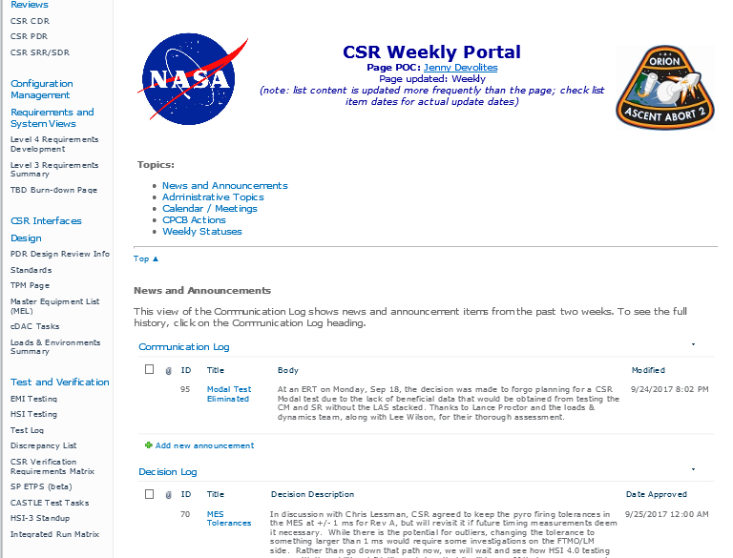
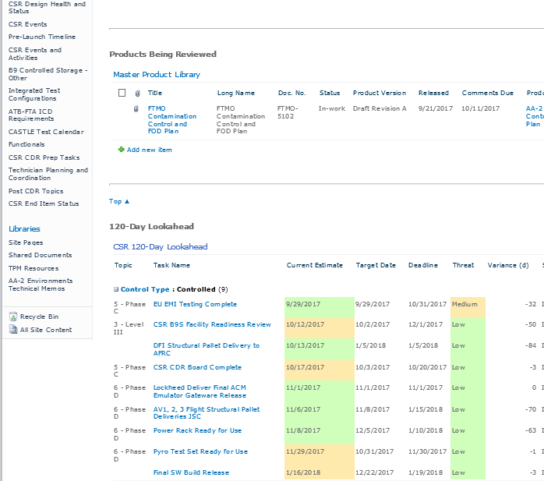



Weekly Portal
This is all on a single web page
Products in Review (internal or external)
This is a filtered view of the Master Product Library (not a separate list)
News and Announcements
Controlled Milestones are color-coded based on proximity to deadline
Decision Log
Weekly meetings +
Leave calendar at the top
Different views of action lists
Weekly Portal is the one-stop shop for team weekly status and planning
All content is available for participants and as a record
The lists keep full chronological records
Reduces need to enter same information in multiple places
Similar portal constructs: Milestone Review Portals, Test Activities
SEIWG and Board Agendas
Team members enter weekly statuses. Great for management roll-ups.
Top Issues (weekly updates)

Slide 32






List Linkages Example
TPS DEFINITION
INTEGRATED RUN MATRIX
VERIF REQ MATRIX
REQUIREMENT LIST
TPS STEPS
INTERFACE LIST
DISCREPANCY LIST

Slide 33

eTPS
(Procedures Tool)
TPS DEFINITION
Custom development using SP capabilities
Usage approach involved extensive conversations with users and quality community
Basically emulates paper procedures but maintains ability to link data elements from within SP (example – can link to requirements that are to be verified by TPS)
Allowed TPS online step check-off by multiple simultaneous users, tablet compatible, authenticated by user logon credentials
Usage:
  Hardware in the Loop Testing procedures
  Ejectable Data Recorder (EDR) fabrication, assembly, hardware handling, and test
  Vehicle-level Assembly and Integration
  Vehicle-level Integration and Verification Testing
  Kennedy Space Center Integration testing (stand-alone and with other elements)
  Day of Launch CSR Countdown Procedure
CSR TPS Library
TPS STEPS
TPS LIST
Tony

