Slide 1








INCOSE Three Rivers Chapter
Quarterly Update
Tues Aug 31, 2021
7:00 - 8:00 PM EST

Slide 2


Tonight’s Agenda
2021 Interim Board and Introductions
Talking Events and Regional Engagement
Upcoming Talks
Future Lunch and Learn
Things in the Pipeline
Finances

Slide 3
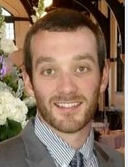
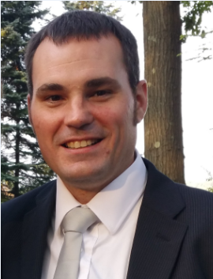
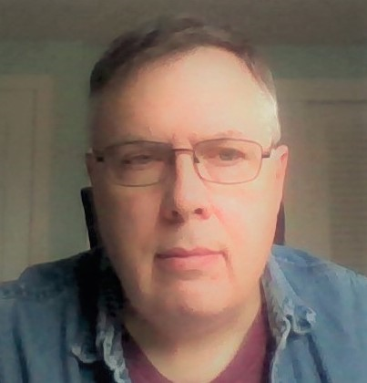
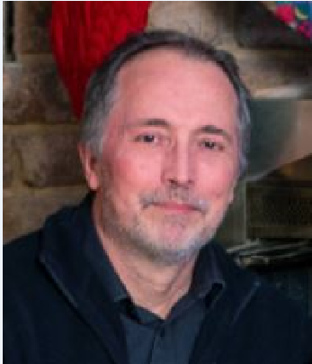
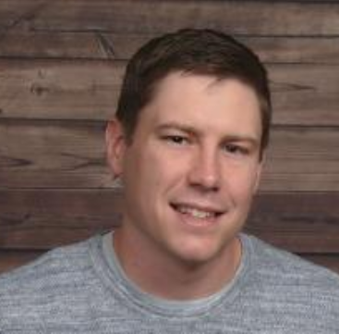
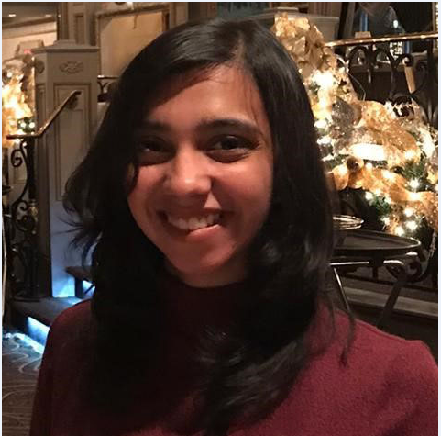
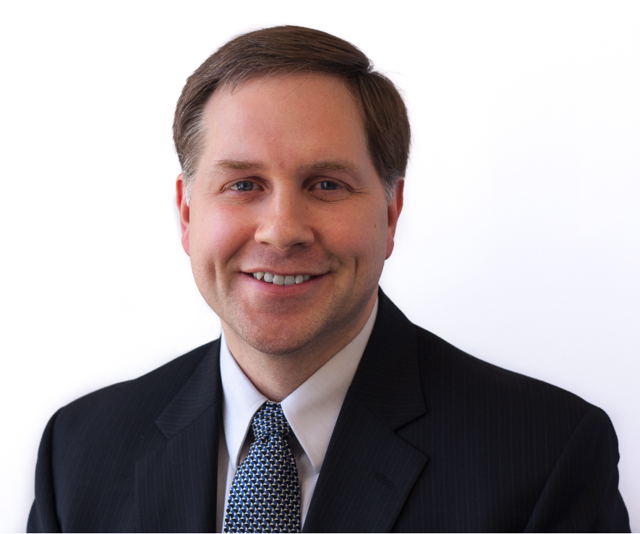
Dan
Ron
Ethan
President
Past President
Vice President
Election open to TRC members only
Election is to install the expanded 2021 TRC officers and BoD
  Primarily the Core Team
Working with the Cleveland Northern Ohio and Chicago Land Chapters for election
  TRC Election Committee member- Casey McBride
Steve
Mike
Secretary
Treasurer
Lavanya
Tom
Program Director
Communications and
Membership Director

Slide 4
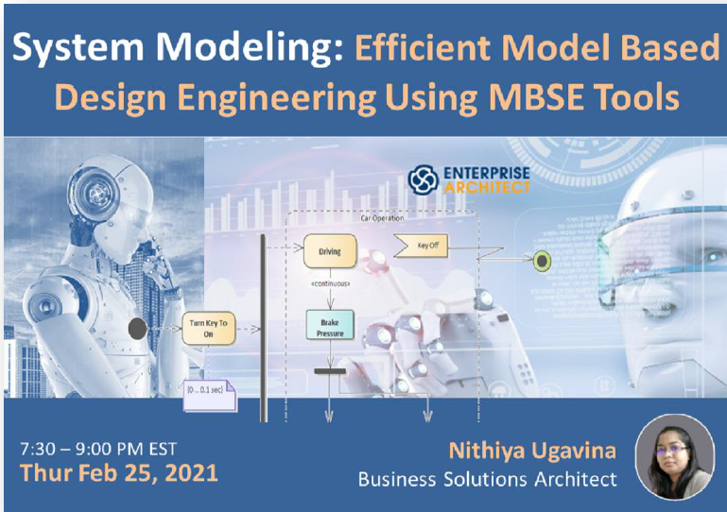

Current Talking Series
First Virtual Regionally-Offered Chapter Meeting
  Thur Feb 25, 2021
  Topic: Efficient Model Based Design Engineering Using MBSE Tools
  Nithiya Krishnan, Business Solutions Architect, Sparx Systems Pty Ltd
  80+ registrants; 40+ attendees
Second Virtual Regionally-Offered Chapter Meeting
  Tues July 27, 2021
  Topic: An Overview of Software Verification and Validation
  Steven Rakitin
  80+ registrants; 36+ attendees

Slide 5
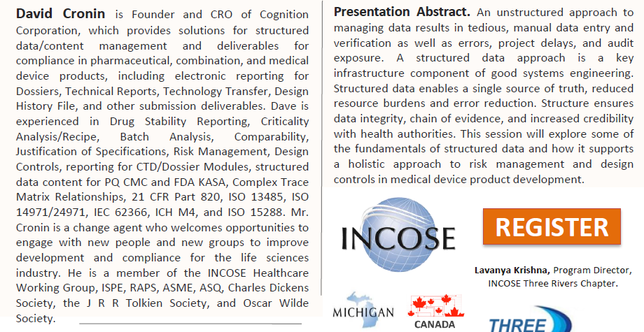
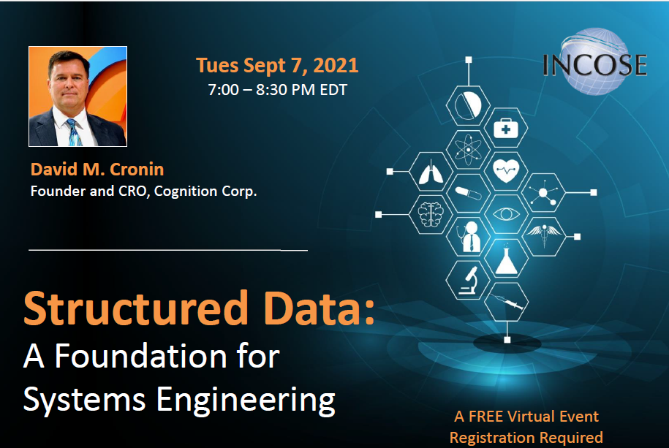
Next Talk Sept 7th

Slide 6
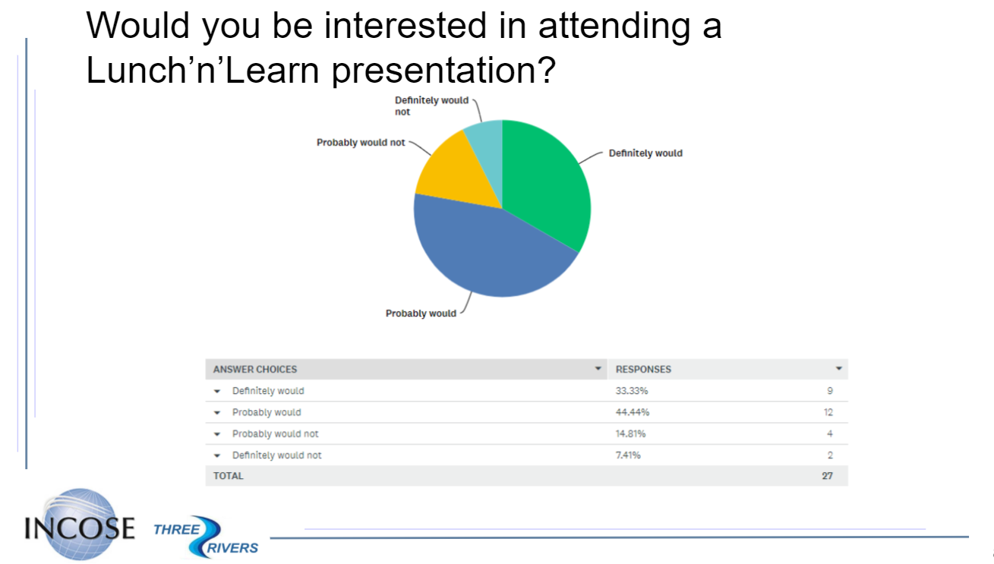

Slide 7
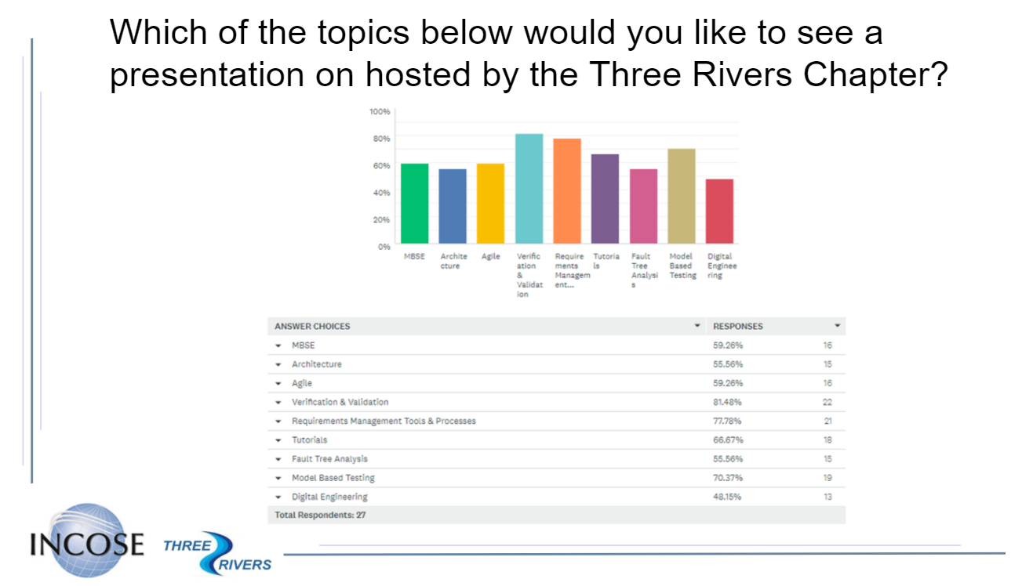

Slide 8
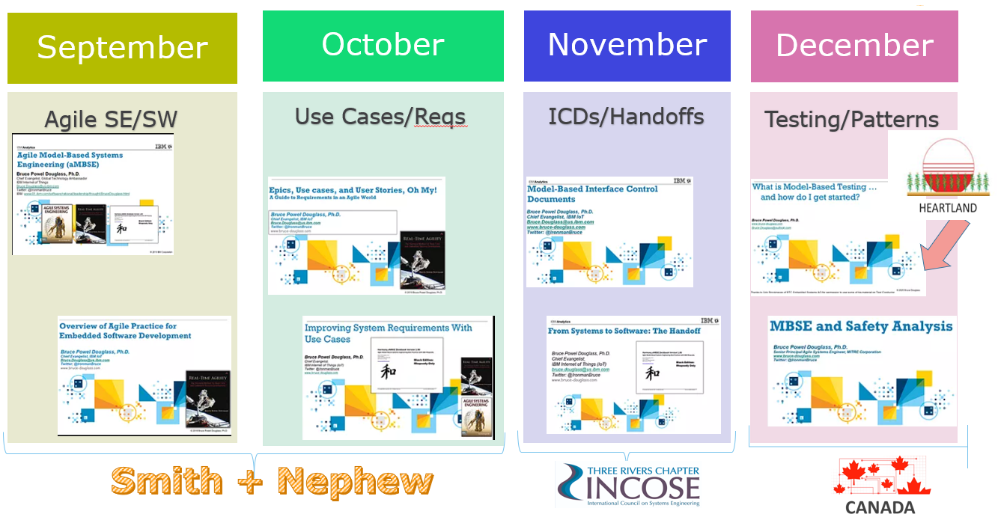
Lunch and Learn Series
https://www.bruce-douglass.com/presentations

