Slide 1
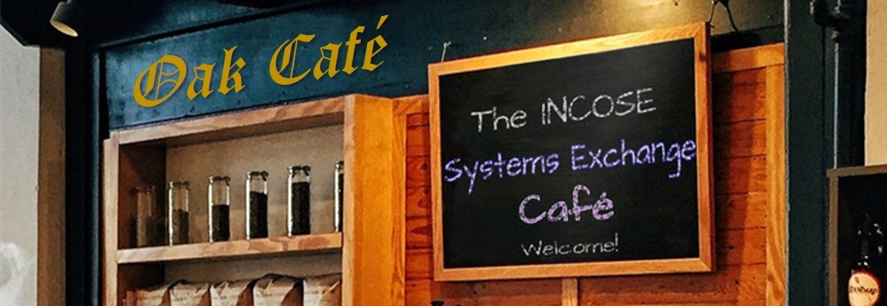
Oak Café – 17th February 2021
Hosted by: Richard Beasley

Slide 2
Topic: Obstacles to implementing Systems Engineering in organisation / projects
Typical obstacles
Systems Engineering is not (universally) taught / known
It is difficult to describe SE (multiple definitions)
Value of SE not understood –
“saving money that isn’t planned to be spent by preventing rework”
Worry about “too much” process (inflexibility)
Over-emphasizing process versus delivered value
Apply fixed approach, rather than adapting to problem type (cf cynefin) and SE capability in the organisation
Inappropriate dependency on tools / methods
Too much doing SE for sake of SE, not increasing probability of success of the project
Systems Thinking / Holistic vs “natural” reductionism
Individual filters and natural tendency for “silos” and resultant sub-optimisation
Natural dislike of uncertainty (which is first outcome of SE) –
asking questions expecting the answer “yes”
Desire for “progress” and to get to detail / problems
Difficulty changing the whole organisation

Slide 3
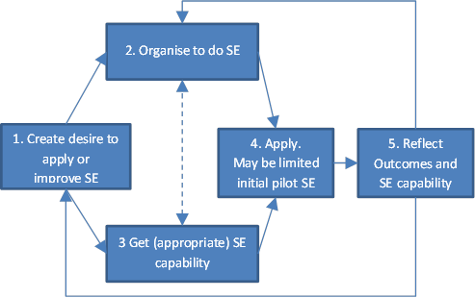
Recognize implementing SE is a journey, and plan the route
SE must be seen as a capability
Beasley, R. & O’Neil, A. 2016 “Selling Systems Engineering by Searching for the ‘Sweet Spot’” INCOSE IS2016 https://doi.org/10.1002/j.2334-5837.2016.00161.

Slide 4
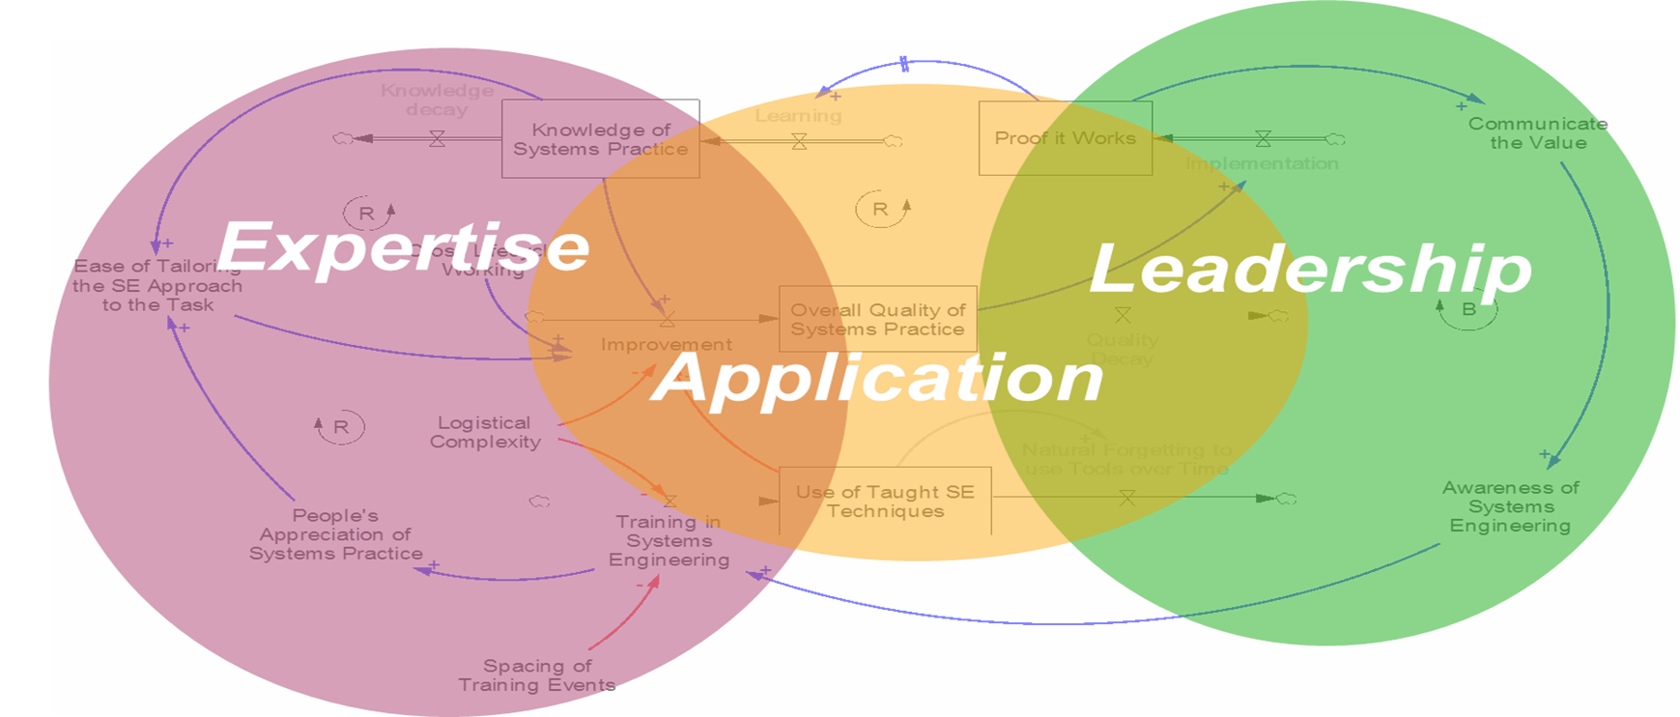
System Dynamic diagram examining quality of System Practice
From Dunford, C. N., Yearworth, M., York, D. M. and Godfrey, P. (2013), “A view of Systems Practice: Enabling quality in design.” Syst. Engin.,16: 134–151. http://dx.doi/10.1002/sys.21220

Slide 5
References / further reading
Apologies for the bias to my work – please share more!
Beasley, R. 2017 “Realising the Value of Systems Engineering” INCOSE IS2017 https://doi.org/10.1002/j.2334-5837.2017.00415.x
Beasley, R. 2012 “The Barriers to Systems Thinking” INCOSE IS2012 https://doi.org/10.1002/j.2334-5837.2012.tb01353.x
Beasley, R. & O’Neil, A. 2016 “Selling Systems Engineering by Searching for the ‘Sweet Spot’” INCOSE IS2016 https://doi.org/10.1002/j.2334-5837.2016.00161.x
Dunford, C. N., Yearworth, M., York, D. M. and Godfrey, P. (2013), “A view of Systems Practice: Enabling quality in design.” Syst. Engin.,16: 134–151. http://dx.doi/10.1002/sys.21220
And see
SEBoK part 5 – Organising to do Systems Engineering - https://www.sebokwiki.org/wiki/Enabling_Systems_Engineering

