Slide 1


INCOSE: MBSE INITIATIVE
& TRANSFORMATION
STRATEGIC OBJECTIVE
Troy A. Peterson Mark E Sampson
INCOSE Assistant Director INCOSE Technical Board
Systems Engineering Transformation MBSE Initiative Chair
troy.peterson@incose.org mark.sampson@incose.org
Vice President & Technical Fellow MBSE/Systems Engineering Evangelist
System Strategy, Inc. (SSI) Siemens, Product Lifecycle Management
Unrestricted

Slide 2
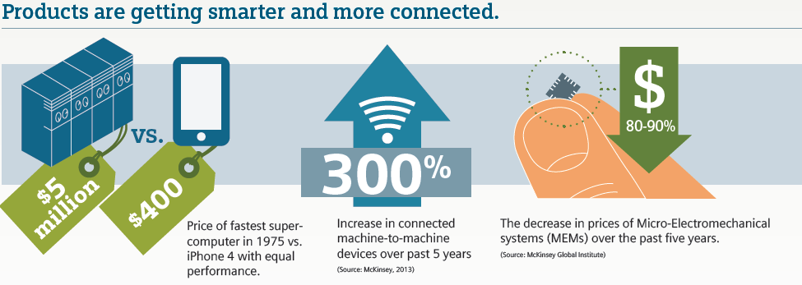
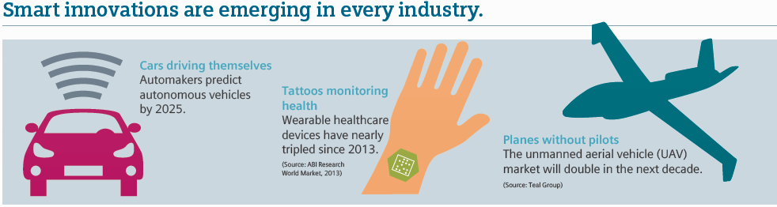
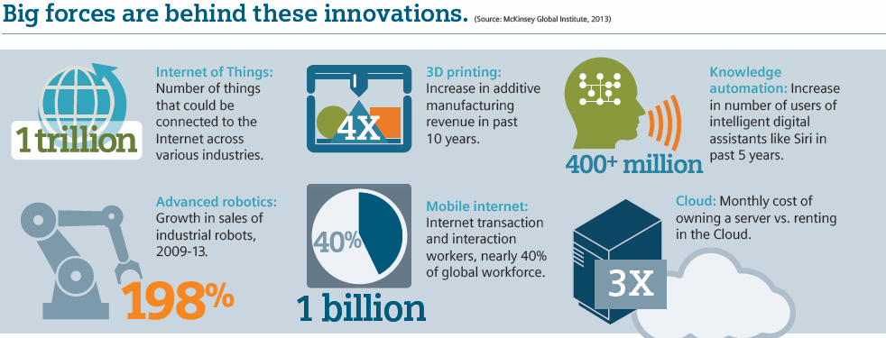
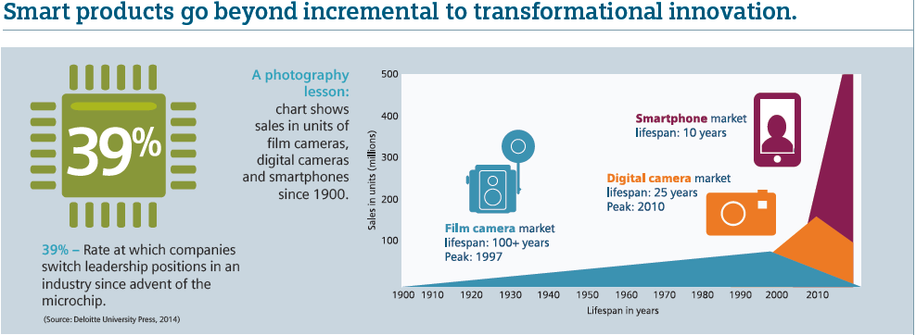
4th Industrial Revolution (Industry 4.0)
Age of smart innovation
Models of all kinds make this possible…
Systems Engineering needs to get with the program…

Slide 3
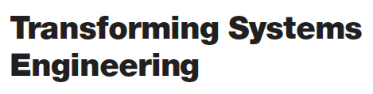


INCOSE Vision 2025
Systems engineering will lead the effort to drive out unnecessary complexity through well-founded architecting and deeper system understanding
A virtual engineering environment will incorporate modeling, simulation, and visualization to support all aspects of systems engineering by enabling improved prediction and analysis of complex emergent behaviors.
Composable design methods in a virtual environment support rapid, agile and evolvable designs of families of products. By combining formal models from a library of component, reference architecture, and other context models, different system alternatives can be quickly compared and probabilistically evaluated.
From: Model-based systems engineering has grown in popularity as a way to deal with the limitations of document-based approaches, but is still in an early stage of maturity similar to the early days of CAD/CAE.
To:Formal systems modeling is standard practice for specifying, analyzing, designing, and verifying systems, and is fully integrated with other engineering models. System models are adapted to the application domain, and include a broad spectrum of models for representing all aspects of systems. The use of internet-driven knowledge representation and immersive technologies enable highly efficient and shared human understanding of systems in a virtual environment that span the full life cycle from concept through development, manufacturing, operations, and support.

Slide 4
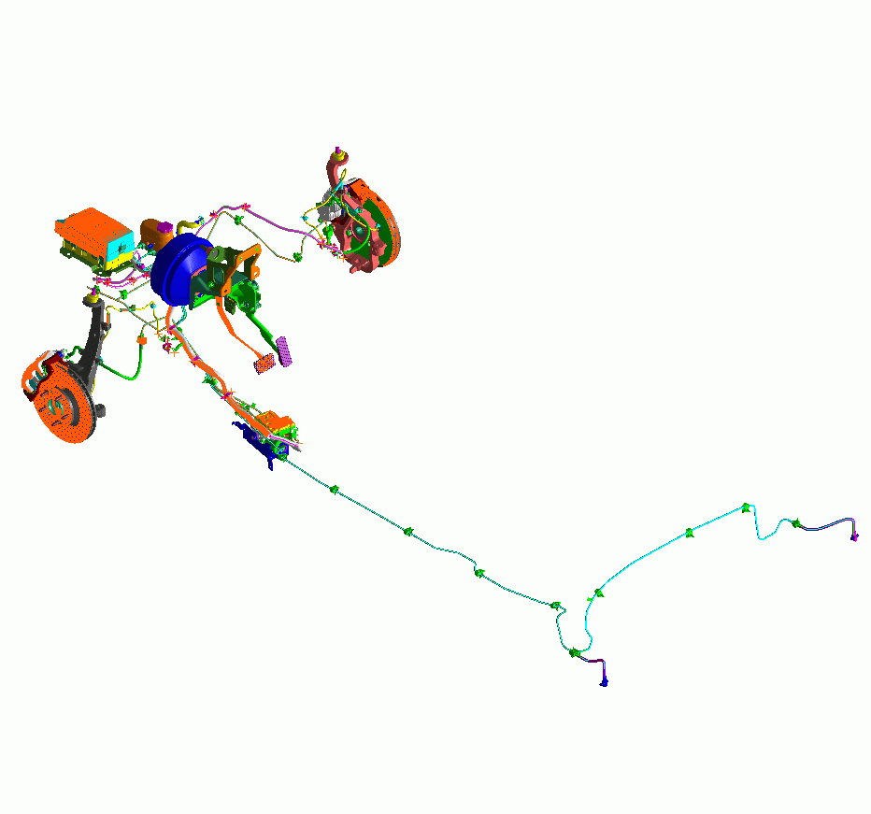
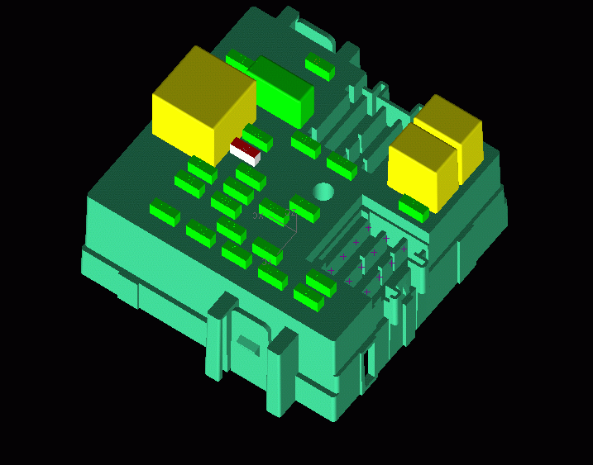
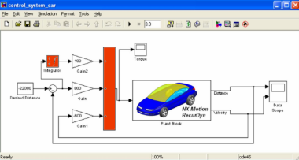
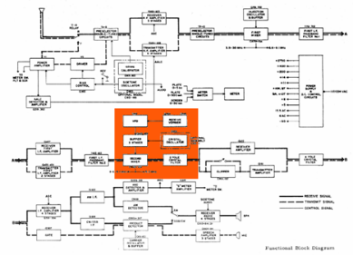
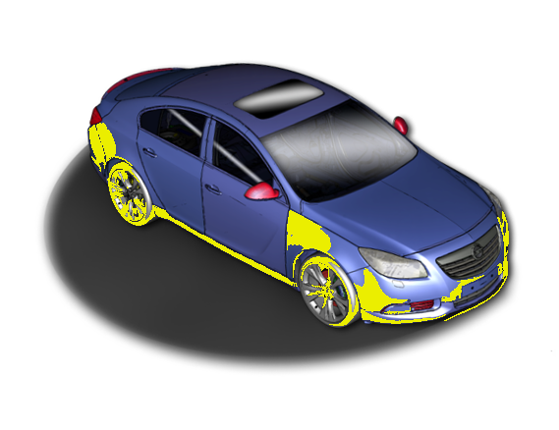
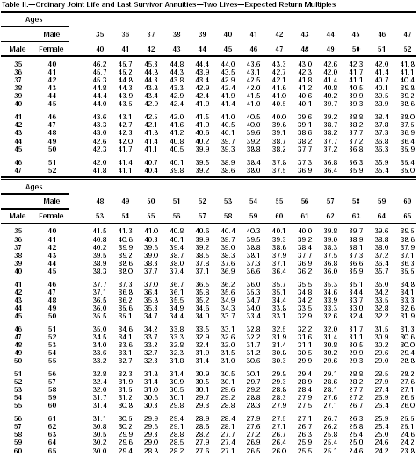
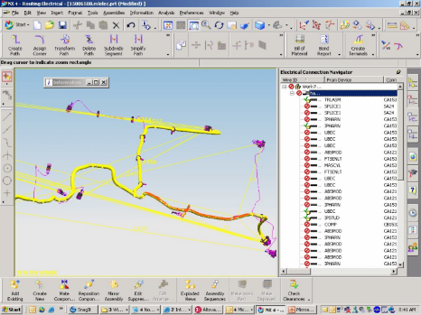
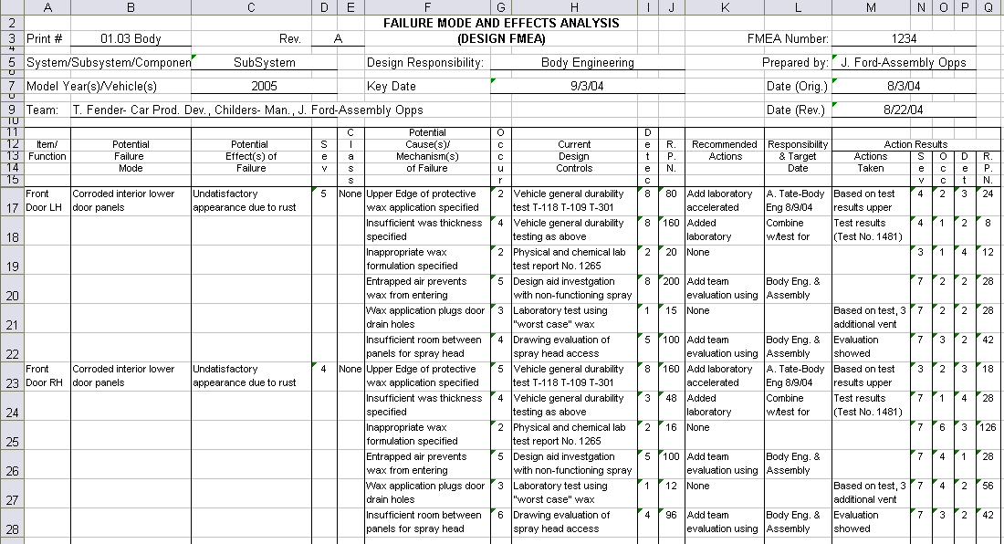
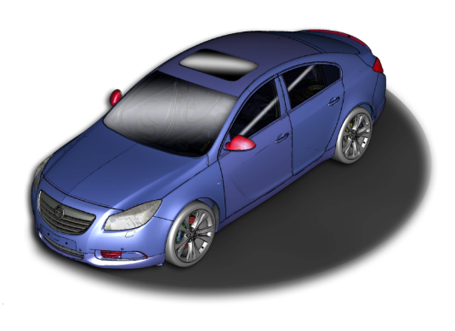
Integrated MBSE Vision
What does the integrated systems engineering look like…
Hydraulic Fluid: SAE 1340 not-compliant
Power Rating:
18 Amps
Thermal/Heat
Dissipation: 780°
Ergonomic/Pedal Feedback: 34 ERGS
Hydraulic Pressure: 350 PSI
Sensor MTBF:
3000 hrs
Automatic Cruise Control <FAULT>
Minimum Turn Radius: 24 ft.
Automatic Dry Pavement Braking Distance at 60 MPH : 110 ft. 90 ft
Minimum Turn Radius: 24 ft.
Automatic Dry Pavement Braking Distance at 60 MPH : 110 ft.
Notes:
The SDPD (integrated model-based SE) Vision is about reaching the potential of integrated models—creating and maintaining the digital thread thru-out the lifecycle. If we can pull this off we can see and navigate the digital thread by visualizing where requirements and relationships go and how they interact with various systems…
For example, …if I was working on autonomous vehicle and ensuring we can do an emergency stop in a shorter required distance, we can ask it what requirements are associated with the front end of this vehicle and what the potential impact is of a change—dry pavement braking distance from 110ft to 90ft
Shows current requirements by graphically clicking on the car…
Diving into the details…
Show the potential impact of changing stopping distance including…
Thermal/heat problems with brakes
Ergonomic feedback problems with brake pedal
Hydraulic fluid rating violation
Failure modes/MTBF rating problems with sensors
Hydraulic pressure problems
Electrical fault problems
Zooming into the electrical box, highlights a fuse
Clicking into the fuse brings up the schematic and highlights a fuse link
Clicking into the schematic zooms in on the wire harness that has the problem—including the signal for a failed sensor that in this particular failure mode causes the short.
…which allows us to go look at the Failure Modes document and update appropriately.
Updating the software to handle that fault
…and even seeing the impact on our safety rating and insurance costs.

Slide 5
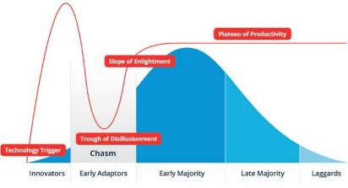
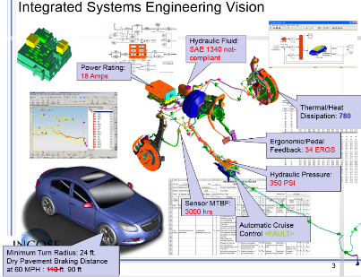
INCOSE’s Transformation Strategic Objective
SE Transformation Overview
Objective:
INCOSE accelerates the transformation of systems engineering to a model-based discipline.
Accelerates:
  Understand the hype cycle¹ and bridge the chasm²…
  Empower others to enlighten and influence adoption
Transformation:
  A marked change, as in appearance or character, usually for the better³. e.g. documents to models
  Lead and support the community in crossing the chasm
Model Based Discipline
  System models of all types
  Modeler Collaboration and Model Integration
1. Hype Cycle is a branded graphical presentation developed and used by IT research and advisory firm Gartner
2. Moore, Geoffrey A. “Crossing the Chasm – and Beyond” Strategic Management of Technology and Innovation Third Edition 1996
3. Excerpted from The American Heritage Dictionary of the English Language, Third Edition 1996 by Houghton Mifflin Company
4. Friedenthal, Sandy and Sampson, Mark - MBSE Initiative Overview - http://www.omgwiki.org/MBSE/doku.php

Slide 6
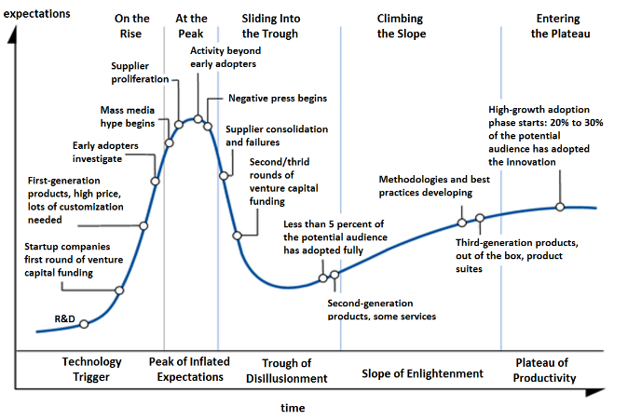
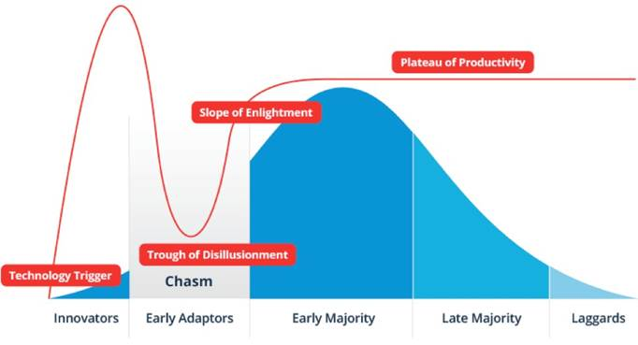
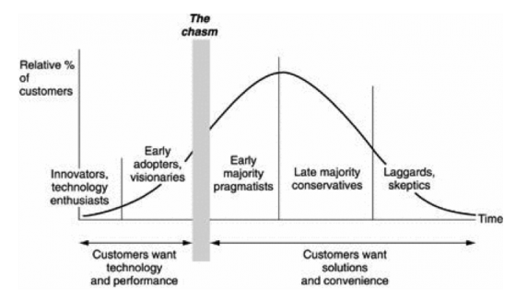
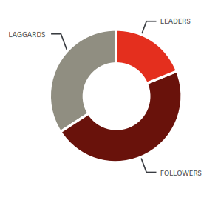
Accelerating: Technology Adoption – Hype and Chasm
Accelerates: Hype Cycle and Chasm
Rating of company’s digital maturity in leadership and management⁵
More than 80% of respondents are either followers or laggards
19%
47%
34%
Acceleration is very much about sharing, communicating and learning
Where would you plot your organization today?
1. Hype Cycle is a branded graphical presentation developed and used by IT research and advisory firm Gartner
2. Hype Cycle Graphic: https://en.wikipedia.org/wiki/Hype_cycle
3. Moore, Geoffrey A. “Crossing the Chasm – and Beyond” Strategic Management of Technology and Innovation Third Edition 1996
4. Hype Cycle, Chasm Combined Graphic: http://www.datameer.com/blog/big-data-analytics-perspectives/big-data-crossing-the-chasm-in-2013.html
5. Driving Digital Transformation: New Skills for Leaders, New Role for the CIO, Harvard Business Review

Slide 7
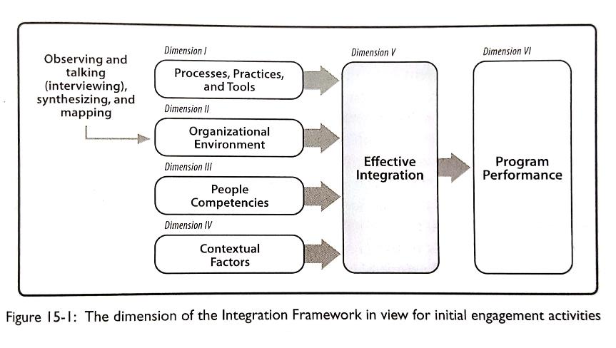
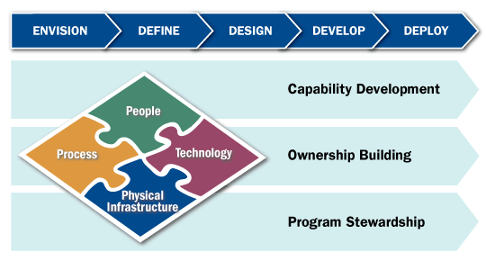
Transformation: Change Management and Leadership
Consider key dimensions of change
People, Process, Technology, and Physical Infrastructure
  Integrate dimensions of change
  Addresses dimensions in parallel
  Leverage concurrency to encourage cross dimension trades
  Build ownership at the grass-root level
Transformation Life Cycle™ (TLC): Booz Allen Hamilton
Consider:
  ABP = CM(OE + BPR + IT)
  ABP = Achieving Breakthrough Performance
  OE = Organizational Environment
  BPR = Business Process Reengineering
  IT = Information Technology
  CM = Change Management
Avoid:
  AIPI = CM(PS + BEP + FV)
  AIPI = Achieving Immediate Perceived Impact
  PS = PowerPoint Skill
  BEP = Briefer’s Executive Presence
  FV = Flashy Visualization
  CM = Change Mandate
Transformation is
very much a people
focused endeavor.

Slide 8
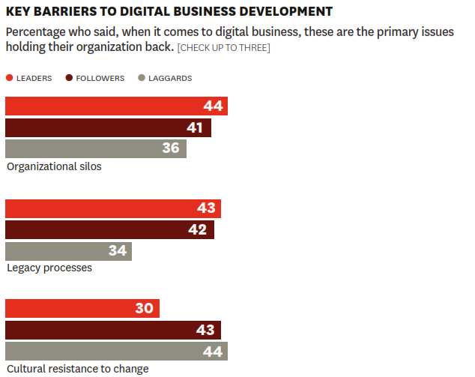
Transformation: Driving Digital Transformation¹
Keys to Digital Transformation (HBR Report)
Start from the customers perspective
Digital leadership starts at the top
Engage in a discussion of trends
Think about agile
Use examples to make it real
Need a foundation of trust
Use KPIs for sharing knowledge
Break down walls wherever possible
Need digital coaches or maters
Create appropriate learning forums
1. Driving Digital Transformation: New Skills for Leaders, New Role for the CIO, Harvard Business Review

Slide 9
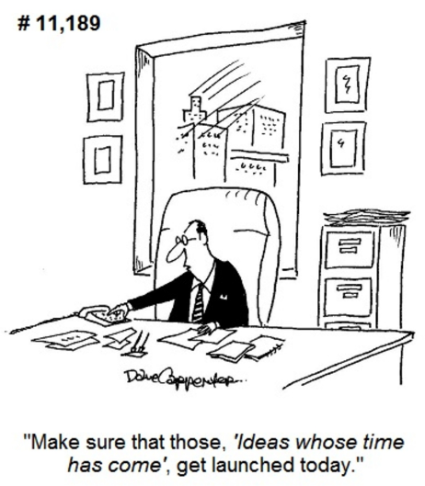
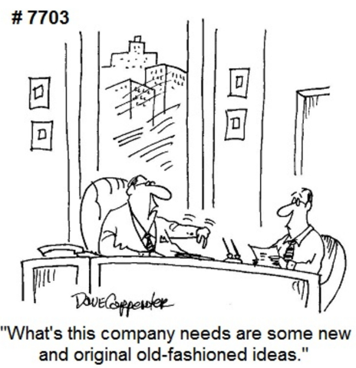
Model Based Discipline: The Next Evolutionary Step
Model Based Discipline
Models are not new to us
In some ways we’re going “back to the future”
Transformation is not a wholesale change
Model based is the next evolutionary step
A transformation whose time has come
Understand the Current State
Take inventory of current state of transition and progress toward becoming a model based discipline
Envision and define the future state of SE:
See Vision 2025,what are the business objectives, metrics, stakeholders, technologies, priorities etc.

Slide 10
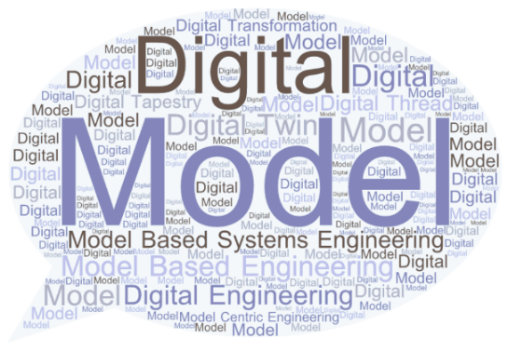
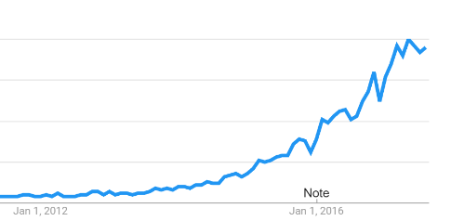


Model Based Discipline: What do we mean by MBSE
What do we mean by:
  Model Based Systems Engineering
  Model Based Engineering
  Model Based Development
  Model Based Design
  Model Centric Engineering
  Model Based Methods
  Digital Engineering
  Digital Design
  Digital Thread
  Digital Twin
  Digital Tapestry
  Et al.
Digital Transformation

Slide 11
Transformation
Strategy
Overview
Vision | Systems Engineering is acknowledged as a model based discipline
Mission | INCOSE accelerates the transformation of systems engineering to a model-based discipline
Mission Area # | 1 | 2 | 3
Mission Area | Infuse INCOSE | Engage Stakeholders | Advance Practice
Mission Area | What can INCOSE Do? | What is practiced and needed? | What is possible?
Goals | Infuse model based methods throughout INCOSE products, activities and WGs | Engage stakeholders to assess the current state of practice, determine needs and values of model based methods | Advance stakeholder community model based application and advance model based methods.
Objective 1 Foundations | Inclusion of model based content in INCOSE existing/new products (Vision, Handbook, SEBoK, Certification, Competency Model, etc.) | Define scope of model based systems engineering with MBE practice and broader modeling needs | Advance foundational art and science of modeling from and best practices across academia, industry/gov. and non profit.
Objective 2 Expand Reach | Expand reach within INCOSE of MBSE Workshop; highlight and infuse tech ops activities with more model based content (products, WGs etc.) | Identify, categorize and engage stakeholders and characterize their current practices, enablers and obstacles | Increase awareness of and about stakeholders outside SE discipline of what is possible with model based methods across domains and disciplines (tech/mgmt)
Objective 3 Collaborate | Outreach: Leverage MOUs to infuse model based content into PMI, INFORMS, NAFEMS, BIM, ASME and others, sponsoring PhD Students, standardization bodies, ABET | Build a community of Stakeholder Representatives to infuse model based advances into organizations practicing systems engineering. | Initiate, identify and integrate research to advance systems engineering as a model based discipline
Objective 4 Assessment/ Roadmap | Assess INCOSE's efforts (WG, Objectives, Initiatives etc.) for inclusion of model based methods across the Systems Modeling Assessment/Roadmap | Engage stakeholder community with Systems Modeling Assessment/ Roadmap to better understand the state of the practice of MBSE. Push and pull content from stakeholders (change agents and the "to be convinced") | Provide baseline assessment framework, Systems Modeling Roadmap, to create a concrete measure of current state of the art of what's possible/what's the potential.
Vision
Mission
Mission Areas
Goals
Objectives

Slide 12
Strategy
Notional
Timeline
Systems Engineering Transformation
Short Wave
6-12 Months
Mid Wave
12-24 Months
Long Wave
24-48 Months
Mission Areas
Internal Short Wave
External Mid Wave
Advancing Long Wave
Waves Run Concurrently
Activities build on each other
Important to fully engage stakeholder this next year. Pilot Assessment & Roadmap this CY and kick-off more broadly at 2017 IW.
Infuse
INCOSE
Engage Stakeholders
Advance
Practice
Synergies
Stakeholder Value
Innovations
Today
Empowering
Change Agents
INCOSE Effectiveness
2015 IS
1
2
3
4
5
2020 IS
Time (Years)

Slide 13
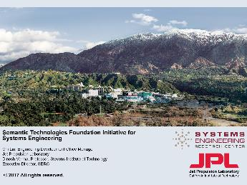
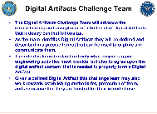
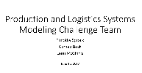
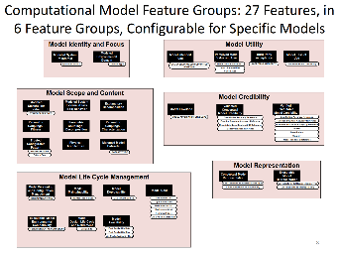
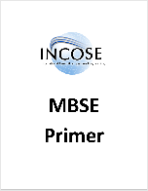
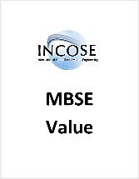
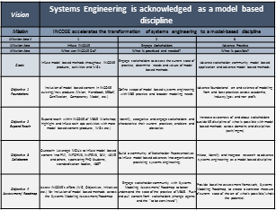
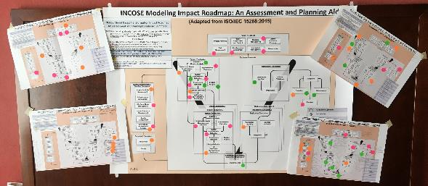
Transformation – Objectives & Initiatives
New/Related Developments
SE Ontology Effort with SERC, JPL et al.
MBSE Initiative Challenge Teams for Digital Artifacts, Production & Logistics Systems Modeling
Collaborative V&V of models in effort with ASME
2018 IS MBSE Workshop “TED Talks” & Case Studies
Products Under Development
Model Based Exemplars
Assessment Roadmap Model Features
INCOSE MBSE Primer
Value Briefing / Case Studies / ROI
Webinar planned for November
Accomplishments
Strategy & Action Plan
Stakeholder List
Assessment Roadmap
Enablers & Roadblocks
Web search improvements
Transformation website created
Integration of MBSE throughout IW
Many professional society and company briefings on Systems Engineering Transformation
Copyright © 2016 by Troy A. Peterson Published and used by INCOSE with permission

Slide 14
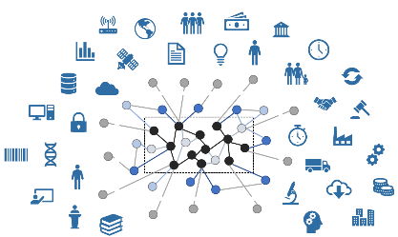

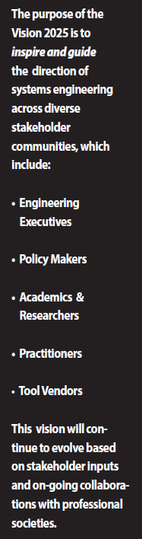
Transformation Stakeholders
Model Consumers
Model Creators
Complex Idea Communicators
Model Infrastructure Providers
INCOSE and other Professional Societies

Slide 15
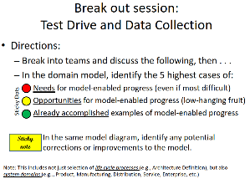
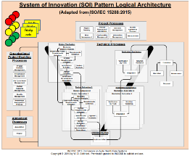
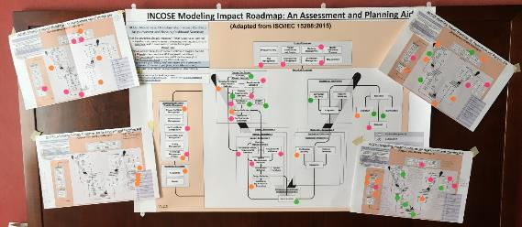
CAB Breakout: Assessment / Roadmap Instrument:
Intentionally very simple:
  Focused “one level down” from the intention to apply model-based methods to SE.
  Level of detail = the individual ISO 15288 life cycle processes.
Intended to address these important questions:
  What are you trying to improve? (Which 15288 processes?)
  Where are the biggest potential gains? The easiest potential gains?
  What is already improved?
But not:
  How will your goals be accomplished?
  What are the details of your plan?
  Not a CMMI

Slide 16
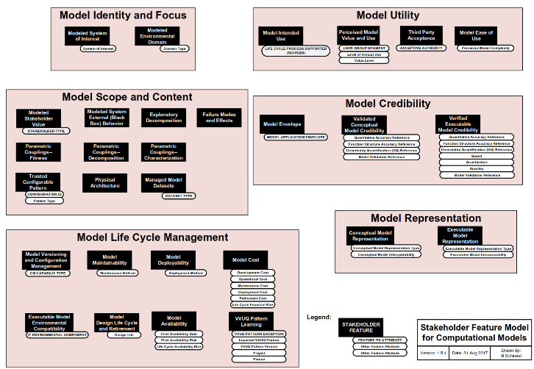
INCOSE/ASME Model Stakeholder Features Pattern
Being created in the INCOSE supported ASME VV50 standards committee project, also in use in the INCOSE Transformation effort.
Metadata in the form of a model itself, describing “what is in the model” – like a barcode which describes a product.
29 Model Features, spread across 6 feature groups
Model Identity and Focus:
Identifies the main subject or focus of the model
Model Utility:
Describes the intended use, user, utility, and value of the model
Model Scope and Content:
Describes the scope of content of the model
Model Credibility:
Describes the credibility of the model
Model Life Cycle Mgmt.:
Describes the related model life cycle management capabilities
Model Representation:
Describes the representation used by the model

Slide 17
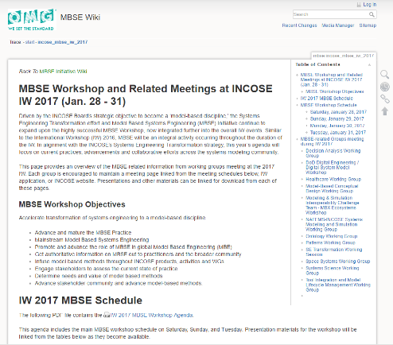
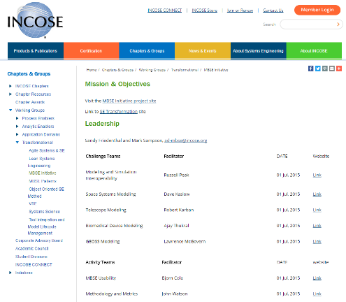
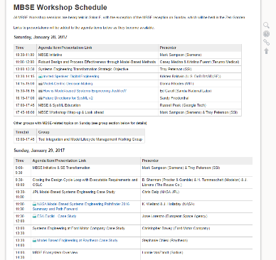
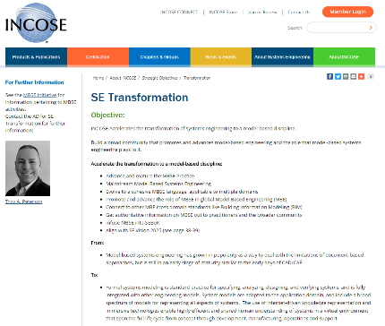
MBSE Wiki and Website
http://www.omgwiki.org/MBSE/doku.php?id=mbse:incose_mbse_iw_2017
http://www.incose.org/about/strategicobjectives/transformation

Slide 18
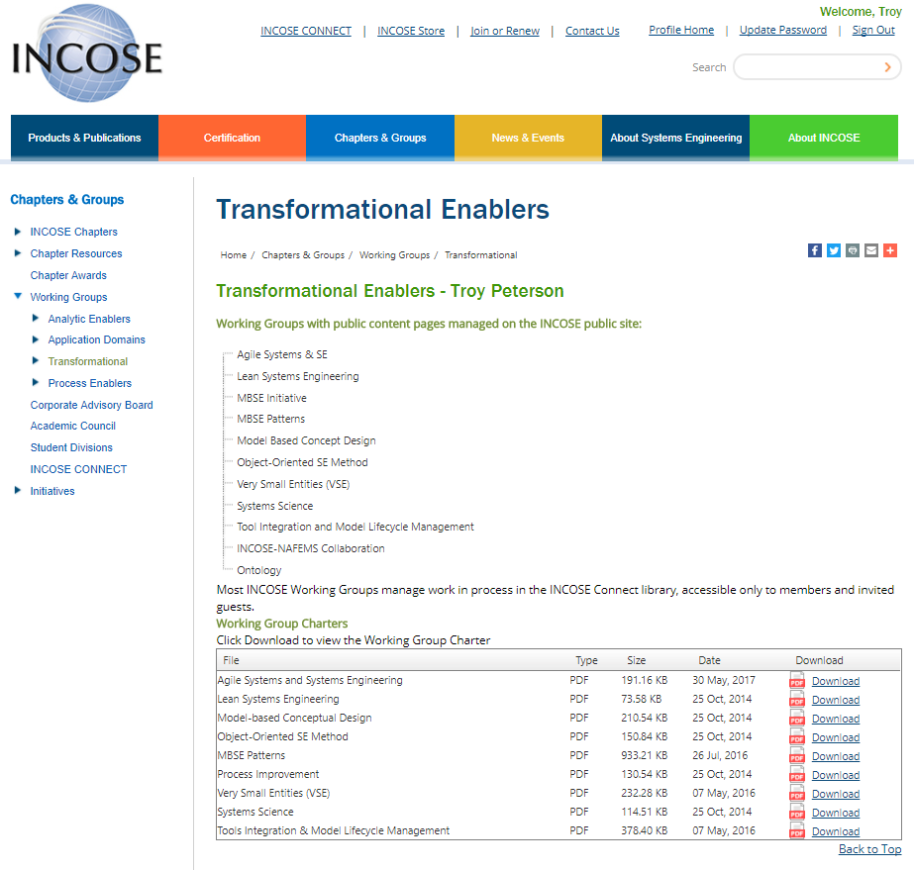
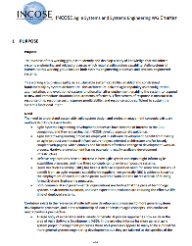
Accomplishments: Website / Discoverability Improvements
Transformational Working Groups (WG)
Agile Systems and Systems Engineering
Lean Systems Engineering
Model Based Systems Engineering Initiative
Model-based Conceptual Design
Object-Oriented SE Method
MBSE Patterns
Very Small Entities (VSE)
Systems Science
Tools Integration & Model Lifecycle Management
INCOSE-NAFEMS Collaboration
Ontology
Visit site for WG charters and to learn more
http://www.incose.org/ChaptersGroups/WorkingGroups/transformational

Slide 19




MBSE Initiative as an Incubator and Transformation Agent
Digital Artifacts Challenge Team:
  Identifying and characterizing MBSE digital artifacts across the lifecycle
Production and Distribution Systems Challenge Team
  Connecting models across the lifecycle – Industry 4.0, Supply Chain, Logistics
V&V of models (Potential Collaboration ASME, INCOSE, NAFEMS)
  Verification and Validation of Models – tied to ASME VV50 standards project
Augmented Intelligence in Systems Challenge Team
  How can machine learning and AI aid systems engineering in the innovation process
MBSE/MBE Capabilities Assessment Challenge Team
  Developing self-assessments and gap analysis, strategic planning, project progress aids

Slide 20
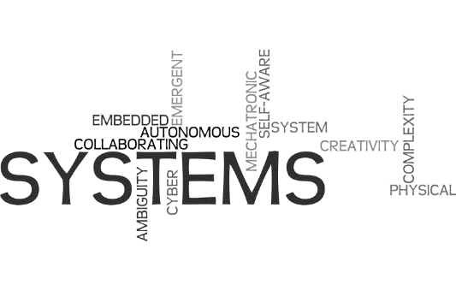
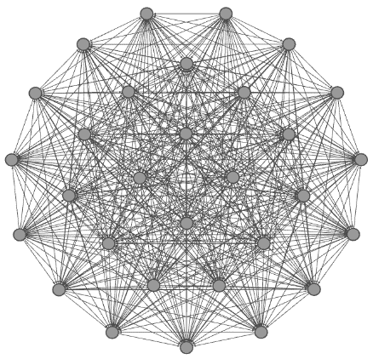
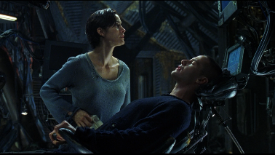



Overcoming the Challenge
Imperative: Resolve Complexity
…the only simplicity to be trusted is the simplicity to be found on the far side of complexity
Alfred North Whitehead (1861-1947)
Simplicity does not precede complexity but follows it.
Alan Perlis (1922 – 1990)
Out of intense complexities intense simplicities emerge
Winston Churchill (1874 – 1965)
Simplicity is complexity resolved.
Constantin Brancusi (1876-1957)
Fools ignore complexity. Pragmatists suffer it. Some can avoid it. Geniuses remove it.
Alan Perlis (1922 – 1990)
I know MBSE
Any intelligent fool can make things bigger and more complex… It takes a touch of genius – and a lot of courage to move in the opposite direction.
Albert Einstein (1879 – 1955)
A genius! For 37 years I’ve practiced fourteen hours a day, and now they call me a genius!
Pablo de Sarasate (1844 – 1908)
Lesson: Endure complexity, add tireless effort, and a touch of genius…

Slide 21


“It is not necessary to change.
Survival is not mandatory.”
W. Edwards Deming
INCOSE’s Transformation Strategic Objective:
http://www.incose.org/about/strategicobjectives/transformation
Engage as a Transformation Stakeholder Representative, visit:
http://www.incose.org/about/strategicobjectives/transformation

Slide 22


Q&A
Digitally Zealous
Digital Denial

Slide 23
Copyright for INCOSE Vision 2025 use and references
Copyright
This product was prepared by the Systems Engineering Vision 2025 Project Team of the International Council on Systems Engineering (INCOSE). It is approved by the INCOSE Technical Operations for release as an INCOSE Technical Product.
Copyright ©2014 by INCOSE, subject to the following restrictions:
Author use: Authors have full rights to use their contributions in a totally unfettered way with credit to the INCOSE Technical Product.
INCOSE use: Permission to reproduce this document and to prepare derivative works from this document for INCOSE use is granted provided this copyright notice is included with all reproductions and derivative works.
External Use: This document may be shared or distributed to non-INCOSE third parties. Requests for permission to reproduce this document in whole are granted provided it is not altered in any way.
Extracts for use in other works are permitted provided this copyright notice and
INCOSE attribution are included with all reproductions; and, all uses including derivative works and commercial use, acquire additional permission for use of
images unless indicated as a public image in the General Domain.
Requests for permission to prepare derivative works of this document or any for commercial use will be denied unless covered by other formal agreements with INCOSE. Contact INCOSE Administration Office, 7670 Opportunity Rd., Suite 220, San Diego, CA 92111-2222, USA.
Service marks: The following service marks and registered marks are used in this document:

Slide 24
Enablers/Obstacles: Change Beliefs to affect Outcomes
Leadership
Method
Funding
Beliefs
Experience
Environment
Behaviors
Collaboration
Culture
Organization
Language

