Slide 1
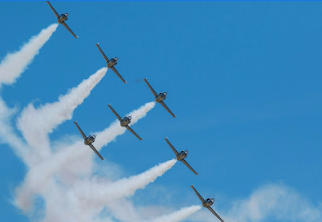
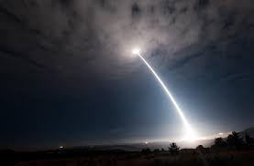
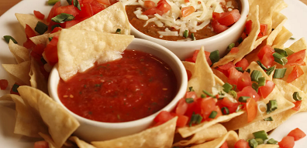
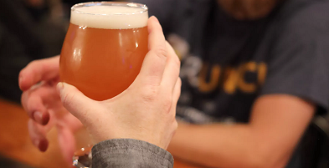
3rd Annual August is for Aerospace Social
Theme: Fishing for Engineers: How to Lure the Best Talent to Utah
Join both rank and file and top leaders in industry, academia, and government
to discuss the future of Utah’s engineering workforce!
Purchase your ticket today at https://aiaa_incose_august_is_for_aerospace_2019.eventbrite.com!
informal, social, relaxed
Date: Thursday, August 8th
Time: 6:00 – 8:30 p.m.
Location: Roosters Brewing Company & Restaurant
748 Heritage Park Blvd.
Layton, UT 84041
Food/Drinks:
Appetizers and soft drinks will be included.
Alcoholic drinks will be available for purchase.
Proceeds:
The proceeds from this event will fund scholarships for local students studying aerospace, systems engineering, or a related degree.
Questions:
Contact Paul White, INCOSE Wasatch Chapter President, at paul.white@kihomac.com.

