Slide 1
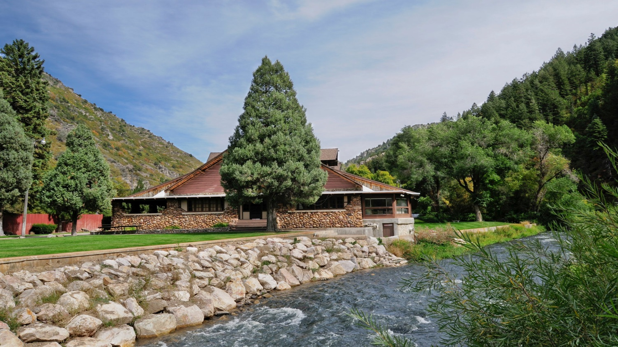


INCOSE Wasatch Chapter
Third Annual Summer Social
July 8, 2019

Slide 2
Agenda
6:00 – 7:15 p.m. | Dinner & Networking
7:15 – 7:30 p.m. | INCOSE Wasatch Chapter Announcements | Paul White, CSEP, INCOSE Wasatch Chapter President
7:30 – 8:00 p.m. | Systems Engineering – Why I Am a Believer | Jim Nichols, Vice President of Integrated Operations - Propulsion Systems Northrop Grumman
8:00 – 8:30 p.m. | Physics, System Engineering, and the AtmoSniffer | Dr. John E. Sohl, Ph.D. Professor of Physics Weber State University

Slide 3
Introduction
Our Sponsor
Overview of INCOSE & Wasatch Chapter
New & Renewed Members
ASEP, CSEP, & ESEPs
Chapter Awards
Chapter Leadership
Chapter Website
Chapter Meetings
INCOSE Events

Slide 4

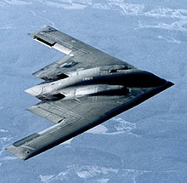
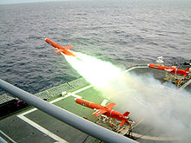
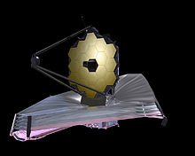
Our Sponsor

Slide 5

What is INCOSE?
International Council on Systems Engineering
Industry organization for systems engineers
Founded in 1990
http://www.incose.org

Slide 6
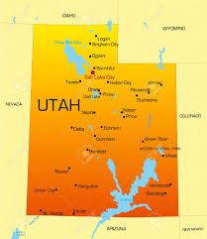
What is the INCOSE Wasatch Chapter?
Chartered in January 1997 to serve Utah systems engineering community
  Systems Engineers
  Companies
  Universities
Membership is mostly along “Wasatch Front”
Support Utah systems engineers & companies as we compete in today’s global marketplace
Member society of Utah Engineers Council (UEC)

Slide 7
What is the INCOSE Wasatch Chapter?
Systems Engineering Presentations
Networking
Conferences
Certification
Training
Scholarships

Slide 8
What is the INCOSE Wasatch Chapter?
The Aerospace Corporation
Air Force Nuclear Weapons Center
ASI
BAE Systems
BYU
BYU-Idaho
Defense Acquisition University
Embraer
Embry Riddle Aeronautical University
General Dynamics
General Electric
Hill Air Force Base
i3DAY Innovation
KIHOMAC
Kimberly Clark
L-3 Harris
Lockheed Martin
Northrop Grumman
Rockwell Collins
Siemens
System Solutions
TASC
Utah State University
Weber State University

Slide 9
New Members!
Nicole Batty (Weber State University)
Christina Zamloot (KIHOMAC)

Slide 10
Renewed Members!
David Shook (Northrop Grumman)
Charlie Vono

Slide 11
ASEPs, CSEPs, & ESEPs
ASEP
  Laura Birkhold
  Aaron Borden
  Tim Coda
  Amy Garcia
  Richard Martin
  John McCrea
  Breanna Whiteleather
CSEP
  William Bearden
  Derek Boddy
  Angie Harbert
  Justin McMurray
  John Metcalf
  Paul Nelson
  David Shook
  David Vickery
  Paul White
ESEP
  Vince Johnston

Slide 12
Chapter Leadership
Name | Officer Role | Company | E-mail Address
Paul White | President | KIHOMAC | Paul.White@kihomac.com
Angie Harbert | Vice President | Northrop Grumman | angie.harbert@ngc.com
Paul Nelson | Secretary | Northrop Grumman | paul.nelson@ngc.com
John Richards | Treasurer | Northrop Grumman | john.richards@ngc.com
Ernest Kyed | Director-at-Large | Northrop Grumman | ernest.kyed@ngc.com
Vince Johnston | Director-at-Large | L3 Harris | vincent.b.johnston@L3Harris.com
John McCrea | Director-at-Large | AFNWC/NI Hill Air Force Base | john.mccrea.3@us.af.mil
Bylaws are available on the chapter website:
http://www.incose.org/wasatch
(Library and Resources)
Quarterly video-teleconferences to touch base
Officers are required; all are invited.

Slide 13
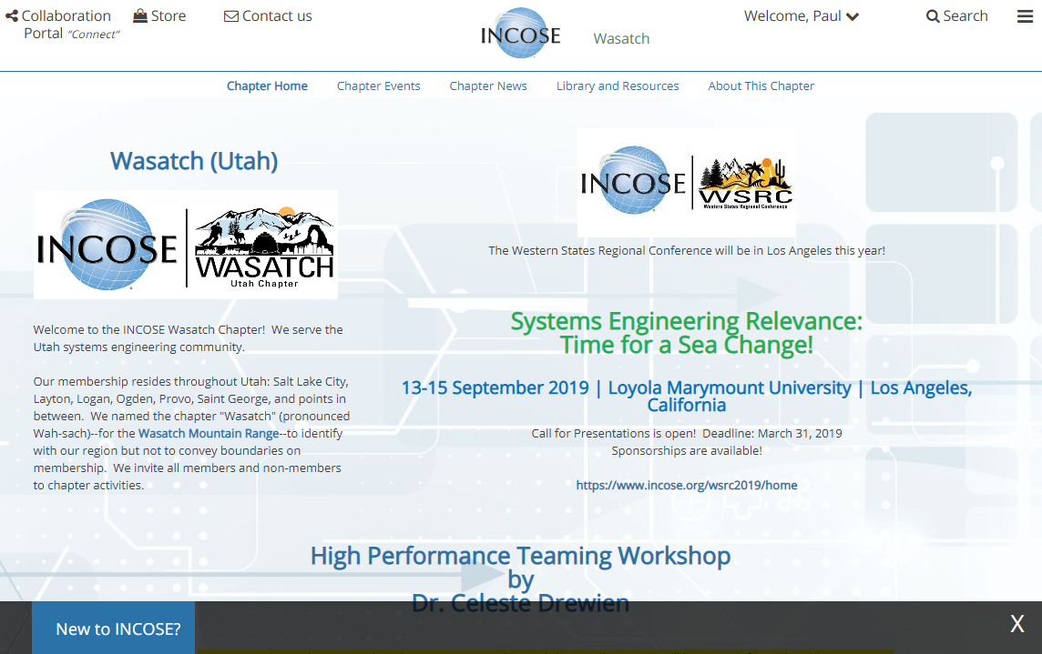
Chapter Website
http://www.incose.org/wasatch

Slide 14

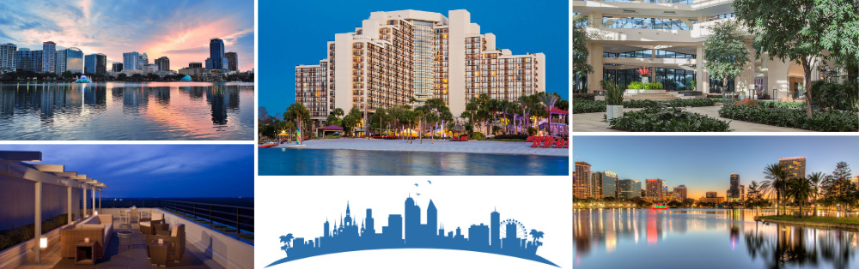
INCOSE 29th Annual International Symposium
https://www.incose.org/symp2019/home

Slide 15

INCOSE 29th Annual International Symposium
Gold Circle Award
Most Improved Chapter Award
Outstanding Service Award – Paul White

Slide 16
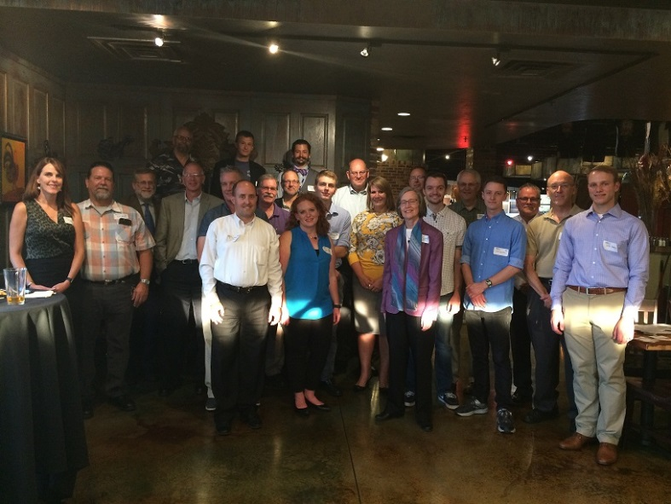

AIAA/INCOSE August is for Aerospace
Thursday, August 8
6:00 – 9:00 p.m.
Roosters
748 Heritage Park Blvd
Layton, UT 84041
Appetizers and soft drinks will be included.
Alcoholic drinks will be available for purchase.
The proceeds from this event will fund scholarships for local students studying aerospace, systems engineering, or a related degree.
https://aiaa_incose_august_is_for_aerospace_2019.eventbrite.com

Slide 17

United Nations 68th Civil Society Conference
August 26-28, 2019
Salt Lake City
INCOSE invited to present about systems engineering
https://outreach.un.org/ngorelations/slc-conference
Workshop Topic – Design for Action: Networking with Global Tech Societies for Sustainable and Inclusive Systems
First time systems engineering, and INCOSE, has been presented at UN!

Slide 18

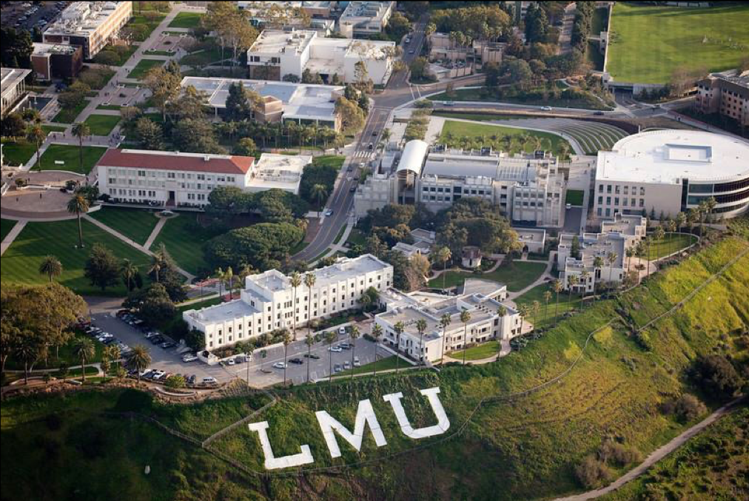
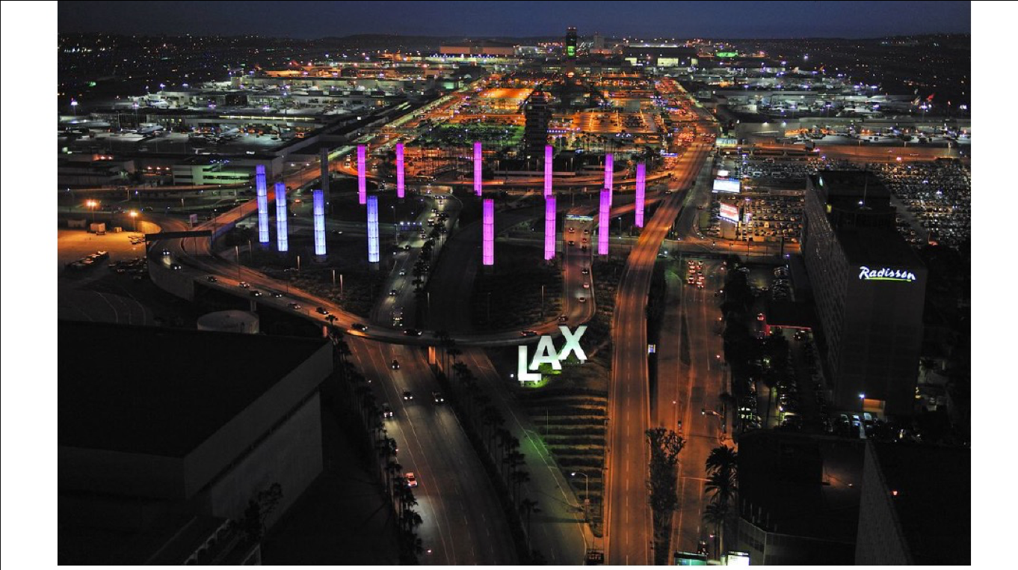
INCOSE Western States Regional Conference
Systems Engineering Relevance: Time for a Sea Change!
September 13-15, 2019
Los Angeles, California
Loyola Marymount University
https://www.incose.org/wsrc2019/home
Opportunities for sponsors or satellite sites

Slide 19
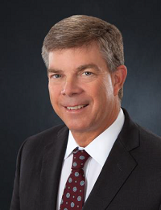
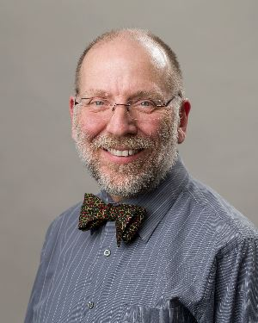
Our Featured Speakers
Jim Nichols
Vice President of Integrated Operations - Propulsion Systems
Northrop Grumman
Dr. John E. Sohl, Ph.D.
Professor of Physics
Weber State University

