Slide 1
INCOSE Wasatch Chapter Monthly Meeting
October 10, 2019

Slide 2
Agenda
6:00 – 6:30 p.m. | Dinner & Networking
6:30 – 6:45 p.m. | INCOSE Wasatch Chapter Announcements | Paul White, CSEP, INCOSE Wasatch Chapter President
6:45 – 8:00 p.m. | Model-based Systems Engineering (MBSE) | Mark Sampson, Chair – INCOSE MBSE Initiative

Slide 3
Introduction
Overview of INCOSE & Wasatch Chapter
New & Renewed Members
ASEP, CSEP, & ESEPs
Chapter Leadership
Chapter Website
Chapter Meetings
Chapter Officer Nominations & Elections
UEC Awards

Slide 4
What is INCOSE?
International Council on Systems Engineering
Industry organization for systems engineers
Founded in 1990
http://www.incose.org

Slide 5
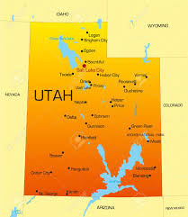
What is the INCOSE Wasatch Chapter?
Chartered in January 1997 to serve Utah systems engineering community
Systems Engineers
Companies
Universities
Membership is mostly along “Wasatch Front”
Support Utah systems engineers & companies as we compete in today’s global marketplace
Member society of Utah Engineers Council (UEC)

Slide 6
What is the INCOSE Wasatch Chapter?
Systems Engineering Presentations
Networking
Conferences
Certification
Training
Scholarships

Slide 7
What is the INCOSE Wasatch Chapter?
The Aerospace Corporation
Air Force Nuclear Weapons Center
ASI
BAE Systems
Boise State University
Defense Acquisition University
Embraer
Embry Riddle Aeronautical University
General Dynamics
General Electric
Hill Air Force Base
i3DAY Innovation
KIHOMAC
L-3 Harris
Lockheed Martin
Northrop Grumman
Siemens
System Solutions
Utah State University
Weber State University

Slide 8
New Members!
Brett Parker (Kihomac)
Donald Plumlee (Boise State University)

Slide 9
Renewed Members!
Derek Boddy (BAE Systems)
Howard Cooper (i3Day)
Michael Renzelman
John Richards (Northrop Grumman)
Mark Sampson (Siemens)
Thomas Uhl (Kihomac)

Slide 10
ASEPs, CSEPs, & ESEPs
ASEP
Laura Birkhold
Aaron Borden
Tim Coda
Amy Garcia
Richard Martin
John McCrea
Kelli Succo*
Breanna Whiteleather
CSEP
William Bearden
Derek Boddy
Angie Harbert
Justin McMurray
John Metcalf
Paul Nelson
David Shook
David Vickery
Paul White
ESEP
Vince Johnston

Slide 11
Chapter Leadership
Name | Officer Role | Company | E-mail Address
Paul White | President | Kihomac | Paul.White@kihomac.com
Angie Harbert | Vice President | Northrop Grumman | angie.harbert@ngc.com
Paul Nelson | Secretary | Northrop Grumman | paul.nelson@ngc.com
John Richards | Treasurer | Northrop Grumman | john.richards@ngc.com
Ernest Kyed | Director-at-Large | Northrop Grumman | ernest.kyed@ngc.com
Vince Johnston | Director-at-Large | L3 Harris | vincent.b.johnston@L3Harris.com
John McCrea | Director-at-Large | AFNWC/NI Hill Air Force Base | john.mccrea.3@us.af.mil
Bylaws are available on the chapter website:
http://www.incose.org/wasatch
(Library and Resources)
Quarterly video-teleconferences to touch base
Officers are required; all are invited.

Slide 12
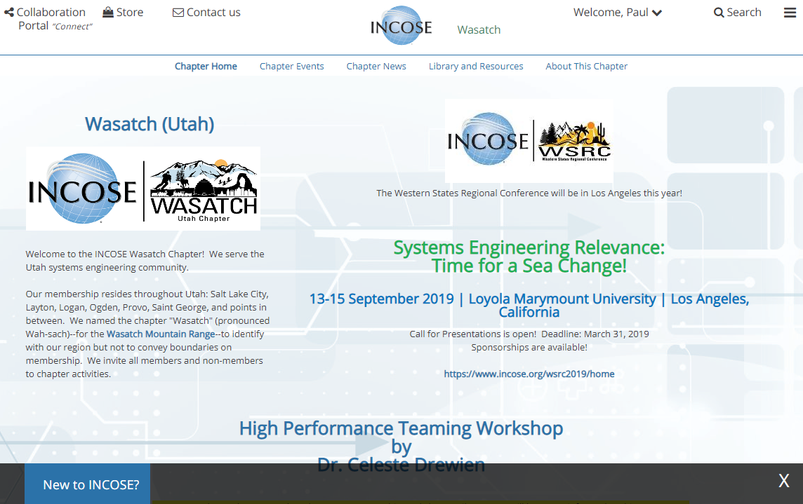
Chapter Website
http://www.incose.org/wasatch

Slide 13
Chapter Meetings
Date | Meeting or Event | Location
10/10 | Model-based Systems Engineering – Mark Sampson | Kihomac
11/14 | TBD | Kihomac
12/12 | 4th Annual Holiday Social | Roosters - Layton
2nd Thursdays of the month

Slide 14
Chapter Officers for 2020
Positions
President
Vice President
Secretary
Treasurer
Director-at-Large
Process
Nominees must be current chapter members.
Send name, e-mail, and short biography to Paul White at paul.white@kihomac.com.
Dates
October 1-31: Nominations open
November 1-30: Officer elections (Chapter members only)
December 12: Thank current officers, and install new officers.

Slide 15
Utah Engineers Council (UEC) Awards
Awards
Engineer of the Year – Seasoned engineer with significant contributions
Fresh Face Engineer of the Year – <5 years experience with strong potential
Engineering Educator of the Year – Educator who has made a significant impact
Process
Nominees must be current chapter members.
Send name, e-mail, and short biography to Paul White at paul.white@kihomac.com.
Dates
October 1-31: Nominations open
November 1-30: Award elections (Chapter members only)
December 12: Recognize selected candidates & submit to UEC for 2020

