Slide 1
Risk Management Ernie Kyed
May 2019
TM The INCOSE SEP Logos are trademarks of INCOSE
© 2006-2018 International Council on Systems Engineering
Subject to the restrictions on Copyright Page

Slide 2
Topics
Overview of risk
Standard risk model
Tools to perform proactive risk management
Miscellaneous thoughts and discussion
Wasatch Chapter
Notes:
2

Slide 3
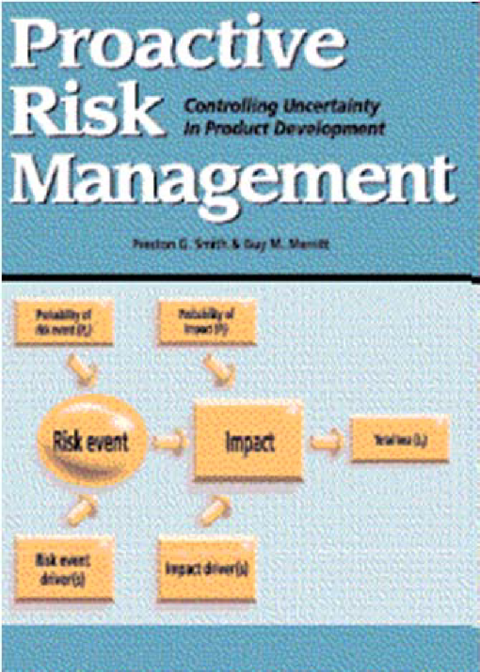
Credit
I have copied a lot of information in this presentation from two sources without providing specific attribution for each instance of use:
ECE/ENGR 531 Spring 2012 Lecture Slides, Dr. Edwin Chong, Colorado State University
Proactive Risk Management Controlling Uncertainty in Product Development, 2002, by Preston Smith and Guy Merritt
Wasatch Chapter
Notes:
3

Slide 4
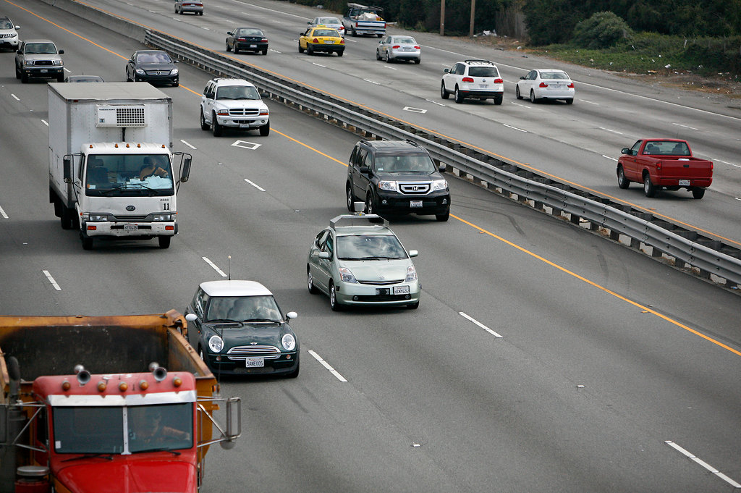
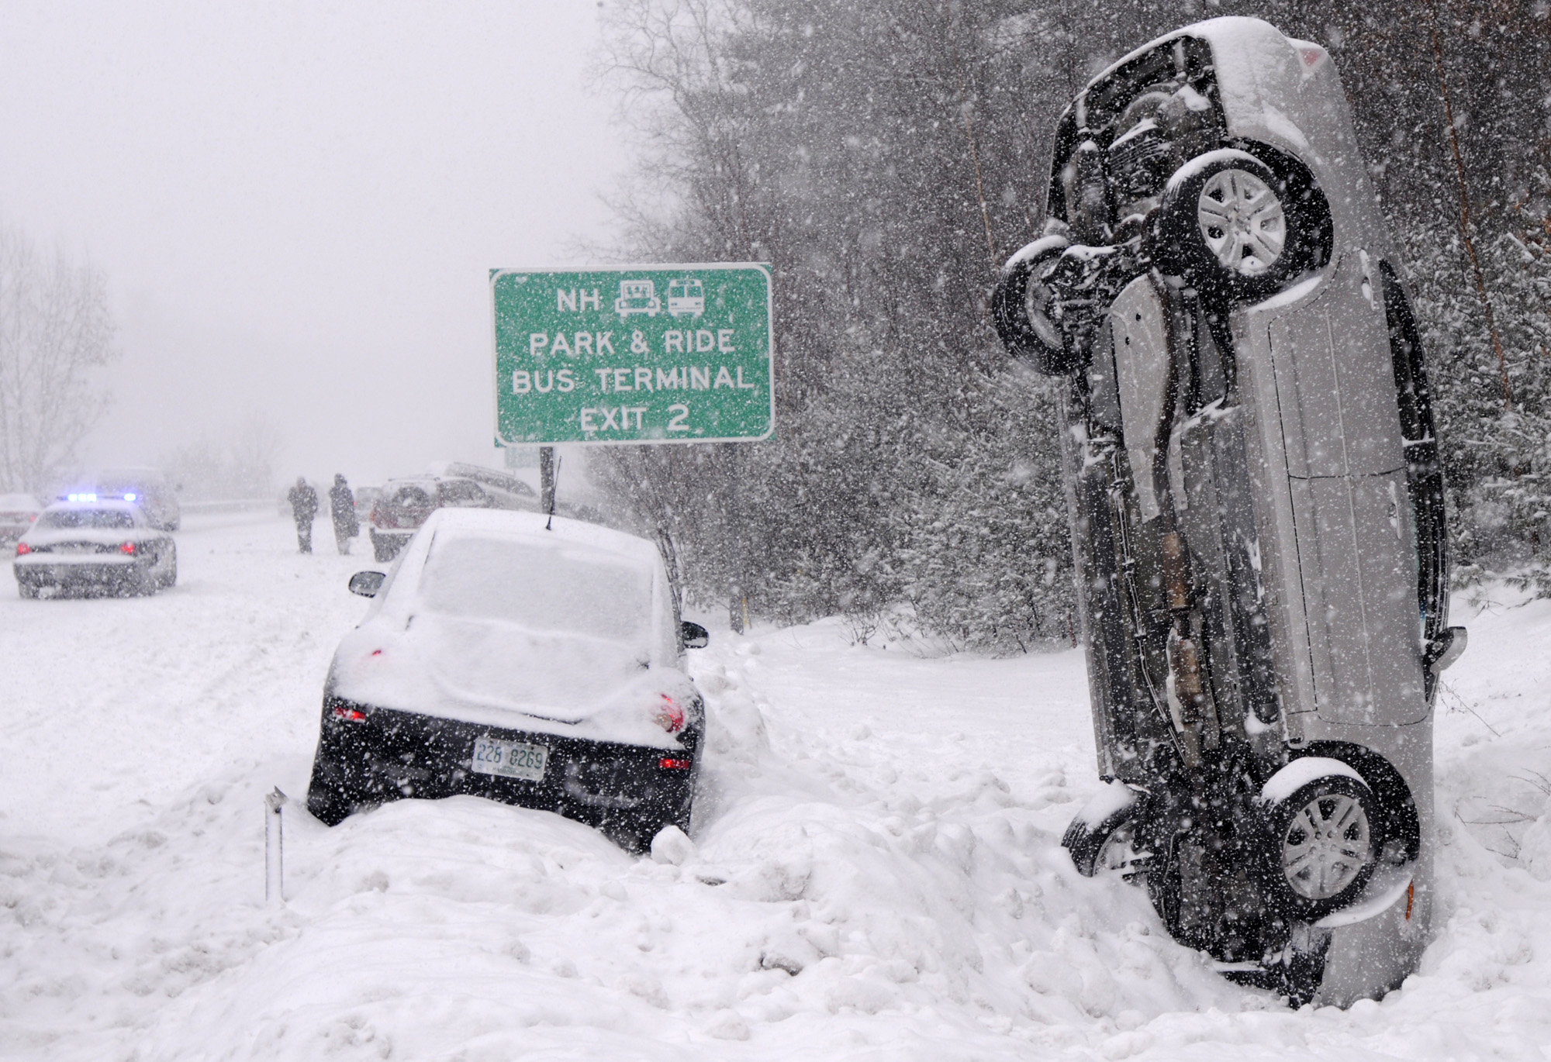
Commentary About Risk
We take risks everyday! We manage risks everyday, it is inherent to all of our lives in some shape or form. All of us have a different perception of risk and a different perception of risk.

Slide 5
Managing Risk is Hard
Risk management can invoke human emotion and counter the ego of participants and management
Risk management is hampered and made difficult by human tendencies and biases:
Optimism Bias – simply, bad things won’t happen to them!
Wishful Thinking – desire to construe circumstances only in a positive light
Cognitive Inertia – unwillingness to change even with new evidence
Illusion of Control – belief in having more control over outcome
Human intuition and psychology are often not probabilistically rational!
Risk management tools enable characterizing risks in a more measured and analytical way

Slide 6
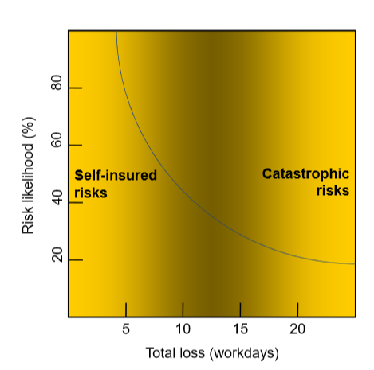
Determining the Degree of Risk Management Necessary
Risk management can be overdone!
Extended-warranty insurance
Analysis-Paralysis
Excessive life insurance
Establishing thresholds for risk guide the degree of risk a project can tolerate
Cost (threat to management reserve)
Schedule (threat to schedule reserve)
Safety (threat to well being of stakeholders)
Environment (threat to well being of the surroundings)

Slide 7
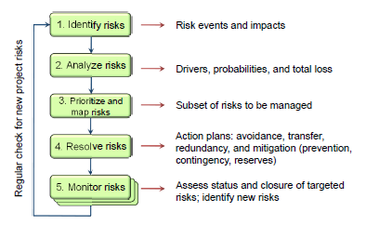
The Risk Management Process
Most of us have probably been involved in risk management during a project:

Slide 8
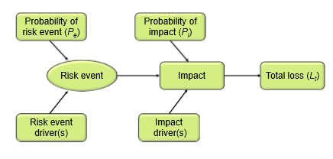
Risk Model
Risk event: Happening or state that “triggers” a loss.
Risk event driver: Factor in project that leads to belief that the risk could occur.
Probability of risk event: Probability that risk will occur.
Impact(of a risk): Consequence or potential loss resulting from risk event.
Probability of impact: Conditional probability that impact will occur, given that its risk event occurs.
Total loss: Magnitude of actual loss value accrued when both risk event and impact occur.
– Measured in days or money
– Consistently use one unit

Slide 9
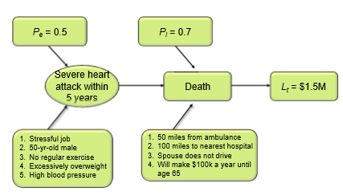
Standard Risk Model Example

Slide 10
Identifying Total Loss
Total loss: Magnitude of loss value accrued when risk event and impact occur.
Preferable to measure loss in time or money (Alternatives: Performance, quality.)
Use one unit of loss throughout.
Potential problem: Subjectivity in determining total loss value.
Subjectivity is reduced by having well‐written impact drivers.
In general, must determine total loss to enable prioritization of risks.

Slide 11
Identifying Risk Drivers
Risk Event Driver: Facts leading us to believe that a risk event is imminent.
Verify that risk event drivers clearly (but briefly) answers the question, “What are the project facts leading to belief that this risk event might occur?”
Impact drivers answer two important questions:
What project facts make impact more or less likely to occur?
What project facts establish magnitude of total loss?

Slide 12
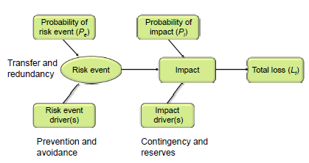
What kind of actions can we take?

Slide 13
Actions Can Be Taken
Avoidance – make choices which steer away from risks
Transfer – transfer action to another party who may be more experienced
Redundancy – follow more than one parallel path
Mitigate – make something less severe, target causes of the risk
Prevention – change risk event drivers to reduce probability of risk
Contingency – change impact drivers to reduce probability of impact
Reserves – buffers against the unknown

Slide 14
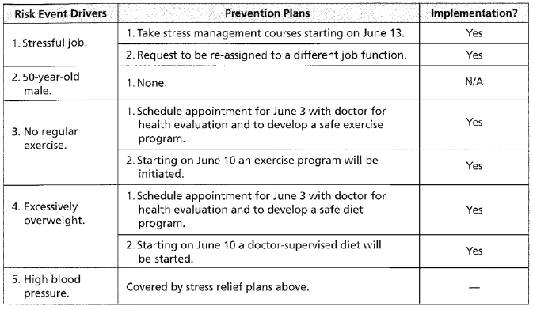
Back to the Example

Slide 15
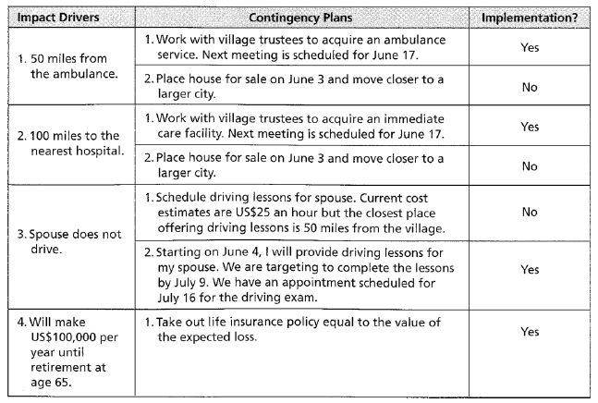
Back to the Example

Slide 16
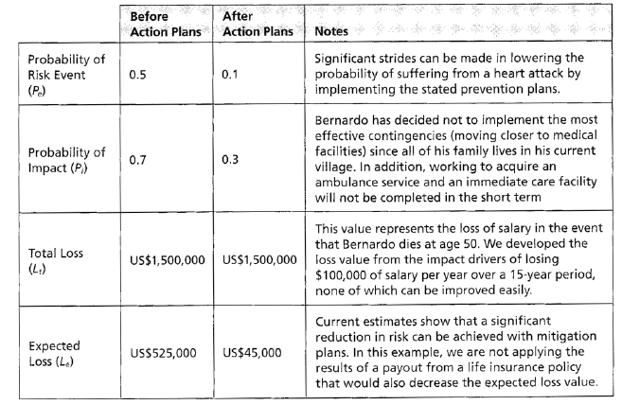
Back to the Example

Slide 17
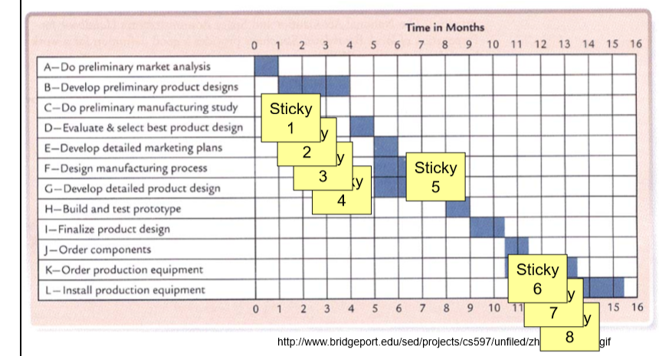
Different Methods Used in Risk Management Process
Identifying schedule risks:
Stick note method:
Gantt chart on wall, participants identifying risks using sticky notes.

Slide 18
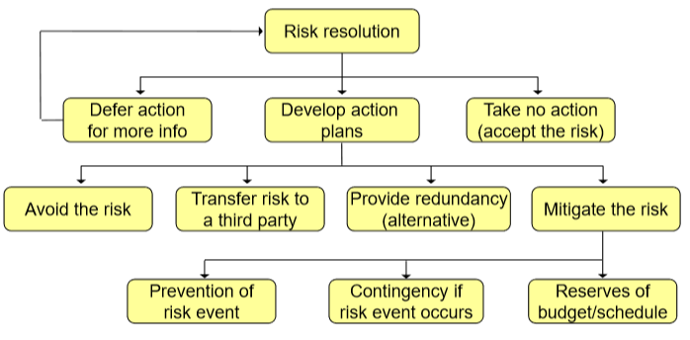
Risk resolution process

Slide 19
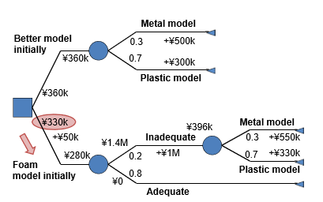
Decision Analysis

Slide 20
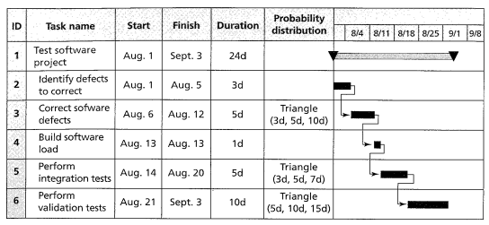
Schedule Analysis

Slide 21
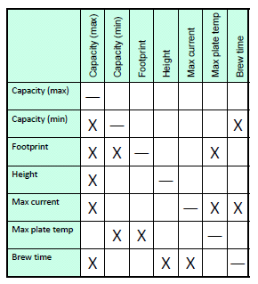
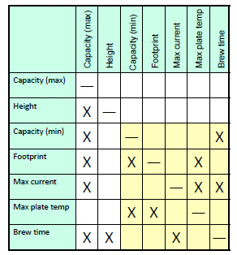
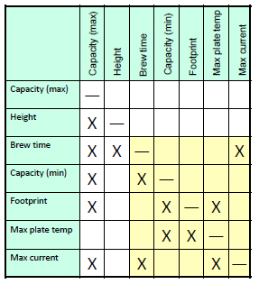
Design Structure Matrix
Rearrange to find minimum interdependencies
Designing a Coffee Maker
Each X is an interdependency (and iteration)
Row items depend on columns when “X” identified
Strategy, move all X to below diagonal and centered along diagonal

Slide 22
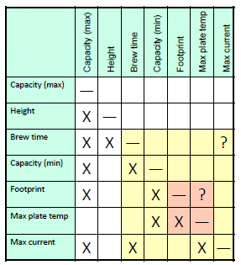
Design Structure Matrix
To proceed with design, work from top down
Select capacity
Determine Height (dependent on capacity)
Determine Brew Time (dependent on capacity, height) – make assumption on max current
Etc.
Remaining X above diagonal need to be assumptions
Also represent areas of potential risk (unknowns)

Slide 23
Other Miscellanous Thoughts for Consideration
Avoid risk when no added value (standardizing)
Mistake proofing
Risk avoidance should not be confused with risk aversion
Stay flexible on unresolved issues
Customer/Stakeholder contact
Don’t procrastinate the difficult risks (doing “easier” ones first)
Apportion risk carefully
Testing!

Slide 24
Any Questions?
Contact
Ernie Kyed
(801) 518-1296
(435) 863-6050
ernest.kyed@ngc.com

