Slide 1

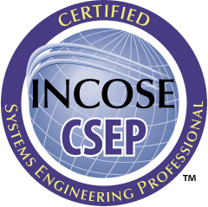
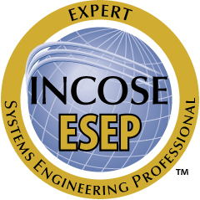
INCOSE Systems Engineering Professional (SEP) Certification
Program Overview
June 2018
TM The INCOSE SEP Logos are trademarks of INCOSE
© 2006-2018 International Council on Systems Engineering
Subject to the restrictions on Copyright Page

Slide 2
What is INCOSE?
The International Council on Systems Engineering (INCOSE) is a not-for-profit membership organization founded in 1990 to develop and disseminate the interdisciplinary principles and practices that enable the realization of successful systems.
Mission
Share, promote and advance the best of systems engineering from across the globe for the benefit of humanity and the planet.
Vision
The world's authority on Systems Engineering.
Certification is just one of many INCOSE products and offerings.
Wasatch Chapter SEP Program Overview
Notes:
2

Slide 3
The INCOSE SEP Program Purpose and Benefits
The INCOSE SEP program has been developed as the highest quality, independent assessment of system engineering professionals benefiting:
Systems engineering community:
  Creates the standard to identify and develop systems engineering professionals .
  Establishes a formal, recognized body of knowledge for the systems engineering community.
System engineering professionals:
  Provides a portable standard of recognition for attainment of knowledge, education, and experience.
  Its recertification requirements serve as a mechanism for continued professional development.
Organizations/institutions:
  A universal, industry-approved measure of a professional’s knowledge –achieved through the independent evaluation of relevant tasks, projects, and programs.
INCOSE’s certification program continues to grow due to the increasing recognition of its value to professionals, to organizations/ institutions, and to the overall systems engineering community.

Slide 4
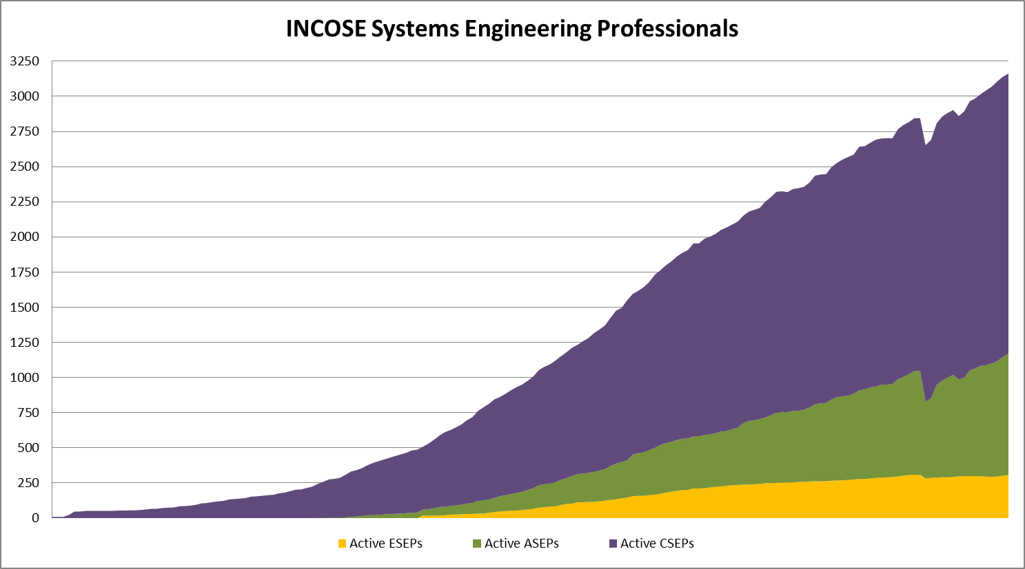
The INCOSE certification program’s three levels of certification have grown steadily since 2004.
As of 31 December 2018:
3162 Total SEPs
1993 CSEPs
862 ASEPs
307 ESEPs
2882
2700
2436
2180
1887
1476
1093
788
487
331

Slide 5
Topics
What is certification and why is it important?
Who is recognizing and supporting certification?
What level of certification is right for me?
How do I apply for certification?
How do I renew my certification?
Where can I find more information?

Slide 6
What Is Certification?
Certification is an occupational designation
  Provides confirmation of an individual's competency (demonstrated knowledge, education, and experience) in a specified profession or occupational specialty
Certification is a formal process
  Issued by an organization
Certification is voluntary
  It is neither a barrier nor a gate to entering a job
  However, it may be used as a qualifier in placement
Certificate
License
INCOSE’s Systems Engineering Professional Certification Program is a formal process that recognizes individuals who have demonstrated a measurable level of comprehension (education and knowledge) and proficiency (experience) in performing tasks applicable to the systems engineering profession.

Slide 7
Organizations are asking for SEP in job postings
Aspiration Software
Barrios
Belcan Government Services
Booz Allen Hamilton
Central Intelligence Agency
ClearMotion
DRS Technologies
Engility
Georgia Tech Research Institute
IDEMIA
INNOVIM
JB Management
KBRWyle
Leidos
Lockheed Martin
Logistics Management Institute
The Mitre Corporation
National Geospatial-Intelligence Agency
Newbrook
Noblis
Northrop Grumman Corporation
Oceaneering
OG Systems
Raytheon
SAIC
Sanmina Corporation
Vencore

Slide 8

Why is Certification Important?
For organizations…
Formally recognizes the Systems Engineering capabilities of your professional staff
Can provide a discriminator for your proposals
Can be used as part of the hiring and promotion process
Provides an independent external assessment
Encourages employee participation in continuing education
INCOSE SEP sets your organization apart!
Notes:
8

Slide 9
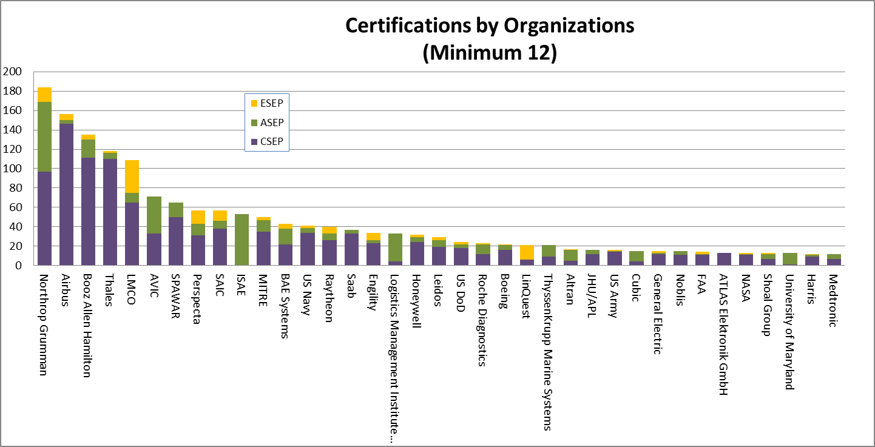
The INCOSE SEPs come from many different organizations and domains.
As of 31 December 2018:
Top Organizations w/ Active SEPs
Northrop Grumman 184 SEPs
The Airbus Group 156 SEPs
Booz Allen 135 SEPs

Slide 10

Why is Certification Important?
For individuals…
Formally recognizes your Systems Engineering capabilities
Provides a discriminator for job applicants
Provides a competitive advantage in your career
Provides a portable Systems Engineering designation that is recognized across industry domains
Participation in continuing education indicates your commitment to personal development
INCOSE SEP sets you apart!

Slide 11

Why is Certification Important?
For your teams…
Allows the team to level-set on Systems Engineering concepts and activities
Helps establish a common Systems Engineering language for your team
Helps break down…
  geographic boundaries
  organizational boundaries
  cultural boundaries
INCOSE SEP is particularly useful for multi-organization, geographically distributed teams.

Slide 12

Ways to Leverage Certification
Individuals
  Recognition
    Designation on business card, resume, signature, etc.
  Performance objective
Organizations
  Performance expectation
  Career ladder alignment
  Job advertisement
  Proposal discriminator
  Supplier qualification

Slide 13
Topics
What is certification and why is it important?
Who is recognizing and supporting certification?
What level of certification is right for me?
How do I apply for certification?
How do I renew my certification?
Where can I find more information?

Slide 14
Certification Agreements
Industry agreements
  The Airbus Group
  Booz Allen Hamilton
  ManTech
  MITRE
  Lockheed Martin
  Engility
  Jacobs Technology
  ASTER Technology & Engineering
  LinQuest
  Thales
  OPS Consulting
  Perspecta
  AVIC IT
  Roche
University agreements
  Stevens Institute of Technology
  University of Texas – El Paso
  École Polytechnique
  ISAE/Supaero
  University of New South Wales
  Worcester Polytechnic Institute
  Drexel University
Other agreements
  OMG OCSMP
  GfSE (Germany)
  SESA (Australia)
  INCOSE UK Chapter
  KCOSE

Slide 15
Topics
What is certification and why is it important?
Who is recognizing and supporting certification?
What level of certification is right for me?
How do I apply for certification?
How do I renew my certification?
Where can I find more information?

Slide 16
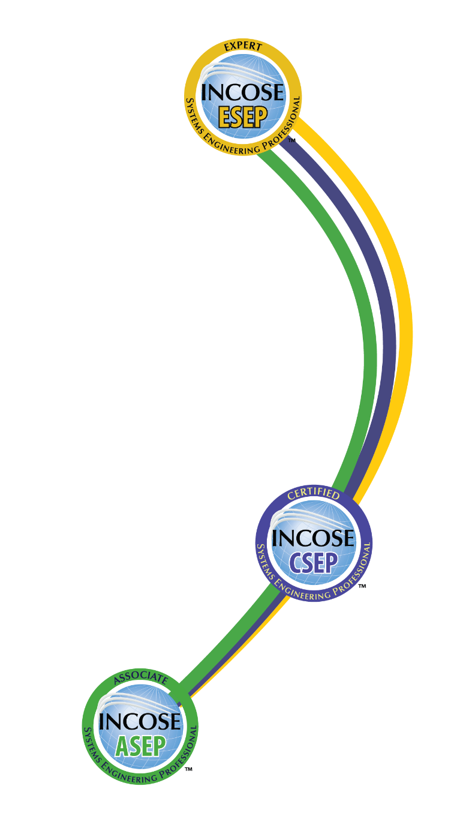
INCOSE SEP Architecture
For wherever you are in your career
Multi-Level Base Credentials
The base ASEP, CSEP, and ESEP credentials cover the breadth of systems engineering at increasing levels of leadership, accomplishments, and experience.

Slide 17

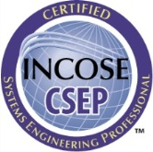
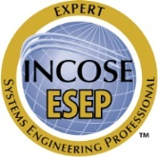
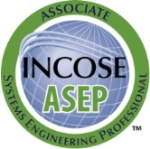
INCOSE provides a measurable standard of certification consistent with ISO guidelines.
Experience
Knowledge
Leadership &
Accomplishments
Education

Slide 18
The SEP Aligns with the Typical Levels of a Systems Engineering Career
ESEP focused on:
- LEADERSHIP
- SE ACCOMPLISHMENTS
- SIGNIFICANT SE EXPERIENCE
INCOSE ESEP
CSEP focused on:
- SE EXPERIENCE
- APPLIED SE KNOWLEDGE
INCOSE CSEP
ASEP focused on:
- SE KNOWLEDGE
INCOSE ASEP
SEP Candidates
You can enter at whatever SEP level is appropriate and can seamlessly transition between levels when ready.

Slide 19
Entry Level ASEP
Associate Systems Engineering Professional
Targeted towards junior engineers/college graduates with limited SE work experience
Certified for knowledge requirements only
  confirmed through INCOSE SE Handbook based exam
Must be, and remain, INCOSE member
  Renewal every 5 years through ongoing professional development, maximum duration of 15 years

Slide 20
Foundation Level CSEP
Certified Systems Engineering Professional
Targeted towards systems engineers with five or more years of SE work experience
Certified on substantiated experience, education, and knowledge requirements
  Experience must be substantiated by 3-5 work-related references
  Meet PDU requirements
  Knowledge confirmed through an exam based on the INCOSE SE Handbook
CSEPs must be, and remain, INCOSE members
  Does not apply to those who applied in 2015 or earlier
  Renewal every 3 years through ongoing professional
  development

Slide 21
Senior Level ESEP
Expert Systems Engineering Professional
Targeted towards senior systems engineering leaders with recognized systems accomplishments, many years of SE experience
ESEPs are certified against substantiated professional leadership, systems engineering accomplishments, experience, and education requirements
  At least 10 years of experience must be substantiated by 3-5 work-related references
  Interviews used to validate leadership and significant systems accomplishments
ESEPs must be, and remain, INCOSE member
  Only requires annual INCOSE membership fees*

Slide 22
CSEP/ESEP Certification Education Requirements
Education
  Qualifying Bachelor’s Degree (or international equivalent)
    Acceptable engineering fields of study include: aeronautics, biomedical, chemical, civil, computer, electrical, environmental, industrial, mechanical, nuclear, software, systems
    Other acceptable fields of study include: chemistry, computer science, mathematics, physics
    If the Bachelor’s degree does not come from the above fields, then a Masters or Doctorate degree (or international equivalent) in those fields is acceptable
    INCOSE is the final authority on degree applicability
Additional Experience Can be Substituted
  Minimum of 5 additional years of general engineering experience for non-technical Bachelor’s degree
    Minimum of 10 years (with at least 5 in SE) for CSEP
    Minimum of 25 years (with at least 20 in SE) for ESEP w/ CSEP
    Minimum of 30 years (with at least 25 in SE) for ESEP w/o CSEP
  Minimum of 10 additional years of general engineering experience if no Bachelor’s degree
    Minimum of 15 years (with at least 5 in SE) for CSEP
    Minimum of 30 years (with at least 20 in SE) for ESEP w/ CSEP
    Minimum of 35 years (with at least 25 in SE) for ESEP w/o CSEP

Slide 23
SE Experience Areas for the Individual Application
Requirements Engineering
Architecture / Design Development
System Integration
Verification and Validation
Technical Planning
Technical Monitoring and Control
Acquisition and Supply
Information Management and Configuration Control
Risk and Opportunity Management
Process and Lifecycle Definition
Specialty Engineering
Organizational Project Enabling Activities
Other
Successful candidates must have balanced experience across multiple areas

Slide 24
CSEP Certification Experience Requirements
CSEP Systems Engineering Experience
  Minimum 5 years of professional level experience in multiple SE functional areas (and any additional general years of experience necessary due to education status)
  Minimum of at least 1 year of professional level SE experience in each of 3 or more of the SE experience areas
  Must be documented on the INCOSE application form
Experience Confirmation
  Recommendations from at least 3 colleagues / peers / managers
  References must cover at least 5 years and 3 areas of SE experience claimed by the applicant (including any additional years)
  References must be knowledgeable in Systems Engineering (or general engineering for any additional years) and have at least five years of relevant experience
  Must be documented on the INCOSE reference form

Slide 25
ESEP Certification Experience Requirements
ESEP Systems Engineering Experience
  Minimum 25 years (20 if already a CSEP) of professional level experience in multiple SE functional areas (and any additional general years of experience necessary due to education status)
  Minimum of at least 2 years of professional level SE experience in each of 6 or more of the SE experience areas
  Must be documented on the INCOSE application form
Experience Confirmation
  Recommendations from at least 3 colleagues / peers / managers
  References must cover at least 10 years of SE experience claimed by the applicant
  References must be knowledgeable in Systems Engineering and have at least five years of relevant experience
  Must be documented on the INCOSE reference form

Slide 26
ESEP Professional Leadership Requirements
Minimum of 5 years of professional leadership.
  Product Development Leadership Years
    Years of leadership in a product development position, such as chief engineer or development team lead
    1 year credit for each year in a leadership position - no limit
  Technical Society Leadership Years
    Leadership of a professional technical society, such as elected officer, appointed committee chair, editor, or thought leader
    0.5 year credit for each year of service – no limit
  Advanced Academics Years
    Technical Master’s degree (or international equivalent)
      1 year credit
    Technical Doctoral degree (or international equivalent)
      2 years credit if separate credit is given for a Master’s degree
      3 years credit if separate credit is not given for a Master’s degree
    Systems engineering graduate-level teaching
      1 year of credit for each 500 hours of classroom instruction spread over a 3 year time period, limited to a maximum of 3 years
    Category limited to a maximum of 4 years credit
ESEPs must show a history of professional leadership

Slide 27
ESEP Certification Oral Review
Applicant must be willing to participate in an oral review
  Purpose of the oral review is to confirm the applicant is a Systems Engineering leader and to verify the applicant’s accomplishments and experience
  The oral review questions are in behavior-based format
At least two (2) of the references must be willing to participate in an oral review (if required)
  Purpose of the reference oral review(s) is to confirm/supplement the applicant’s information
The oral reviews
  Are done via phone
  Typically do not exceeding 60 minutes (30 minutes for references)
  Are in the English language
  Are conducted by an evaluation panel consisting of INCOSE ESEPs trained as Certification Application Reviewers (CARs)
The oral reviews focus on verifying the applicant’s leadership, accomplishments, and experience.

Slide 28

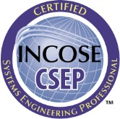

The Key Elements of INCOSE Certification
(What is Certified?)
 | SE Knowledge | Education | SE Experience | SE Leadership & Accomplishments
 | Via an exam based on the INCOSE SE Handbook
 | Via an exam based on the INCOSE SE Handbook | Via confirmation of qualifying degree (or additional experience, if required) | Via confirmation of applicant’s and references written experience claims
 |  | Via confirmation of qualifying degree (or additional experience, if required) | Via confirmation of applicant’s and references written experience claims | Via oral review of applicant (and references, if required)
These four elements (knowledge, education, experience, and leadership & accomplishments) allow for a variety of SE certifications to be earned.

Slide 29
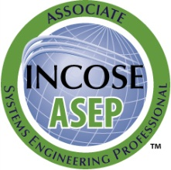
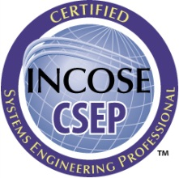

So What Certification is Right for You?
If you have just started (or plan to start) practicing systems engineering or have recently graduated and are interested in systems engineering
If you are a practicing Systems Engineer with more than five years of systems engineering professional work experience
If you are a systems engineering leader with recognized systems accomplishments and have many years of systems engineering professional work experience

Slide 30
Topics
What is certification and why is it important?
Who is recognizing and supporting certification?
What level of certification is right for me?
How do I apply for certification?
How do I renew my certification?
Where can I find more information?

Slide 31


ASEP Application Process
Study
INCOSE SE Handbook
Application
Development
Notify
Applicant
5 year
Certification
Notify
Applicant
Pass
Two weeks
Submit Completed
Application
And Fee
Two weeks
Pay test fee
Schedule & Take Exam
(Prometric Test Center)
Applicant
Information
$
Applicant’s own pace
Applicant has up to one year to pass the test. Test is scheduled directly with Prometric.
Applicant’s own pace
Timeline

Slide 32
CSEP Application Process
Study
INCOSE SE Handbook
Notify
Applicant
Pass
Two weeks
3 year
Certification
3 year
Certification
Application
Development
Notify
Applicant
Pay test fee
Schedule & Take Exam
(Prometric Test Center)
Pass
Submit Completed
Application
And Fee
Two weeks
Applicant’s own pace
INCOSE
Application
Center
1. Verifiable
Education
$
Reference
Submittal
2. Verifiable
Experience
3. Applicant’s
Advocates (three references knowledgeable about SE)
Applicant has up to one year to pass the test. Test is scheduled directly with Prometric.
INCOSE
Evaluation
Applicant’s own pace
References’ own pace
Four to six weeks
Timeline

Slide 33
ESEP Application Process
Application
Development
Pass
INCOSE
Application
Center
Notify
Applicant
Notify
Applicant
Certification
1. Verifiable
Education
Conduct Oral Review
with Applicant and
Up to Two References
(Via telephone conference)
2. Verifiable
Experience
3. Applicant’s
Advocates (three references knowledgeable about SE)
Submit Completed
Application
And Fee
INCOSE
Evaluation
$
Applicant has up to one year to complete the entire process.
4. Verifiable
Professional
Development
Four to six weeks
Mutual
Agreement
Two weeks
Applicant’s own pace
Timeline

Slide 34
How Long Will It Take to Get CSEP?
There is no one answer. Much depends on the applicant.
Applicant
Downloads information from INCOSE web page
Collects information
Fills out and submits forms via e-mail
Pays fee on-line
Applicant
Schedules exam with test organization
Takes exam at test site
Receives results immediately
Schedules exam, if needed
References submit recommendations via e-mail to INCOSE. Applicant submits missing material.
A. ??????
C. Averaging 50 days
E. Averaging 62 days
Time
B. < 2 weeks
D. Approx. 30 days
F. < 2 weeks
INCOSE
Receives application & fee
Checks completeness of submittal
Notifies applicant by e-mail that application was received and is complete or has missing material
INCOSE
Receives recommendations from references and missing information
Evaluates education and experience
Notifies applicant of evaluation results. If minimum requirements are met, authorizes exam
INCOSE sends CSEP certificate via postal mail to applicant
While the times vary, the average time for CSEP is ~200 days.
Notes:
Go through this slide very slowly. Emphasize that the applicant is the main pacer for most parts of the certification process, and thus the length of the process.
INCOSE involvement for processing is restricted by procedure to approximately 2 months.
Note: We will collect metrics to establish a better historical estimate.

Slide 35
Topics
What is certification and why is it important?
Who is recognizing and supporting certification?
What level of certification is right for me?
How do I apply for certification?
How do I renew my certification?
Where can I find more information?

Slide 36
Certification Renewal Requirements
Certification is Valid for
  3 Years for CSEP, and applicants starting in 2016 must maintain INCOSE membership
  5 Years for ASEP and must maintain INCOSE membership
  Indefinite for ESEP, but must maintain INCOSE membership
  Extensions (e.g., Acq) are renewed concurrent with the base certification, regardless of when earned
Certification renewal requires
  Minimum of 120 Professional Development Units (PDUs)
  Renewal application
  Continuing education log submittal
  Must be submitted before current certification period ends
  Up to 30 “excess” PDUs can be “carried forward”
INCOSE certified professionals have an ongoing growth and learning obligation

Slide 37
PDUs for Certification Renewal (1 of 2)
Professional Development Activities (All must be relevant to the practice of systems engineering) | Credit | 3/5 Year Limit
Technical Society Participation Category
Be an INCOSE individual, senior, or student member | 5 PDU/year | 15 PDU
Attend professional technical society local event/chapter presentation/exhibit | 1 PDU/hour attendance | 30 PDU
Attend professional technical society conference/symposium | 1 PDU/hour attendance | 72 PDU
Participate on professional technical society working groups, committees, etc. | 1 PDU/hour of effort | No limit
Perform leadership role in professional technical society at local, national or international level | 1 PDU/hour of effort | No limit
Volunteer activities with youth in schools or community related to science, technology, engineering, and math (STEM) | 1 PDU/hour of effort | 72 PDU
Volunteer activities with community, school, or non-profit organizations that help them accomplish their technical needs | 1 PDU/hour of effort | 30 PDU
Earn an SE-relevant, exam-based, professional certification other than INCOSE SEP | 5 PDU/certification (Up to 2 per renewal period) | 10 PDU
Notes:
Highlight that this table identifies ways for earning continuing education credits.
Point out that these credits may be earned over a three year time period, and that as many as 30 PDUs may be carried forward.

Slide 38
PDUs for Certification Renewal (2 of 2)
Professional Development Activities (All must be relevant to the practice of systems engineering) | Credit | 3/5 Year Limit
SE Course Work & Publication Category
Complete a technical graduate level course | 2 PDU/class hour | No limit
Attend educational course, tutorial, or seminar | 1 PDU/hour | No limit
Teach professional development coursework, including presentations not part of job function. | 2 PDU/hour (prep) 1 PDU/hour (teach) | 40 PDU
Write & publish SE article | 5 PDU/article | No limit
Write & publish SE book | 30 PDU (primary author)/book 10 PDU (contrib. author)/book | No limit
Attend vendor presentation with educational value | 1 PDU/hour attendance | 15 PDU
SE Job Function Participation Category
Receive patent award | 10 PDU/award | No limit
Serve as designated lead systems engineer for a system, product or service | 15 PDU/year | 45 PDU
Lead organization to increase INCOSE systems engineering certifications | 5 PDU/year | 15 PDU
Volunteer (i.e., non-compensated) activities within your organization related to engineering and science | 1 PDU/hour of effort | 30 PDU
Notes:
Highlight that this table identifies ways for earning continuing education credits.
Point out that these credits may be earned over a three year time period, and that as many as 30 PDUs may be carried forward.

Slide 39
Managing the ESEP Maze
Follow Form 42 (ESEP Instructions for Form 41) to the letter!
Take your time filling out the application (Form 41)!
INCOSE will not tell you what or how to fix your application if they find a mistake!
Choose three solid long-term references that have distinguished careers!
Find a mentor that has done it before – preferably, a prior or active CAR member

Slide 40
ESEP Application Index
Section 1 : General Information
Section 2 : INCOSE Membership
Section 3 : Fee Payment – important section!
Section 4: Education
Section 5: Experience – most important section!
Section 6: Professional Development & Contribution to SE Profession
  Product Development or Technical Service Leadership
  Technical Society Leadership
  Advance Academic Years
  Graduate SE Teaching
Section 7: Affidavit
Section 8: Optional Info

Slide 41
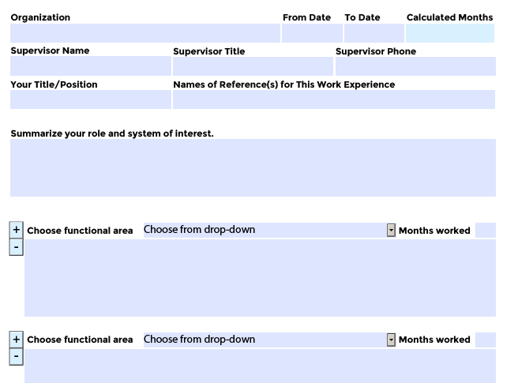
Professional Experience

Slide 42
SE Experience Areas for the Individual Application
Requirements Engineering
Architecture / Design Development
System Integration
Verification and Validation
Technical Planning
Technical Monitoring and Control
Acquisition and Supply
Information Management and Configuration Control
Risk and Opportunity Management
Process and Lifecycle Definition
Specialty Engineering
Organizational Project Enabling Activities
Other
Successful candidates must have balanced experience across multiple areas

Slide 43
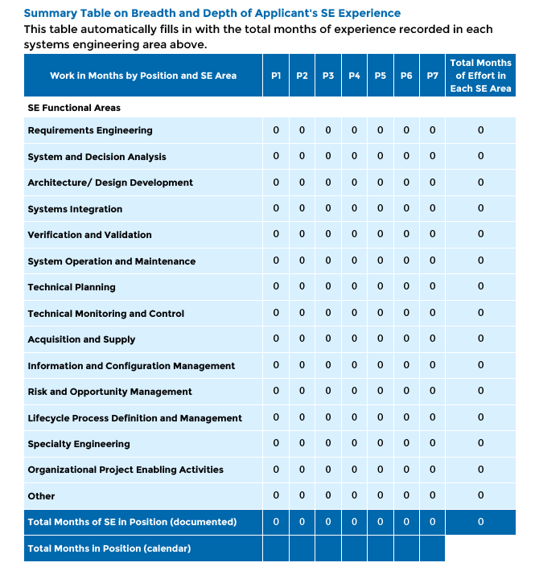
Experience Summary Table

Slide 44
Topics
What is certification and why is it important?
Who is recognizing and supporting certification?
What level of certification is right for me?
How do I apply for certification?
How do I renew my certification?
Where can I find more information?

Slide 45
Any Questions?
Email Contacts
Certification Office:
certification@ incose.org
Courtney Wright, CSEP
Certification Program Manager:
Courtney.Wright@incose.org
For more information visit:
http://www.incose.org/certification/
For copy of SE Handbook v4.0 tutorial:
https://connect.incose.org/Pages/Product-Details.aspx?ProductCode=HandbookTutorial

Slide 46
INCOSE Copyright Notice
Copyright © 2006-2018 by INCOSE, subject to the following restrictions:
  Author Use. Authors have full rights to use their contributions in a totally unfettered way. Abstraction is permitted with credit to the source.
  INCOSE Use. Permission to reproduce and use this document or parts thereof by members of INCOSE and to prepare derivative works from this document for INCOSE use is granted, with attribution to INCOSE and the original author(s) where practical, provided this copyright notice is included with all reproductions and derivative works.
  External Use. This document may be shared or distributed to non-INCOSE third parties. Requests for permission to reproduce this document in whole are granted, provided it is not altered in any way. Requests for permission to prepare derivative works of this document for external and/or commercial use will be denied unless covered by other formal agreements with INCOSE. Copying, scanning, retyping, or any other form of reproduction of the content of whole pages or source documents is prohibited except as approved by the INCOSE Central Office, 7670 Opportunity Rd #220, San Diego, CA 92111.
  Electronic Version Use. Any electronic version of this document is to be used for personal use only and is not to be placed on a non-INCOSE sponsored server for general use. Any additional use of these materials must have written approval from INCOSE Central.
  Permissions. INCOSE has granted permission to member companies of the INCOSE Corporate Advisory Board to post and use this document internally, subject to the external use restriction.
  Technical Data. This data was prepared by INCOSE for information only. It has been released by INCOSE as Technical Data. It is subject to change without notice and may not be referred to as an INCOSE Technical Product.
  This briefing was created from information from various INCOSE sources as indicated in the Notes section of this slide. Send comments to certification@incose.org.
Notes:
This presentation was extracted and updated from:
The INCOSE Certification web site: http://www.incose.org/educationcareers/certification/
Certification Status Report, INCOSE IW & IS, Certification Program Manager, January/February & June/July 2006, 2007, 2008, 2009, 2010, 2011
Associate Systems Engineering Professional (ASEP) Certification: A Credential Tailored for Students and Junior Engineers, Steven Walter, CSEP & David Walden, CSEP 2010 Annual ASEE Conference & Exposition in Louisville, KY , June 2010
Leveraging Certification: Individually and for Your Organization, David Walden, CSEP, INCOSE North Star Chapter Presentation, January 2010
Certification of Systems Engineers, INCOSE-TD-2006-001-01, John Clark, CSEP and Karl Geist, CSEP, August 2007
INCOSE Certification of Systems Engineers, Certification Program Briefing for Chapters, CB0104, Karl C. Geist, CSEP, 9 Nov 2005 and CB0607, Karl C. Geist, CSEP, 6 Jun 2007
INCOSE Certification of Systems Engineers Program, Program Status Report, John Muehlbauer, CSEP, January 2007
New Member Introduction & Orientation, INCOSE IS 2006, Bruce Shelton, CSEP, 10 July 2006
Presentation to INCOSE IW06, Kenneth J. Kepchar, CSEP, 28 Jan 2006

