Slide 1
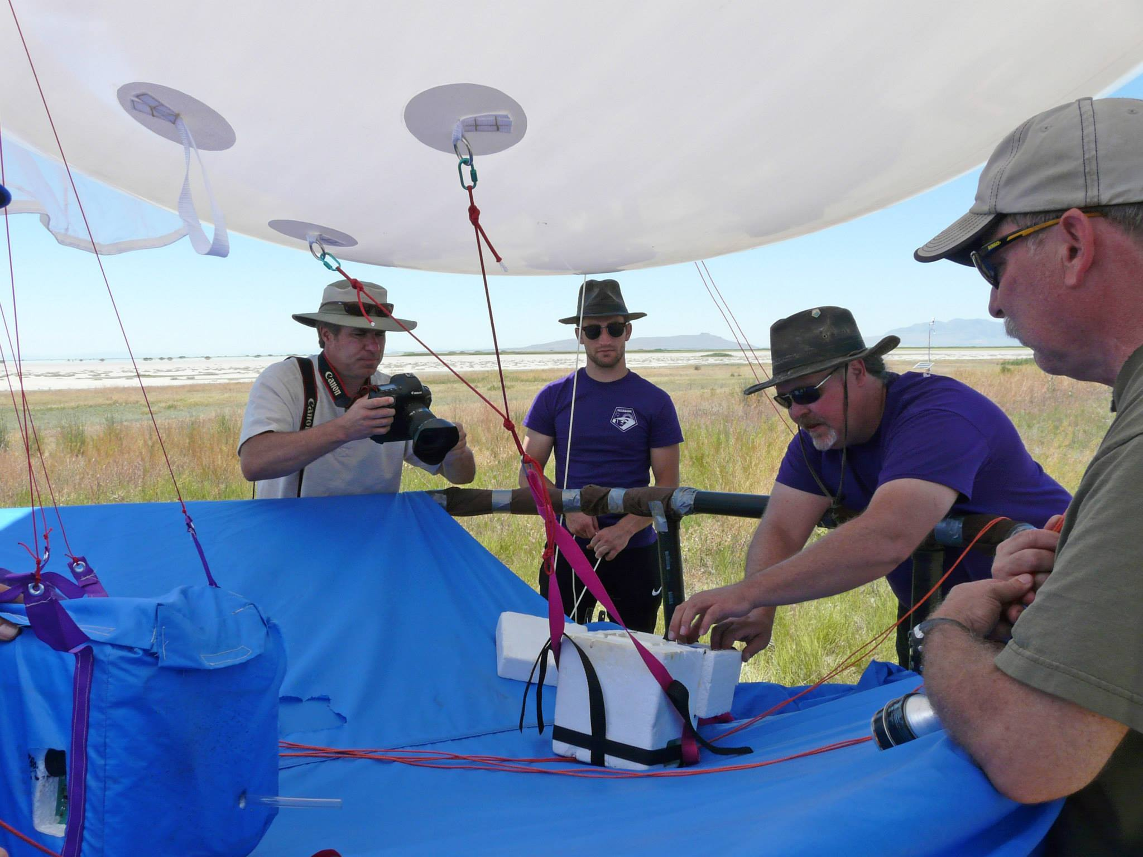
"Physics, Systems Engineering, and the AtmoSniffer"
John E. Sohl
Weber State University, Physics

Slide 2
A Shameless Plug for Weber State!
Physics (B.S.) & Applied Physics (B.S.)
HARBOR near-spaceflight program
One of the most hands-on physics programs in the US
Alumni in “all” fields: Semiconductor design, aerospace, business, environment, nuclear energy & waste, national labs, universities, etc.
Truth: All engineering is based on physics
Engineering (B.S., M.S.)
Electrical, Mechanical (B.S. only), Computer
Manufacturing Systems Engineering (B.S.)
Just started Fall 2018
~20 declared majors in the first year!

Slide 3
Key Elements of Systems Engineering
Upfront Systems Engineering:
Spending money early saves money later.
Rapid Prototyping:
Learn from simple models and sub-projects.
MSA, Mini-MSA, Tricorder, Mini-Beacon, etc.
Design for Manufacturability:
Ease of assembly, relationship between parts, assembly sequence
Design for Maintainability
Enterprise Value:
Market research to establish user needs.
Integration, Test, and Validation:
Continuous calibration of prototypes

Slide 4
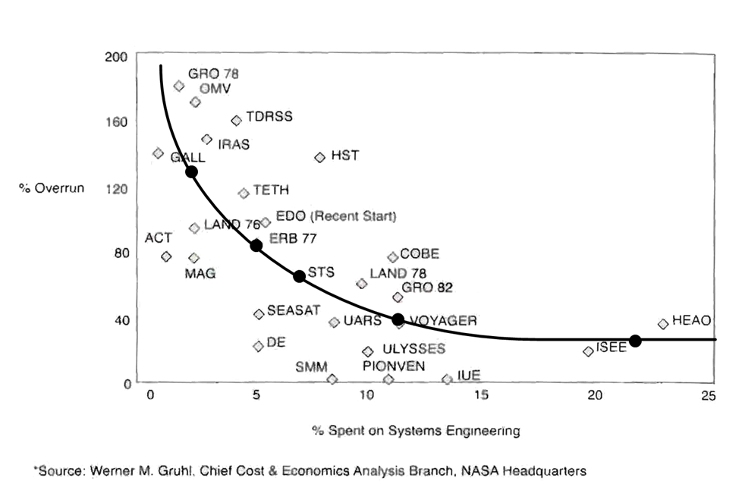
Werner Gruhl’s famous NASA analysis

Slide 5
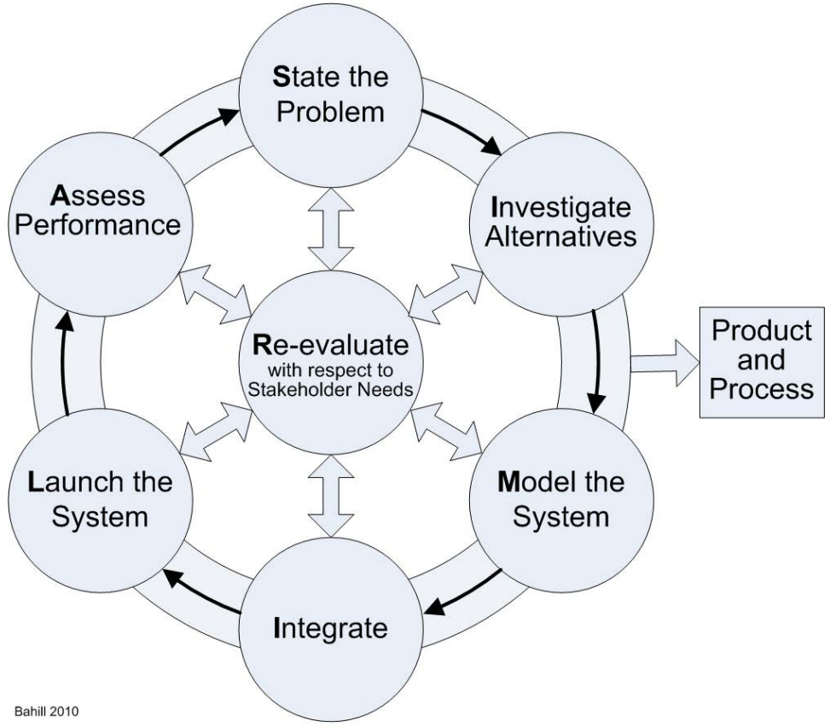
From Bahill (2010) and INCOSE
The SIMILAR Process

Slide 6
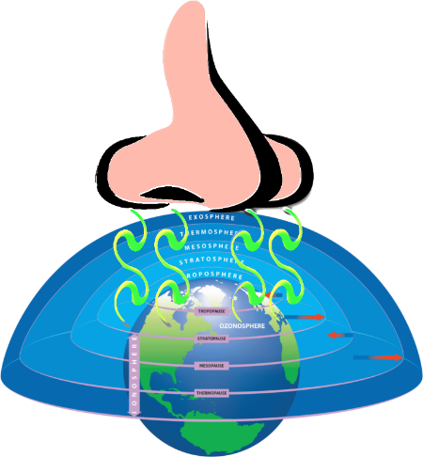
What is the AtmoSniffer?
Lightweight: < 1.4 kg
Compact: Loaf of Bread
Low Power: Runs 7 hours on 5200 mAh battery
Measures:
CO, CO₂, NO, NO₂, SO₂, NH₃, O₃, VOCs
Particulate Counter: 1 µm to 10 µm
Temp., Press., %RH, GPS Location (wind)
9-axis inertial sensor (turbulence)
Multiple Interfaces
Onboard datalogging to microSD
Wi-Fi, Bluetooth, 900 MHz, Cellular
Simple onboard display/buttons

Slide 7
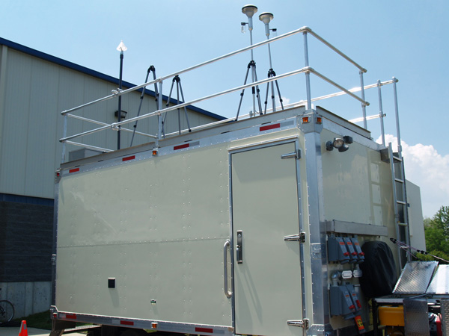
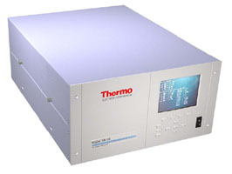
The Problem
Existing Air Quality Stations
Large, heavy, expensive; but very accurate, high precision, low drift
Typically one gas is measured
Needs trained workforce to operate
Needs AC power
$2M = 300+ AtmoSniffers

Slide 8
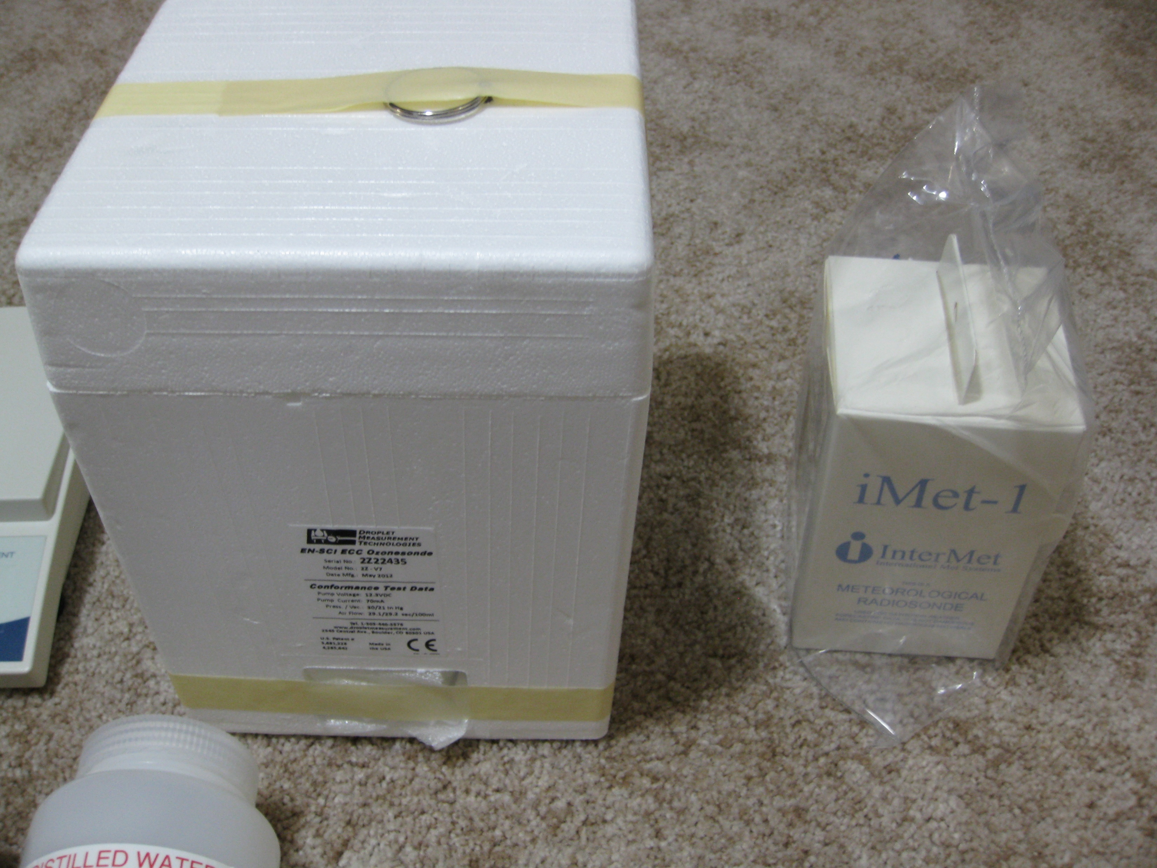
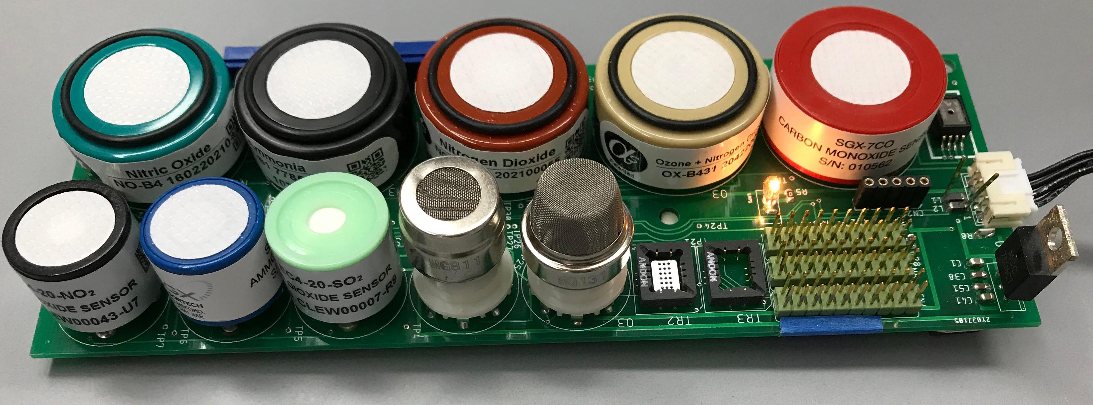
Motivation
Ozonesonde/Radiosonde
Compact Modern Sensors
Need for a Full Data Set
Multiple Flight Platforms
Need for agile mounting

Slide 9
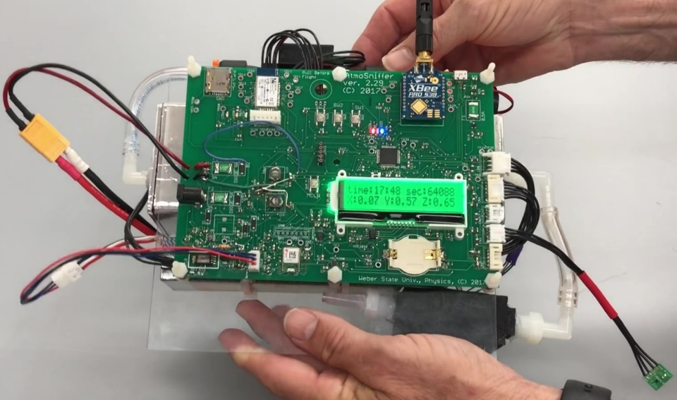
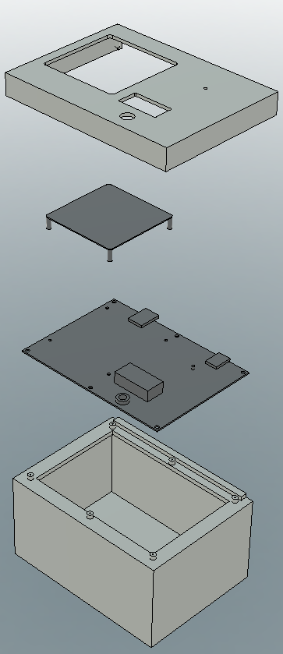
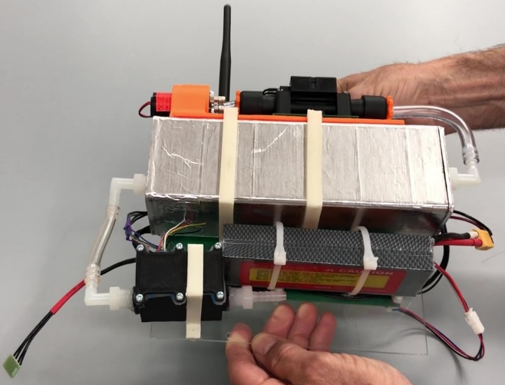

Slide 10
Problems?
Pushing sensors to their limits
Low level measurements & precision
Oxygen starvation at high altitudes
Response times and flight
Cross-species sensitivity
Moisture affects calibration
Ambient Temperature affects calibration
Calibrating for Pressure
Surface chemistry
RF Noise
Oxygen starvation
Sensor zero-drift

Slide 11
The Basic Idea

Slide 12
Reality

Slide 13
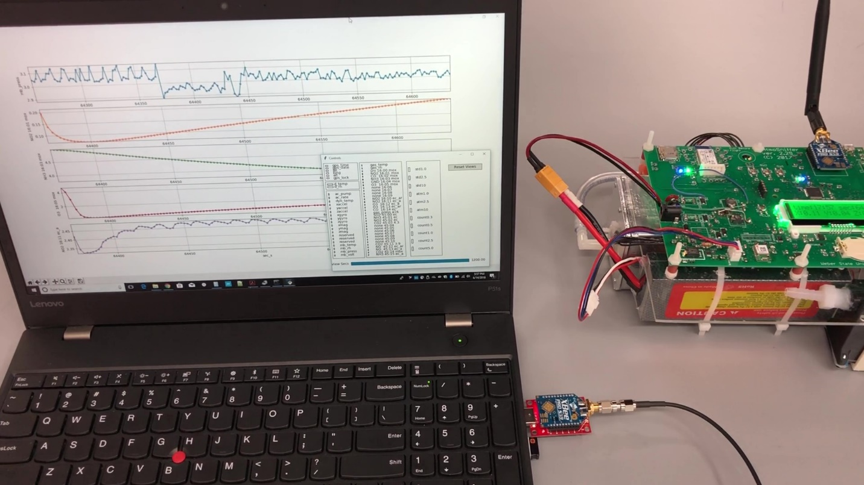
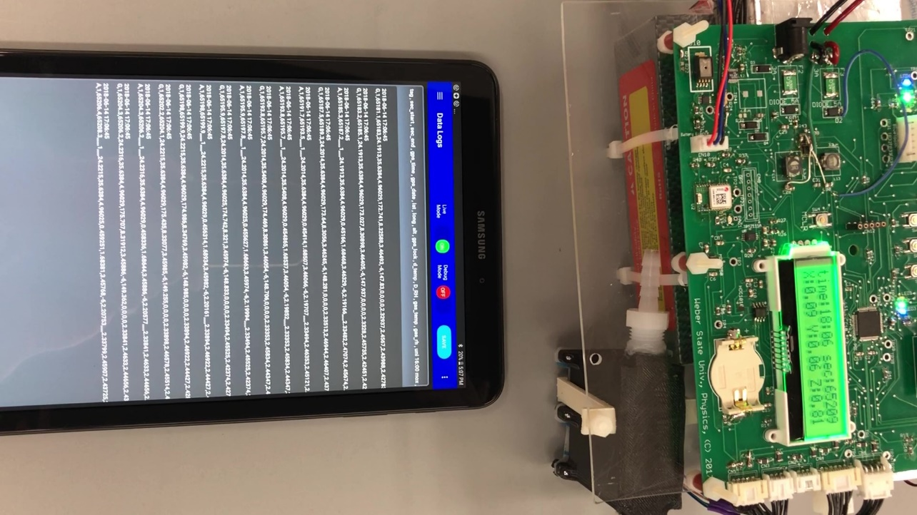
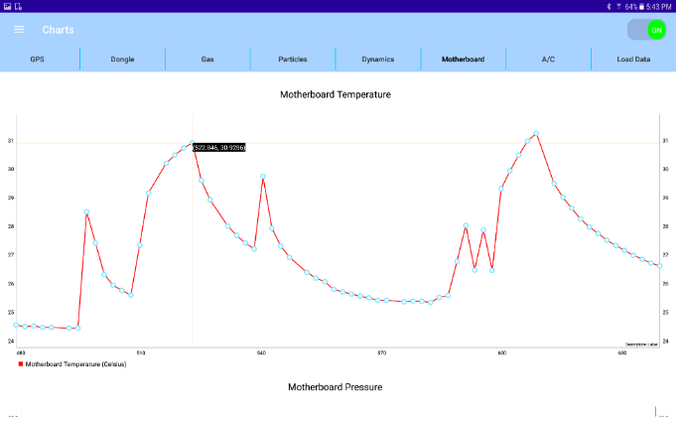
Just so you know where we are at…
The user interface
Some Calibration Results
Some actual flight data

Slide 14
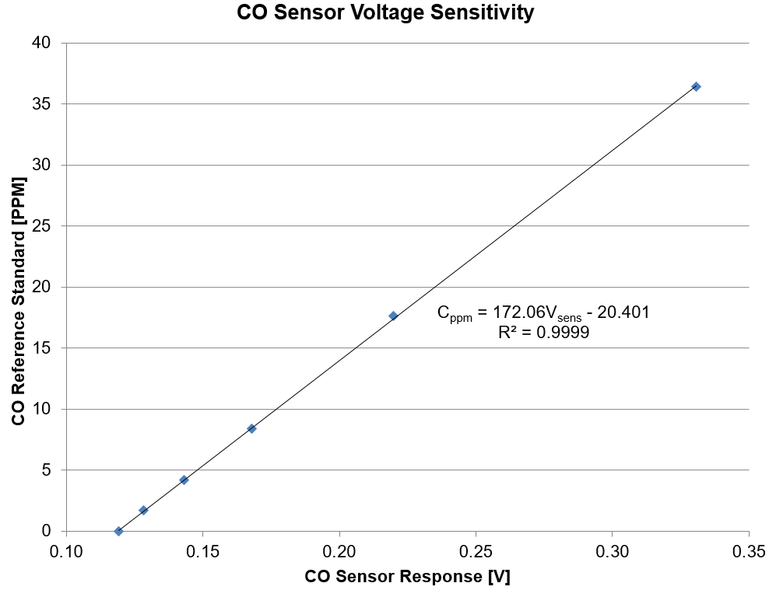

Slide 15
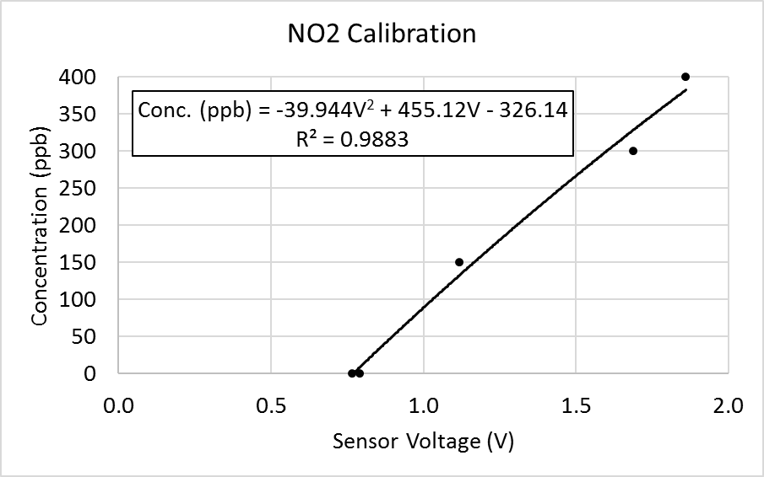

Slide 16
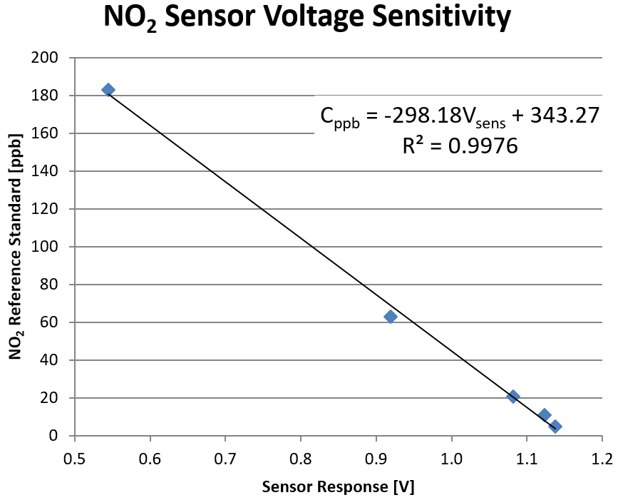

Slide 17
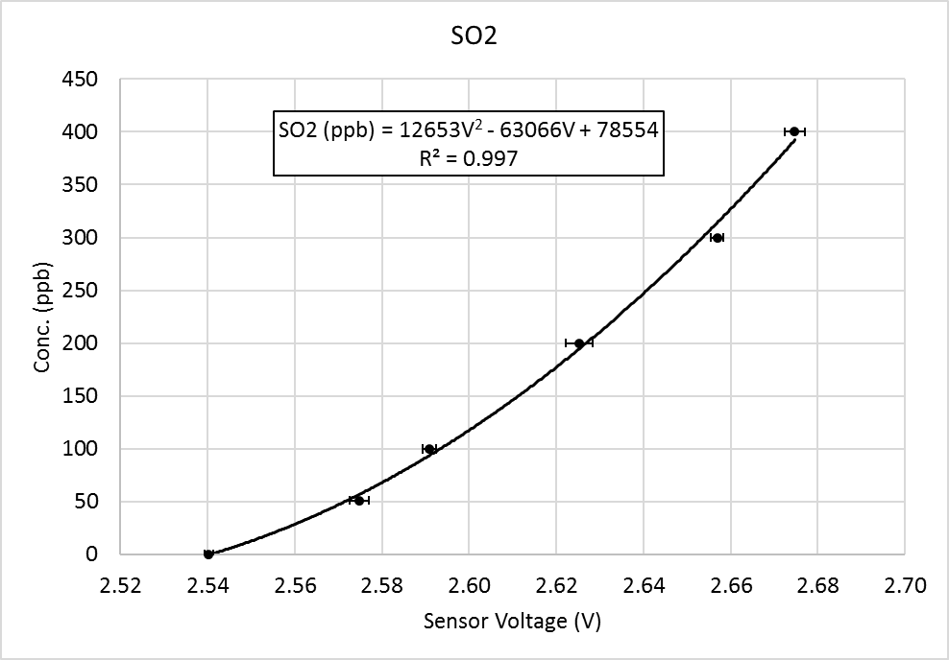

Slide 18
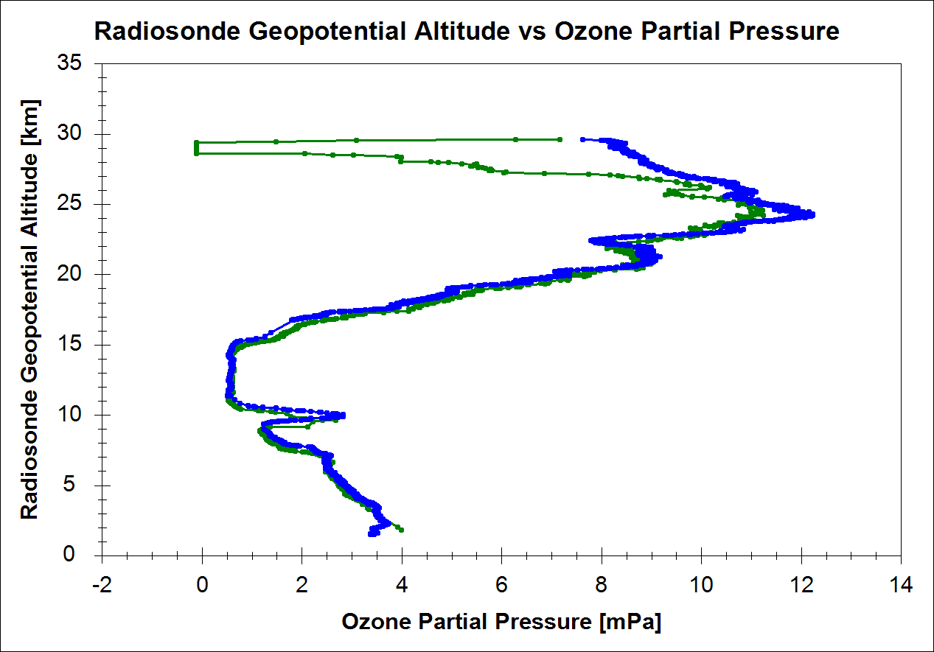
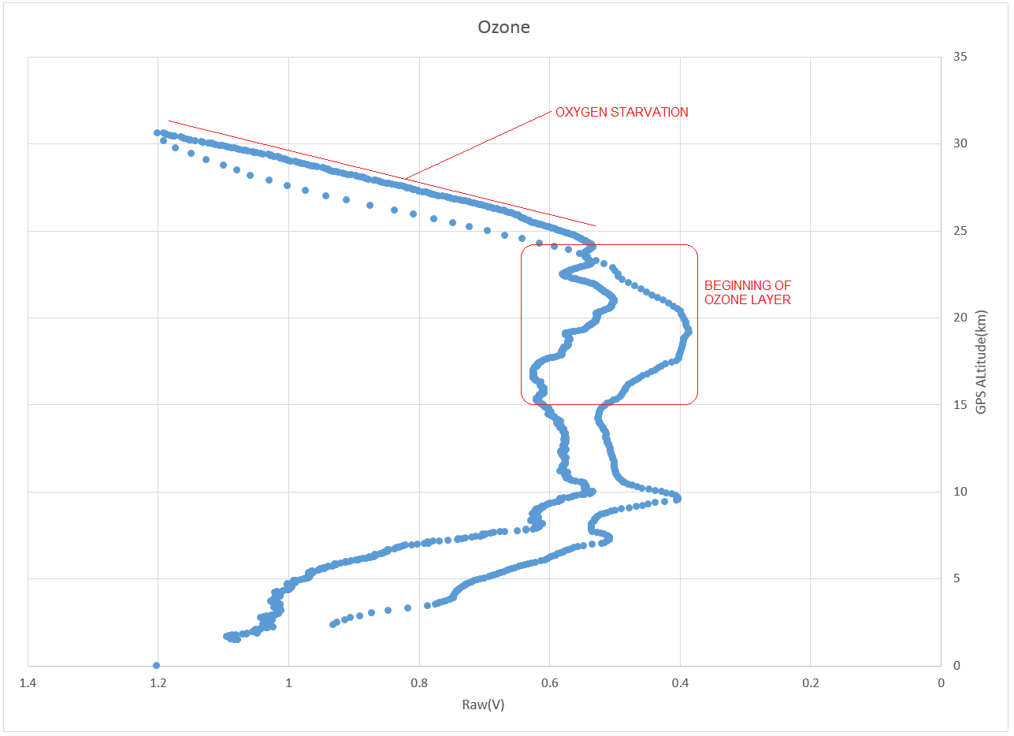
Ozonesonde vs. AtmoSniffer (90 min apart)
Ozonesonde is calibrated for pressure.
AtmoSniffer is raw data, without pressure correction.

Slide 19
Problem Solving at Each Table!
Your task: The project is nearly ready for market, where would you put your final efforts? Why?
Suggestions for Conversation:
Manufacturability
Software
User Interface
Alpha and Beta Testing
Signal Noise, Electronics, Calibration
Housings: internal (function) and external (appearance)
Other?

Slide 20
So, what have you?

