Slide 1
Decision Analysis Data Model
Working Group Kickoff

Slide 2

Context
The INCOSE Vision 2035 describes several key opportunities that must be realized to achieve the Vision 2035 outcomes, and Decision Management plays a key role in their realization.
01
Decision Analyses can touch multiple disciplines and stakeholders and should leverage a digital ecosystem to enhance collaboration
02
Trusted collaboration and interactions through a digital ecosystem
Decision Management methodologies provide an analytical structure for approaching multi-factor decision making throughout the system lifecycle
03
Analytical frameworks for managing the lifecycle of complex systems
By creating a reusable Decision Analysis Data Model, practitioners are aided in quickly deploying decision management strategy for traditional or model-based projects
Widely adopted reuse practices

Slide 3
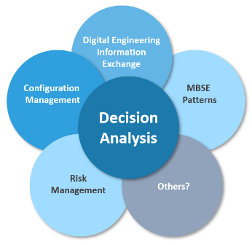
Decision Analysis Data Model (DADM)
The Decision Analysis Working Group will develop a reusable, model-based, data model to:
Aid practitioners in making multi-factored decisions
Digitally define decision management analytical framework
Establish reuse practices for off-the-shelf job aids for practitioners
Leverage digital ecosystem to more collaboratively manage risks and decision making
Cross Domain Partnerships
The DADM will require collaboration with other INCOSE working groups and disciplines that span the system lifecycle to help identify:
Interfaces and dependencies
Data inputs and outputs
Existing best practices and lessons learned
Additional DADM use cases

Slide 4
Roadmap & Benefits
The Roadmap
  Initial model prototyped and ready for collaborative development
  Initial model completed and ready for user testing and feedback
  Model v.1.0 delivered for INCOSE review
  Model v.1.0 review event (IW 24)
  Model v.1.0 approved and ready for release to community
Phase 1: Develop Initial Model
Phase 2: Refine Model
Phase 3: Specialize & Scale
IW 23
IS 23
IW 24
IS 24
Q1 | Q2 | Q3 | Q4
Q1 | Q2 | Q3
Q4
2022
2023
2024
Benefits
Digital Ecosystem
Analytical Framework
Reuse
    Leverage digital ecosystems to more consistently and collaboratively apply Decision Management principle
    Provide an analytical methodology for Decision Analysis to aid practitioners throughout the system lifecycle
    Encourage reuse by providing practitioners a consistently deployable data model for the managing decisions

Slide 5
Initial Activity Backlog
Develop and Document Operating Procedures
Wireframe Landing Page
Refine Package Structure
User Story Survey
Storyboard DADM Uses
Refine Data Types
Refine Activity Diagram
Identify and Document Hierarchy of Decision Types/Specializations

