Slide 1

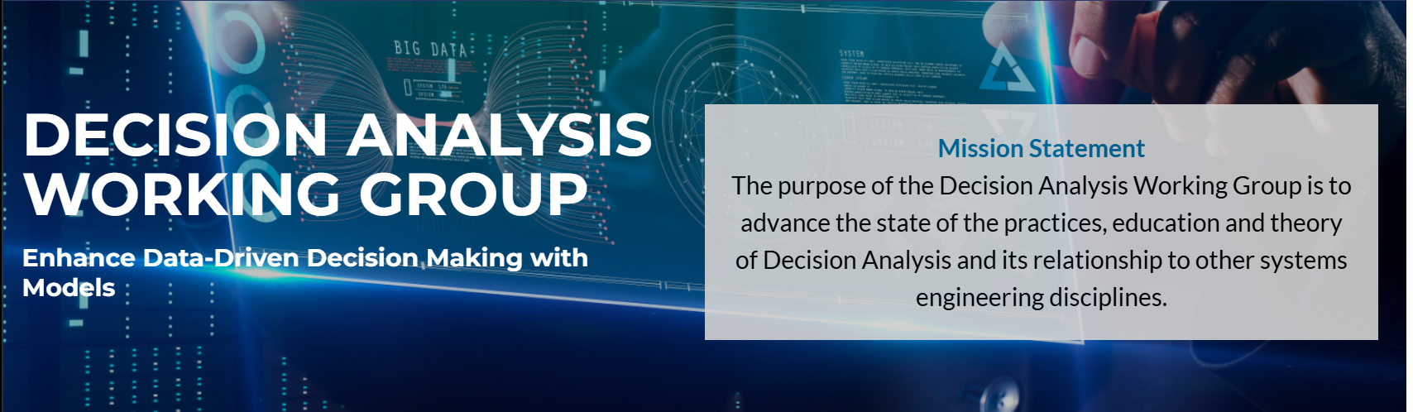


A Decision Analysis Data Model for Digital Engineering Decision Management
2 Jun 2025
Dr. Greg Parnell
Department of Industrial Engineering
University of Arkansas
gparnell@uark.edu

Slide 2
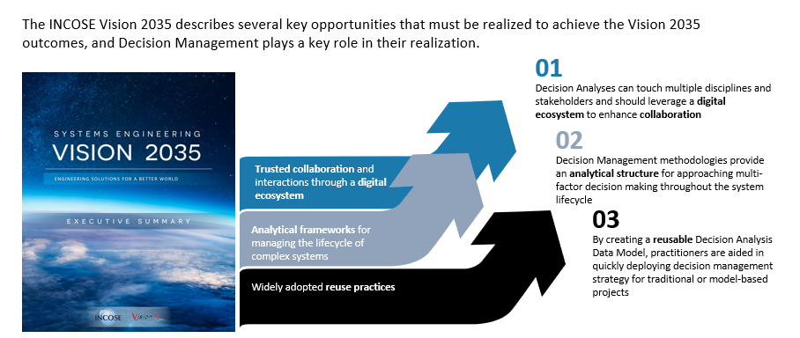
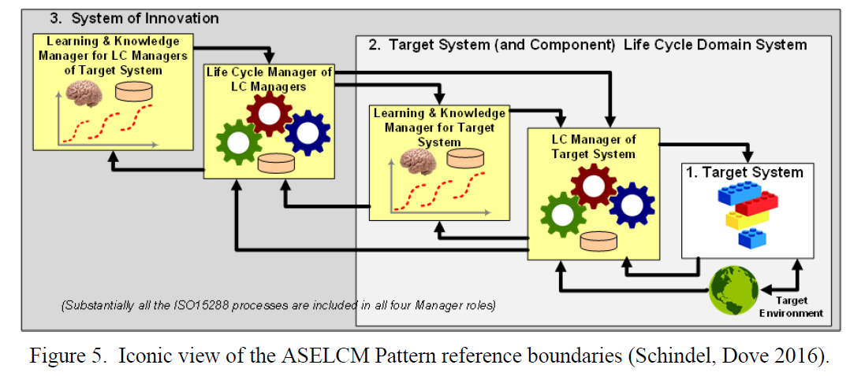
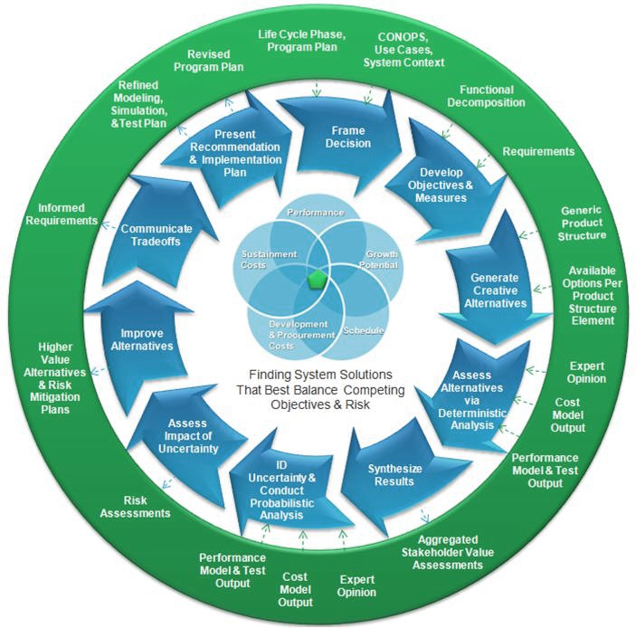
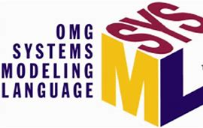
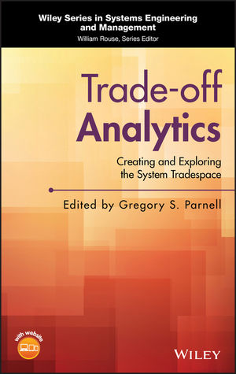
BLUF - Decision Analysis Data Model (DADM)
The Decision Analysis Working Group (DAWG) has developed DADM to help realize the INCOSE Vision 2035 objectives for analytical frameworks, data-centricity, model re-use by doing the following:
1
2
3
Develop a reusable Decision Analysis Data Model to support SE Vision 2035
Integrate Decision Management Life Cycle Process in MBSE
Enhance Data Driven Decision Making with Models
Decision Management
DADM
MBSE
The DADM is an INCOSE product that is available on SE Lab for INCOSE members to use
The DADM is a data model validated against a Decision Analysis Process Model flexible to multiple domains and lifecycle stages
The DADM enhances pre-existing SE literature by incorporating system modeling and data architecture practices into decision analysis.

Slide 3






DADM Team in the INCOSE Decision Analysis WG
Frank Salvatore
Senior Systems Engineer
SAIC
Dr. Gregory S. Parnell
Professor of Practice
University of Arkansas
Devon Clark
Specialist Leader
Deloitte
Dr. Robert Kenley
Professor of Practice
Purdue University
Jared Smith
Manager
Deloitte
Contributors | Company | WG Role
Dr. Matt Cilli | JHAPL | SEBoK
Jeremy Doerr | GTRI | Member
Dr. William Fischer | MITRE | Member
Bill Schindel | ICTT | Member
Dr. Eric Specking | University of Arkansas | Member
Drake Nwobodo
Senior Consultant
Deloitte

Slide 4
Evolving Decision Management
CURRENT STATE
NEW WORLD
DEVELOPING ADOPTION FOR MBSE AND DE
Many initiatives exist in government and industry to accelerate adoption of MBSE and DE; however, many engineering organizations remain manual and document-based
MATURITY OF DECISION MANAGEMENT AND ANALYSIS
Many quality trade-off studies make good use of data; however, decision processes are not reused and must be redefined with each “new” decision.
DISCONNECTED DATA AND MODELS
MBSE models are largely isolated to system models and not integrated. Decision analyses are often disconnected from technical processes and data.
“BORN DIGITAL” ENGINEERS
System Engineers work predominantly in models and are tightly integrated with data and software activities. Systems Engineers actively exchange and integrate models (including process models)
SCALABILITY THROUGH COMMON DATA MODELS
Open systems are software-enabled and aligned to common data models. Decision Analysis systems and processes are aligned to a common Decision Analysis Data Model
ARTIFICIAL INTELLIGENCE ACCELERATES DECISION MAKING
Advanced analytics, ML, and AI solutions increase the consistency, scalability and quality of decision processes. Data is required for all critical decisions.
Decision Management
MBSE
Decision Management
DADM
MBSE
Digital engineering can provide better data to enable better decisions.

Slide 5
DADM Use Case: Decision Management Life Cycle Process in MBSE
DADM is INCOSE-provided MBSE software available for System 2 Decision Management process owners to use and reuse for Decisions Management for their System 1 Engineered System in different life cycle stages.

Slide 6
Decisions Across the System Lifecycle
System Engineering Life Cycle
Examples Decisions
Determine mission objectives
Determine conceptual scenarios
Determine operating environments
Data
Example Decisions
Determine retirement approach
Define asset recovery approach
Data
Concept
Retirement
Example Decisions
Determine security update method
Define maintenance methods
Determine maintenance frequency
Example Decisions
Compare system architectures
Select HW/SW technologies
Determine integration approach
Decision Analysis
Development
Support
Example Decisions
Determine system usage
Determine system storage approach
Determine operational procedures
Production
Example Decisions
Make/Buy decisions
Tooling decisions
Productions quantities
Utilization
DADM will provide integrated, reusable, decision analysis data models throughout the system lifecycle

Slide 7
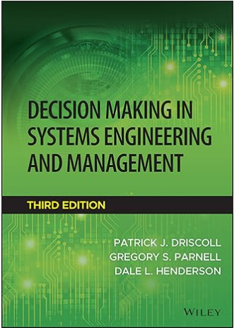
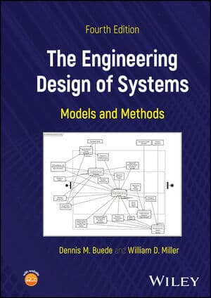
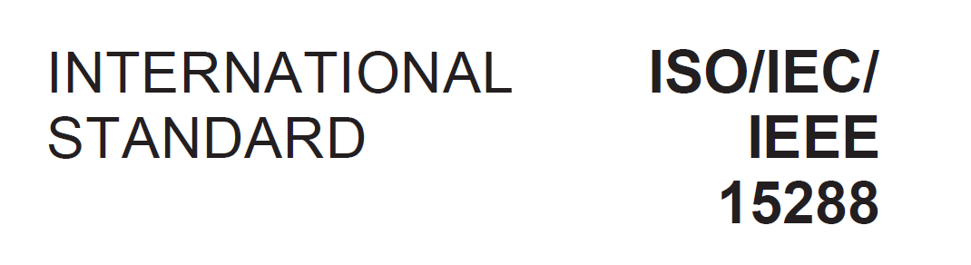
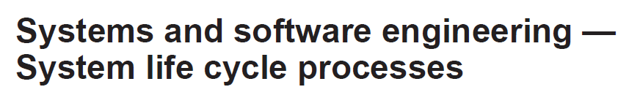

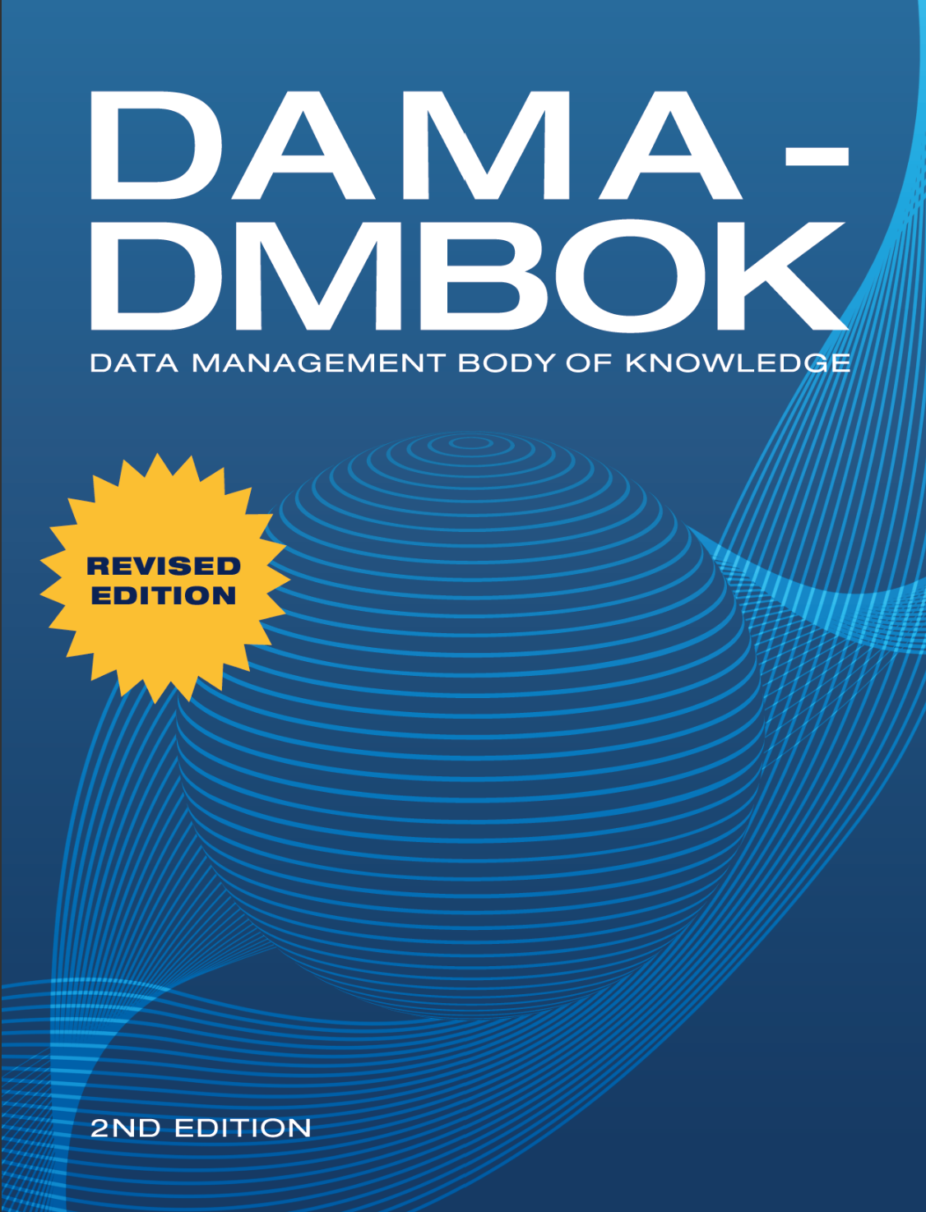
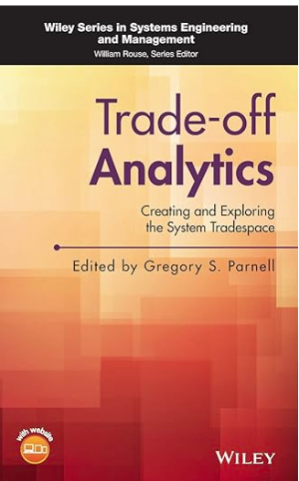
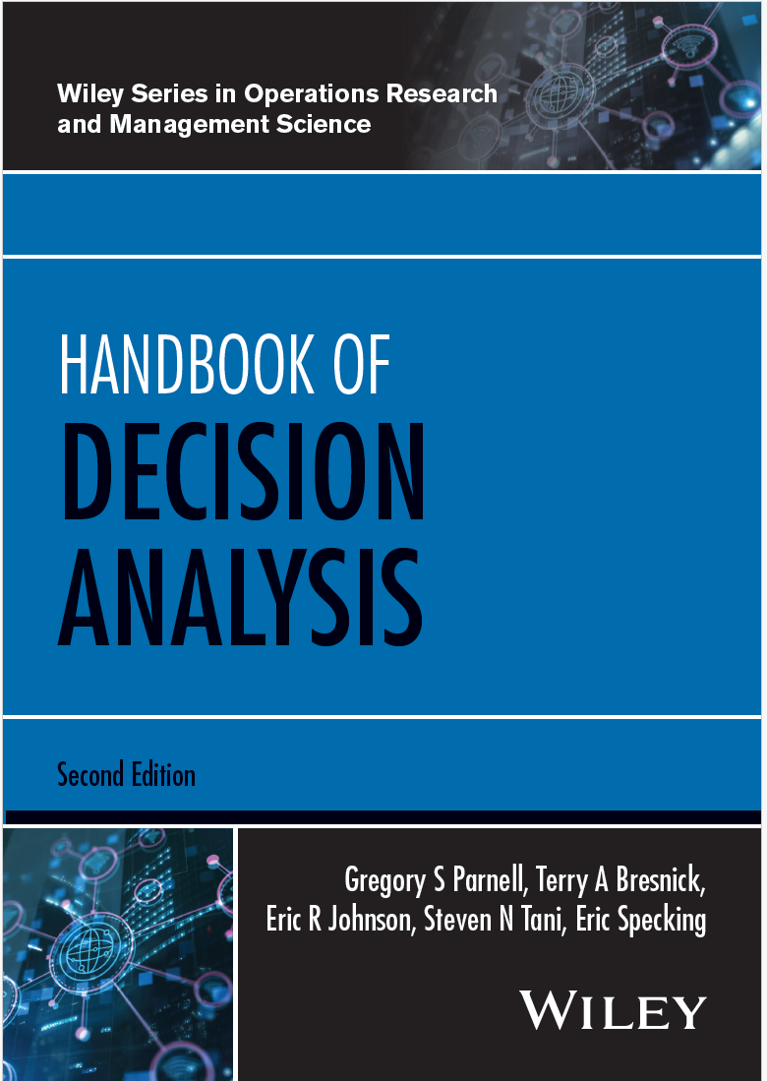

Several standards, bodies of knowledge, SE Handbook, textbooks. and journal papers have been published on using data and decision analysis for systems decision-making.
Knowledge Sources
3rd Edition 2022
4rd Edition 2024
2016
2nd Edition 2025

Slide 8
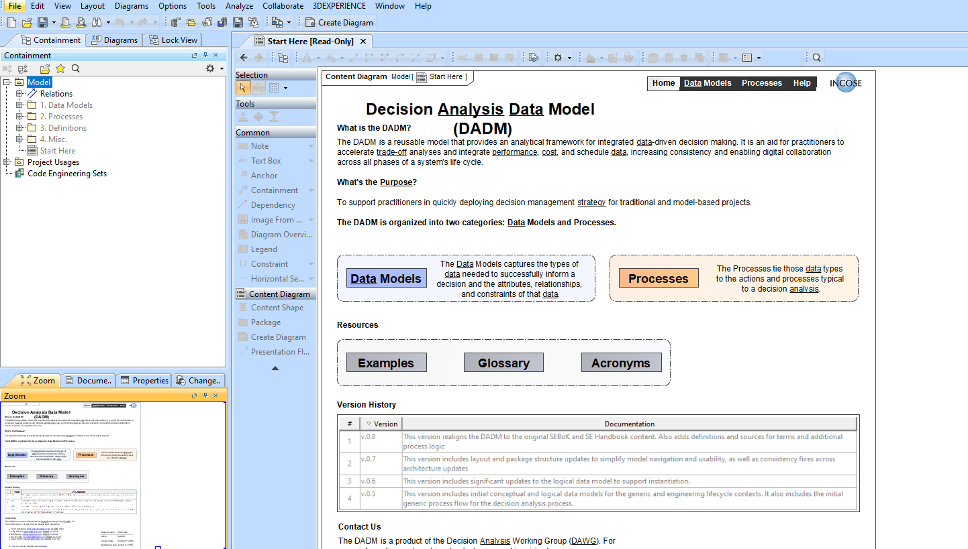
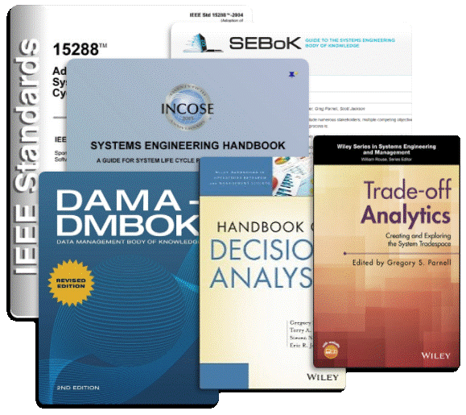
Decision Analysis Data Model
A data and process model for world-class decision analyses
A model-based data model using SysML v1
Contains both data model and process models for Conceptual and Logical levels
Meaningfully links process activities to the data they need
Based on INCOSE SE Handbook, SEBoK, textbooks
Data Model
Processes
8
Available in INCOSE SE Lab and the Decision Analysis Working Group
https://www.incose.org/communities/working-groups-initiatives/decision-analysis

Slide 9
DADM Process Model
DADM uses a 10 step process model.

Slide 10
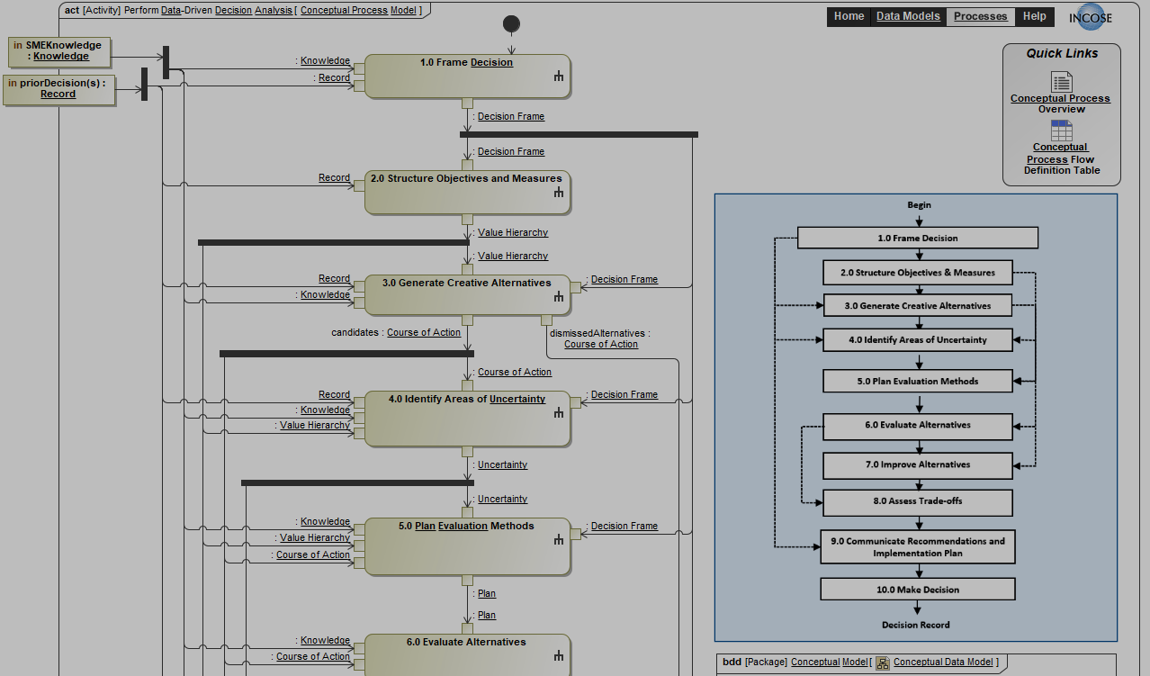
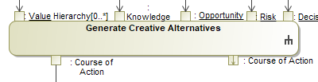
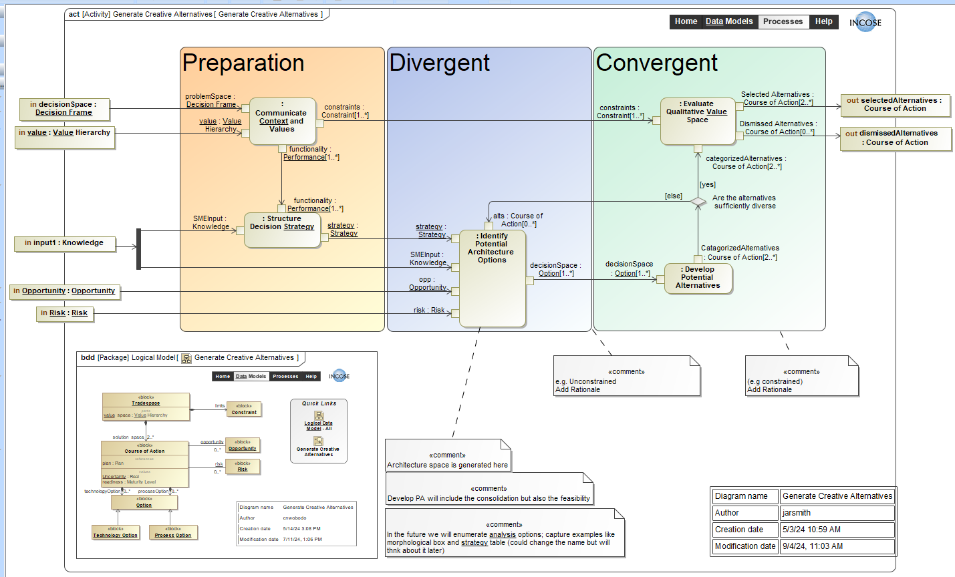
Process Model 10 Steps
Step 3 Generate Creative Alternatives
Leverages decades of expert experience to capture the decision analysis process
Validates the data model by describing the data exchanged between all activities
Aids users in performing consistent decision analyses and serves as the foundation for decision management in each life cycle stage

Slide 11
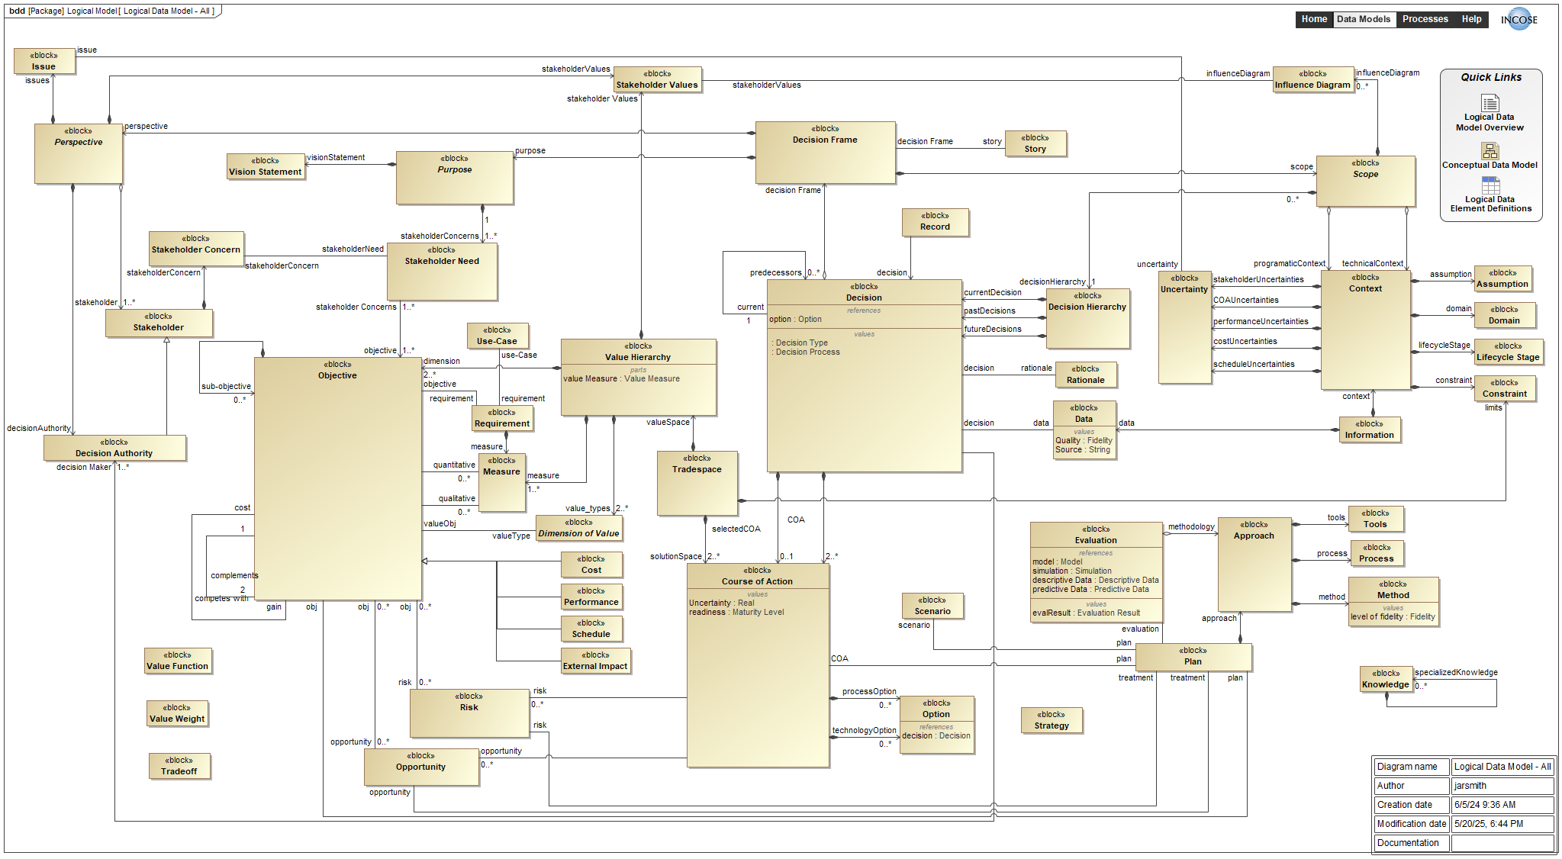
Full Logical Data Model
The logical data model represents a comprehensive Decision Analysis process and data definition that supports decision management in the system life cycle.

Slide 12
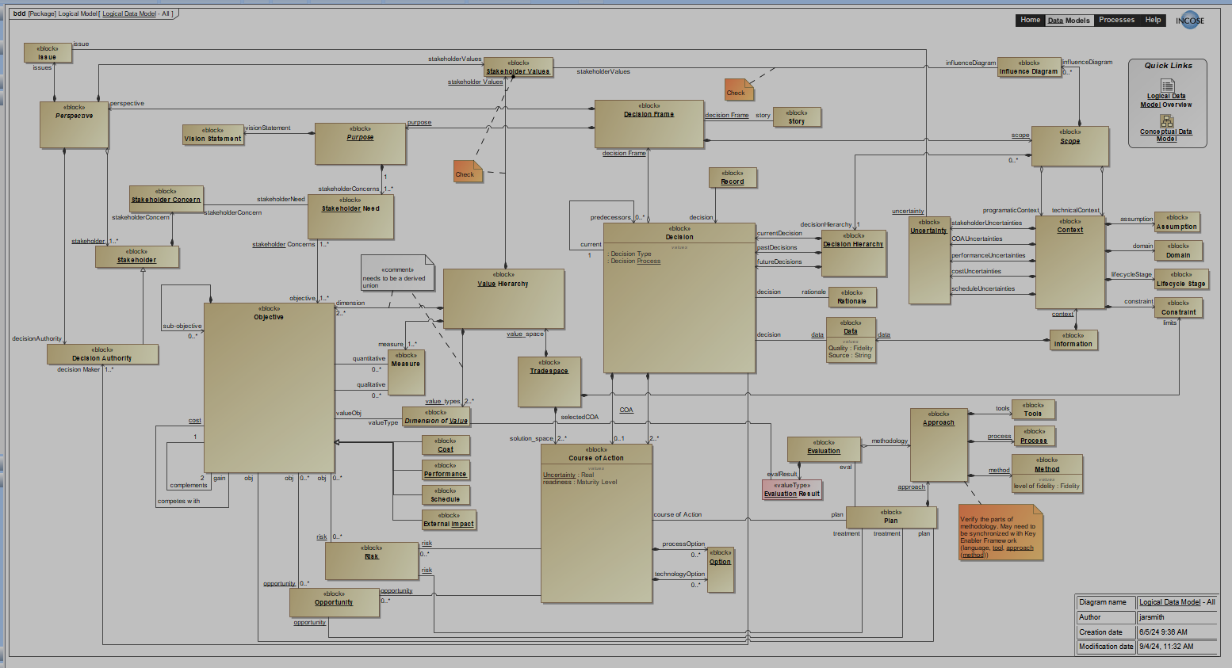
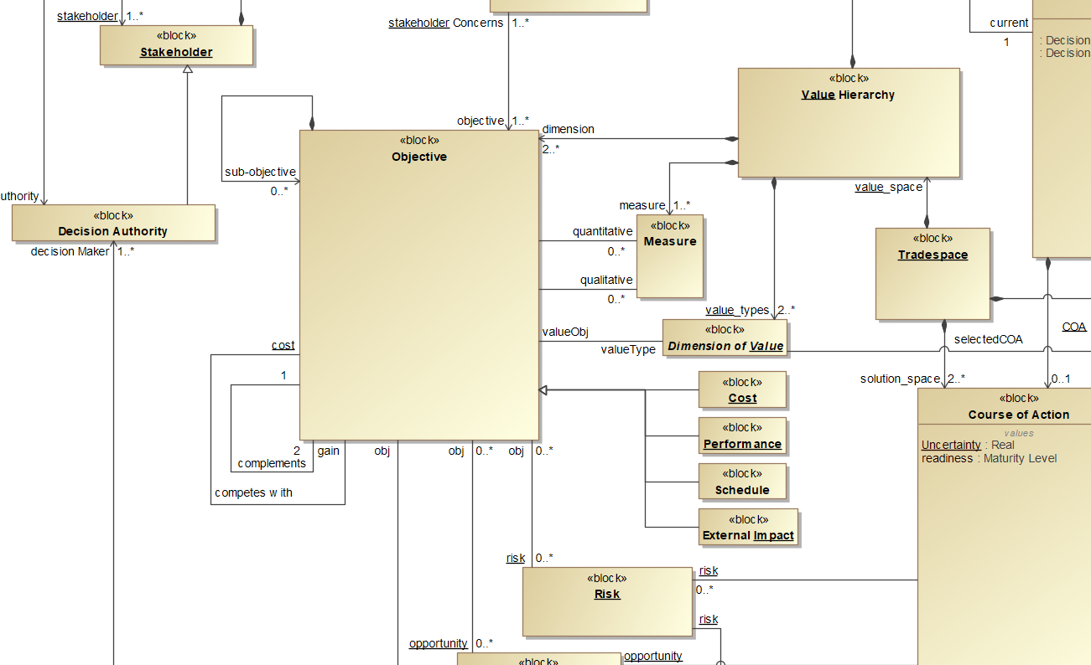
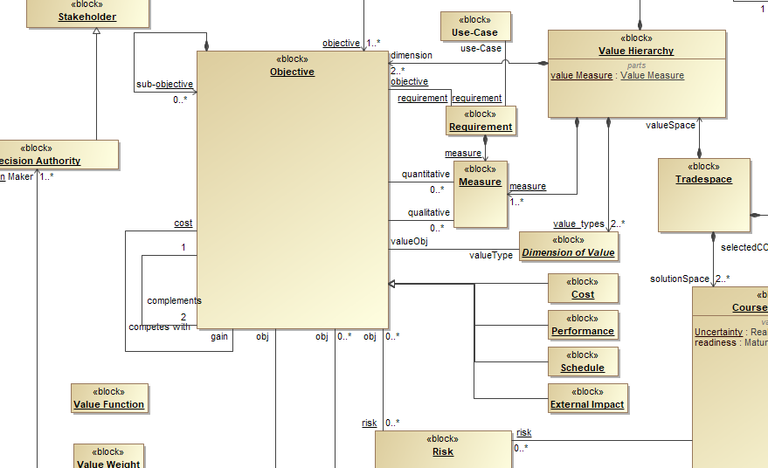
The Data Model
Explicitly define the data needed for a quality decision
This definition enables consistency across decisions
This consistency enables the reuse of past decisions in future decisions
This chain of decisions enables real analytics for decision quality and program outcomes for an organization

Slide 13
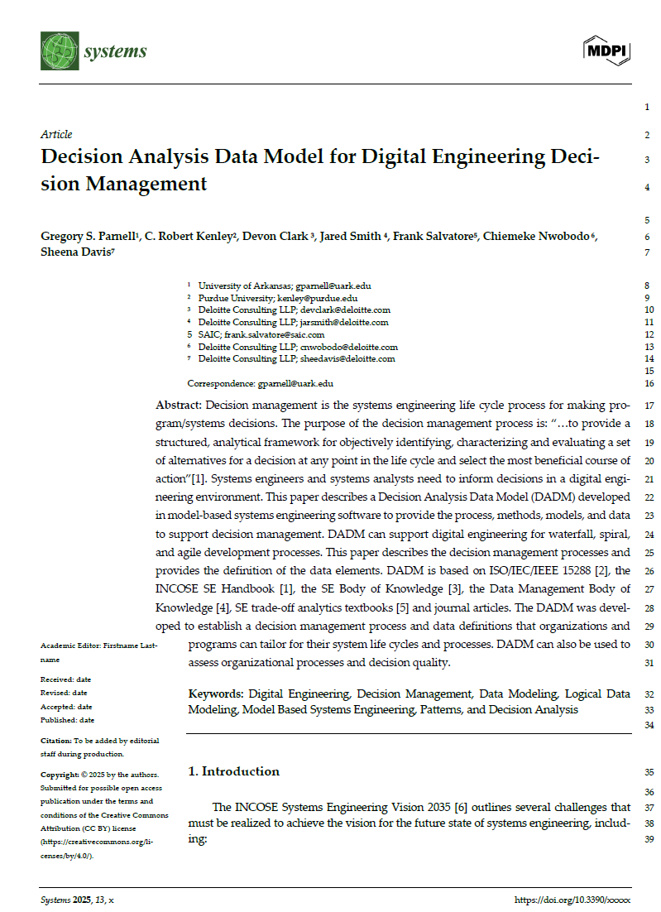
Submitted Journal Paper on DADM
Describes the 10 steps in the Decision Management process
  Purpose
  Common value-added SE techniques used
  Logical Process Model: Activity Diagram
  Activities and the value-added data artifacts created or updated
  Illustrative examples of important value-added data artifacts
  Logical Data Model: Block Definition Diagram
  Data elements to communicate decision recommendations
  Tailoring and reuse guidance for teach step
  Impact of not doing each step
Identifies for each life cycle stage
  Illustrative decisions
  Data availability
Uses 130 definitions of terms and value-added data items
Contains 73 references
Submitted to Digital and Data-Driven Systems Engineering: Bridging Theory and Practice special issue on 16 May 25.

Slide 14


A Look Ahead
Available DADM Beta in INCOSE SE Lab*
  Identify pilot participants and early adopters
Update SE Body of Knowledge
  Provide UAV Design example
  Describe DADM
Develop DADM decision management process organizational assessment guide (IW)
Develop DADM User Guide
Continue DADM v2
  Pursue Standard designation
  BPMN translation
  SysML v2 integration
  Example implementation
Update SE Handbook v6
International Workshop 26
* For INCOSE members. Others can obtain from the paper authors.

Slide 15
Using DADM as a Decision Management Capability Assessment Tool
One Initial Model
Process Model
Begin
Value-Added Data Artifacts
1.0 Frame Decision
Stakeholders, Stakeholder Need, Decision Context, Scenarios, Use Cases, Vision, Issues, Decision Hierarchy, Influence Diagram, Uncertainty, Decision Frame
Scale | Capability Demonstrated*
10 | 100% of Value-Added Data Artifacts
8 | 80% of Value-Added Data Artifacts
6 | 60% of Value-Added Data Artifacts
4 | 40% of Value-Added Data Artifacts
2 | 20% of Value-Added Data Artifacts
0 | Step not used
2.0 Structure Objectives & Measures
Values, Decision Objectives, Value Measures ((Performance, Cost, and Schedule), Value Hierarchy, Requirements
3.0 Generate Creative Alternatives
Context, Value Hierarchy, Qualitative Value Space, Options, Potential Alternatives
4.0 Identify Areas of Uncertainty
Decision Frame, Value Hierarchy, Scenarios, Use Cases, Uncertainties (Stakeholder, Performance, Cost, Schedule, Other, Courses of Action, Previous)
5.0 Plan Evaluation Methods
Previous Systems Analysis Plan, Value Hierarchy, Courses of Action, Data, Models, Simulations, Assessment Flow Diagram
6.0 Evaluate Alternatives
Assessment Flow Diagram, Quantitative Value Model, Alternative Values, Deterministic Analysis, and Probabilistic Analysis
7.0 Improve Alternatives
Risk Treatments, Opportunity Treatments, Revised Courses of Action, Reevaluate Alternatives
8.0 Assess Trade-offs
Value Hierarchy, Courses of Action, Tradespace Analysis (Deterministic, Probabilistic), Trade-offs
9.0 Communicate Recommendations and Implementation Plan
Decision Frame, Value Hierarchy, Courses of Action, Requirements, Decision Story, Recommendation, Risks, Implementation Plan
Decision Hierarchy, Value Hierarchy, Tradespace, Course of Action, Rationale, Implementation Plan, Decision Record
10.0 Make Decision
End
Decision Management Capability Assessment score = sum of the scores for each of the 10 steps.

Slide 16
Summary - Decision Analysis Data Model (DADM)
The Decision Analysis Working Group (DAWG) is developing DADM to help realize the INCOSE Vision 2035 objectives for analytical frameworks, data-centricity, model re-use by doing the following:
1
2
3
Develop a reusable Decision Analysis Data Model to support SE Vision 2035
Integrate Decision Management Life Cycle Process in MBSE
Enhance Data Driven Decision Making with Models
Decision Management
DADM
MBSE
The DADM is an INCOSE product that is available on SE Lab for INCOSE members to use
The DADM is a data model validated against a Decision Analysis Process Model flexible to multiple domains and lifecycle stages
The DADM enhances pre-existing SE literature by incorporating system modeling and data architecture practices into decision analysis.
Further info, copy of presentation, or copy of paper: gparnell@uark.edu

Slide 17
Backups

Slide 18
Key Definitions
Decision Analysis: Decision analysis is a philosophy and a social-technical process to create value for decision makers and stakeholders facing difficult decisions involving multiple stakeholders, multiple (possibly conflicting) objectives, complex alternatives, important uncertainties, and significant consequences.
Decision Management: A process providing a structured, analytical framework for objectively identifying, characterizing, and evaluating a set of alternatives for a decision at any point in the life cycle and select the most beneficial course of action.
Data Model: A model that aligns data definitions to the information and concepts necessary to support the organization’s mission and operations, driving consistency and interoperability across disparate developers and teams.

Slide 19
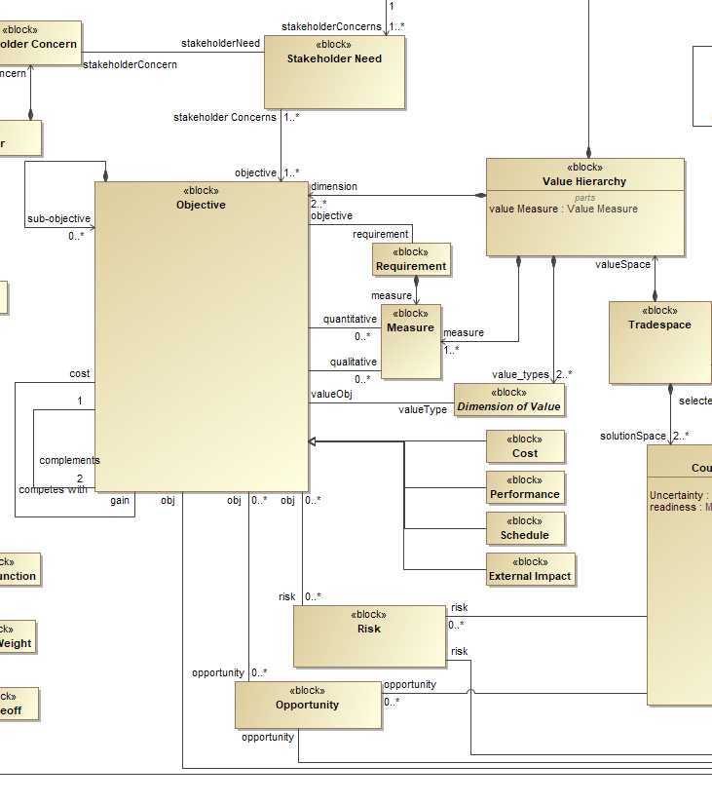
Treatment of Requirements
Requirements are a class of objective
A requirement must be associated with a measure of stakeholder value
Measures are used to define a value hierarchy for determining the tradespace

