Slide 1
Decision Analysis Data Model
Road to IS24 Session #1

Slide 2
INCOSE IW 2024 Outcomes
Session Attendance
Session #1: 12 in person, 5 online
Session #2: 16 in person, 4 online
Outcomes
Tied Data Types to the Process Model
Determined Conceptual Process Model is needed
Live iteration of existing logical data model
Refined distinction between conceptual and logical layers of data model
Considering a name change…

Slide 3
INCOSE IW 2024 Agenda Options
Process Model Review
Process Model Variants
Data Model Review
Data Model Variants
White Paper Concepts

Slide 4
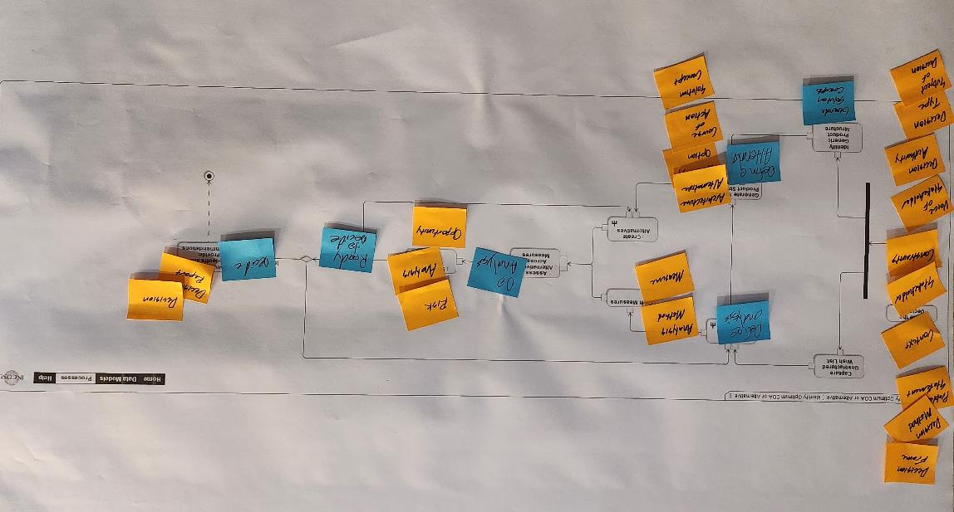
Day 1 Activity Results [Team 1]

Slide 5
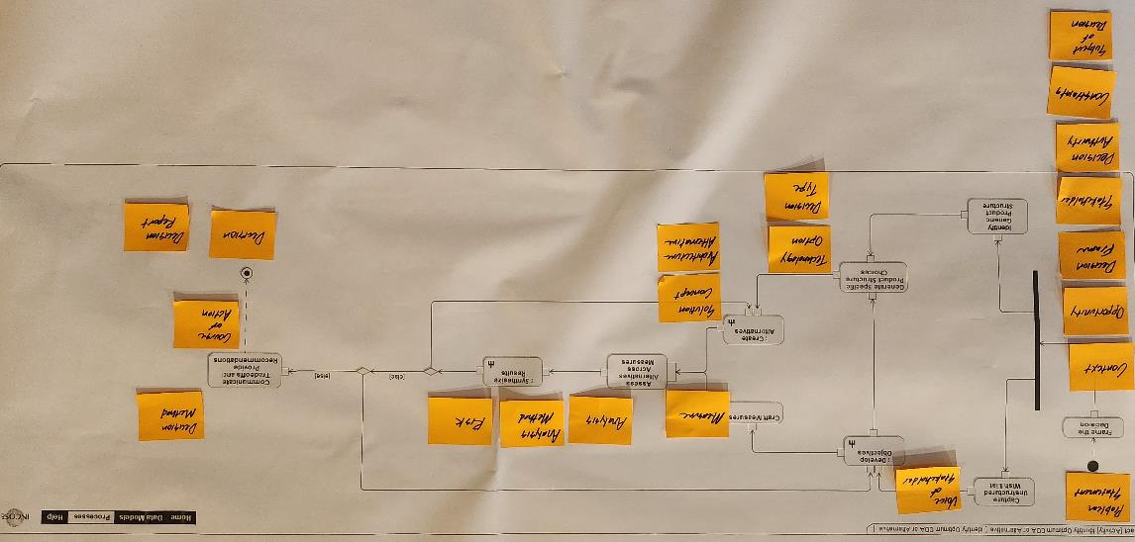
Day 1 Activity Results [Team 2]

Slide 6
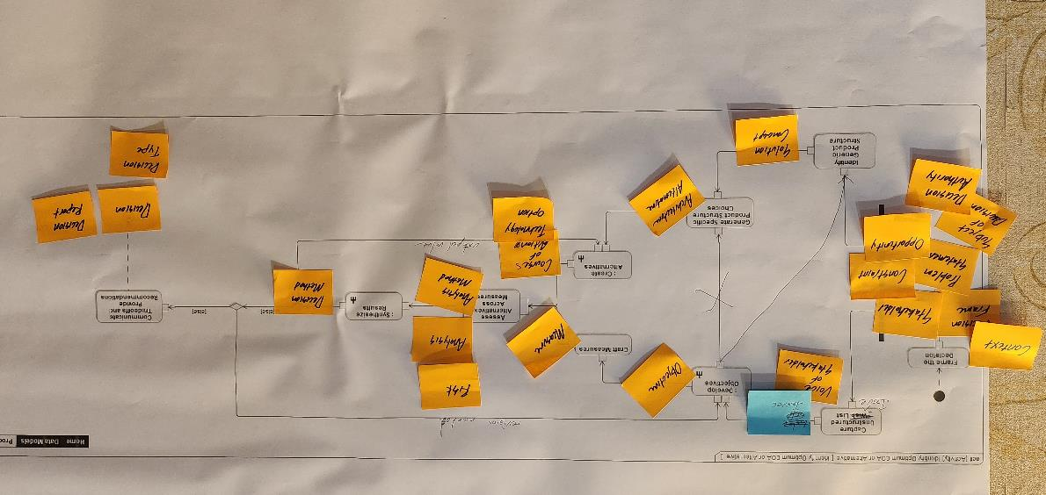
Day 1 Activity Results [Team 3]

Slide 7
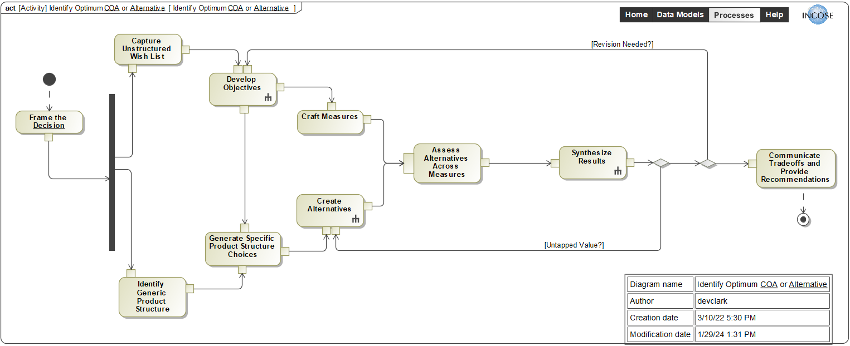
Day 1 Activity Results [Team 1]
Analysis Method
Measure
Objective
Risk
Analysis
Decision Frame
Opportunity
Decision Method
Problem Statement
Decision Report
Context
Decision
Stakeholder
Constraint
Architecture Alternative
Voice of Stakeholder
Technology Option
Decision Authority
Course of Action
Decision Type
Solution Concept
Subject of Decision

Slide 8
Day 1 Activity Results [Team 2]
Voice of Stakeholder
Problem Statement
Objective
Measure
Analysis
Risk
Decision Method
Context
Analysis Method
Opportunity
Decision Frame
Stakeholder
Solution Concept
Course of Action
Decision Authority
Architecture Alternative
Decision
Constraint
Decision Report
Subject of Decision
Technology Option
Decision Type

Slide 9
Day 1 Activity Results [Team 3]
Voice of Stakeholder
Objective
Measure
Risk
Context
Analysis
Decision Frame
Decision Method
Problem Statement
Analysis Method
Constraint
Course of Action
Decision Type
Opportunity
Technology Option
Decision Authority
Decision Report
Subject of Decision
Decision
Stakeholder
Architecture Alternative
Solution Concept
Notes:
Clean this thing up
Build Roadmap
Definition of Done w/ % complete for model elements
TPP
Bite-size actions for Deloitte and WG members
Develop External comms plan
Develop Internal comms plan
Solicitation to SCs, Cs, and As
Plan to LnL

Slide 10
Day 1 Activity Results [Feb 9 Session]
Voice of Stakeholder
Objective
Analysis
Measure
Context
Models
Decision Frame
Data
Problem Statement
Analysis Method
Analysis Results
Constraint
Course of Action
Risk (of alternative not meeting objectives)
Opportunity
Technology Option
Decision
Decision Authority
Decision Method Process (Interaction with Decision Authority)
Decision Report
Subject of Decision
Stakeholder
Architecture Alternative
Decision Type
Risk (of not doing nothing)
Solution Concept

Slide 11
Day 1 Activity Results [Aggregate]
Objective
Measure
Decision Frame
Context
Analysis Method
Constraint
Stakeholder
Decision Report
Subject of Decision
Decision Authority
Decision
Problem Statement
Opportunity
Voice of Stakeholder
Course of Action
Risk
Solution Concept
Analysis
Architecture Alternative
Decision Method
Technology Option
Decision Type

Slide 12
Day 1 Activity Results [Aggregate]
Define Analysis
Analyze
Ready to Decide
Decide
Define Alternatives

