Slide 1
IS2023 RWG Meeting
INCOSE Requirements Working Group

Slide 2
Meeting Agenda
Welcome and Introduction
Current Status
Guide to Writing Requirements V4 release
RWG plans for rest of 2023
Open Discussion

Slide 3
Welcome and Introduction

Slide 4
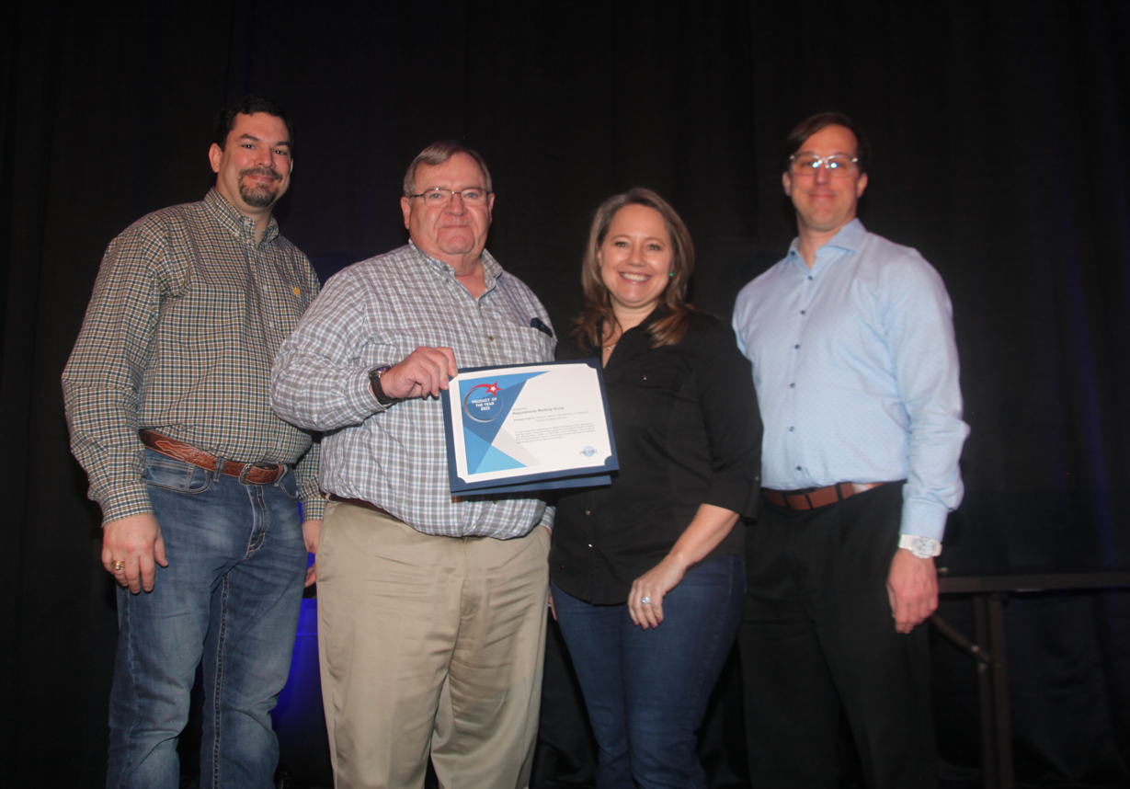
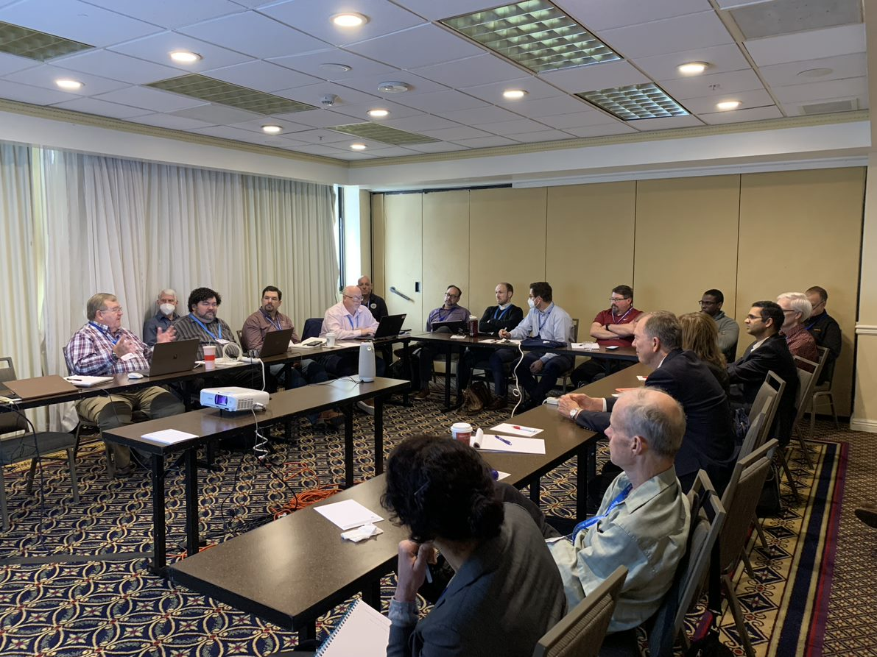
Welcome!
Welcome to the Requirements Working Group (RWG) Meeting for IS2023!
Attendees are welcome to join us in the discussions, this is an open meeting for anyone to attend.
Introduction of meeting attendees

Slide 5
RWG Charter
1
Purpose
Advance:
Practices, education, and theory of needs and requirements development and management
Relationship of needs and requirements to other systems engineering activities.
RWG is About…
Improving the practice of systems engineering through excellence in needs and requirements definition and management across the lifecycle.
Learning from experiences and sharing with the SE community.
Questioning approaches that yield poor outcomes.
Publishing guidance and continuing research into needs and requirements definition and management, including understanding the role of Needs, Requirements, Verification, and Validation across the lifecycle.
2
Goal
Expand and promote the body of knowledge of needs and requirements and their benefits within the systems engineering community.
3
Scope
Activities relating to best practices throughout the product lifecycle including:
Elicitation, Analysis, Allocation, Traceability
Elaboration, Management, Integration
Change Assessment and Management
Expression, Verification, Validation

Slide 6
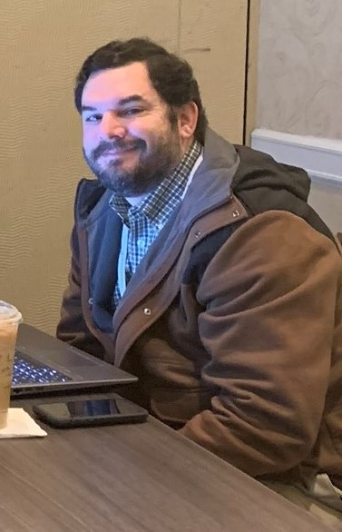
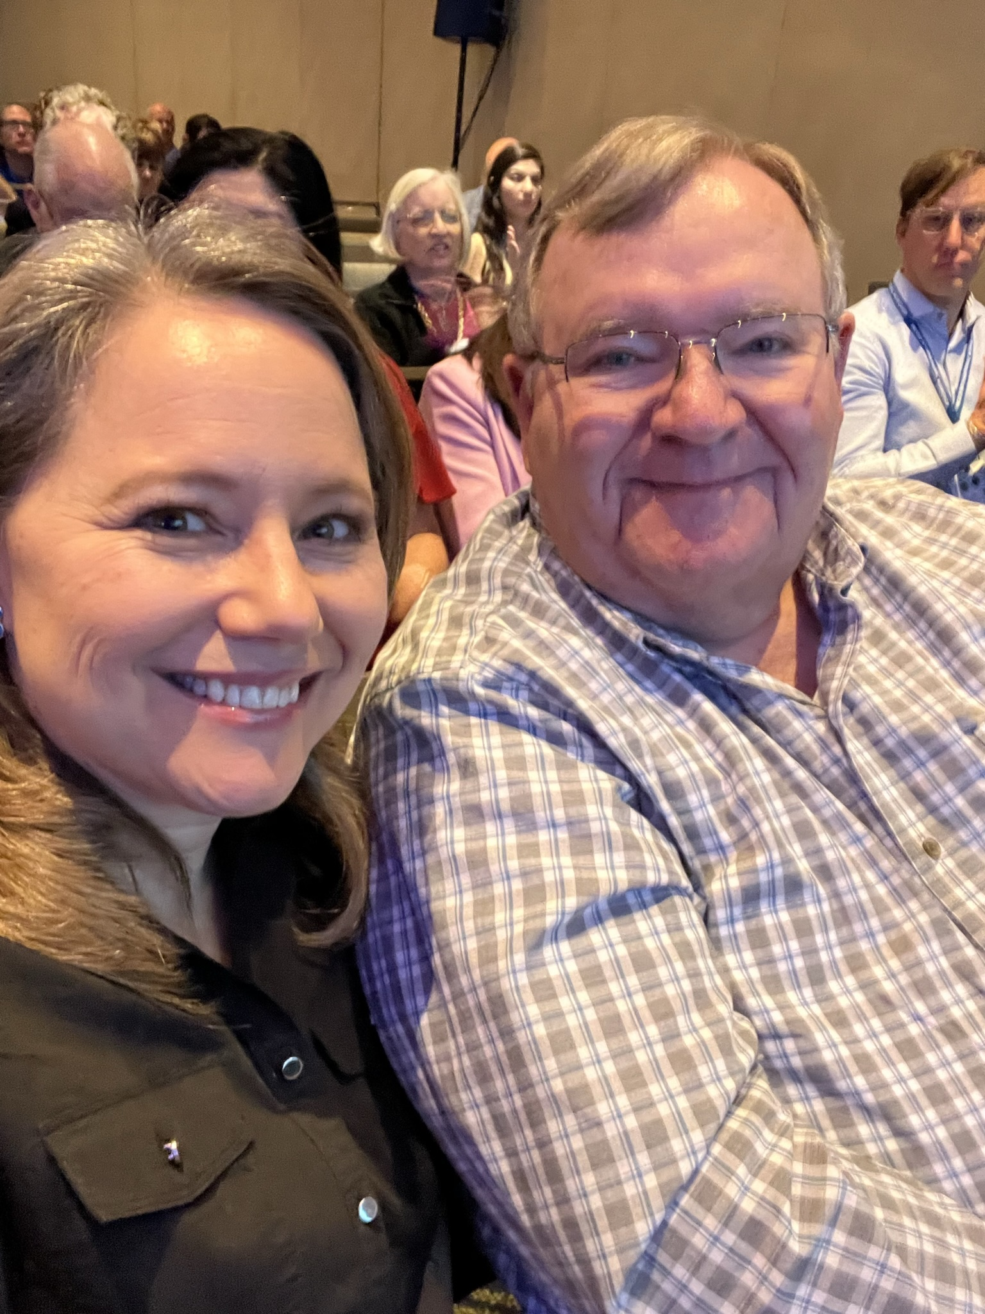
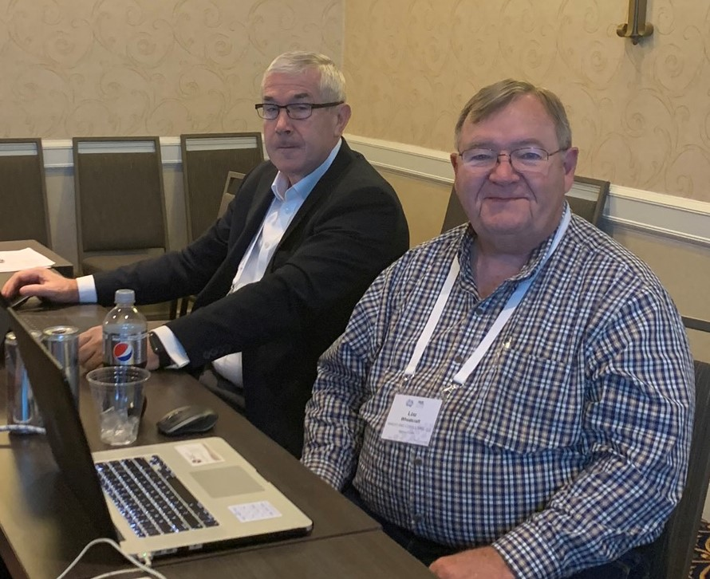
RWG Leadership
Chair: Tami Katz; Ball Aerospace, USA
Co-Chair: Lou Wheatcraft; Wheatland Consulting, LLC, USA
Co-Chair: Mike Ryan; Capability Associates Pty Ltd, AU
Co-Chair: Kevin Orr, Eaton, USA
INCOSE Websites:
  https://www.incose.org/incose-member-resources/working-groups/process/requirements
  https://www.incose.org/inet/working-groups/requirements
  https://www.youtube.com/channel/UCadgYaqKWDckenP2SU8-cPw
Number of Members: 466 (776 followers on Viva Engage), one of INCOSE’s largest WG
The RWG is comprised of members from industry and academia with a common purpose of improving the practice of systems engineering through improvement of Needs and Requirements definition and management across the system lifecycle.

Slide 7
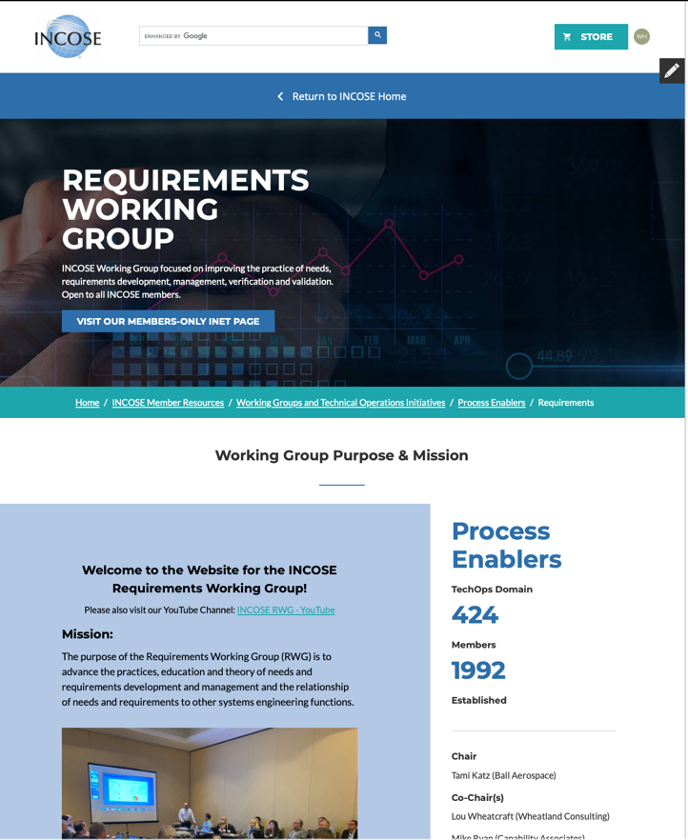
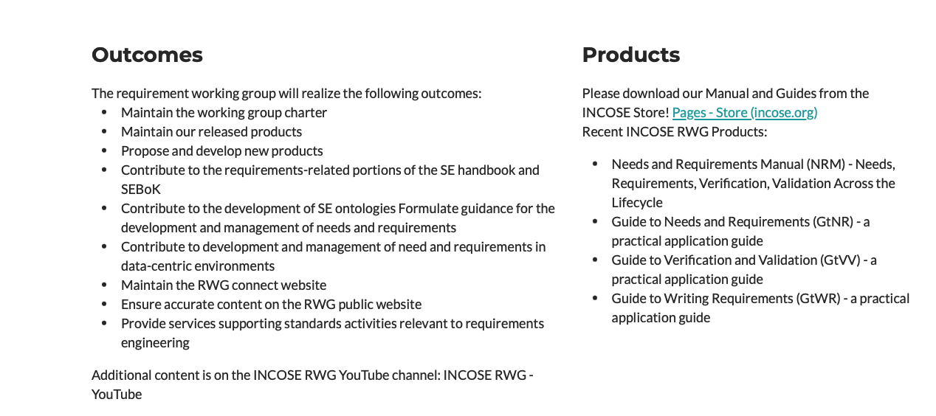
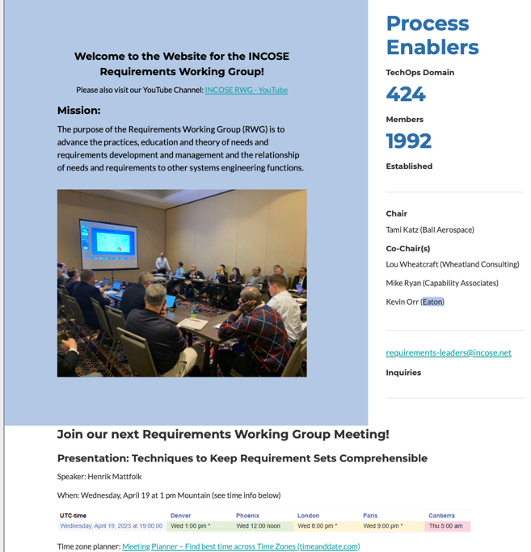
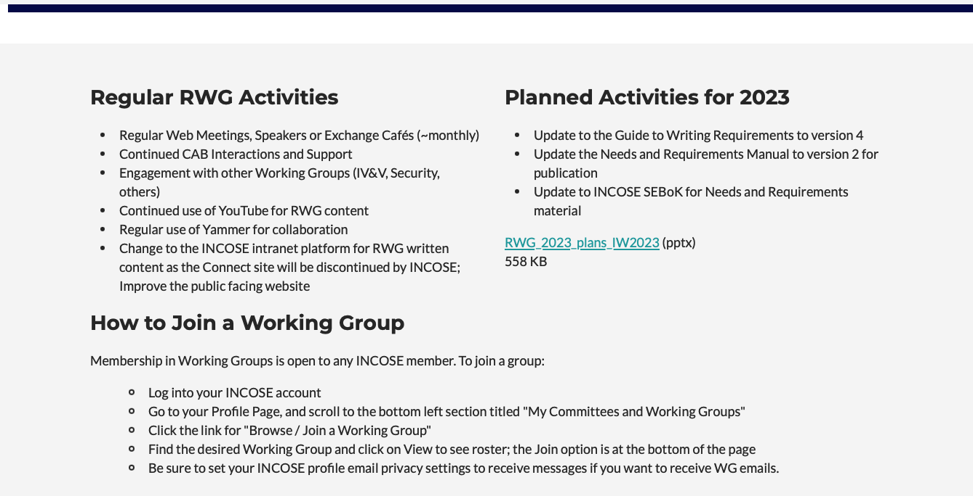
INCOSE RWG External Website
The RWG maintains an external website (no INCOSE membership needed to view)
Information on upcoming meetings and in work activities is provided.
Anyone interested in participating in requirement working group activities is welcome to view this site to stay informed and obtain links to content.
  https://www.incose.org/incose-member-resources/working-groups/process/requirements

Slide 8
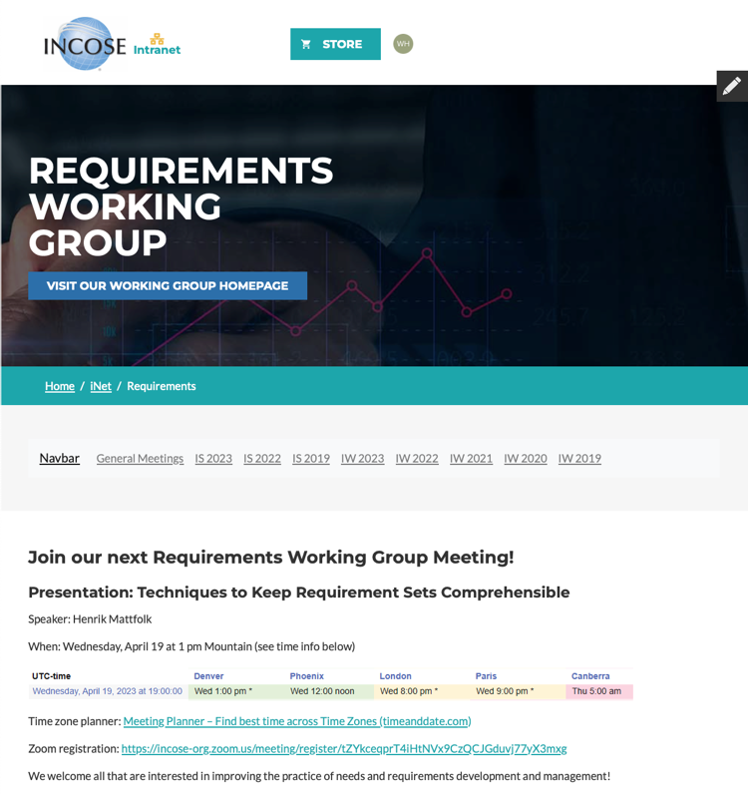
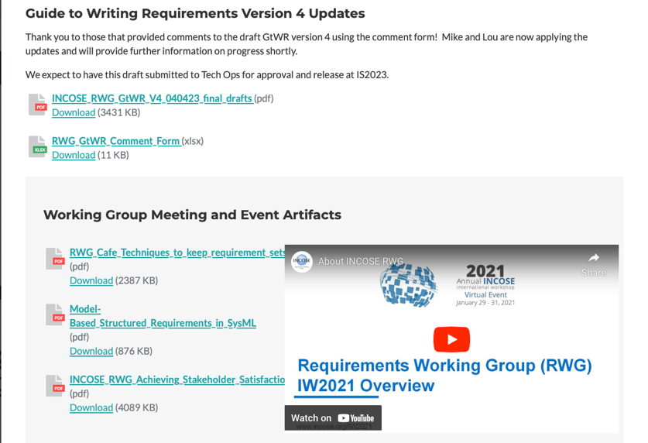
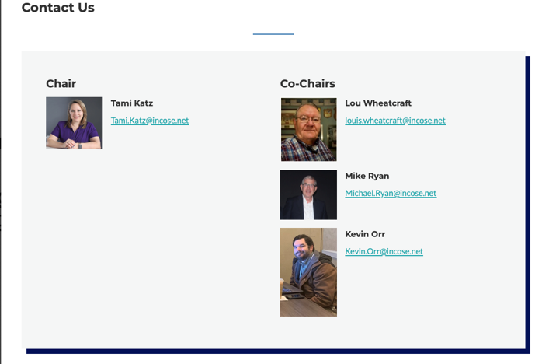
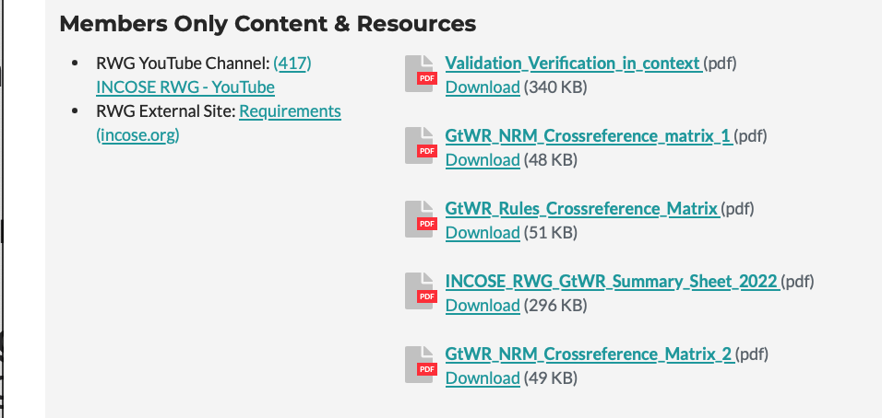
INCOSE RWG Internal Website (iNet)
The RWG is using the new “iNet” intranet sites for member only resources
Information on upcoming meetings and current activities are provided as well as additional, member-only content.
IW2023 material and presentations will be provided on this platform.
The Connect sites have been retired and are no longer utilized for INCOSE working group communication.
https://www.incose.org/inet/working-groups/requirements

Slide 9
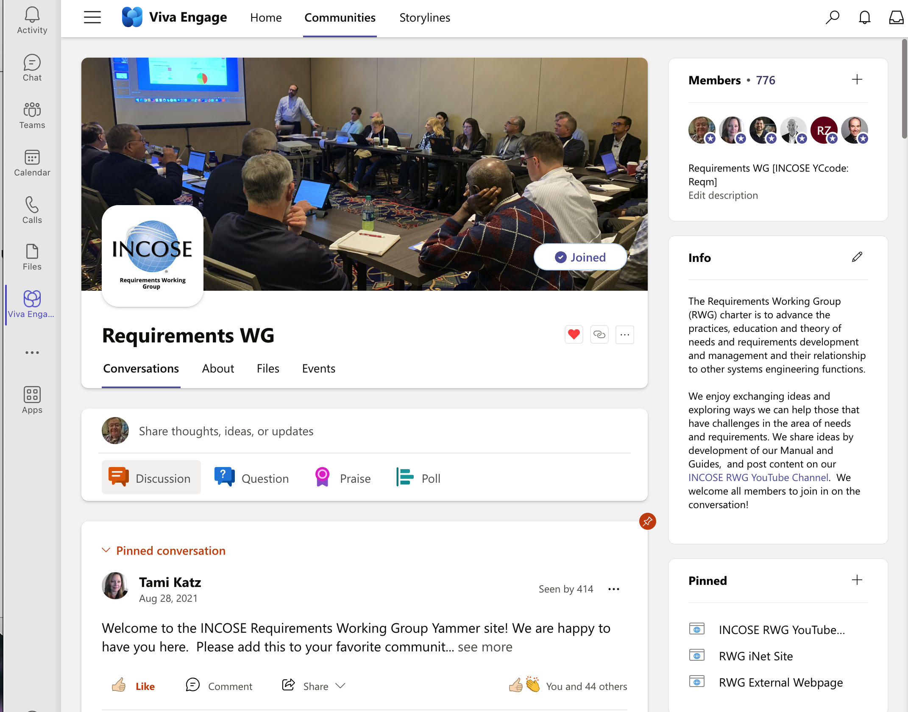
RWG Viva Engage (Yammer) Community
The INCOSE organization has established Microsoft platforms for INCOSE member engagement.
Upon obtaining the member login from the INCOSE CIO Barclay Brown, navigate to Viva Engage and join the Requirements WG Community.
This platform enables more interactive announcements, questions, and discussions throughout the year!
Access to Communities is through the Microsoft Teams App, Viva Engage App (iOS), or the online Microsoft Teams site.

Slide 10
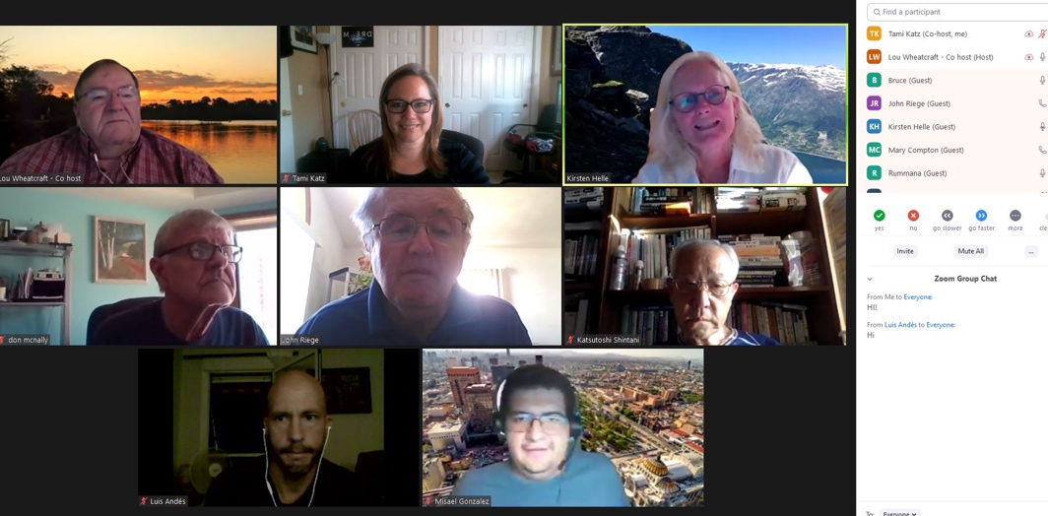
RWG Outreach Events
RWG engages with the INCOSE community as well as the larger SE community through regular events centered around the topic of Needs and Requirements.
  Guest speakers on Requirements Topics
  RWG Exchange Cafés
Open to INCOSE members and non-members.
RWG members contribute ideas towards topics discussed.
Attendees are encouraged to share their experiences and questions with the broader working group community.

Slide 11
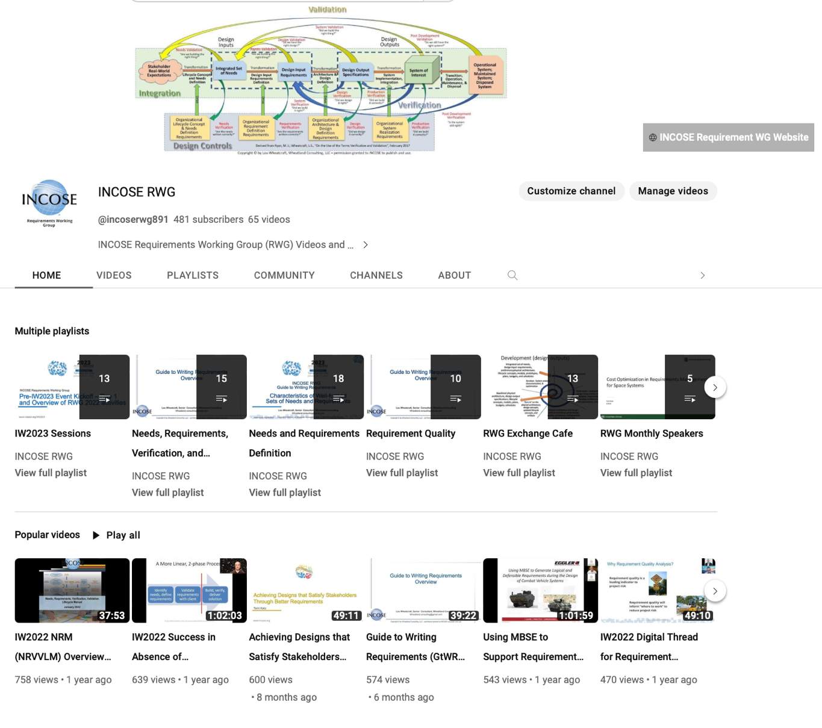
INCOSE RWG YouTube Channel
YouTube channel has recordings of meetings and presentations to the broader community.
Available to everyone to catch up on events and learn more about the RWG activities and products.
Also exists to attract interest in joining INCOSE and the RWG and share experiences, lessons learned, best practices, wisdom, and ideas with all that engage in needs, requirements, verification, and validation activities.
https://www.youtube.com/channel/UCadgYaqKWDckenP2SU8-cPw/playlists

Slide 12
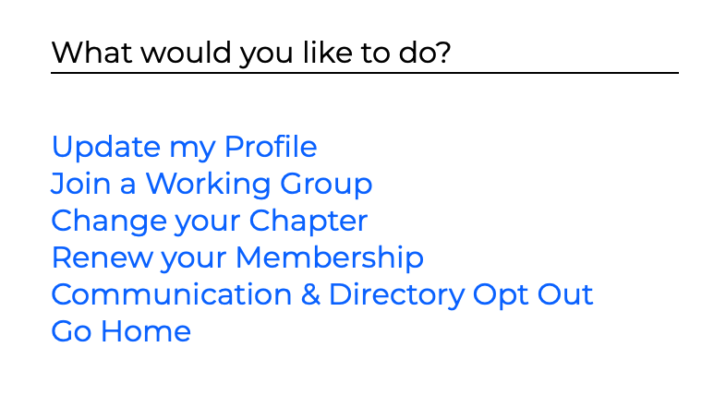
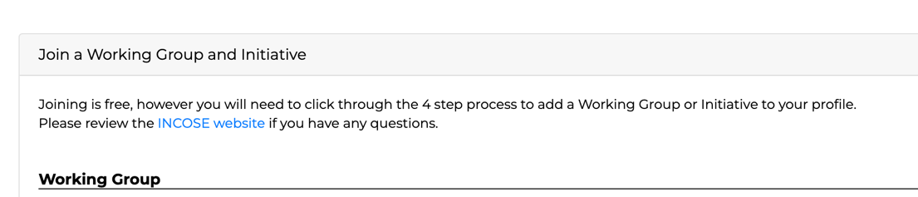
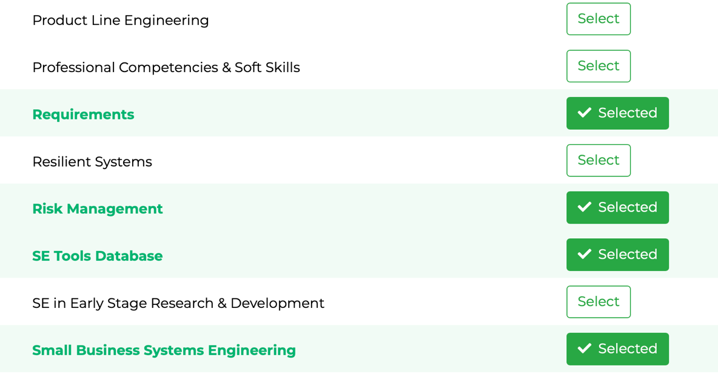
How to Become Involved in RWG
As a large working group, the RWG has been very active in virtual events as well as smaller product team efforts.
Joining the RWG enables the members to learn about the products, provide an opportunity to contribute to product development, and participate in the RWG virtual events with other practitioners.
Members can be very involved (product support), involved in our monthly meetings, or minimally involved (view Viva Engage conversations or watch meeting recordings) - the intention is to enable all levels of participation and interaction.
Top right of Profile Page

Slide 13
RWG 2023 Activities and Status

Slide 14
RWG 2023 Completed Events
June: Exchange Cafe: SE Quality Management WG and Requirements WG Interactions
May: Applying AI for Requirements Development
April: Techniques to Keep Requirements Sets Comprehensible
April: EMEA 2023 Presentation - Defining Needs and Requirements for Sustainable Systems
March: Model-Based Structured Requirements in SysML
February: RWG Exchange Cafe - Insights from IW2023
January: RWG Meetings at IW2023
  Pre-event virtual sessions included six speakers, shown on next slide
Recordings of monthly meetings and presentations are available on the INCOSE RWG YouTube Channel

Slide 15
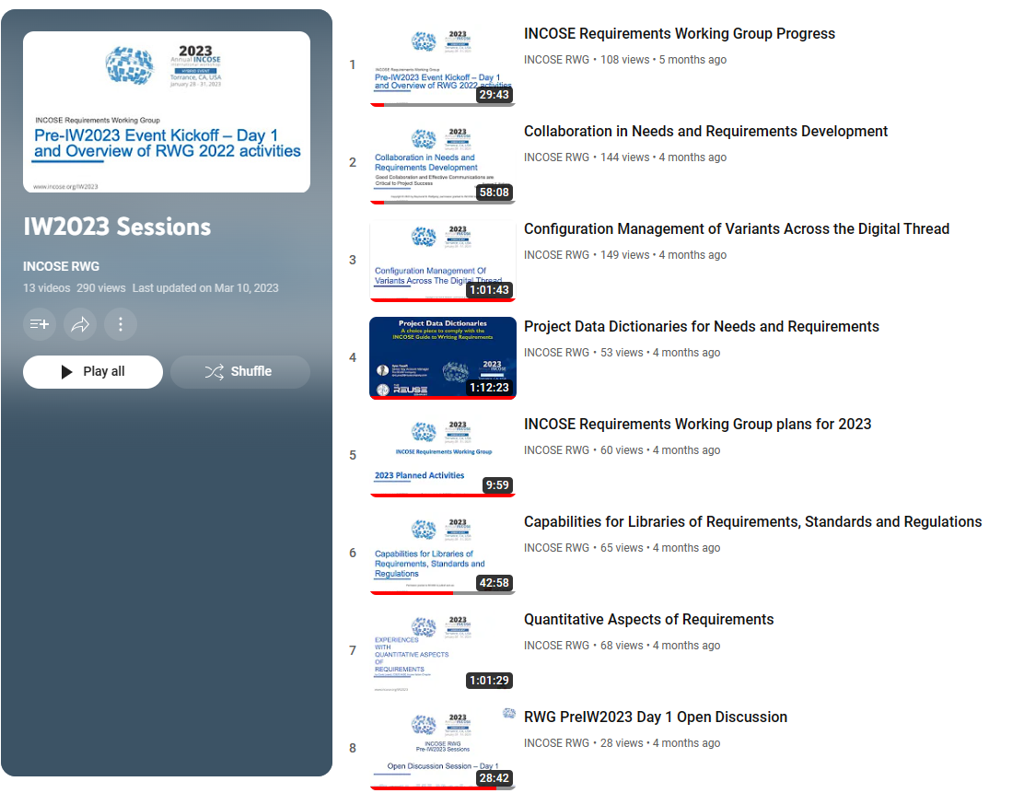
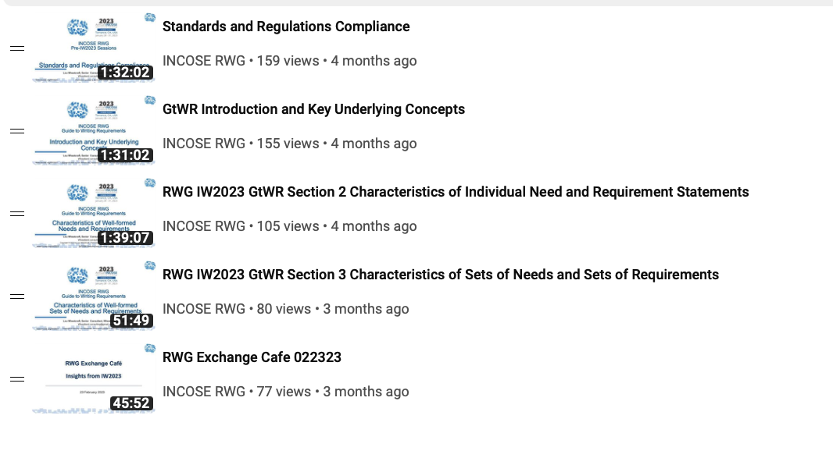
IW2023 Sessions (including pre-event)
YouTube Playlist

Slide 16
RWG Product Tree
The RWG has developed a family of products and supported development of other INCOSE publications.
RWG Inputs Provided
RWG Inputs Needed
V1.1 Released
V1 Released
V1 Released
V4 Released
RWG Inputs In work

Slide 17

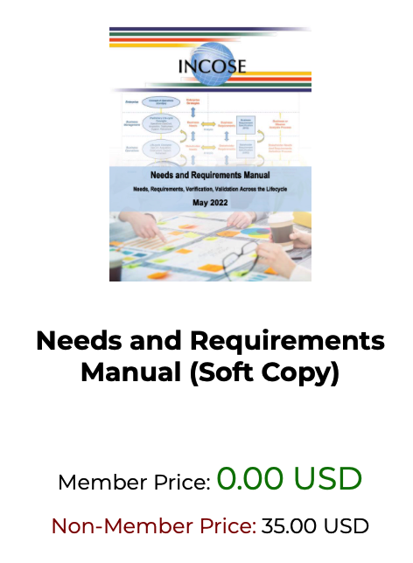
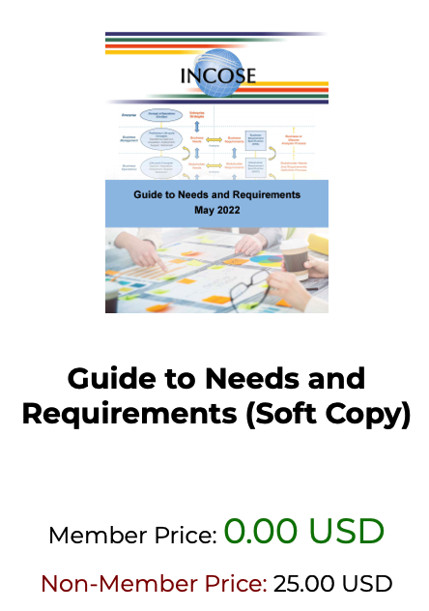

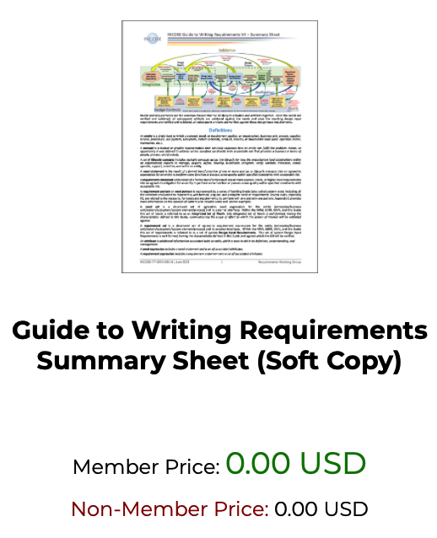
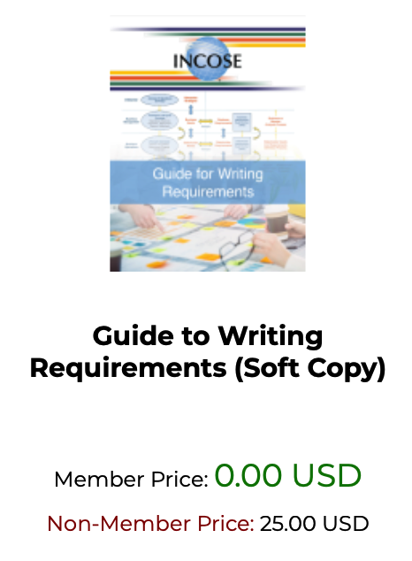
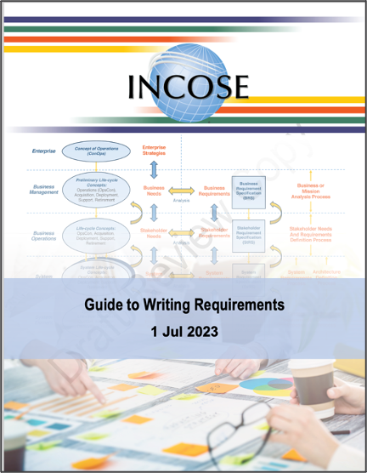
RWG Products are in the INCOSE Store!
RWG Products are available in the INCOSE Store!
Free to INCOSE members
All are encouraged to download and start using, feedback is welcome!

Slide 18
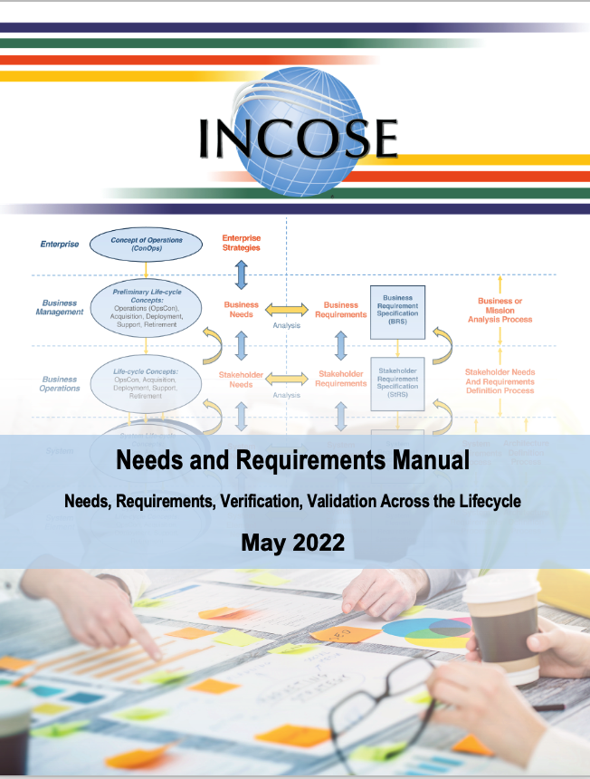
Needs and Requirements Manual (NRM)
The NRM (was NRVVLM) is the RWG flagship product, V1 released in January 2022
V1.1 minor updates in May 2022 to shorten title, add subtitle, and align with other RWG products
Content aligns with, and expands, the INCOSE SE Handbook version 5 material.
After IW will begin updating to Version 2, which is planned to be published by Wiley in 2024.

Slide 19
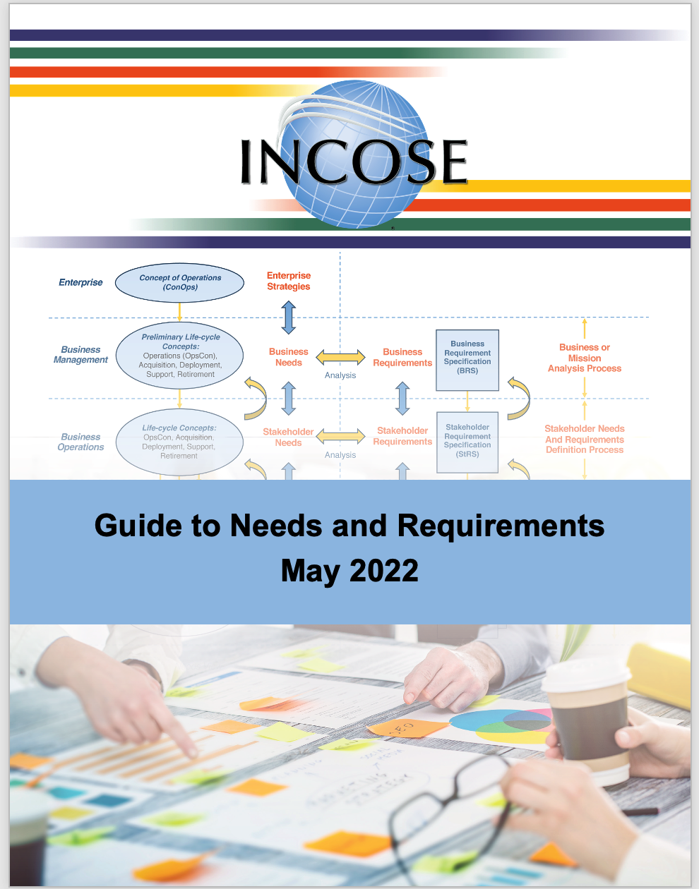

The RWG Guides Provide Practical Application of the NRM

Slide 20
Guide to Writing Requirements Updates

Slide 21
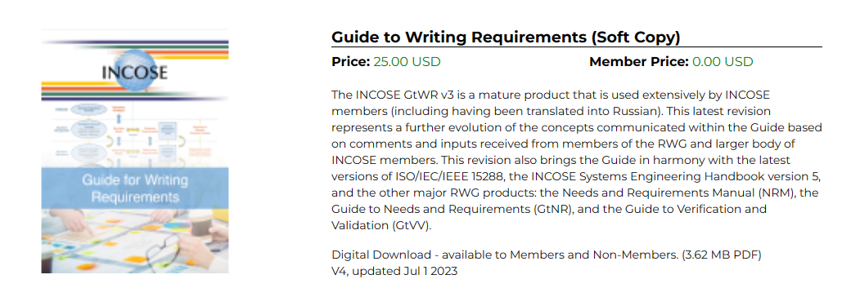
Recent Updates to the Guide to Writing Requirements
The Guide to Writing Requirements (GtWR) has been a popular product from the RWG for many years.
The RWG recently released V4, now available in the INCOSE Store.
The following slides highlights these updates.
The INCOSE GtWR v4 is a mature product that is used extensively by INCOSE members. This latest revision represents a further evolution of the concepts communicated within the Guide based on comments and inputs received from members of the RWG and larger body of INCOSE members. This revision also helps ensure the Guide and INCOSE Systems Engineering Handbook version 5 are in harmony as well as the other major RWG products: the Needs and Requirements Manual (NRM), the Guide to Needs and Requirements (GtNR), and the Guide to Verification and Validation (GtVV).
Also included in a separate file is a 7 page summary of the GtWR including definitions, a summary of the characteristics of well-formed need and requirement statements and sets of needs and requirements, a summary of the rules for writing well-formed need and requirement statements and sets of needs and requirements, a summary of the attributes that can be combined with the need and requirements statements to form need and requirement expressions; as well as cross-reference matrices tying the various information together.
Digital Download - available to Members and Non-Members. (4.7 MB PDF)
V4, updated Jul 1 2023

Slide 22
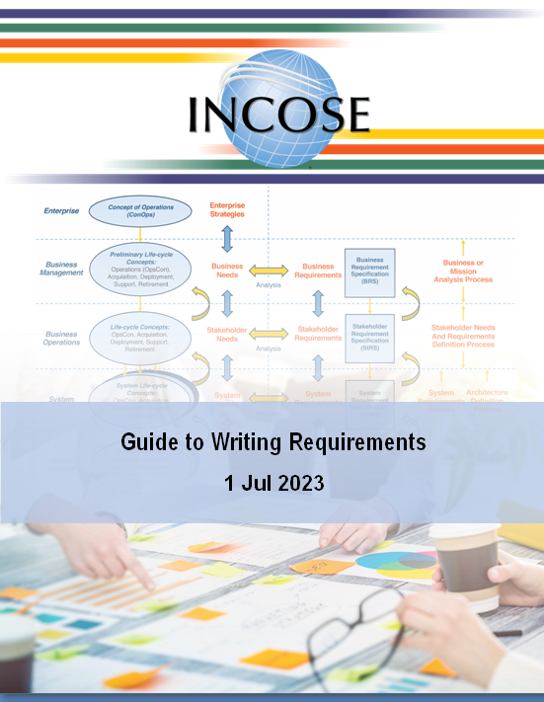
1: Introduction
2: Characteristics of Need & Requirement Statements
3: Characteristics of Sets of Needs & Requirements
4: Rules for Need and Requirement Statements &Sets Of
Needs & Requirements
Appendix A: References
Appendix B: Acronyms and Abbreviations
Appendix C: Patterns
Appendix D: Rule Applicability Matrix
Appendix E: Cross Reference Matrices
Appendix F: Comment Form
Many thanks to all those that reviewed the GtWR and supplied comments during the multiple review cycles.
144 pages

Slide 23
Change Summary
Updated definitions and concepts
Added more emphasis concerning differences between needs and requirements
Described stakeholder needs and requirements as compared to an Integrated Set of Needs and set of Design Input Requirements Transformed from those needs.
Added new Section 1.11: Conditional Clauses and Ubiquitous Requirements
Revised descriptions and guidance for characteristics
  Added figures from NRM to better illustrate characteristics
  Added new characteristic for sets of needs and requirements – C15: Correct
Updated rules (now includes 42 rules)
  Changed how rule titles are communicated and included distinct definition for each rule
  Revised rule elaborations
  Updated all rule examples
  Added new rule - R40: Decimal Format
Moved relationships between characteristics, rules, attributes, and NRM concepts to matrices in Appendix E.
Updated Appendix C: Patterns
  Added additional content for patterns for need and requirement statements
  Increased emphasis on inclusion of conditional and qualifying clauses
Added Appendix D for application of rules
  To needs vs requirements
  Which rules depend on well defined terms in glossary or data dictionary

Slide 24
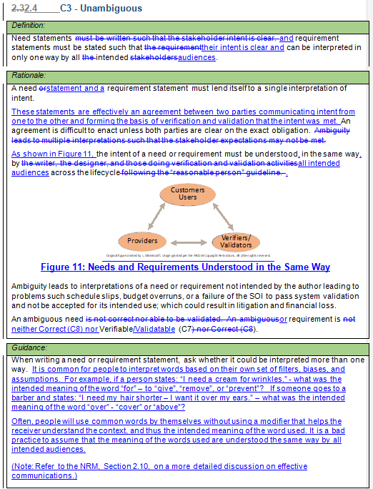
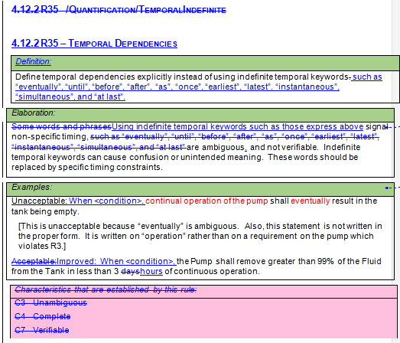
Sample updates

Slide 25
Rules to Characteristics Cross Reference Matrix

Slide 26
NRM Concepts and Activities to Characteristics Cross Reference Matrix (partial)

Slide 27
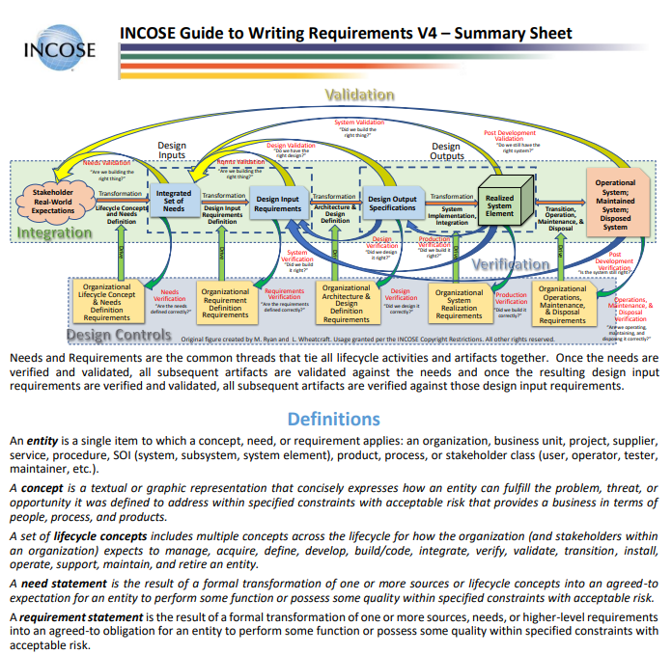
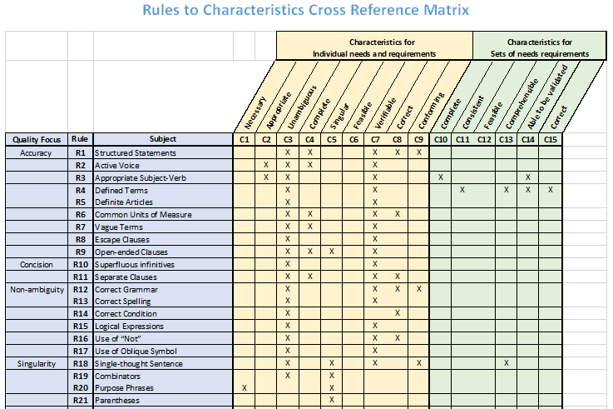
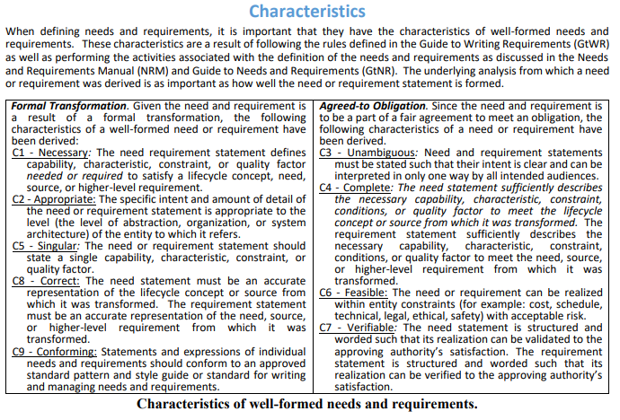
Also updated the
GtWR Summary Sheet
(The update includes the matrices)

Slide 28
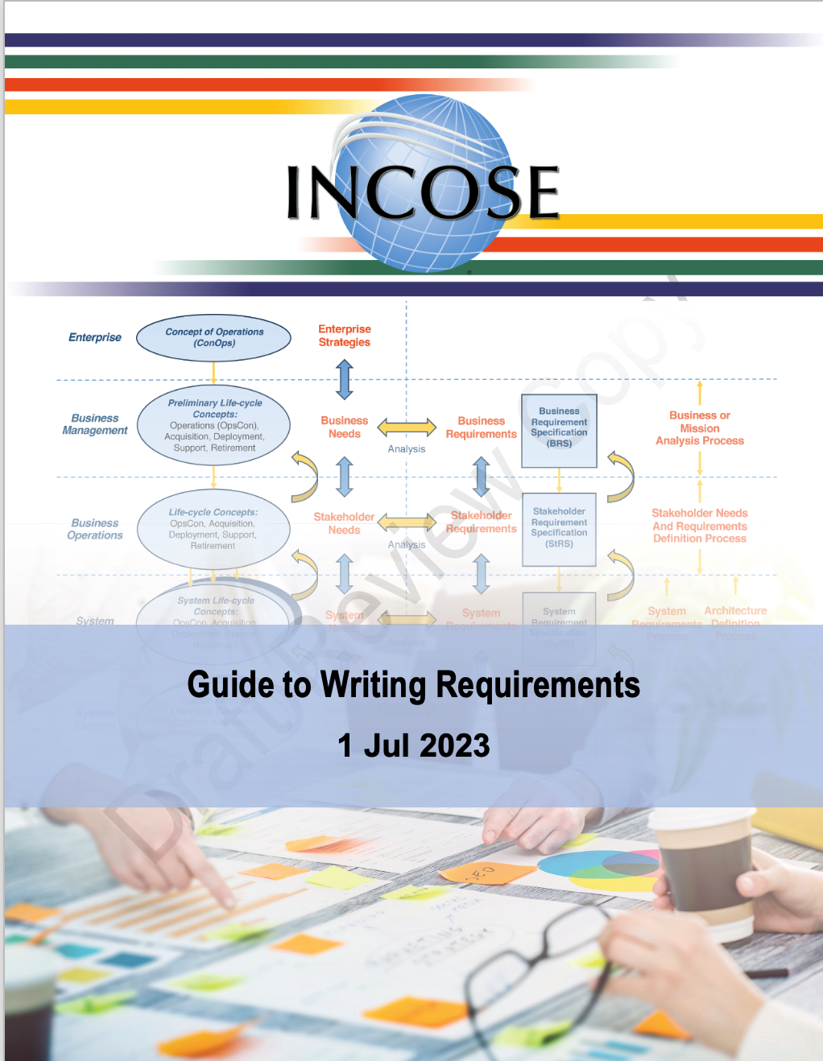
Guide to Writing Requirements
At IW2023, several presentations were given on the GtWR:
Section 1 - Introduction and Basic Concepts
Section 2 - Characteristics of well-formed needs and requirements
Section 3 - Characteristics of well-formed sets of needs and requirements.
In May, Lou Wheatcraft gave a presentation on Section 4: Rules for Individual Need and Requirement Statements and Sets of Needs and Requirements.
Recordings of these presentations are available on the INCOSE RWG YouTube Channel: https://www.youtube.com/playlist?list=PLVfZ7HbxxzBUVFtJzdHO6zp8LK0qk-aW5
www.incose.org/symp2023

Slide 29
RWG 2023 Planned Activities

Slide 30
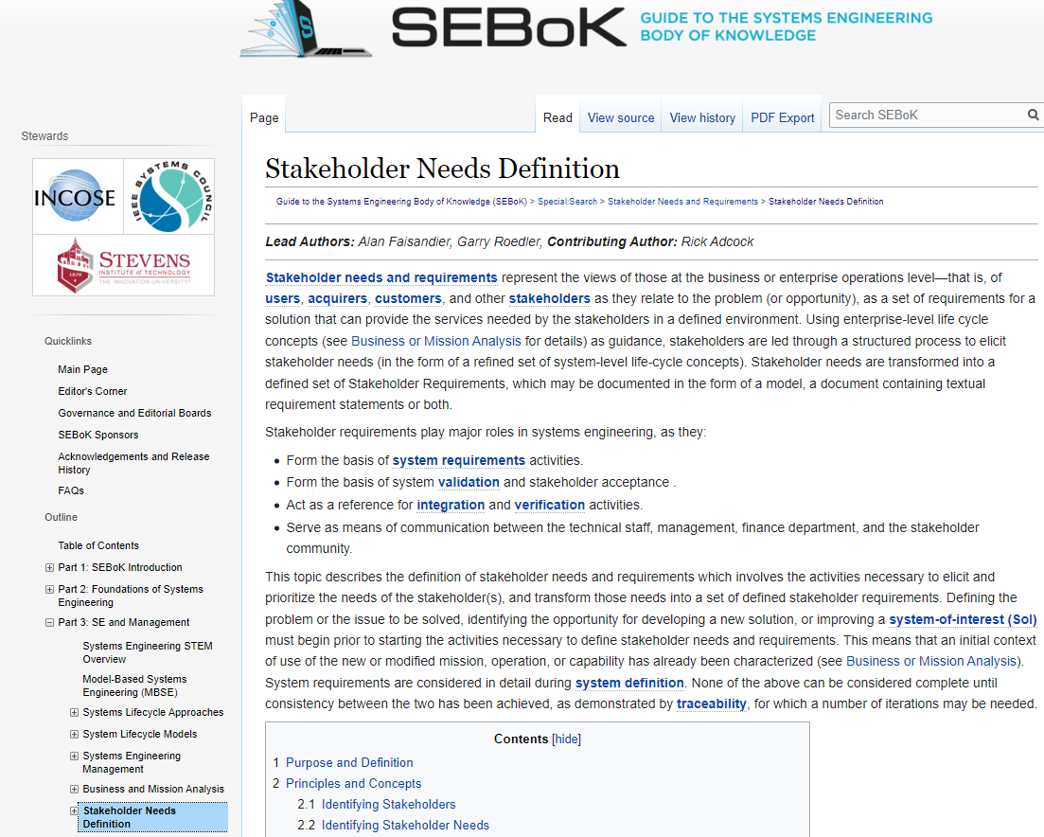
Update of SEBoK
With updates to RWG material, we plan to ensure alignment of the SEBoK with the concepts in the NRM.
With updates to the SE HB V5, we plan to ensure alignment of the SEBOK with sections of the SE HB dealing with needs, requirements, verification, validation, interface management, and traceability.
Tami and Khadijha Stewart are scrubbing material on the SEBoK related to Needs, Requirements, Verification, Validation to propose updates for alignment of concepts and nomenclature.

Slide 31
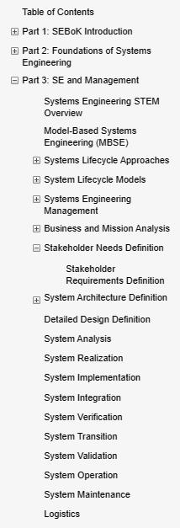
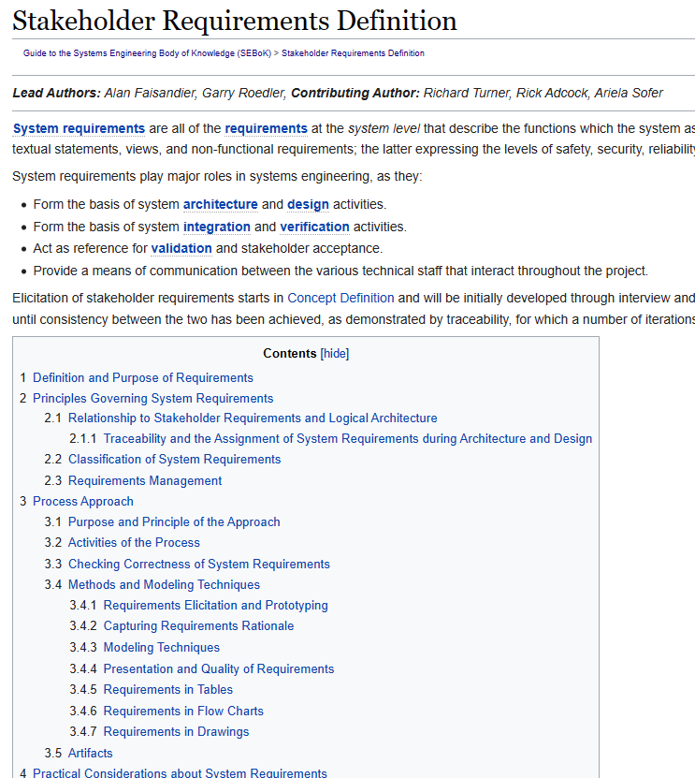
SEBoK Observations
The “Part 3” section covers ISO 15288 technical processes plus enabling practices
The 15288 “System Requirements” process is missing from this topic list
The section on Stakeholder Requirements mixes in concepts of Stakeholder and System Requirement technical processes, and is out of alignment with ISO 15288 and the SE Handbook
Overall – the content is light on practical information and cites (points to) outdated content (over ten years old). Example – the transformation of Needs to Requirements is not covered.

Slide 32
Planned Updated Content
Add a section specific to System Requirements after Stakeholder Needs
  Generate content moving some content from Stakeholder Requirements, and adding in concepts from SE Handbook v5 and INCOSE NRM
  Add in more guidance, add in more pointers to current material from INCOSE
Revise Stakeholder Requirements section to better align with 15288, 29148, SE Handbook, INCOSE NRM
Add a section on Traceability, providing overall content and guidance (and pointers), which can go at end of Part 3
Provide markups for Stakeholder Needs, System Verification and System Validation sections and point to INCOSE NRM and guides
In addition to suggested content, provide information on other updates to consider (such as adding a section on Disposal, another missing 15288 process).
Add Section
Add Section
RWG will provide content to SEBoK authors and editors for consideration of update.

Slide 33
NRM V2
INCOSE is under contract with Wiley to publish the NRM.
Over the last 18 months, we have used 2022 v1 and v1.1 to get feedback based on actual use
Response has been very positive, e.g.,
  “The NRM has been a godsend for my organization!”
  “The 2022 Needs and Requirements Manual is a must read! Awesome work!”
If you have any comments, please provide them to us ASAP.
Currently we are coordinating changes/updates based on comments received to date.
Once a draft revision is made, we will have a review cycle in which you can provide additional comments.

Slide 34
Continue Collaboration with Other Working Groups
System of Systems (SoS) WG
System Security Engineering (SSE) WG
Configuration Management (CM) WG
Systems Engineering and Quality Management (SEQM) WG

Slide 35
Continue To Hold our Monthly Meetings
If you have a topic you would like addressed or a presentation you would like to give, let us know.
Meeting announcements will be via Viva Engage and email
IW2024 Planning
We plan to hold a pre-IW event as has been done the last 2 years.
If you have a topic you would like addressed or a presentation you would like to give, let us know.
Meeting announcements will be via Viva Engage and email

Slide 36
Open Discussion

Slide 37
INCOSE NRM Underlying Concepts
Perform Integration, Verification and Validation Activities Throughout the Lifecycle
Define Security, Safety, and Sustainability as Prime Characteristics
Define an Integrated Set of Needs
+
Use Data-Centric Development Practices
+
+
Often a major focus is on the development of system level requirements, rather than first ensuring an understanding of the actual problem or opportunity, developing feasible lifecycle concepts, and defining an Integrated Set of Needs that represents the scope of the project and from which the system design input requirements will be transformed.
There is a lot of work and analysis to be done before defining the requirements.
Developers will often wait until they have a realized system before addressing integration, system verification, and system validation.
This can result in risk that issues will not be discovered until late in the lifecycle.
Past practices treated security, and sustainability (and other –ilities) as non-functional needs and requirements, rather than prime characteristics of the system.
Security, Safety, and Sustainability must be addressed from the beginning and reflected within the Integrated Set of Needs.
Document-centric practice of SE, presents challenges of having multiple sources of truth.
Moving to a data-centric practice of SE results in a single authoritative source of truth.
Development of a digital thread connecting SE artifacts across the lifecycle helps with effective change impact assessment.

Slide 38
Needs vs. Requirements
Needs represent the stakeholder, customer/acquirer view of the system of interest (SOI)
  What do the stakeholders need the system to do that will result in their problem to be solved or opportunity to be realized within defined constraints?
  Communicates the stakeholder expectations for the end-state once the SOI is delivered – in the end what will make the customer happy?
  The SOI will be validated against its integrated set of needs
Requirements represent the technical, developer view of the SOI
  What must the SOI do in order to meet the needs?
  Inputs to the design definition process
  Both the design and realized SOI will be verified against its design input requirements
  We must clearly understand the needs before we can define the requirements that will result in those needs being met.

Slide 39
Needs vs. Requirements

Slide 40
Needs vs. Requirements
There is a lot of work to be done before we can define the requirements.

Slide 41
Needs vs. Requirements
The quality of the requirements is dependent on the quality of the needs from which they are transformed.
Discussion points:
What are the challenges of defining requirements when there is little understanding of the overall needs?
What are some approaches to better ensure the Integrated Set of Needs are captured early in the project?
What are the impacts on project system validation (and product acceptance) if the needs are not clearly defined, understood, documented, baselined, and managed?

Slide 42
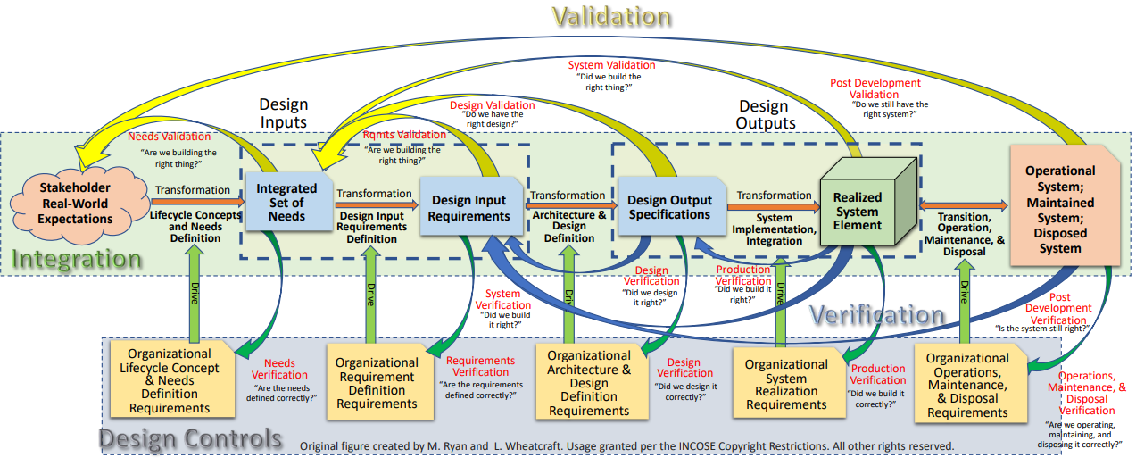
Continuous Integration, Verification, and Validation
Integration, Verification, and validation are performed concurrent with architecture maturation, as they occur concurrently with the other SE technical processes across all lifecycle stages.

Slide 43
Continuous Integration, Verification, & Validation across the lifecycle
Integration is an activity that must start at the beginning of the project
During development, view the system as an integrated system using both the hierarchical and holistic views, not just as a sum of its parts.
  Focus must be on the behavior of the system which is a function of the interaction of the parts of the system as well as the interaction of the system with external systems and its operating environment.
  Must always be on the lookout of emerging properties due to these interactions – both good and bad.
Integration, Verification, & Validation must occur across the lifecycle.
  Models of parts of the system must be developed in the context of an overall, integrated model of the integrated system.
  Waiting until the system is realized before Integration, Verification and Validation leads to an inability to pass system verification and system validation through errors in data, incomplete data, and late discoveries during integration resulting in schedule slips and budget overruns!

Slide 44
Continuous Integration, Verification and Validation
Performing verification and validation throughout the lifecycle ensures that data is provided early to highlight any defects in the design.
Discussion points:
What issues have you experienced because integration, verification, and validation activities were only done on the right side of the SE Vee for the realized system?
What are some approaches to better ensure Integration, Verification, and Validation are performed across the lifecycle as shown in the figure?
What challenges are there for supplier developed systems in terms of integration, verification, and validation?

Slide 45
Security, Safety, and Sustainability
Security, Safety, and Sustainability must be addressed from the beginning of the project.
In addition to use cases - define “mis-use cases” and “loss scenarios”.
As part of lifecycle concept analysis and maturation activities, define system capabilities that address these mis-use cases and loss scenarios.
Communicate the need for these capabilities within the Integrated Set of Needs.
Get commitment from the customer to provide resources, time, and budget to provide those capabilities.
Transform those needs into functional requirements that will result in those capabilities.
  Treating security, safety, and sustainability as nonfunctional requirements will not result in a system that those characteristics!

Slide 46
Security, Safety, and Sustainability
Security, Safety, and Sustainability must be viewed as prime characteristics of the system.
Discussion points:
Do you agree that treating security, safety, and sustainability as non-functional requirements will not result in a system that has those characteristics?
What are the advantages of treating them as functional requirements in order to ensure those characteristics are part of the system?

Slide 47
Data-Centric Practice of SE
Using a data-centric approach, needs, requirements, and other development artifacts (models, diagrams, drawings, etc.) are visualizations of an integrated data and information model of the system.
This approach is enabled by use of an integrated set of tools which support data interoperability standards and the sharing and linking of data between tools.
Instead of individual and separate artifacts, data and information are inter-connected (via traceability) forming digital threads across the lifecycle.
  Inconsistent multiple sources of truth result in challenges during development, integration, verification, and validation activities

Slide 48
Data-centric Practice of SE
Data-centric practice of SE versus a document-centric practice of SE enables an authoritative source of truth and traceability of all artifacts across the system lifecycle.
Discussion points:
What are some of the issues you are having because of a document-centric practice of systems engineering?
What are some organizational barriers to moving to a data-centric practice of systems engineering?
What are some approaches to help organizations move towards a data-centric practice of systems engineering successfully?

Slide 49
Other Topics
Any additional questions or challenges from the attendees related to the concepts of needs, requirements, verification, or validation?

