Slide 1


J.D. Baker, jbaker@Sparxsystems.com

Slide 2

Two for the Price of One
Sparx Systems Ambassador
  Responsible for supporting Sparx Systems at various standards groups
  Interested in what the users like and perhaps more importantly what they want
OMG Architecture Board member
  The Architecture Board is the OMG’s technical oversight board, acting as a senior advising body on both a wide range of technologies, and the processes of the OMG.

Slide 3

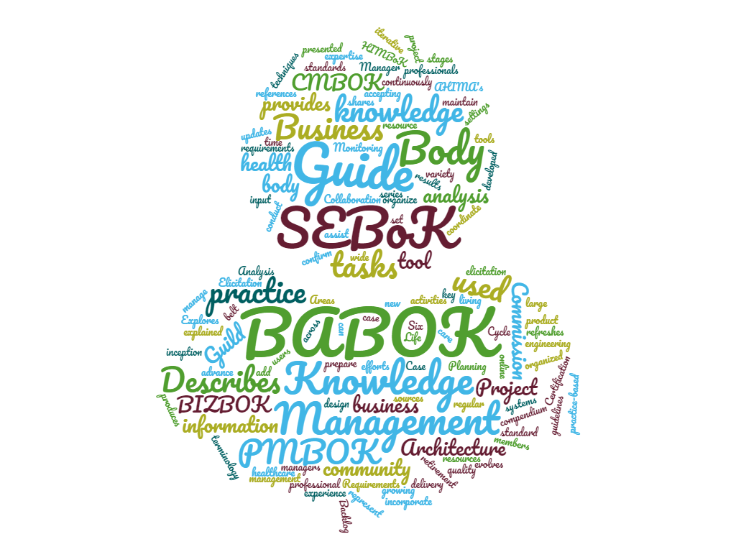
Body of Knowledge
There are a vast number of bodies of knowledge
Two that are of interest today are the SEBoK and the BABOK

Slide 4
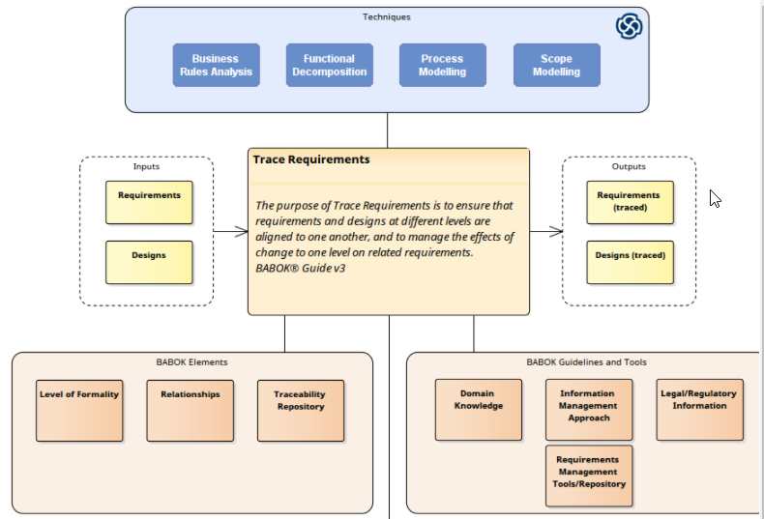
From the BABOK

Slide 5
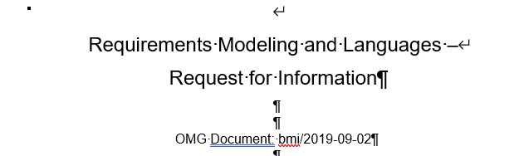


BMI – Business Modeling and Integration Task Force
The BMI DTF was organized to examine opportunities to standardize models and languages related to business concepts, in order to facilitate integration and interoperability at the level of business semantics (rather than software or communication systems).

Slide 6
The RFI
The Task Force has recently been discussing the need and opportunity to help users exchange models of business requirements
Ultimately, the Task Force may solicit through an RFP a Requirements Management Metamodel, which will be connected to the Business Architecture Core, and/or an RFP for a formal language to express requirements.
  Understand current best practices in requirements capture and management, not limited to the engineering domain, but also encompassing domains such as business transformation and strategy execution.
  Determine what can and should be standardized (e.g., a model, a language, etc.) and what such a standard should include.
  Inventory the models and standards that already exist in this area.
  Gauge the end users’ as well as the vendor community’s interest in such a standard, leading to the identification of potential respondents to one or more subsequent RFP(s).
  Gather any additional information to enable the BMI DTF to determine its next steps.

Slide 7



Questions
X
Twelve of the questions are subject to the qualifier
  “For the purpose of the following questions, please remember that we are looking for responses concerning any type or level of requirements (business as well as technical, non-functional as well as functional, externally imposed vs. internal, etc.)”

Slide 8










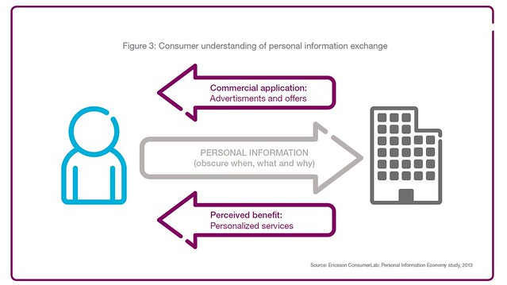
Demographic Questions (1 - 4)
Type of organization
  E.g. government, etc.
What domain are you concerned with
  E.g transportation, etc.
Outside influences
Information exchanges
  Specifically communicating requirements

Slide 9

Substantial (Substantive?) Questions
What is your definition of requirement?
What do you mean when you say requirements management?
Do you have a requirements taxonomy?
Methods?
Models?
Requirements attributes?
  These answers ought to be interesting
Are there associations or consortia devoted to requirements management in your sector? Please name them and indicate which ones you are part of.

Slide 10
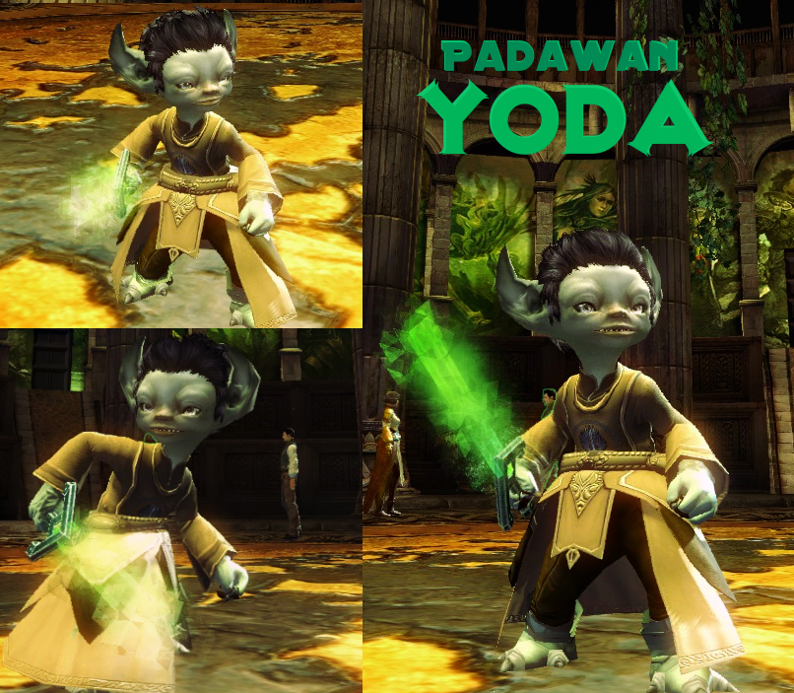
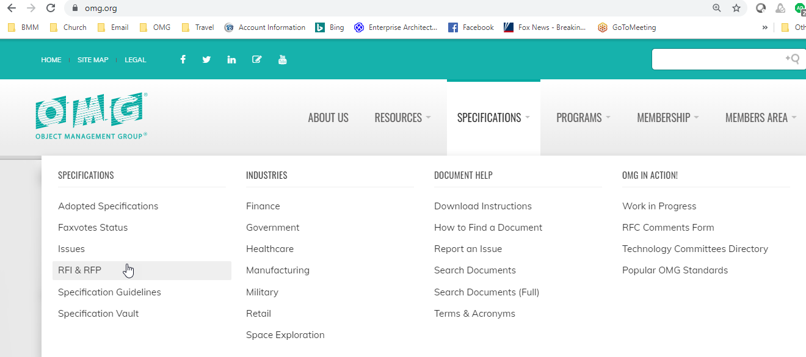
Where Is This RFI?
Respond I Must!!

Slide 11
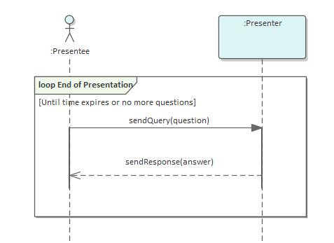
The MBSE Part

