Slide 1
Evaluation of COTS Hardware Assemblies for use in Risk Averse, Cost Constrained Space-based Systems
Tami Katz

Slide 2
Overview
Introduction to COTS
Challenges associated with COTS usage
Framework for evaluating usage of COTS
Example evaluation
Lessons learned

Slide 3
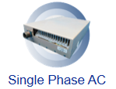
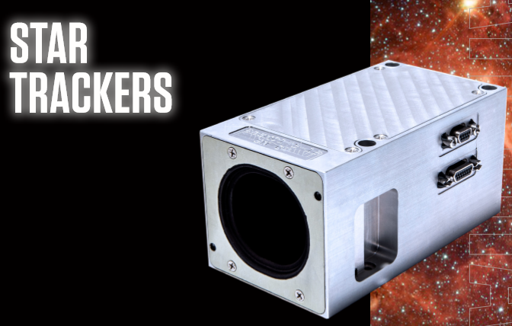

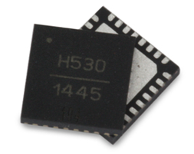
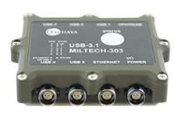

What is COTS?
COTS = Commercial Off the Shelf
Comes in many forms
  Software
  Assemblies
  Small components (fasteners, rivets, resistors)
http://aegispower.com/index.php/main
https://bluecanyontech.com/static/datasheet/BCT_DataSheet_Components_StarTrackers.pdf
http://www.criterialabs.com/pems-rf-parts-upscreening-to-nasa-eee-inst-002-l1-l2/
https://wpo-altertechnology.com/cots-commercial-off-shelf/
Scope of this paper is COTS Assemblies
https://militaryethernet.com/products/
https://www.slideshare.net/JosiahRenaudin/testing-in-the-new-world-of-offtheshelf-software

Slide 4
Why use COTS?
During the architecture and design definition phase a project may assess use of existing products against effort of developing a new product.
  This is part of a “make vs. buy” trade, where the buy is an existing product (COTS) compared to paying a company to develop the product.
Usage of COTS can save on development costs and schedule.
Determination of COTS benefit is typically done with a trade that leverages heritage of the product and supplier.

Slide 5
Aerospace Challenges of Using COTS
Aerospace space-based systems can vary!
Government funded programs often have a risk averse customer that expects specific documentation for verification of the products being provided.
New industry trends have utilized a more commercial approach with traditionally risk averse customers (DoD, NASA, other…), some of these still expect specific verification documentation based on safety concerns.
  Example: NASA’s Commercial Crew Program
Challenges exist when the customer still expects the high amount of verification documentation on a commercial program, particularly as COTS products are limited in available data.

Slide 6
Existing COTS Evaluation Processes
Prior to implementing this effort research was conducted to find existing processes which could be used to guide a program team in evaluation of COTS assemblies.
None of the existing frameworks provided a complete assessment and ability to show verification records for COTS hardware assemblies.
Existing COTS Evaluation Framework | Evaluation Process
Overndorf, et al, An Activity Framework for COTS-Based Systems [1] | Discussed that the usage of COTS is an act of reconciliation identifying what is wanted and comparing with what is available.
Ferris, et al, The Impact of Understanding the Need and Available Products in COTS Selection [2] | Addressed issues associated with the selection of COTS assemblies, recommending parameters of interest for use in evaluating the potential of COTS subsystems.
Albert, et al, Evolutionary Process for Integrating COTS-Based Systems (EPIC): An Overview [3] | Presented a method to evaluate software COTS using the COTS in the final software solution and assessing results.
Carney, et al, Identifying Commercial Off-the-Shelf (COTS) Product Risks: The COTS Usage Risk Evaluation [4] | Presented a method to evaluate software COTS by addressing the stakeholder’s needs and ensuring the resultant usage was assessed against the needs.

Slide 7
Proposed COTS Evaluation Approach
A proposed approach has been generated that leverages prior research and allows for customization by a project.
Results of this approach include documented risk mitigations and records useable in product verification.

Slide 8
COTS Evaluation Approach Steps
Identify Project Requirements and Constraints
Create criteria for the project (checklist)
Obtain Data for COTS product and supplier
Analyze to Determine Gaps
Perform Risk Assessment and Document Results
Make Decision on Whether to Proceed with Recommendation of COTS Usage
Obtain Project and Stakeholder Approval for COTS Usage
Provide Documentation as Evidence to support Verification

Slide 9
Step 1 – Identify Requirements / Constraints
Many parameters needed by the COTS item can be collected summarized by the systems engineers, including:
  Performance parameters and Functions needed
  Operational Environments
  Non-functional design and quality requirements
  Mission assurance process requirements
Additionally, constraints may exist for both technical (interfaces) and programmatic (risk posture, reliability, safety criticality) which can also be provided.
The project team collects this information to be used as a basis for risk assessments and understanding of expected verification data required for the product (formats can vary)

Slide 10
Step 2 – Develop a COTS Evaluation Checklist
Once the project requirements and constraints are identified, a checklist of specific parameters can be developed (example shown on next slide).
This checklist is an aid for evaluation of different COTS solutions to address specific criteria for the project.
Subject areas to consider for the checklist include (but not limited to):
  design data (performance, environments, part and material data, Interfaces)
  heritage of use
  fabrication processes
  test program and data
  security vulnerability
  plans for product upgrade or obsolescence
  past product failures
  post-delivery support for product

Slide 11
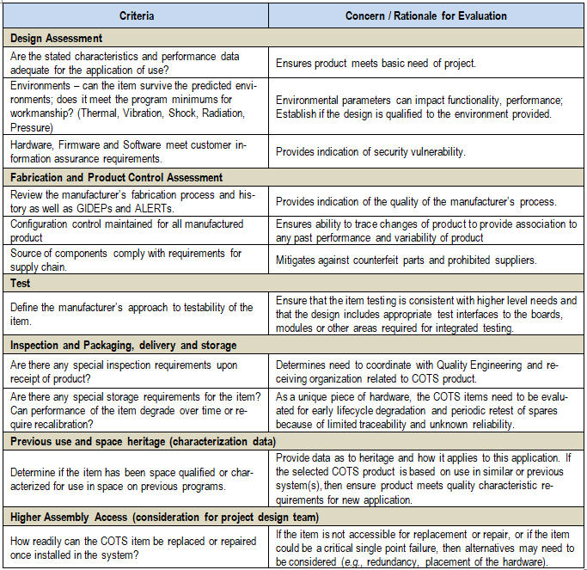
Example Checklist
The checklist includes the assessment of critical parameters needed to ensure the COTS satisfies program requirements
Because this checklist simplifies the resultant verification data it will likely need to be agreed-to with customer and other program stakeholders prior to usage

Slide 12
Step 3 – Obtain COTS Data
Assessment of the COTS solution uses information about the COTS assembly and the COTS supplier themselves.
COTS suppliers typically provide datasheets for public usage.
Conversations with the suppliers may also yield additional data, and in some cases the supplier may be willing to support providing data towards the evaluation checklist.
For some suppliers this is additional scope; they may either not provide this information, or provide at a substantial increase in cost.
Any missing data is a risk and assessed accordingly.

Slide 13
Step 4 – Analyze to Determine Gaps
The project team compares the requirements and constraints against the COTS data to identify any gaps.
Areas where the COTS product is either not meeting the project criteria, or the data is missing, are identified.
For identified gaps, a trace to customer requirements identifies whether the customer will need to be included in any subsequent approvals towards the COTS usage.
Gap?

Slide 14
Step 5 – Perform Risk Assessment and Document the Results
The project team performs a risk assessment for the parameters that do not meet the project requirements or processes.
For the identified gaps, evaluations of mitigation options assess if the gaps can be reduced using techniques such as:
  system design solutions by the project (isolators, etc.)
  additional qualification tests by the supplier or project
  additional analyses or inspections
The results are captured into a report for the COTS assembly that shows the assessment of the COTS assembly against the requirements and any identified risks and mitigation plans.
The amount of effort put into this assessment is a function of the risk profile of the project.

Slide 15
Step 6 – Recommendation of COTS Usage
The project technical team determines if the COTS assembly is a fit for the project, forming a recommendation whether to proceed with the COTS.
This consists of a trade study to ensure all parameters are evaluated against other options (e.g. developing a custom assembly, subcontracting with a supplier for unit development, or purchasing a different COTS product).
Decision to proceed will lead to a more formal program acceptance of the product.

Slide 16
Step 7 – Obtain Project and Stakeholder Approval for COTS Usage
Approval for the decision to use COTS will depend on the project, but at a minimum involves personnel with authority to accept any residual project risk or costs associated with the mitigation plans, such as a program review board.
For projects with risk averse customers that require insight or oversight this may go to a customer review board for formal acceptance to ensure resultant verification evidence or requirement gaps are accepted.

Slide 17
Step 8 – Provide Documentation as Verification Evidence
Upon approval for usage of the COTS assembly, the assessment report serves as record for the evaluation effort for the COTS hardware assembly usage.
This report, along with evidence obtained from any mitigation plans, serves as the verification evidence for the COTS assembly against the project requirements.

Slide 18
Example Evaluation
An example of the application of the COTS framework is shown through evaluation of a specific set of material and process (M&P) requirements on a project.
The resultant effort would reduce a 200 requirement standard to a material list request and evaluation of a handful of parameters by a subject matter expert.

Slide 19
Lessons Learned
While applying this to the author’s program a few items were observed:
  The engineering staff required training to understand the concept of meeting intent of requirements and addressing associated risk, this was a new paradigm for them as they were previously conditioned to ensure every individual requirement shows verification evidence.
  The checklist needed a few iterations to ensure it was complete and singular; time was spent after the first few evaluations to adjust the checklist for use on subsequent evaluation efforts.
  Systems engineering needed to identify and communicate the full program list of COTS assemblies and their evaluation process (became an SE oversight function).
  Safety and Mission Criticality of the COTS assemblies is a key factor in the evaluation.
  COTS piece-part and COTS assemblies can vary in what evaluation process and which stakeholder approval is required; Having both types of processes defined and communicated was key to addressing this confusion.

Slide 20
References
Overndorf, T, Brownsword, L, Sledge, CA 2000, An Activity Framework for COTS-Based Systems, CMU/SEI-2000-TR-010 addressed the
Ferris, TLJ, Do, Q 2010, The Impact of Understanding the Need and Available Products in COTS Selection, INCOSE IS 2010
Albert, C, Brownsword, L 2002, Evolutionary Process for Integrating COTS-Based Systems (EPIC): An Overview
Carney, DJ, Morris, EJ, Place PRH 2003, Identifying Commercial Off-the-Shelf (COTS) Product Risks: The COTS Usage Risk Evaluation, CMU/SEI-2003-TR-023

