Slide 1
Integrated Data as a Foundation for Systems Engineering
Document No.: INCOSE-TP-2018-001-01 Version/Revision: 1.0
Date: Dec 20, 2018
Prepared by the INCOSE Requirement Working Group (RWG)

Slide 2
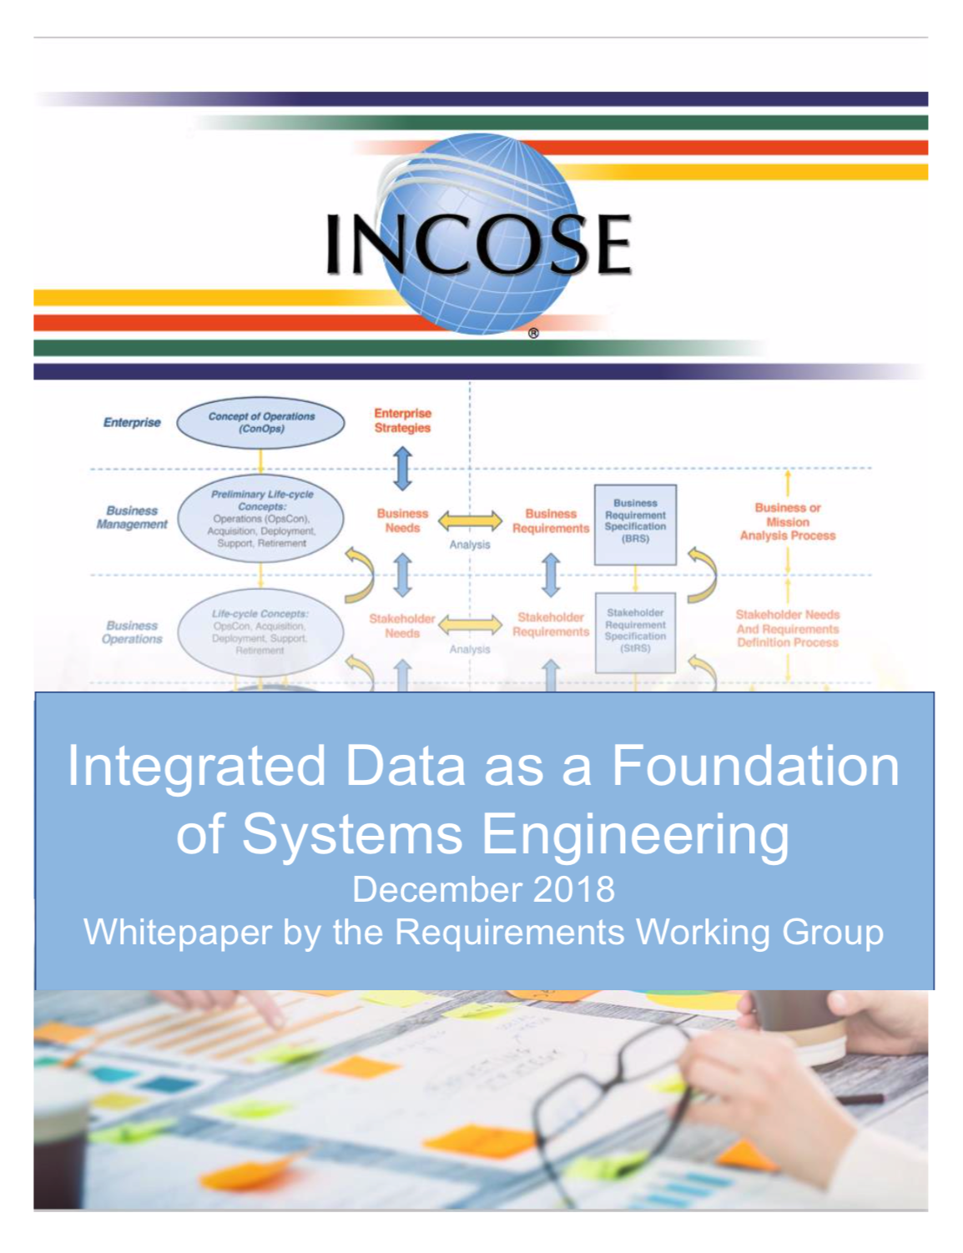

Slide 3
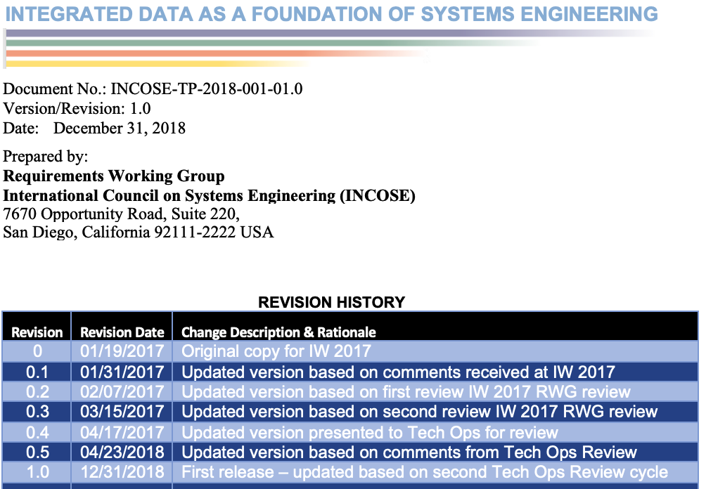

Slide 4
Preface
This whitepaper is an outgrowth from discussions concerning the RWG participation in and collaborating with the MBSE Initiative that occurred within the RWG sessions during INCOSE IW 2016 and IW2017 in Torrance, CA and subsequent communications between the authors, members of the RWG, and members of other INCOSE Working Groups.

Slide 5
Purpose
The purpose of this whitepaper is to help organizations implement Systems Engineering by addressing the following areas:
  Help organizations understand that the data-centric approach to practicing SE advocated in this whitepaper is a major part of MBSE.
  Outline the importance for an organization to keep track and manage data and information across all the system life cycle process activities.
  Provide guidance regarding the management principles and decisions important to the implementation and management of SE from a data-centric perspective.
  Propose a method that can be used to measure and benchmark an organization’s capability to practice SE from a data-centric perspective.
  Furnish guidance and a roadmap to help an organization move towards practicing SE from a data-centric perspective.

Slide 6
Goals
Expanding on the concept of SE from a data-centric perspective, the goals of this whitepaper are to:
  Present a broader data-centric perspective of SE that meets the intent the MBSE initiative.
  Provide organizations an understanding that integrated (federated), shareable sets of data are a key foundation of SE.
  Provide an integrated context of the various perspectives of MBSE which can be built upon and expanded on by the various INCOSE Working Groups, SE tool vendors, and practitioners of SE.
  The overall goal is to make this whitepaper a useful product to help organizations implement the level of SE capability that best fits their needs.
The overall goal is to make this whitepaper a useful product to help organizations implement the level of SE capability that best fits their needs.

Slide 7
Intended Audience
Project and product managers and systems engineers who are stakeholders in activities defined by the SE discipline and are thinking about, or are in the process of, implementing SE within their organization.
Those who are wondering how to successfully implement the intent of the MBSE Initiative within their organization and those that are interested in maturing their current SE capabilities toward a more data-centric implementation of SE - irrespective of the size and complexity of the system under development and the size and culture of the organization developing the system.

Slide 8
This guide is also targeted to:
From a requirements perspective, this whitepaper is also targeted to those who have been, or are currently, focused on defining, documenting, and managing requirements as a distinct and separate, siloed activity from other system life cycle process activities.
From a tool vendor perspective, this whitepaper is targeted to those whose tools do not provide the capability to integrate and share requirements and the other work products and their underlying data and information across all system life cycle process activities.
  While these approaches may have worked in the past and may work for some present system development efforts, it is doubtful these approaches will allow organizations to meet the future challenges of increasingly complex systems.

Slide 9
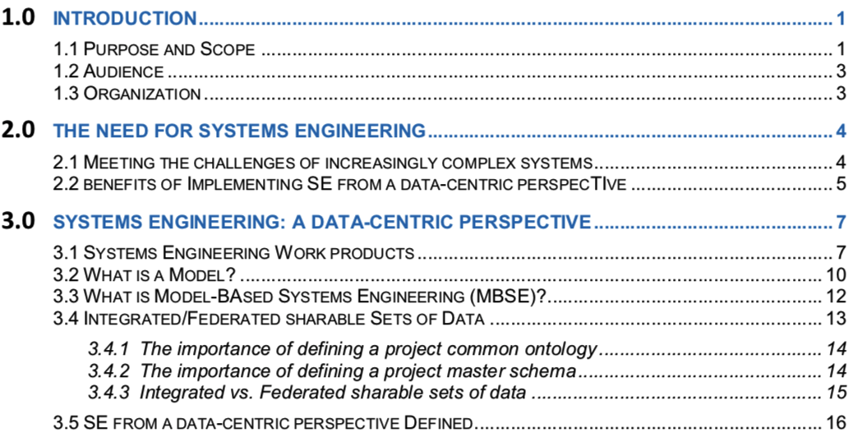
Table of Contents

Slide 10
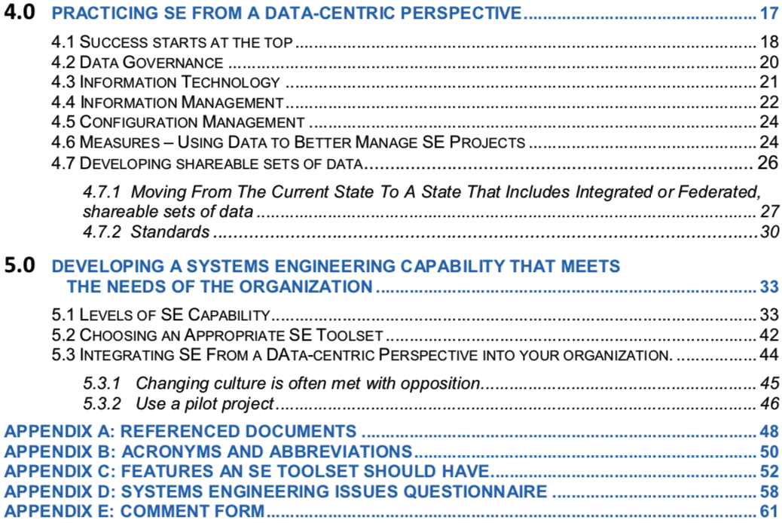
Table of Contents

Slide 11
SE Capability Levels (SCLs) Example- SCL 0
Area of Capability | Current state
Organization | The system life cycle process activities are divided across organizational units operating in silos.
Enterprise Level Data & Governance Policy, Processes, & Procedures | The enterprise has no documented data and information governance policy, processes, and procedures.
Project level Data and Information Management | Projects have not included data management concepts in their PMP nor SEMP and have no IMP.
Master Ontology | There is no defined master ontology for the enterprise nor project.
Master Schema | The project does not store data in a database so there is no defined master schema for the project.
Systems Engineering (SE) Tool Set | The primary SE toolset used by the project is limited to common office applications: word-processing, spreadsheets, presentations, and basic drawing and diagraming tools.
Project Management (PM) Tool Set | The primary PM toolset used by the project is common office applications: word-processing, spreadsheets, and presentations.
Work product Format | The primary focus of the project is on hardcopy, printed documents, design description documents, ICDs, CAD drawings, etc.
Shareability of data and information | While the files representing work products are stored electronically, they exist as independent files (vs. in a database containing underlying data) making it difficult to share information contained within the files other than with other office applications (copy/paste).
Linking (Traceability) between work products developed in different development life cycles | Few, if any, work products are linked together across system life cycle process activities making it is difficult to identify and manage dependencies between work products. Any traces between requirements is done manually, if at all.
Consistency of data across work products | There are often inconsistencies between and within work products.
Completeness of work products | It is difficult to assess completeness of data and information within work products.
Use of work product attributes and associated measures | Few, if any, SE work product attributes and measures are defined and used to help manage the project. PM measures focus on schedule and budget.
Configuration Management | The project baselines and configuration manages individual printed documents or electronic versions of the printed documents (e.g., pdf files). The single source of truth of project's data and information is represented by these baselined and configuration managed documents.

Slide 12
Information Model
The RWG produced this whitepaper from the perspective that requirements, along with all work products (models, designs, documents, diagrams, drawings, etc.) generated during the performance of system life cycle process activities are represented by underlying sets of data and information.
Data and information in these sets need be able to be accessible and shared between organizations and PM and SE tools used within an organization as well as external organizations.
This sharing will help to ensure consistency, correctness, and completeness of work products developed across all system life cycle stages.
To enable this sharing of data and information, the project/program needs to manage these sets of data in a way that enables sharing of the data across all system life cycle stages.

Slide 13
Data-centric Perspective of SE
The authors believe this data-centric perspective of SE provides an alternate lens through which to acquire a more complete understanding of the system life cycle process activities and resulting work products and underlying data and information needed to manage the development of increasingly complex systems of the future.
This perspective aids in acquiring a practical understanding of the system life cycle process activities from the perspective of not only models, but all work products that are generated from activities conducted during each of the system life cycle process activities and the underlying data and information used to represent these work products.

Slide 14
SE from a Data-Centric Perspective defined:
“SE, from a data-centric perspective, involves the formalized application of shareable sets of data to represent the SE work products and underlying data and information generated to support concept maturation, requirements development, design, analysis, and verification and validation activities throughout the system life cycle, from conceptual design to retirement.”

Slide 15
Integrated data as a foundation of SE
Notes:
During our discussions at IW 2016, the RWG Chair, Dr. Mike Ryan, made a very good observation that the focus should not be on “modeling”, but rather on data and the management of that data that is stored in a database a shown in the following diagram. "Data Based SE" rather than "Model Based SE". Thus rather than just thinking models, think data and what outcomes you need for your organizations to realize an ROI. The point Mike made was that we don’t store models, designs, diagrams, etc. in the database we store data that results from the SE tools we are using. These same tools can then be used to visualize the data in whatever form your organizations needs. If you need a very detailed model that is defined via a complex modeling language will allow you to run simulations, then you will need the proper tool to allow you to do this. However, you may not need this fidelity. Maybe you just want to better manage requirements throughout the product development lifecycle. Maybe you want to use functional flow diagrams and context diagrams to better understand your interfaces and to better understand the functionality of a complex system and the interactions of the parts that make up that system. Then you may want to develop requirements from these diagrams and link your requirements to these diagrams. Another point that was made by Rick Zinni, is that this is not really anything new, we have been using some form of model for years. All that is changing is perspective and focus.
Thus the important thing is to first decide what your organization needs to help you better manage the development of the systems in your domain. Then decide what capabilities you need and then develop the organizational policies, processes, and procedures, select and procure the tools that support your processes, and then train your people in the tools and processes.
It is also important to realize is that this journey can be done in a series of small steps. You don’t have to jump into SYSML complex modeling at the beginning. Start small with a requirement management capability. Then add to that the capability to manage the requirements over the lifecycle of the project, linking requirements to design, and linking requirements to verification planning artifacts. Then add the capability to use diagrams like functional flow diagrams or context diagrams and link your requirements to those diagrams. From there you can add the capability for simple modeling and overtime, progress to more complex simulation grade models (only if there is some benefit to be gain from doing so.) To me there are different levels of “maturity” of an organization concerning the use of the data. Similar to the levels of maturity in CMMI.
What capabilities you need depends on your product line, its complexity, issues you are having and want to address, and your workforce knowledge and experience. You need to understand what data best meets your needs.
We had a lady come to our RWG that had been sent to IW to figure out what it was and how it could be used to help her organization. A lot of this discussion resulted from our discussions with her. For a lot of people, MBSE is a lot like a deer standing on the road looking into the head lights of an approaching car. It can be overwhelming. Because of this, I am proposing that the next product the RWG works on is a “Guide to Data-Based SE” or “Guide to Data-Centric SE."

Slide 16
The basic premises of this document are:
Using this perspective, integrated (or federated), shareable sets of data can be viewed as a foundation of Systems Engineering.
From this data-centric perspective of SE, there are many key benefits that will aid organizations in successfully meeting the challenges associated with today’s ever increasingly complex systems, meeting the intent of the MBSE Initiative, and helping organizations move toward INCOSE’s Vision 2025.

Slide 17
The shareable, integrated dataset is the foundation of all SE lifecycle activities
The data-centric SE perspective focuses attention on the common, shareable integrated dataset that underpins all SE activities, including
  Modeling the system being developed
  Modeling the SE lifecycle processes
  Generation and management of all SE work products and their underlying data and information
A data-centric SE perspective is essential to:
  Manage the system development efforts across all lifecycles,
  Address the challenges of increasingly complex systems,
  Meet the intent of INCOSE’s MBSE Initiative
  Move towards INCOSE’s Vision 2025.

Slide 18
Questions?

