Slide 1
A Proposed Model-Based Approach
To Qualification (Formal V&V)
Raymond Wolfgang, Surety Engineering, Sandia National Laboratories
Albuquerque, NM, 87112
rwolfga@sandia.gov
SAND2020-0710 PE
Sandia National Laboratories is a multi-mission laboratory managed and operated by National Technology and Engineering Solutions of Sandia, LLC., a wholly owned subsidiary of Honeywell International, Inc., for the U.S. Department of Energy’s National Nuclear Security Administration under contract DE-NA0003525.

Slide 2
MBSE – Not Just For Design
Qualification = V&V!
  Government systems, formal process
Many companies have moved to model based design and development
Some operations – qualification – still document based
Using MBSE tool to track, organize, and finally grant “Qualified” status to a product can save time and money
Notes:
This sets the stage, and links “Qualification”, a term that will be known to Mil/Defense/Aero/Gov’t, to Verification and Validation, V&V, which others know.

Slide 3
Document Based Qualification
My role: Qualification Engineer for multiple components
Qualification Plan in MS Word
  Wide range of parts: tire valve to complex Electro/mech parts
  Requirements, design, production, Reliability
  Plan is for Verification; approach works for Validation also
Required for Government / High Consequence Items
Tracking the work is not doing the work; any reductions through use of a MBSE tool are most welcome

Slide 4
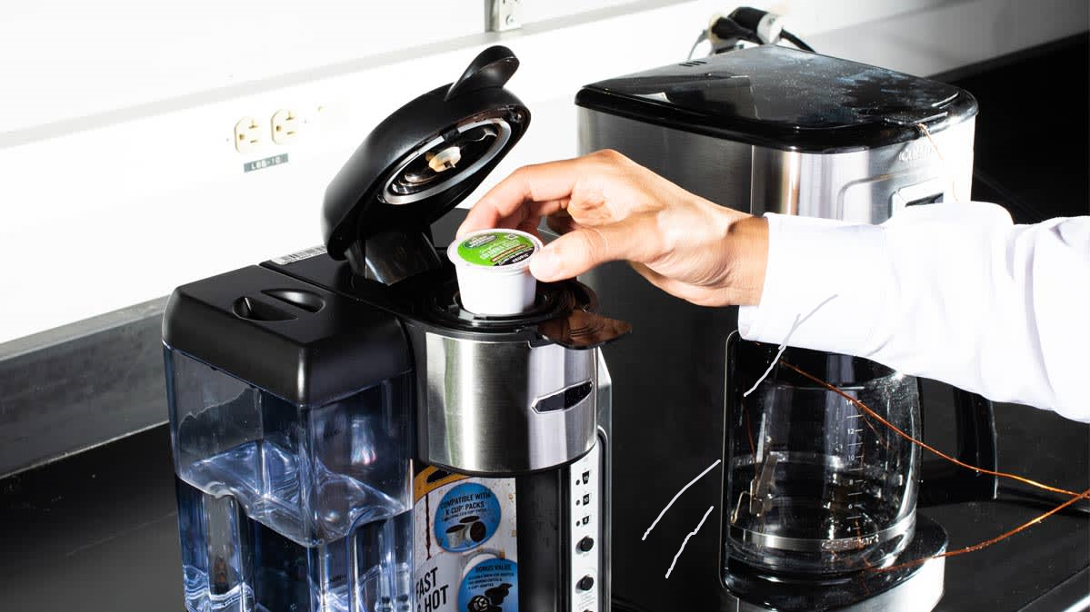
Example: Coffee Pot

Slide 5
Data Elements: Requirements & Design
Integrated Data as a Foundation of Systems Engr.
Define data elements!
  Requirements
    Functional, Interface, Transport, Environmental, …
  Solid drawings / CREO
  Handling specification
  Production specifications
  Programmatic: status reports, SEMP, REMP, V&V plan, …

Slide 6
Coffee Pot: Top Level, Physical
Standard SE process apply: physical architecture
Coffee System
Chassis
Cartridge Receptacle Assembly
Water Reservoir
Heating Element
Water flow system
Electrical System

Slide 7
Move to V&V Plan: MS-Word
Introduction
Product Information
Drawing Set
Qualification Strategy
  Prototype Builds
  Status Reports
  Test Equipment
  Customer Experience tests
Requirements Validation
  Chassis, Cartridge seat, … Electrical
Design Qualification
  Prototype Build 1, 2, 3
  Chassis, Cartridge seat, … Electrical
Readiness Level
  TRL / MRL
  Chassis, Cartridge seat, … Electrical
Production Development
  Tooling, gauges
  Vendor data and qualification
  Production, Handling, Packaging specs
Test Strategy
  Acceptance Equipment
  Customer trials
Verification
  Data repository
Final Acceptance
The MS-Word approach is “One-dimensional”: up and down the page. It’s all there, but hard to access specific data quickly

Slide 8
Very Linear! Read Top-to-Bottom
Introduction
Product Information
Drawing Set
Qualification Strategy
  Prototype Builds
  Status Reports
  Test Equipment
  Customer Experience tests
Requirements Validation
  Chassis, Cartridge seat, … Electrical
Design Qualification
  Prototype Build 1, 2, 3
  Chassis, Cartridge seat, … Electrical
Readiness Level
  TRL / MRL
  Chassis, Cartridge seat, … Electrical
Production Development
  Tooling, gauges
  Vendor data and qualification
  Production, Handling, Packaging specs
Test Strategy
  Acceptance Equipment
  Customer trials
Verification
  Data repository
Final Acceptance
The MS-Word approach is “One-dimensional”: up and down the page. It’s all there, but hard to access specific data quickly

Slide 9
New Approach: Model Based
Coffee System
Requirements
Drawings
Production Spec
Handling Spec
Packaging Spec
Prelim. Review
Status Reports
Gate Review
Final Des. Rev.
Prod. Review
TRL
MRL
KPPs
CPPs
Test Equipment
Test Plans
Test Results
Tooling
Gauges
Each physical item’s data is more accessible than buried in a MS Word document

Slide 10
Recursive
Chassis
Requirements
Drawings
Production Spec
Handling Spec
Packaging Spec
Prelim. Review
Final Des. Rev.
Prod. Review
MRL
KPPs
CPPs
Tooling
Gauges
Model allows flexible and recursive approach

Slide 11
Can Work with Different Views
Coffee System
Require- ments
Reviews
Status Reports
Tests
TRL / MRL
PP’s
Equipment
This view very helpful for formal V&V

Slide 12
Still have Functional Architecture
Make Coffee
Stay in one piece during use
Accept Keurig Cartridges
Store Water for successive uses
Heat Water
“Brew” Coffee
Be Electrically Safe
Duplicating this is MS Word far more complex
Notes:
All these functions can link to tests, reviews, maturity levels, PP’s, in the tool. This allows the Qualification Engineer to “wrap one’s head” around the larger Qualification effort. More than just V&V

Slide 13
Can Link the Data Elements …
Reviews:
Conceptual
Final
Functions:
Make coffee
Be elec. Safe
Hold Water
….
Tests:
Repeatability
Taste
User Interface
Status Reports:
Report 1
Report 2
Report 3
Requirements:
Req 1
Req 2
Req 3
Product Def’n:
Part 1, ver. A
Part 2, ver. B
Part 3, ver. B

Slide 14
… to Produce the Traceability Matrix
Reviews:
Conceptual
Final
Functions:
Make coffee
Be elec. Safe
Hold Water
….
Tests:
Repeatability
Taste
User Interface
Status Reports:
Report 1
Report 2
Report 3
Requirements:
Req 1
Req 2
Req 3
Requirements to Activities = RVTM !

Slide 15
Works for Production V&V
Tooling:
Tool 1
Tool 2
Functions:
Make coffee
Be elec. Safe
Hold Water
….
Physical:
Chassis
Electrical
Water Reservoir
Test Equip:
Machine 1
Rack 2
Testbench 3
Production Observations:
Process 1
Process 2
Process 3
Notes:
For qualifying production, a similar approach can be used. This could also work for showing compliance with programmatic requirements: Status Reports, Gate Reviews, etc. These would usually be linked at the top level. While a coffee maker wouldn’t need this, some large government programs may.

Slide 16
V&V Data Much More Accessible
Requirements, mapped to:
  Functions, Physical architecture, Testing, equipment, tooling
Adaptable to changes
  Edit a MS Word doc –> now we edit the Model.
Verification & Validation now far smoother
  Test activities, pointers to artifacts (plans, reports) linked.
  RVTM can be produced automatically
    May still want to enter linking into a RM database such as DOORS

Slide 17
Clarifications
Not a replacement for a RM system such as DOORS
Not performing engineering design
  May find interfaces
  Could hang off of a design MBSE system
Requires maintenance, tool support
Not for change control, or workflow management
All of these are workable! MB approach still recommended

Slide 18
Proposed: Worth the Front End Effort
Easier for Qualification Engineer to perform job
  Built-in Context Diagram
  Scalable: can drill-down to part (or function) in question
Can easily pass on work to successor, mid-project
Government acceptance can be Model-Based
  Reviews can walk through the model, vs. a Word doc.
Can spot gaps, hidden interfaces more easily
  Early on is best, but can see gaps at any time
Notes:
The final thesis, is that

Slide 19
Higher Quality Product, Lower Cost
Time (hours, salary) spent on qualification effort reduced
Visual approach, easier to spot interface V&V gaps
Increase customer confidence, satisfaction
  Some government customers, very concerned about transparency
  Some like to ‘drill down’.
Up-front investment in MBSE V&V infrastructure is worth it

