Slide 1
Guide to Verification and Validation
Status (IW 2021)
Raymond Wolfgang
Sandia National Laboratories
raymondbwolfgang@gmail.com
INCOSE Requirements Working Group
January 26, 2021

Slide 2
RWG Product Plan
Suite of documents
INCOSE Systems Engineering Handbook
SEBok
Needs and Requirements Life-Cycle Management Handbook
Guide for
Writing Requirements
Guide to
Developing and Managing Requirements
Guide to
Verification and Validation

Slide 3
NRLM
Guides Key off of the Needs and Requirements Lifecycle Manual
  More detail
  Theory
  More in-depth description of considerations

Slide 4
Guides
Guides are much shorter
Focus is on needs of practitioners
  Step-by-step processes
  List of considerations
  Size: 50-60 pages
    Brief background
    Process
    Specific considerations

Slide 5

New Guides: Split V&V
Guide to Managing Requirements
  Handles the V&V for Needs, and Requirements
Guide to V&V
  Design, and realized System-of-Interest
Based on when V&V performed in a project
Needs and requirements early; design and system, later.

Slide 6
Some “Familiar” Terms may be New
Terms
Need Statement
Design Input Requirement
Design Output Requirement
System of Interest (SOI)
System Element
Product
Requirement Verification
Requirement Validation

Slide 7
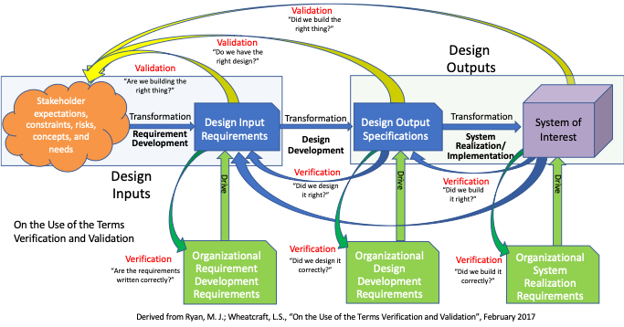
Guide focus: Design, and System V&V

Slide 8

Outline Completely Upgraded
Excellent contributions
Alignment with NRLM necessitated overhaul
“Started from scratch”

Slide 9

Outline Covers Same Content as Before
Introduction, definitions, R&R
Concepts and Principles
V&V Process
Further V&V Considerations
Conclusion
Appendices

Slide 10
Guide to V&V Schedule: Update
Tasks | Date
Update TPP | IW 2020
Confirm ToC and writing assignments | IW 2020
Contributor inputs | February – April
Integrate Inputs | March - August
Contributor/Editorial committee Review | August - November
Integrate Comments | November - December
Final alignment with NRLM | December - January
Release of Guide to RWG | IW2021
Review period | February – March
Disposition and Incorporate RWG Comments | March – April
Submit to Tech Ops for final Release | Early May
Final G to V&V Submitted | June – early July
Announcement/Release of Guide | IS 2021

Slide 11


Call to Action
You have a chance to influence!
Reviewers needed
In-depth comments welcome

Slide 12
Questions?

