Slide 1
Requirements Working Group (RWG) IW2021 Overview

Slide 2
RWG Charter
1
Purpose
The purpose of the Requirements Working Group (RWG) is to advance the practices, education and theory of needs and requirements development and management and the relationship of needs and requirements to other systems engineering functions.
2
Goal
Expand and promote the body of knowledge of needs and requirements and its benefits within the systems engineering community
3
Scope
Activities relating to best practices for needs and requirements development and management throughout the product lifecycle including:
Elicitation Analysis Allocation Traceability
Elaboration Management Change Management
Expression Verification Validation
All IW presentations and associated materials are available on the RWG Connect web site:
  Click on the “RWG sessions at IW2020” link on the left, then select “documents”
https://connect.incose.org/WorkingGroups/Requirements/Pages/Home.aspx

Slide 3
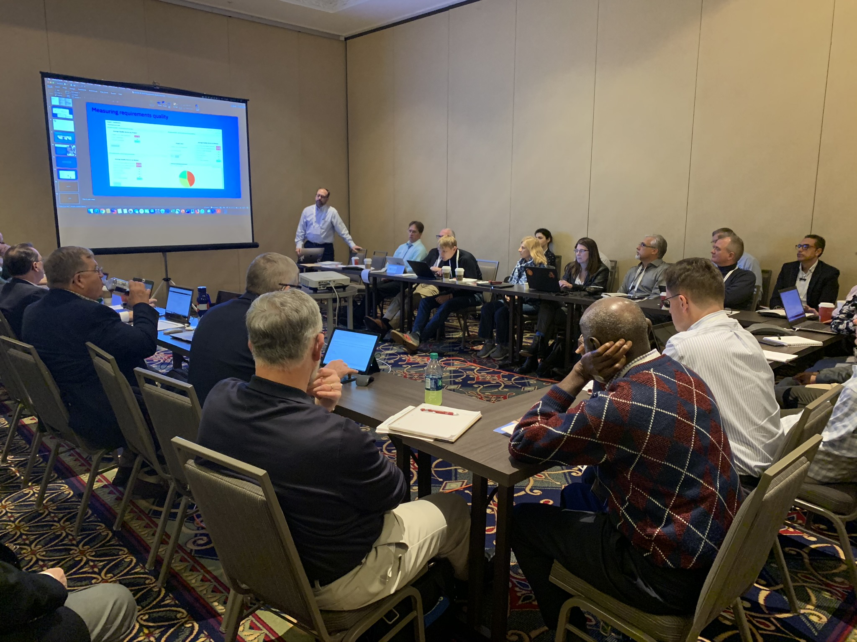
RWG is About….
Understanding how to improve the practice of systems engineering through excellence in needs and requirements development and management
Learning from experiences and sharing with community
Questioning approaches that yield poor outcomes
Publishing guidance and continuing research into requirements development and management, including the understanding of Needs, Requirements, Verification and Validation approaches

Slide 4
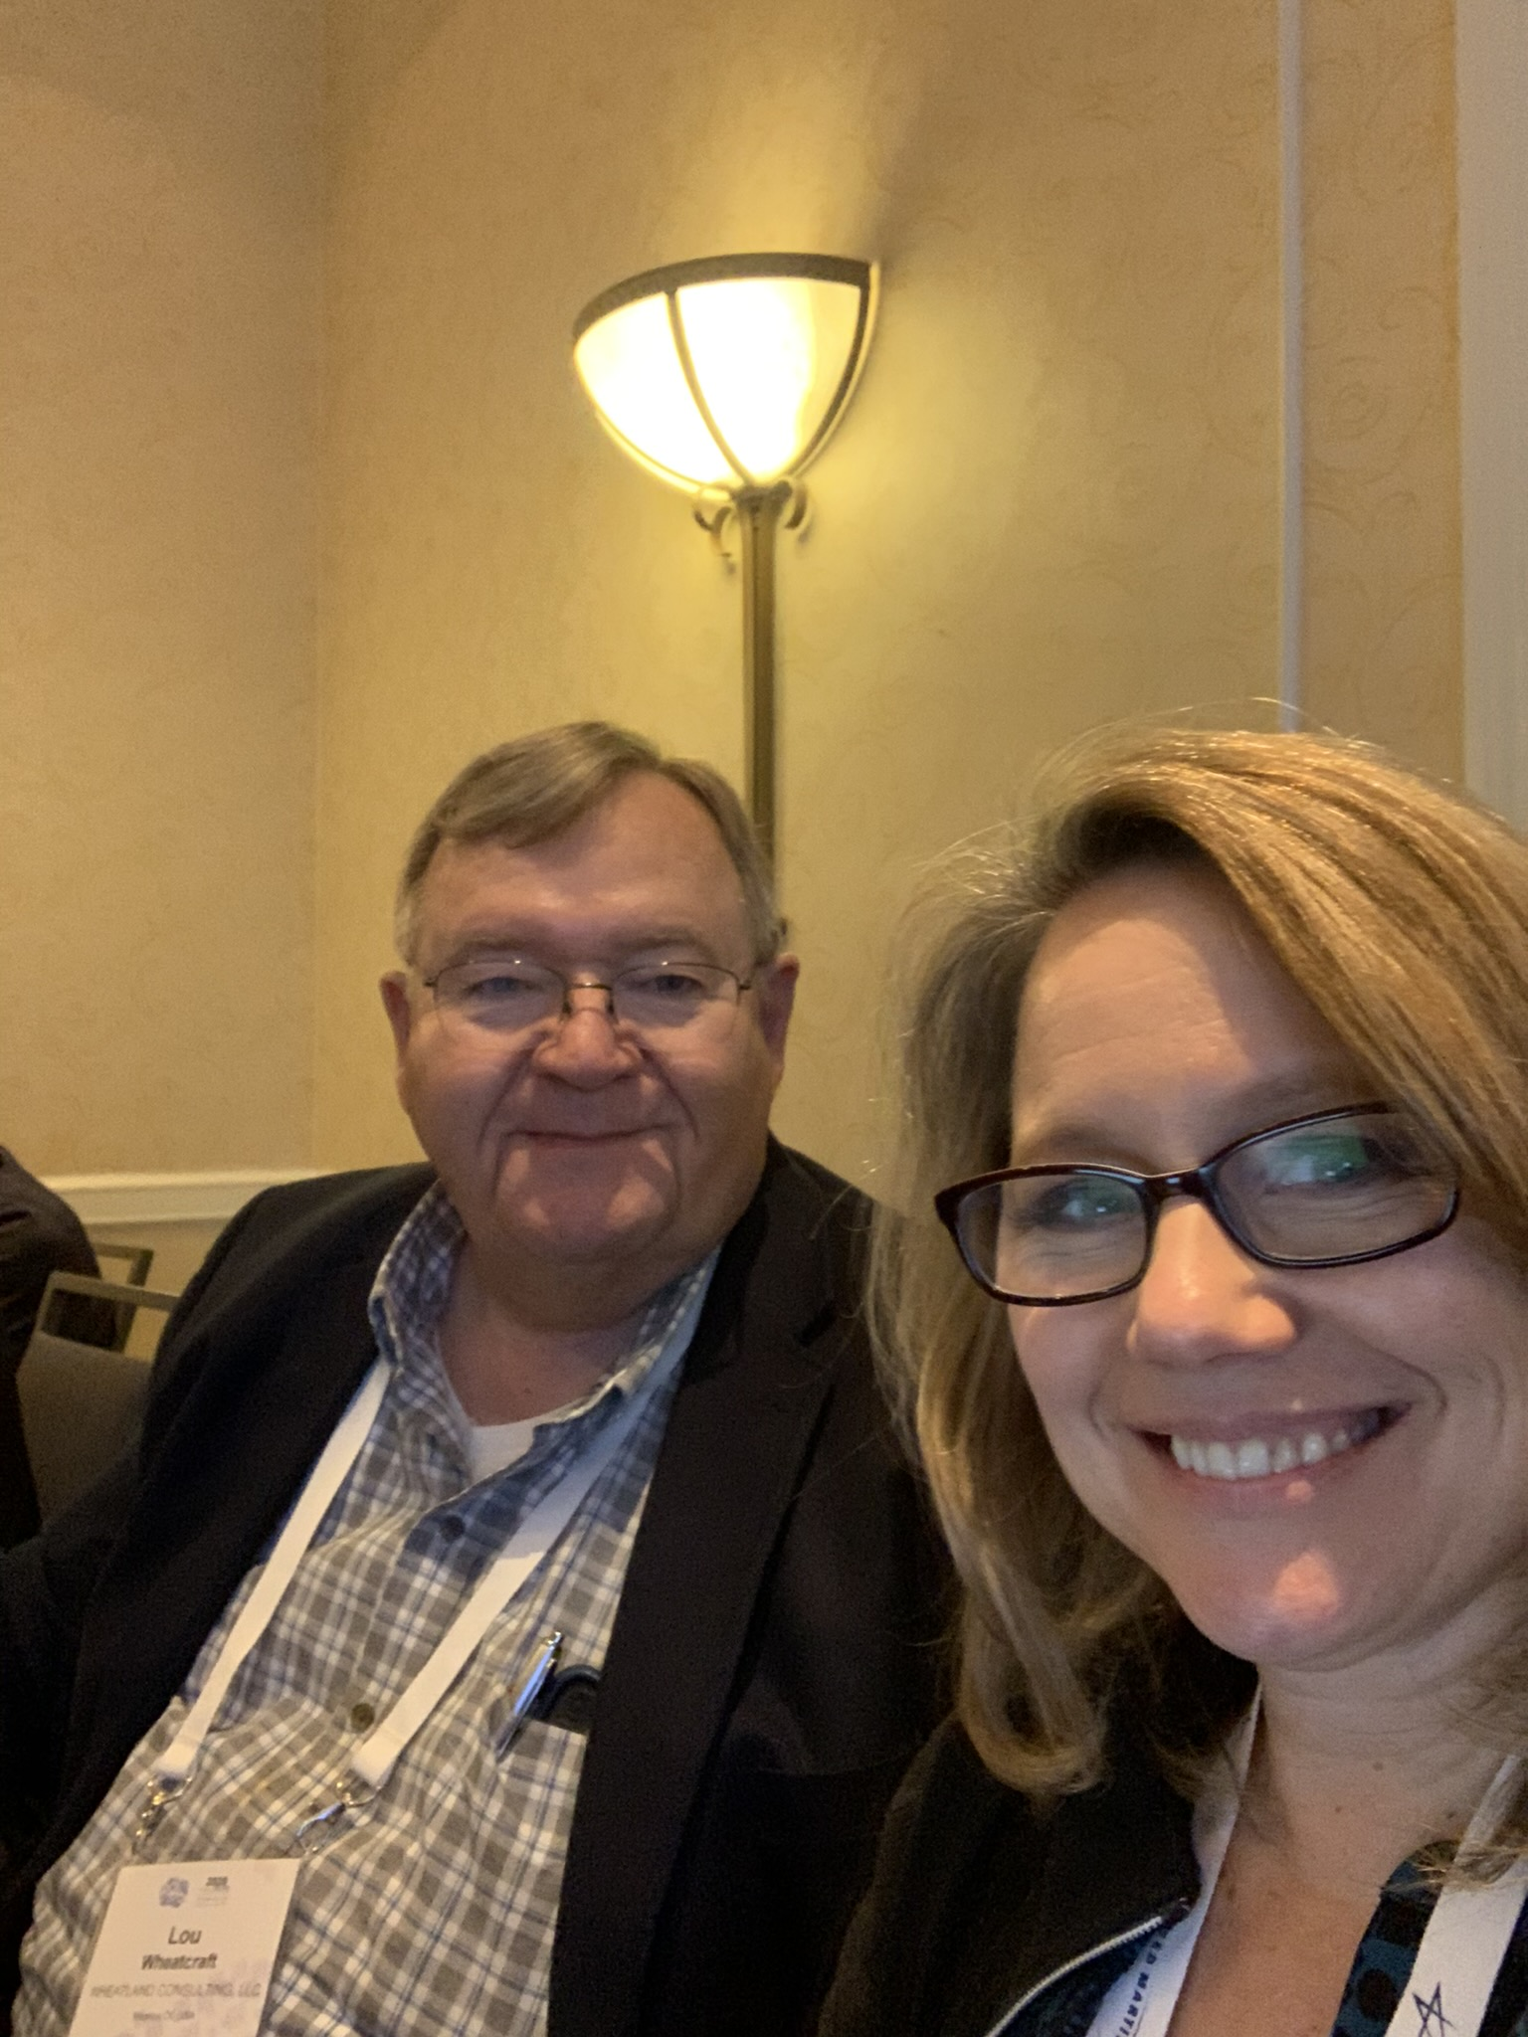
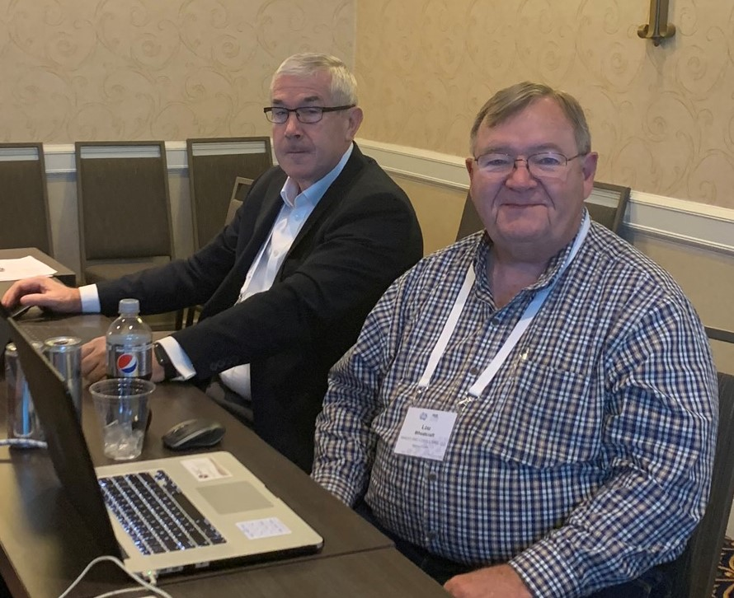
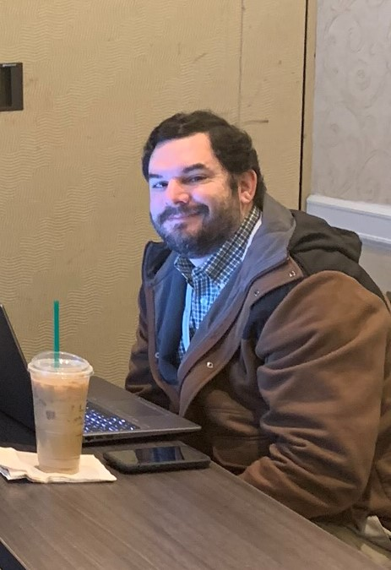
RWG Leadership
Chair: Tami Katz; Ball Aerospace, USA
Co-Chair: Lou Wheatcraft, Wheatland Consulting, USA
Co-Chair: Rick Zinni, Harris Corp, USA
Co-Chair: Mike Ryan; University of New South Wales in Canberra, Australia
Co-Chair: Kevin Orr, Eaton, USA
INCOSE Connect address:
https://connect.incose.org/WorkingGroups/Requirements/Pages/Home.aspx
Number of Members: 635, INCOSE largest WG for members
The RWG is comprised of members from industry and academia with a common purpose of improving the practice of requirements engineering

Slide 5
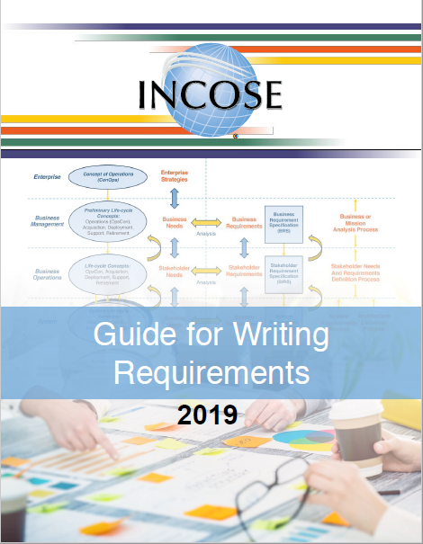
Current RWG Published Products
The following products from RWG are available in the INCOSE Store:
  Guide for Writing Requirements – 2019 version
  Guide for Writing Requirements Summary – 2019 version
  Whitepaper: Integrated Data as a Foundation of SE - March 2019

Slide 6
Upcoming RWG Products
The RWG has been working on new products and supporting development of other INCOSE publications
Product | Product Lead/Lead Author
Needs and Requirements Life-Cycle Management Handbook | Lou Wheatcraft
Guide for Writing Requirements | Mike Ryan
Guide for Developing and Managing Requirements | Kevin Orr
Guide to Verification and Validation | Raymond Wolfgang
RWG Inputs
RWG Inputs
New
Updates
New
New
RWG Inputs

Slide 7
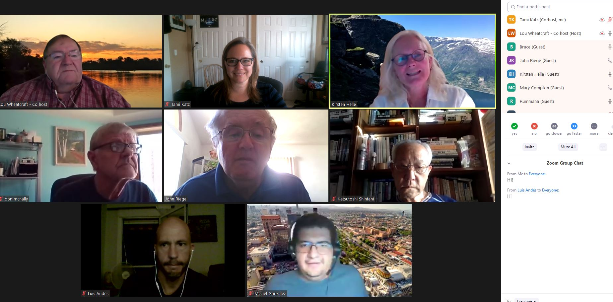
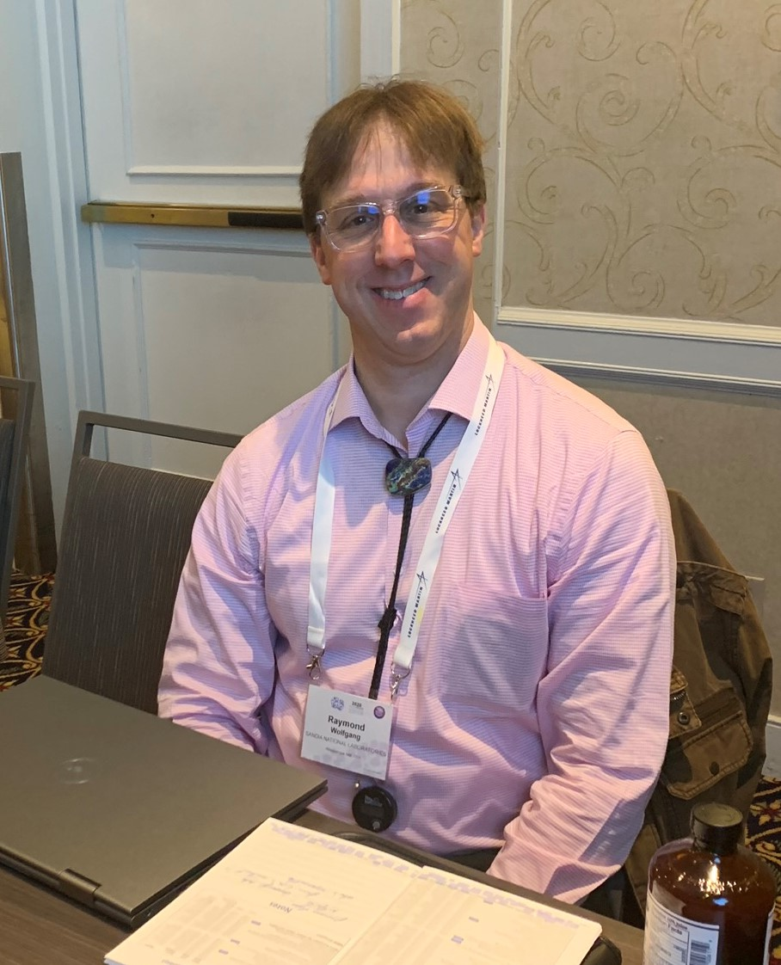
RWG Events
RWG engages the INCOSE community through regular events around the topic of Requirements Engineering
  Guest speakers on Requirements Topics
  RWG Exchange Cafes
RWG members contribute ideas towards topics discussed and are encouraged to share their experiences and questions with the broad working group community.

Slide 8
New Product – Needs and Requirements Lifecycle Manual
This Needs and Requirements Lifecycle Manual (NRLM) addresses the lack of detailed practical guidance on developing and managing needs and requirements, as well as the planning and managing the associated verification and validation (V&V) activities across the product development lifecycle.
This manual is intended for those whose role it is to perform NRDM and V&V activities throughout the system lifecycle and is addressed to practitioners of all levels of experience.
This manual is a supplement to and elaboration of the INCOSE SE HB, providing more detailed guidance on the what, how, and why concerning needs and requirement definition and management, verification, and validation.
It addresses ambiguity and inconsistencies in ontology concerning needs and requirements definition and management, verification, and validation.
Promoting Key concepts: A large focus on Requirements has overshadowed the fundamental concept of ensuring products address the Needs – this manual aims to showcase the strong importance of both Needs and Requirements in the development of systems.

Slide 9
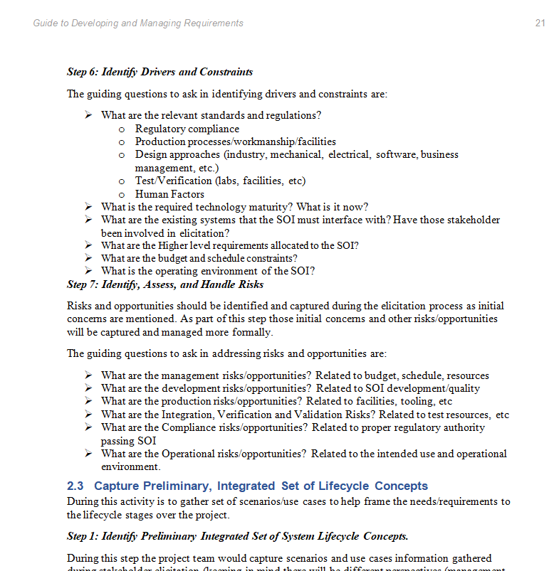
New Products - Guides
The guides are condensed content from the NRLM that provides practical implementation approaches for systems engineering practitioners
The Guide for Writing Requirements has been a popular guide by many in the INCOSE community – the new guides will expand on this with developing and managing needs and requirements and verification and validation guidance.

Slide 10
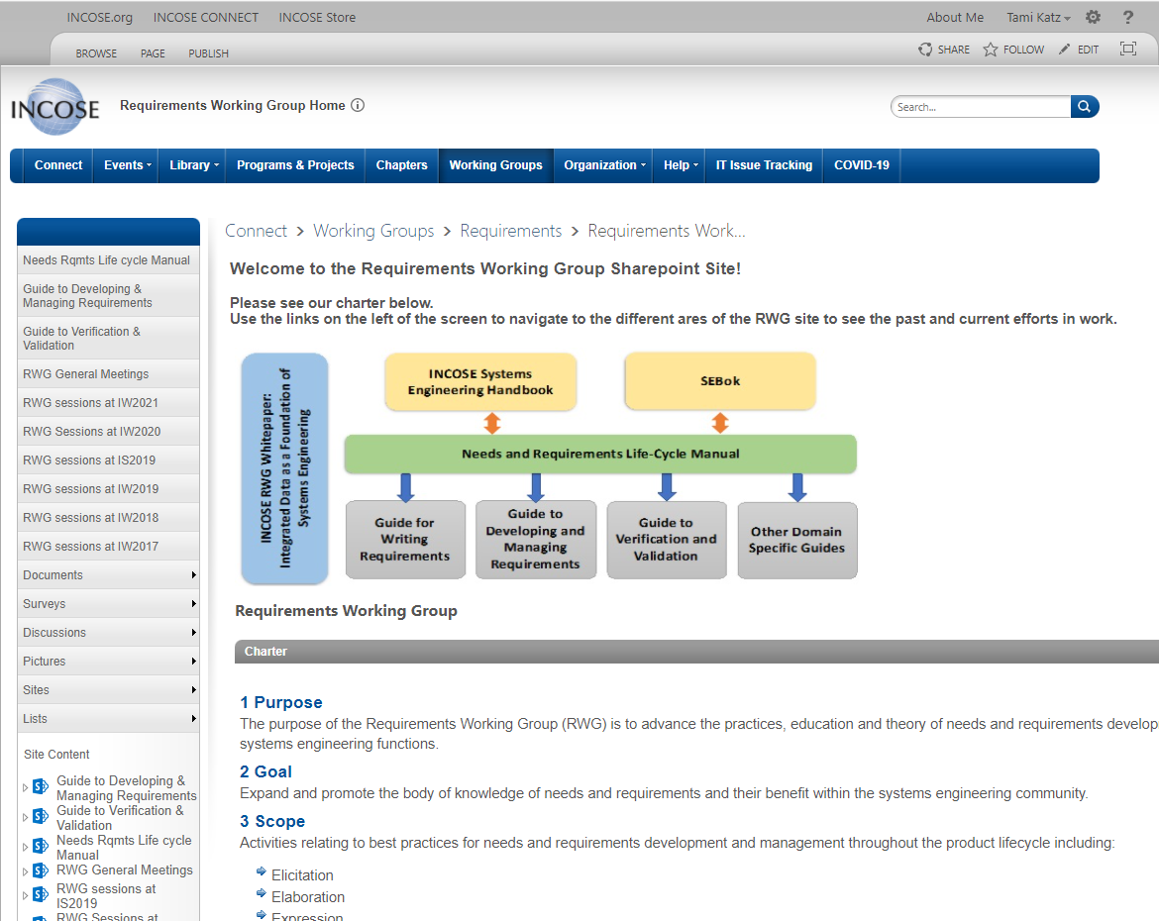
RWG Connect Site
Information about RWG meetings, products, and ongoing efforts are found on the INCOSE RWG Connect website, available to INCOSE members.
https://connect.incose.org/WorkingGroups/Requirements/Pages/Home.aspx

Slide 11
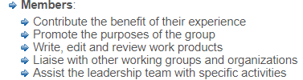
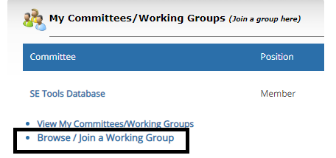
How to Become Involved in RWG
As a large working group, the RWG has been very active in virtual events as well as smaller product team efforts.
Joining the working group enables the members to learn about the products, provide opportunity to contribute (or review), and participate in the RWG virtual events with other practitioners.
Members can be very involved (product support) or minimally involved (watch meeting recordings), the intention is to enable all levels of participation and interaction.

