Slide 1
Guide to Needs and Requirements Overview
INCOSE Requirements Working Group

Slide 2
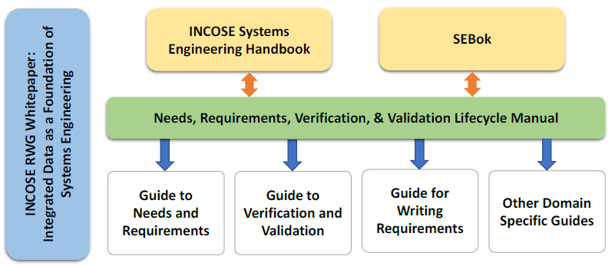
Upcoming RWG Guides
The RWG has been working on new guidelines in support of application of the Needs, Requirements, Verification and Validation Life Cycle Manual (NRVVLM)
The NRVVLM addresses the “why”, the guides address the “how”, and provide examples to the user community.
Product | Product Lead/Lead Author
Guide to Needs and Requirements | Tami Katz
Guide to Verification and Validation | Raymond Wolfgang

Slide 3
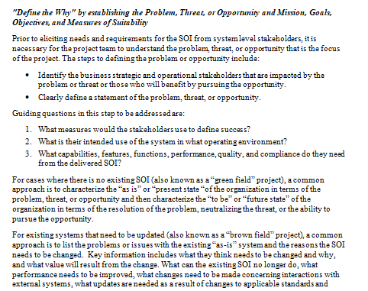
New Products - Guides
The guides are condensed content from the NRVVLM that provides practical implementation approaches for systems engineering practitioners
The Guide for Writing Requirements has been a popular guide by many in the INCOSE community – the new guides will expand on this with developing and managing needs and requirements and verification and validation guidance.

Slide 4
Relationships Between RWG Guides
The new RWG Guides align with the NRVVLM to summarize the processes and describe application of approach of the processes.
Each guide covers a specific area and is intended to be short (<100 pages) to help with user readability.
This figure shows the summary outline contents of the RWG guides and how the Guide to Needs and Requirements (GtNR) works in conjunction with the other RWG guides.
Next Slide

Slide 6
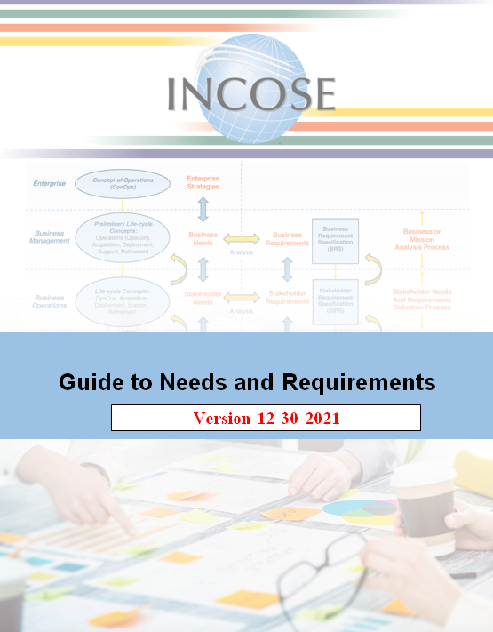
Guide to Needs and Requirements Evolution
This guide was originally called Guide to Developing and Managing Requirements (GDMR)
  Additional focus of Needs within the RWG manual was desired in the guide name.
  The RWG renamed this to Guide to Needs and Requirements (GtNR) at IW2021
Initial guide creation occurred by Kevin Orr, using inputs from contributors (Ron Carson, Celeste Drewien, Lou Wheatcraft, Don McNally, Tami Katz)
Tami Katz led guide generation efforts starting in 2021
Guide now at 90% completion, draft sent to RWG prior to IW2022 for comments.
After IW2022 final comments will be incorporated, guide release expected Spring 2022.

Slide 7
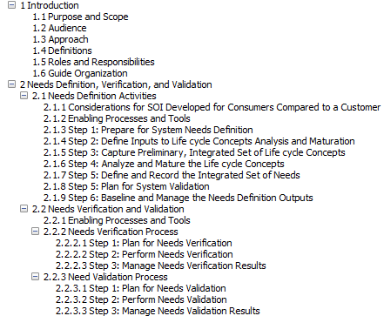
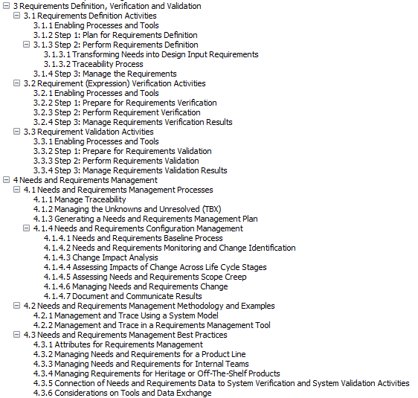
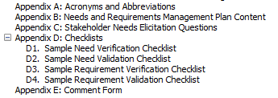
Guide to Needs and Requirements Outline
The GtNR Outline: Four sections and multiple appendices containing numerous examples and methods of approach.

Slide 8
GtNR Approach
This guide expands upon the input/process/output (IPO) diagrams from the NRVVLM and provides procedural steps towards implementation
In addition to procedural steps, situational considerations and example applications are provided.
The next slides will cover some of the material to demonstrate this approach.
Methods to accomplish Activities

Slide 9
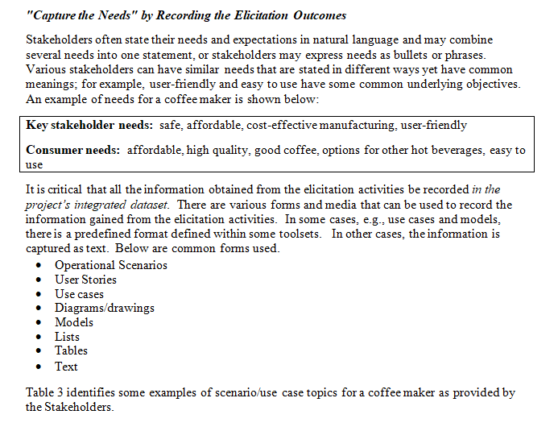
Example GtNR Approach

Slide 10
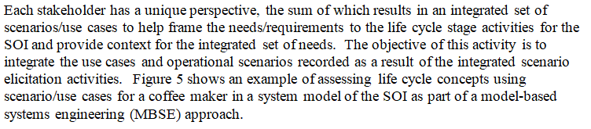
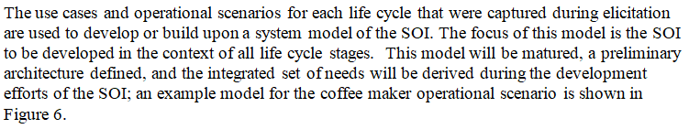
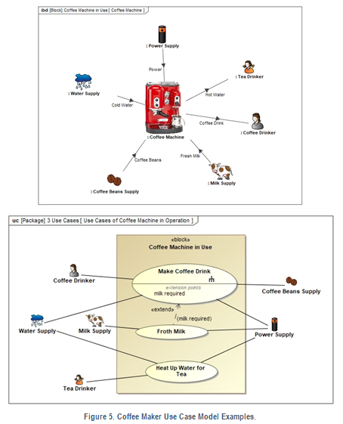
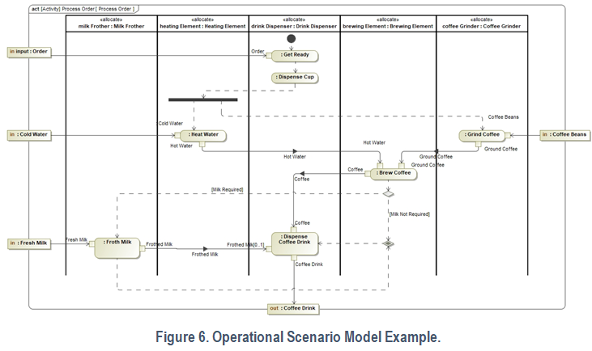
More GtNR Examples (Needs Definition)

Slide 11
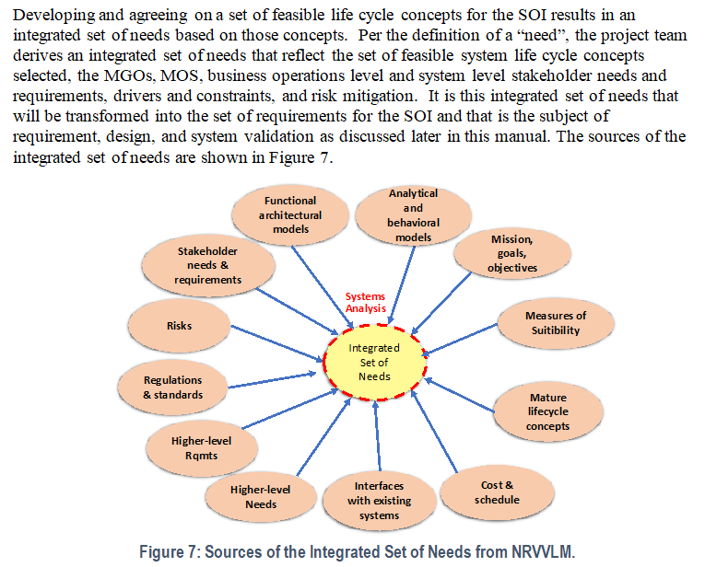
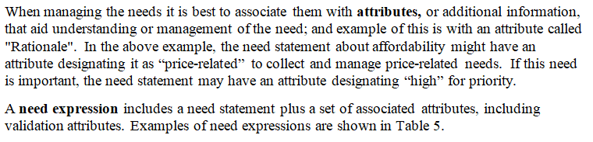
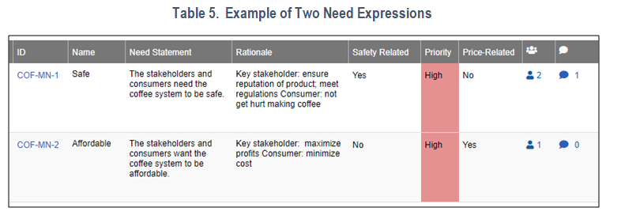
More GtNR Examples (Needs Capture)

Slide 12
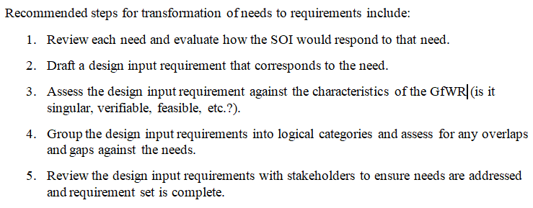
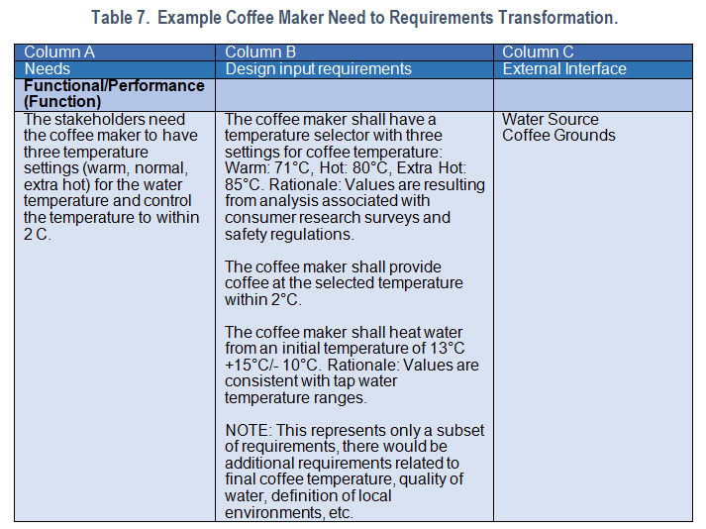
More GtNR Examples (Requirements Transformation)

Slide 13
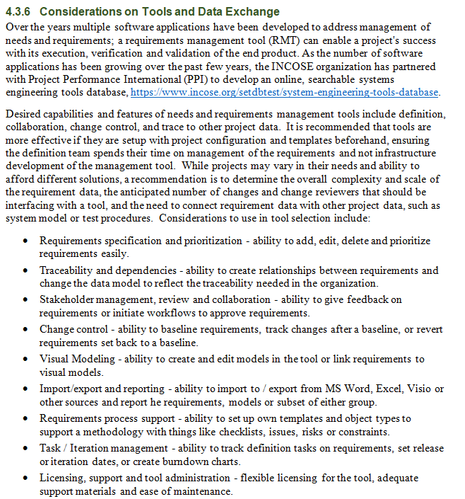
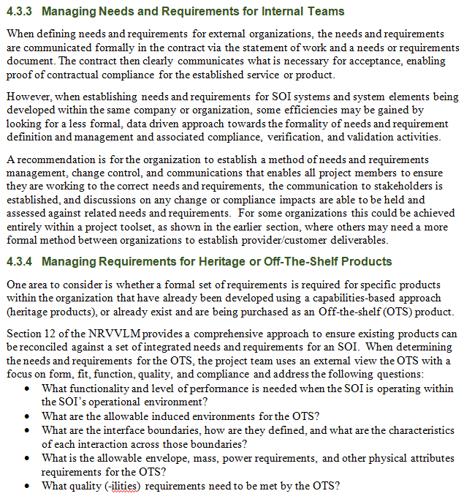
More GtNR Examples (Best Practices)

Slide 14
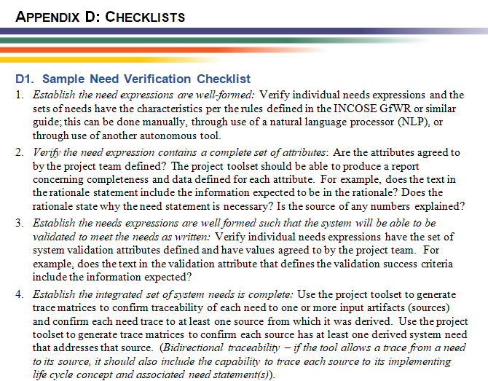
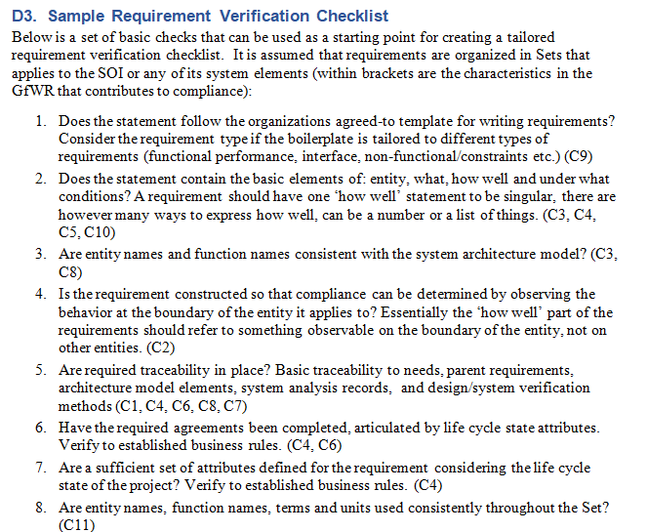
More GtNR Examples (Appendix - Checklists)

Slide 15
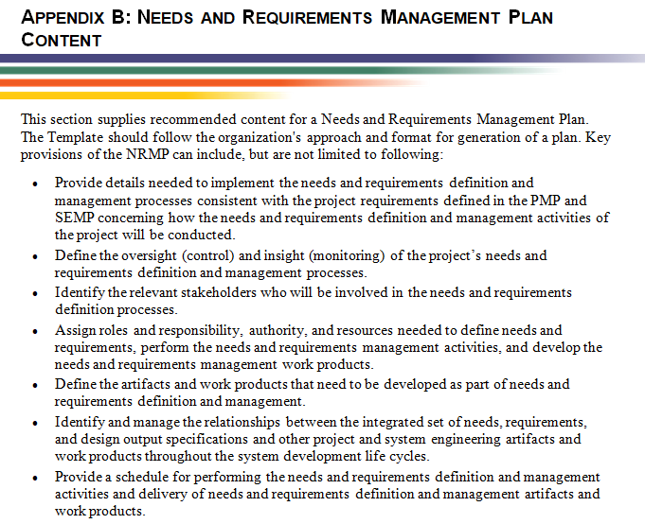
More GtNR Examples (Appendix – NRM Plan Template)

Slide 16
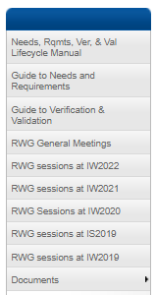
Call for GtNR Feedback
The draft for Guide to Needs and Requirements has been posted on the RWG Connect site.
RWG community is welcome to review and provide inputs up to 2/28/22.
In March the guide will be finished and submitted to INCOSE for release.
Future updates are planned, so feedback after release is still able to be obtained using the comment form process.

