Slide 1
Guide to Verification & Validation Overview
INCOSE Requirements Working Group
January 25, 2022
Raymond B. Wolfgang
Sandia National Laboratories
Albuquerque, NM, USA
Raymond.Wolfgang@incose.net
Also on LinkedIn
Copyright © by Raymond B. Wolfgang – permission granted to INCOSE to publish and use.

Slide 2
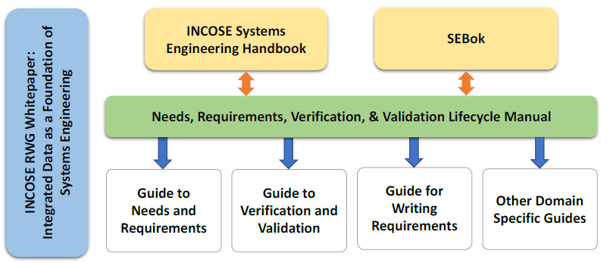
Upcoming RWG Guidelines
The RWG has been working on new guidelines in support of application of the Needs, Requirements, Verification and Validation Life Cycle Manual (NRVVLM)
The NRVVLM addresses the “why”, the guides address the “how”, and provide examples to the user community.
Product | Product Lead/Lead Author
Guide to Needs & Requirements | Tami Katz
Guide to Verification and Validation | Raymond Wolfgang

Slide 3
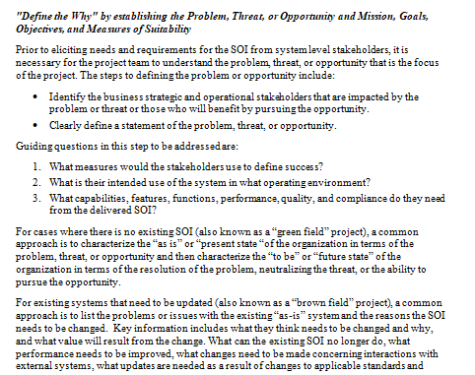
New Products - Guides
The guides are condensed content from the NRVVLM that provides practical implementation approaches for systems engineering practitioners
The Guide for Writing Requirements has been a popular guide by many in the INCOSE community – the new guides will expand on this with developing and managing needs and requirements and verification and validation guidance.

Slide 4
Relationships Between RWG Guides
The new RWG Guides align with the NRVVLM to summarize the processes and describe application of approach of the processes.
Each guide covers a specific area, and is intended to be short (<100 pages) to help with user readability.
This figure shows the summary outline contents of the RWG guides and how the Guide to Needs and Requirements (GtNR) works in conjunction with the other RWG guides.
Next Slide

Slide 6
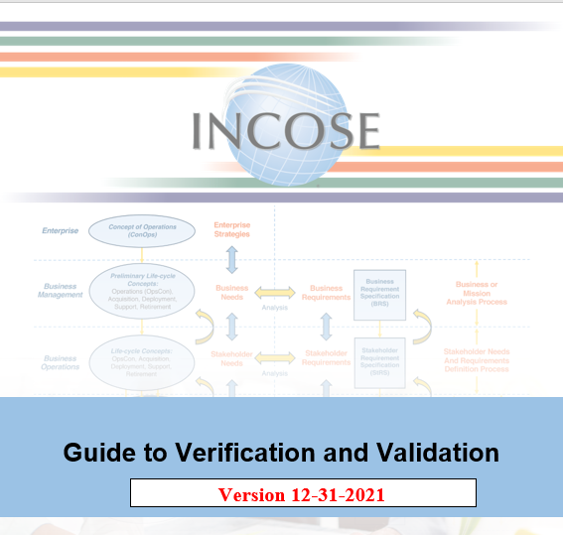
Guide to Verification and Validation Evolution
Initial drafts at IW-2020, major revisions at IW-2021
  Quickly grew beyond original 60 page limit
  Created manual for theory/background
  Emphasis on Verification and Validation as separate tasks
  From IW2021 to today, alignment with NRVVLM
Initial guide creation used inputs from contributors
  List of contributors will be mentioned in guide
Guide also at 90% completion, draft sent to RWG prior to IW2022 for comments.
  Received more feedback! Thank you!
After IW2022 final comments will be incorporated, guide release expected Spring 2022.
This process has produced an aligned, useful, and accessible tool for practitioners.

Slide 7
Guide Outline
Introduction
Verification and Validation Common Principles
Needs and Requirements Verification and Validation Process
Design Verification and Validation Process
Production Verification
System Verification and Validation Processes
Use of OTS Parts, Supplier Developed System Elements, and the Supplier-Customer Relationship
Needs, Requirements, Verification and Validation Management
Conclusion
Outline provides the most verification and validation information, with minimal overlap with the GtNR

Slide 8
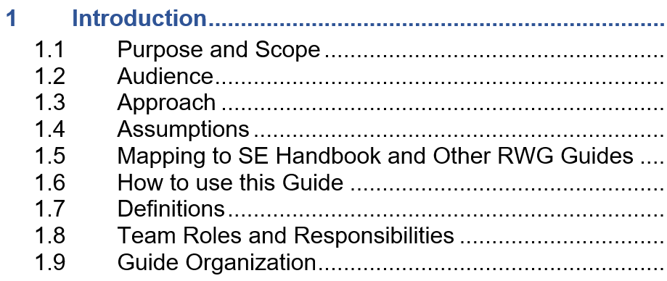

Slide 9
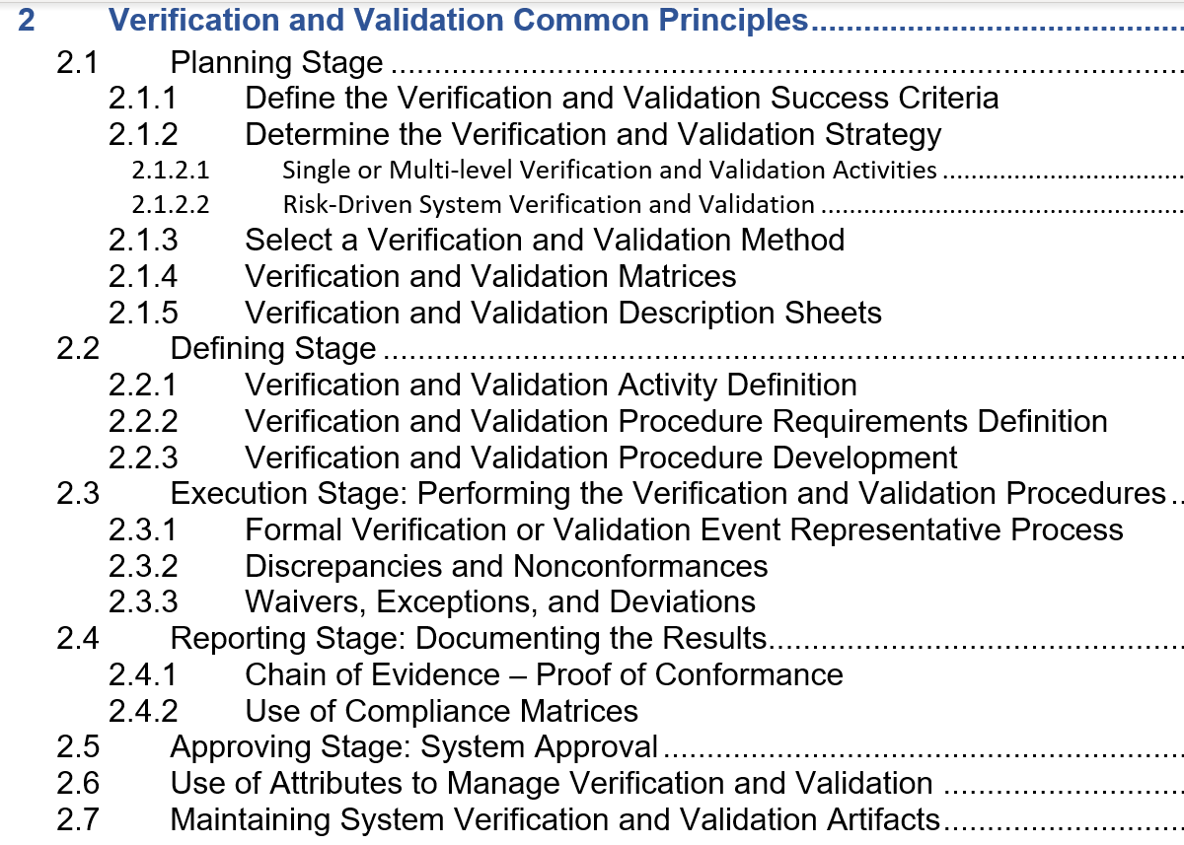

Slide 10
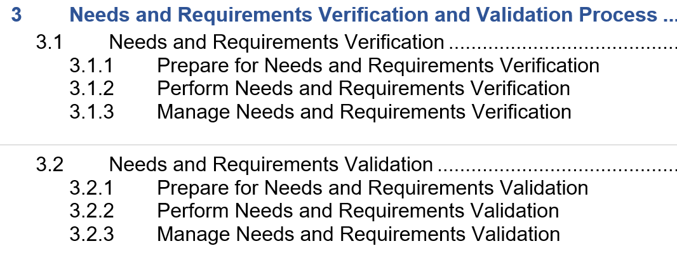

Slide 11
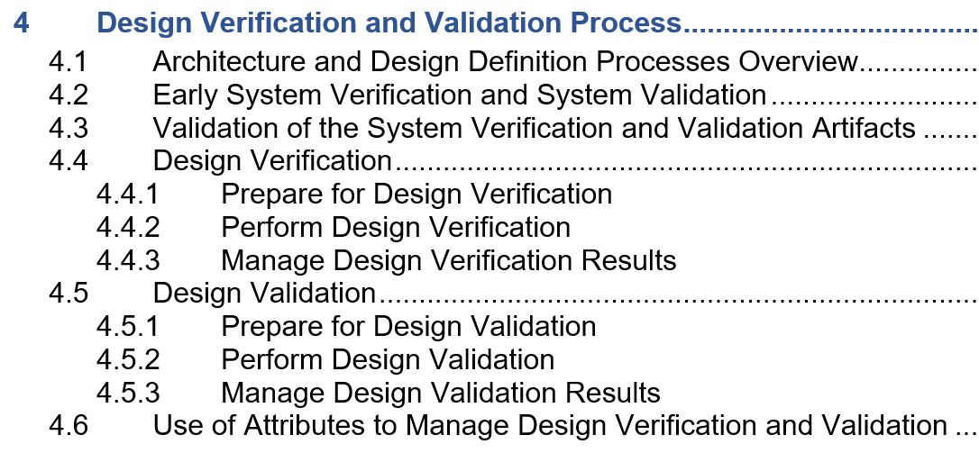

Slide 12
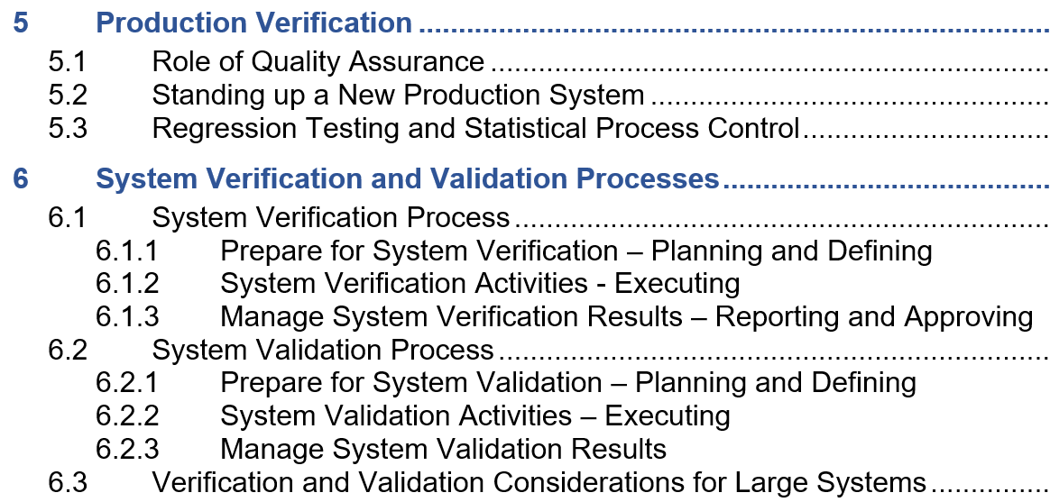

Slide 13
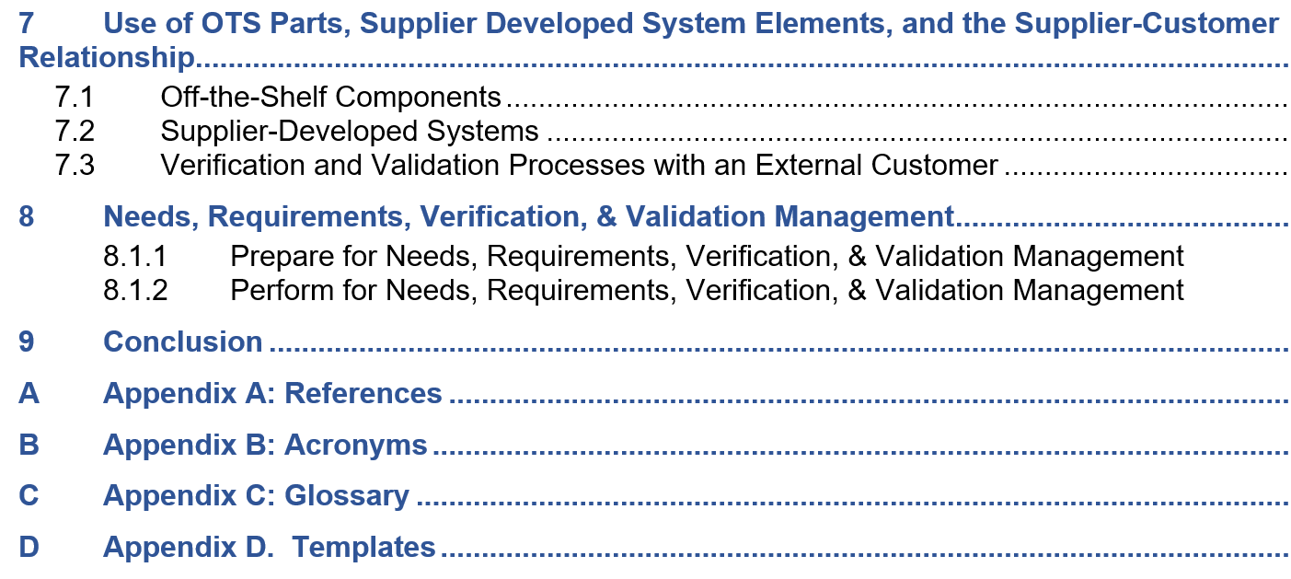

Slide 14
Evolution of Common SE Terms
Transforming terms for consistency across the Handbook, Manual and Guides
Common Term | New Term
Concepts of Use, Operational Concepts | Lifecycle Concepts
Stakeholder Needs | Integrated Set of Needs
System Requirements | Design Input Requirements
Design | Design Output Requirements or Specifications
Product, part, component | System (or component) of Interest (SOI)
Mission, Goals, Objectives | Same terms – but become MGO’s for the customer
Verification, Validation | Same terms – correct/right but treated more separately
Anchor point: the Systems Vee

Slide 15
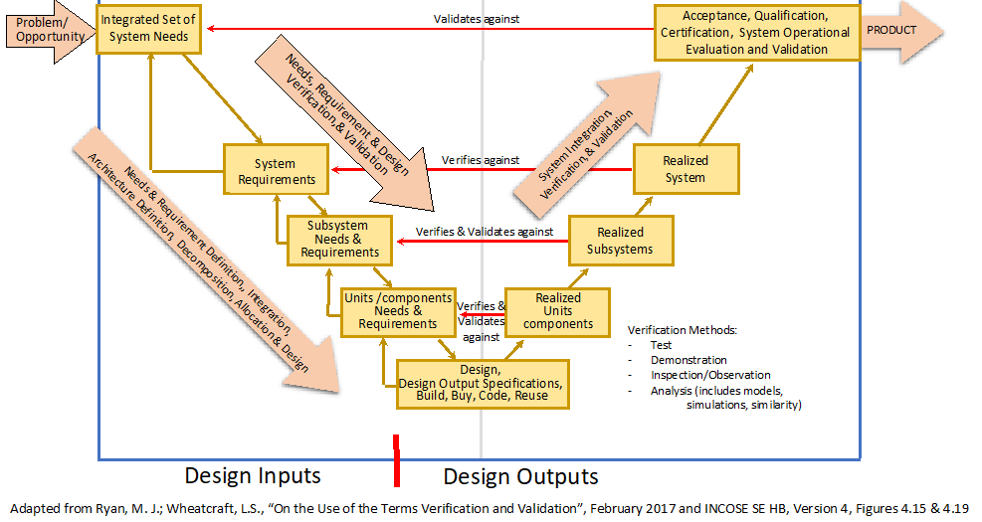
25 January 2022
INCOSE's Guide to Verification and Validation – Raymond Wolfgang
Notes:
We are emphasizing that integration, verification and validation are continuous activities across the system lifecycle. This is indicated by the small feedback arrows, on the left side of the Vee, pointing back up to the next higher allocation level.

Slide 16
A Different Model
If we draw the SE Vee out into a straight line, left to right …
We can open up the Vee model to show a fuller process
  Includes continuous Verification and Validation (V&V) across lifecycle
  Easier to see the difference between Verification and Validation
This model used throughout manual, guides
The Systems Vee = a helpful model.
The NRVVLM expands the Vee and focuses on a single system of interest, at a single architectural level

Slide 17
Same Needs as Before
Verification and Validation Throughout the SE Process
25 January 2022
INCOSE's Guide to Verification and Validation – Raymond Wolfgang

Slide 18

Lifecycle Concepts Drive Needs
Where do the Lifecycle Concepts come from?
  Mission
  Use cases / stories
  Goals & Objectives
  Concepts of Use
  Operational Scenarios
  Measures of Effectiveness
  Risk (Org./Business level)
Where do the needs come from?
  Parent needs/requirements
  Drivers and constraints
  KPPs, other Measures of Suitability
  Lifecycle concepts

Slide 19
N
e
e
d
s
P
r
o
b
l
e
m
o
r
o
p
p
o
r
t
u
n
i
t
y
V
a
l
i
d
a
t
i
o
n
•
M
i
s
s
i
o
n
,
g
o
a
l
s
,
o
b
j
e
c
t
i
v
e
s
•
M
O
E
’
s
,
M
O
P
s
,
T
P
M
s
,
K
P
P
s
C
o
n
c
e
p
t
N
e
e
d
s
•
P
r
e
l
i
m
i
n
a
r
y
s
t
a
k
e
h
o
l
d
e
r
n
e
e
d
s
V
a
l
i
d
a
t
i
o
n
V
a
l
i
d
a
t
i
o
n
&
r
e
q
u
i
r
e
m
e
n
t
s
•
U
s
e
c
a
s
e
s
,
u
s
e
r
s
t
o
r
i
e
s
,
s
y
s
t
e
m
c
o
n
c
e
p
t
s
,
O
p
s
C
o
n
,
I
m
p
l
e
m
e
n
t
e
d
b
y
T
r
a
n
s
f
o
r
m
a
t
i
o
n
I
n
t
e
g
r
a
t
e
d
S
e
t
C
o
n
O
p
s
L
i
f
e
c
y
c
l
e
•
H
i
g
h
e
r
l
e
v
e
l
N
e
e
d
s
L
i
f
e
c
y
c
l
e
C
o
n
c
e
p
t
C
o
n
c
e
p
t
s
S
y
s
t
e
m
N
e
e
d
s
o
f
N
e
e
d
s
R
e
q
u
i
r
e
m
e
n
t
s
•
H
i
g
h
e
r
l
e
v
e
l
R
e
q
u
i
r
e
m
e
n
t
s
A
n
a
l
y
s
i
s
D
e
f
i
n
i
t
i
o
n
D
e
f
i
n
i
t
i
o
n
M
a
t
u
r
a
t
i
o
n
•
H
i
g
h
e
r
l
e
v
e
l
l
i
f
e
c
y
c
l
e
c
o
n
c
e
p
t
s
•
D
r
i
v
e
r
s
&
c
o
n
s
t
r
a
i
n
t
s
,
L
i
f
e
c
y
c
l
e
N
e
e
d
s
•
E
x
t
e
r
n
a
l
s
y
s
t
e
m
s
C
o
n
c
e
p
t
D
V
e
r
i
f
i
c
a
t
i
o
n
r
D
i
•
S
t
a
n
d
a
r
d
s
r
v
i
V
e
r
i
f
i
c
a
t
i
o
n
e
v
•
R
e
g
u
l
a
t
i
o
n
s
e
•
T
e
c
h
n
o
l
o
g
y
•
O
p
e
r
a
t
i
n
g
E
n
v
i
r
o
n
m
e
n
t
O
r
g
a
n
i
z
a
t
i
o
n
a
l
O
r
g
a
n
i
z
a
t
i
o
n
a
l
•
R
i
s
k
s
R
e
q
u
i
r
e
m
e
n
t
s
f
o
r
R
e
q
u
i
r
e
m
e
n
t
s
f
o
r
d
e
f
i
n
i
n
g
d
e
f
i
n
i
n
g
n
e
e
d
s
B
u
s
i
n
e
s
s
&
M
i
s
s
i
o
n
l
i
f
e
c
y
c
l
e
c
o
n
c
e
p
t
s
A
n
a
l
y
s
i
s
P
r
o
c
e
s
s
e
s
V&V in the Lifecycle Concepts and Needs Phase – Result = Excellent Requirements, and more
25 January 2022
INCOSE's Guide to Verification and Validation – Raymond Wolfgang
Notes:
Needs Verification and Needs Validation. Main question here: do the lifecycle concepts and integrated set of needs represent a system of interest that can accomplish its intended use in the operational environment, when operated by its intended users?

Slide 20

End-to-End Process Delivers the Right SOI
Starting with Lifecycle Concepts
  To develop an Integrated Set of Needs
  Leads to Requirements
  Create the Design
  Design maturated into “build to print” drawings, specs, models
  SOI created (HW, SW, or mix)
Ending with a Validated SOI
  Verification
  Built Correctly (Verif.)
  Designed Correctly
  Requirements Crafted Correctly
  Validation
  SOI Validated vs Requirements
  Accepted vs original Needs
We delivered the “Right Rock”!

Slide 21
Instructional Videos Explain More
What is the new paradigm? Details on the drawings:
  https://www.youtube.com/watch?v=ZRli_wSCmRg
Guide to V&V (IW2021)
  https://www.youtube.com/watch?v=_33sZ0IntwY
What is the RWG all about?
  https://www.youtube.com/watch?v=L_Z6XitproI
Overview of the manual
  NRVVLM: https://www.youtube.com/watch?v=g_fJk_UBONM
Integrated Data piece
  https://www.youtube.com/watch?v=Rc3O6lPO5x4

Slide 22
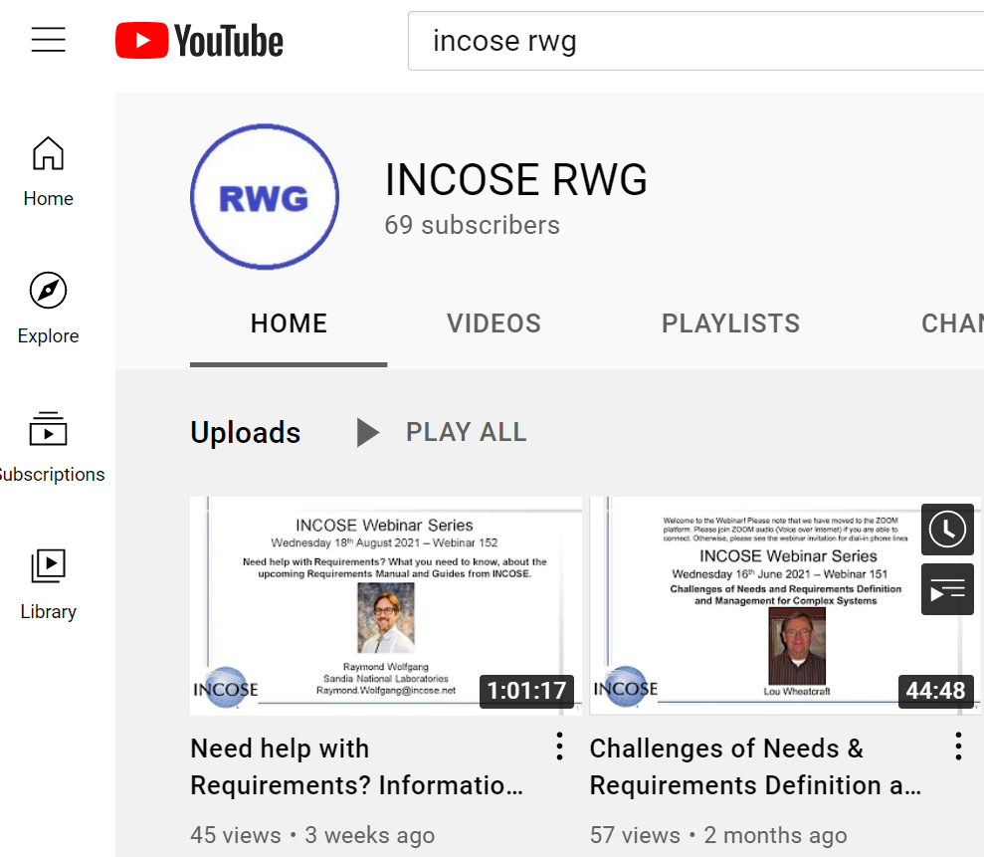
YouTube Channel – Provides “Deeper Dive”

Slide 23
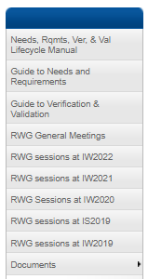
Call for Feedback
Version 0.9 released 12/31/2021.
This draft is on the RWG Connect site.
RWG community can provide inputs up to 2/28/22.
  If no comments, the working draft from comments submitted so far will be the submitted version “1.0”.
  Contact me directly, if you are planning to review the ver. 0.9 draft if you have not already done so.
To be finished in March, submitted to INCOSE for release.
Future updates are planned, feedback after release is still possible and encouraged using the comment form process.
25 January 2022
INCOSE's Guide to Verification and Validation – Raymond Wolfgang

Slide 24
Guidance is On The Way!
Multiple guides answer the SE community’s needs
  Goes beyond current Guide for Writing Requirements
  Provides than SE Handbook or SEBoK
  Offers different levels of detail and background
  Goal is to make our work as complete as possible, useful, and accessible
Team effort
  Over 20 different contributors and reviewers
  Several different document leads
  RWG participation at IS and IW
Large volume of work will benefit SE community across disciplines. Release goal of Guide to Verification and Validation is late March, 2022.

