Slide 1
Needs, Requirements, Verification, Validation Lifecycle Manual (NRVVLM)
Overview
Requirements Working Group
Lou Wheatcraft, Senior Consultant, Wheatland Consulting, LLC
Wheatland.consulting@gmail.com
Copyright © by Wheatland Consulting, LLC – permission granted to INCOSE to publish and use

Slide 2
The focus of this presentation

Slide 3
Introduction
Supplements and elaborates on the INCOSE SE HB
  Provides more detailed guidance on the what, how, and why concerning needs and requirement definition and management, verification, and validation across the lifecycle.
  Addresses ambiguity and inconsistencies in ontology concerning needs and requirements definition and management, verification, and validation.
Presents systems engineering lifecycle concepts from the perspective of needs, requirements, verification, and validation (NRVV) definition and management across the system lifecycle.
To successfully complete system verification and system validation, the needs and requirements of the system as well as the system verification and system validation artifacts must be managed throughout the entire system lifecycle.
This Manual provides practical guidance on the activities required to achieve those outcomes.
“Needs, Requirements, Verification, and Validation are common threads that tie all lifecycle activities and processes together.” Lou Wheatcraft

Slide 4
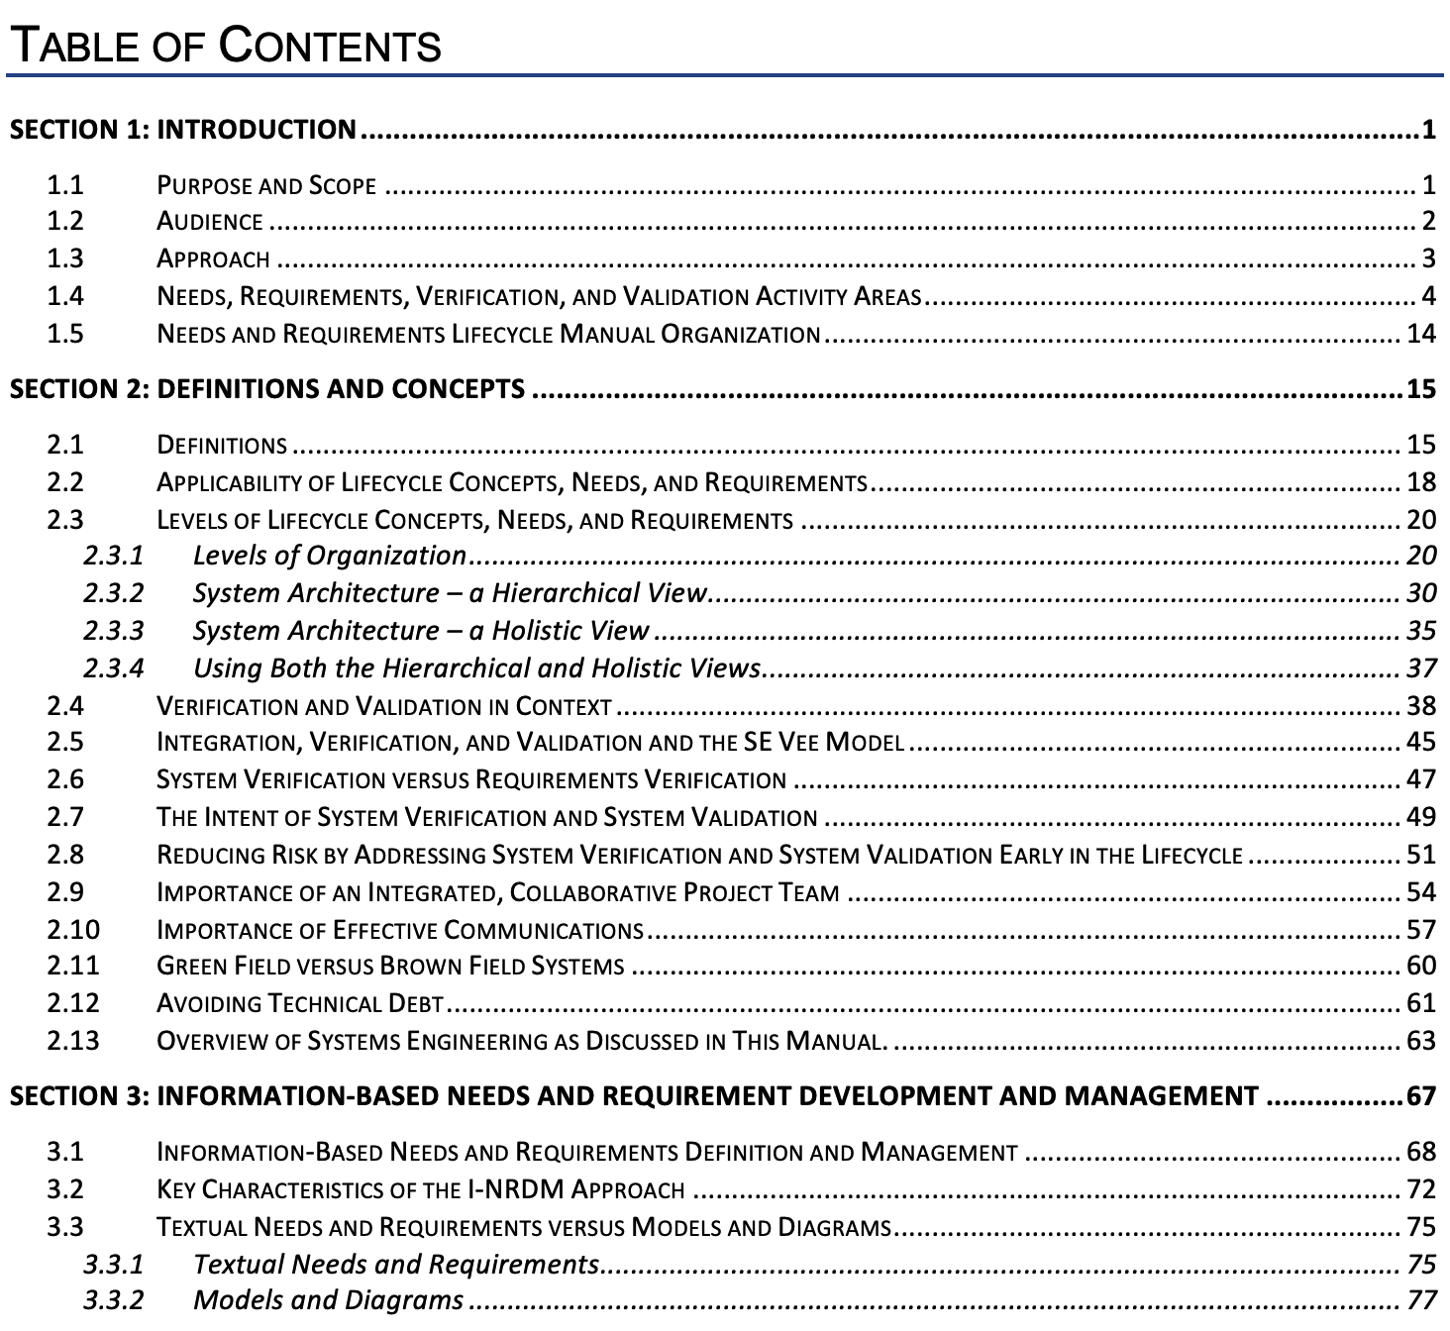

Slide 5
Levels of Lifecycle Concepts, Needs, & Requirements
Focus of this Manual

Slide 6
SE Processes are Intended to be Practiced Concurrently
Concurrent definition, analysis, and maturation applied iteratively and recursively as we move down the left side of the SE Vee
Faster and cheaper than classical waterfall/serial, document-centric processes with silos
Aids in establishing correctness, completeness, and consistency, of all SE artifacts

Slide 7
The System Engineering “Vee” Revisited
System Integration should not be thought of as only occurring on the right side of the SE Vee during IV&V
The integrated SOI must be managed from the beginning of the project across all lifecycle stages
The customer/supplier relationship must allow management of the integrated SOI

Slide 8
Validation Across the Lifecycle
Validation should not be thought of as only occurring on the right side of the SE Vee during system integration, verification, and validation
Validation is done across the system lifecycle:
Needs
Design Input Requirements
Architecture
Design
Design Output Specifications
Realized system elements, subsystems, & the integrated SOI
Validation on the left side of the SE Vee decreases issues on the right side of the SE Vee

Slide 9
9

Slide 10
Design Inputs vs Design Outputs
The “line”
10

Slide 11
Data-Centric Practice of Systems Engineering

Slide 12
Needs vs Requirements
Needs represent the stakeholder, customer/acquirer, user view of the system
  What do the stakeholders need the system to do that will result in their problem to be solved or opportunity to be realized within defined constraints?
  Communicates the stakeholder expectations for the end-state once the System is delivered – in the end what will make the customer(s) happy?
  The system will be validated against its integrated set of needs
Requirements represent the technical, developer view of the system
  What must the system do in order to meet the needs?
  Needs are transformed into design input requirements that will result in a design that will implement that need
  The system will be verified against its design input requirements

Slide 13
Rather than just focusing on the requirements, we must focus on both needs and requirements!!
Rather than just focusing on verification that the requirements are met, we must also focus on validation that the needs are met!!
Needs, requirements, verification, and validation are the common treads that tie all SE lifecycle activities and artifacts together.
From a holist view of SE, needs, requirements, verification, and validation must be managed in the context of all other SE process areas rather than in silos distinct from the other process areas.

Slide 14
Levels of a System – Hierarchical View
Focus on decomposition makes it easier to develop the SOI in bite sized chunks across multiple organizational units (internal and external) based on specialize knowledge and expertise
Lifecycle concepts, needs, and requirements should be defined for the system as well as each subsystem and system element that is part of the system architecture
14

Slide 15
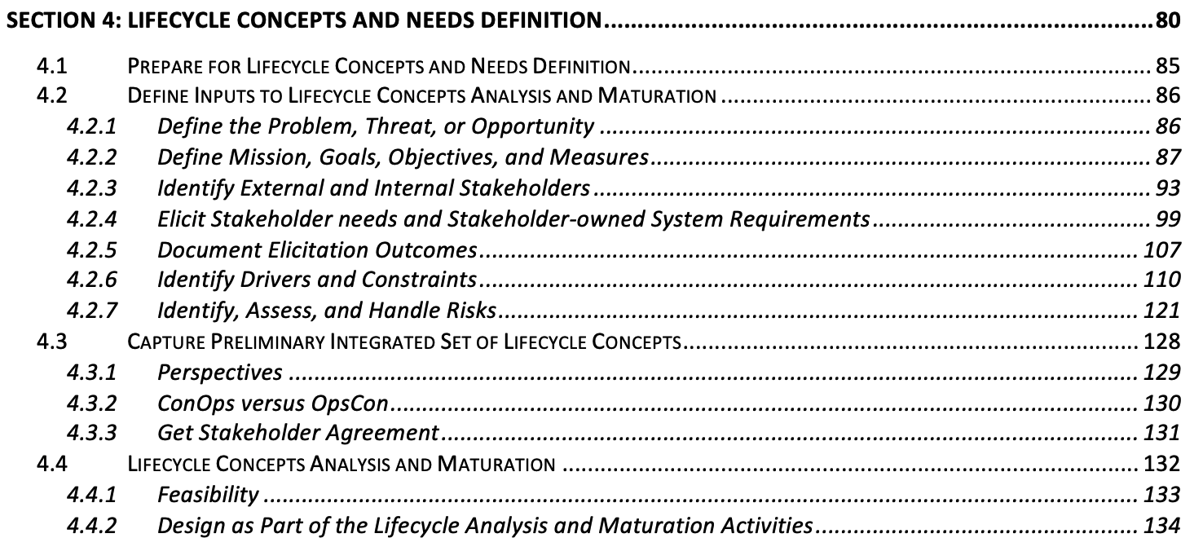
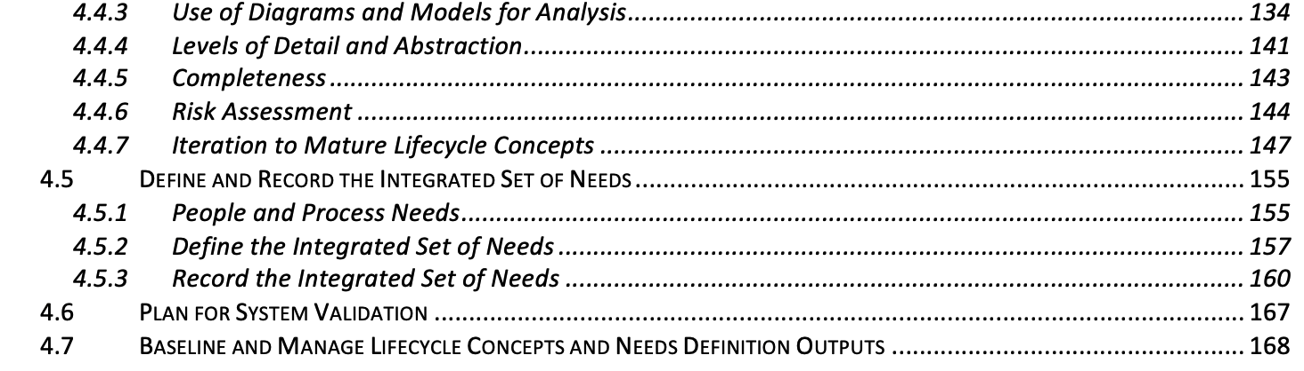
Table of Contents

Slide 16
Establish completeness, consistency, correctness, and feasibility before defining needs and transforming them into the design input requirements
Needs Before Requirements
There is a lot of work to be done BEFORE defining requirements!

Slide 17
Lifecycle Concept and Needs Definition Part 1
17

Slide 18
Lifecycle Concept and Needs Definition Part 2
18

Slide 19
Use of Diagrams and Models

Slide 20
Zeroing in on a Feasible Set of Lifecycle Concepts

Slide 21
Defining the Integrated Set of Needs
21

Slide 22
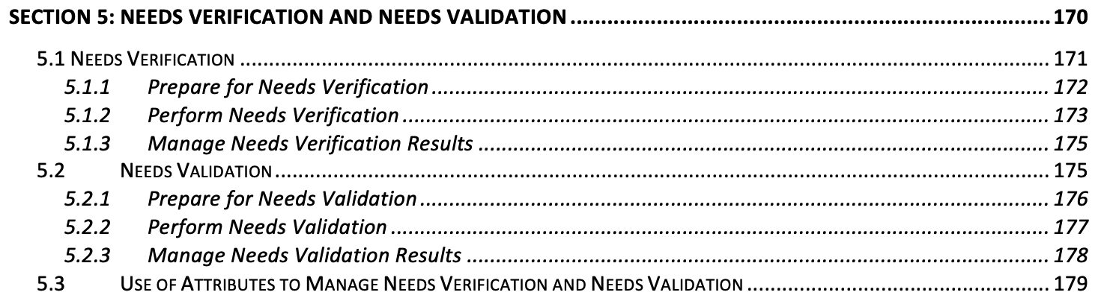
Table of Contents
Do the individual need expressions have the characteristics defined in the INCOSE GfWR: Necessary, Appropriate, Unambiguous, Complete, Singular, Feasible, Verifiable, Correct, and Conforming?
Does the integrated set of system needs have the characteristics defined in the INCOSE GfWR: Complete, Consistent, Feasible, Comprehensible, Able to be validated?
Have attributes been defined for each need statement?
Are all need statements traceable to their source?
Does the integrated set of system needs clearly communicate the stakeholder expectations concerning the intended use of the SOI in its operational environment by its intended users?

Slide 23
Needs Verification and Validation
23

Slide 24
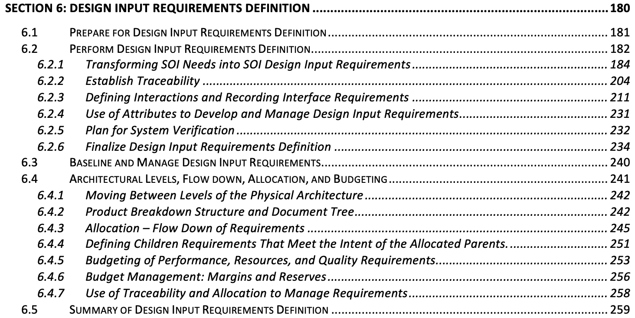
Table of Contents

Slide 25
Defining Design Input Requirements
25

Slide 26
Assessing Interactions Across Interface Boundaries

Slide 27
Moving Down the System Architecture
Requirements at one level are allocated/budgeted to the subsystems and system elements at the next level
These requirements are inputs to the lifecycle concepts, needs, and requirements definition process for each of the subsystems and system elements to which the requirements were allocated/budgeted
Process repeats until a buy, build, code, or reuse decision is made.
27

Slide 28
Alternate Architecture for Software Centric Systems

Slide 29
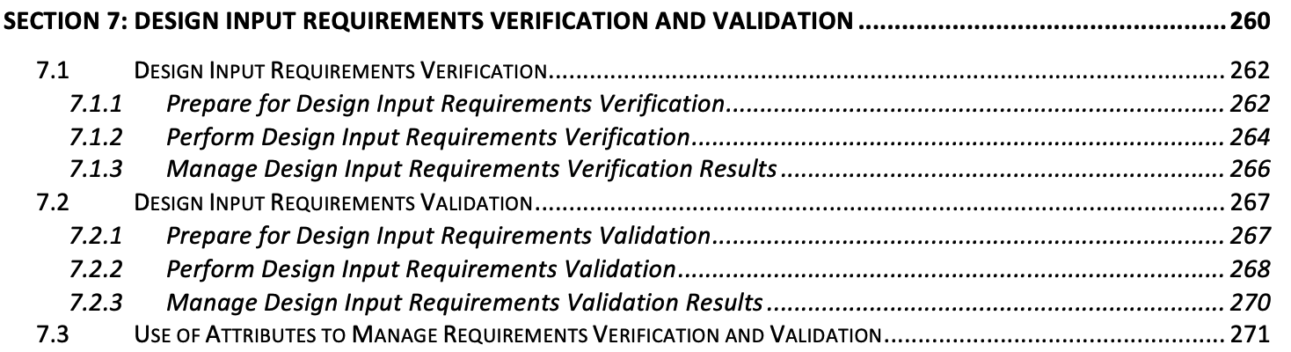
Table of Contents
Do the individual requirement expressions have the characteristics defined in the INCOSE GfWR: Necessary, Appropriate, Unambiguous, Complete, Singular, Feasible, Verifiable, Correct, and Conforming?
Does the set of design input requirements have the characteristics defined in the INCOSE GfWR: Complete, Consistent, Feasible, Comprehensible, Able to be validated?
Have attributes been defined for each requirement statement?
Are all requirement statements traceable to their parent, source, or dependent peer requirements?
Does the set of design input requirements communicate the intent of the integrated set of system needs from which they were transformed?

Slide 30
Requirements Verification and Validation
30

Slide 31
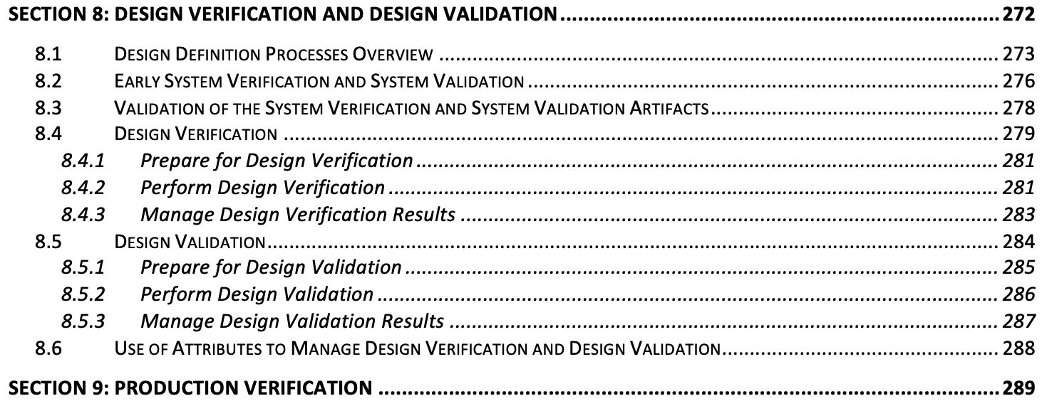
Table of Contents

Slide 32
Design
32

Slide 33
Design Verification and Validation
33

Slide 34
Production Verification and Validation
34

Slide 35
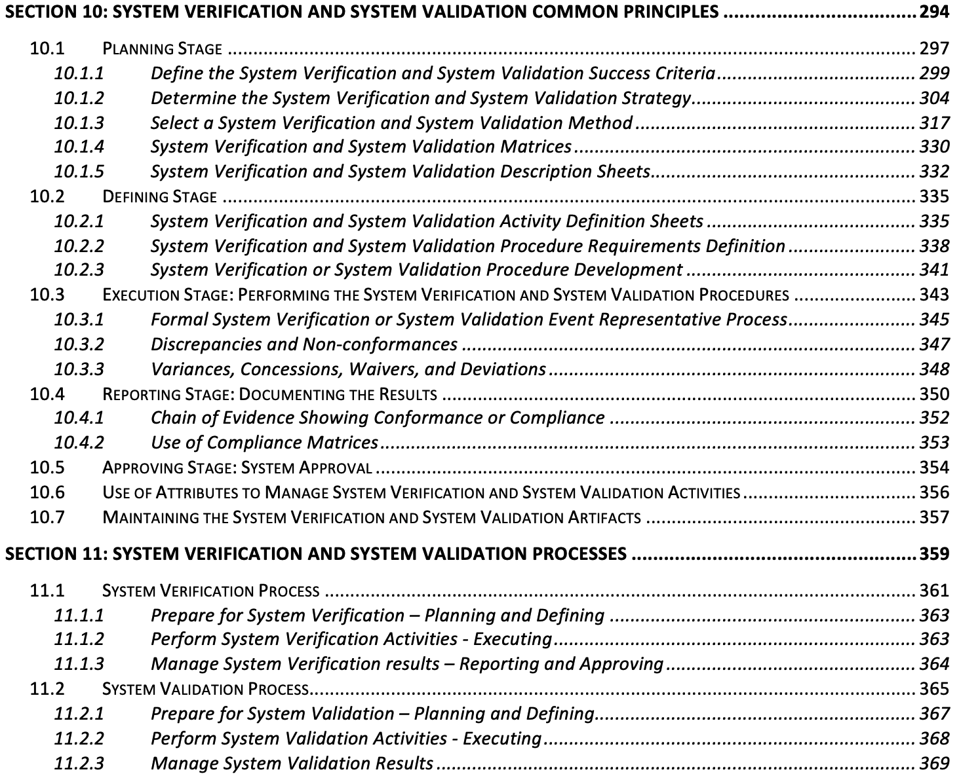
Table of Contents

Slide 36
System Verification & System Validation Stages

Slide 37
System Verification & System Validation Artifacts

Slide 38
Sequence of System Verification & Validation Activities

Slide 39
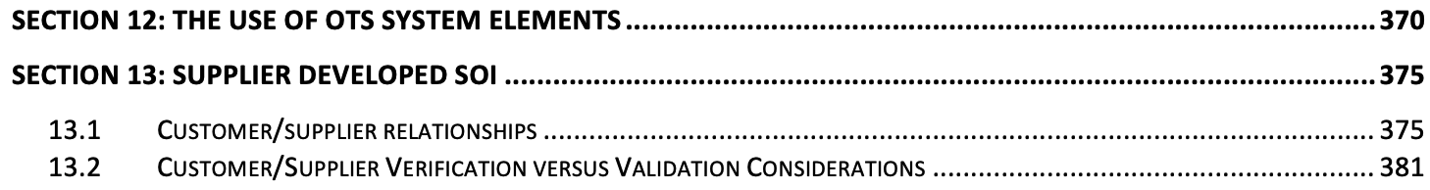
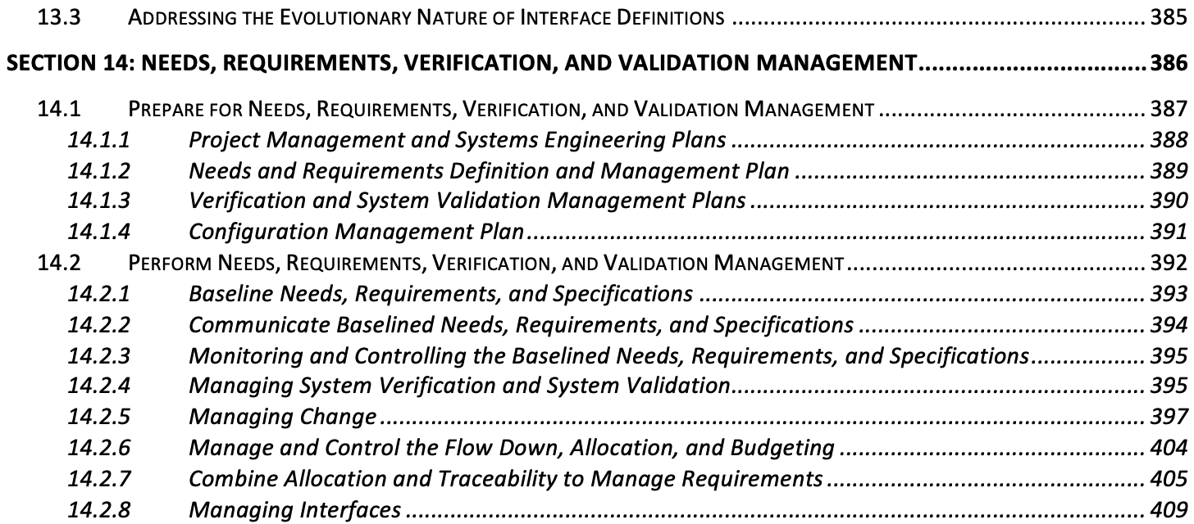
Table of Contents

Slide 40
Needs, Requirements, Verification, and Validation Management
40

Slide 41
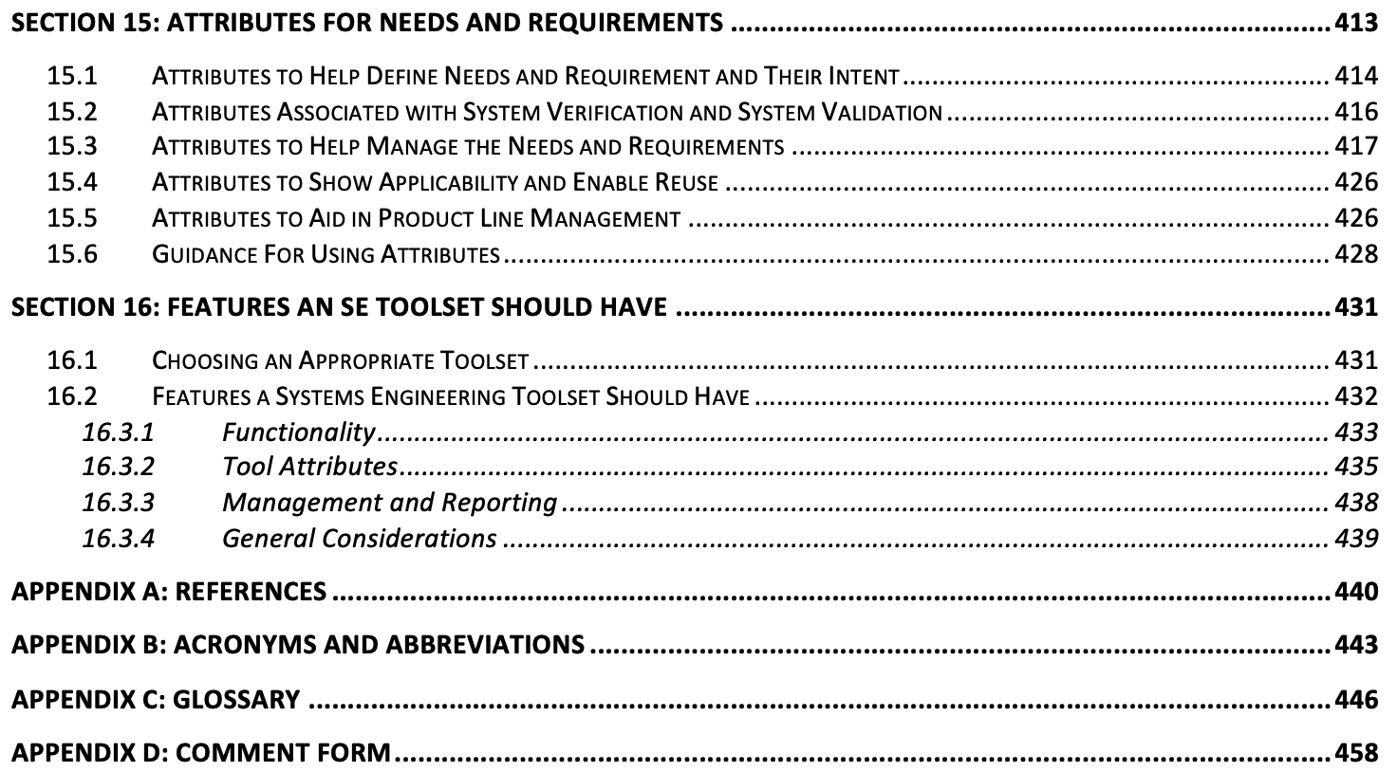
Table of Contents

Slide 42
Questions and Discussion

