Slide 1
IW2022 RWG Overview
INCOSE Requirements Working Group

Slide 2
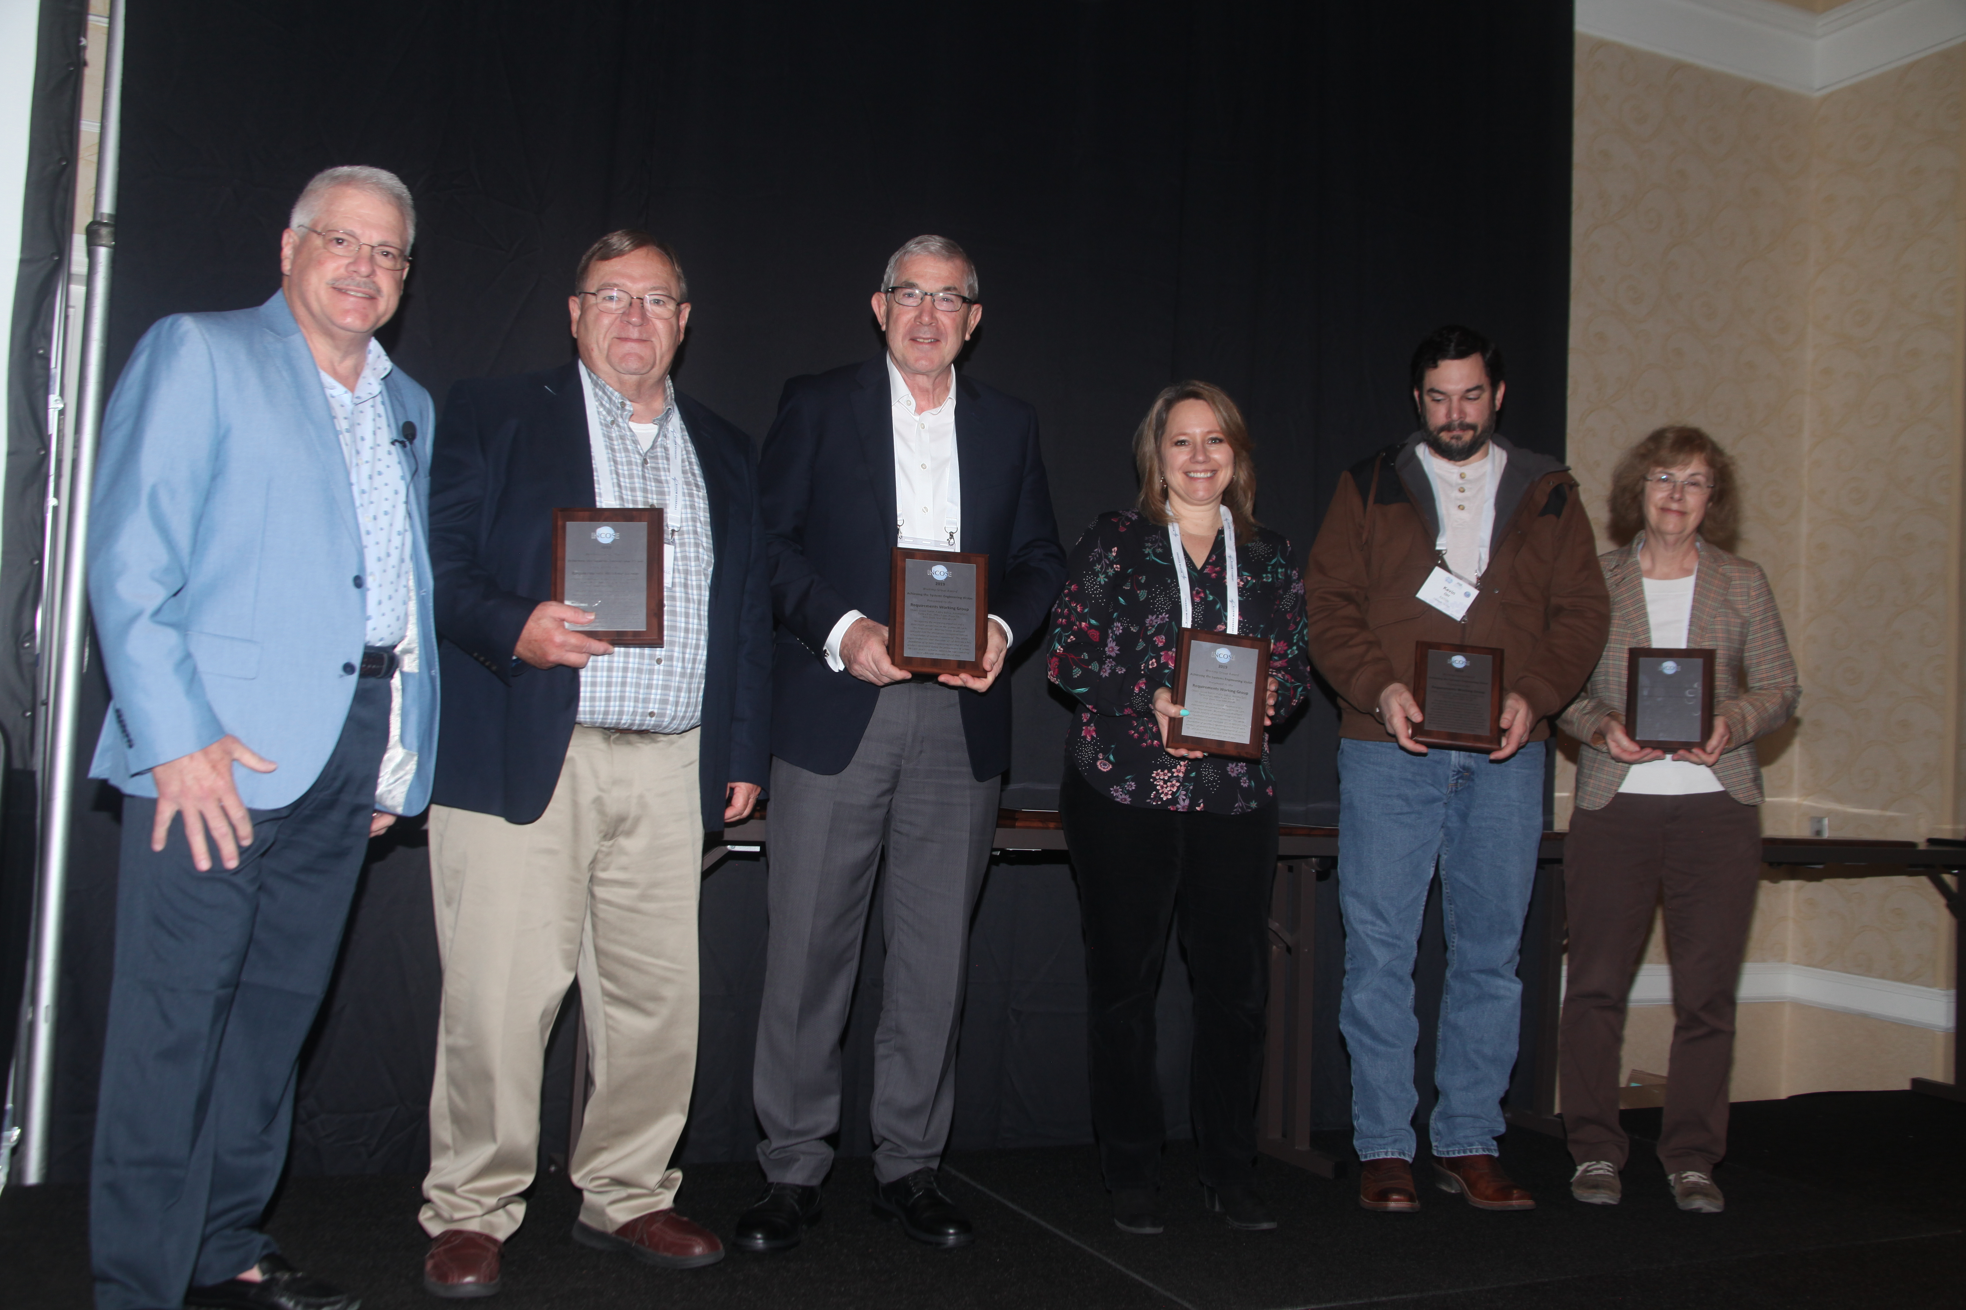
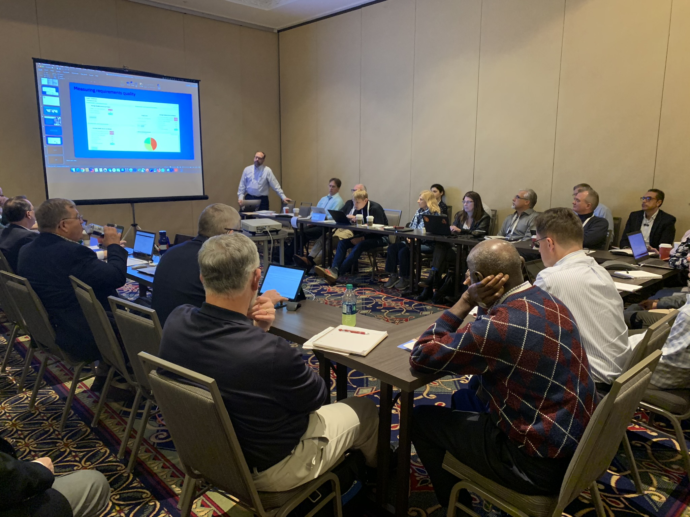
RWG at IW2022
Welcome to the RWG Overview for IW2022!
This WG meeting will present highlights from our prior virtual presentations, happenings from 2021, plans for 2022, and welcome new members to the RWG community.
Our last in-person meeting, IW2020!

Slide 3
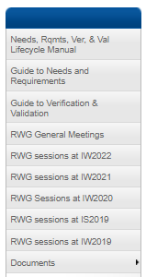
Agenda
Links to the Slides and Recordings are available on our RWG Connect Site
​Welcome Members
Overview of RWG
Overview of 2021 Activities
Highlights of pre-IW2022 Event
Discussion of RWG 2022 Activities and Interests
Wrap-up and Next Steps

Slide 4
Welcome to IW2022
This is our first hybrid meeting!
There are in-person participants, and participants online at this RWG event.
During this meeting we will have the online platform up for engagement with the online participants, including video and chat.
We ask that participants in the room please remember to speak clearly towards the camera/microphone to ensure the best audible experience for those online.
Today’s forum will have some presentations, but we are using this as a collaboration opportunity and encourage participants to ask questions and participate in the discussions.
We will try to monitor the chat, but please feel free to unmute and ask your questions or make comments directly, to maximize the dialog for all involved.

Slide 5
INCOSE RWG Overview

Slide 6
RWG Charter
1
Purpose
The purpose of the Requirements Working Group (RWG) is to advance the practices, education, and theory of needs and requirements development and management and the relationship of needs and requirements to other systems engineering functions.
RWG is About…
Understanding how to improve the practice of systems engineering through excellence in needs and requirements development and management across the lifecycle
Learning from experiences and sharing with the SE community
Questioning approaches that yield poor outcomes
Publishing guidance and continuing research into requirements development and management, including the understanding of Needs, Requirements, Verification, and Validation approaches
2
Goal
Expand and promote the body of knowledge of needs and requirements and its benefits within the systems engineering community
3
Scope
Activities relating to best practices for needs and requirements development and management throughout the product lifecycle including:
Elicitation Analysis Allocation Traceability
Elaboration Management Change Management
Expression Verification Validation

Slide 7
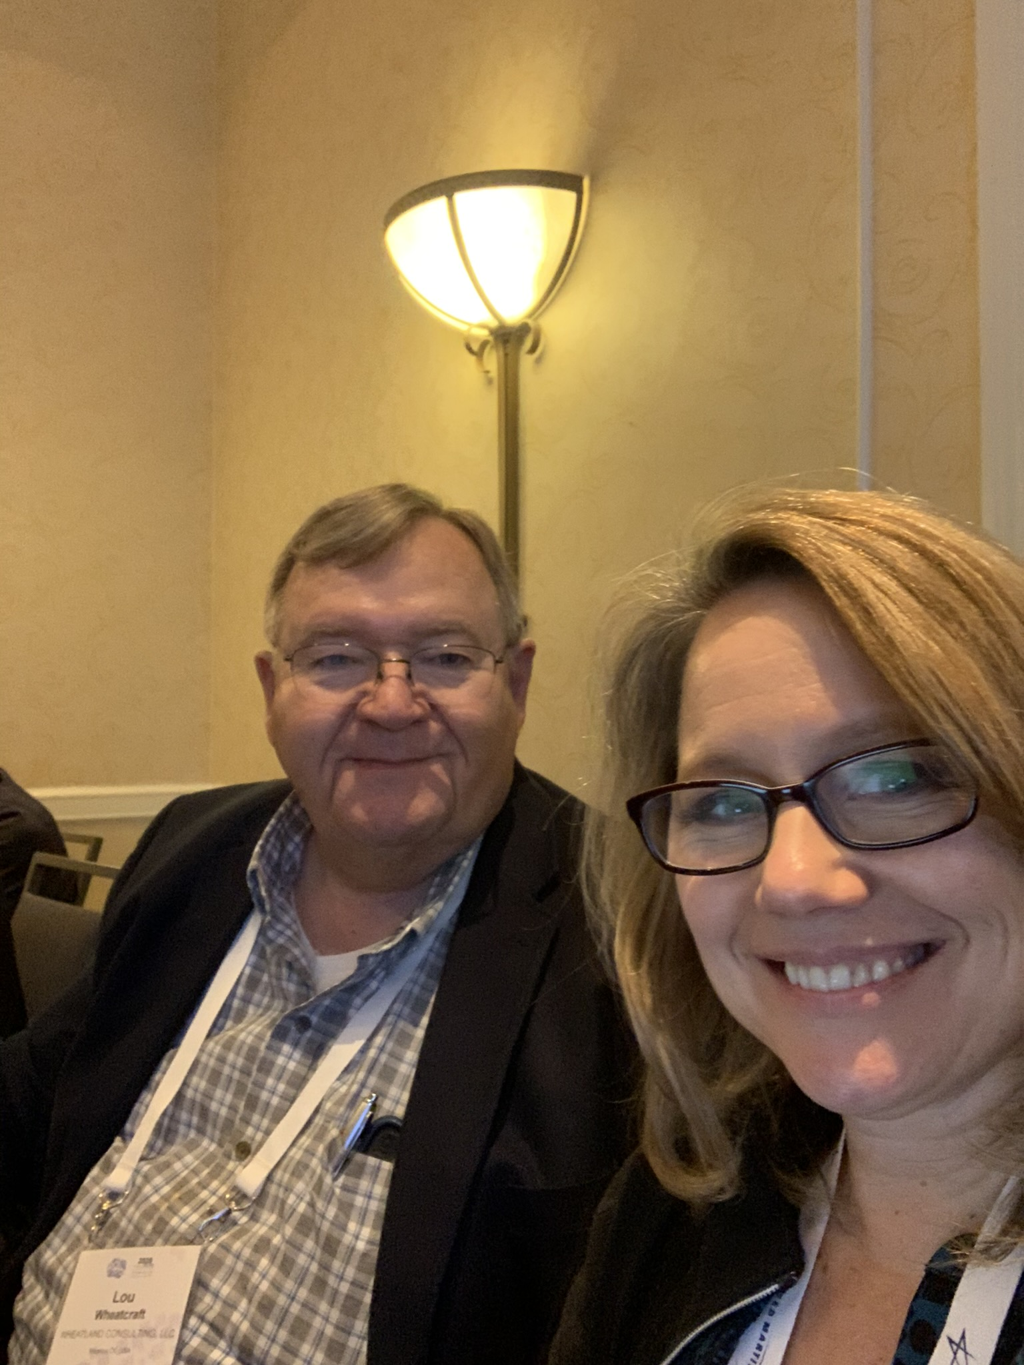
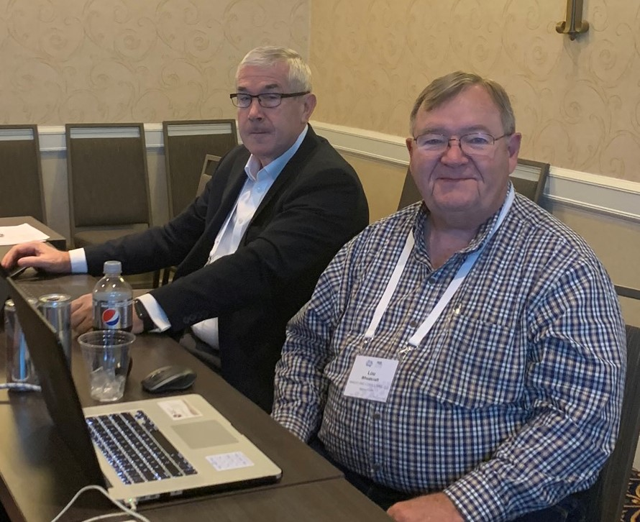
RWG Leadership
Chair: Tami Katz; Ball Aerospace, USA
Co-Chair: Lou Wheatcraft; Wheatland Consulting, USA
Co-Chair: Mike Ryan; Capability Associates Pty Ltd, AU
INCOSE Connect address:
https://connect.incose.org/WorkingGroups/Requirements/Pages/Home.aspx
Number of Members: 410, INCOSE largest WG for members
The RWG is comprised of members from industry and academia with a common purpose of improving the practice of systems engineering through improvement of Needs and Requirements development and management across the system lifecycle.

Slide 8
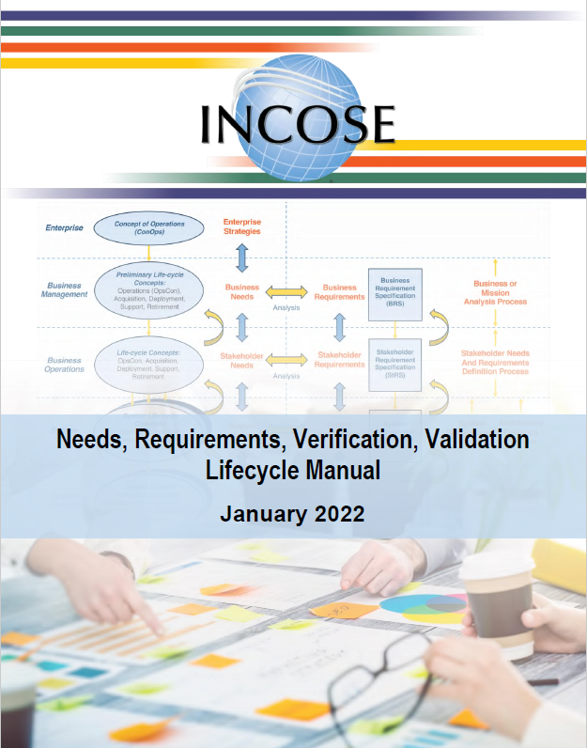
Current RWG Published Products
The following products from RWG are available in the INCOSE Store:
  **NEW** Needs, Requirements, Verification and Validation Life Cycle Manual (NRVVLM) – 2022 version
  Guide for Writing Requirements – 2019 version 3
  Guide for Writing Requirements Summary – 2019 version 3
  Whitepaper: Integrated Data as a Foundation of SE - March 2019

Slide 9
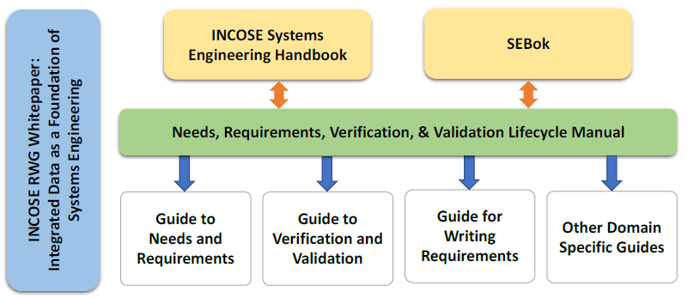
Upcoming RWG Products
The RWG has been working on new products and supporting development of other INCOSE publications
Currently in work:
Product | Product Lead/Lead Author
Guide for Writing Requirements | Mike Ryan
Guide to Needs Requirements | Tami Katz
Guide to Verification and Validation | Raymond Wolfgang
Inputs to the SE Handbook version 5 | Mike Ryan, Lou Wheatcraft
Inputs to the SEBok | Tami Katz
RWG Inputs
RWG Inputs
New
New
New
Updates
RWG Inputs

Slide 10
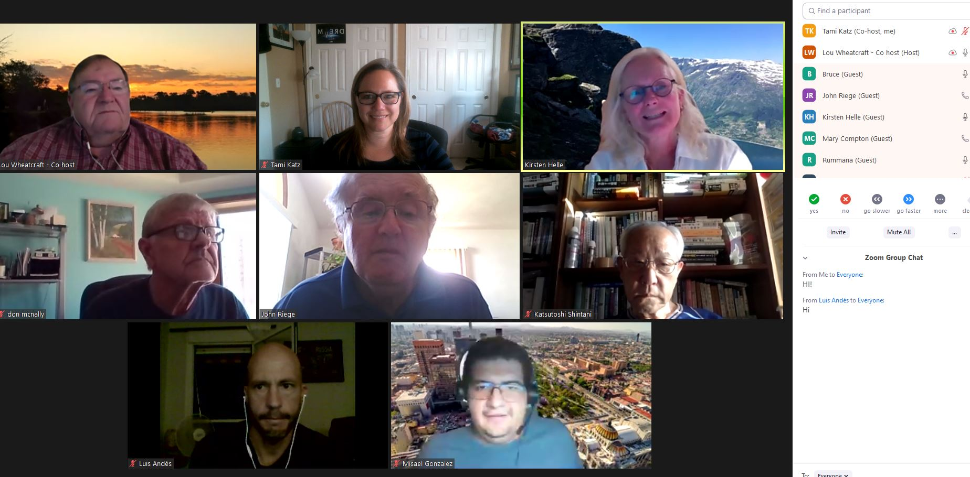
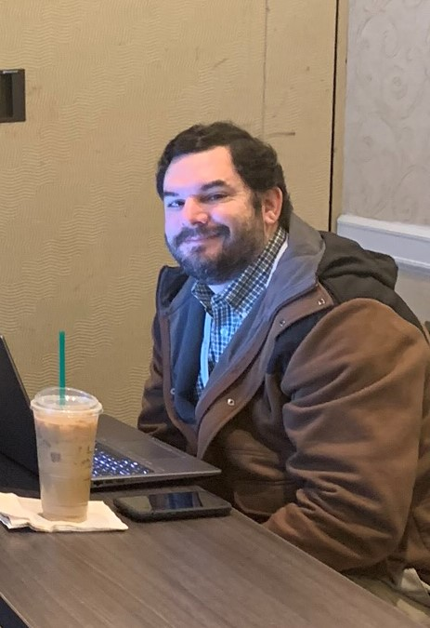
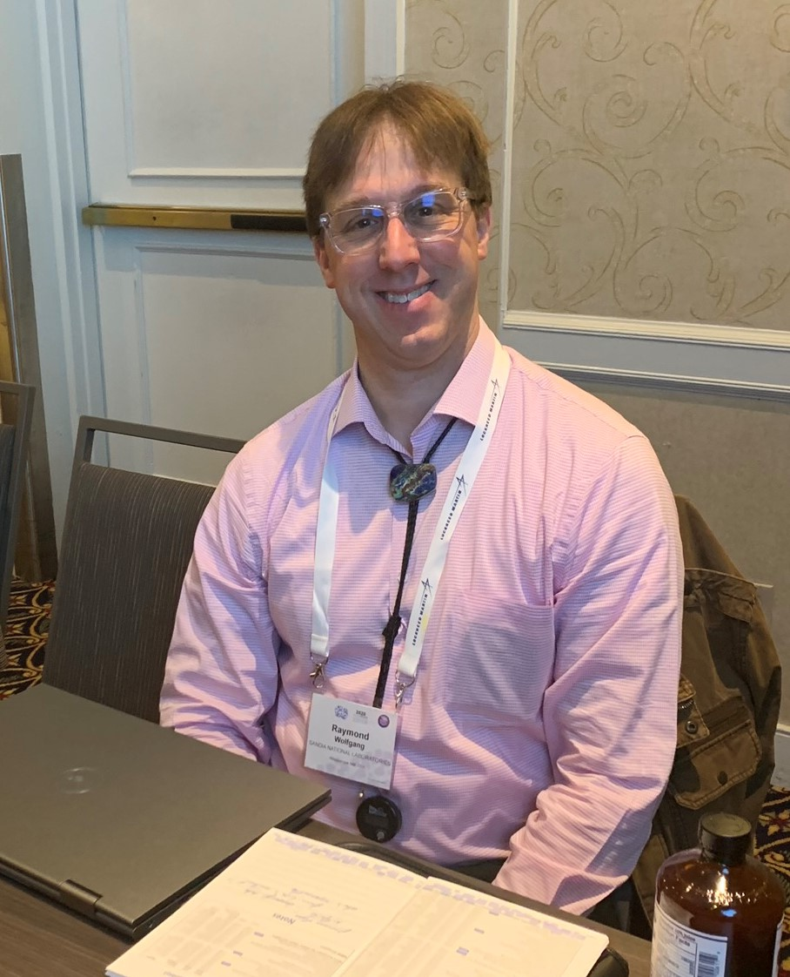
RWG Events
RWG engages the INCOSE community through regular events around the topic of Needs and Requirements
  Guest speakers on Requirements Topics
  RWG Exchange Cafés
RWG members contribute ideas towards topics discussed and are encouraged to share their experiences and questions with the broad working group community.

Slide 11
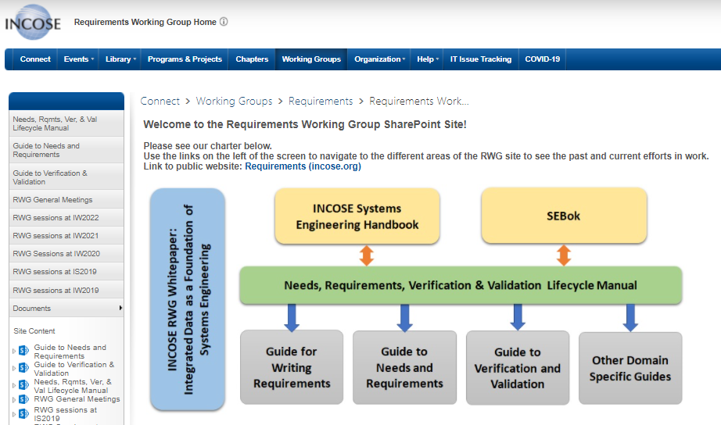
RWG Connect Site
Information about RWG meetings, products, and ongoing efforts are found on the INCOSE RWG Connect website, available to INCOSE members.
https://connect.incose.org/WorkingGroups/Requirements/Pages/Home.aspx

Slide 12
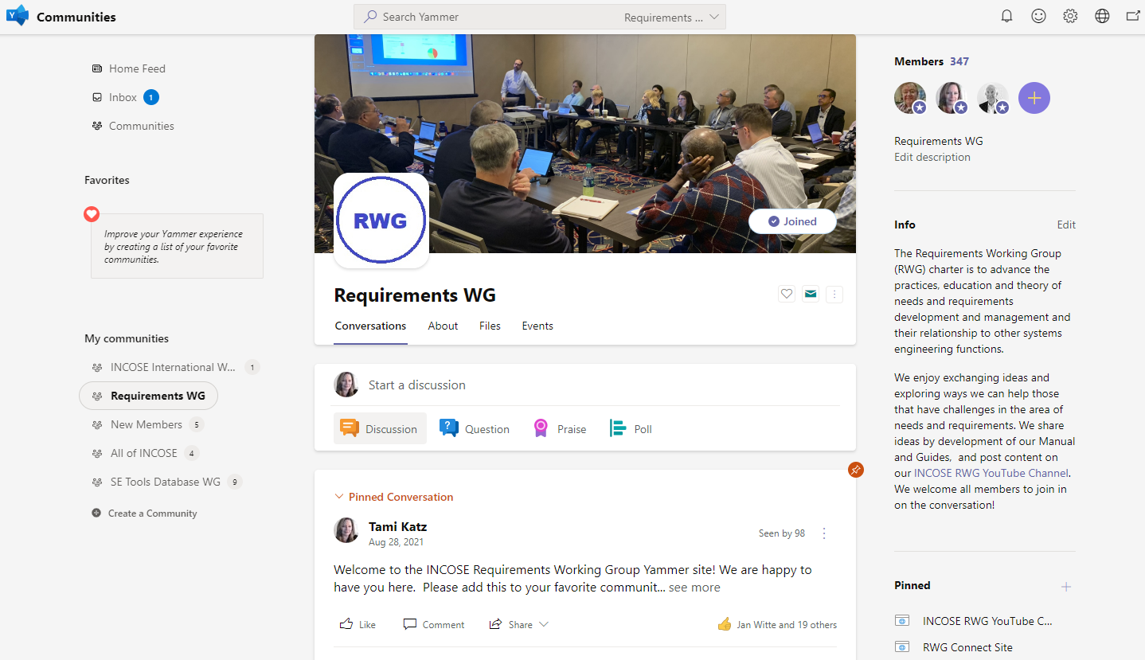
RWG Yammer Community
New in 2021! The INCOSE organization has established Microsoft platforms for INCOSE member engagement.
Upon obtaining the member login from the INCOSE CIO Barclay Brown, navigate to Communities (Yammer) and join the Requirements Working Group Community.
This platform enables more interactive announcements, questions, and discussions throughout the year!
Access to Communities is through the Microsoft Teams App, or the online Microsoft Teams site.

Slide 13
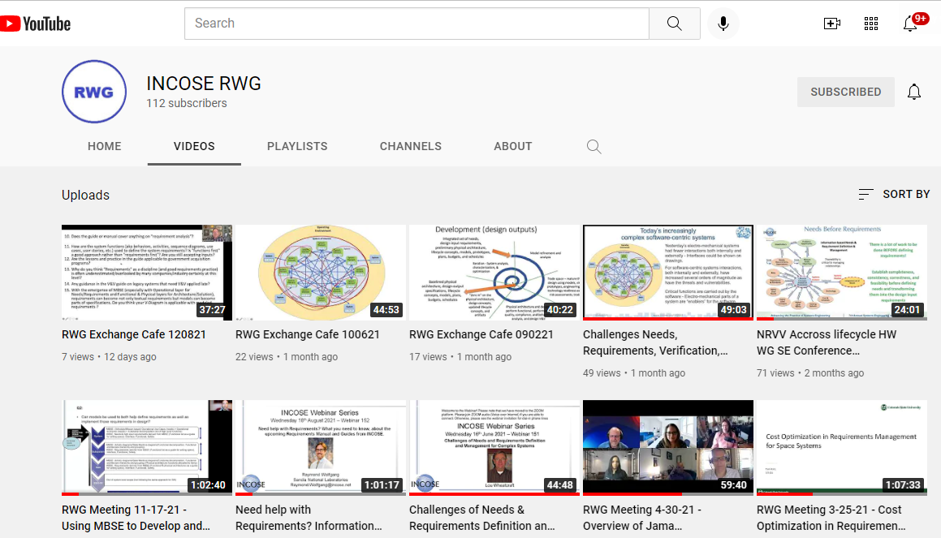
RWG YouTube Channel
New in 2021! The INCOSE RWG chairs have created a YouTube channel to post recordings of meetings and presentations to the broader community.
This is available to everyone that would like to catch up on events and learn more about the RWG efforts and products.
This is also available to non-INCOSE members as a method to attract interest in potentially joining INCOSE and the RWG and share good options to all that engage in needs and requirements efforts.
https://www.youtube.com/channel/UCadgYaqKWDckenP2SU8-cPw/playlists

Slide 14
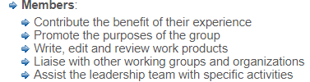
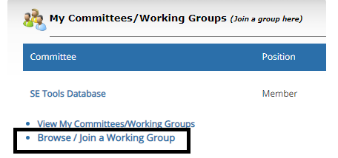
How to Become Involved in RWG
As a large working group, the RWG has been very active in virtual events as well as smaller product team efforts.
Joining the working group enables the members to learn about the products, provide opportunity to contribute (or review), and participate in the RWG virtual events with other practitioners.
Members can be very involved (product support) or minimally involved (watch meeting recordings), the intention is to enable all levels of participation and interaction.

Slide 15
INCOSE RWG 2021 Activities

Slide 16
Assessment Against Planned 2021 Activities
Release of the new Manual and two Guides
Regular Web Meetings, Speakers or Exchange Cafés (~monthly)
INCOSE Webinars
    https://www.incose.org/products-and-publications/webinars
    Webinar 152: Need help with Requirements? What you need to know, about the upcoming Requirements Manual and Guides from INCOSE, 8/18/21
    Webinar 151: Challenges of Needs and Requirements Definition and Management for Complex Systems, 6/16/21
Potential – IS2021 overview on RWG Products (dependant on IS logistics)
Continued CAB Interactions and Support
Update to the Guide for Writing Requirements to align with new products
Engagement with other Working Groups (IV&V, Security, others)
Additionally, the RWG events at IW2021 were the first fully virtual workshop meetings, held over several days, which inspired the pre-meetings for IW2022.

Slide 17
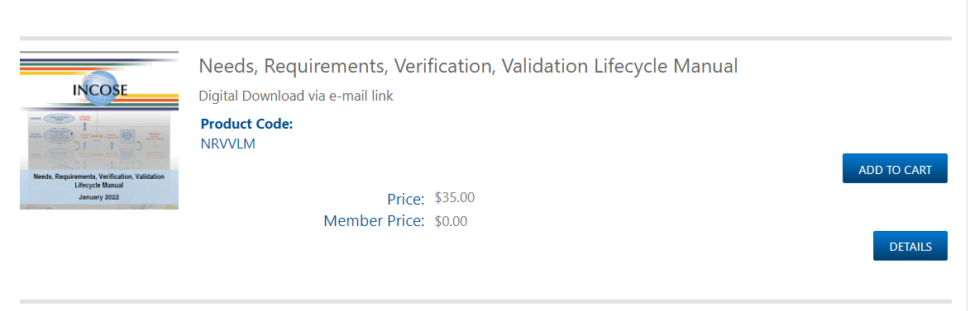
NRVVLM is Released!
The Needs, Requirements, Verification and Validation Life Cycle Manual (NRVVLM) is released and in the INCOSE Store!

Slide 18
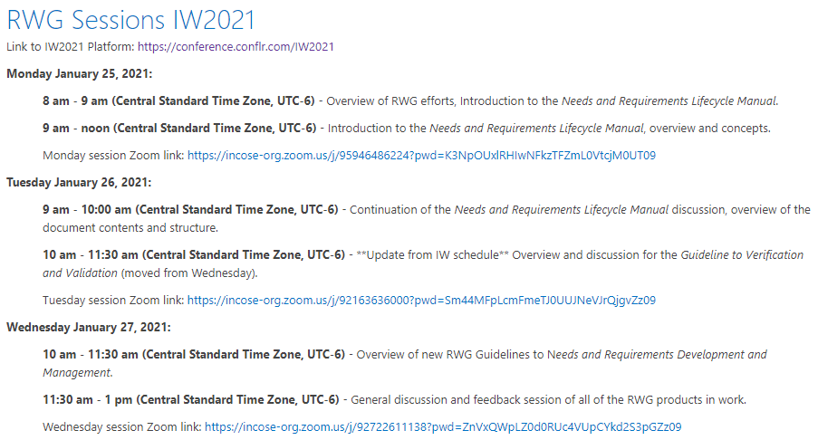
RWG IW2021 Recap
IW2021 was fully virtual, and the RWG held several meetings that enabled group discussions and engagement.
Primary focus was on the RWG Manual and Guidelines and obtaining feedback.
Presentations and links to video are at RWG sessions at IW2021 - Home (incose.org)

Slide 19
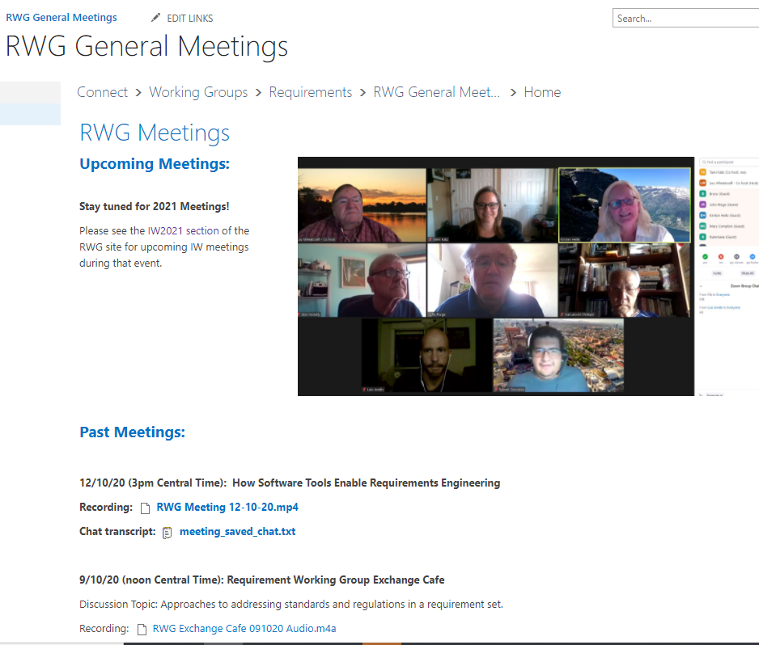
RWG 2021 General Web meetings
https://connect.incose.org/WorkingGroups/Requirements/RWGMeetings/SitePages/Home.aspx
2/25/21: Requirement Modeling for Early V&V (Brendan Hall and Don Ward)
3/25/21: Cost Optimization in Requirements Management (Tami Katz)
4/30/21: Overview of the Jama Requirements Tools (Cary Bryczek)
9/2/21: RWG Exchange Café, addressing questions on the NRVVLM concepts
10/6/21: RWG Exchange Café, addressing questions on the NRVVLM concepts
11/17/21: Using MBSE to Define and Validate Needs and Requirements (Luis Andes Olmedo)
12/8/21: RWG Exchange Café, addressing questions on the NRVVLM concepts
All meeting slides and recordings are on the RWG Connect Site, and recordings are on the RWG YouTube Channel

Slide 20
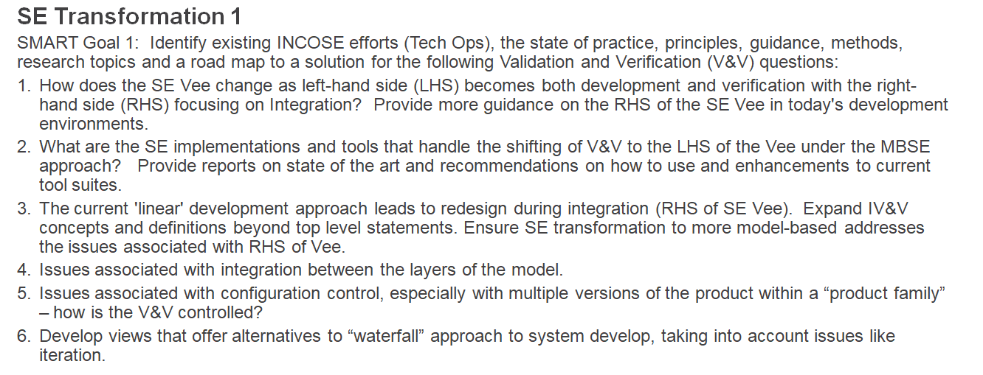
Corporate Advisory Board Support
RWG has supported the CAB initiatives to develop products in support of industry needs
Recently addressed aspects of CAB SMART Goal #1, Re-envisioning Verification & Validation with the release of the NRVVLM.

Slide 21
Highlights of pre-IW2022 Event

Slide 22
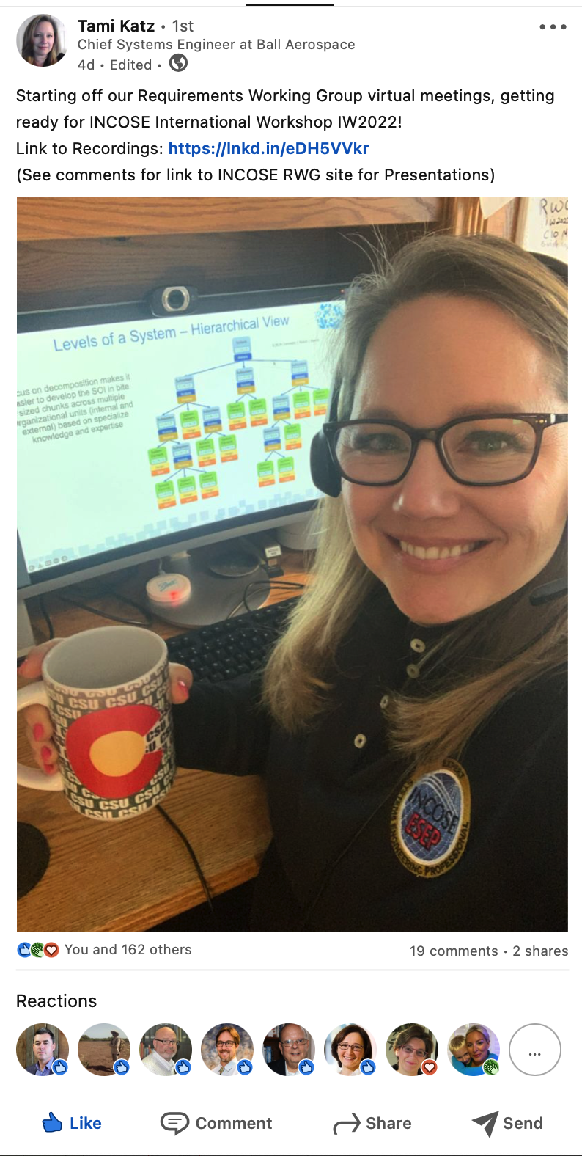
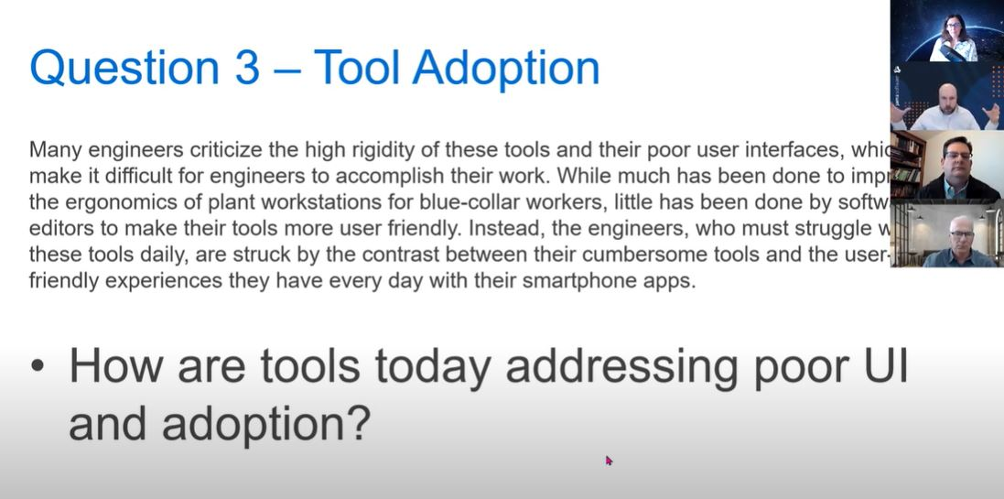
IW2022 Pre-Event Overview
This year the RWG hosted a fully virtual Pre-event over two days to enable information on our new material, guest speakers, and collaboration.
~30 participants at the Zoom sessions, with others opting to watch the recorded sessions afterwards
This event is considered a success by the RWG leadership, and we plan to host more events like this in the future.

Slide 23
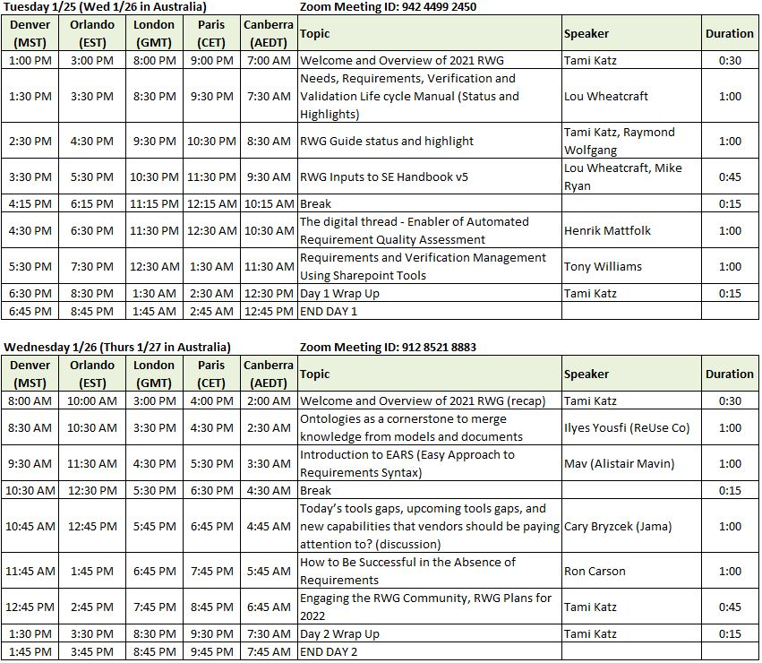
RWG pre-IW2022 Sessions
Links to the Zoom Sessions are available on our RWG Connect Site and YouTube

Slide 24
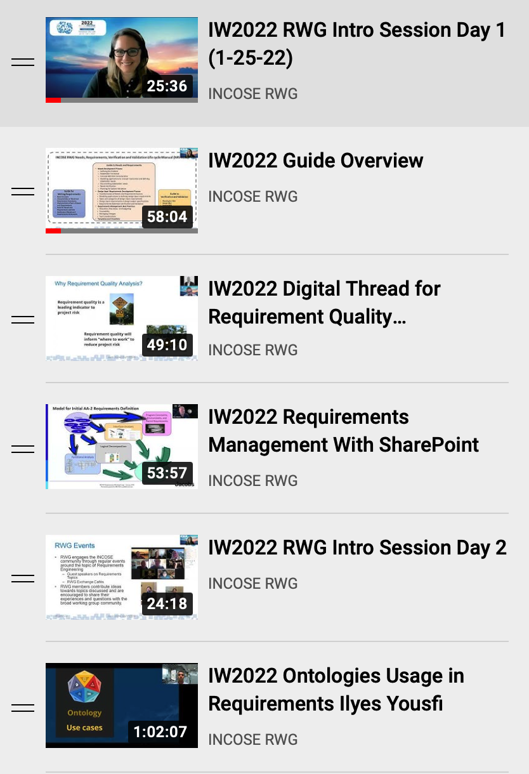
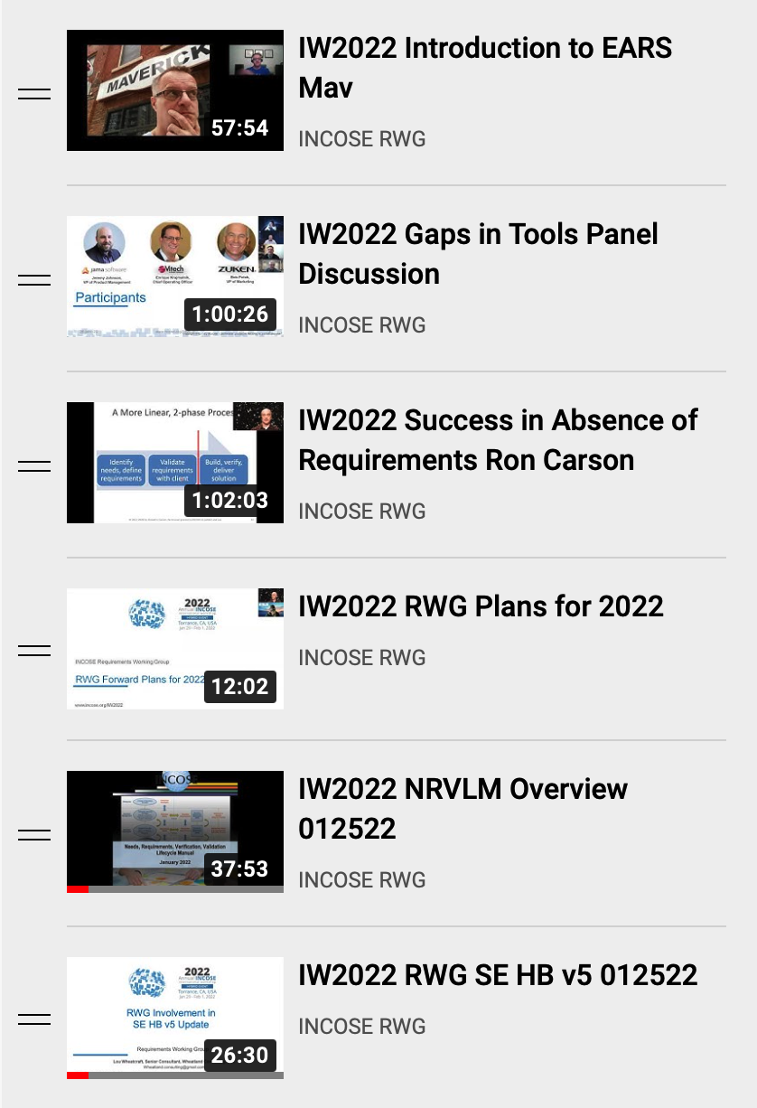
RWG IW2022 Playlist on YouTube
12 presentation videos from RWG pre-IW event on Jan 25 & 26, 2022
YouTube: https://www.youtube.com/playlist?list=PLVfZ7HbxxzBXTd8vieYUbHU-RCYTSfbcS

Slide 25
NRLVVM Overview
Lou Wheatcraft presented an overview of the new Needs, Requirements, Verification and Validation Lifecycle Manual (NRLVVM).

Slide 26
Guide Overview
Tami Katz presented an overview of the new Guide to Needs and Requirements.
Raymond Wolfgang presented an overview of the new Guide to Verification and Validation.

Slide 27
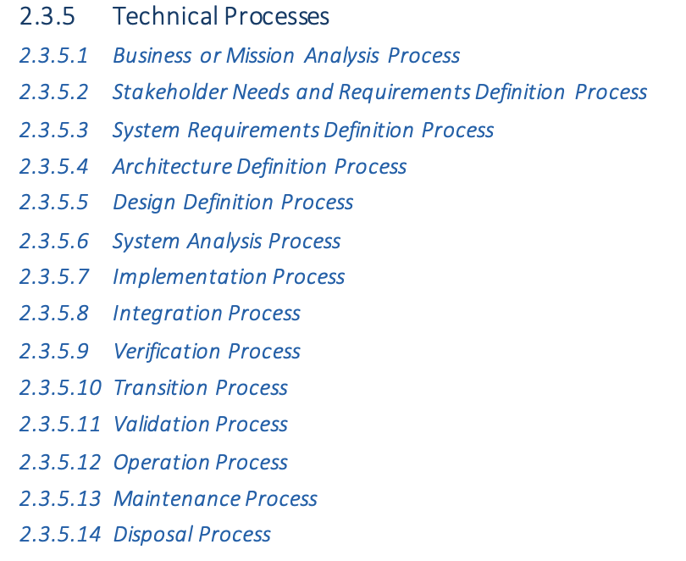
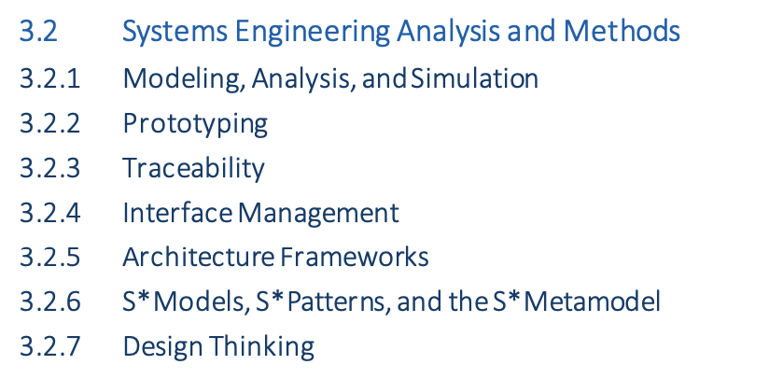
SE Handbook RWG Contribution Overview
Lou Wheatcraft presented an overview of the RWG contributions to the SE Handbook version 5.

Slide 28
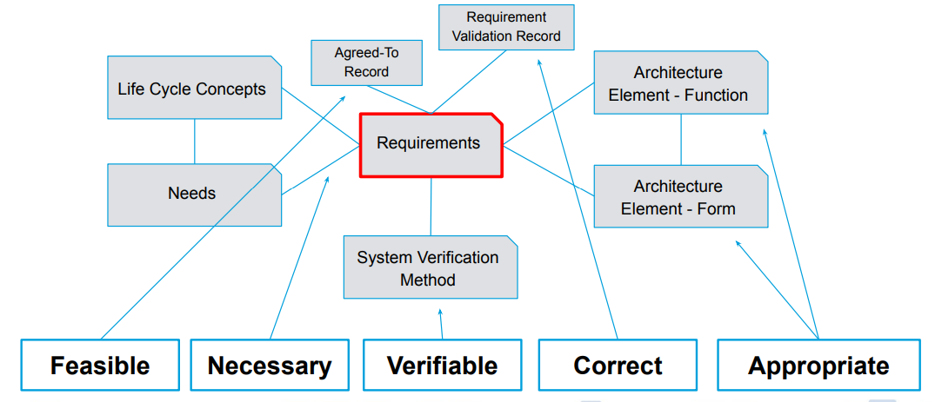
Digital Thread for Requirement Quality Overview
Henrik Mattfolk presented the concept of using digital threads as a method of ensuring requirement quality.

Slide 29
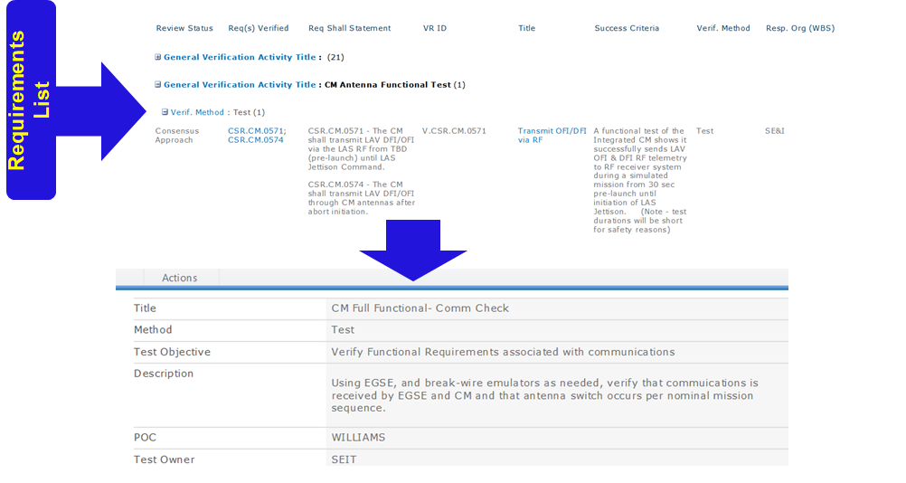
Requirement Management in SharePoint Overview
Tony Williams presented the concept of using SharePoint as a method of requirement and verification management (with overview of how used on a NASA project).

Slide 30
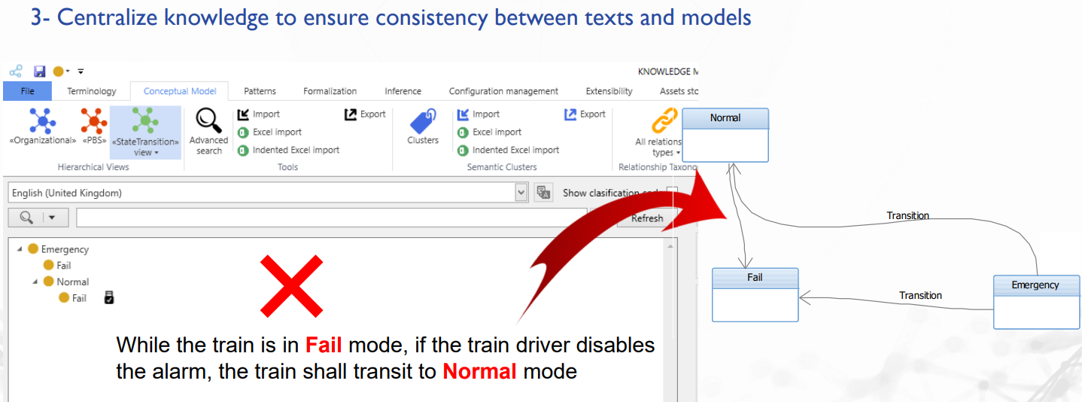
Ontology for Requirement Quality Overview
Ilyes Yousfi presented the concept of using defined ontologies as a method of ensuring requirement quality.

Slide 31
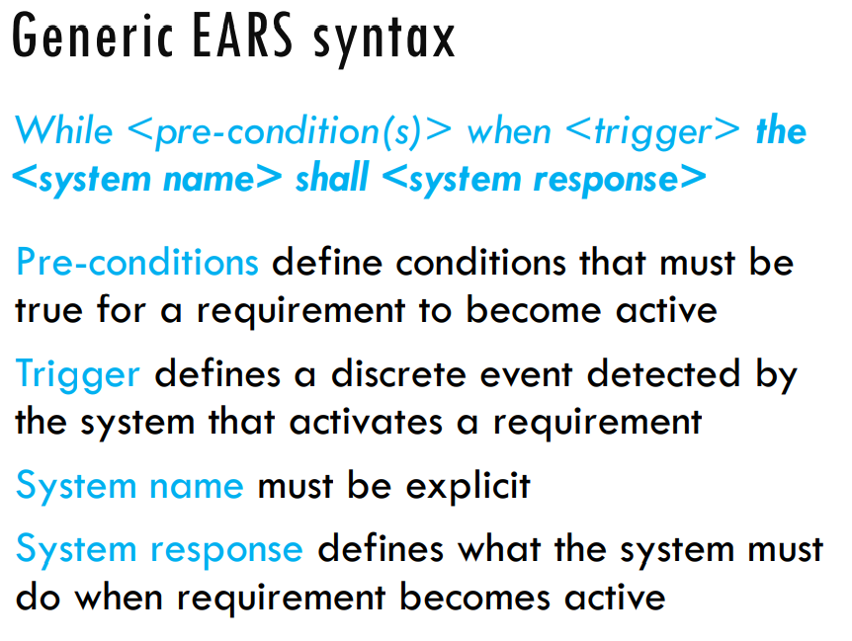
Introduction to EARS Overview
Mav (Alistair Mavin) presented the concept of Easy Approach to Requirements Syntax (EARS)

Slide 32
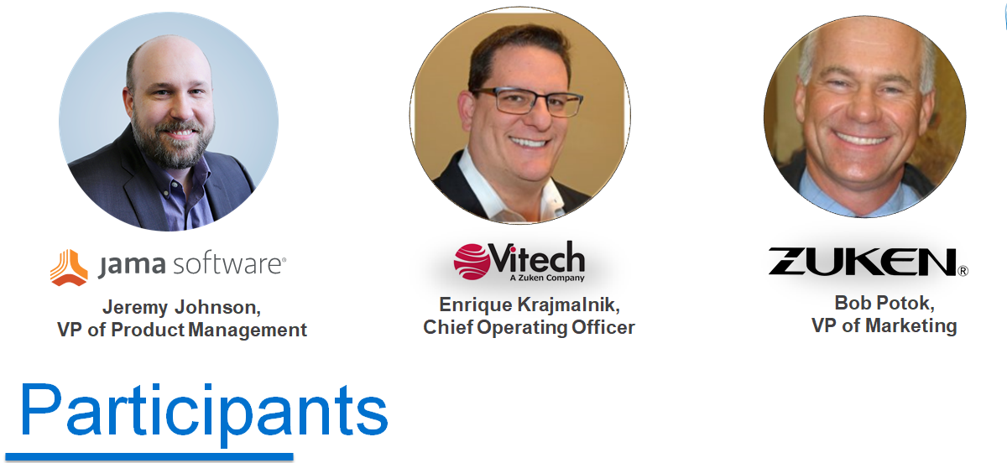
Tool Improvement Panel Discussion Overview
Cary Bryczek from Jama led a panel discussion on Tool Sets and how they can evolve to meet emerging needs and address current gaps.

Slide 33
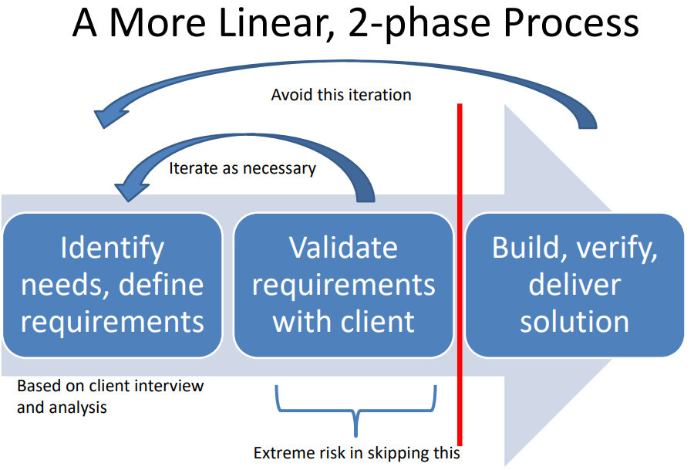
Requirements Derivation Overview
Ron Carson presented how to address projects where the customer did not specify the requirements.

Slide 34
Discussion of RWG 2022 Activities and Interests

Slide 35
RWG Planned 2022 Activities
Regular Web Meetings, Speakers or Exchange Cafés (~monthly)
Continued CAB Interactions and Support
Release of the new Guides
Update to the Guide for Writing Requirements to align with new products
Engagement with other Working Groups (IV&V, Security, others)
Continued use of YouTube for content to RWG
Regular use of Yammer for collaboration
New - Change to the INCOSE intranet platform for RWG written content as the Connect site will be discontinued by INCOSE

Slide 36
Plan for Publishing RWG Products
During 2022 the Guides will be released, SE Handbook content refined, and SEBok material updated.
Currently in work:
Product | Product Lead/Lead Author
Guide for Writing Requirements | Mike Ryan
Guide to Needs Requirements | Tami Katz
Guide to Verification and Validation | Raymond Wolfgang
Inputs to the SE Handbook version 5 | Mike Ryan, Lou Wheatcraft
Inputs to the SEBok | Tami Katz
Update with RWG Inputs
Release Spring 2022!!
Update Summer 2022
Reach out to WGs in 2022

Slide 37
For Discussion….
Have attendees seen any of the pre-event material? If so, what takeaways exist that you would like to share?
Is the published RWG material helpful to the users? What can be improved?
What other items should RWG be doing beyond what was addressed in this meeting? Are we missing opportunities?
What speaker topics should be brought forward in 2022?
Other topics?

Slide 38
IW2022 Wrap-up

Slide 39
Join the INCOSE RWG Leadership!
This summer, Tami’s three year run as RWG Chair is concluding, and she will become a co-chair in July.
We are actively recruiting members to join the RWG leadership team and help continue the good work.
Interested in leading this team? Please reach out to Tami Katz to learn more, and we will train new lead(s) this Spring.
  Estimate 1-2 hours a week average of effort
  A Passion for addressing Needs and Requirements is helpful!

Slide 40
Thank you!!
The RWG appreciates your support of this IW2022 event!
Please download the Needs, Requirements, Verification and Validation Manual from the INCOSE Store!
  ….and help us further improve it by applying it in your subject areas and providing feedback.
Please join the INCOSE RWG Yammer Community and help us keep communication going throughout the year!

