Slide 1
Pre-IW2022 Event Kickoff
INCOSE Requirements Working Group

Slide 2
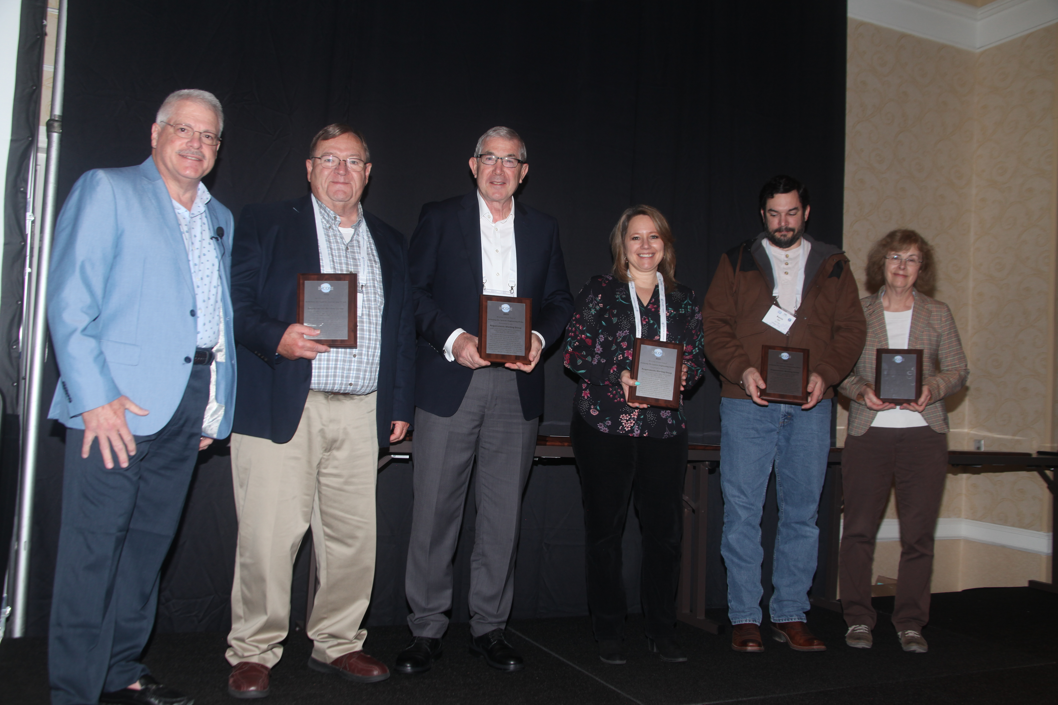
RWG at IW2022 (pre-Event)
Welcome to the General RWG Overview for IW2022!
This set of pre-IW2022 meetings is to enable a fully virtual experience and catch up interested members in the happenings of the INCOSE Requirements Working Group throughout the last year.
In the spirit of our monthly meetings, we have also lined up some guest speakers to go through topics of interest to our RWG community.
The IW2022 hybrid event includes one in-person/virtual event on Sunday, 1/30/22, which will be used as a summary event to present highlights from this virtual presentation, happenings from 2021, plans for 2022, and welcome new members to the RWG community.

Slide 3
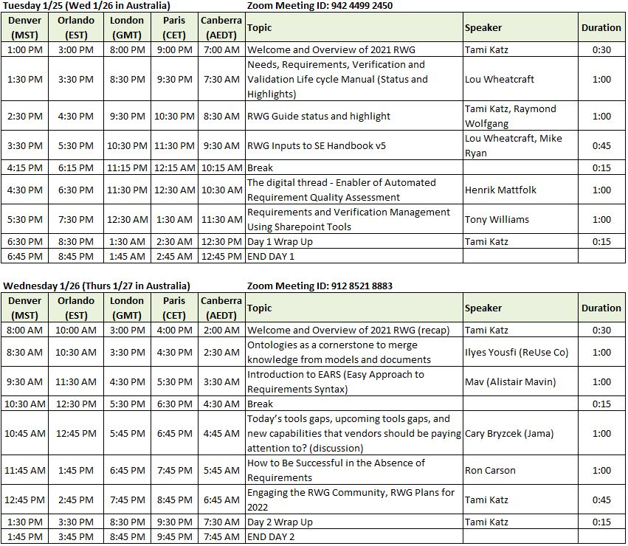
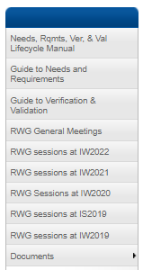
Planned Sessions for pre-IW2022
We are here
Links to the Zoom Sessions are available on our RWG Connect Site

Slide 4
INCOSE RWG Overview

Slide 5
RWG Charter
1
Purpose
The purpose of the Requirements Working Group (RWG) is to advance the practices, education and theory of needs and requirements development and management and the relationship of needs and requirements to other systems engineering functions.
2
Goal
Expand and promote the body of knowledge of needs and requirements and its benefits within the systems engineering community
3
Scope
Activities relating to best practices for needs and requirements development and management throughout the product lifecycle including:
Elicitation Analysis Allocation Traceability
Elaboration Management Change Management
Expression Verification Validation

Slide 6
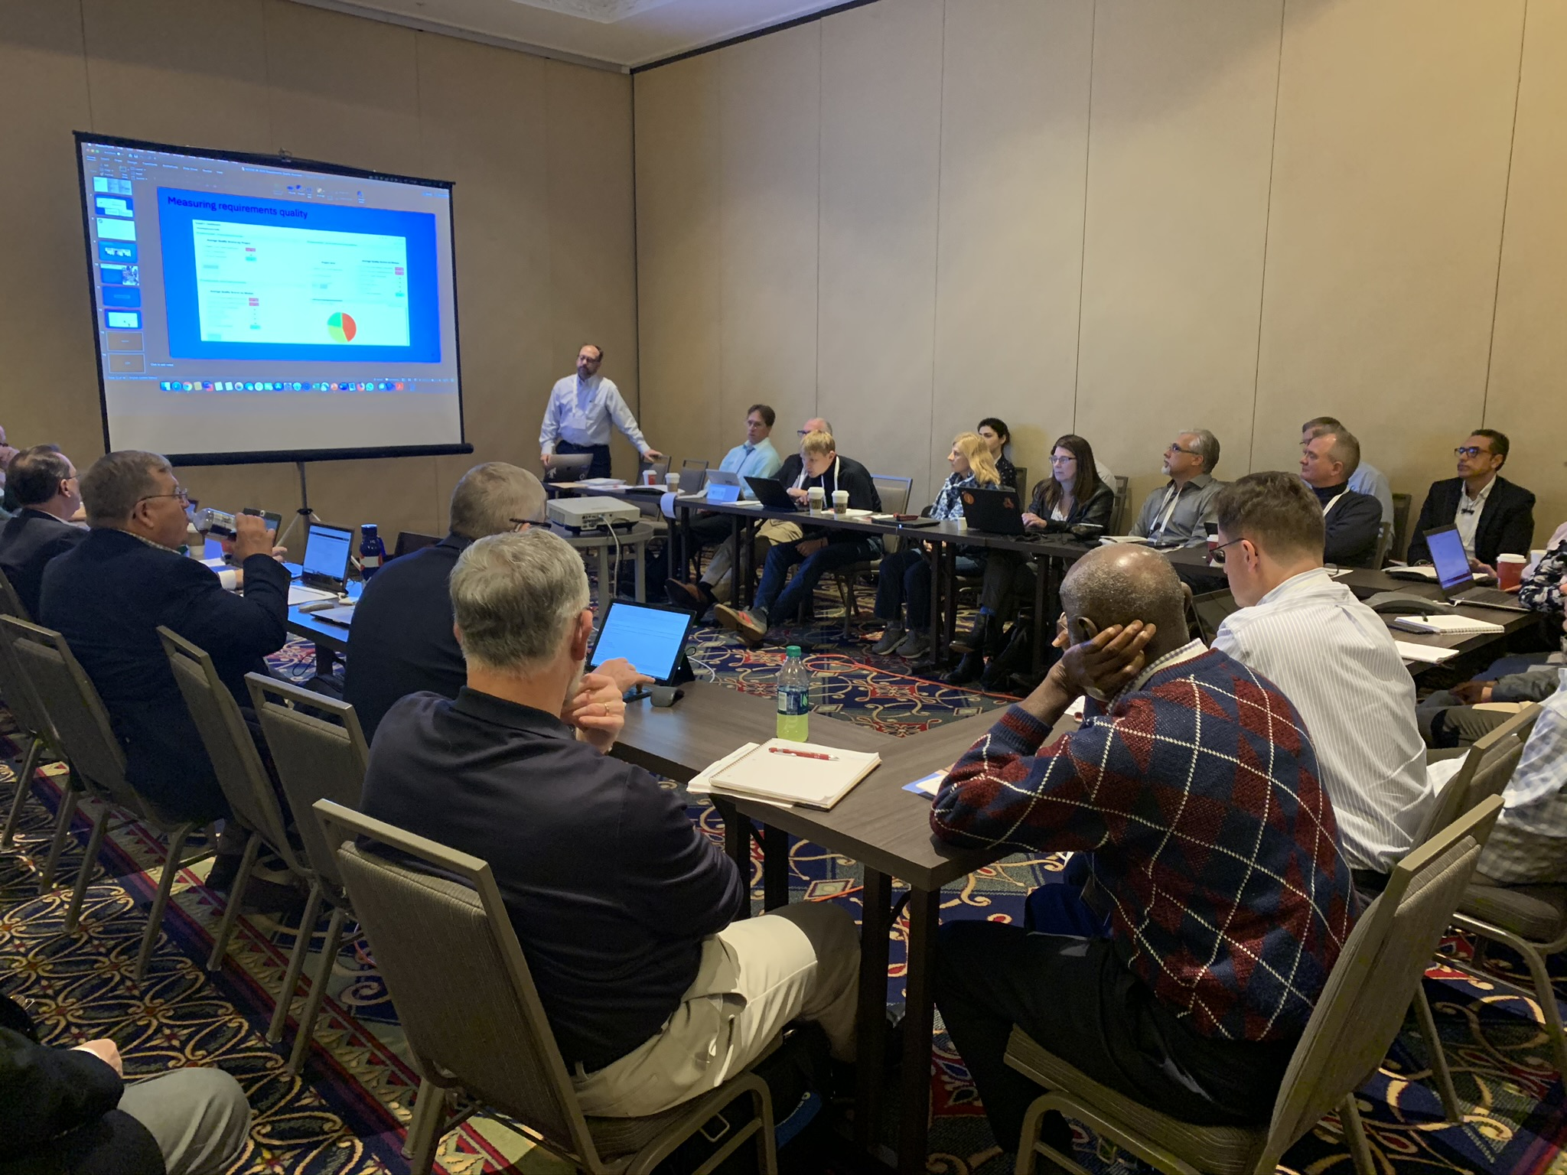
RWG is About….
Understanding how to improve the practice of systems engineering through excellence in needs and requirements development and management
Learning from experiences and sharing with the SE community
Questioning approaches that yield poor outcomes
Publishing guidance and continuing research into requirements development and management, including the understanding of Needs, Requirements, Verification and Validation approaches

Slide 7
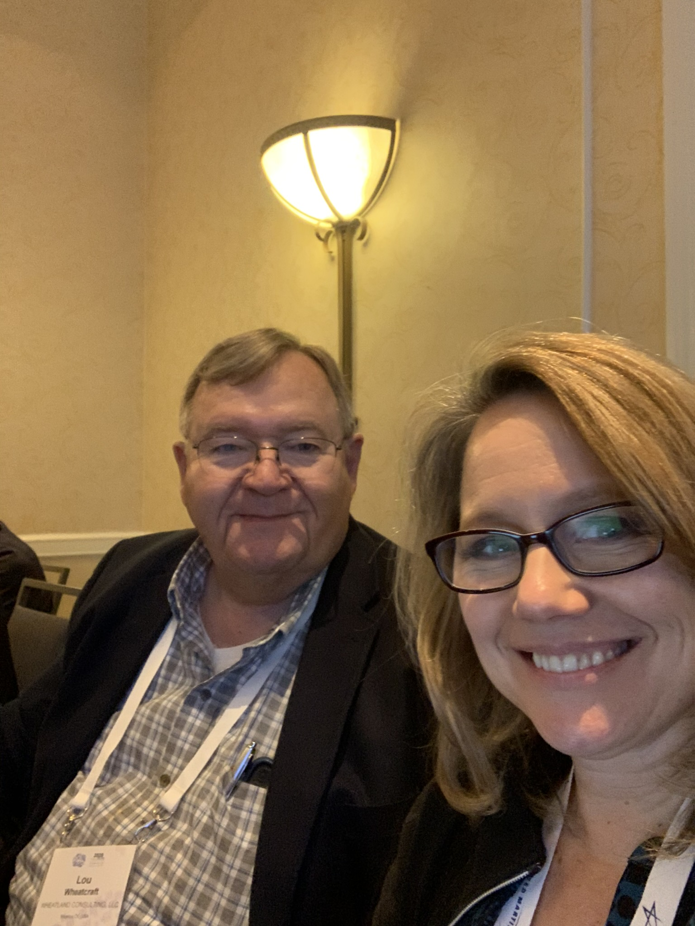
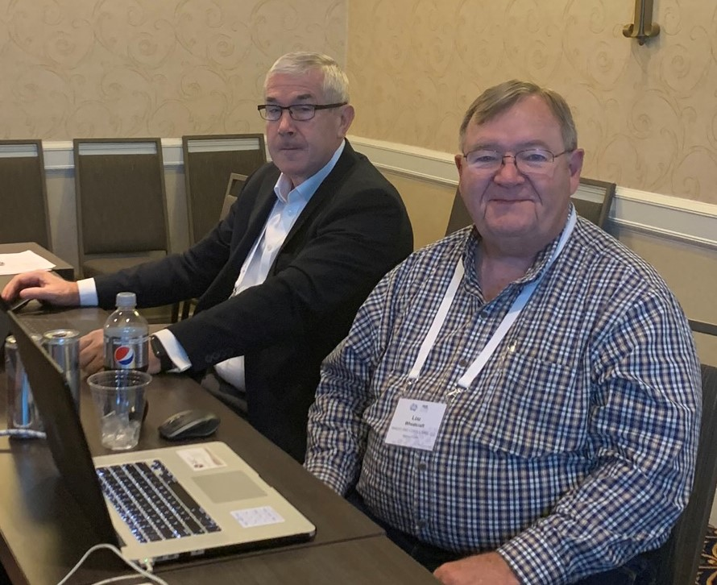
RWG Leadership
Chair: Tami Katz; Ball Aerospace, USA
Co-Chair: Lou Wheatcraft, Wheatland Consulting, USA
Co-Chair: Mike Ryan; Retired
INCOSE Connect address:
https://connect.incose.org/WorkingGroups/Requirements/Pages/Home.aspx
Number of Members: 406, INCOSE largest WG for members
The RWG is comprised of members from industry and academia with a common purpose of improving the practice of systems engineering through improvement of Needs and Requirements development and management

Slide 8
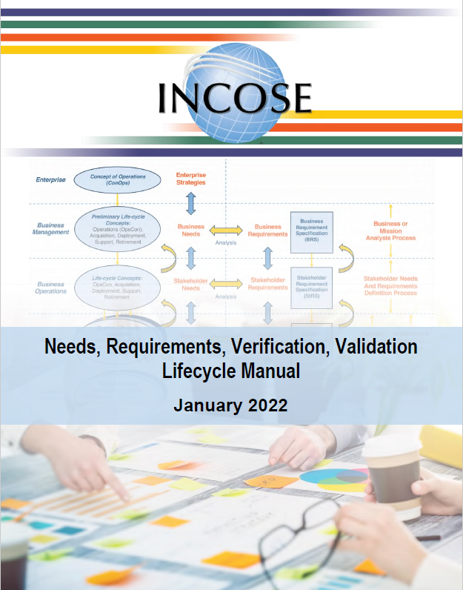
Current RWG Published Products
The following products from RWG are available in the INCOSE Store:
  **NEW** Needs, Requirements, Verification and Validation Life Cycle Manual (NRVVLM) – 2022 version
  Guide for Writing Requirements – 2019 version
  Guide for Writing Requirements Summary – 2019 version
  Whitepaper: Integrated Data as a Foundation of SE - March 2019

Slide 9
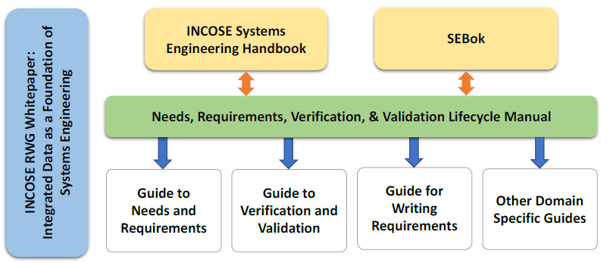
Upcoming RWG Products
The RWG has been working on new products and supporting development of other INCOSE publications
Currently in work:
Product | Product Lead/Lead Author
Guide for Writing Requirements | Mike Ryan
Guide to Needs Requirements | Tami Katz
Guide to Verification and Validation | Raymond Wolfgang
Inputs to the SE Handbook version 5 | Mike Ryan, Lou Wheatcraft
Inputs to the SEBok | Tami Katz
RWG Inputs
RWG Inputs
New
New
New
Updates
RWG Inputs

Slide 10
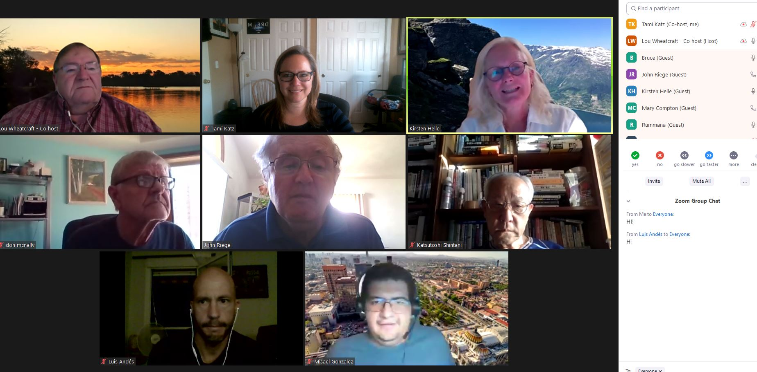
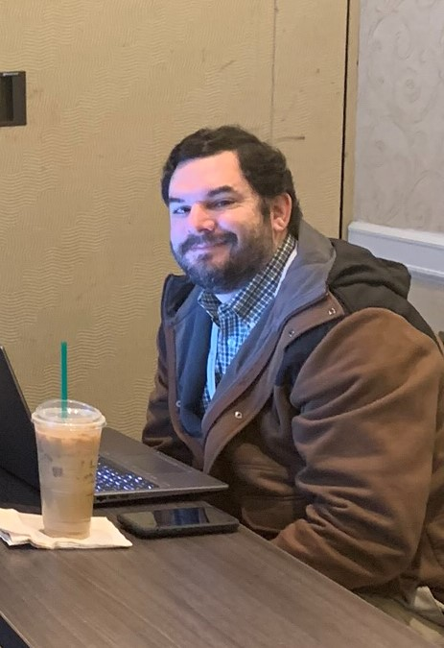
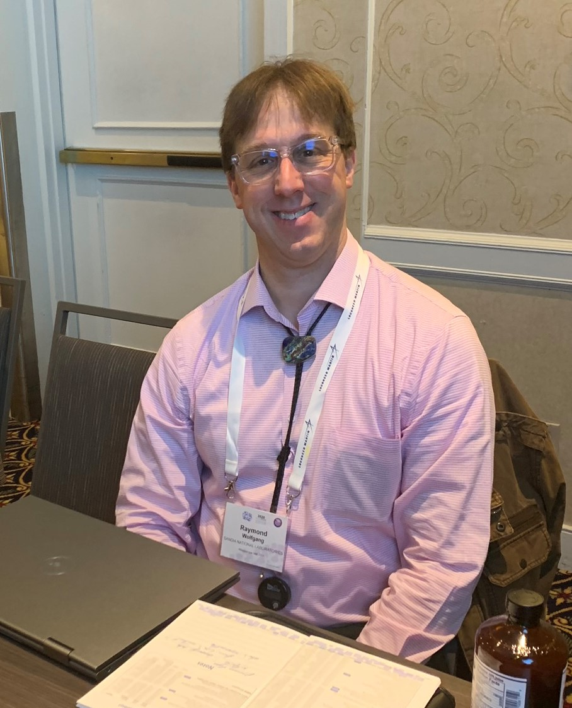
RWG Events
RWG engages the INCOSE community through regular events around the topic of Requirements Engineering
  Guest speakers on Requirements Topics
  RWG Exchange Cafés
RWG members contribute ideas towards topics discussed and are encouraged to share their experiences and questions with the broad working group community.

Slide 11
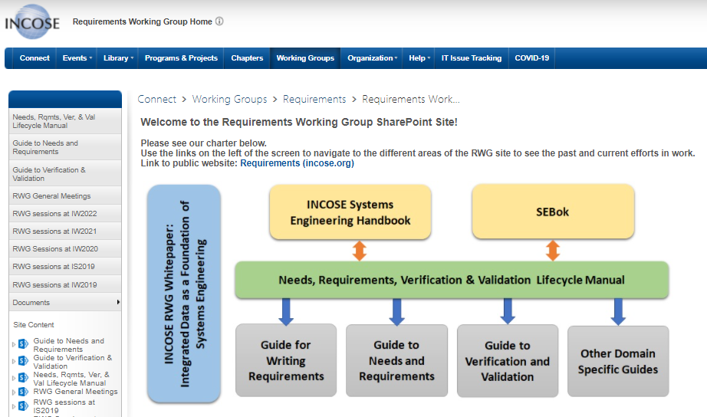
RWG Connect Site
Information about RWG meetings, products, and ongoing efforts are found on the INCOSE RWG Connect website, available to INCOSE members.
https://connect.incose.org/WorkingGroups/Requirements/Pages/Home.aspx

Slide 12
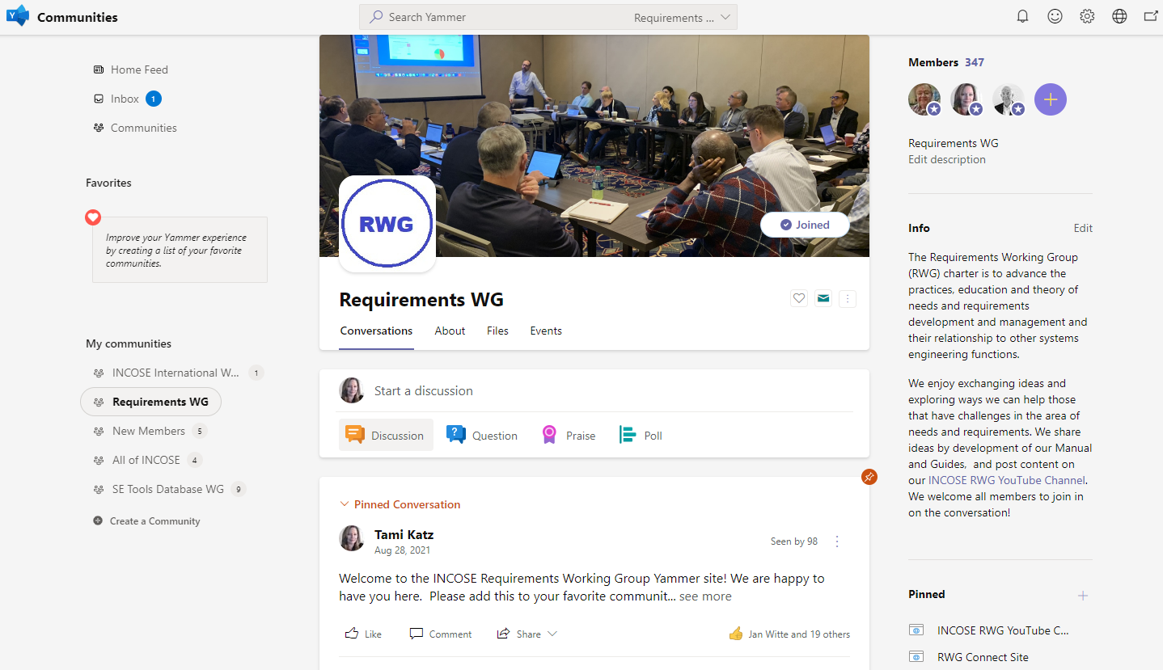
RWG Yammer Community
New in 2021! The INCOSE organization has established Microsoft platforms for INCOSE member engagement.
Upon obtaining the member login from the INCOSE CIO Barclay Brown, navigate to Communities (Yammer) and join the Requirements Working Group Community.
This platform enables more interactive announcements, questions, and discussions throughout the year!
Access to Communities is through the Microsoft Teams App, or the online Microsoft Teams site.

Slide 13
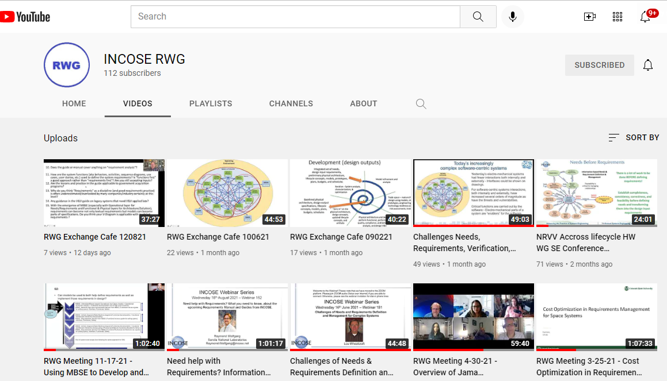
RWG YouTube Channel
New in 2021! The INCOSE RWG chairs have created a YouTube channel to post recordings of meetings and presentations to the broader community.
This is available to everyone that would like to catch up on events and learn more about the RWG efforts and products.
This is also available to non-INCOSE members as a method to attract interest in potentially joining INCOSE and the RWG and share good options to all that engage in needs and requirements efforts.
https://www.youtube.com/channel/UCadgYaqKWDckenP2SU8-cPw/playlists

Slide 14
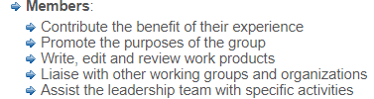
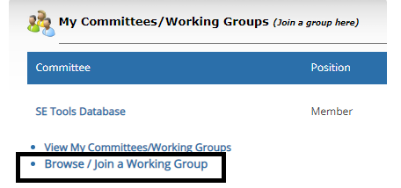
How to Become Involved in RWG
As a large working group, the RWG has been very active in virtual events as well as smaller product team efforts.
Joining the working group enables the members to learn about the products, provide opportunity to contribute (or review), and participate in the RWG virtual events with other practitioners.
Members can be very involved (product support) or minimally involved (watch meeting recordings), the intention is to enable all levels of participation and interaction.

Slide 15
INCOSE RWG 2021 Activities

Slide 16
INCOSE RWG Activities for 2021
The INCOSE RWG is an active working group with regular activities throughout the year, including:
  Regular Web Meetings, Speakers or Exchange Cafés
  INCOSE Webinars
    https://www.incose.org/products-and-publications/webinars
    Webinar 152: Need help with Requirements? What you need to know, about the upcoming Requirements Manual and Guides from INCOSE, 8/18/21
    Webinar 151: Challenges of Needs and Requirements Definition and Management for Complex Systems, 6/16/21
  CAB Interactions and Support
  Generation of new material for the new Manual and Guides
  Contribution to the Needs, Requirements, Verification and Validation content in the SE Handbook Version 5 updates
Additionally the RWG events at IW2021 were the first fully virtual workshop meetings, held over several days, which inspired the pre-meetings for this IW.

Slide 17
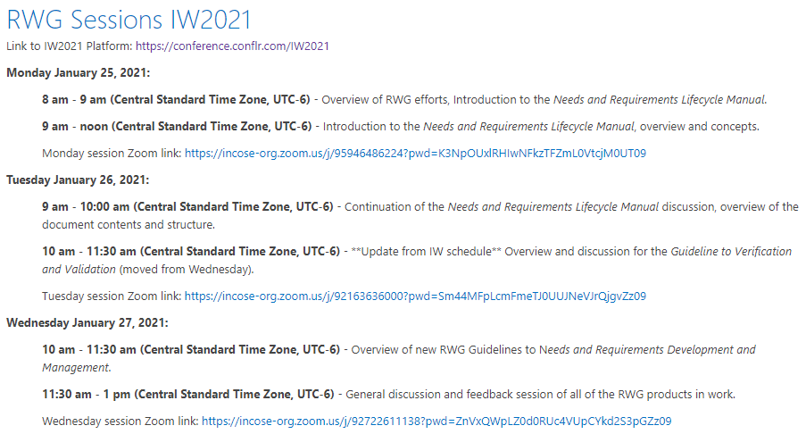
RWG IW2021 Recap
IW2021 was fully virtual, and the RWG held several meetings that enabled group discussions and engagement.
Primary focus was on the RWG Manual and Guidelines and obtaining feedback.
Presentations and links to video are at RWG sessions at IW2021 - Home (incose.org)

Slide 18
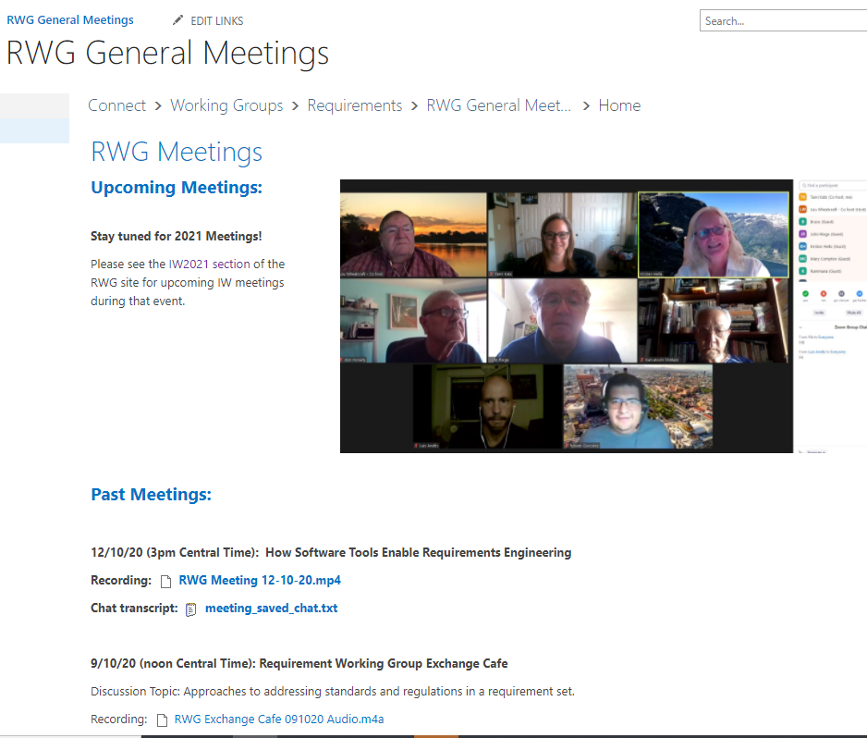
RWG 2021 General Web meetings
https://connect.incose.org/WorkingGroups/Requirements/RWGMeetings/SitePages/Home.aspx
2/25/21: Requirement Modeling for Early V&V (Brendan Hall and Don Ward)
3/25/21: Cost Optimization in Requirements Management (Tami Katz)
4/30/21: Overview of the Jama Requirements Tools (Cary Bryczek)
9/2/21: RWG Exchange Café, addressing questions on the NRVVLM concepts
10/6/21: RWG Exchange Café, addressing questions on the NRVVLM concepts
11/17/21: Using MBSE to Define and Validate Needs and Requirements (Luis Andes Olmedo)
12/8/21: RWG Exchange Café, addressing questions on the NRVVLM concepts
All meeting slides and recordings are on the RWG Connect Site, and recordings are on the RWG YouTube Channel

Slide 19
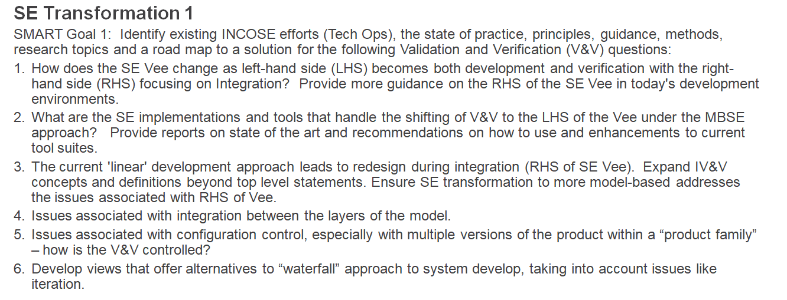
Corporate Advisory Board Support
RWG has supported the CAB initiatives to develop products in support of industry needs
Recently addressed aspects of CAB SMART Goal #1, Re-envisioning Verification & Validation with the release of the NRVVLM.

Slide 20
RWG IW2022 Activity Overview
Please note that our working group has established regular meetings and discussions throughout the year (open to all RWG members and guests), so the INCOSE IW is treated as a reflection point to share highlights and interesting content.
During our pre-IW2022 event, the RWG has planned several presentations to share information and enable discussions.
  With the Zoom platform, we encourage usage of the chat feature, as well as verbal questions during the presentations.
  This community has a lot of interest in hearing about new approaches and ideas, and we encourage the exchange of information during the sessions!
  Please use our Yammer Community to provide addition questions and interesting information during this event and throughout the year, as a way to keep these conversations going.
During the actual IW2022 event, the RWG will host a meeting on Sunday, 1/30/22, to enable in-person participation, and will have ability for virtual attendance for those that registered for the IW.
Note: Monthly presentations and Exchange Cafes will resume late February and occur throughout the year, as well as continued discussions on the RWG published products and concepts.

