Slide 1
2022 Year in Review
INCOSE Requirements Working Group
Permission granted to INCOSE to publish and use

Slide 2
INCOSE RWG Overview

Slide 3
RWG Charter
1
Purpose
Advance:
Practices, education, and theory of needs and requirements development and management
Relationship of needs and requirements to other systems engineering activities.
RWG is About…
How to improve the practice of systems engineering through excellence in needs and requirements development and management across the lifecycle
Learning from experiences and sharing with the SE community
Questioning approaches that yield poor outcomes
Publishing guidance and continuing research into requirements development and management, including the understanding of Needs, Requirements, Verification, and Validation
2
Goal
Expand and promote the body of knowledge of needs and requirements and its benefits within the systems engineering community
3
Scope
Activities relating to best practices throughout the product lifecycle including:
Elicitation, Analysis, Allocation, Traceability
Elaboration, Management
Change Management
Expression, Verification, Validation

Slide 4
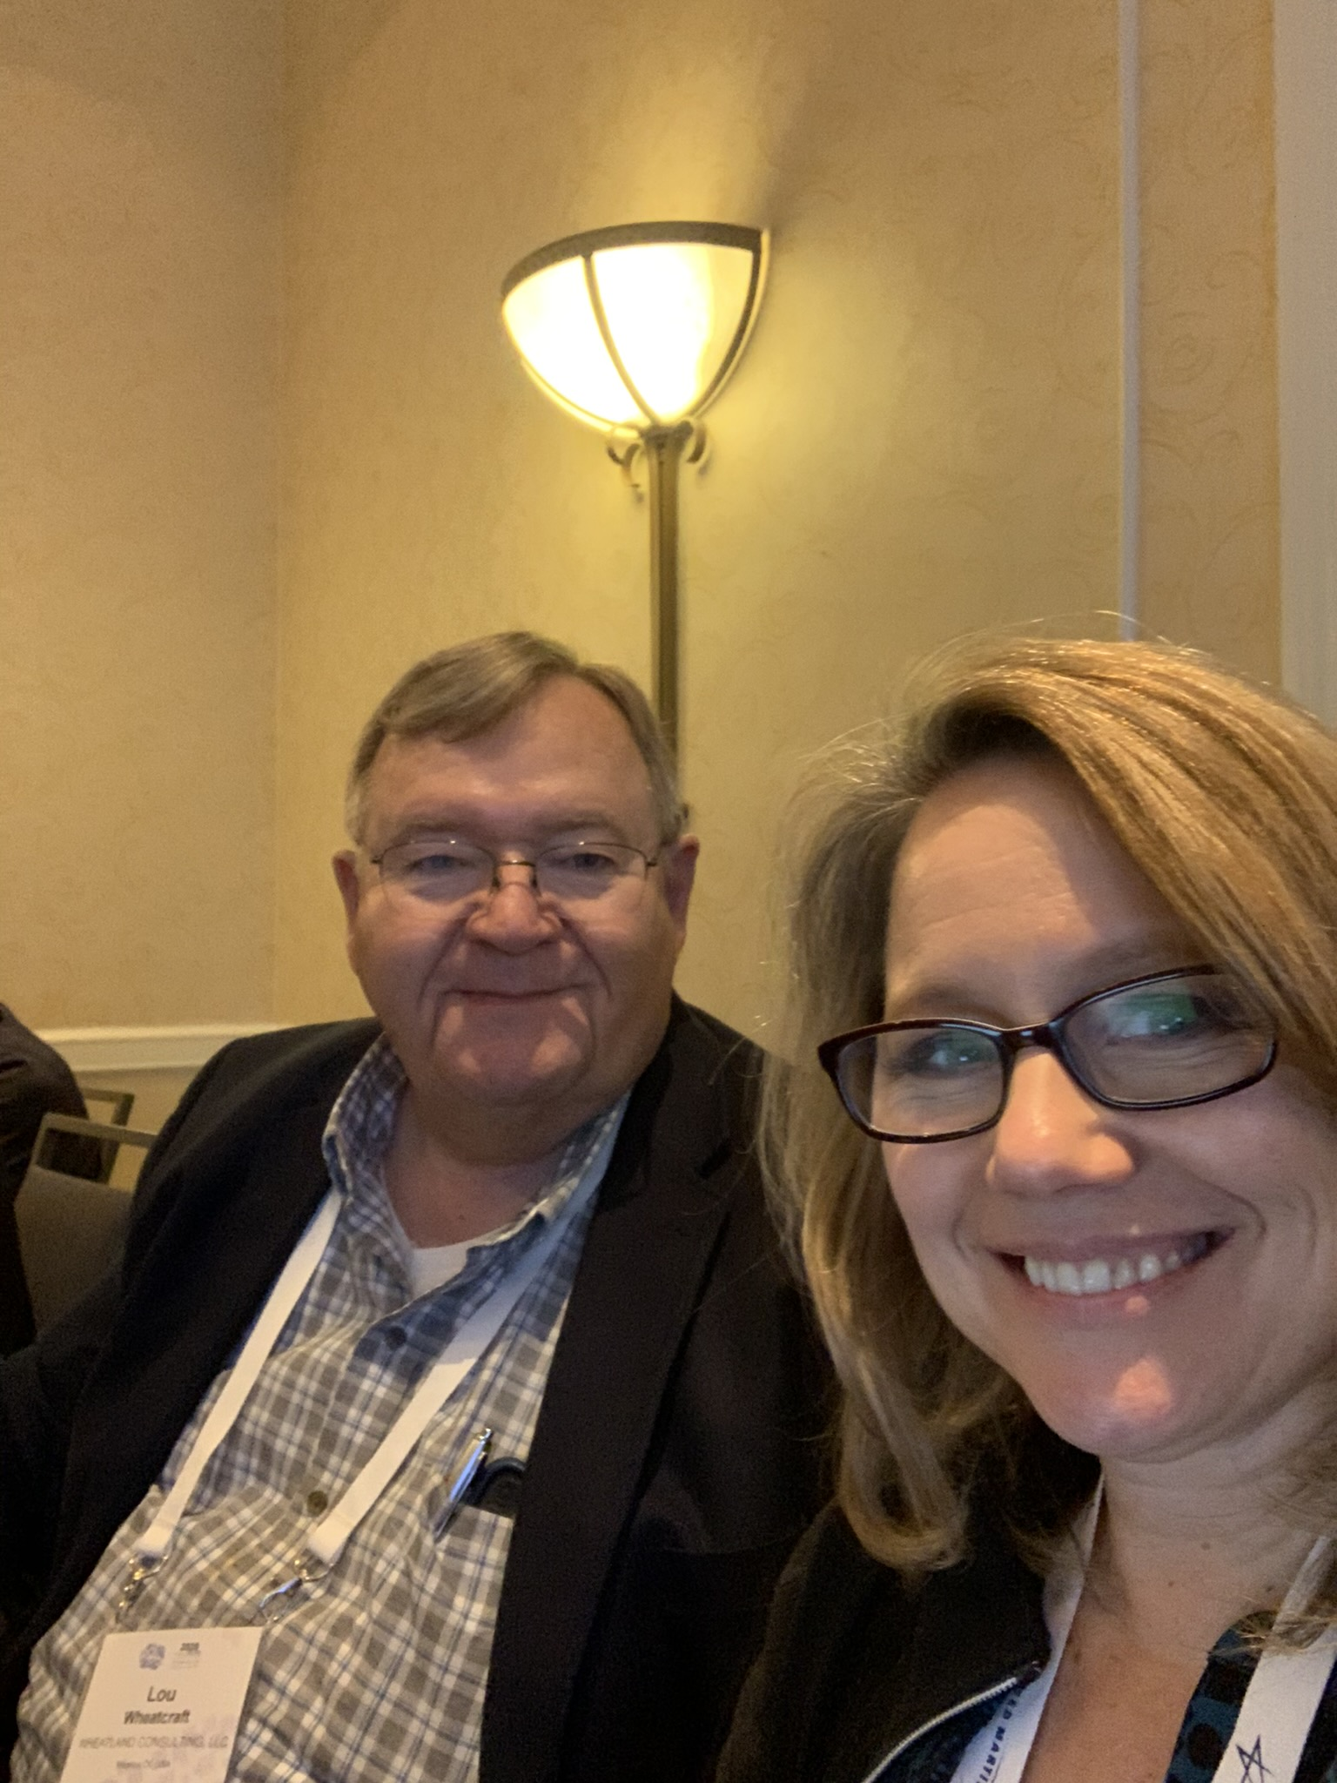
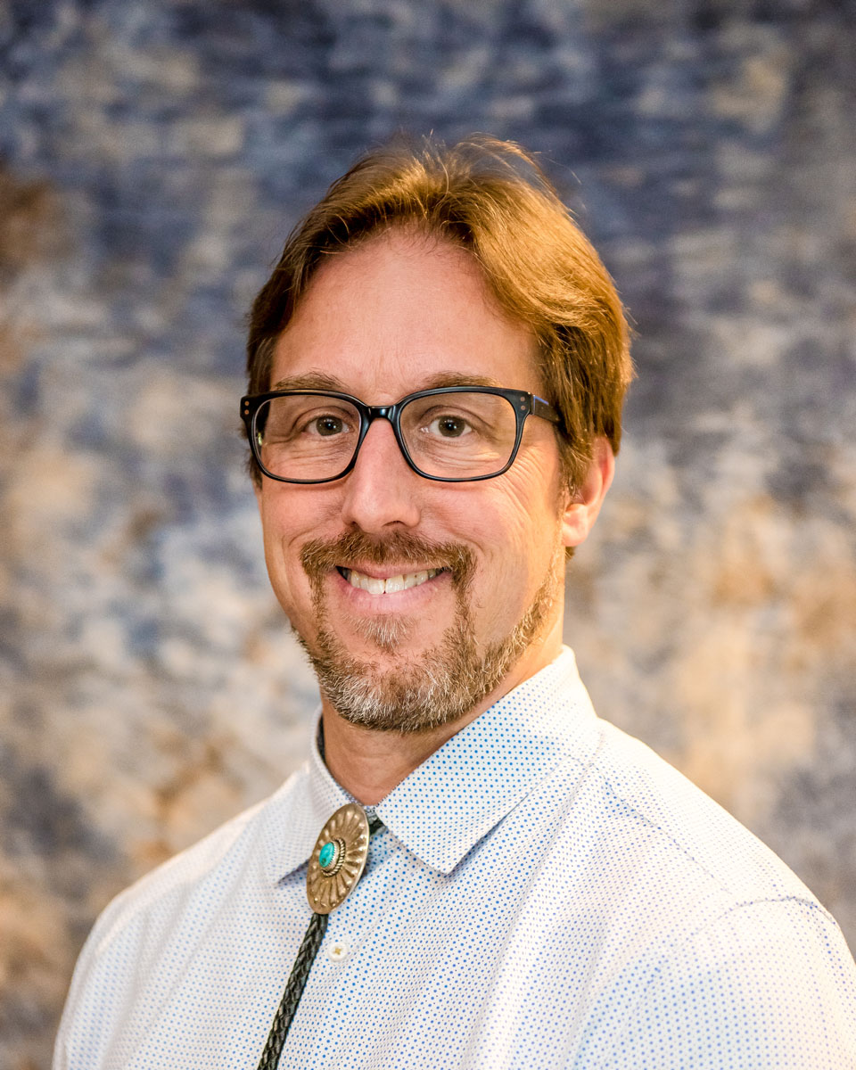
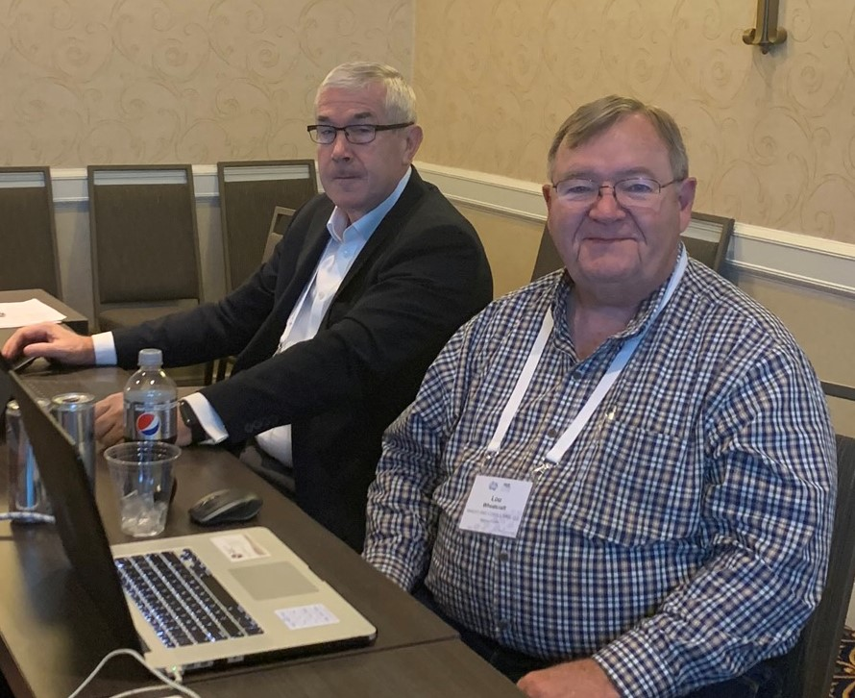
RWG Leadership
Chair: Tami Katz; Ball Aerospace, USA
Co-Chair: Lou Wheatcraft; Wheatland Consulting, USA
Co-Chair: Mike Ryan; Capability Associates Pty Ltd, AU
Co-Chair: Raymond Wolfgang; Sandia National Labs, USA
INCOSE Websites:
  https://www.incose.org/incose-member-resources/working-groups/process/requirements
  https://connect.incose.org/WorkingGroups/Requirements/Pages/Home.aspx
  https://www.youtube.com/channel/UCadgYaqKWDckenP2SU8-cPw
Number of Members: 423 (656 followers on Yammer), one of INCOSE’s largest WG
The RWG is comprised of members from industry and academia with a common purpose of improving the practice of systems engineering through improvement of Needs and Requirements development and management across the system lifecycle.

Slide 5
Our Philosophy - Looking Towards the Future
We fully support the Future of SE (FuSE) Initiative
We fully support moving toward INCOSE’s Vision 2035
“Our situation is not comparable to anything in the past. It is impossible, therefore, to apply methods and measures which at an earlier age might have been sufficient. We must revolutionize our thinking, revolutionize are actions……..”
Albert Einstein (1948) in “A Message to Intellectuals”

Slide 6
Need for Continuous Evaluation
“….it’s remarkable how many industries and government agencies are still operating on ancient (as in 1990s) technology, [just] muddling through.”
“... what happens when those organizations take off their old-tech handcuffs? They will run better and develop new capabilities they never had before. Customers, workers, and investors will all benefit.”
“Humans have a comparative advantage at higher levels of abstraction: creativity, intuition, and holistic judgements. Each is necessary. The best technologies do not automate complex problems, as many assume; they equip people to solve them faster and more effectively.”
From “Technology Rules” by John Mauldin
https://www.mauldineconomics.com/frontlinethoughts/technology-rules
We are 23 years into the 21st Century, why are so many still practicing system engineering based on outdated 20th Century electro/mechanical, document-centric methodologies?
www.incose.org/IW2023

Slide 7
Change or Risk Becoming Irrelevant
“Several INCOSE dignitaries have been warning since about 2013 that if INCOSE did not take the lead to quickly understand software and start leading in software-intensive systems, INCOSE would be at risk of becoming irrelevant.”
(Roedler 2018, Stoewer 2017).
“If the rate of change on the outside exceeds the rate of change on the inside, the end is near,” as support to the idea that INCOSE’s rate of change must increase to match the rate of change in industry and the rapidly evolving technology universe. (quote attributed to Jack Welch of GE)
This applies equally to organizations practicing Systems Engineering!
S. Sheard, M. Bouyaud, M. Osaisai, J. Siviy, K. E. Nidiffer; A Guide for Systems Engineers to Finding Your Role in 21st-Century Software-Dominant Organizations, Technical Paper presented at IS2021

Slide 8
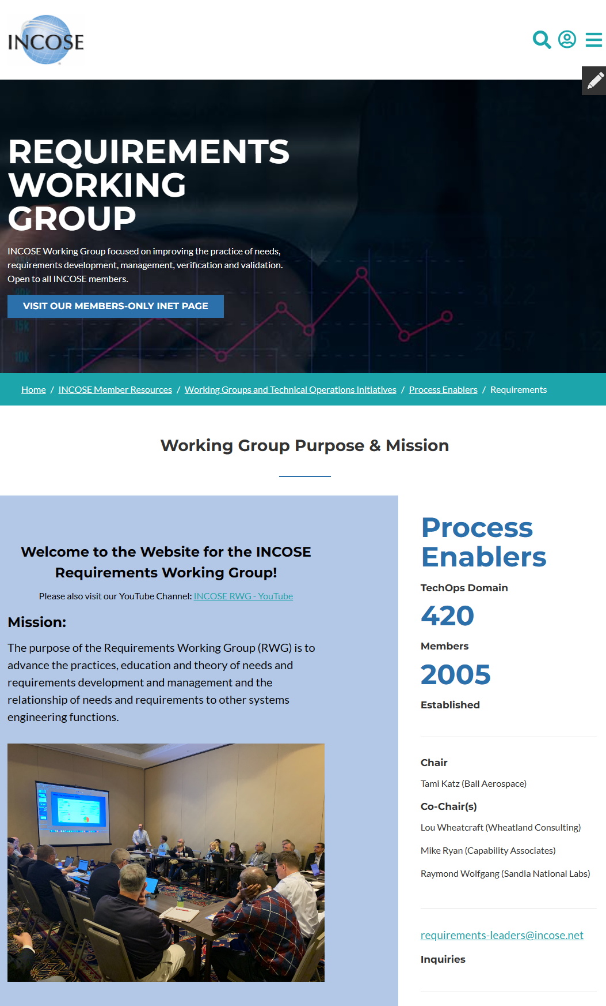
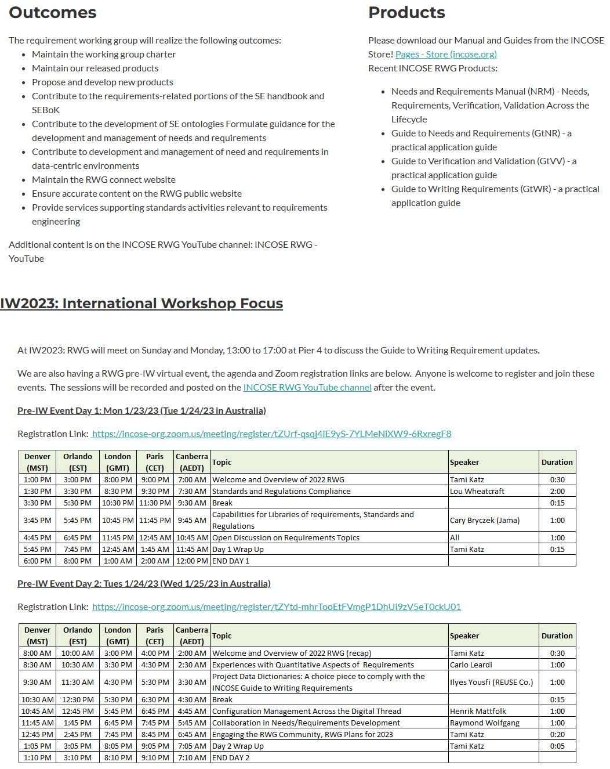
INCOSE RWG External Website
The RWG maintains an external website (no INCOSE membership needed to view)
Information on upcoming meetings and in work activities is provided.
Anyone interested in participating in requirement working group data share is welcome to use this site to stay informed and obtain links to content.
https://www.incose.org/incose-member-resources/working-groups/process/requirements

Slide 9
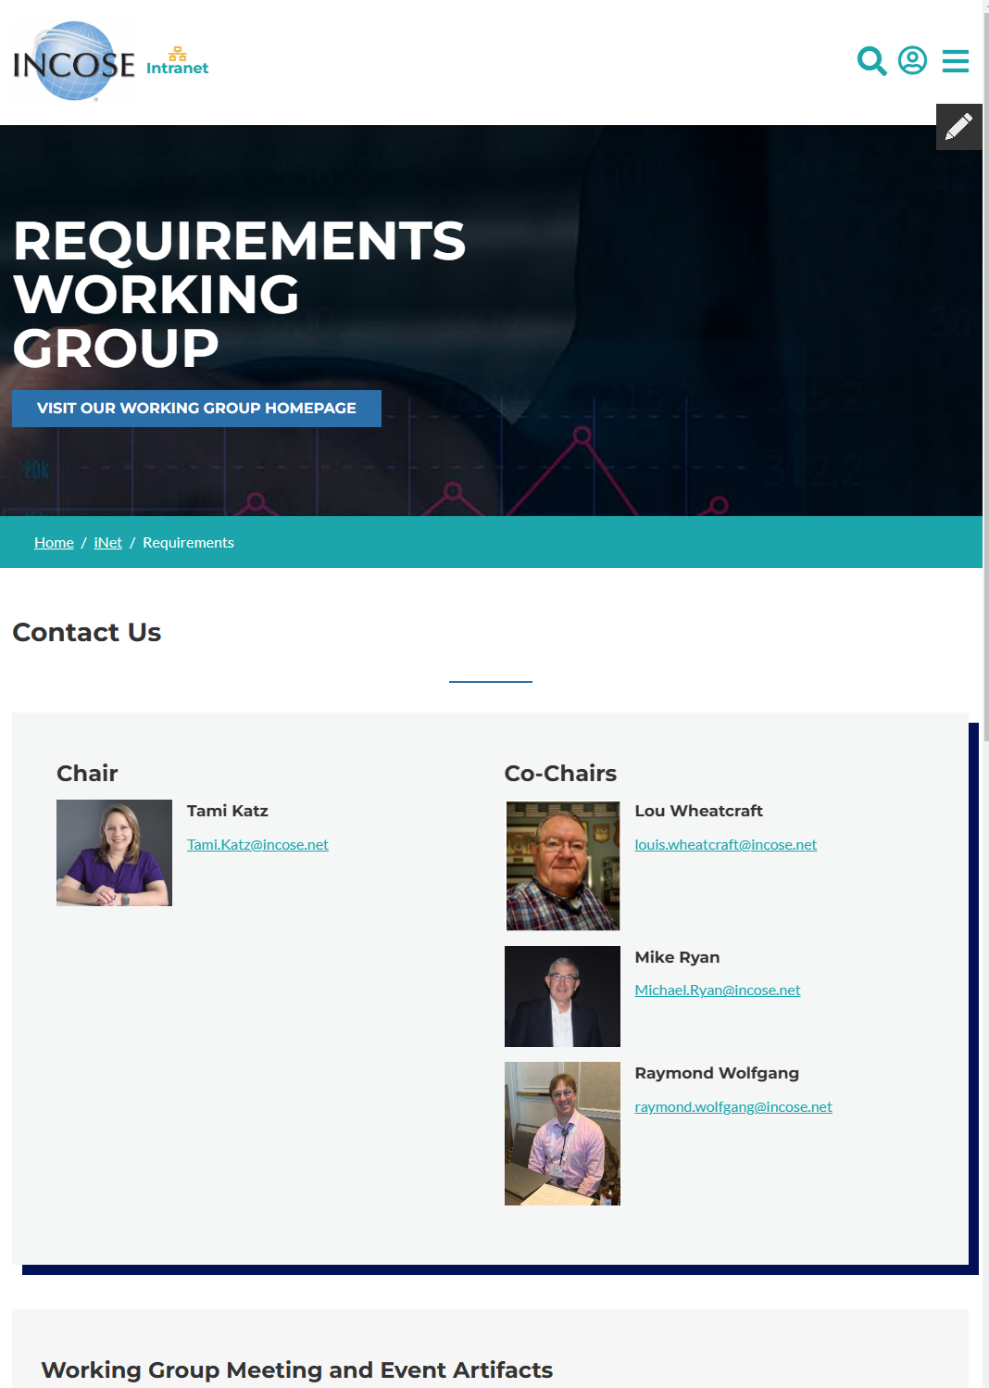
INCOSE RWG Internal Website (iNet)
The RWG is using the new “iNet” intranet sites for member only resource
Information on upcoming meetings and work in effort is provided as well as additional, member-only content.
IW2023 material and presentations will be provided on this platform.
The Connect sites are being retired and no longer utilized for INCOSE working group communication.
https://www.incose.org/inet/working-groups/requirements

Slide 10
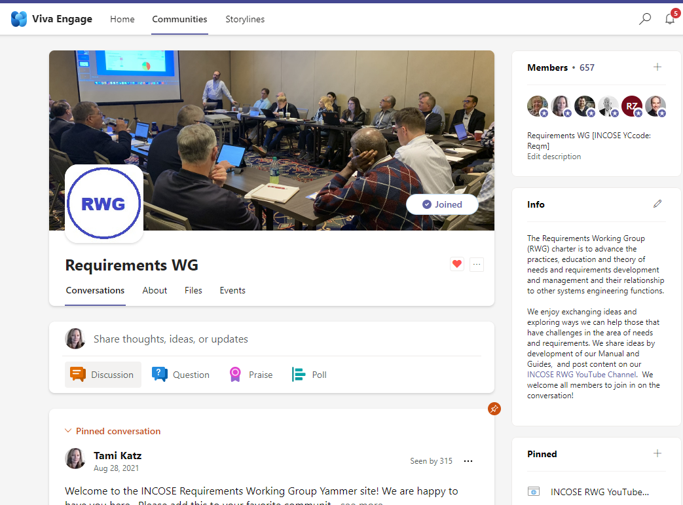
RWG Yammer Community
The INCOSE organization has established Microsoft platforms for INCOSE member engagement.
Upon obtaining the member login from the INCOSE CIO Barclay Brown, navigate to Communities (Yammer) and join the Requirements Working Group Community.
  May also be called Viva Engage on the App
This platform enables more interactive announcements, questions, and discussions throughout the year!
Access to Communities is through the Microsoft Teams App, Yammer App (iOS), or the online Microsoft Teams site.

Slide 11
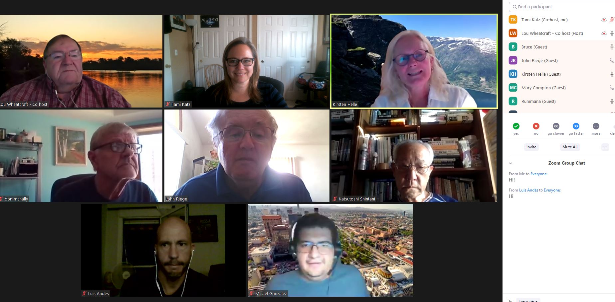
RWG Outreach Events
RWG engages the INCOSE community as well as the larger SE community through regular events around the topic of Needs and Requirements.
  Guest speakers on Requirements Topics
  RWG Exchange Cafés
Open to INCOSE members and non-members.
RWG members contribute ideas towards topics discussed.
Attendees are encouraged to share their experiences and questions with the broad working group community.

Slide 12
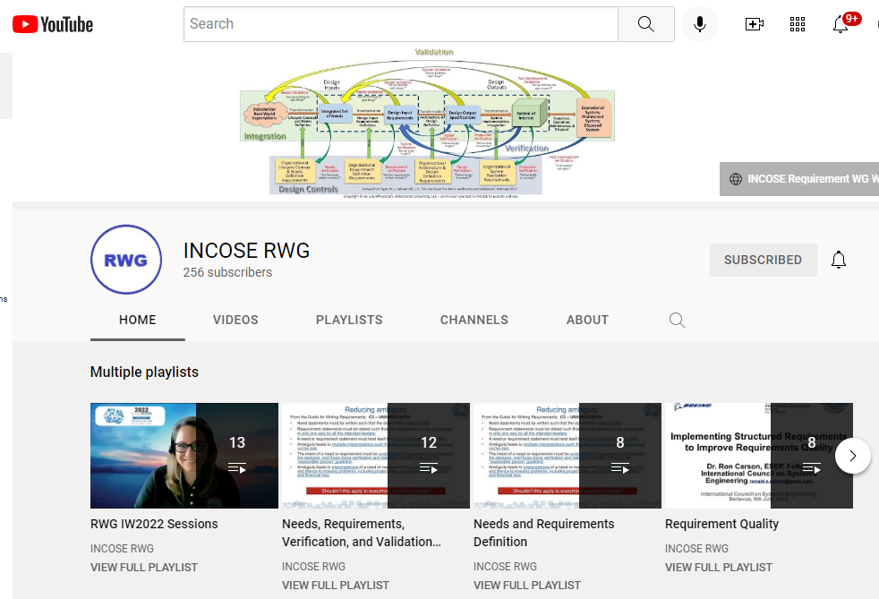
INCOSE RWG YouTube Channel
YouTube channel has recordings of meetings and presentations to the broader community.
Available to everyone to catch up on events and learn more about the RWG efforts and products.
Also exists to attract interest in joining INCOSE and the RWG and share wisdom, experience, and ideas with all that engage in needs, requirements, verification, and validation activities.
https://www.youtube.com/channel/UCadgYaqKWDckenP2SU8-cPw/playlists

Slide 13
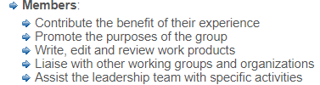
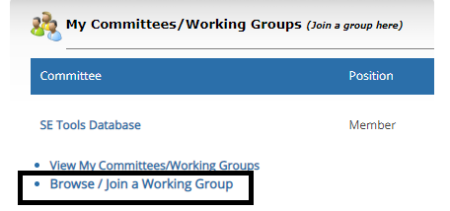
How to Become Involved in RWG
As a large working group, the RWG has been very active in virtual events as well as smaller product team efforts.
Joining the working group enables the members to learn about the products, provide opportunity to contribute (or review), and participate in the RWG virtual events with other practitioners.
Members can be very involved (product support), involved in our monthly meetings, or minimally involved (watch meeting recordings) - the intention is to enable all levels of participation and interaction.

Slide 14
RWG 2022 Activities

Slide 15
RWG Products

Slide 16
RWG Product Tree
The RWG released multiple new products and supported the development of other INCOSE publications (e.g., SE HB v5)
RWG Inputs Provided
RWG Inputs Needed
V1.1 Released
V1 Released
V1 Released
V 3.1 Released
RWG Inputs In work

Slide 17
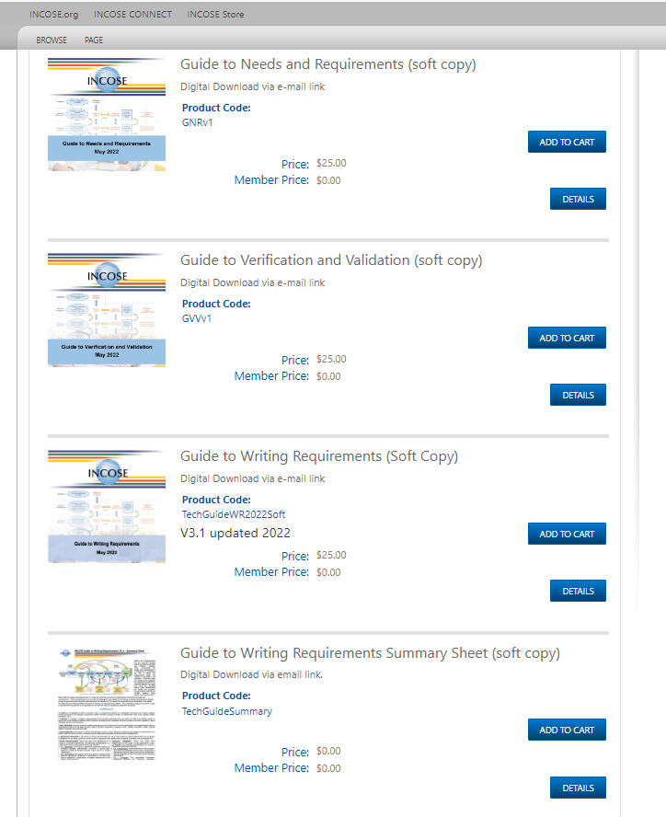
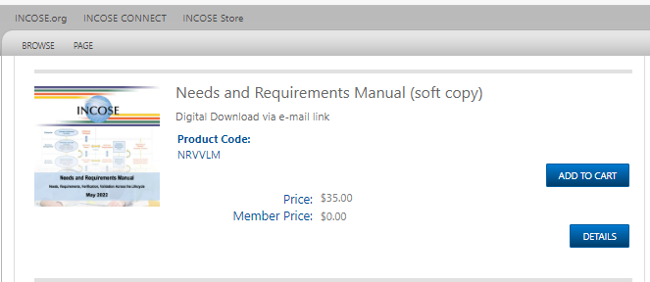
RWG Products are in the INCOSE Store!
RWG Products are released in the INCOSE Store!
Free to INCOSE members
All are encouraged to download and start using, feedback is welcome!

Slide 18
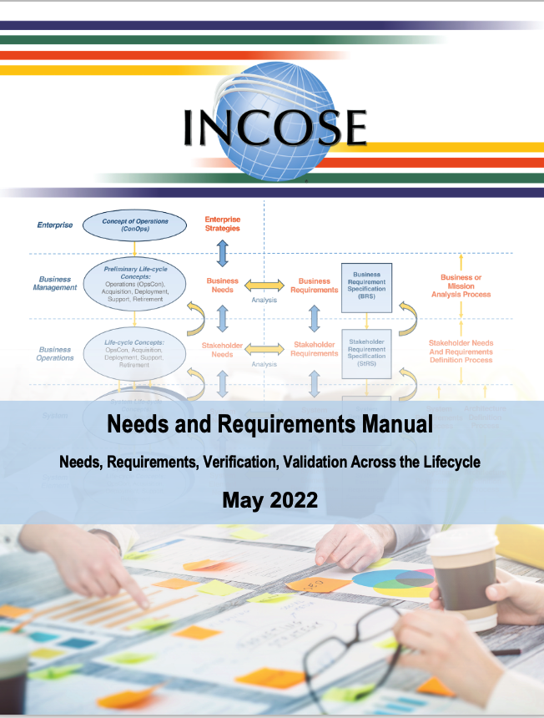
Needs and Requirements Manual (NRM)
The NRM (was NRVVLM) is the RWG flagship product, V1 released in January 2022 for IW2022
V1.1 minor updates in May to shorten title, add subtitle, and align with other RWG products
Content from this aligns with, and expands, the INCOSE SE Handbook version 5 material.

Slide 19
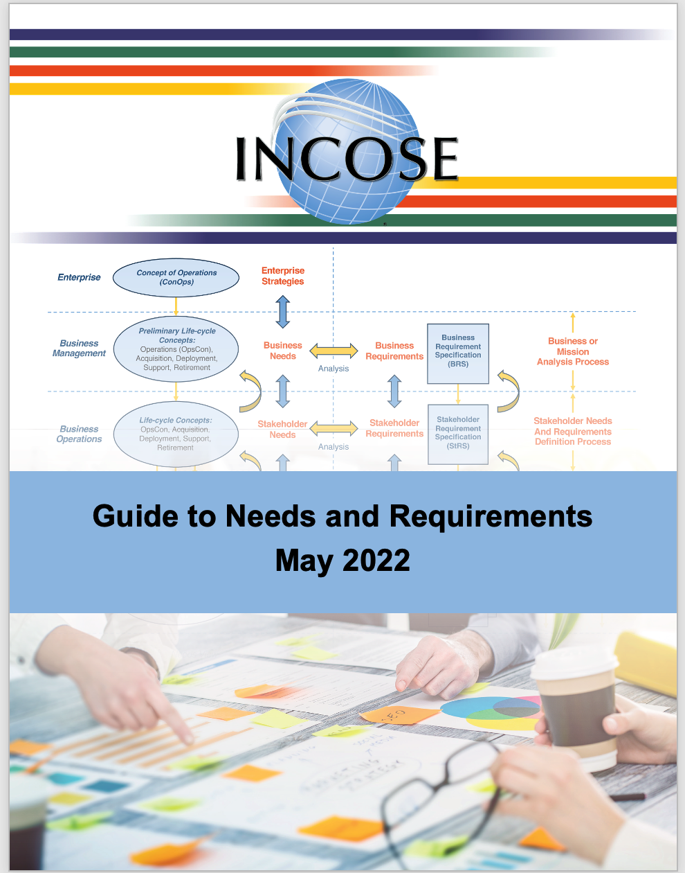
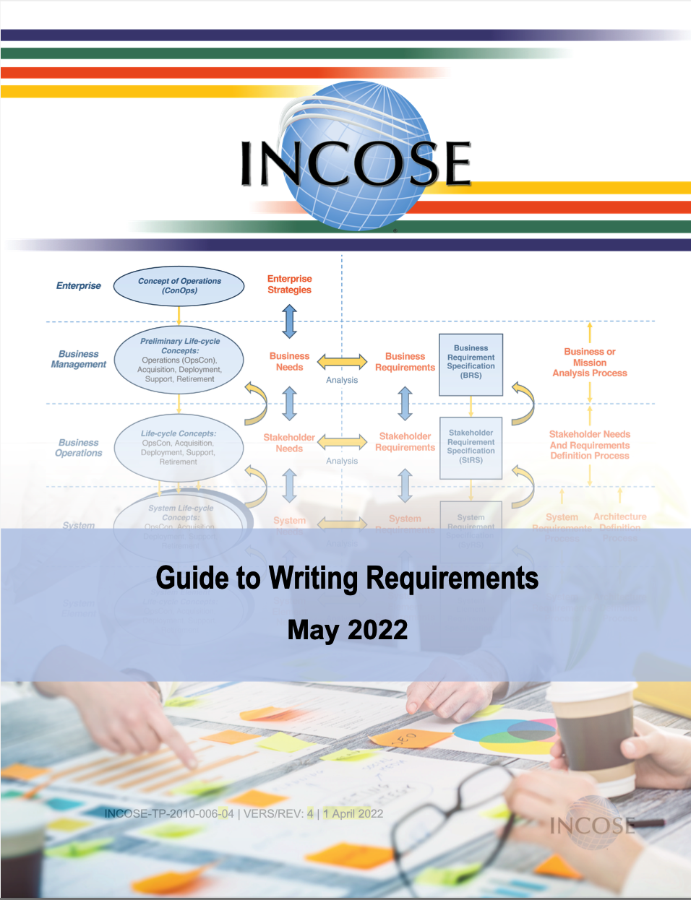
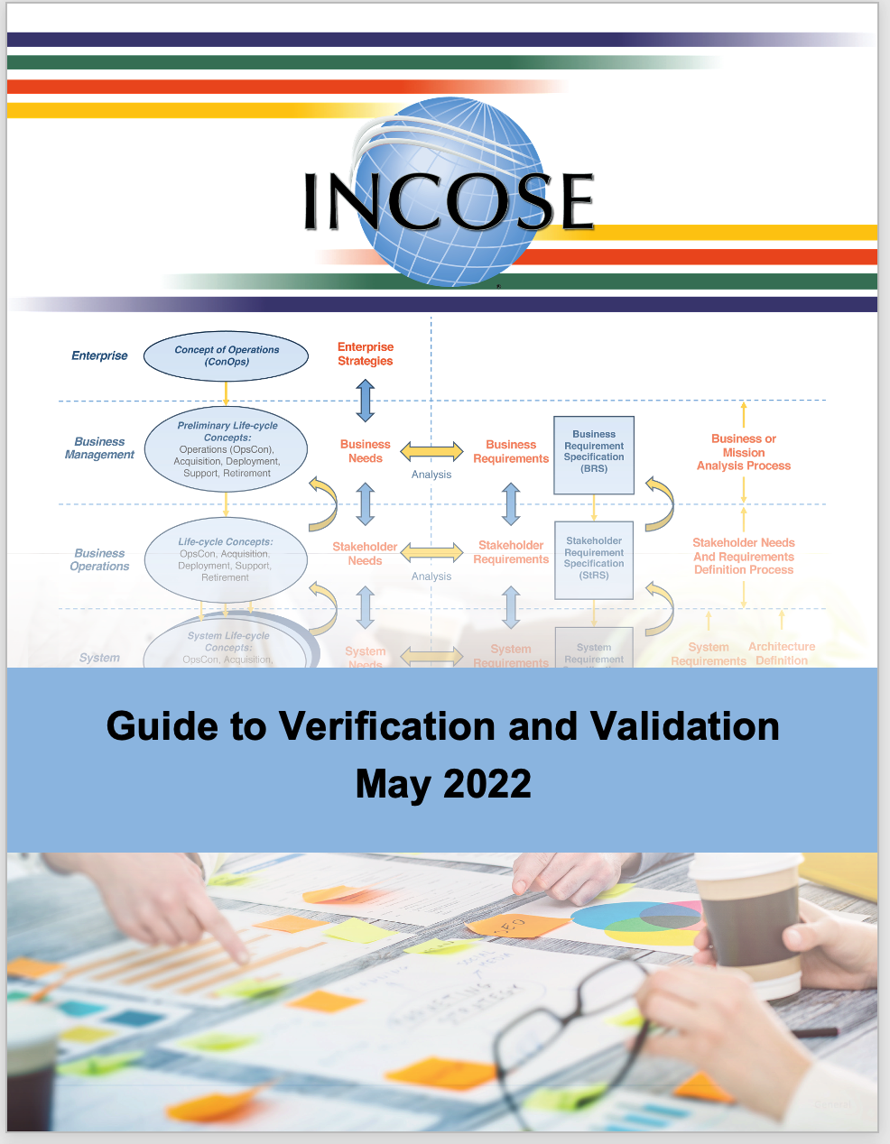
The RWG Guides Provide Practical Application of the NRM

Slide 20
Relationships
1: Introduction
2: Definitions and Concepts
3: Information-Based Needs & Requirement Development and Management
4: Lifecycle Concepts & Needs Definition
5: Needs Verification & Needs Validation
6: Design Input Requirements Definition
7: Design Input Requirements Verification & Validation
8: Design Verification & Design Validation
9: Production Verification
10: System Verification & System Validation Common Principles
11: System Verification & System Validation Processes
12: The Use of OTS System Elements
13: Supplier Developed SOI
14: Needs, Requirements, Verification, & Validation Management
15: Attributes for Needs &Requirements
16: Features an SE Toolset Should Have
Appendix A: References
Appendix B: Acronyms and Abbreviations
Appendix C: Glossary
Appendix D: Comment Form
1: Introduction
2: Verification & Validation Common Principles
3: Needs and Requirements Verification & Validation Process
4: Design Verification & Validation Process
5: Production Verification
6: System Verification & Validation Processes
7: Use Of Off-The-Shelf Parts, Supplier Developed System Elements, & The Supplier-Customer Relationship
8: Needs, Requirements, Verification, & Validation Management
9: Conclusion
Appendix A: Acronyms
Appendix B: Glossary
Appendix C: References
1: Introduction
2: Needs Definition, Verification, & Validation
3: Requirements Definition, Verification, & Validation
4: Needs & Requirements Management
Appendix A: Acronyms & Abbreviations
Appendix B: Needs and Requirements Definition & Management Plan Content
Appendix C: Needs Elicitation Questions
Appendix D: Checklists
Appendix E: References
Appendix F: Comment Form
GtNR
(120 pgs.)
NRM
(457 pgs.)
GtVV
(109 pgs.)

Slide 21
YouTube Presentations
For a more detailed overview of the NRM, GtNR, GtVV, and GtWR you can watch the following videos:
  NRM (NRVVLM) overview (IW2022): https://youtu.be/ypgGHHaLbqI
  NRM and GtNR “Lifecycle and Needs Definition”
  https://youtu.be/hEGfNLvuyXo
  Underlying Concepts (IW2021): https://youtu.be/ZRli_wSCmRg
  GtNR and GtVV Overview (IW2022): https://youtu.be/Uy5oZmneJM0
  GtWR Overview:
  https://youtu.be/27k--0stAiM

Slide 22
Collaboration with other WGs

Slide 23
System Security Engineering (SSE) WG
As our world becomes increasingly digital, the issue of security also known as cybersecurity is a factor that the systems engineer practitioner needs to consider and understand.
Both hardware and software systems are increasingly at risk for disruption or damage caused by threats taking advantage of digital technologies.
Security through systems security engineering (SSE) when properly integrated into SE, provides the needed complementary engineering capability that extends the notion of trustworthiness to deliver trustworthy secure systems.
The SE should understand the basic systems engineering and system life cycle processes and how they are impacted by the needs for organizational mission and/or business security needs including stakeholder protection needs and security requirements.
The RWG products mention security as an important consideration but provides no guidance in the context of defining security related needs and requirements nor verification the requirements were met nor validation the needs have been met.
Show how the concepts and activities discussed within the RWG products work within the Cyber Resiliency Engineering Framework, cyber resiliency wheel, criticality analysis, and other techniques the SSE WG are trying to elevate for security requirements analysis.

Slide 24
Key Points from the RWG/SSE Sessions:
SSE is a critical area that all SEs must be aware and address, both customers and suppliers, no matter the type of system.
SSE is really about loss protection, prevention, and recovery.
SSE is a lot more than just IT.
While the cost and time to deal with loss may seem to be problematic, the cost of not doing so will be much more expensive in the long run.
SSE is closely linked to safety and resilience and are merging together. Many losses have a direct safety consequence.
SSE applies across the lifecycle, not just during use.
SSE must be built in from the beginning, not just added on at the end as an after thought.
In addition to the standard use cases and operational scenarios, mis-use cases, and loss scenarios must be addressed. What are the threats and what loss can users and customers not tolerate? The likelihood and impact of these losses are risks to the organization that must be addressed.
Lifecycle concepts concerning protection, prevention, and recovery must be defined and needs of those affected by the loss must be defined against which the System of Interest (SOI) will be validated against. The integrated set of needs and resulting requirements will not be complete unless the SSE needs and requirements are included.
Requirements to address these needs must be in the form of functional/performance requirements that the SOI can be verified against. These design input requirements address the capabilities needed to be provided by the system to prevent, protect, and recover from loss.

Slide 25
System of Systems (SoS) WG
A System of Systems (SoS) is a set of systems or system elements that interact to
provide a unique capability that none of the constituent systems can accomplish on its own.
Constituent systems can be part of one or more SoS.
Each constituent is a useful system by itself, having its own development, management goals and resources, but interacts within the SoS to provide the unique capability of the SoS.
Challenges
  Each system has its own owner, stakeholders, users, needs, processes, & development approaches.
  Lack of common leadership and funding
  Each system has a specific purpose of its own, but are being leveraged as part of the SoS
  SoS purpose, stakeholders, constraints, needs, and requirements may conflict with individual constituent systems purpose, stakeholders, constraints, needs, and requirements.
  Constituent systems may continue to change independently from the SoS
  SoS verification and validation against the SoS needs and requirements is difficult
  Emerging properties and behavior of the integrated SoS is difficult to predict and if issues occur which constituent system contributed and how the issue be resolved given their independence.
  System Security of the SOS is dependent on the system security of the constituent systems.
Identified the Need for a practical SoS guide mapping SoS standards to the activities discussed within the RWG products.

Slide 26
Configuration Management (CM) WG
Collaborated on a paper regarding Traceability that has been submitted for presentation at IS2023.

Slide 27
RWG 2022 Events

Slide 28
RWG 2022 Completed Events
November 16: RWG Exchange Café – Beth Wilson - System Security Guide vs NRM, GtNR, GtVV
  Recording: https://www.youtube.com/watch?v=IVdICwMF8Uc
October 26: Presentation by Beth Wilson – System Security Challenges
  Recording: https://www.youtube.com/watch?v=GV2_qFZFe6g
September 28: RWG Exchange Café – General discission focusing on interfaces
  Recording: https://www.youtube.com/watch?v=pJlH6nj2TzM
August 24: RWG Exchange Café – Beth Wilson - SoS Guide vs the NRM, GtNR, GtVV
  Recording: https://www.youtube.com/watch?v=FsDVci-zl2s
July 20: RWG Exchange Café – Beth Wilson - Systems of Systems (SoS) challenges.
  Recording: https://www.youtube.com/watch?v=_CfOKVDyjWQ
June 28: IS2022 Hybrid Event
  Recording: https://youtu.be/lz0TvNdZgfI

Slide 29
RWG 2022 Completed Events
May 25, 2022 - RWG Exchange Café - Cary Bryczek - Demonstrating SE Value Using Traceability Measurement
  Slides: INCOSE RWG Jama Software Measurement May 2022.pdf
  ​Recording: https://youtu.be/GSpQdachXZU
April 27, 2022 - RWG Exchange Café – General discussion addressing the Operational Environment
  Slides: RWG Exchange Cafe 042722.pdf
  ​Recording: https://youtu.be/Ei81HLUxxAE
March 24, 2022 – Presentation by Mark Eggler “Using Model-Based Systems Engineering Techniques to support Requirements Generation for the Design of New Generation Armored Combat Vehicle Systems” Slides: Presentation-INCOSE-MBSE in Combat Vehicle Design-1hr-Mar 22-v1.0.pdf​
  Recording: https://youtu.be/bMtoDvsKB84​​
February 23, 2022 - RWG Exchange Café – Lou Wheatcraft - NRM Overview and Q&A.
  Recording: https://youtu.be/HZo2jR-zDFY
January 25-30, 2022 – RWG hybrid sessions at IW2022
  Playlist of Recordings: https://www.youtube.com/watch?v=IM0eR8P3ixc&list=PLVfZ7HbxxzBXTd8vieYUbHU-RCYTSfbcS
  13 presentations and sessions in the playlist.

Slide 30
Other Presentations Added to the RWG
YouTube Channel in 2022:
September 30, 2022: “Everything You Wanted to Know About Interfaces but Were Afraid to Ask!”
  Presentation given by Lou Wheatcraft to the CSU Graduate Requirements Class in November 2021
  Recording: https://youtu.be/7qcoSeBEJ5Y
September 15, 2022: “Guide to Writing Requirements (GtWR) Overview”
  Presentation given by Lou Wheatcraft to the graduate class at Colorado State University Requirements Class
  Recording: https://youtu.be/27k--0stAiM
August 9, 2022: “Achieving Designs that Satisfy Stakeholders Through Better Requirements”
  Presentation given by Tami Katz to the INCOSE LA Chapter
  Recording: https://youtu.be/YVtchkhpDFE
July 28, 2022: “These are our Needs - Make it Happen!”
  Presentation given by Lou Wheatcraft to the Clearlake/Galveston Project Management Institute (CLG PMI) Chapter
  Recording: https://youtu.be/YdbZk_zK6H0
March 17, 2022: “Lifecycle Concepts and Needs Definition”
  Presentation given by Lou Wheatcraft to the ChicagoLand INCOSE Chapter providing an overview of Section 4, Lifecycle and Needs Definition, of the Needs and Requirements Manual (NRM) and Section 2 of the Guide to Needs and Requirements.
  Recording: https://youtu.be/hEGfNLvuyXo

Slide 31
Questions and Discussion

