Slide 1
2023 Planned Activities
INCOSE Requirements Working Group
Permission granted to INCOSE to publish and use

Slide 2
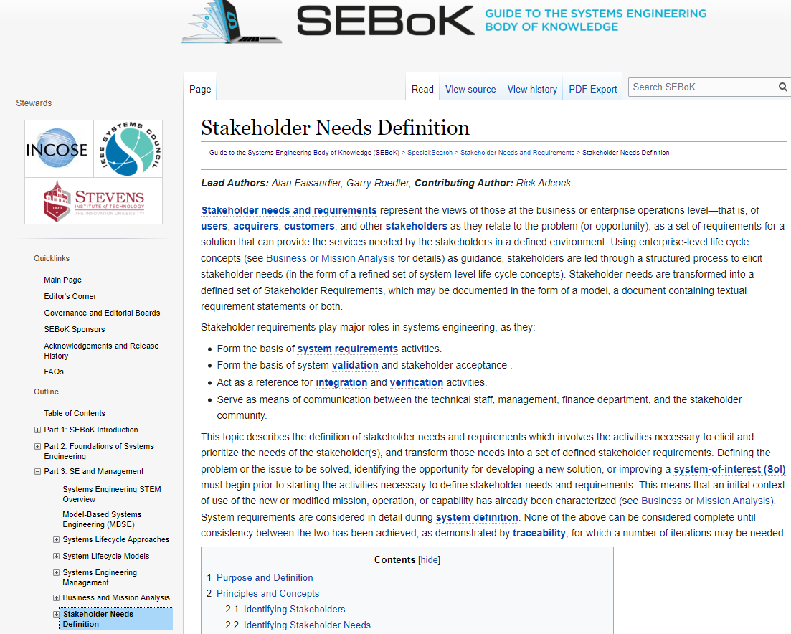
Update of SEBoK
With updates to RWG material, we plan to ensure alignment of the SEBoK with the concepts in the NRM.
Tami and Khadijha Stewart are scrubbing material on the SEBoK related to Needs, Requirements, Verification, Validation to propose updates for alignment of concepts and nomenclature.
Example presented here ->

Slide 3
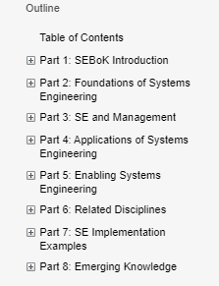
Update of SEBoK - Methodology
As the SEBoK is a large collection of topics, the task would include navigation to various pages and usage of the search function.
Tami will submit updates/markups by working with the INCOSE SEBoK leads.
Objective is to have this done by IS2023.
Other volunteers are welcome!
SEBoK (sebokwiki.org)

Slide 4
GtWR V4
The RWG plans to continue to evolve the GtWR.
Planning for a V4 to be released by IS2024 (TBD).
We need suggestions from the INCOSE community concerning future updates.
In Fall 2022, we asked all RWG members to do a detailed review of V3.1 and provide comments (typos, errors, further elaboration, more examples, ideas for improving the Guide.)
We have received multiple review comments to date.
These are being incorporated
We have a draft V4 ready for IW2023
We are planning another review cycle after IW2023
We will have IW2023 sessions dealing with the GtWR.
Focus on concepts discussed in Section 1
Detailed discussion on the Characteristics discussed in Sections 2 & 3.

Slide 5
NRM V2
INCOSE is under contract with Wiley to publish the NRM.
We used 2022 v1 and v1.1 to get feedback based on actual use
Response has been very positive
e.g., “The NRM has been a godsend for my organization!”
If you have any comments, please provide them to us ASAP.
Following IW2023, we will start making changes/updates based on comments received to date
Will carry across applicable changes to the GtWR to keep both documents in sync.

Slide 6
Continue Collaboration with Other Working Groups
System of Systems (SoS) WG
System Security Engineering (SSE) WG
Configuration Management (CM) WG

Slide 7
Upcoming RWG Meetings for 2023
January 2023
IW 2023 RWG pre-event sessions – Monday and Tuesday before IW
IW 2023
Two General RWG sessions scheduled
Collaboration sessions also planned with the leadership of two other WGs
See IW 2023 schedule for specific dates, times, and location.
Rest of 2023
Specific RWG Exchange Café monthly sessions and guest presentations
Currently seeking ideas for topics.
Please send an email with ideas for topics and/or if you have a topic you would like to present to Requirements-leaders@incose.net

Slide 8
Questions and Discussion

