Slide 1
Systems of Systems Working Group
Business Meeting

Slide 2
SoSWG At IW24
Software InterfaceWorking Group (SaSIWG)
Sunday, January 28 - 1-5: Working session on approaches to SoS Engineering
The current SEBOK SoS knowledge area focuses on broad discussion of systems of systems (SoS) characteristics and systems of systems (SoS) challenges. When we look at progress which has been made in the last few years, it is time for a revision and a new focus on approaches to addressing SoS. This session will provide a venue for SoSWG members to share approaches they have implemented, and their lessons learned. The results of this session will provide input to the update of the SEBOK.
Monday, January 29: 9:30-12: SoSWG Business Meeting
This meeting will review the status and plans for current activities of the SoSWG and open discussion of possible new initiatives.

Slide 3
Agenda
Software InterfaceWorking Group (SaSIWG)
Welcome and Introductions
Webinars
Upcoming Conferences – IEEE 2024, SoSE 2024, IS 2024
SEBOK
Collaboration with INCOSE WGs Systems and Software Interface Working Group (SaSIWG)- Macaulay Osaisai
Review of IW 22 Actions
Open discussion – What next?
Close

Slide 4
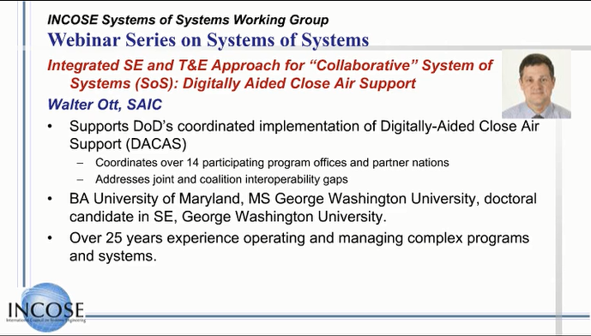
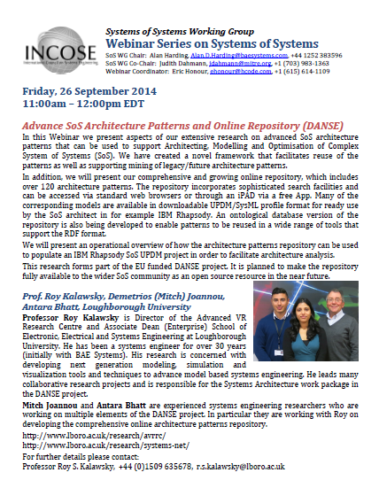
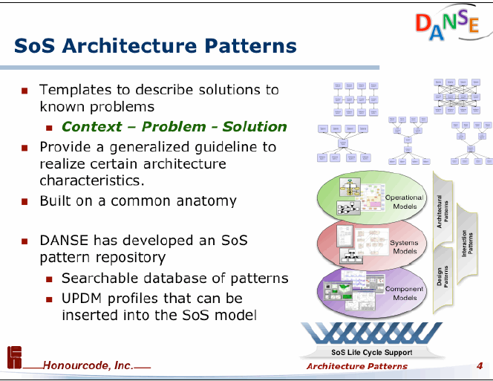

SoS Webinars
Monthly online webinars
Recorded and posted on SoS WG Connect Site
Contact Jason Sherey with recommendations for added webinars at Jason.sherey@gmail.com
Suggestions?
Introduction to SoS
Harding SoSE 23 Keynote
Others?
https://connect.incose.org/Library/Webinars/Pages/Working-Group-Webinars.aspx

Slide 5
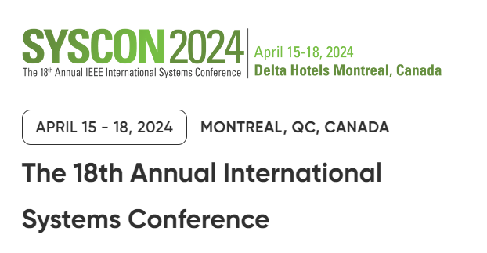
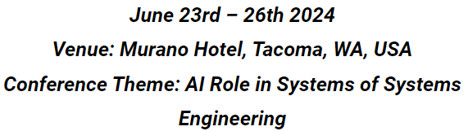




Upcoming Conferences
IEEE Systems 2024
SoSE 2024
INCOSE International Symposium
https://2024.ieeesyscon.org/
https://sosengineering.org/2024/
https://www.incose.org/symp2024

Slide 6
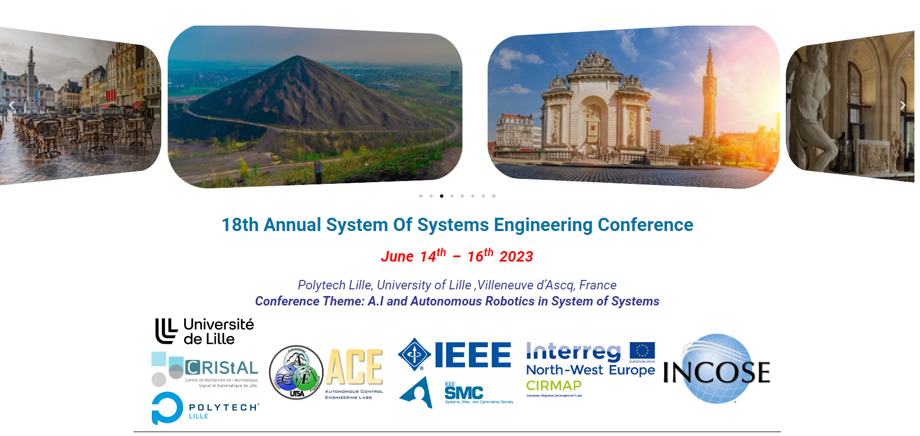
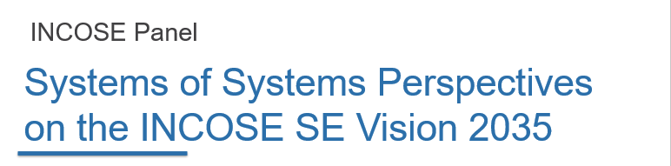
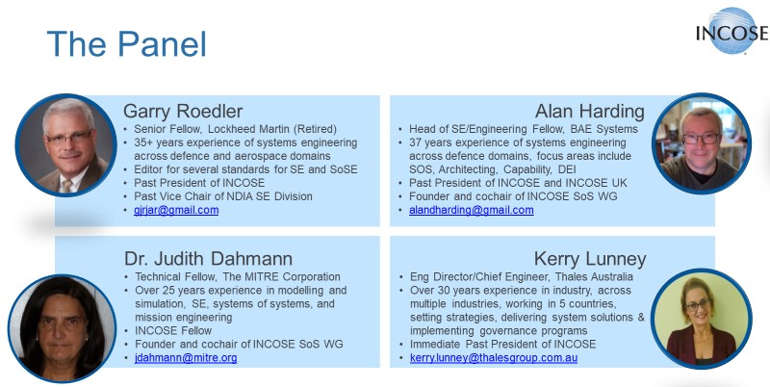
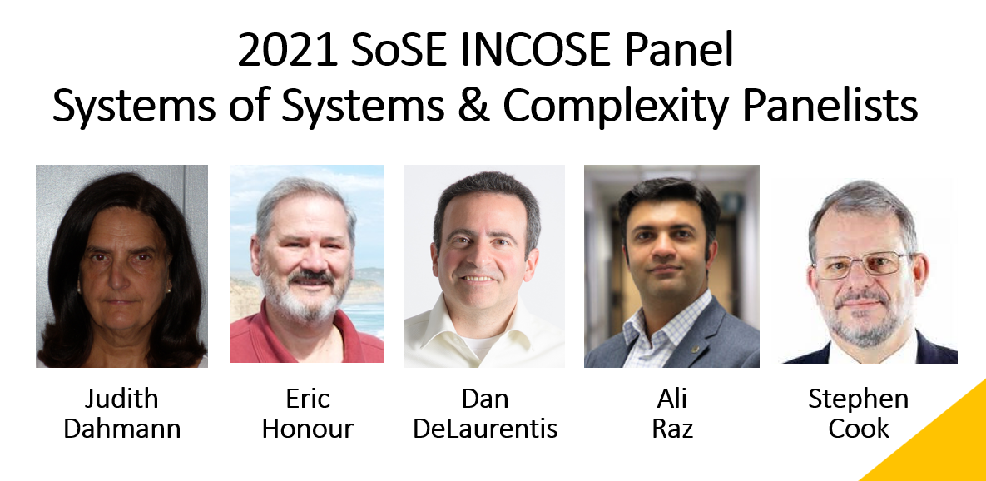
Conferences
IEEE SoSE Conference 2023 SoSWG Panel
INCOSE is a partner in this conference
Traditionally, the SoS WG has sponsored one or more sessions
  2021: SoS and Complexity
  2022: SoS and INCOSE Vision
  2023: SoS Pain Points
2023 INCOSE Panel: SoS Pain Points
10-year retrospective
Roedler, Dahmann, Harding, Axelsson

Slide 7
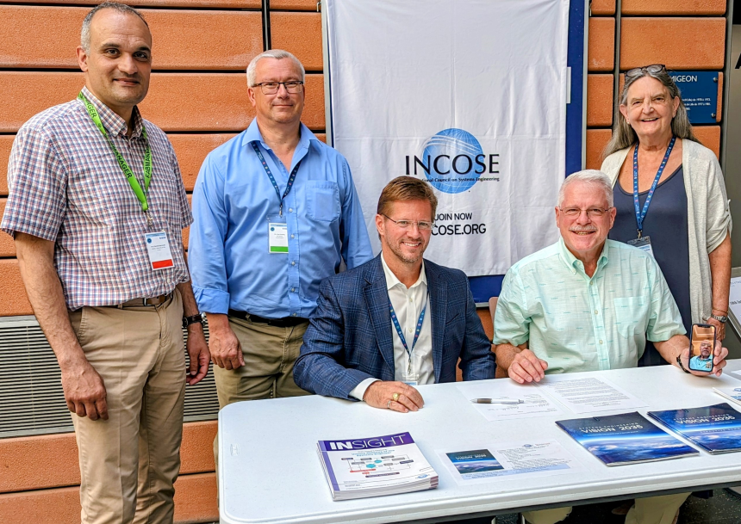


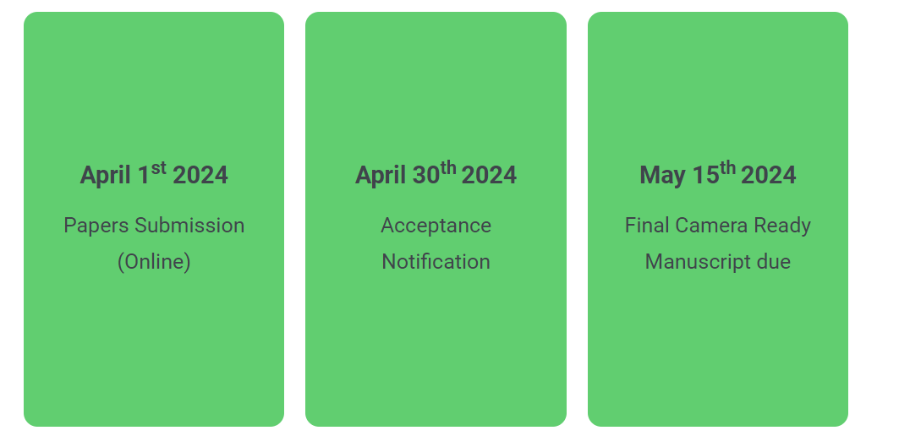

SoSE 2024
Keynotes:
Marilee Wheaton, INCOSE Past President
Sky Matthews – IBM
John Palmer - Boeing
INCOSE SoS Panel
“The Impact of Advanced Technologies on SoSE”
MOU Signing Event between SoSE Conference and INCOSE

Slide 8
Engagement with Other WGs - Opportunities
Complexity
Long time partner; Sunday afternoon collaboration session;
Review New Complexity Primer for SoS Implications
Smart Cities
Recognizing the SoS aspects of smart cities, Jennifer Russell has invited SoSWG members to join online Smart Cities monthly meetings
Agile WG:
There was WG interest in Scaled Agile Framework/DEVSECOPS Lessons for/applications to SoSE expressed during IW22 discussions
Review Agile Primer for SoS Implications
DEIX WG:
Digital thread through SoS was a topic raised during IW22 discussions, with proposal for follow-up with an exchange with DEIX WG
Productline WG Engagement (Hoehne)
Relationship to Productline WG recognized as area of interest
Is there still interest in engaging with these working groups?
Volunteers to lead these engagements?

Slide 9
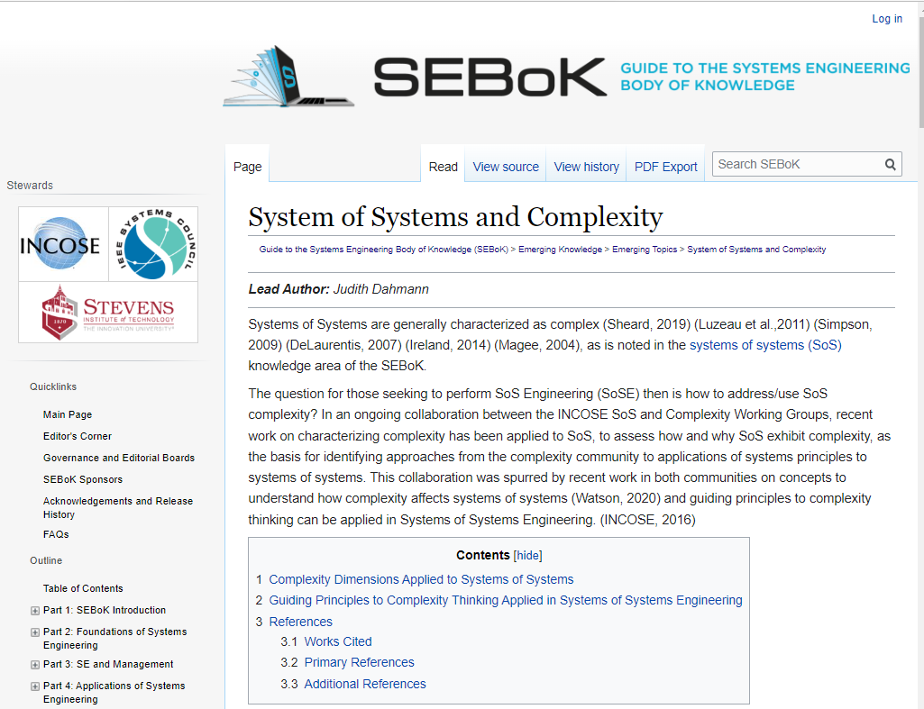
SEBoK: SoS and Complexity
Article in ‘Emerging Knowledge’ on SoS and Complexity
Based on work of SoS and Complexity Working Groups
https://sebokwiki.org/wiki/System_of_Systems_and_Complexity

Slide 10
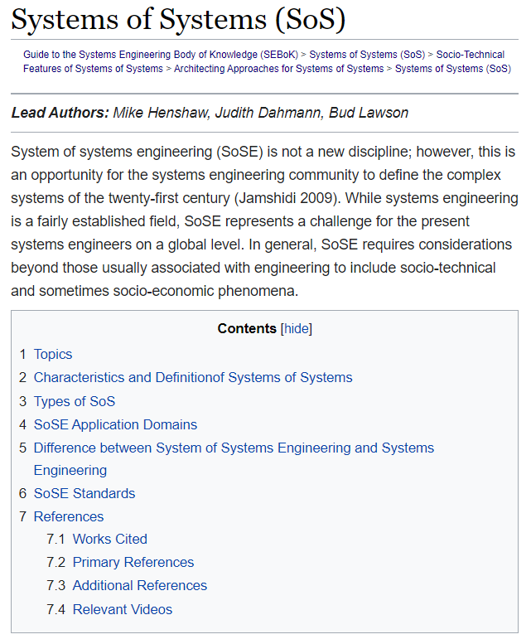
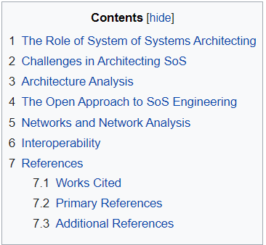
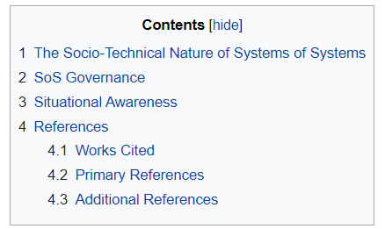
SEBoK: SoS Knowledge Area (KA)
Micheal Henshaw and Judith Dahmann Co-Editors of SoS KA
Plan to update SoS KA in 2024
Retain/Update basic information
Update and replace other content with a focus on approaches to implementing SoSE
Sunday, January 28 - 1-5: Working session on approaches to SoS Engineering
https://sebokwiki.org/wiki/Systems_of_Systems_(SoS)

Slide 11
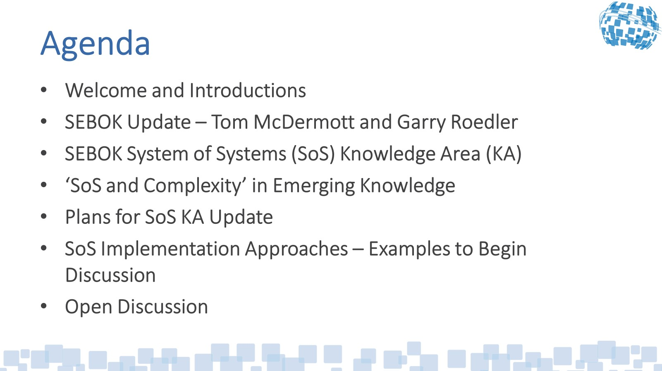
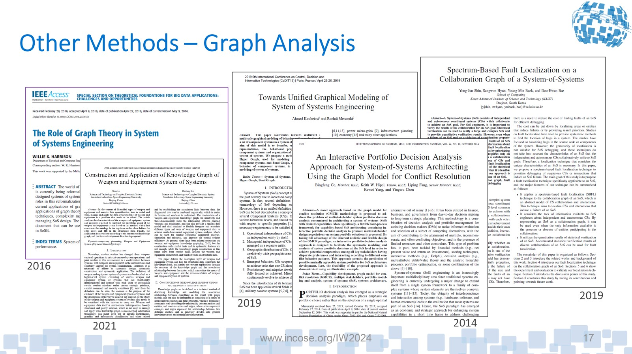
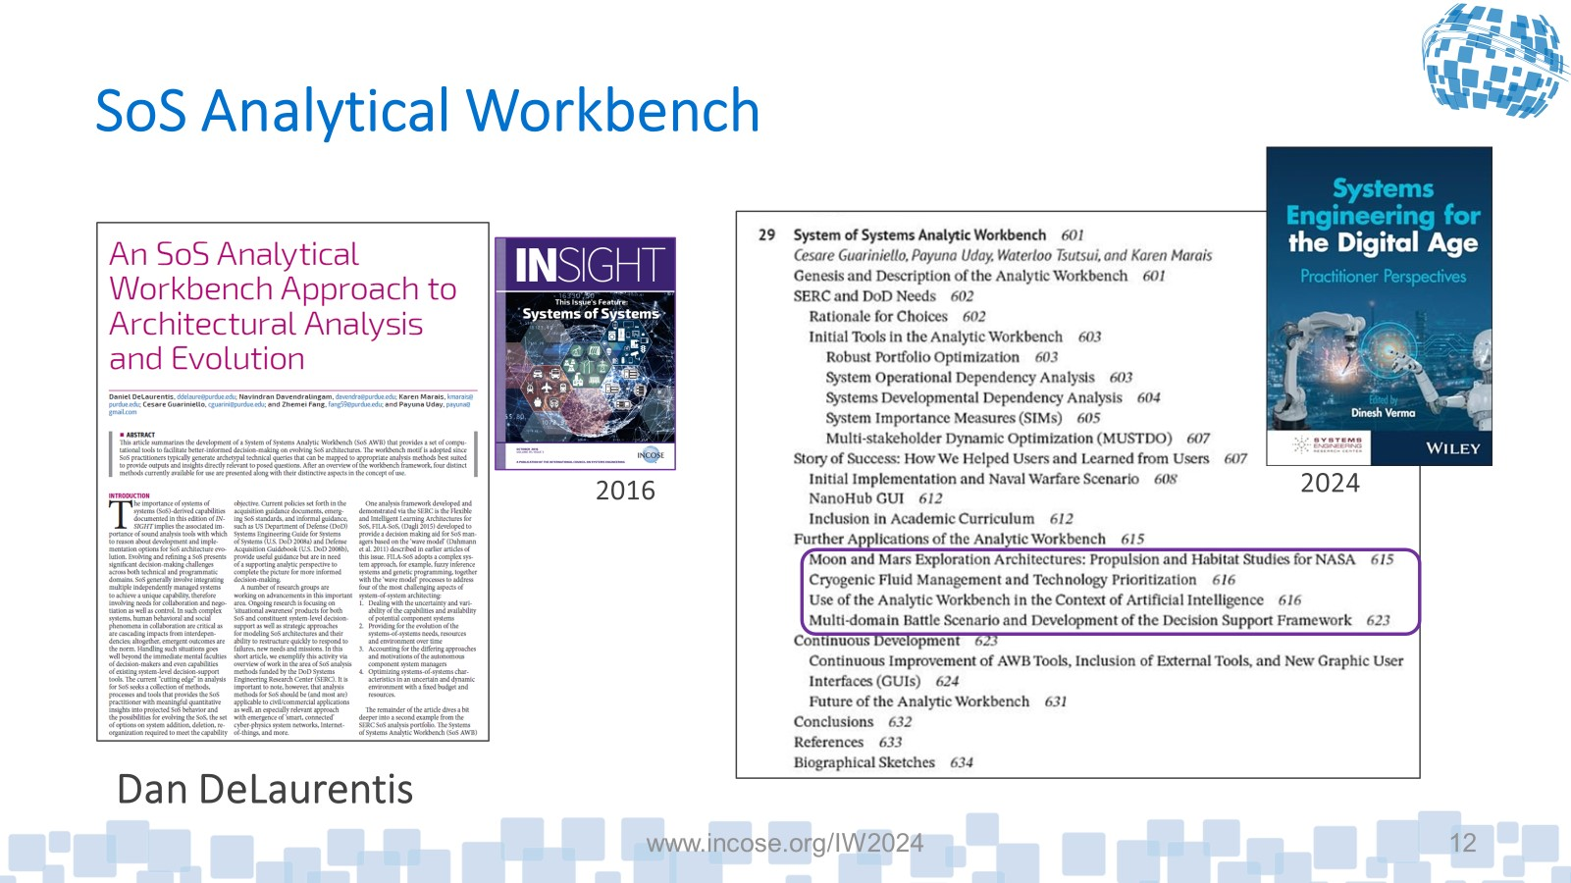
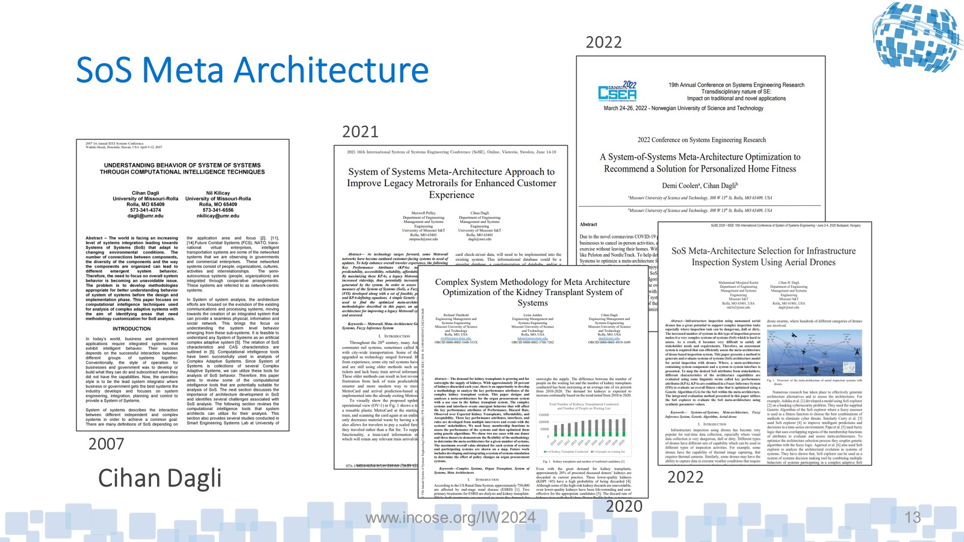
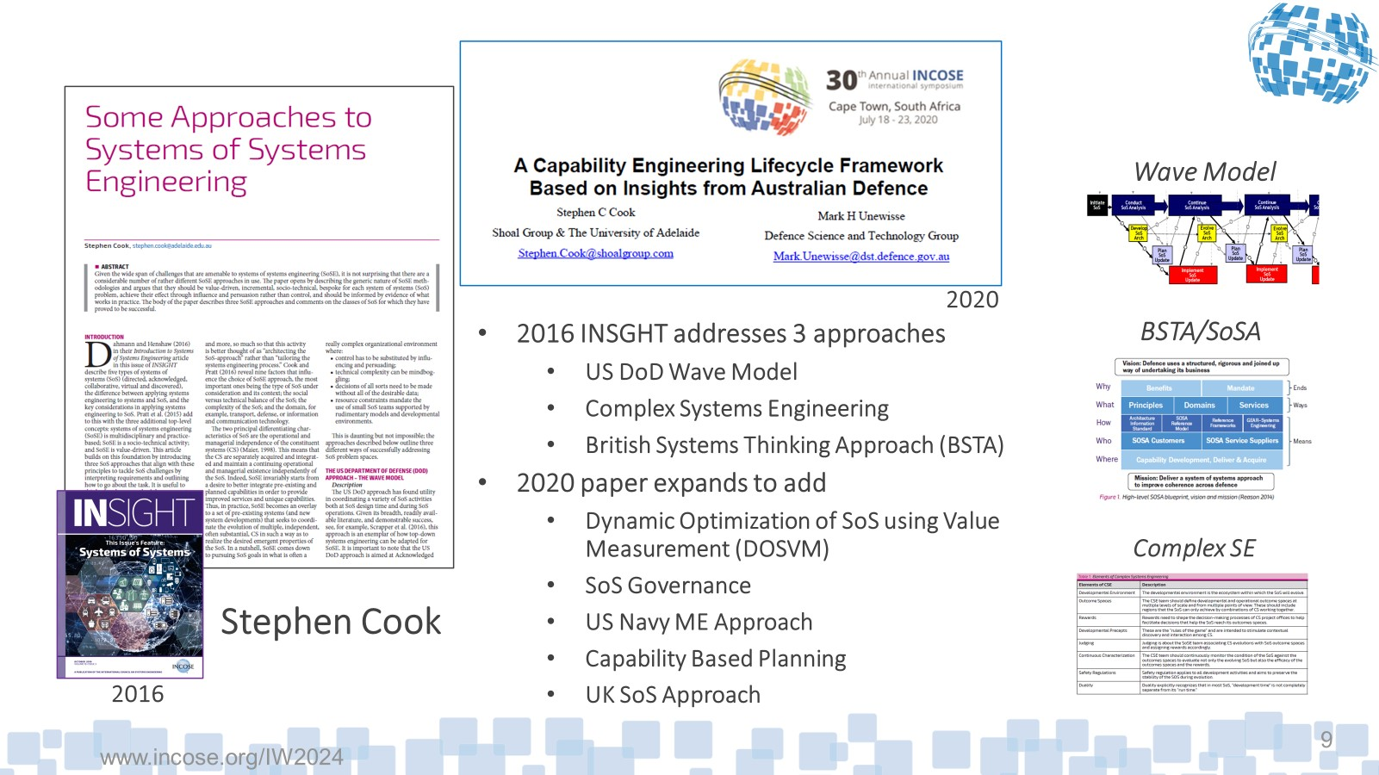
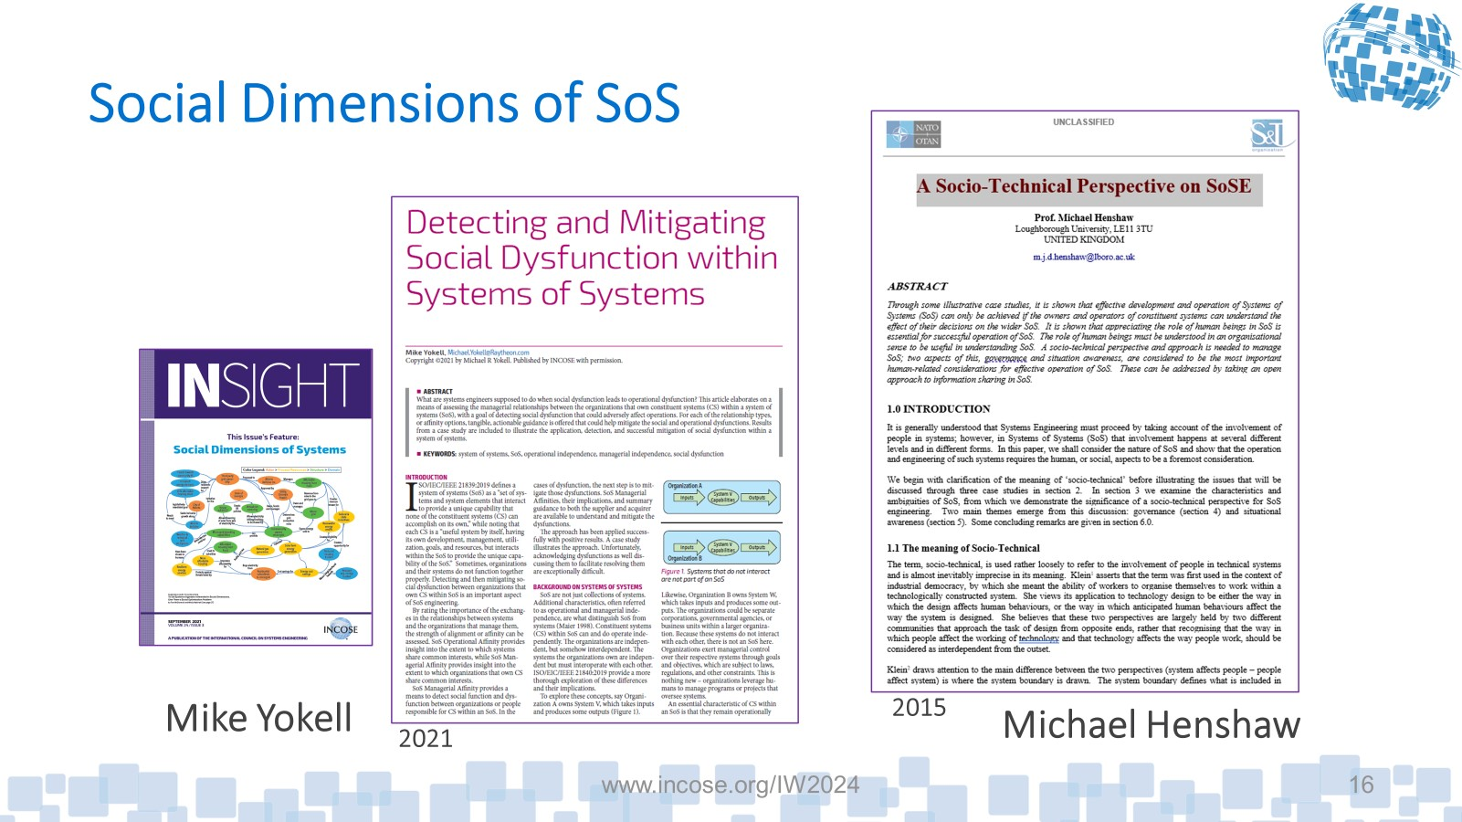
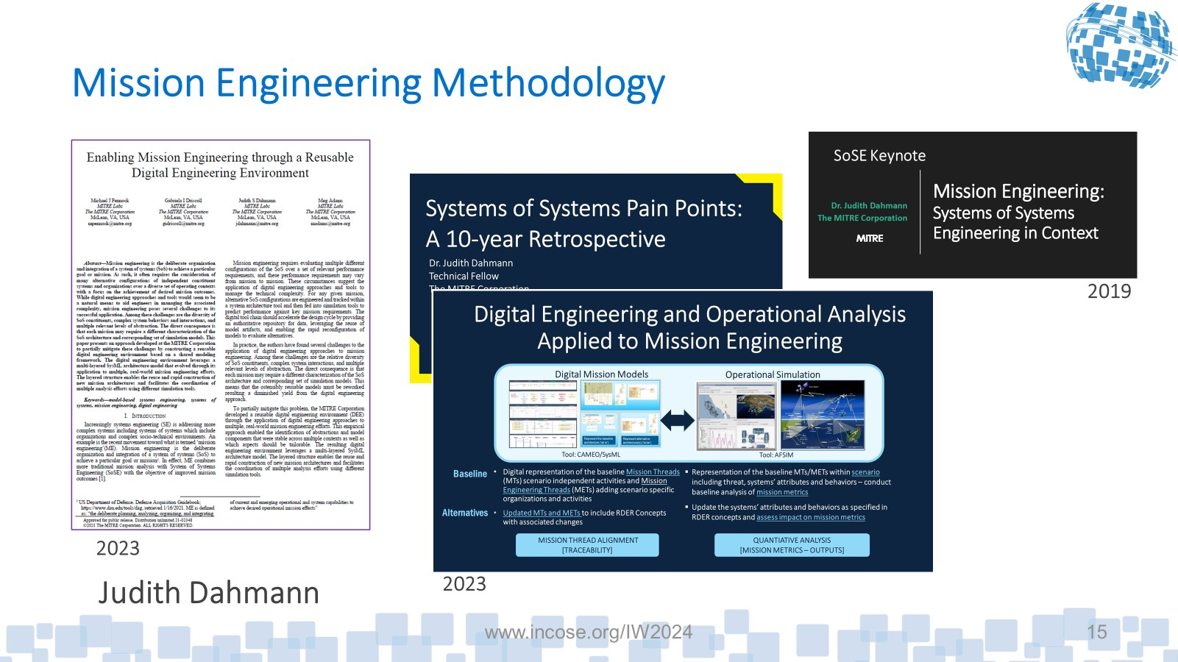
Sunday SEBOK/SoSE Approaches Session
Great participation (~40 in-person and remote participants) and lively discussion
Found good opportunities in the approaches included in the discussion slides
Suggest include discussion of ‘enablers’ which are important for different approaches
Identified additional near and long-term areas
  Multi-Scale (socio-technical SoS)
  Innovation Systems/ SoS
  Methods from specific domains (e.g.. Rail, Energy)
  Ultra-Large – Mega Systems
Next steps
  Review discussion for near-term SEBOK updates and options for SoSWG initiatives
  Solicit volunteers to support these
Data analytic methods for understanding SoS performance
Address issues beyond technical
Leverage/update some longstanding approaches (e.g., wave model)
Build on emerging complexity materials (e.g., most recent Complexity Primer)
Relevant but needs to be translated to non-Defense language

Slide 12
Review of Opportunities identified at IW23
INCOSE Handbook - Complete
Cyber Security from SoS perspective – Beth Wilson - Complete
SEBOK – SoS and Complexity - Judith Dahmann - Complete
Relationship between SoS, Mission Engineering, Capability Engineering and Complexity - Pending
SoS reflection on INCOSE products – Pending
Heuristics (New - Kerry Lunney)

Slide 13

SoS Input to the INCOSE SE Handbook Update
The update to the INCOSE SE Handbook (SEH) is underway
Working Groups had an opportunity to provide input
Several SoSWG graciously provided comments
Content was updated following INCOSE IS 21
Additional updates were reviewed at IW22: Six additional comments submitted and accepted in principle by the SEH core group and one comment was deferred to the working group
SoSWG comments were accepted and were included in the handbook
Released July 2023!

Slide 14
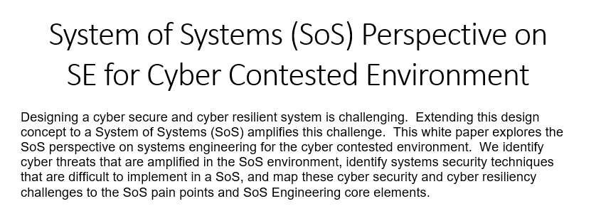
Cyber Security from SoS Perspective
System of Systems (SoS) Perspective on
SE for Cyber Contested Environment
Cyber Threats Amplified in the SoS Environment
  Lateral Movement
  Insider Threat
  Evolving Threats
Systems Security Techniques Made Difficult for SoS
  Network Segmentation/Segregation
  Defense-in-Depth
  Patching Vulnerabilities
  Encryption
  Access Control
SoS Pain Points Amplified by Systems Security Concerns
  Testing
  Capabilities and Requirements
  Autonomy, Interdependence, and Emergence
  Constituent Systems
Core Elements in SoS Engineering Challenged by Systems Security
  Understanding Systems and Relationships
  Assessing Performance against Capability Objectives
  Developing and Evolving an SoS Architecture
  Monitoring and Assessing Changes/Orchestrating Upgrades
Summary
At IW22 SoSWG received a request SE Enablers lead
SoS Working Group agree to develop a paper on SoS perspective on Cyber Security.
This was implemented in partnership with the Complexity Working Group.
Completed
Beth Wilson draft paper and shared draft with Complexity team
Paper was reviewed and completed
Paper is available
Contact: Beth Wilson wilsondrbeth@aol.com

Slide 15
SoS Reflection on INCOSE Products In Progress
At IW22, the working group decided to undertake a new line of effort, to provide an SoS perspective on INCOSE products.
As the SE Vision 2035 interconnected systems – SoS – are becoming the norm which calls for an SoSE perspective as we move to the future.
This provides an opportunity of the working group to support INCOSE writ large by bringing an SoS perspective to INCOSE products in several ways.
By exposing products to the SoS community, the SoSWG can promote broader use of products from other working groups.
In the process, the WG can assess whether there is a need for added guidance or advice on how to effectively leverage the products when address an SoS – possible creating a short addendum offing this perspective.

Slide 16
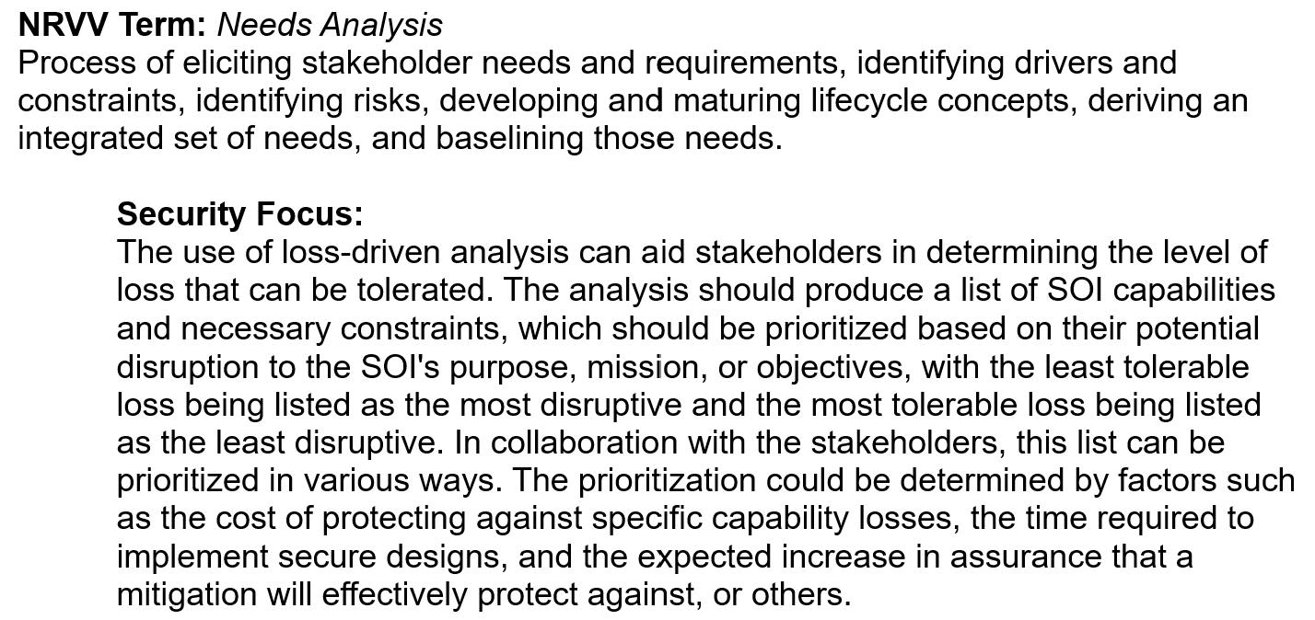
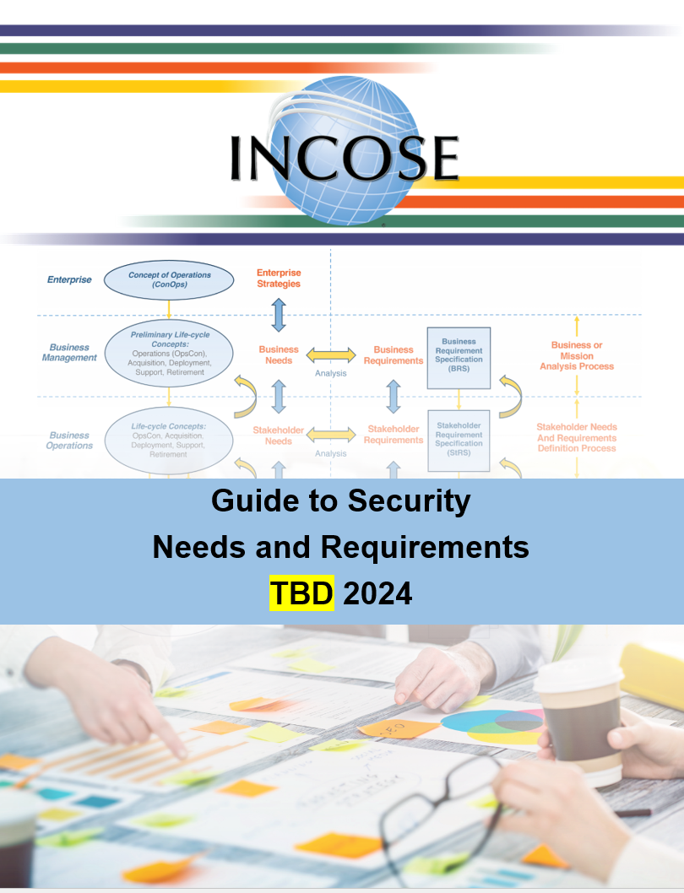
Summary of Project Progress
SoS Perspective on Requirements WG Products
Timeline | Activity | Results
July 2022 | RWG Cafe | How does SoS use RWG products?
Aug 2022 | SoS Project Kickoff | Decided against stand-alone option GtNR = 120 pages, GtSoSNR would be ~150 pages Would replicate content in ISO/IEC/IEEE 21840 Decision: create a “Rosetta Stone”
Jan 2023 | First Draft | Identified SoS mapping for each of RWG terms Sent to WG for comments after IW23
Oct 2022 – Jan 2024 | SSE WG | Similar project for Systems Security Sep 2023: Major change from Rosetta Stone format Want SSEs to relate to RWG product content Want SEs to create better security requirements Changed to use RWG term, explain SSE focus
Jan 2024 | Proposal | Similar approach for SoS Guide to Requirements
2024 | PLANS | Develop Guide to SoS Needs and Requirements Needs/Requirements/Verification/Validation Term SoS Focus for activity
Guide to Security
Needs and Requirements
~12 pages of text
Jan 2024:
Latest draft out for review, plan official INCOSE product in 2024
If you are interested to engage, contact Beth Wilson <wilsondrbeth@aol.com>

Slide 17
Relationship between SoS, Mission Engineering, Capability Engineering and Complexity - Pending
Update
Due to time conflicts, this task is still pending
Recommend initiate now given continued interest in this area (Dahmann, Kemp, Delicado)
The US Department of Defense has a new focus on “Mission Engineering” (ME) which applies systems engineering to defense missions drawing on SoSE capabilities along with mission analysis and digital engineering.
Mission Engineering shares core characteristics with ‘Capability Engineering” in the UK. Both Mission Engineering and Capability Engineering recognize complexity challenges.
Based on the discussion at the joint session with Complexity, it was agreed that we would look at the relationship among SoS, Capability Engineering, Mission Engineering & Complexity.
Contact Judith Dahmann jdahmann@mitre.org
if you are interested to engage

Slide 18
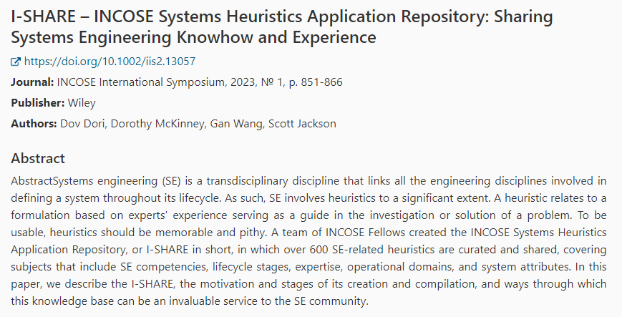

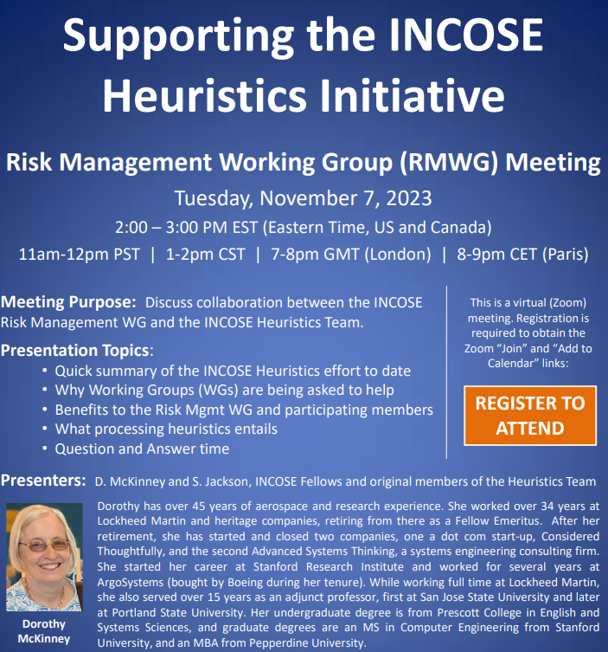
Heuristics
Does the SoS WG have things to offer the Heuristics Initiative?
Contact Judith Dahmann jdahmann@mitre.org
if you are interested to engage

Slide 19
What is next for the SoS WG?
Open Discussion

