Slide 1
Systems of Systems Working Group
SEBOK – SoSE Implementation Approaches
Working Session

Slide 2
SoSWG At IW24
Software InterfaceWorking Group (SaSIWG)
Sunday, January 28 - 1-5: Working session on approaches to SoS Engineering
The current SEBOK SoS knowledge area focuses on broad discussion of systems of systems (SoS) characteristics and systems of systems (SoS) challenges. When we look at progress which has been made in the last few years, it is time for a revision and a new focus on approaches to addressing SoS. This session will provide a venue for SoSWG members to share approaches they have implemented, and their lessons learned. The results of this session will provide input to the update of the SEBOK.
Monday, January 29: 9:30-12: SoSWG Business Meeting
This meeting will review the status and plans for current activities of the SoSWG and open discussion of possible new initiatives.

Slide 3
Agenda
Welcome and Introductions
SEBOK Update – Tom McDermott and Garry Roedler
SEBOK System of Systems (SoS) Knowledge Area (KA)
‘SoS and Complexity’ in Emerging Knowledge
Plans for SoS KA Update
SoS Implementation Approaches – Examples to Begin Discussion
Open Discussion

Slide 4
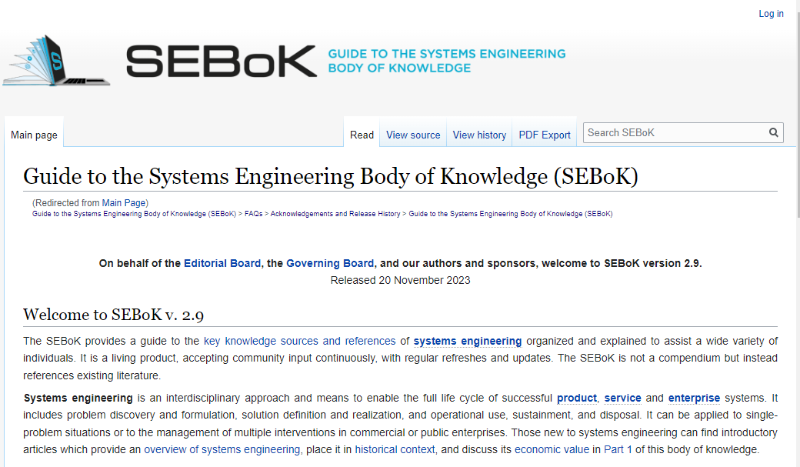
SEBOK Update
Tom McDermott
Garry Roedler

Slide 5
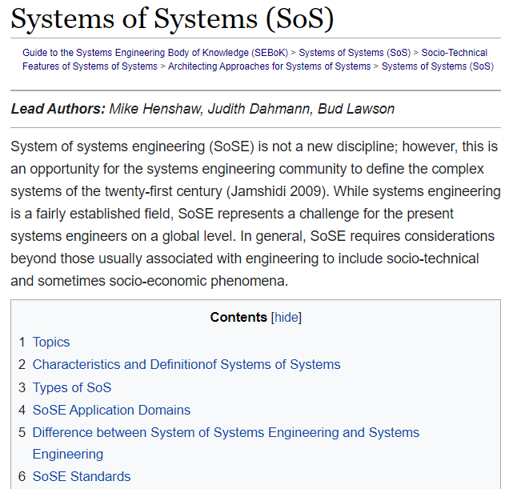
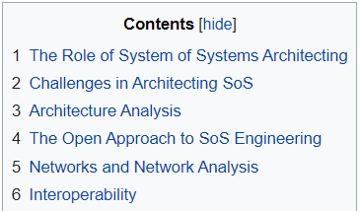
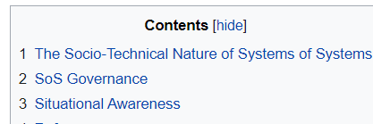
SoS Knowledge Area
https://sebokwiki.org/wiki/Systems_of_Systems_(SoS)

Slide 6
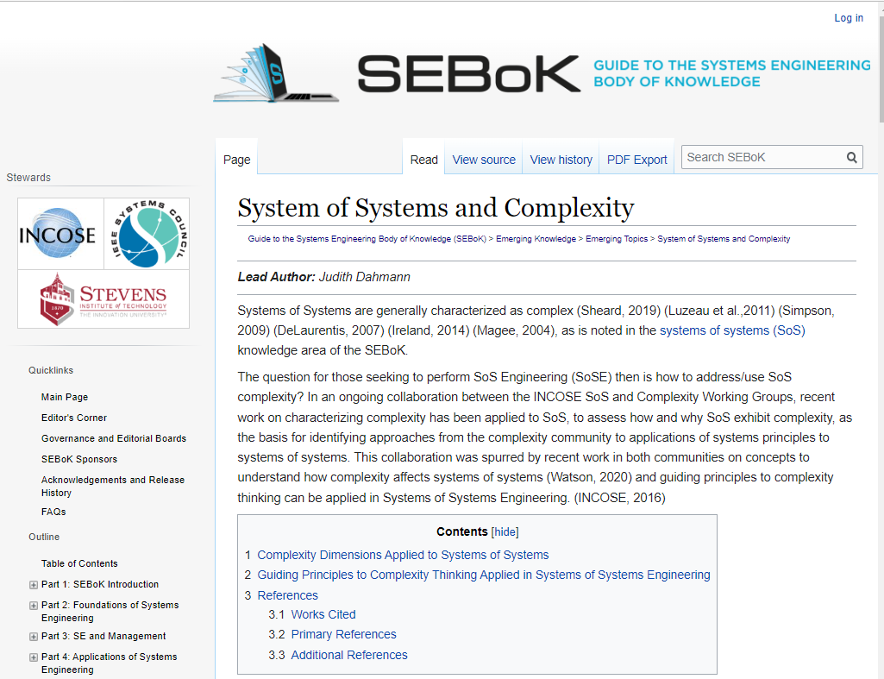
Emerging Knowledge: SoS and Complexity
Article in ‘Emerging Knowledge’ on SoS and Complexity
Based on work of SoS and Complexity Working Groups
Move into SoS KA?

Slide 7
Objective of this session is to discuss current approaches to implementation of SoSE as input to the SoS KA update

Slide 8
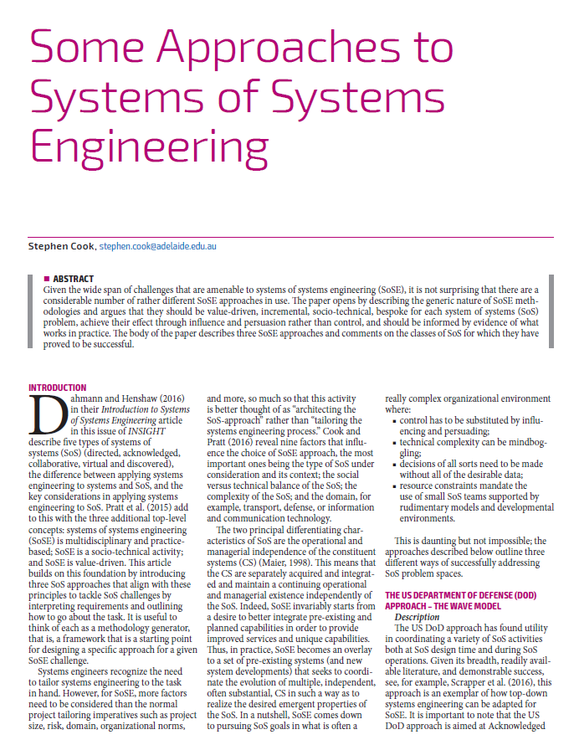
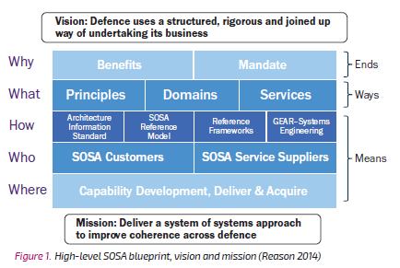
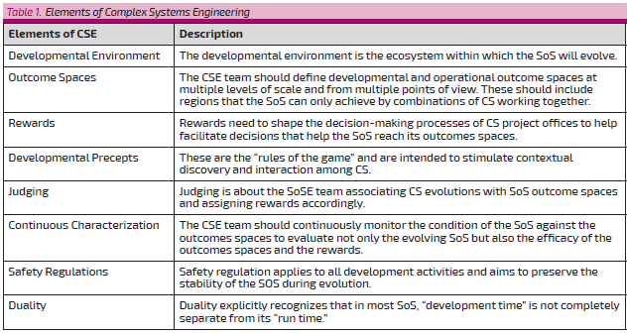

Features Three Approaches
  US DoD Wave Model
  Complex Systems Engineering
  British Systems Thinking Approach (BSTA)
Wave Model
BSTA
Complex SE
Stephen Cook
2016

Slide 9
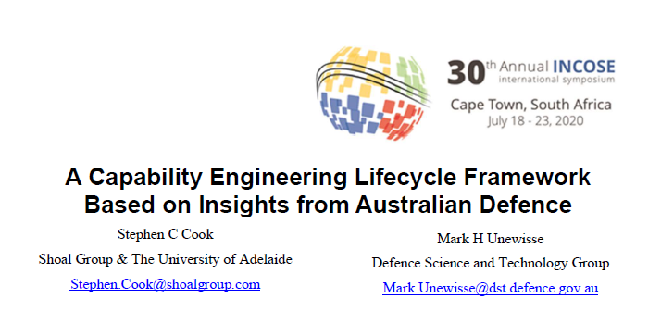
Wave Model
2020
2016 INSGHT addresses 3 approaches
  US DoD Wave Model
  Complex Systems Engineering
  British Systems Thinking Approach (BSTA)
2020 paper expands to add
  Dynamic Optimization of SoS using Value Measurement (DOSVM)
  SoS Governance
  US Navy ME Approach
  Capability Based Planning
  UK SoS Approach
BSTA/SoSA
Complex SE
Stephen Cook
2016

Slide 10
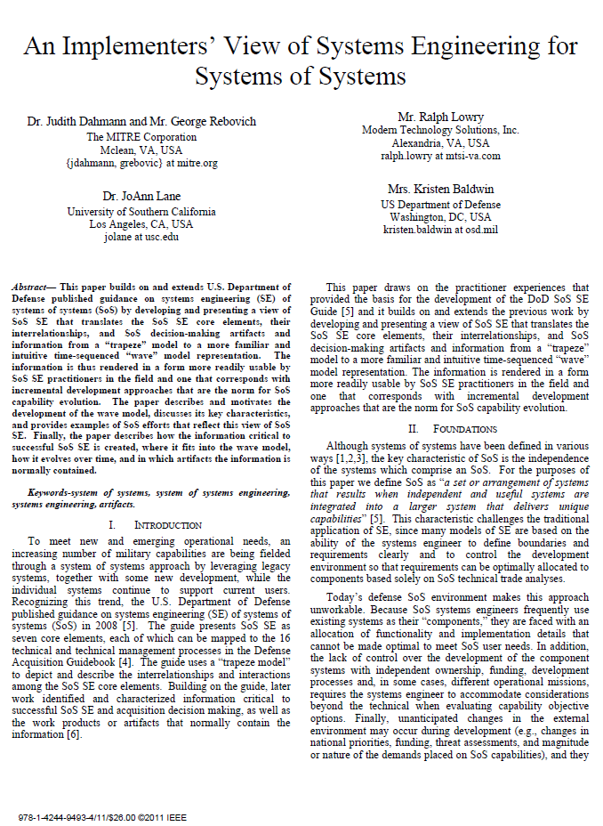
Implementers View of SE for SoS: SoS Wave Model
External Environment
Initiate SoS:
  Provides foundational information to initiate the SoS
Conduct SoS Analysis:
  Provides analysis of the ‘as is’ SoS and basis for its evolution
Develop SoS Architecture:
  Develops/evolves the persistent technical framework for SoS evolution and a migration plan identifying risks and mitigations
Plan SoS Update:
  Evaluates SoS priorities, backlog of SoS changes, and options to define plans for the next SoS upgrade cycle
Implement SoS Update:
  Oversees system implementations and plans/conducts SoS level testing, resulting in a new SoS product baseline
Continue SoS Analysis:
  Ongoing SoS analysis revisits the state of and plans for the SoS as the basis for SoS evolution
IEEE Systems Conference, 2011
Judith Dahmann

Slide 11
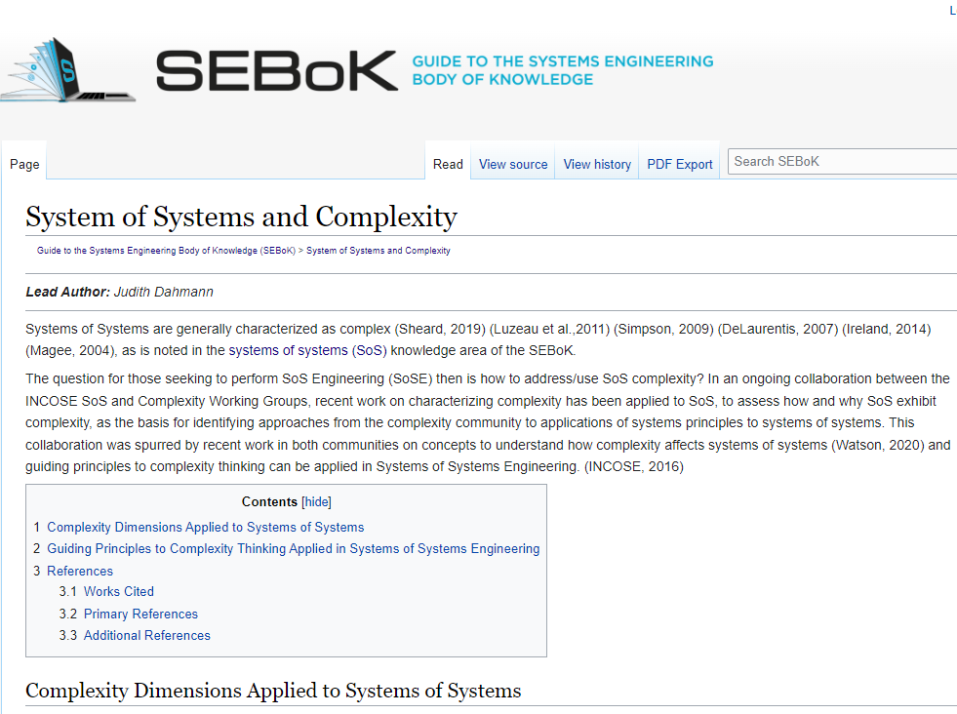
Complex Systems Engineering
Emerging Knowledge
2016
Ongoing Area of Inquiry

Slide 12


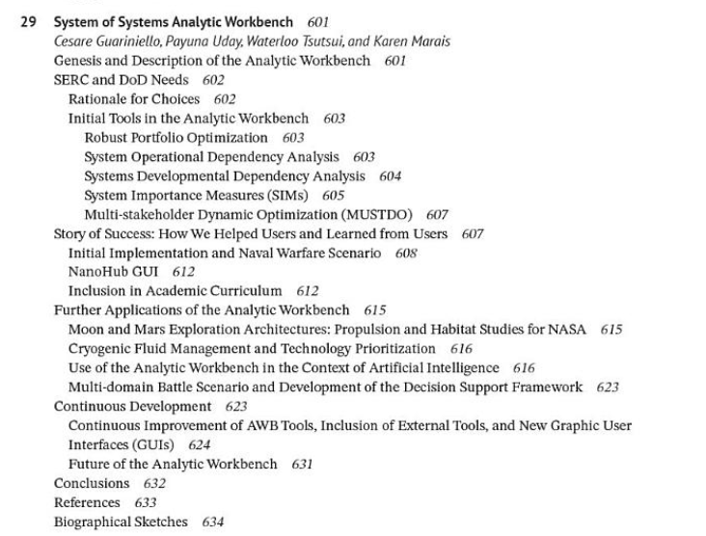
SoS Analytical Workbench
2016
2024
Dan DeLaurentis

Slide 13

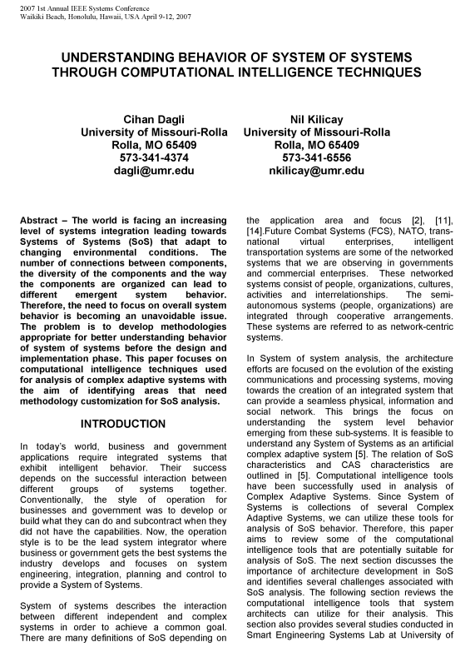
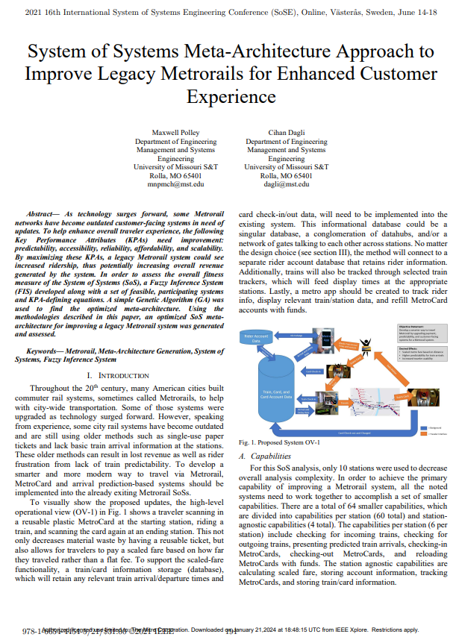
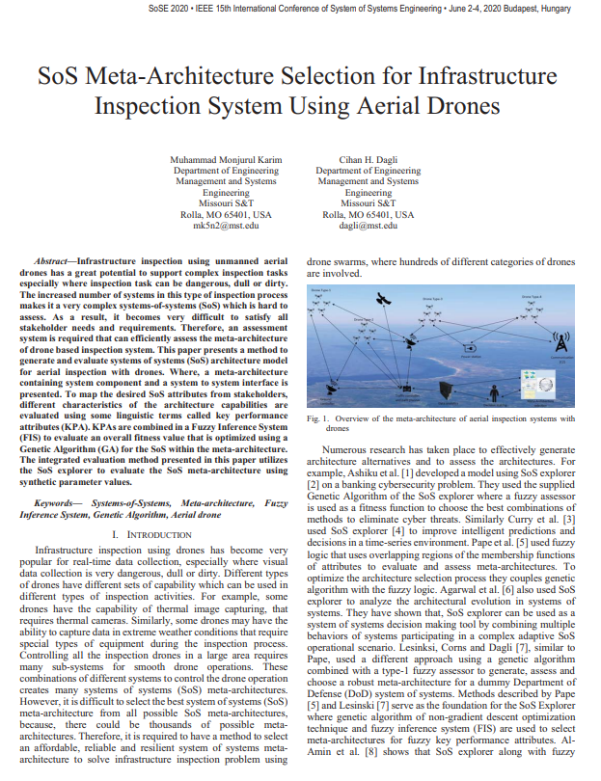
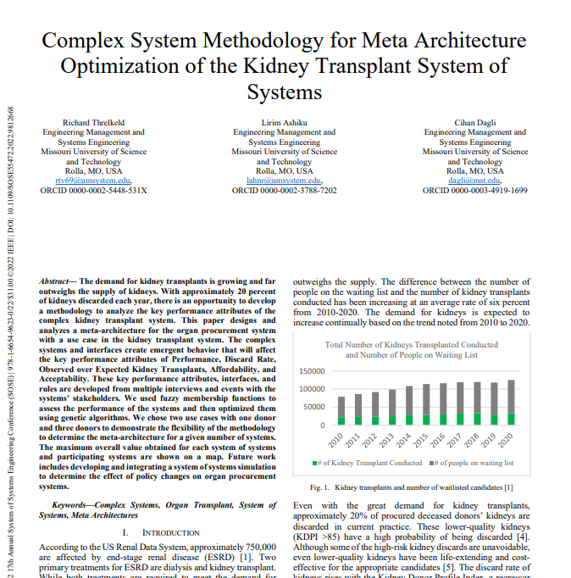
SoS Meta Architecture
2022
2021
2007
Cihan Dagli
2022
2020

Slide 14


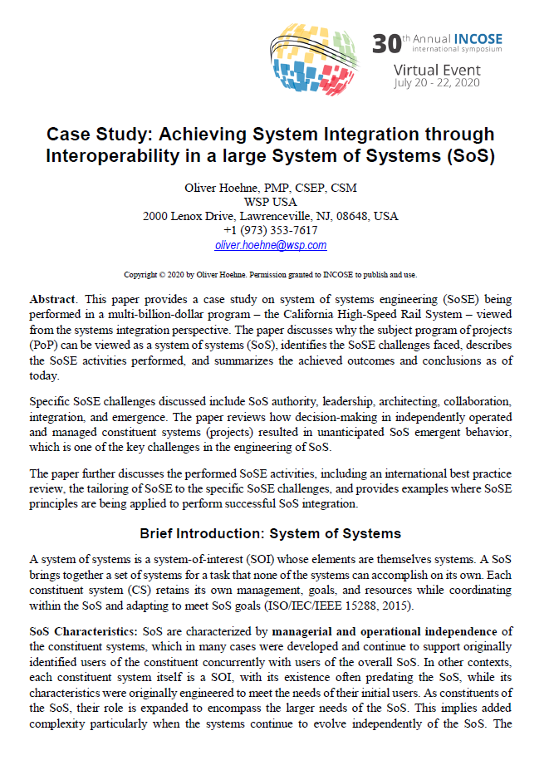
Rail Examples
Oliver Hoehne
Duncan Kemp
2016
2020
2016

Slide 15
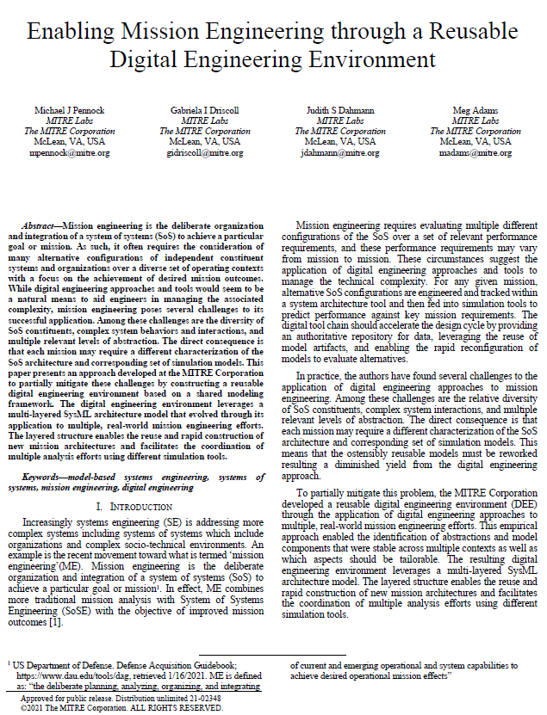
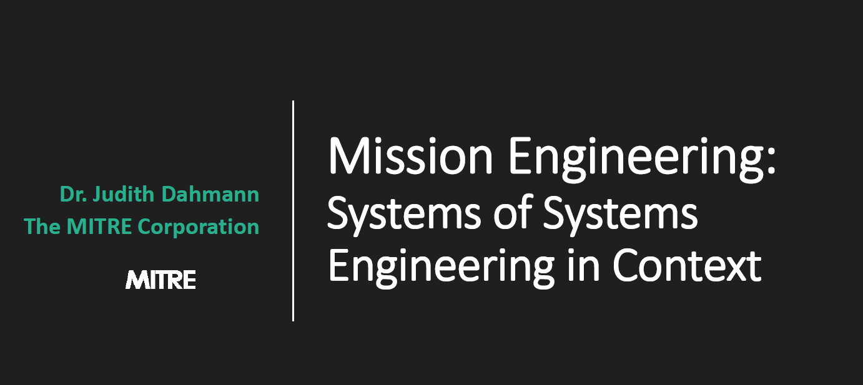
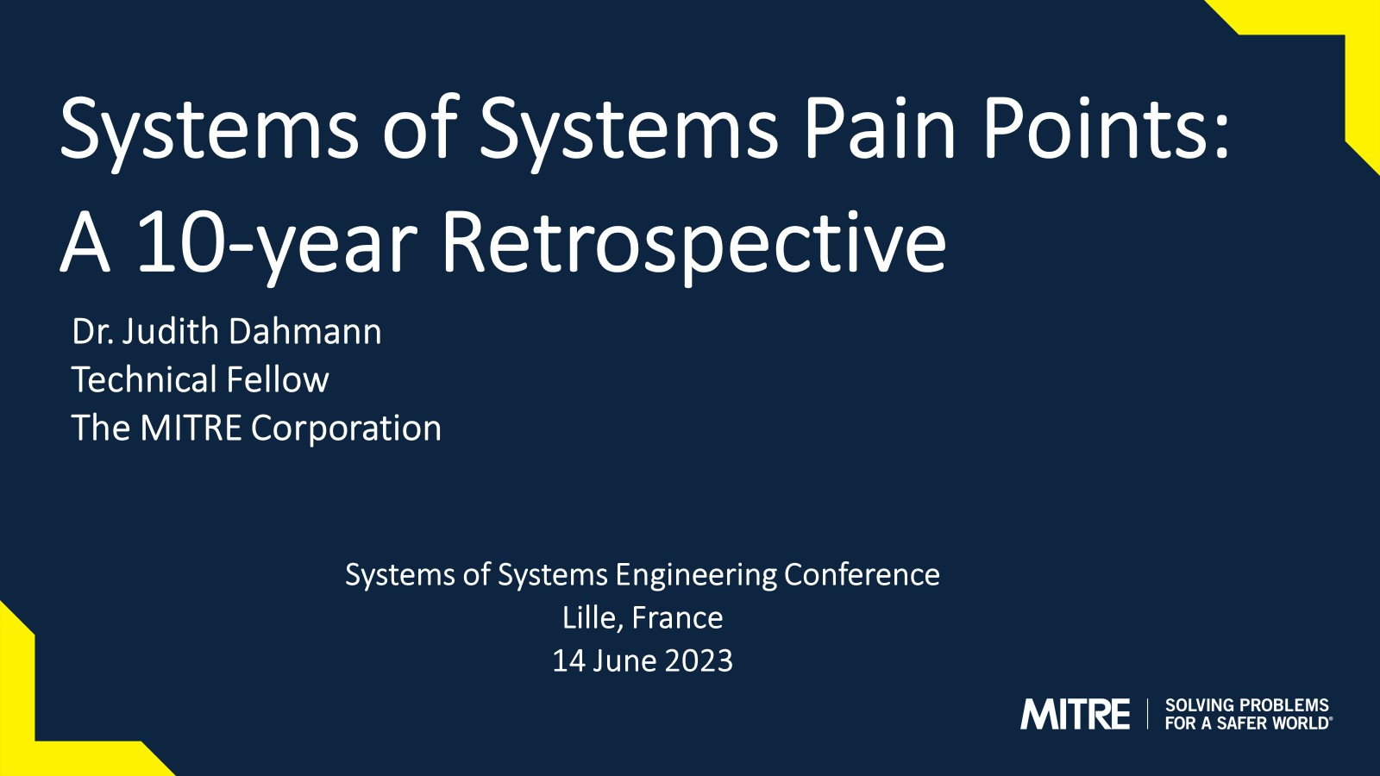
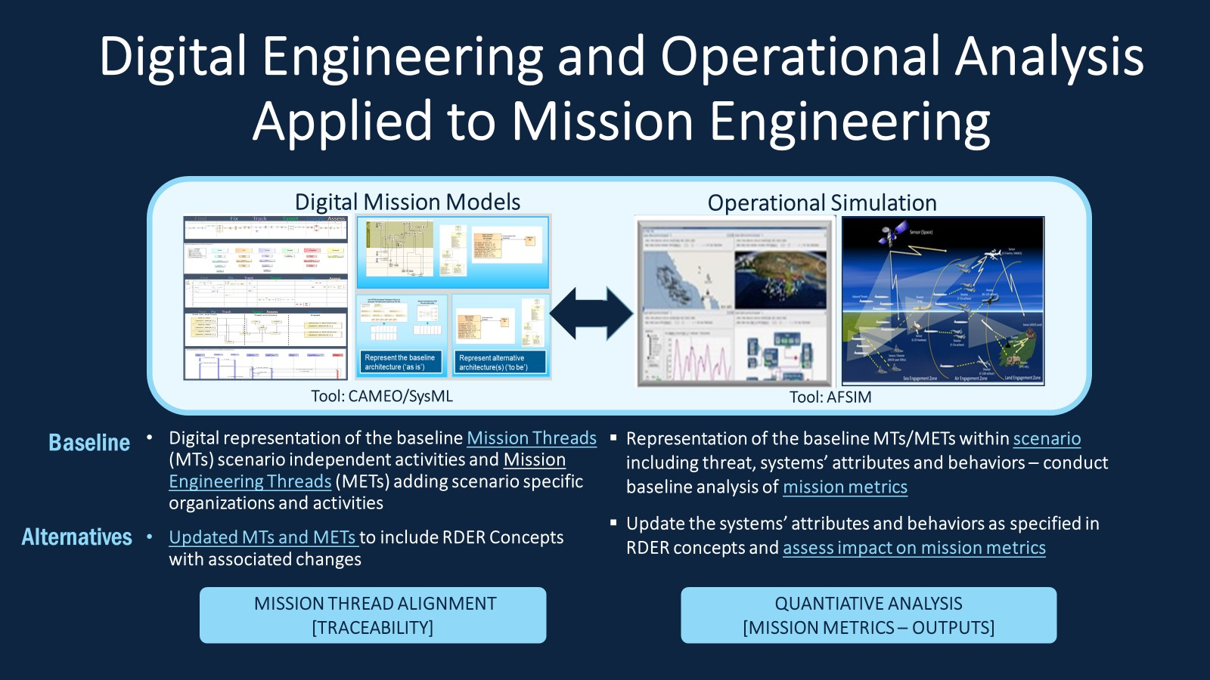
Mission Engineering Methodology
SoSE Keynote
2019
2023
Judith Dahmann
2023

Slide 16
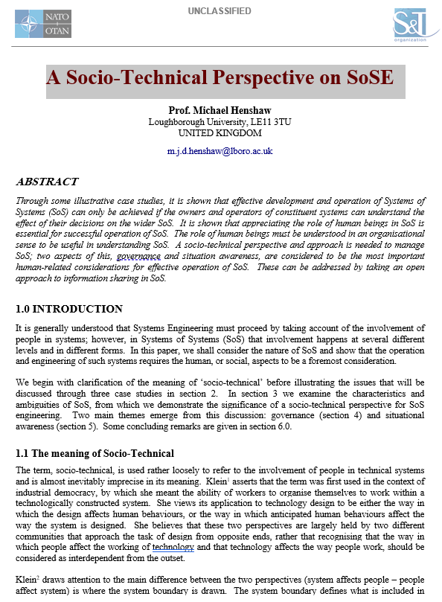


Social Dimensions of SoS
Mike Yokell
2015
Michael Henshaw
2021

Slide 17
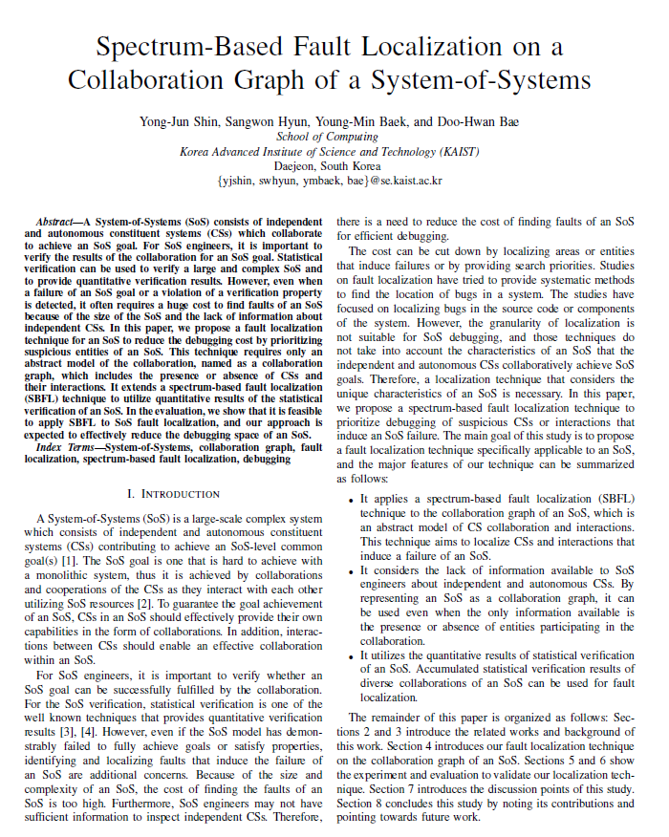
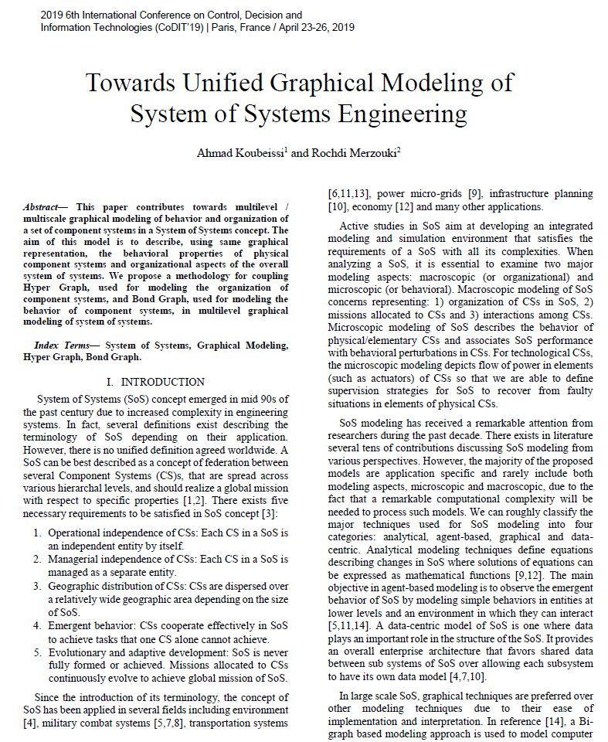


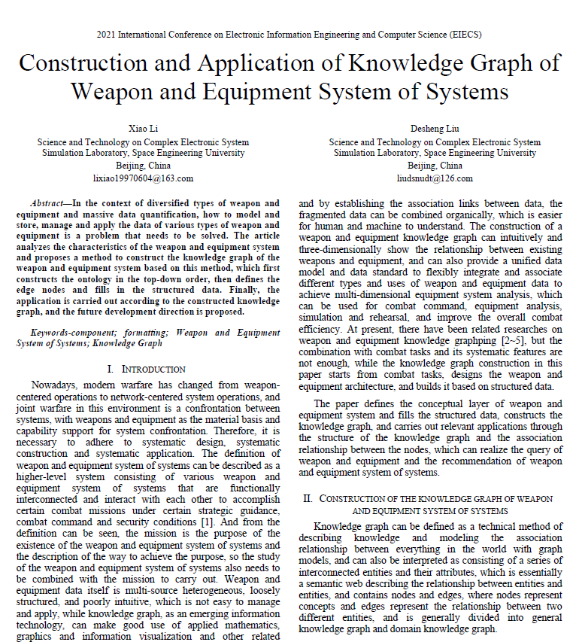
Other Methods – Graph Analysis
2016
2019
2019
2021
2014

Slide 18
Other Examples?
Open Discussion

