Slide 1
Loyola Marymount University (LMU)
Enter campus from Lincoln Blvd
Follow the road around to Ignatian Circle
Parking on Thursday and Friday is $15.00/day no exceptions
If parking is full under the Life Science Building (LSB), you could part in Lot A.
Parking
Lot A Backup Parking

Slide 2
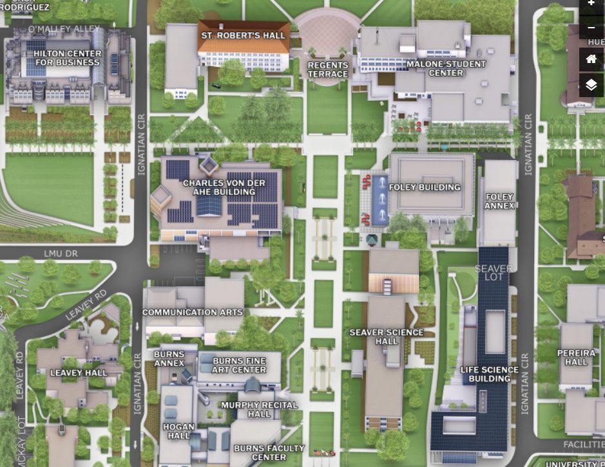
Thursday:
The Hill Malone room 460c, SE Bootcamp, Registration
Walking Path
THURSDAY
Parking

Slide 3
Fri: SE Bootcamp and CSEP Prep Workshops
Friday: The Hill Malone room 460c, half-day tutorials open to all conference attendees, Registration
FRIDAY
Walking Path
Parking
Shuttle Drop Off

Slide 4
Registration on the PLAZA outside LSB 120 Auditorium
SATURDAY &
SUNDAY
Parking
Walking Path
Saturday: all tracks in these buildings
Shuttle Drop Off

