Slide 1

Welcome to the INCOSE Webinar Series
International Council on Systems Engineering
A better world through a systems approach
Wednesday, 18 June 2025 – Webinar 182
incose.org

Slide 2

Thank you to our 2025 Webinar Sponsor!
Interested in being a Sponsor of the INCOSE Webinar Series? Please contact us at sponsorship@incose.net

Slide 3
INCOSE Webinar 182:
Behind the scenes of The Essential Guide to Part Re-Identification
Presented by
Martijn Dullaart

Slide 4
About the INCOSE Webinar Series
Piloted in 2008
A virtual offering aimed to provide relevant technical information and topics on systems engineering, on a regular basis and on an easy to access platform
Held once a month (normally on the 3rd Wednesday)
Questions? Comments? Suggestions? Email us at webinars@incose.net!

Slide 5
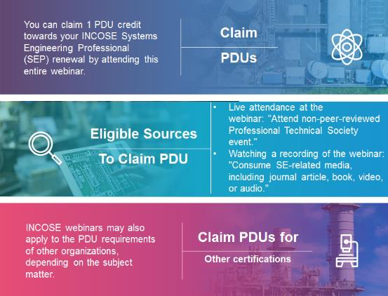
Webinars & SEP PDU* Credits
More information can be found on Renewing Certification (incose.org)
*PDU – Professional Development Unit

Slide 6
This Webinar is being recorded.
The full recording and slide deck will be made available to all INCOSE members and CAB Associates within 10-12 business days from original air date in the Professional Development Portal (PDP).
Questions? Comments? Suggestions? Email us at webinars@incose.net!

Slide 7
INCOSE Webinar 182:
Behind the scenes of The Essential Guide to Part Re-Identification
Presented by
Martijn Dullaart

Slide 8
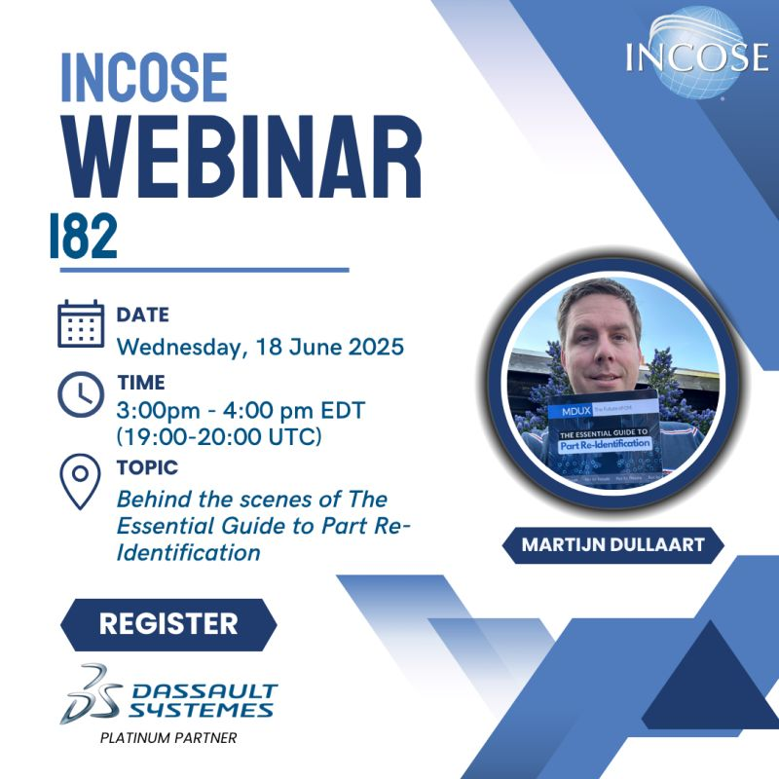
Today’s program
Introduction (3 mn)
Presentation (45 mn)
The author
The genesis of the book
The book content
It’s not about the tree…
FFF or FFFI?
Some more insights
Next edition
Q&A (15 mn)
Closure

Slide 9
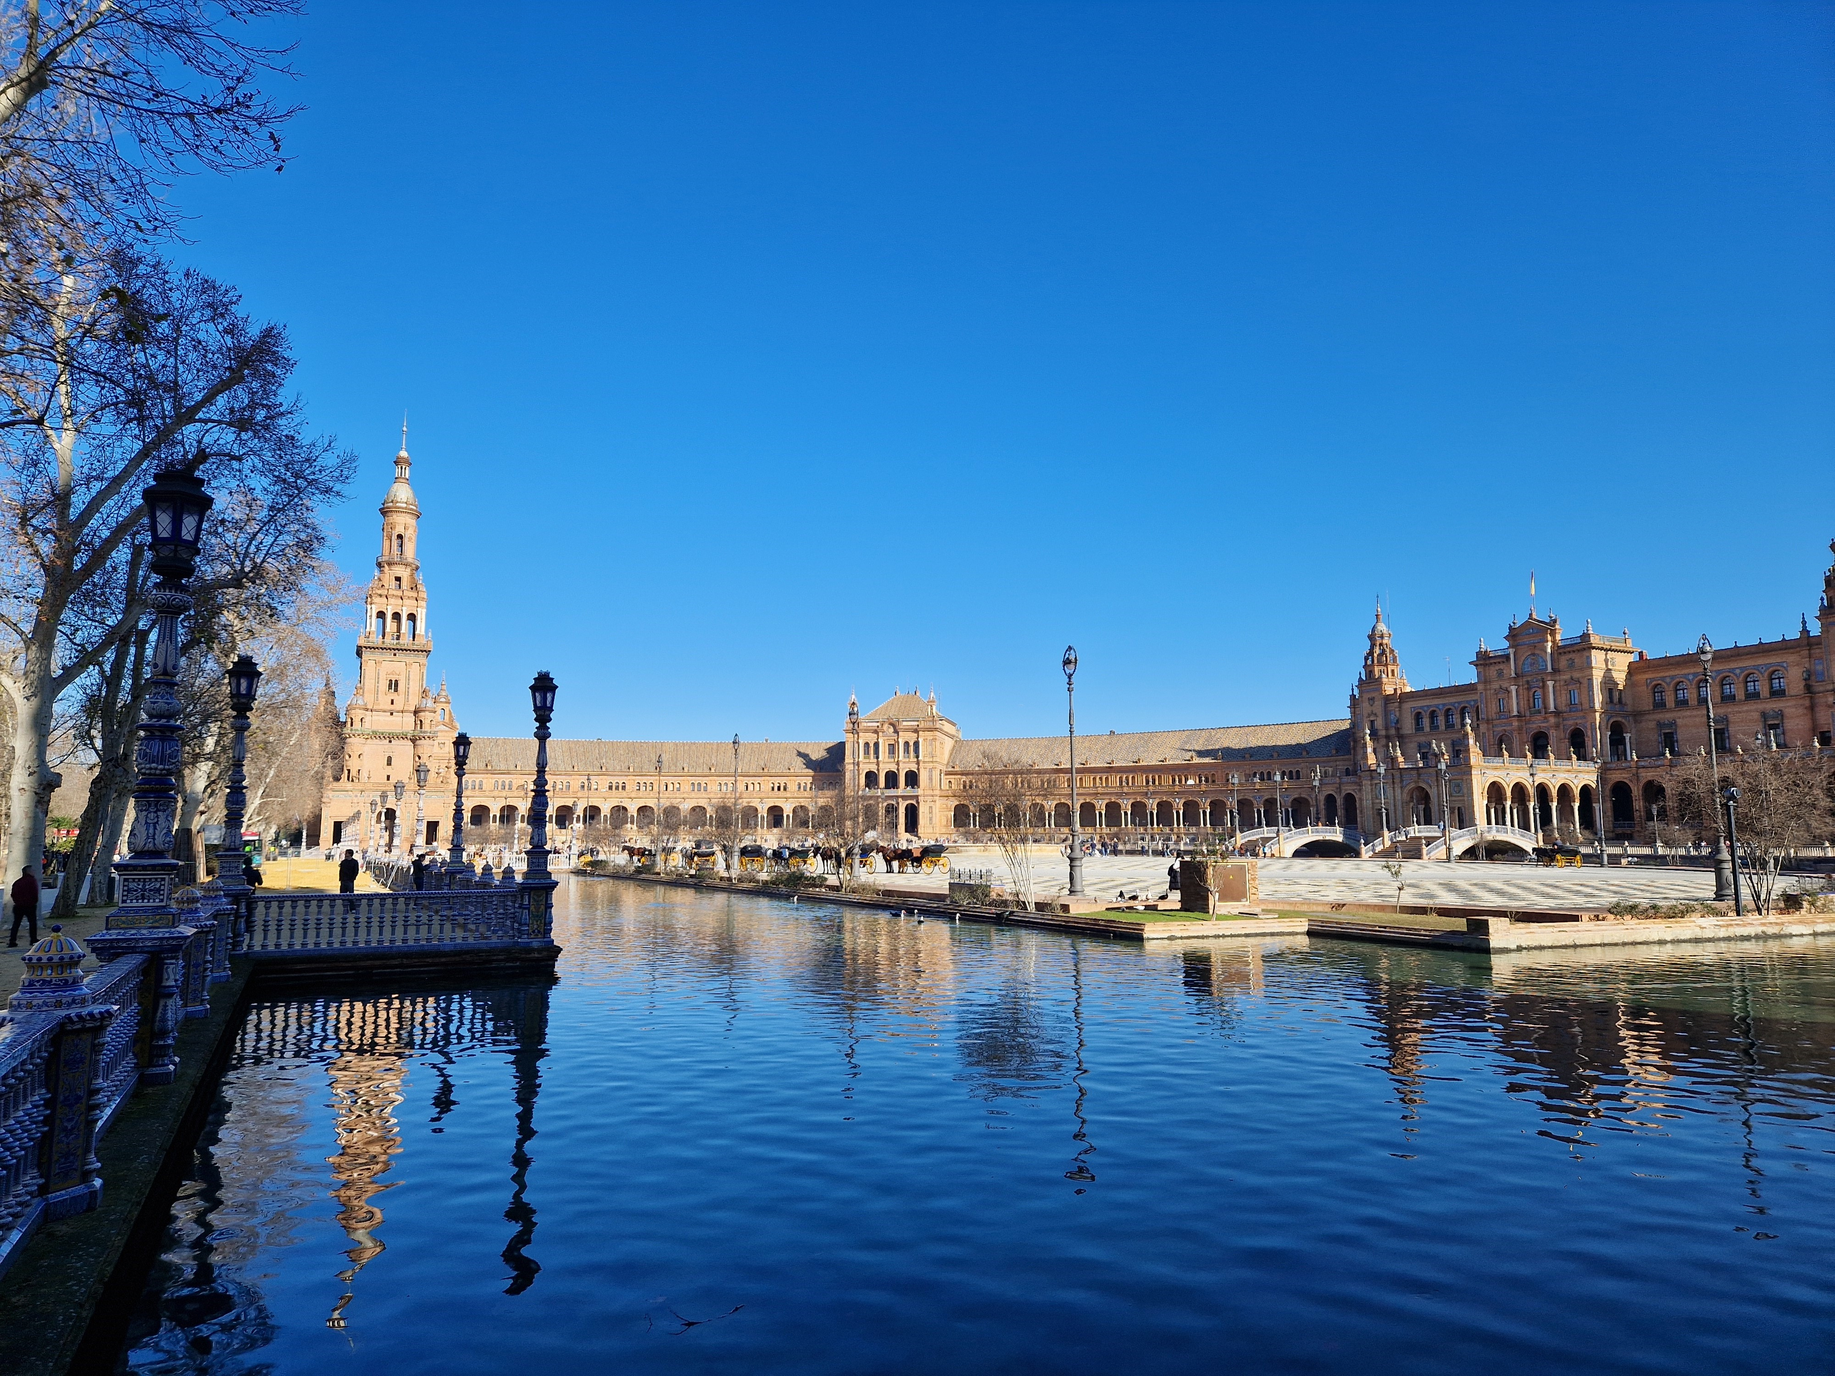
Introduction
At International Workshop IW2025 in Seville, our INCOSE Configuration Management Working Group members expressed their interest in further exploring webinars focused on Configuration Management.
Decisions on Part re-identification are a key topic addressed along the change process, which is part of Configuration Management activities.
This topic has been thoroughly explored in a book frequently referenced in our CM WG publications (papers, SEBoK,…).
Today, we have the opportunity to propose a webinar with the book author, whom we are very pleased to welcome for this session, organised with the support of the INCOSE webinar series team.

Slide 10
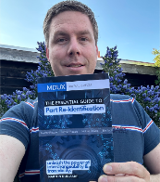
Welcome to Martijn Dullaart, author of the ‘Essential Guide to Part Re-Identifcation’
Martijn is Lead Architect Enterprise Configuration Management at ASML, Author and Blogger on mdux.net.
He is dedicated to transforming organizations by making their configuration management future-proof, ensuring efficiency and traceability across complex systems.
Focus on…
“Do I need to change the part number?"
A question that is inevitable when introducing changes to systems and products.
It is also considered a difficult question to answer and can lead to lengthy discussions or downstream issues when making the wrong decision.
Let us explore the content he developed in his book, which provides valuable insights and a useful methodology to help us deeply understand the complexities involved in part re-identification.

Slide 11





Who am I ?
Industrial Engineering
& Management Science
Product Lifecycle
Management (PLM)
From PLM
to CM
Configuration
Management (CM)
CM2
#MDUX 2025
Copyright @2025 by Martijn Dullaart. Permission granted to INCOSE for publish and use

Slide 12
WHY?
What is at stake in mastering part re-identification?
  Part Re-Identification decisions affect the security, safety, quality, compliance to regulations, as well the image of the company and the customer satisfaction.
  Reduce corrective actions/rework
Why is it so difficult to decide to re-identify a part?
    Re-Identifying is perceived as more work for the Engineer
    Lack of understanding of the end-2-end impact of a change (not only an engineering responsibility)
    Because the associated risks are insufficiently understood
    Due to the induced consequences about reassessing qualification or certification.
Intended to write a blog post, ended up with a book…
#MDUX 2025

Slide 13
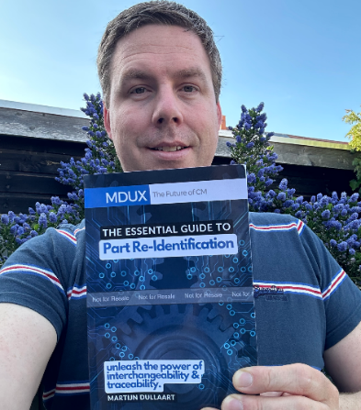



Status Accounting 😉
1st book 🎉
365+ books sold
~9 Months 😅
51 ebook versions 😱
12 chapters
8 paperback versions 😎
7 exercises
Positive feedbacks from the CM/PLM community!!!
149 pages
#MDUX 2025

Slide 14

What’s in it?
THE DILEMMA
IDENTIFICATION
IMPACT ANALYSIS
IT IS NOT ABOUT THE TREE
ORDERS
TRACEABILITY
INTERCHANGEABILITY
RESTORE INTERCHANGEABILITY
SPECIAL CASES AND CONSIDERATIONS
WAYS TO SIMPLIFY RE-IDENTIFICATION
AUTOMATION
SUMMARY AND EXERCISES
From FFF to FFFI 😱
My favorite chapter
There is also a Glossary
#MDUX 2025

Slide 15
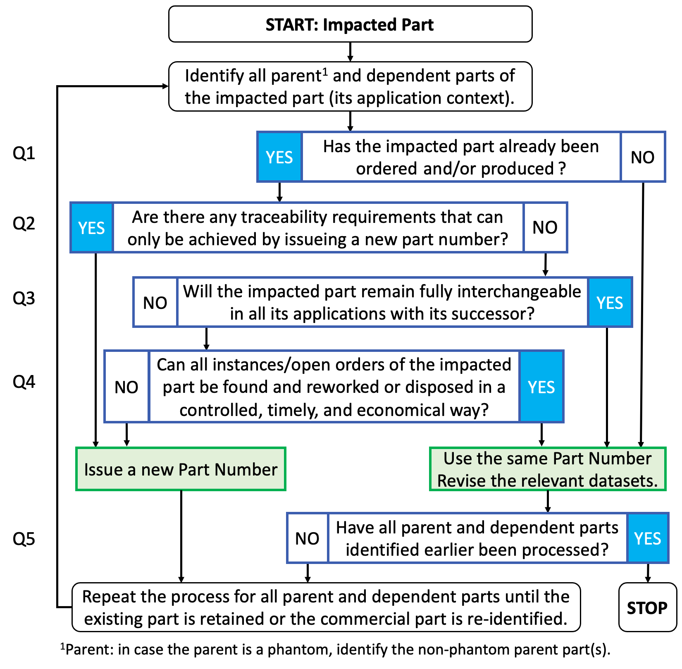
It is not about the Tree!
’Easy’ questions first
The difficult one
What about Phantoms?
#MDUX 2025

Slide 16
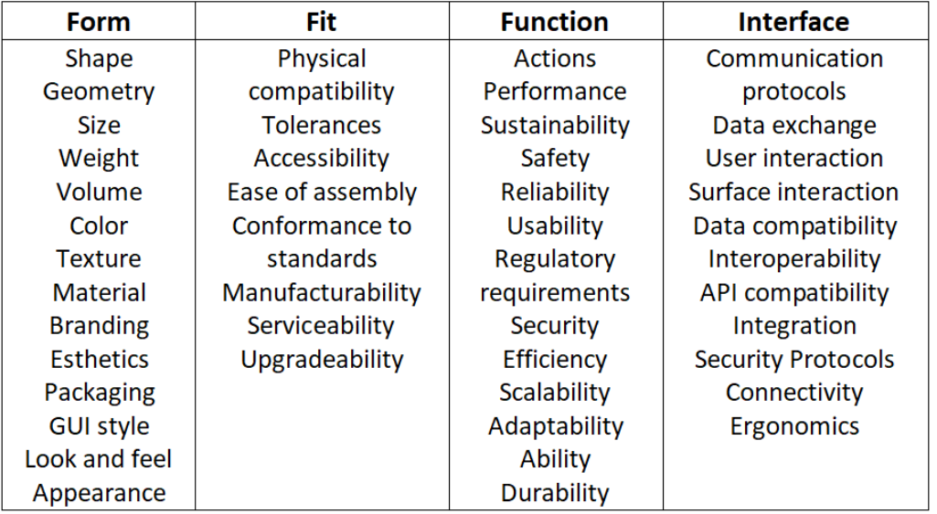
From FFF to F3I
Refers to a part’s
Refers to fit-for-use, which translates
functional, reliability,
to the ability to mate with other parts and
regulatory, sustainability,
conformance to any relevant manufacturability,
safety, and performance
and serviceability requirements.
requirements.
Refers to the interaction
between parts and
Refers to the
between parts and their
appearance/esthetic
environment, including
requirements of a part.
the user.
#MDUX 2025

Slide 17
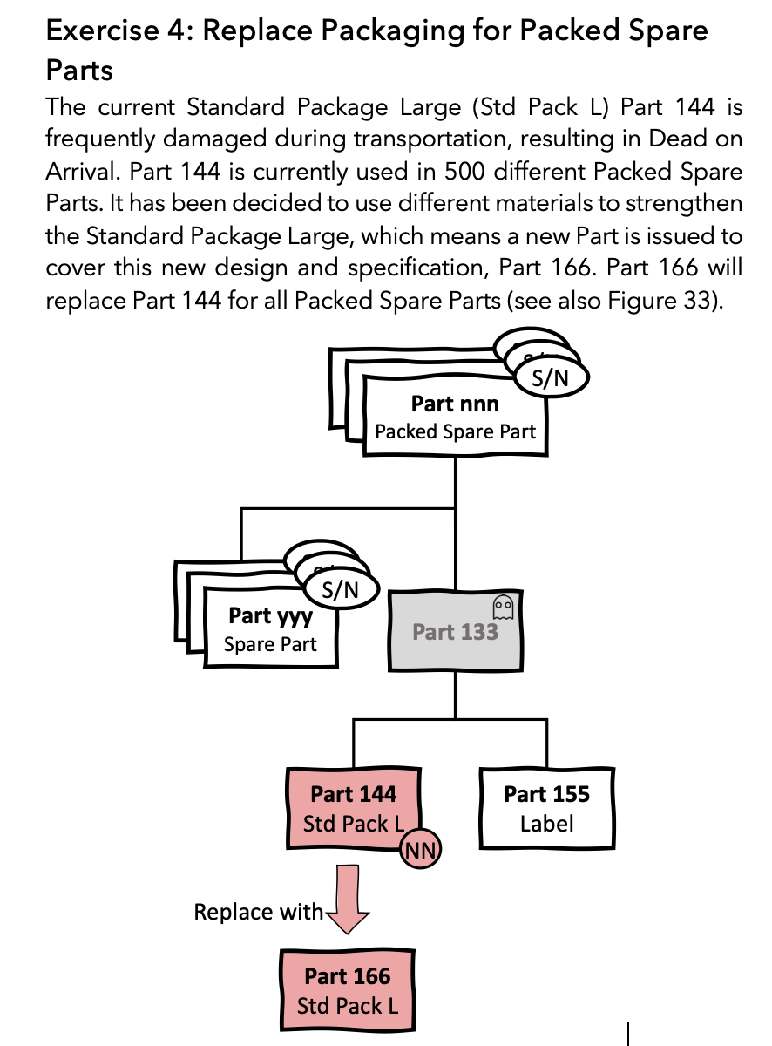
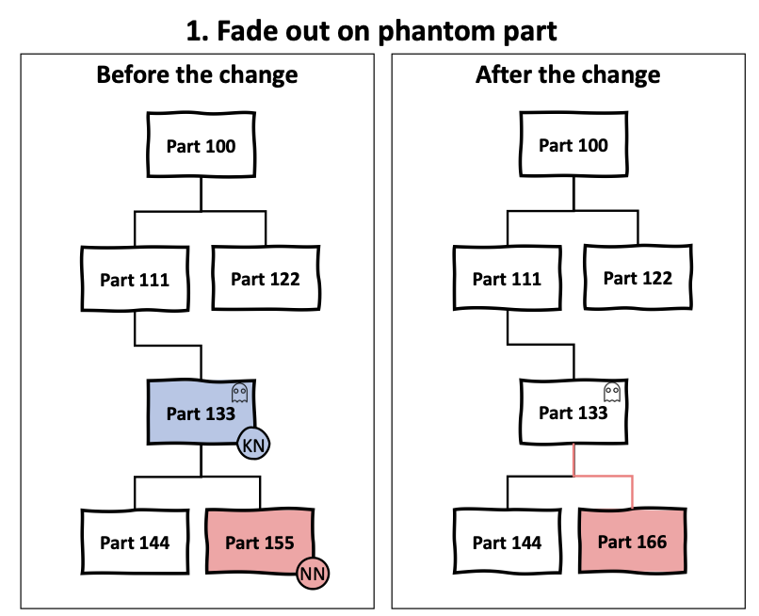
A few insights on some other chapters
Sub-Decision Tree for some questions part of the Main Tree
Exercises
Special Cases & Considerations
Traceability example
#MDUX 2025

Slide 18
New version planned
Update in progress 👍
Process feedback and fix typos
Extend Chapter 9 Special Cases & Considerations
Tool & Packaging Parts
Software Parts
  Software versioning
Software Components
Imprecise versus Precise Bills of Materials
Alternates and Equivalents
Commonality
More exercises
Extend Terms & Definitions
Release date to be planned.
#MDUX 2025

Slide 19


Questions & Answers
incose.org | 19

Slide 20

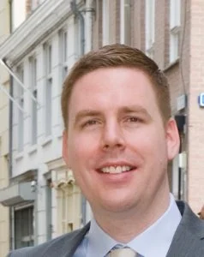






THANK YOU
Keep in Touch
A free chapter can be found here:
Martijn Dullaart
martijn@mdux.net
Connect on
English version, Paperback available in local stores:
CA | DE | ES | FR | IT
NL | PL | SE | UK | US
www.linkedin.com/in/mdullaart
Blog
mdux.net
#MDUX

Slide 21
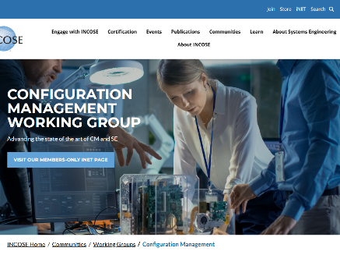

INCOSE Configuration Management Working Group
Advancing Configuration Management in Systems Engineering
Our website
Our contacts
Sandrine Gonthier | sandrine.gonthier@incose.net | Chair
Adriana D’Souza | adriana.dsouza@incose.net | Co-Chair
Aryes Lahiry | aryes.lahiry@incose.net | Co-Chair
Aleksander Przybylo | aleksander.przybylo@incose.net | Co-Chair

Slide 22

Quick Reminders
All the previous webinars are now located in the Professional Development Portal (PDP).
Attending a Webinar does count as 1 PDU credit towards your SEP renewal

Slide 23
Thank you to our 2025 Webinar Sponsor!
Interested in being a Sponsor of the INCOSE Webinar Series? Please contact us at sponsorship@incose.net

Slide 24


© 2025 INCOSE. All rights reserved.
INCOSE.org

