Slide 1


INCOSE SEP
(Systems Engineering Professional)
Certification Program
Program Summary

Slide 2

What is INCOSE?
INCOSE is the International Council on Systems Engineering (INCOSE).
We are a global non-profit professional organization dedicated to advancing the state of the art and practice of Systems Engineering with more than 25,000 members across 70+ different Chapters
incose.org/certification | 2

Slide 3
What is the SEP Certification?
The SEP Program is INCOSE’s globally recognized standard for validating systems engineering expertise. It:
Builds credibility in a competitive global marketplace.
Opens doors to new opportunities and professional growth.
Demonstrates mastery of systems engineering principles applied across aerospace, defense, technology, and beyond.
incose.org/certification | 3

Slide 4
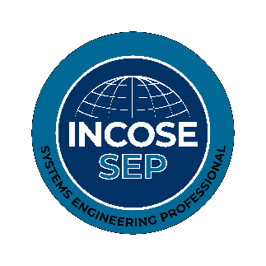











Industry and Academic Validation
The SEP Program is supported by both industry and academia.
Certification Advisory Board (CAB) 100+
Our CAB, composed of systems engineering leaders
from industry, government, and academia, provides
strategic guidance for the Certification Program,
ensuring it remains relevant to current industry
needs and best practices.

Slide 5








Industry and Academic Validation
The SEP Program is supported by both industry and academia.
Academic Equivalency partners 40+
Our Academic Equivalency partners offer courses that have
been evaluated against the INCOSE Systems Engineering
Handbook, allowing their students to bypass the INCOSE
Knowledge REquirement (exam) when applying.

Slide 6
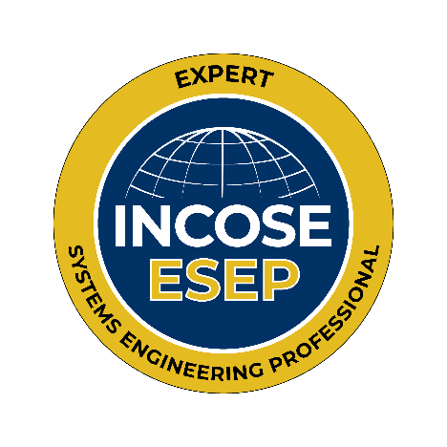

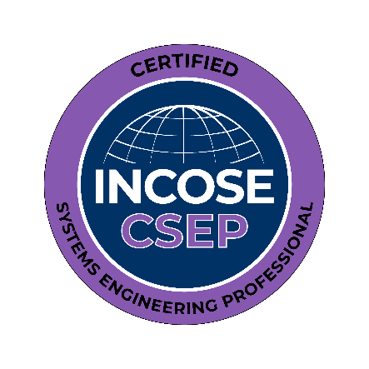
SEP Certification Metrics
Globally, as of July 2026
397
5,562
Current Active Certifications
2,332
2,833

Slide 7
Program Architecture
A pathway supporting systems engineers from entry to leadership.
Associate
Certified
Expert
  Who it’s for: Individuals seeking
  recognition for their knowledge
  and commitment to professional
  growth.
  Who it’s for: Practicing systems
  engineers with at least 5 years of
  experience.
  Who it’s for: Senior systems engineers
  and technical leaders with at least
  25 years of experience, guiding high-
  impact programs.

Slide 8
Associate Systems Engineering Professional
Who is it for?
Those who have mastered the core knowledge — the “book knowledge” — of systems engineering - students and early-career professionals
ASEP application requirements:
Knowledge verification via INCOSE Exam or Academic Equivalency
What will you gain?
Validation of your systems engineering knowledge and a strong start toward advanced certification.

Slide 9
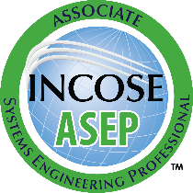
Certified Systems Engineering Professional
Who is it for?
Those who have CSEP both knowledge and proven professional experience in systems engineering — mid-career systems engineers.
CSEP application requirements:
-At least ≥5 years of practiced SE experience (including at least 1 year in 3 or more SE functional areas). The experience must be confirmed by references.
-Knowledge verification via INCOSE Exam or Academic Equivalency (bypass this step if you are already an ASEP).
What will you gain?
Global recognition, enhanced career credibility, and professional validation of your expertise.

Slide 10
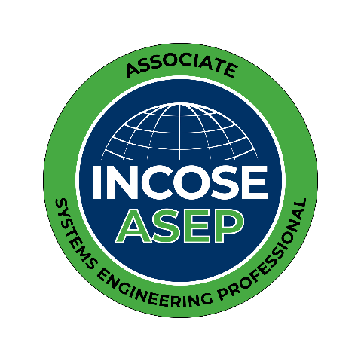
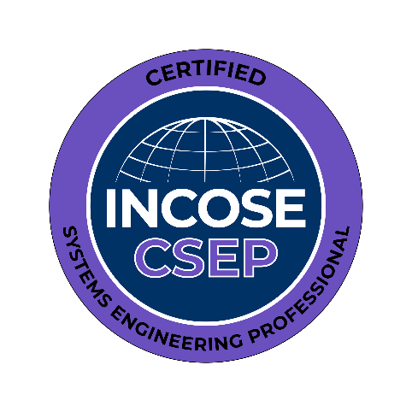

Knowledge Requirement
For ASEP and CSEP applications
INCOSE Knowledge Exam
Academic Equivalency
• Agreement between INCOSE and educational institutions
• Give eligible students the advantage of applying their coursework towards certification
• Over +40 universities worldwide hold Academic Equivalency status
• 120 multiple-choice questions (single-answer format), 120 minutes*​​
• Up to 3 attempts per 12 months​​
• Based on SE HB v.5
*From the 120 questions, only 100 of them count towards your final score.

Slide 11
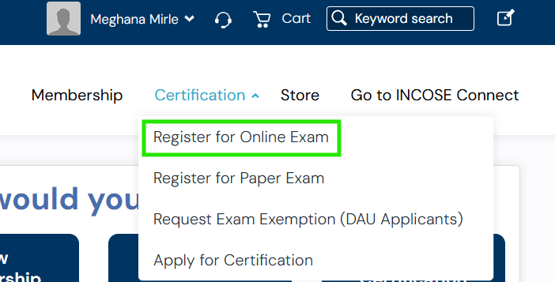
How to: Register for an exam
(before or after applying for certification)
Step 1:
You must have an INCOSE account (not necessarily a member at this step).
Log in to www.incose.org and click on “Manage Account” (at the top right of the screen).
From the banner menu, click on “Certifications.”
Step 2:
Select either “Register for Online Exam” or “Register for Paper Exam” using the drop-down menu.

Slide 12
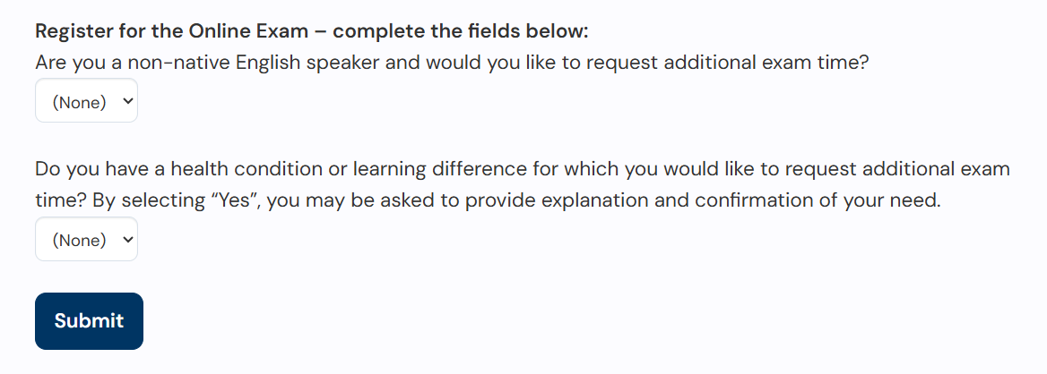
How to: Register for an Online Exam
(before or after applying for certification)
Step 3:
Complete the registration questions and selections. Click “Submit.”
In 3-5 days, you will receive an e-mail with instructions to pay and schedule the exam.

Slide 13
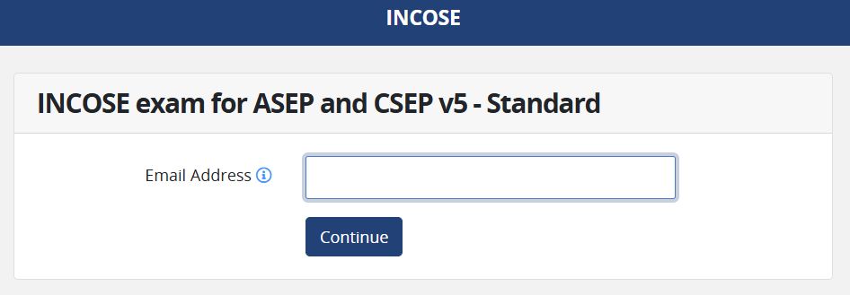

How to: Register for an Online Exam
(before applying for certification)
Step 4:
Log In to TESTWise and schedule the exam.
The Scheduling Guide provides all details and instructions you need for scheduling your exam.

Slide 14
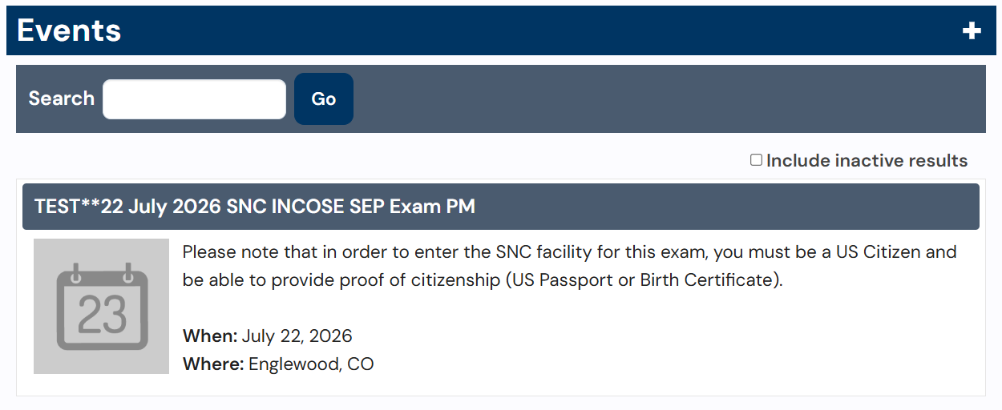
How to: Register for a Paper Exam
(before applying for certification)
Step 2:
Scroll down to view all available paper exam events. Click on the event you wish to register for.

Slide 15
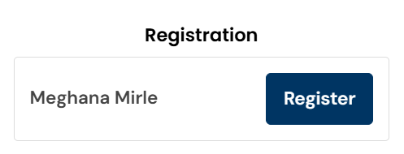
How to: Register for a Paper Exam
(before applying for certification)
Step 3:
Click on Register.
Complete the registration questions and selections.
Step 4:
Input your credit card details and complete the payment.

Slide 16
How to: Use your Exam Results to Apply for Certification
Online Exam: Results are displayed on screen after you complete the exam.
Paper Exam: Results are processed within 2–5 business days. You will receive your results once processing is complete.
Exam results are valid for one year. Once your results have been processed, you may apply for ASEP or CSEP at any time within the one-year validity period.
During that one-year period, you can use the same exam result to apply for either ASEP or CSEP, depending on which certification you qualify for.

Slide 17
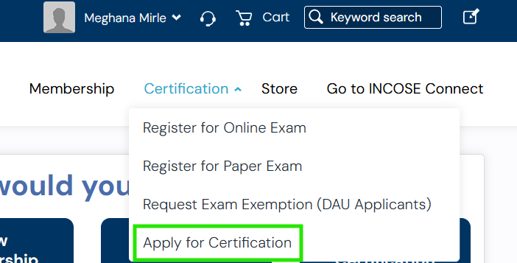
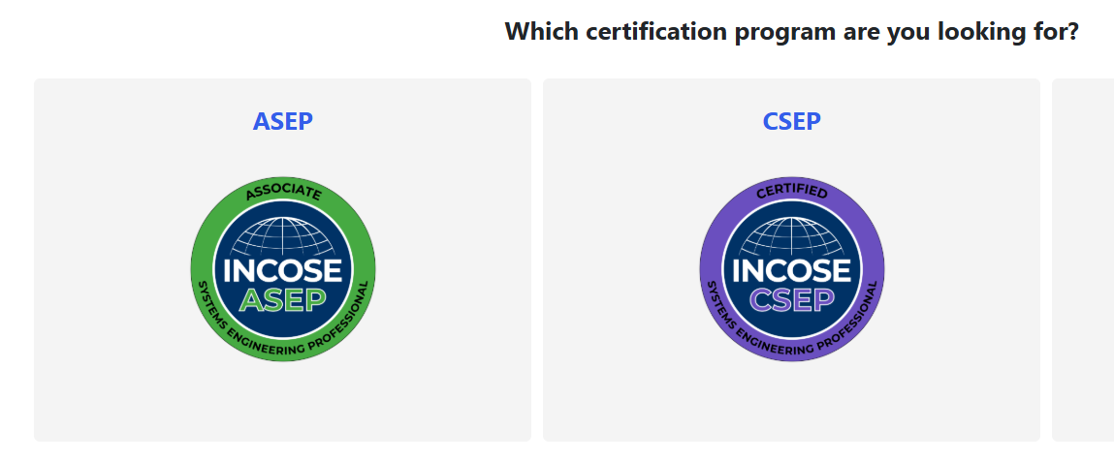
How to: Use your Exam Results to Apply for Certification
Log in to your member profile and select "Apply for a Certification". Then, choose the SEP certification program (ASEP or CSEP) you wish to apply for.
ASEP: Approved within a few business days after application submission.
CSEP: Longer review due to experience verification and references.

Slide 18
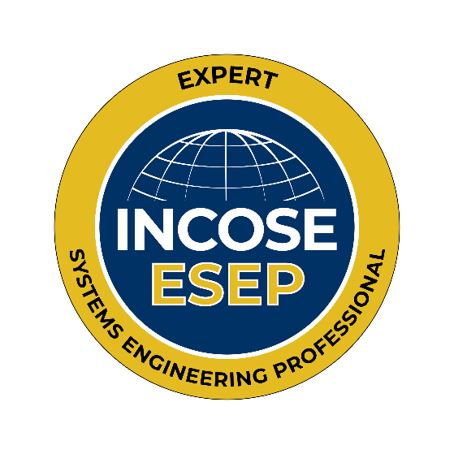
Expert Systems Engineering Professional
Who is it for?
Those who have made significant contributions and demonstrated leadership in systems engineering - senior professionals.
What will you gain?
Recognition as an industry expert and the opportunity to mentor and influence the next generation of systems engineers.

Slide 19
Expert Systems Engineering Professional
ESEP application requirements:
- At least ≥20/25 years of practiced SE experience (including at least 2 years in 6 or more SE functional areas). 10 years of the documented experience must be confirmed by at least 3 references.
- At least ≥5 years of post-Bachelor professional development (product development, technical society leadership, academic work).
- Technical Leadership interview (in writing or orally).

Slide 20
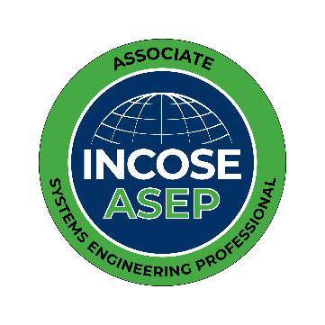
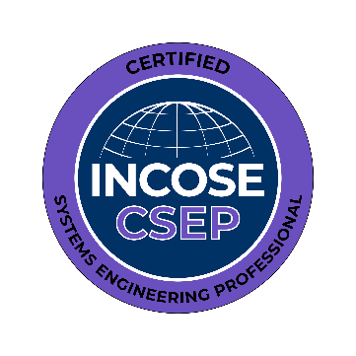
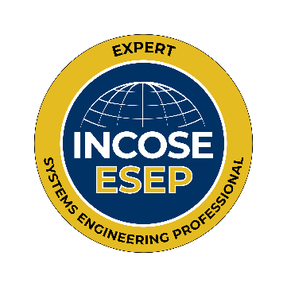
Renewal and Continuous Education
  5 Years for ASEP
  3 Years for CSEP
  Indefinite for ESEP
• For renewal, certification-holders must document 120 PDUs (Continuous Education Credits) through:
- SE coursework
- Publications and teaching
- INCOSE events and workshop participation
- Professional SE roles

Slide 21
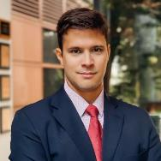

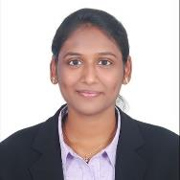
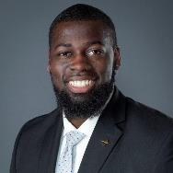
What People Are Saying
Diego Rangel
David R. Schneider
Raksha Mani
Kahdeem Cohens
“I understood that it is essential to certify your knowledge, especially at the beginning of your career. The SEP certification is an excellent way to demonstrate your qualification standard since it is internationally recognized. This motivated me to get SEP Certification.”
“For the university, Academic Equivalency helps to ensure that the curriculum is well-aligned to the INCOSE methodologies and hence has significant professional value for our students. It also distinguishes the course(s)/program offering academic equivalency from peer institutions.
For students, they too earn additional distinction as it is not just the institution stating their SE skill capability, but the student has demonstrated that they met the larger standard established by INCOSE.”
“The SEP certification by the INCOSE is a universally recognized certification, helping me prove my competence and knowledge in the different aspects of systems engineering.”
“I promote SEP certification. I would suggest that everyone considering it do some introspection on their "why."
In an ideal world, all systems engineering professionals are INCOSE SEPs for personal motivations like recognition, objective communication of your knowledge, and the ability to apply systems engineering learnings in the workplace.”
Notes:
www.incose.org/certblog

Slide 22

SEP
Program Summary
The SEP Certification Program:
• Validates expertise for systems engineers
• Promotes their professional growth
• Strengthens the systems engineering community
How to start your application?
1) Sign up to the INCOSE Portal
2) Create your Log In
3) Chose the "Certification" option at the top menu, select the desired path.
INCOSE Members have access to discounted certification application and renewal fees!​
Complete price-tables available at the INCOSE website.​

Slide 23


Certification Office certification@incose.net
For more information visit www.incose.org/certification

