Slide 1
Welcome to the INCOSE Webinar
19 August 2026 INCOSE Webinar #203
incose.org

Slide 2

Thank you to our 2026 Sponsor!

Slide 3
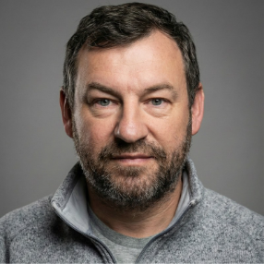
INCOSE
Webinar 203: Flight Simulator with SysML - SysFly. Integrating FlightGear, SysML v1 Simulation, FMI/FMU, Dymola, and Hardware-in-the-Loop
Presented by:
Dr. Saulius Pavalkis

Slide 4
About the Webinar
Piloted in 2008
A virtual offering aimed to provide relevant technical information and topics on systems engineering, on a regular basis and on an easy to access platform
Held on Wednesdays
Questions? Comments? Suggestions? Email us at webinars@incose.net!

Slide 5
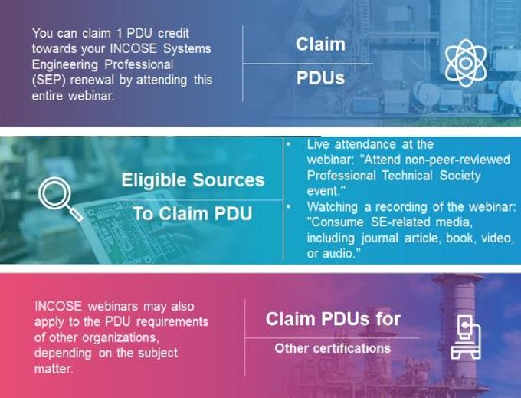
Webinars and SEP
PDU* Credits
More information can be found on Renewing Certification (incose.org)
*PDU- Professional Development Unit

Slide 6
Schedule for remaining portion of webinar
Dr. Saulius will speak 40-45 minutes
You can ask questions via the chat while he presents PowerPoint, which is a one way presentation.
Take advantage of the Q & A at the bottom of the browser screen. We will have an opportunity for questions at the end.
Brief closing

Slide 7
This Webinar is being recorded.
The full recording and slide deck will be made available to all INCOSE members and CAB associates.
The recording will be made available in the INCOSE library within 10-12 business days.
Questions? Comments? Suggestions?
Email us at: webinars@incose.net

Slide 8
INCOSE
Webinar 203: Flight Simulator with SysML - SysFly. Integrating FlightGear, SysML v1 Simulation, FMI/FMU, Dymola, and Hardware-in-the-Loop
Presented by:
Dr. Saulius Pavalkis

Slide 9
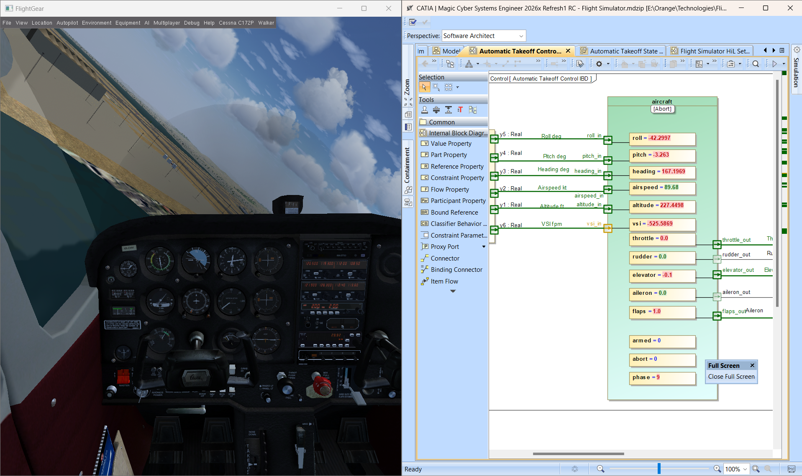



Flight Simulator - SysML Simulation
SysML v1, Co-Sim, Hil, FMI/FMU, Dymola

Slide 10
Agenda
Intro
Solution architecture
Model overview
Live demo
Value
Next steps

Slide 11
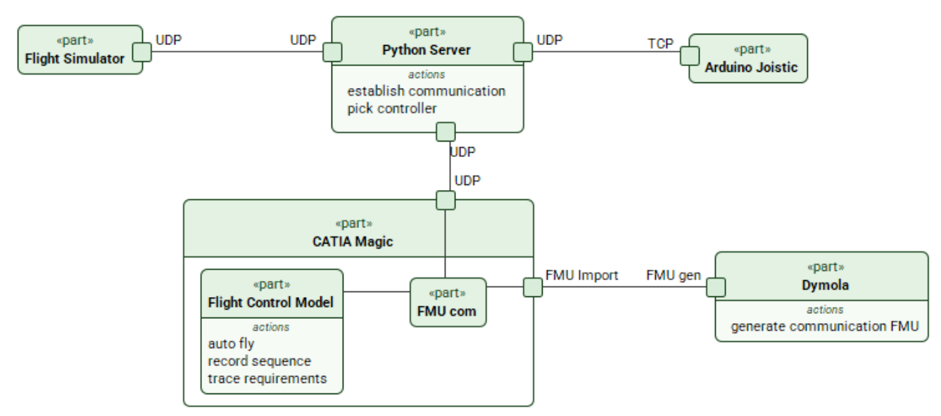
Solution Architecture

Slide 12
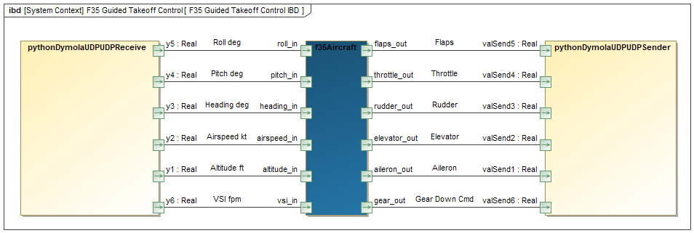
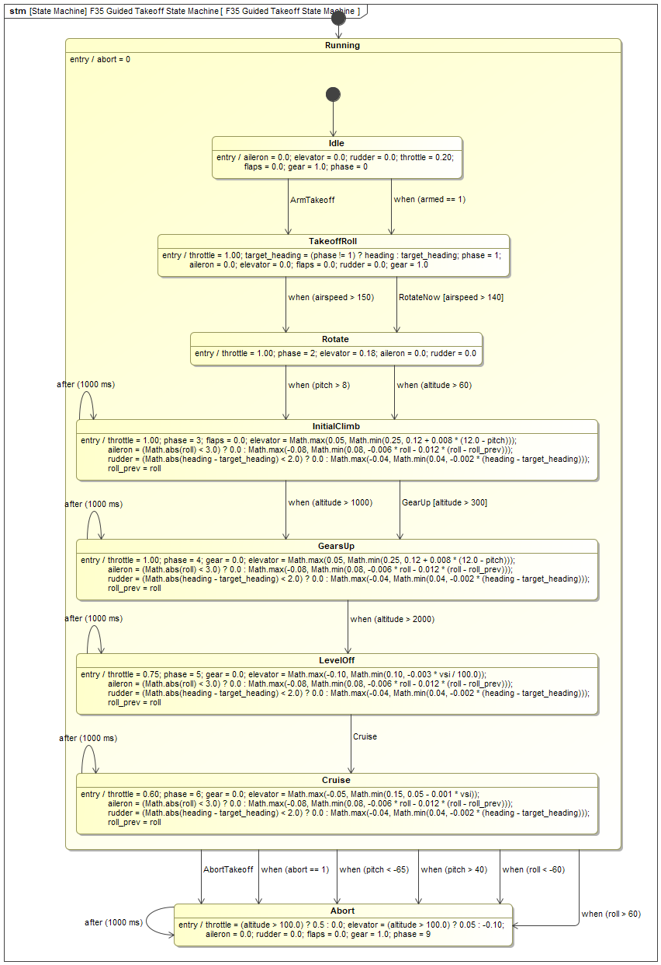
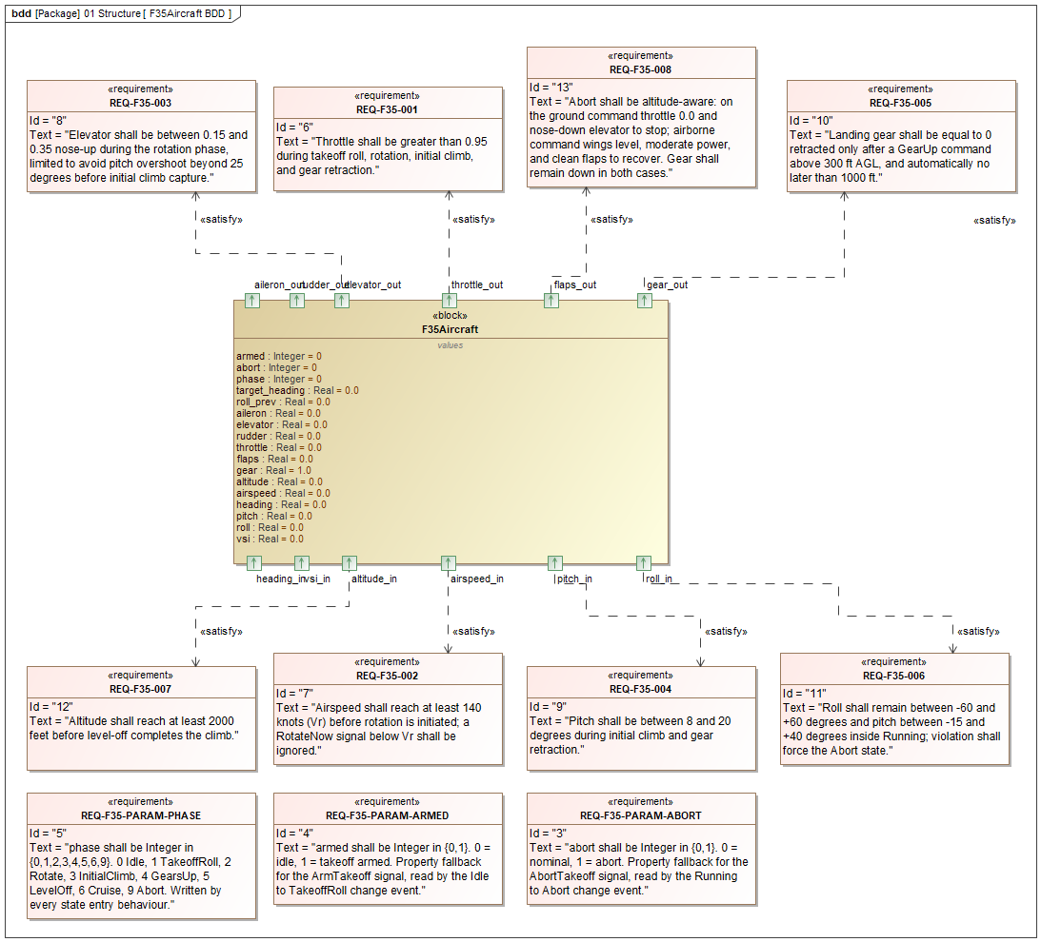
Model Overview

Slide 13
Live Demo

Slide 14
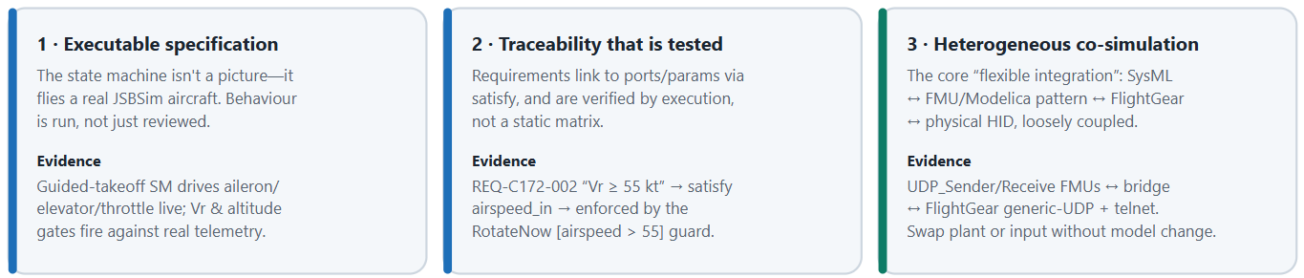
Value of the Flexible Integration Framework (1)

Slide 15
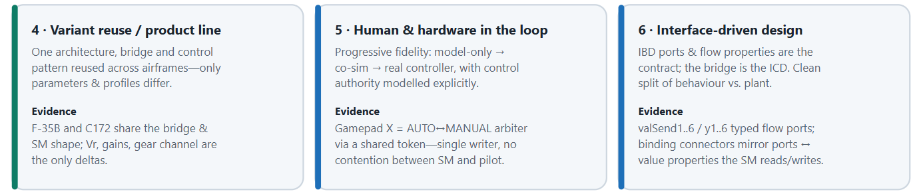
Value of the Flexible Integration Framework (2)

Slide 16
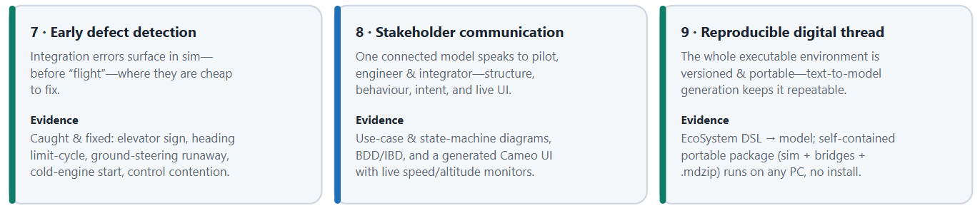
Value of the Flexible Integration Framework (3)

Slide 17
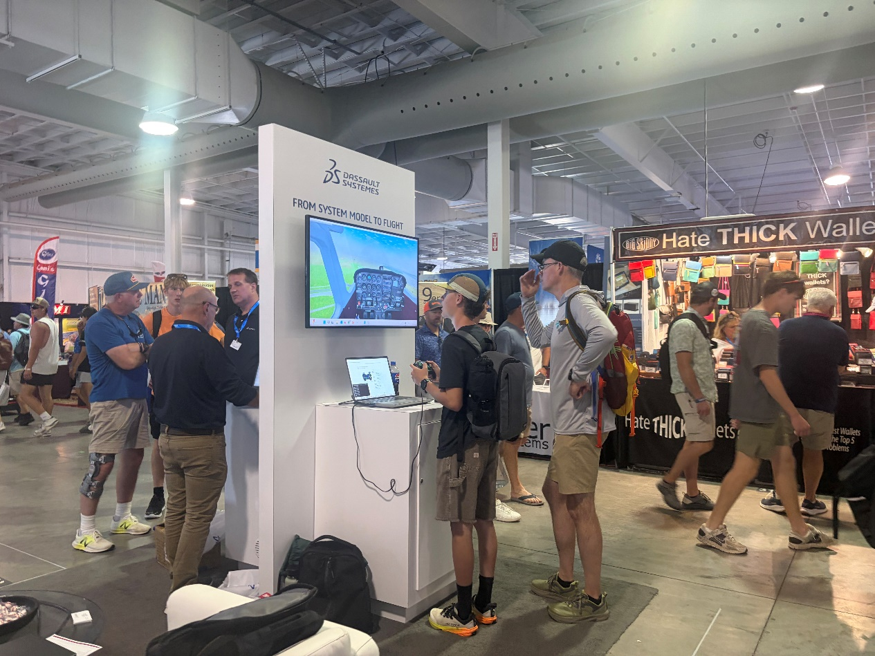
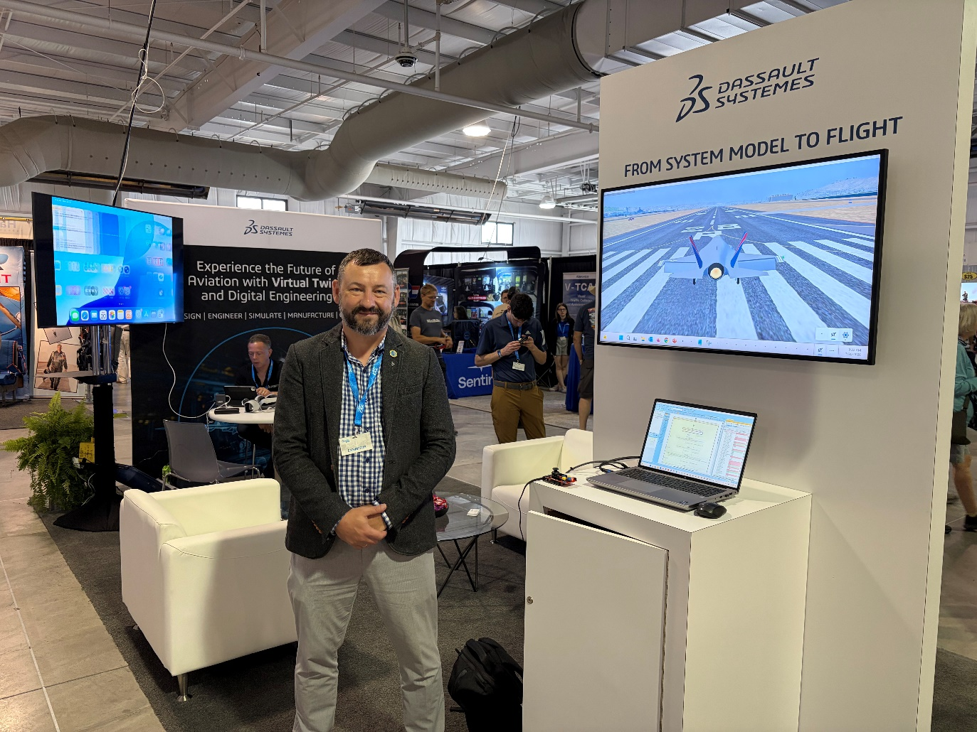
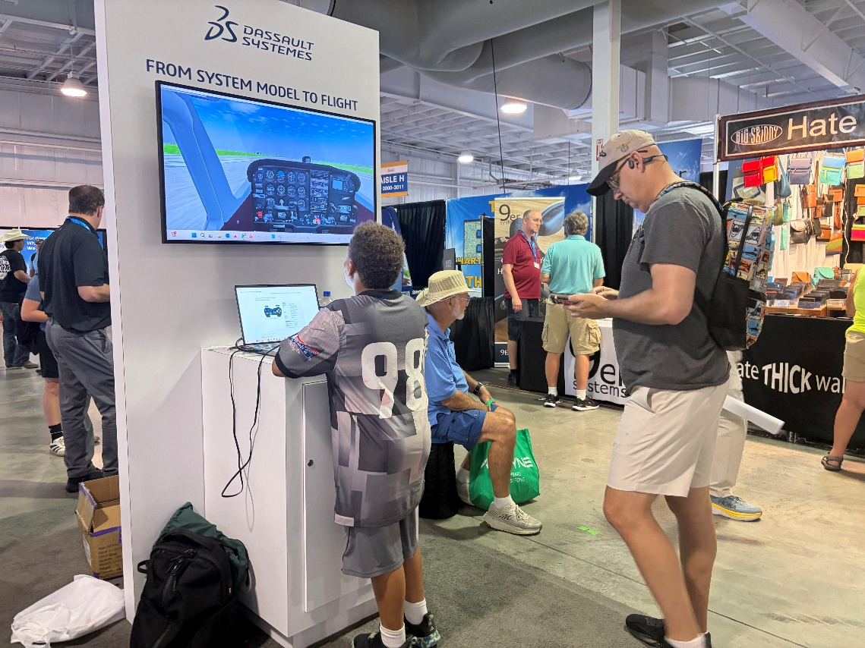
SE and MBSE Promotion

Slide 18
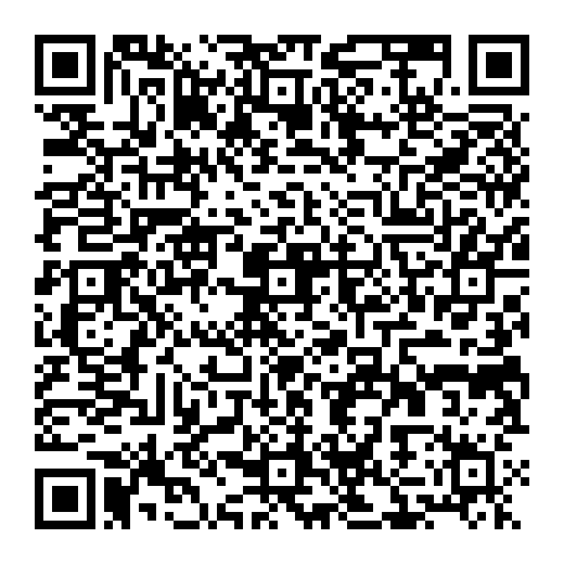
Next Steps
Find more at CATIA MBSE Cyber Systems Community
Download framework and run simulation
Reach out to adopt to your needs

Slide 19
Q & A

Slide 20
Quick Reminders
All the previous webinars are located in the INCOSE Library.
Attending a Webinar does count as a 1PDU credit towards your SEP renewal.

Slide 21
Thank you to our 2026 Sponsor!

Slide 22


Thank you for joining us today!

