Slide 1
Welcome to the INCOSE Webinar
14 October 2026 INCOSE Webinar #207
incose.org

Slide 2

Thank you to our 2026 Sponsor!

Slide 3
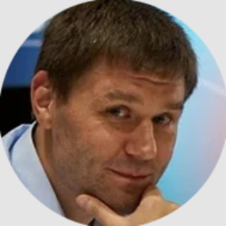

INCOSE
Webinar 207: Straight Out of the R&D Oven: SysML v2, Unfiltered
Presented by: Nerijus Jankevicius & Petras Litvinas

Slide 4
About the Webinar
Piloted in 2008
A virtual offering aimed to provide relevant technical information and topics on systems engineering, on a regular basis and on an easy to access platform
Held on Wednesdays
Questions? Comments? Suggestions? Email us at webinars@incose.net!

Slide 5
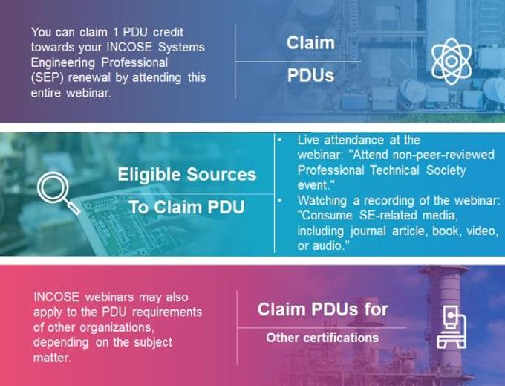
Webinars and SEP
PDU* Credits
More information can be found on Renewing Certification (incose.org)
*PDU- Professional Development Unit

Slide 6
Schedule for remaining portion of webinar
Nerijus Jankevicius & Petras Litvinaswill speak 40-45 minutes
You can ask questions via the chat while they present PowerPoint, which is a one way presentation.
Take advantage of the Q & A at the bottom of the browser screen. We will have an opportunity for questions at the end.
Brief closing

Slide 7
This Webinar is being recorded.
The full recording and slide deck will be made available to all INCOSE members and CAB associates.
The recording will be made available in the INCOSE library within 10-12 business days.
Questions? Comments? Suggestions?
Email us at: webinars@incose.net

Slide 8
INCOSE
Webinar 207:
Straight Out of the R&D Oven: SysML v2, Unfiltered
Presented by:
Nerijus Jankevicius & Petras Litvinas

Slide 9
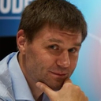
Nerijus Jankevicius
 | Senior Product Manager @ No Magic / Dassault Systemes Working on MagicDraw/Cameo since 1997 Contributing to UML/SysML/fUML/SysPhS standards at OMG since 2004 SysML v2 Execution Semantics WG
 | Product Manager of Cameo Systems Modeler – led SysML v1 and MBSE direction Product Manager of Cameo Simulation Toolkit Product Manager of Cameo AI Assistant

Slide 10
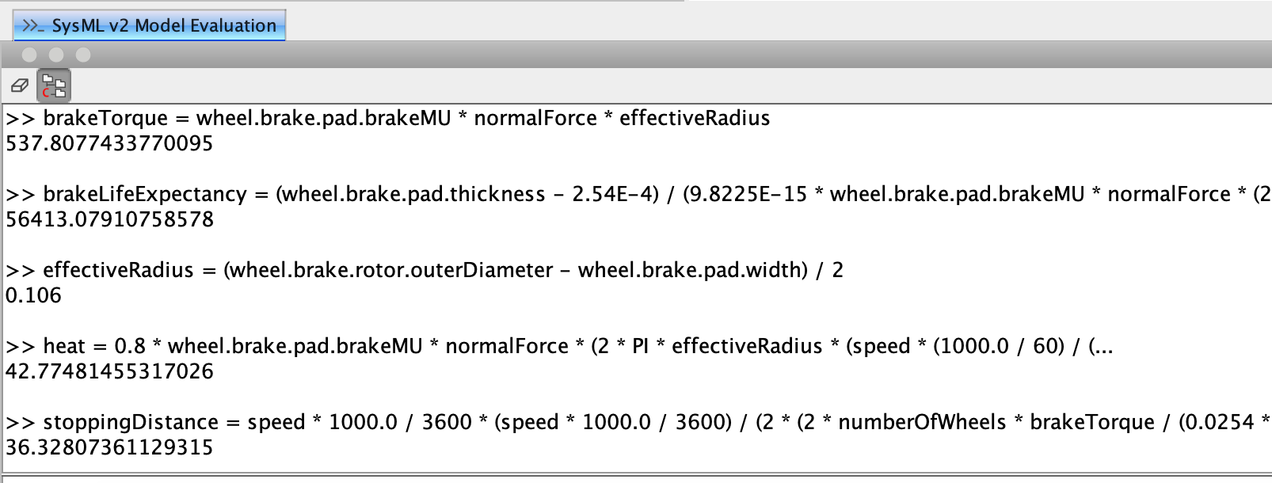
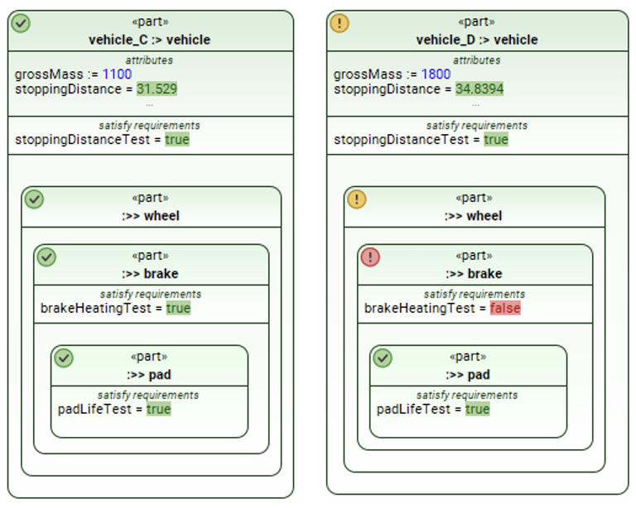
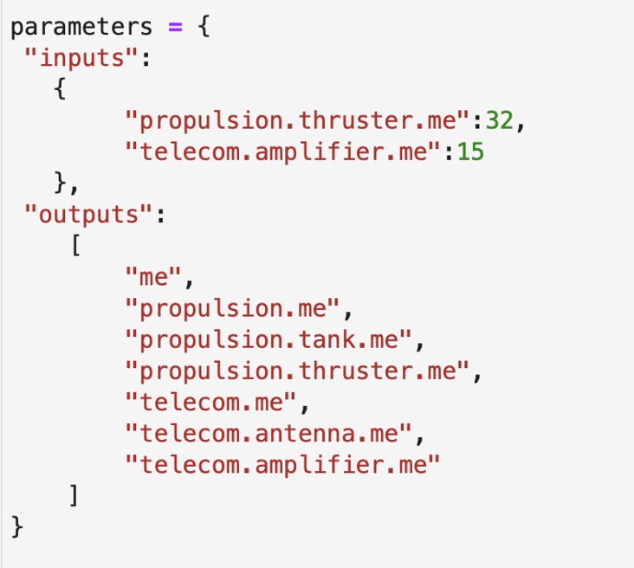
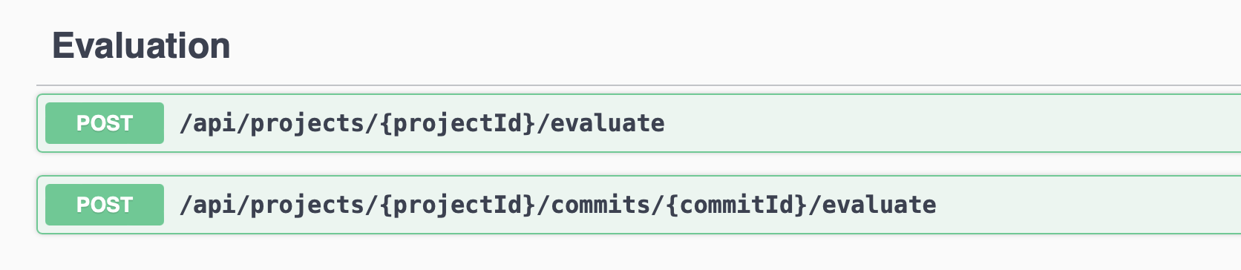
Recap : Sysml v2 sim in 2026x GA
Full parametrics
Requirements verification
Rollups
Analysis Cases, Verification Cases
Trade studies, parameter sweep
Monte Carlo analysis
Scripting languages
Matlab integration
Reading/writing data files
Server-side, web interface
REST API, Python client
In short – everything you can do with a STATIC model evaluation (no changes in time)

Slide 11
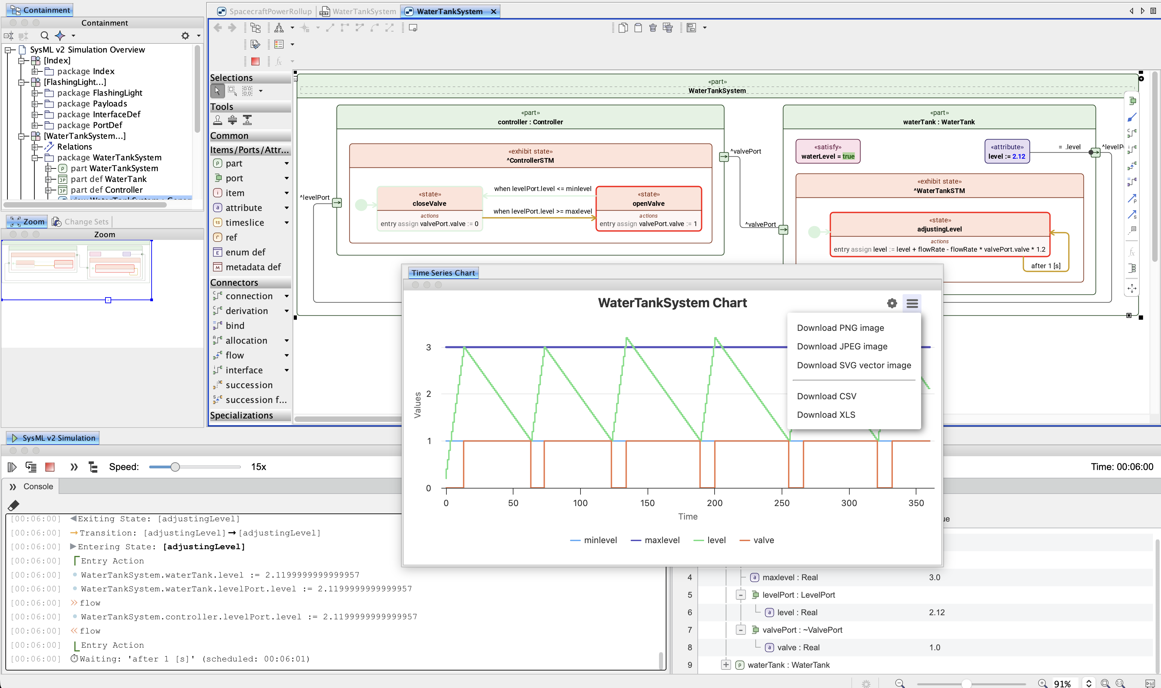
Introducing sysml v2 behaviors execution (simtoolkit v2)!
Deterministic clocked execution of v2 behaviors
Support of expression language
Requirements verification
Diagram annotations
Plotting, CSV export
User interaction (value changes, signal insertion)
Familiar UI and user experience
Availability
  Released in 2026x R1 (July 2026) as “Technology Preview”
  Cameo Simulation Toolkit license required (or CSM Enterprise edition)

Slide 12
Live demo

Slide 13
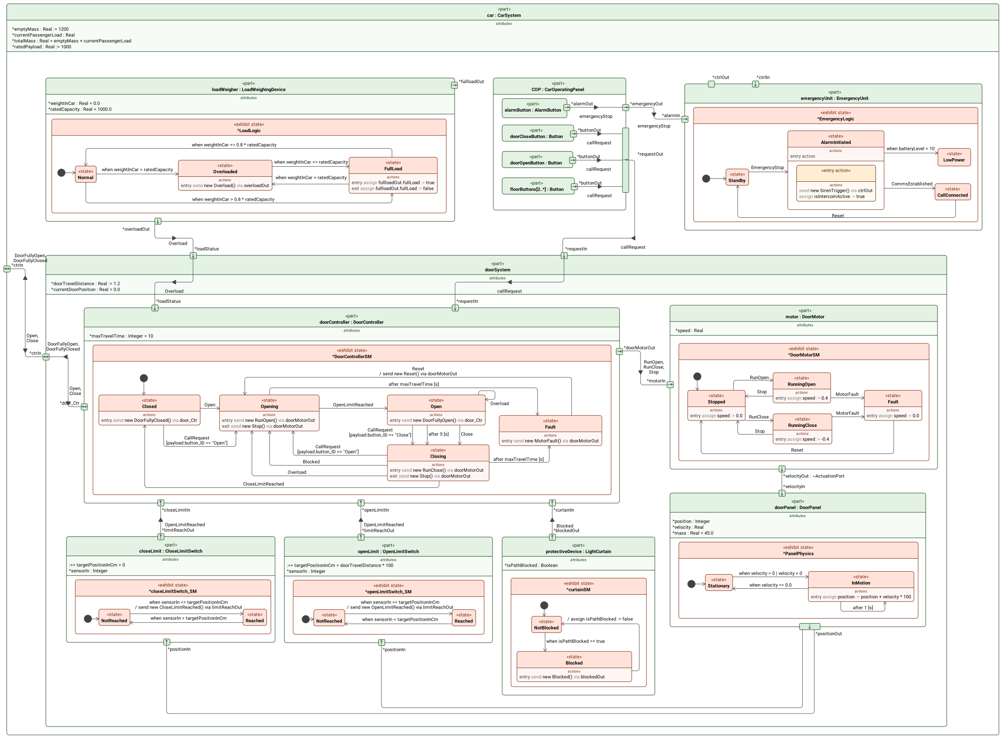
What’s supported in 2026 R1?
Multiple nested parts running state machines
Entry/do/exit actions (assign, send signal)
Ports/interfaces/connectors/value flows
Expressions, guards, change events
Bindings, update of “derived” values
Clock, speed, current time, time events

Slide 14
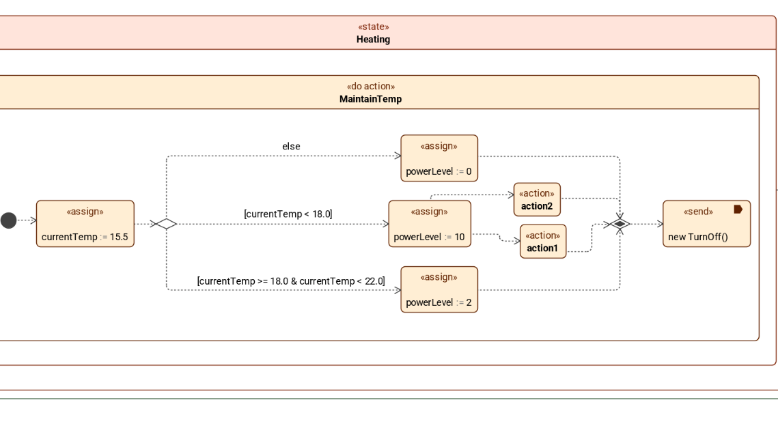
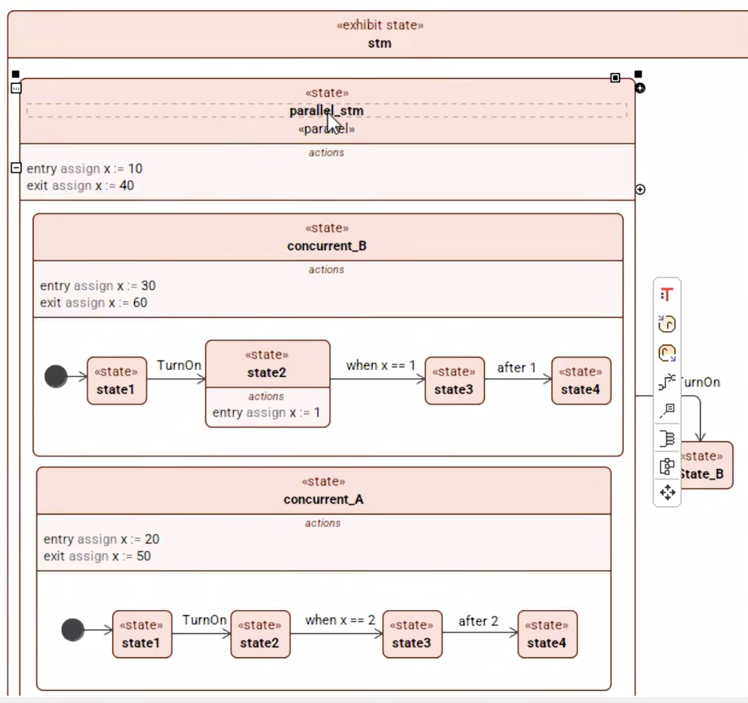
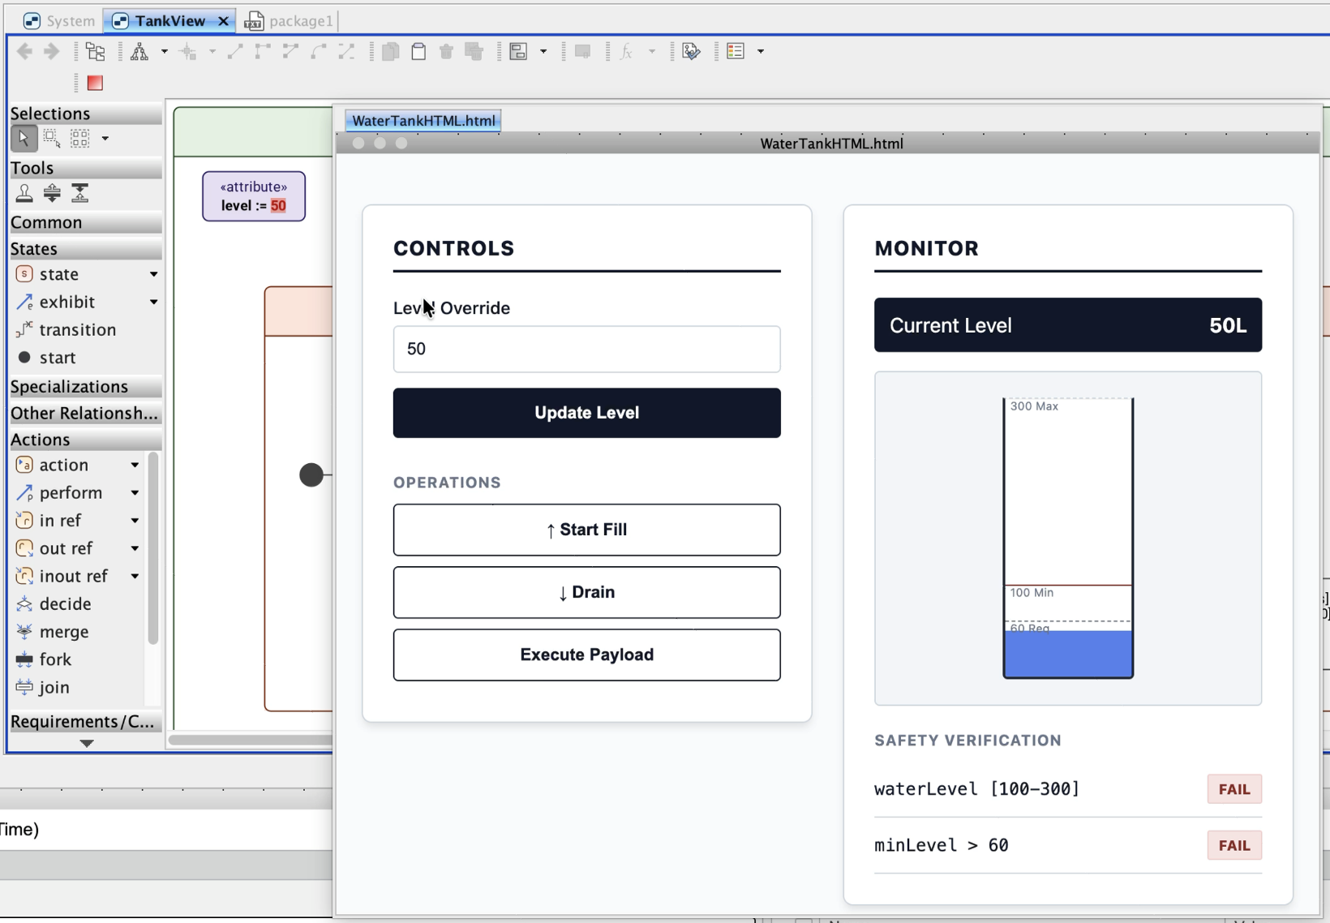
What’s coming in 2026 R2 (november)?
Composite, parallel states, composite actions
Activity flow (decisions, guards, loops)
Interruptible do activity, duration constraints
Simulation configs
  Custom HTML UI mockups (user or AI generated)
  Stand-alone webapp
  Early access

Slide 15
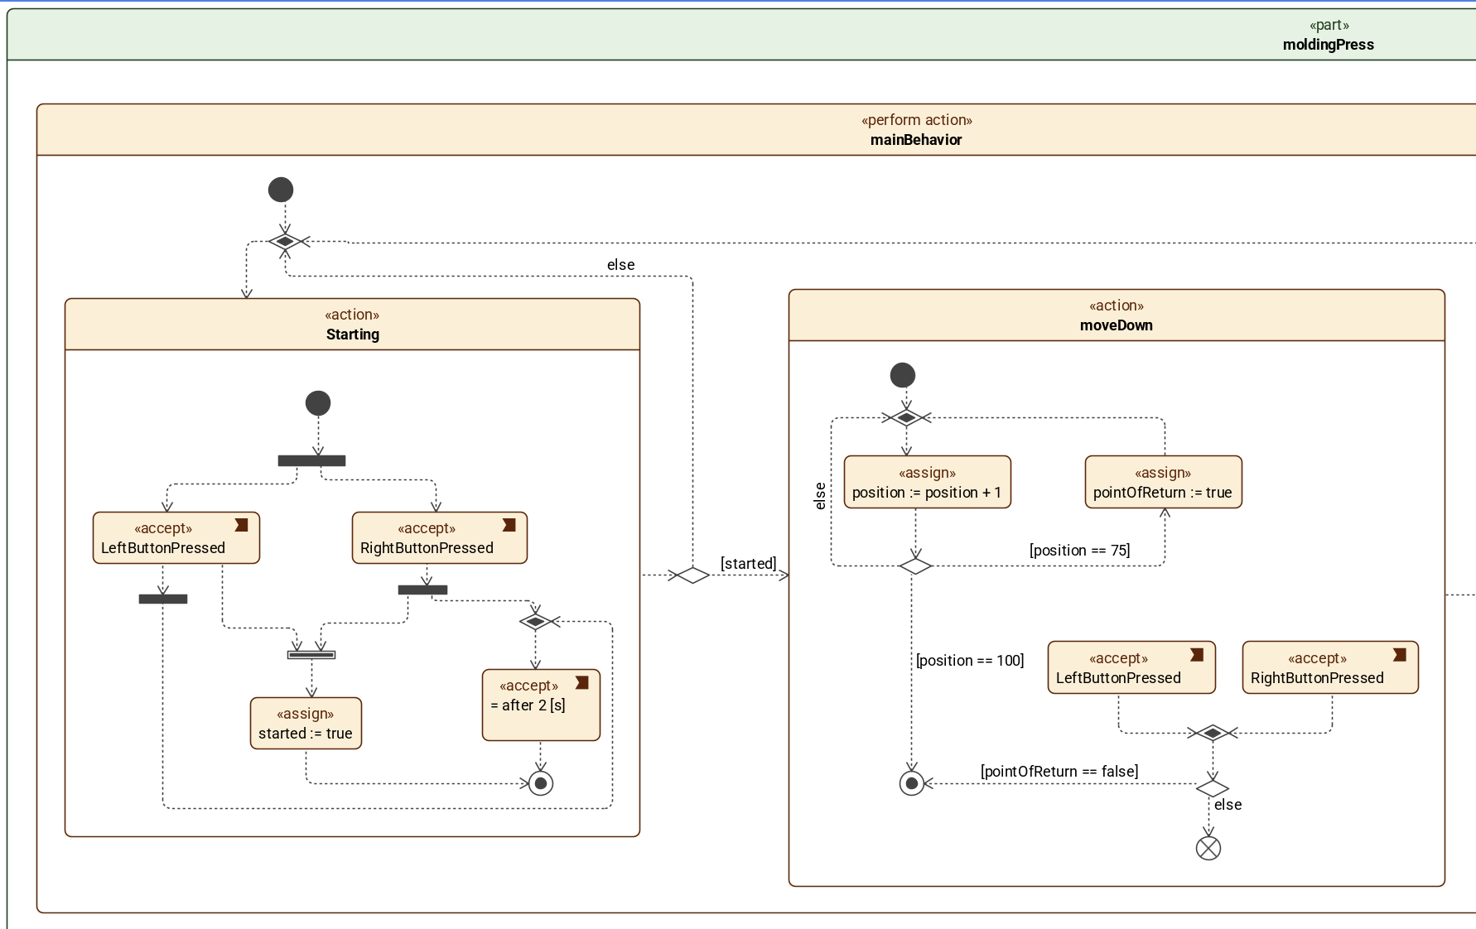
2026x R3 (next summer)(pending)
Perform actions
  Activity as main behavior
  Swimlane “allocations”
  Use Cases and Verification Cases
Accept actions
Succession flows (data flow)
FMU export
Saving snapshots
Import/export CSV (importing scenario, exporting timelines/logs)
Server side/MagicLab integration POC
More…
Early access around Christmas ? ☺

Slide 16
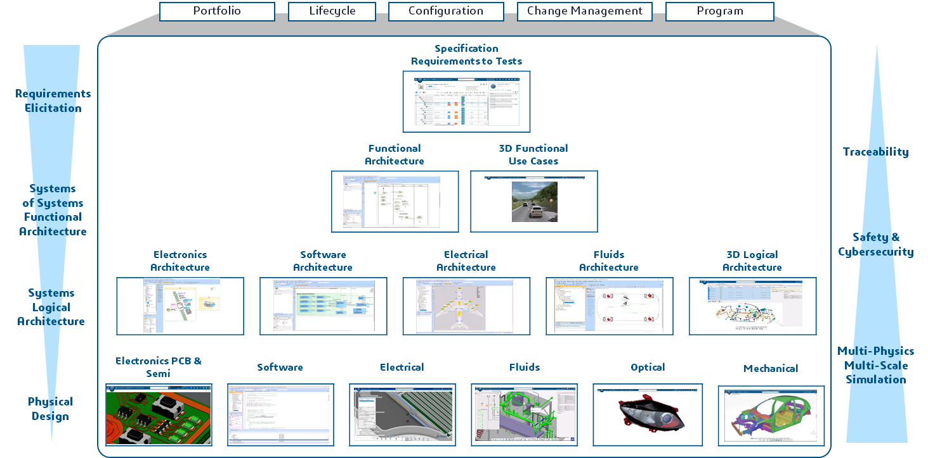
CATIA Cyber Systems | MBSE Competencies & Generative Experiences
Notes:
Referencial for CATIA System protfolio

Slide 17

CATIA Cyber Systems | MBSE Competencies & Generative Experiences
LEO | Systems Architecture
Generative Systems Architecture …
Notes:
LEO for Systems architecture.
Leveraging SysML modeling en embarked in CATIA Magic
LEO for Systems behavior Analysis
Leveraging modelica multi-physique modeling and Dymola simulation engines
Let’s start with Systems architecture

Slide 18

CATIA Cyber Systems | MBSE Competencies & Generative Experiences
AURA | Regulatory Compliance
Generative Requirements
Generative Traceability …
LEO | Systems Architecture
Generative Systems Architecture …
LEO | Systems Behavior Analysis
LEO | Electrical, Electronics and Software Architecture
Generative Electrical & Electronics Topology
Generative Software Architecture
Generative Signal Routing …
LEO | Physical Domain Engineering
Notes:
Requirement Elicitation +Functional architecture

Slide 19

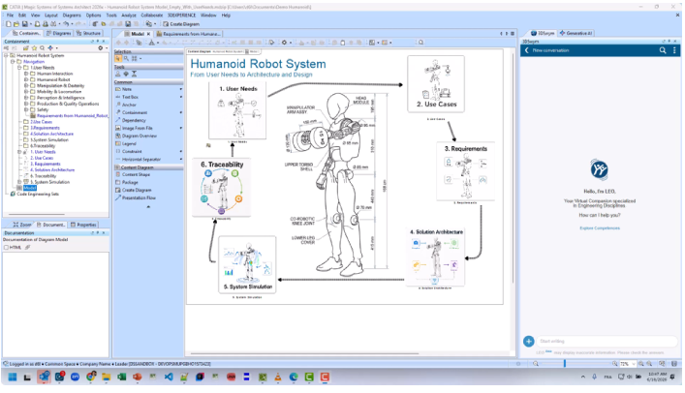

GENERATIVE SYSTEMS Architecture
Analyze and generate system architecture with LEO
Generative Experiences
Generative Systems Architecture
Generate suggestions of models, relations and diagram
User customisable
Analyze selected model, relations and diagrams
Understand uploaded document in conversation
Assist with CATIA Magic user assistant
Generate models, relations and diagrams
Virtual Companion
LEO | Systems architecture
Notes:
Refresh 1 is focus on simulating and analyze results inside Dymola.
Assist users to democratize Dymola application.
Analyse modelica models, equations and diagrams.
Modify
Simulate
Plot and analyze
Generate documentations

Slide 20
Live demo

Slide 22
Q & A

Slide 23
Quick Reminders
All the previous webinars are located in the INCOSE Library.
Attending a Webinar does count as a 1PDU credit towards your SEP renewal.

Slide 24
Thank you to our 2026 Sponsor!

Slide 25


Thank you for joining us today!

